Slide 1
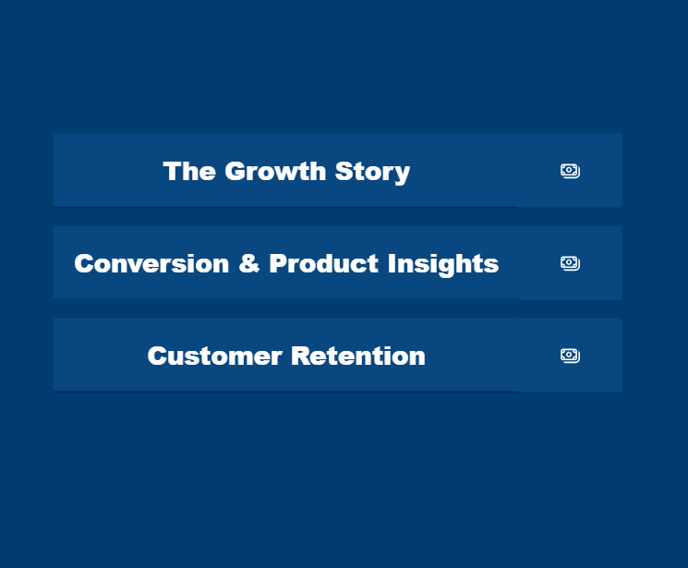
MavenFuzzyFactory Growth Analysis
Business Analytics Hackathon
Team 12
Interact in Power BI Web

Slide 2
Table of contents
01 | Data Quality Report
02 | Growth Trends: Sessions, Orders & Revenue Efficiency
03 | Channel Mix Evolution
04 | Conversion Funnel Analysis & A/B Test Results
05 | Product Revenue, Margins & Seasonal Patterns
06 | Repeat Customer Behavior
07 | Conclusion & Bidding Strategy Recommendations

Slide 3
01
Data Quality Report

Slide 4
Data Quality Audit - Ensuring Reliable Insights
Issue Category | Records Affected | Resolution
Invalid Prices | 8 orders | Excluded (zero/negative prices)
Cost > Price | 3 orders | Excluded (impossible economics)
Impossible Timestamps | 7 pageviews | Excluded (view before session)
Fake Test Products | Product ID 99 | Excluded from analysis
Price Data Errors | Products 3 & 4 | Corrected to $49.99 & $24.99
Text Inconsistencies | Multiple fields | Standardized (trim, lowercase)

Slide 5
Data Governance Recommendations
Validation at Entry: Implement database constraints (price > 0, COGS ≤ price, NOT NULL timestamps)
Referential Integrity: Enforce foreign key constraints (session_id, product_id must exist)
Automated Quality Checks: Weekly data quality dashboard flagging anomalies before analysis

Slide 6
02
Key insights

Slide 7
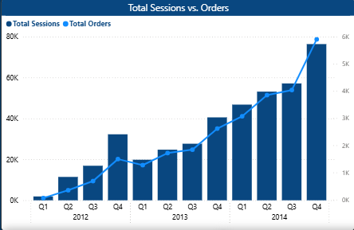
Strong Growth - Sessions & Orders by Quarter
Q2 2012 — lander-1 landing page test drove first session spike.
Q1 2013 — Love Bear launch added a second SKU, lifting order volume sharply.
Q4 2013 — Birthday Panda launch pushed sessions and orders to new highs heading into 2014.

Slide 8
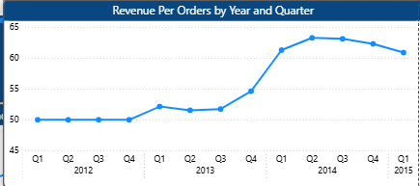
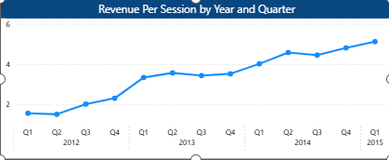
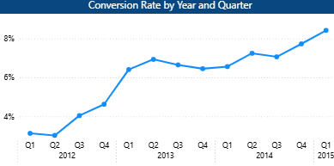
Conversion & Revenue Efficiency Improvements
Revenue per session increased from $1.57 in Q1 2012 to $5.12 in Q1 2015
Revenue per order increased from $49.99 in Q1 2012 to $60.89 in Q1 2015
Conversion rate improved from 3.14% in Q1 2012 to 8.42% in Q1 2015

Slide 9
At launch, we struggled with low conversion rates and minimal revenue per session.
However, through continuous website testing specifically the landing and billing page optimizations.
We have significantly improved our efficiency and consistently grown the value of every site visitor.

Slide 10
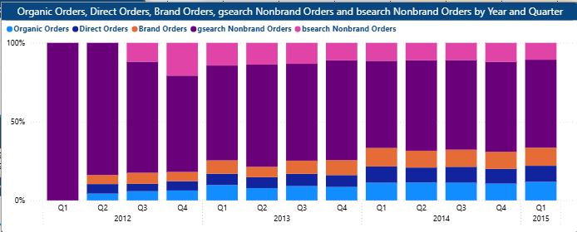
Channel Mix Evolution
"If paid ad costs doubled overnight, 28.87% of revenue base would remain unaffected"

Slide 11
Gsearch nonbrand orders dominate the total order volume across all periods, making it the primary growth driver.
Brand and direct orders show steady growth, indicating improving brand awareness and returning customers.
Organic orders remain relatively small but gradually increase, suggesting stronger SEO performance over time.
Bsearch nonbrand contributes the least, with minimal impact compared to gsearch.
Overall, the order mix becomes more diversified over time, but paid search (especially Gsearch) remains the largest contributor.

Slide 12
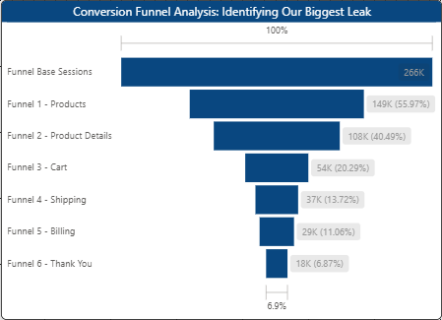
Conversion Funnel Analysis
Funnel Base Sessions → 266,356 (100%)
↓
Funnel 1 - Products → 149,089 (55.97%) ↓ 44.03% drop
↓
Funnel 2 - Product Details → 107,849 (40.49%) ↓ 15.48% drop
↓
Funnel 3 - Cart → 54,038 (20.29%) ↓ 20.20% drop
↓
Funnel 4 - Shipping → 36,547 (13.72%) ↓ 6.57% drop
↓
Funnel 5 - Billing → 29,451 (11.06%) ↓ 2.66% drop
↓
Funnel 6 - Thank You → 18,304 (6.87%) ↓ 4.19% drop
“If we could improve the conversion rate at this step by 10 percentage points,
it would generate approximately $77.51K in additional monthly revenue”

Slide 13
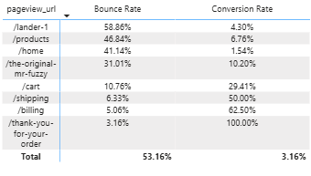
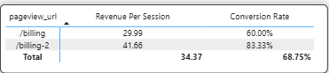
Landing Page / Billing Page Test Results

Slide 14
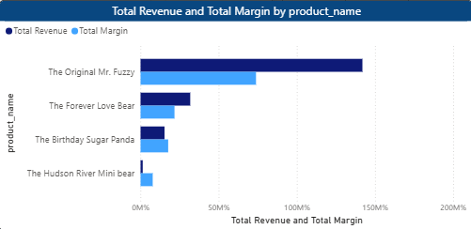
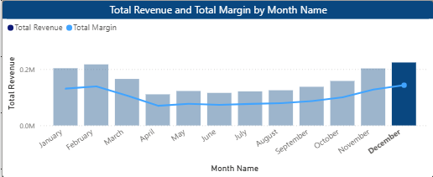
1. Product revenue & margin dashboard
The priority product is The Original Mr. Fuzzy, as it generates the highest total revenue (about 170K), significantly outperforming all other products. This strong sales performance, combined with its high margin, indicates it is the most valuable product to focus on.

Slide 15
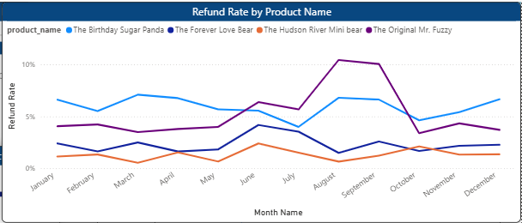
2. Seasonal demand patterns & refund rate trend

Slide 16
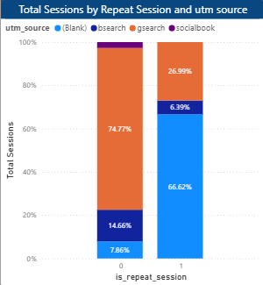
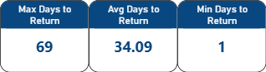
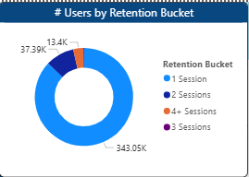
Repeat Customer Behavior

Slide 17
Conclusion
Key Risks to Manage: Over-reliance on Gsearch: ~75% of new traffic comes from Google Search.
↓
Mitigation: Diversify spend into social and brand awareness.
Supplier Quality: Past defects in "Mr. Fuzzy" caused refund spikes.
↓
Mitigation: Strict QA protocols with our new supplier.
Missing Data for Next Steps: To optimize further, we need Customer Demographics (age, location) to target ads better, and Cart Abandonment Surveys/Heatmaps to know exactly why users leave the billing page.

Slide 18
CLV & Bidding Strategy Recommendation
Channel Mix: Repeat customers heavily rely on Organic Search and Direct type-ins. We are not paying twice for the same clicks.
Revised CLV: Because acquired customers return organically, our true Customer Lifetime Value (CLV) is significantly higher than our first-session revenue indicates.
Bidding Strategy: Increase acquisition bids on paid channels (gsearch/bsearch nonbrand).
Since backend repeat revenue is highly profitable and mostly organic, we can afford to spend more upfront to acquire a new customer.

Slide 19
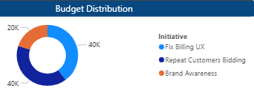
Strategic Recommendation 3 + $100K budget allocation
🚀 Top Growth Priority: Our biggest revenue leak is the drop-off at the Billing step. By fixing the Billing UX (as proven by the /billing-2 test), we can immediately recover lost revenue. This is our #1 priority because it requires no extra marketing spend (High ROI).
Text Box 3 (The Missing Data):
🔍 Missing Data for Next Steps: To optimize further, we need Customer Demographics (age, location) to target ads better, and Cart Abandonment Surveys/Heatmaps to know exactly why users leave the billing page.
⚠️ Key Risks to Manage:
Over-reliance on gsearch: ~75% of new traffic comes from Google Search. Mitigation: Diversify spend into social and brand awareness.
Supplier Quality: Past defects in "Mr. Fuzzy" caused refund spikes. Mitigation: Strict QA protocols with our new supplier.

Slide 20
Any Questions?

Slide 21
Thanks!
Presented by Team 12
Jana Mohamed Gomaa (BA2614049)
Toka Mohamed Hassan (BA2614100)
Yousef Ahmed Mohamed (BA2614102)
Nour Gomaa Abdel Sadek (BA2614084)
Zeyad Emam Mostafa (BA2614105)

