Slide 1
Pattern Recognition Feature Extraction (2)
Lab. 6
2017-2018

Slide 2
Agenda
Feature Extraction?
Principle Component Analysis (PCA)
Choosing # PCs
Task(4) Description

Slide 3
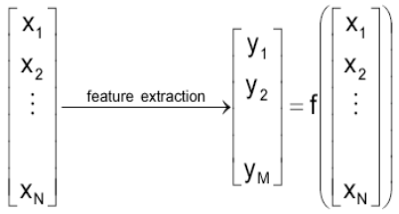
Feature Extraction
Transforming the existing features into a lower dimensional space with preserving most of the information.
Feature extraction precedes feature selection.

Slide 4
Principle Component Analysis
PCA is a way to reduce the number of dimensions (features), without much loss of information.
PCA transforms m-dimensional input space to l-dimensional space (l < m).
PCA is an optimal unsupervised linear feature extractor.
Practical uses of PCA
Data Compression
Feature Extraction as a step before classification/recognition

Slide 5
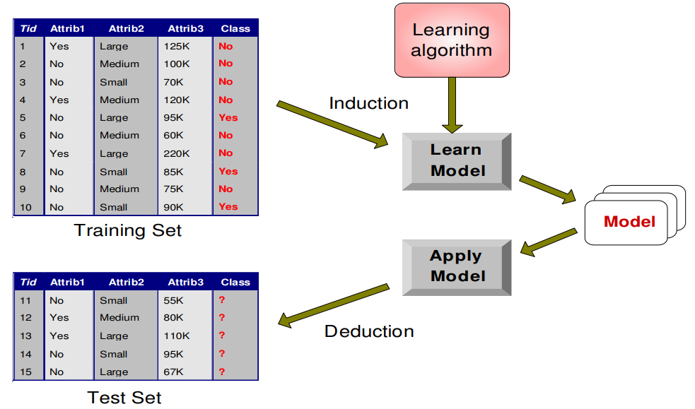
Principle Component Analysis
PCA
* Mean
* Eigenvectors
.
.
.
.
.
.
.
.
.
.
.
.
.
.
.
.
.
.
.
.
.
Notes:
Eigenvectors = Principle Components

Slide 6
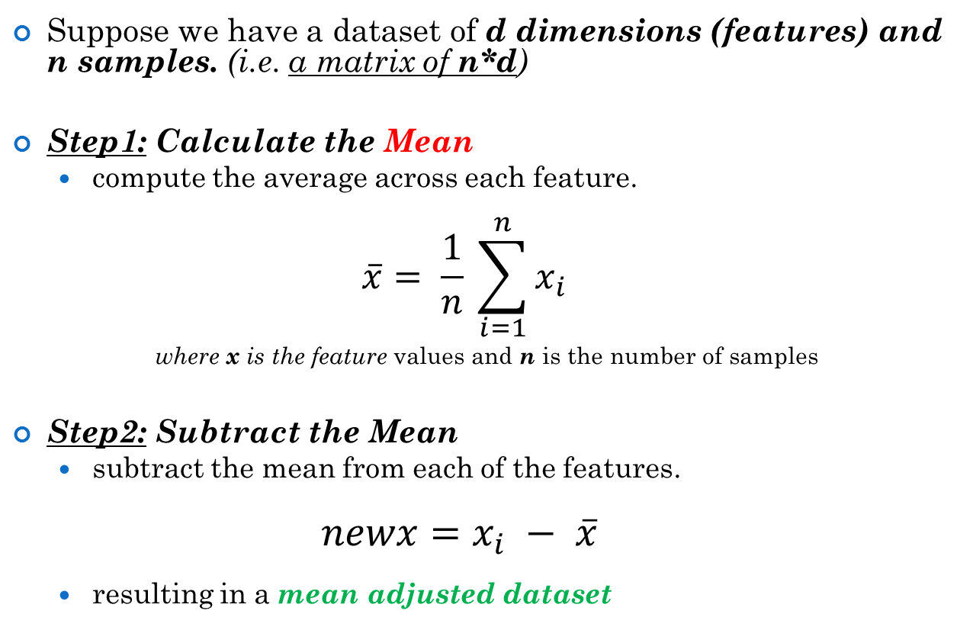
Principle Component Analysis (Steps)
Suppose we have a dataset of d dimensions (features) and n samples. (i.e. a matrix of n*d)
Step1: Calculate the Mean
compute the average across each feature.
$$\overline{x}= \frac{1}{n} \sum_{i=1}^{n}{x_{i}}$$
where x is the feature values and n is the number of samples
Step2: Subtract the Mean
subtract the mean from each of the features.
$$newx=x_{i} − \overline{x}$$
resulting in a mean adjusted dataset

Slide 7
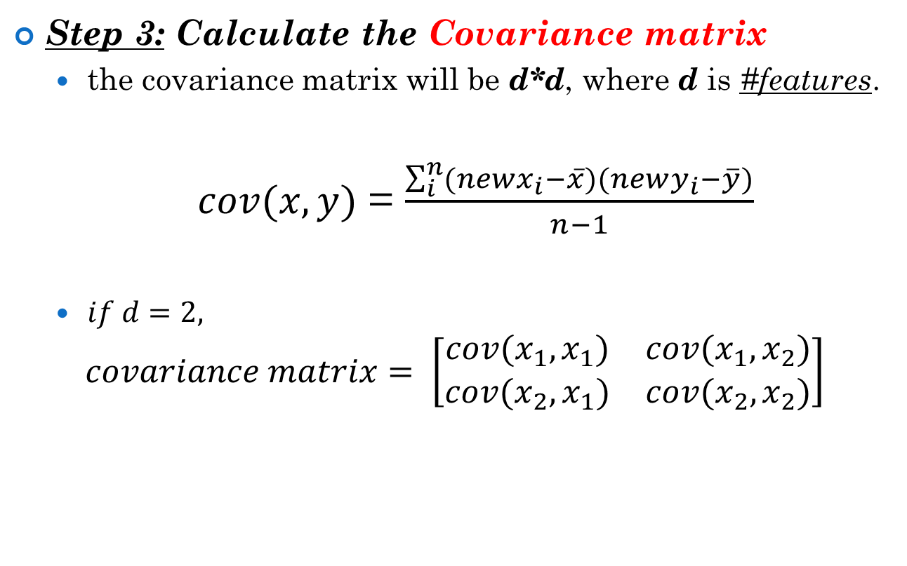
Principle Component Analysis (Steps)
Step 3: Calculate the Covariance matrix
the covariance matrix will be d*d, where d is #features.
$cov(x,y)$ = $\frac{\sum_{i}^{n}{({newx}_{i}−\overline{x})(newy_{i}−\overline{y})}}{n−1}$
$if d=2,$
$$covariance matrix= \left[\begin{matrix}cov(x_{1},x_{1}) & cov(x_{1},x_{2}) \\ cov(x_{2},x_{1}) & cov(x_{2},x_{2})\end{matrix}\right]$$
Notes:
Variance is a measure of the spread of one feature in a dataset.
Covariance is such a measure. Covariance is always measured between 2 features.

Slide 8
Principle Component Analysis (Steps)
Step 4: Calculate the Eigenvectors and Eigenvalues of the covariance matrix
resulting in d eigenvectors and eigenvalues.
eigenvectors is a matrix of d*d, where columns are the eigenvectors of data.
eigenvalues is a vector of d

Slide 9
Principle Component Analysis (Steps)
Step 5: Choosing Principle Components
Order eigenvectors by eigenvalues, highest to lowest.
Choose only the highest P eigenvectors.
Why?
Eigenvector with highest eigenvalue captures the most variation among training vectors x.
Eigenvector with lowest eigenvalue has least variation.
The top few eigenvectors are known as the principal components (PCs).

Slide 10
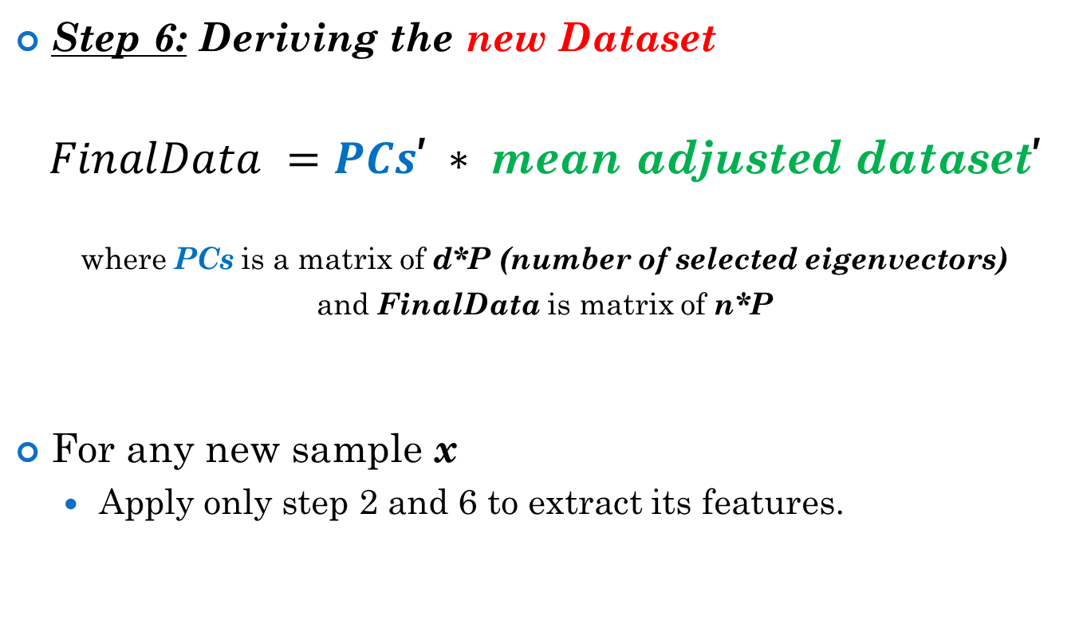
Principle Component Analysis (Steps)
Step 6: Deriving the new Dataset
$FinalData =PCs\text{’} ∗ \text{mean} \text{adjusted} \text{dataset}$’
where PCs is a matrix of d*P (number of selected eigenvectors)
and FinalData is matrix of n*P
For any new sample x
Apply only step 2 and 6 to extract its features.

Slide 11
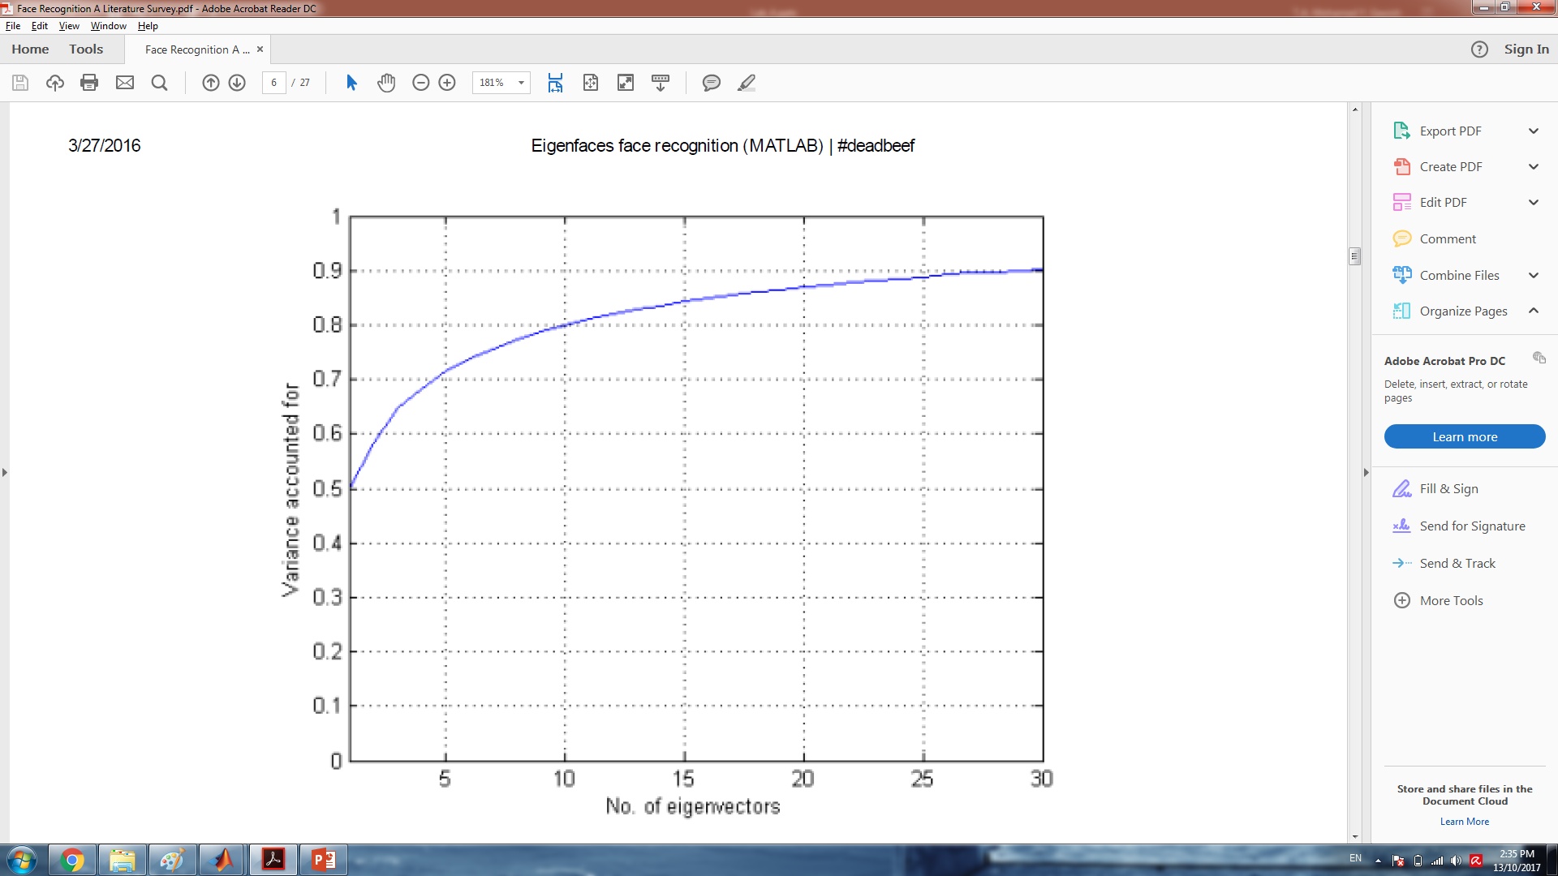
Choosing # PCs
Methods
Arbitrary
Feature Selection Method
Cumulative Eigenvalues
Examining how much variability each eigenvector accounts for.
Notes:
In the graph, using cumulative eigenvalues, we can see that the first eigenvector accounts for 50% of the variance in the data set, while the first 20 eigenvectors together account for just over 85%, and the first 30 eigenvectors for 90%.

Slide 12
Choosing # PCs
Increasing the number of eigenvectors generally increases recognition accuracy but also
increases computational cost.
The ideal number of eigenvectors to retain will depend on the application and the dataset.
In general, a size that captures around 90% of the variance is usually a reasonable trade‑off.
Notes:
However, using too many principal components does not necessarily always lead to higher accuracy, since we eventually reach a point of diminishing returns where the low‑eigenvalue components begin to capture unwanted within class scatter.

Slide 13
Task(4) Description

Slide 14
Thanks!

