Slide 1

SMART PARKING
Survivors:
Yousef Shaaban
Matta Mikhael
Eman Mamdouh
Ziad Hussien
Michale

Slide 2
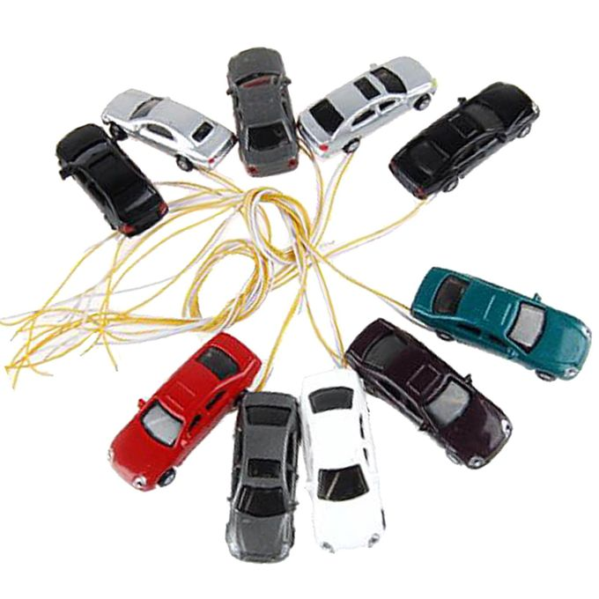
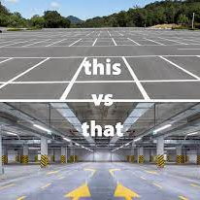
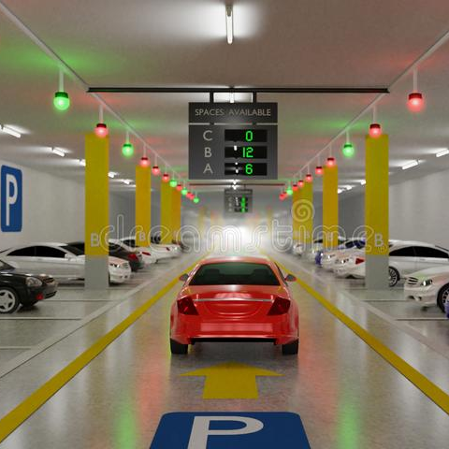
Outlines
Overview
Pic
Arduino
Raspberry pi
Future enhancements

Slide 3
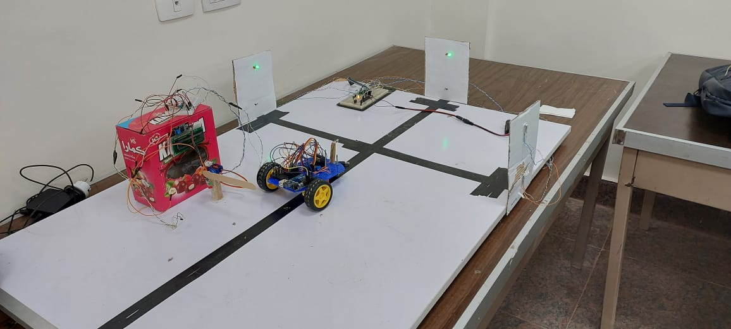
Overview
Parking nowadays is a difficult task especially with the new drivers. Our project covered the automated parking in the garages by the communication between the car and the system, which also care about the security of the place.
By using automation in this task, we saved time and effort with the advantage of letting the system show the car its parking spot at the gate.

Slide 4

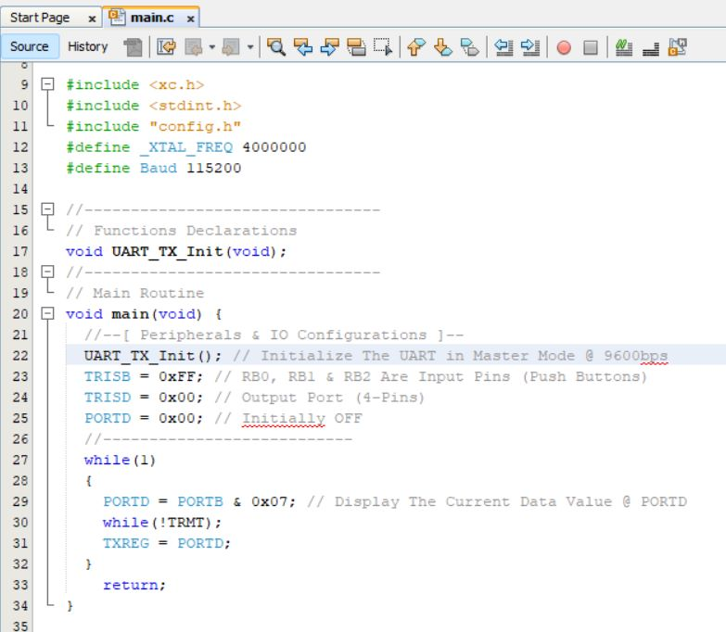
Pic
Parking sensor
Lights in each park
Interface with raspberry pi

Slide 5
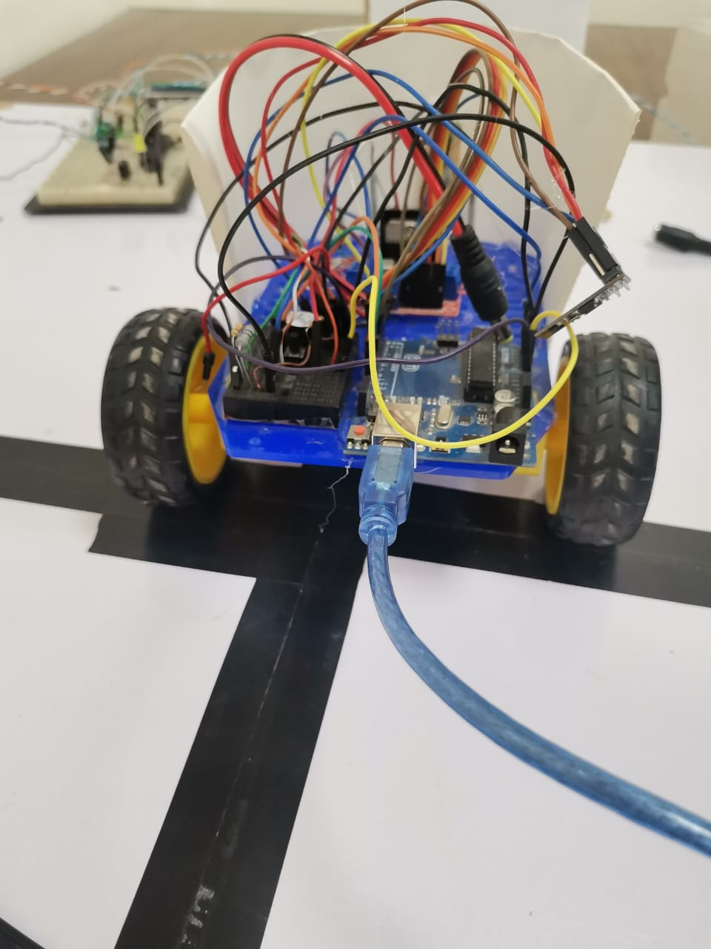
Arduino
The car
Robbery alarm

Slide 6
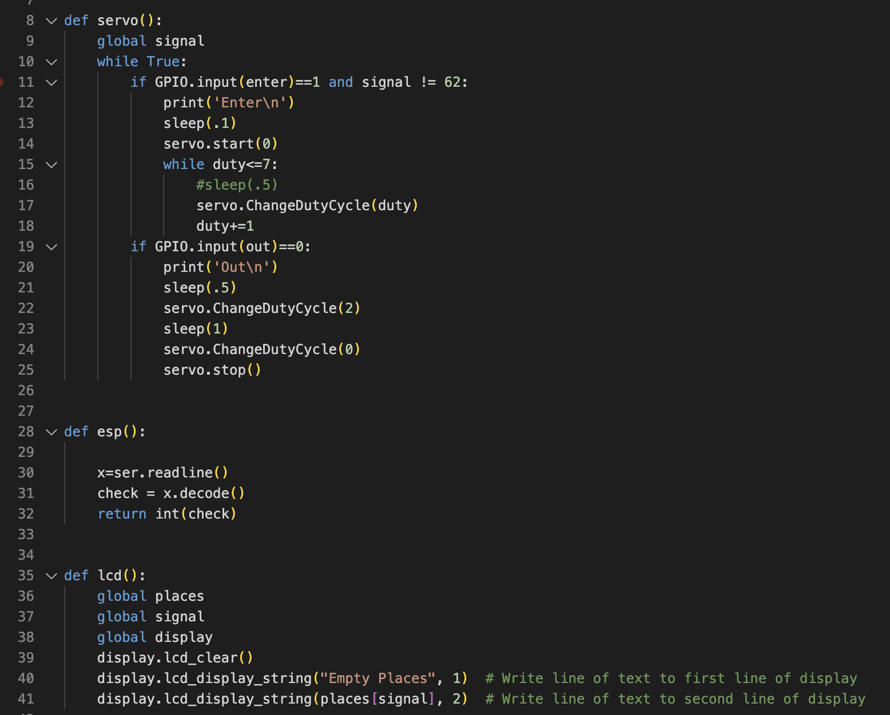
Raspberry pi
The gate
Lcd
Availability
Security Control
Interfacing with Arduino and Pic

Slide 7
Future Enhancements
Connect the system to a mobile application.
- Increasing the features introduced through this app by sending to the driver a map locating its parking spot to decrease his parking time.
- Being able to reserve your parking spot a certain period of time before arriving.
Increase ways of security.
- Adding Video detection software to detect the floors that have strange behavior in the robbery state.

Slide 8

“How long should you try? Until.”
Jim Rohn

Slide 9


Thank You

