Slide 1



Rocket Transformation
FASTEN YOUR SEATBELT ON OUR ROCKET AND GET READY FOR A JOURNEY WITH THE DESTINATION: THE BEST VERSION OF YOURSELF.

Slide 2


AGENDA
1 - ABOUT US
2 - PROBLEM
3- SOLUTION
4- DIAGRAMS

Slide 3


About Us
ROCKET TRANSFORMATION IS AN ONLINE COACHING APPLICATION THAT HELPS ATHELETE TO ACHIEVE HIS GOAL BY PROVIDING ONLINE COACHING SERVICE AND A PLAN DESIGNED SPECIFICALLY FOR THEM TO REACH THEIR GOAL IN THE FASTEST TIME AND IN A HEALTHY WAY.

Slide 4
Problem
IN THE CURRENT FITNESS AND LIFESTYLE COACHING INDUSTRY, SEVERAL CHALLENGES EXIST:
MANY INDIVIDUALS STRUGGLE TO FIND RELIABLE AND PERSONALIZED ONLINE COACHING SOLUTIONS.
COACHES FACE DIFFICULTIES IN MANAGING CLIENTS REMOTELY, INCLUDING TRACKING PROGRESS AND MAINTAINING COMMUNICATION.
FREE ONLINE CONTENT IS OFTEN FRAGMENTED AND LACKS STRUCTURE, FAILING TO CONVERT USERS INTO LOYAL CLIENTS.
MANY INDIVIDUALS STRUGGLE WITH ACHIEVING THEIR FITNESS GOALS DUE TO LACK OF ACCESS TO:
PERSONALIZED WORKOUT AND DIET PLANS.
CONTINUOUS MOTIVATION AND PROFESSIONAL FOLLOW-UP.
A CENTRALIZED PLATFORM INTEGRATING ALL ASPECTS OF FITNESS GUIDANCE.
TRUSTWORTHY COACHING RESOURCES WITH TRACKABLE PROGRESS.
IN ADDITION, FITNESS PROFESSIONALS FACE DIFFICULTY MANAGING CLIENTS, OFFERING VIDEO TUTORIALS, AND MAINTAINING COMMUNICATION IN A STREAMLINED WAY.
MOST EXISTING APPS ARE EITHER TOO GENERALIZED OR OVERLY COMPLEX, CREATING A POOR USER EXPERIENCE FOR BOTH COACHES AND CLIENTS.
ADMINISTRATIVE TASKS SUCH AS USER APPROVAL, SERVICE MANAGEMENT, AND SECURITY ARE OFTEN MANUAL OR INEFFICIENT.
THESE ISSUES LIMIT THE EFFECTIVENESS, REACH, AND IMPACT OF COACHING SERVICES IN A GROWING DIGITAL ENVIRONMENT.

Slide 5
Solution
ROCKET TRANSFORMATION OFFERS A CENTRALIZED PLATFORM WITH THE FOLLOWING BENEFITS:
FOR CLIENTS:
EASY ONBOARDING (REGISTER, LOGIN, SUBSCRIBE).
PERSONALIZED COACHING PLANS INCLUDING DIET, WORKOUTS, AND FOLLOW-UPS.
ACCESS TO FOOD RECIPES, VIDEO ILLUSTRATIONS, AND EXPERT GUIDELINES.
BUILT-IN CALCULATORS FOR CALORIES, BMI, STEPS, AND NUTRIENT TRACKING.
DIRECT COMMUNICATION VIA CHAT AND FEEDBACK SYSTEMS.
FOR COACHES:
TOOLS FOR CLIENT ASSESSMENT, PLANNING, AND FOLLOW-UP.
UPLOAD AND REVISE VIDEO CONTENT (TRAINING AND NUTRITION).
ANSWER CUSTOMER QUERIES THROUGH CHAT AND SYSTEM RESPONSES.
FOR ADMINS:
MANAGE USERS, ROLES, AND CLIENT ACCOUNTS.
CONTROL ACCESS, VIEW PAYMENT DETAILS, AND MANAGE FEEDBACK.
BY INTEGRATING ALL THE NECESSARY COMPONENTS INTO ONE SYSTEM, ROCKET TRANSFORMATION ENHANCES THE FITNESS JOURNEY WITH PROFESSIONAL SUPPORT AND USER-FRIENDLY FEATURES.

Slide 6

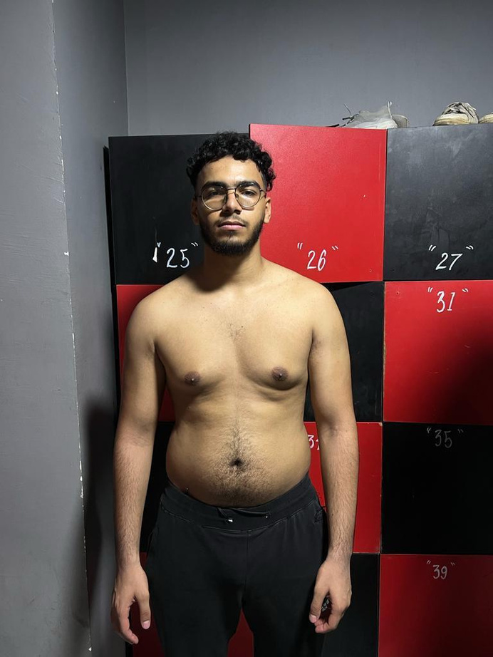
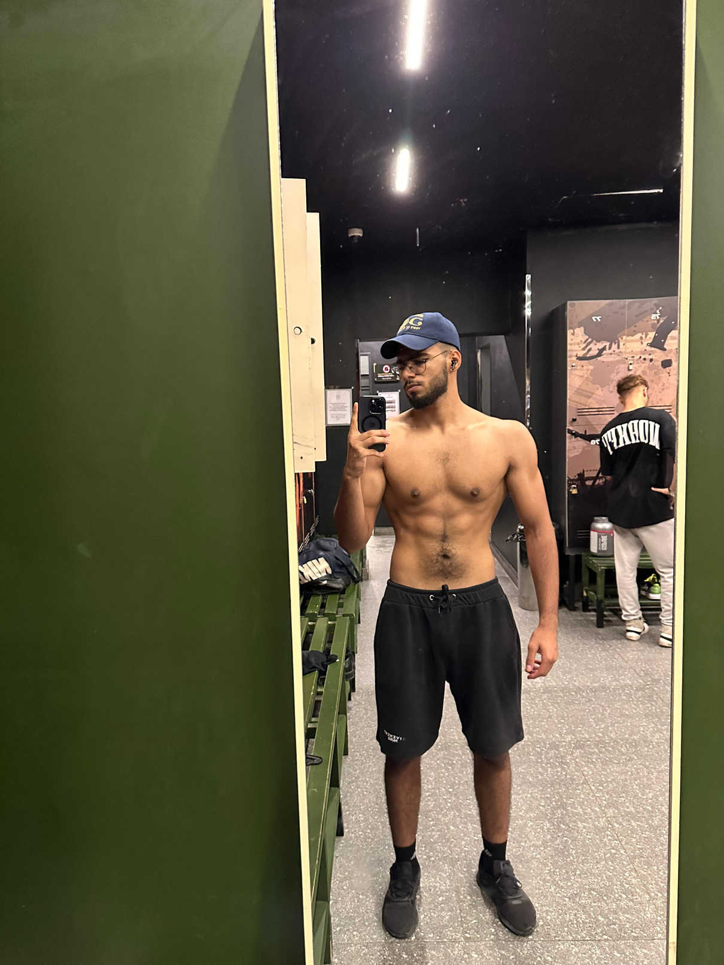
BEFORE
AFTER

Slide 7
Certified Coaches
Customized Plans
Why Rocket Transformation?
Flexability
Experience with more than 10000+ Clients

Slide 8
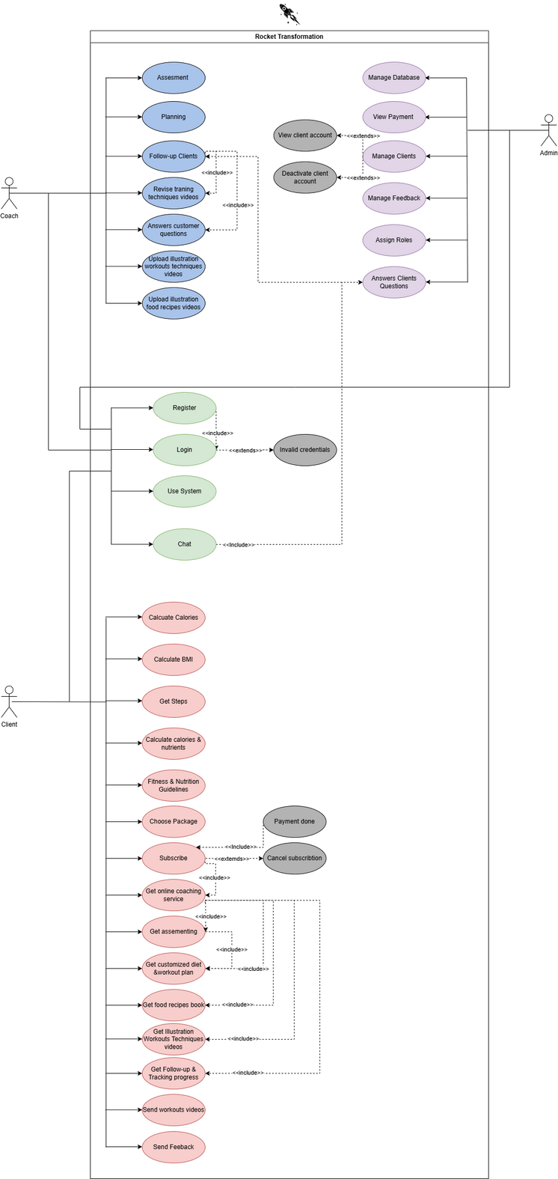

Slide 9
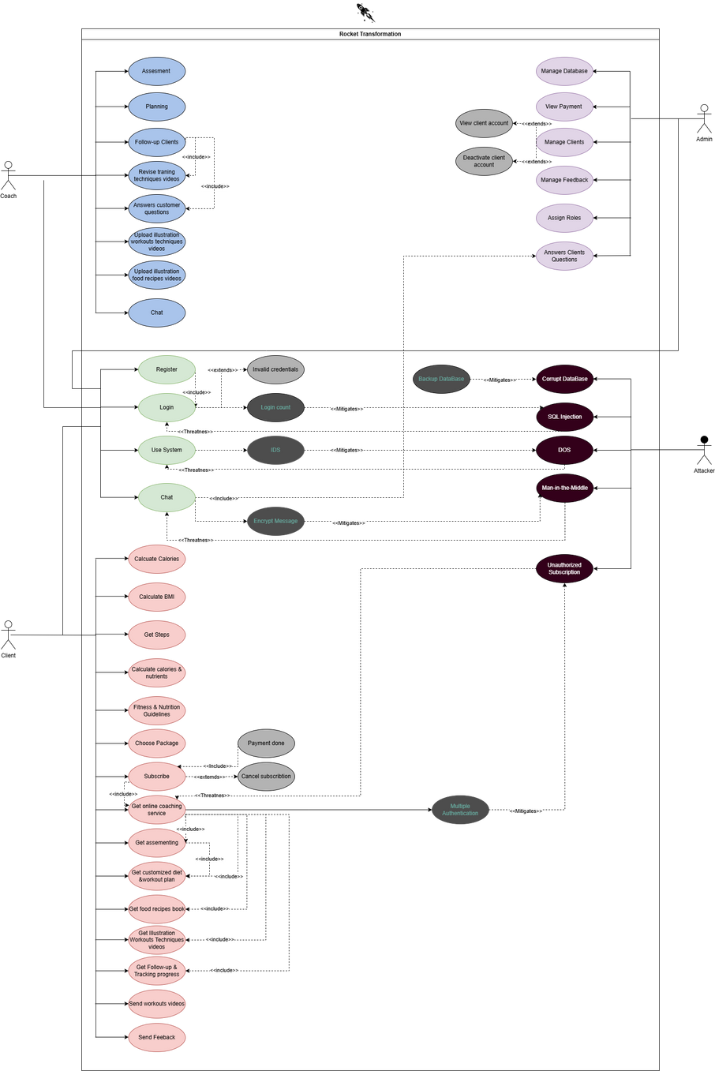

Slide 10
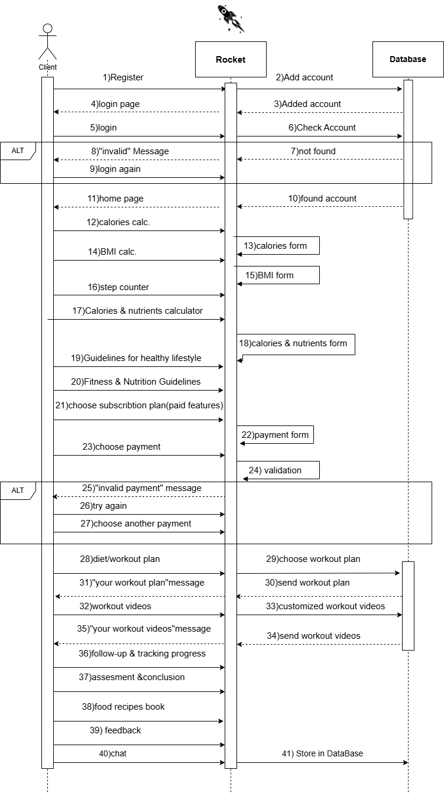

Slide 11
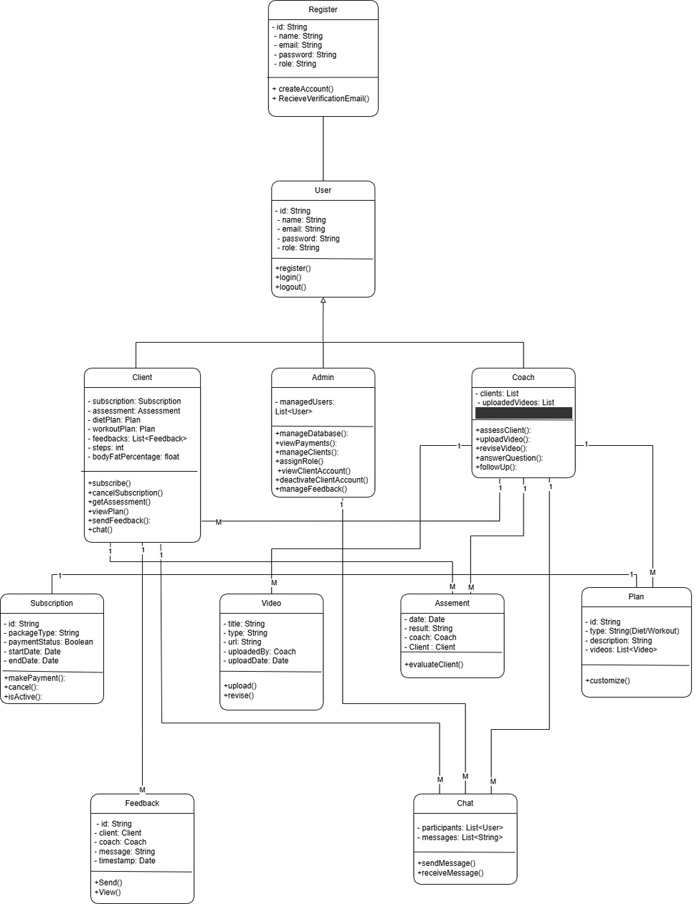

Slide 12
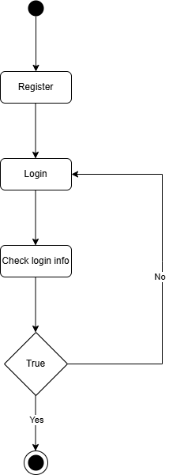

Slide 13
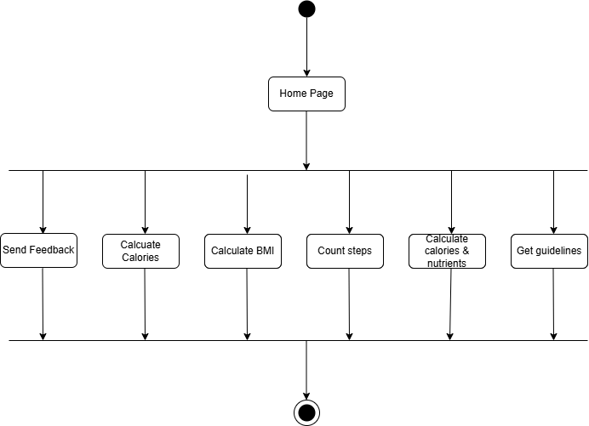

Slide 14
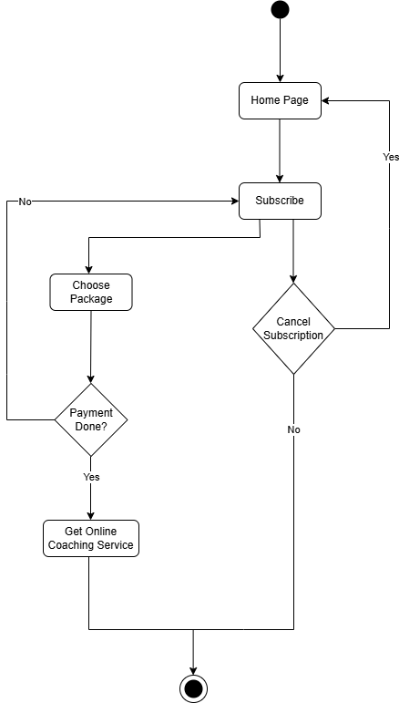

Slide 15
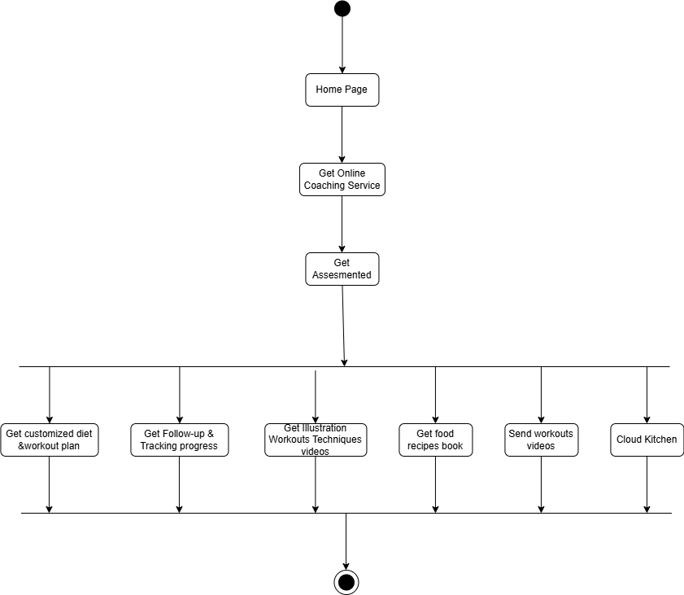

Slide 16
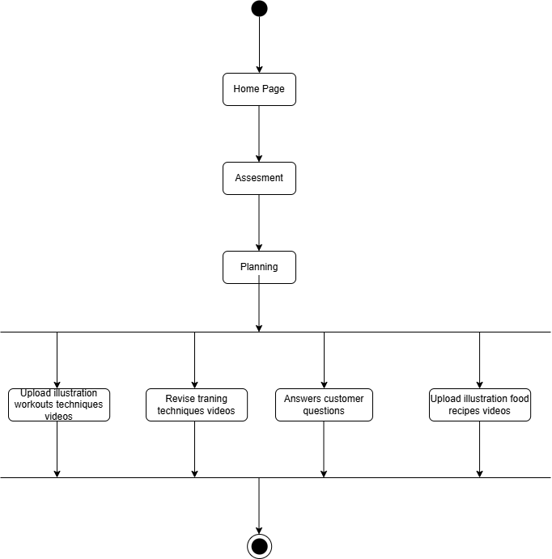

Slide 17
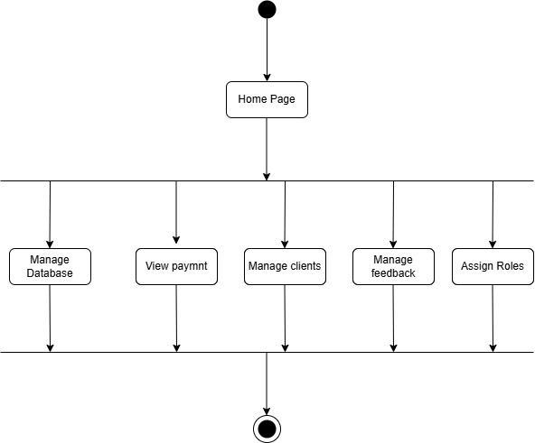

Slide 18

THANK YOU

