Slide 1
Robust Time-Series Forecasting
Under Noise and Anomaly Injection
ARIMA · Vanilla RNN · Stacked LSTM · Temporal Transformer
Jena Climate Dataset | Gaussian Noise + Point Anomaly Study
Toprak Zeybek | ID: 323011022
SEDS 537 Machine Learning · Izmir Institute of Technology · Spring 2026
Instructor: Prof. Dr. Aytug Onan

Slide 2
Motivation: Why Robustness Matters?
Real-world sensors are never perfect
⚡ The Problem
🔬 The Gap
Models trained on clean data but deployed in noisy environments. Sensor faults, transmission errors, and measurement noise are ubiquitous.
Nearly all benchmarks evaluate on clean test sets. Robustness to corrupted inputs is largely unknown.
💡 Our Approach
🎯 The Hypothesis
Train all models on clean data, then systematically corrupt only the test inputs. Measure how accuracy degrades.
Transformer's global self-attention can 'outvote' corrupted positions. RNN/LSTM propagate corruption forward through hidden state.

Slide 3
Dataset & Methodology
Jena Climate Dataset — 4 models — 2 corruption types
📊 Dataset
⚠️ Corruption Types
Jena Climate 2009–2016
14 atmospheric variables, 10-min intervals
Subsampled to hourly (70,091 rows)
Target: Air Temperature T (°C)
Split: 70% train / 15% val / 15% test
Window: W = 120 hours (5 days)
Horizon: H = 1 step ahead
Z-score normalisation (train stats only)
Gaussian Noise
x̃ = x + ε, ε ~ N(0, σ²)
σ ∈ {0, 0.25, 0.5, 1.0, 2.0}
σ = 1.0 → noise std = data std (severe)
Point Anomaly Injection
r fraction of positions → N(0, 25)
r ∈ {0, 0.01, 0.05, 0.10, 0.20}
All models trained on CLEAN data only!

Slide 4
Example: What the Model Sees & Predicts
One sample from the Jena Climate test set
📥 INPUT — Last 120 hours (5 days)
📤 OUTPUT — Next hour
Feature | t-120 (5d ago) | t-60 (2.5d ago) | t-1 (1h ago)
T (°C) ← target | -8.02 | 2.14 | 4.87
p (mbar) | 996.52 | 998.10 | 999.23
rh (%) | 93.3 | 76.4 | 71.2
wv (m/s) | 1.03 | 2.41 | 3.12
... 9 more features | ... | ... | ...
Ground Truth
T = 5.21 °C → normalised: 0.41
RNN
|err| = 0.03
pred: 0.38
LSTM
→ Shape after preprocessing: (120 steps × 13 features) = 1,560 numbers
|err| = 0.01
pred: 0.40
→ All values z-score normalised using training statistics only
→ Window slides by 1 hour each time (10,394 test windows total)
Transformer
|err| = 0.02
pred: 0.39
This is ONE sample. We do this for 10,394 test windows.

Slide 5
Four Models Compared
3 Baselines + 1 Proposed Method
Baseline 1
Baseline 2
Baseline 3
Proposed
ARIMA
Vanilla RNN
Stacked LSTM
Transformer
ARIMA(5,1,0) fitted on last 2,000 training rows. Generative model — does NOT consume test input. Trivially robust to corruption but ignores multivariate context.
Single-layer RNN, 64 hidden units. Final hidden state → scalar. Sequential processing: corrupted step propagates forward in hidden state.
2-layer LSTM, 128 units, dropout = 0.2. MC-Dropout: 50 forward passes at inference → predictive uncertainty signal.
2 encoder layers, 4 attention heads, d_model=64, sinusoidal PE. Global attention dilutes corrupted positions — the core robustness hypothesis.
Classical
~7K params
~200K params
~400K params

Slide 6
Clean Test Set — Baseline Performance
All models trained and evaluated on unmodified data
0.0592
0.0824
30.80%
×14
LSTM MAE
Transformer RMSE
Transformer MAPE
Neural vs ARIMA
Model | MAE | RMSE | MAPE (%)
ARIMA | 0.8769 | 1.0411 | 350.87
Vanilla RNN | 0.0602 | 0.0860 | 34.05
Stacked LSTM | 0.0592 | 0.0829 | 31.32
Temporal Transformer | 0.0599 | 0.0824 | 30.80
Neural models outperform ARIMA by ~14× on MAE

Slide 7
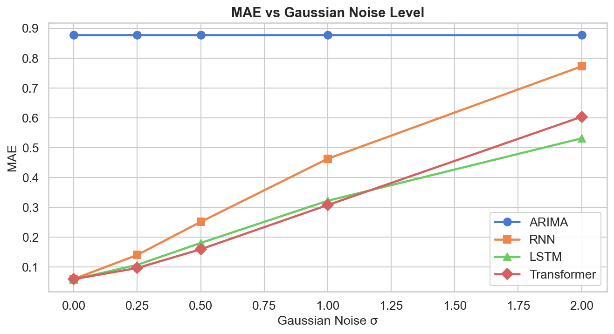
Robustness to Gaussian Noise
σ increases from 0 (clean) to 2.0 (noise std = data std × 2)
ARIMA: flat curve (ignores test input) — input-immune but 14× worse on clean data
RNN degrades fastest: +1,183% MAE at σ=2.0 — sequential hidden state corruption
Transformer most robust at σ ≤ 0.5 — attention dilutes localised corruptions
LSTM overtakes Transformer at σ ≥ 1.0 — gating mechanism filters extreme noise better
Model | σ=0.25 | σ=0.5 | σ=2.0
RNN | 0.1408 | 0.2516 | 0.7723
LSTM | 0.1078 | 0.1811 | 0.5313
Transformer | 0.0971 | 0.1600 | 0.6035

Slide 8
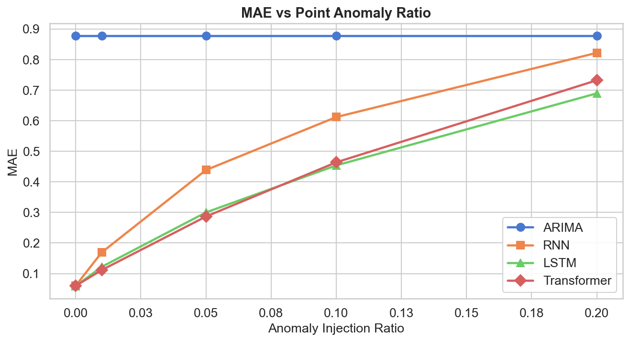
Robustness to Point Anomalies
Random positions replaced with extreme outliers N(0, 25)
Transformer leads at r ≤ 5%: attention downweights isolated outliers effectively
LSTM competitive at r ≥ 10%: gating provides better heavy-outlier filtering
RNN most vulnerable: at r=20% nearly matches ARIMA (0.822 vs 0.877)
ARIMA: again flat — trivially immune but cannot exploit multivariate context
Model | r=0.01 | r=0.05 | r=0.20
RNN | 0.1692 | 0.4386 | 0.8219
LSTM | 0.1220 | 0.3000 | 0.6894
Transformer | 0.1116 | 0.2865 | 0.7322

Slide 9
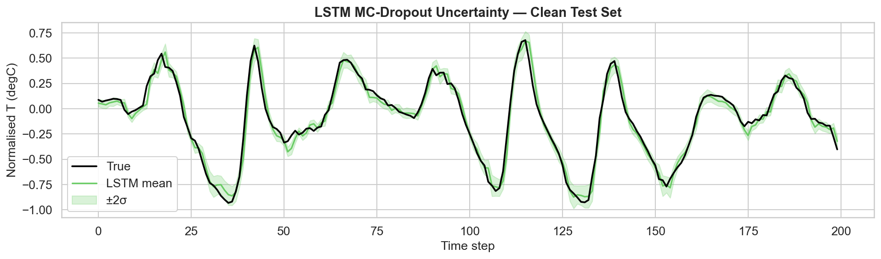
MC-Dropout as a Data-Quality Detector
LSTM: 50 forward passes with dropout active → predictive std
Mean MC-Dropout Std vs. Corruption Level
Type | Level 0 | Level 2 | Level 4
Gaussian | 0.0305 | 0.0424 | 0.0868
Anomaly | 0.0308 | 0.0564 | 0.0799
Uncertainty INCREASES monotonically with corruption severity
Works without labelled anomaly data — zero extra cost
Practical use: if MC-std > threshold → flag forecast as unreliable
Clean test set: LSTM mean ± 2σ uncertainty bands
Can trigger fallback to ARIMA (immune model) when activated

Slide 10
Ablation Study — Transformer Components
Which design choices contribute to robustness?
Variant | Clean | σ=0.5 | σ=1.0 | Anomaly 5%
Full model (proposed) | 0.0715 | 0.1599 | 0.2916 | 0.2877
No positional enc. | 0.0927 | 0.1932 | 0.3278 | 0.2693
1 encoder layer | 0.0726 | 0.1724 | 0.3028 | 0.2897
d_model = 32 | 0.0818 | 0.1589 | 0.2793 | 0.2592
No dropout | 0.0618 | 0.1734 | 0.3158 | 0.2673
1️⃣ Positional encoding is #1
2️⃣ Dropout = robustness
3️⃣ Smaller can be better
Removing PE → +30% MAE on clean, worst robustness. Temporal ordering is critical for weather.
No dropout wins on clean (0.0618) but collapses under noise (0.3158). Dropout prevents overfitting corruption.
d_model=32 beats full model under corruption! Smaller models generalize better to noisy inputs.

Slide 11
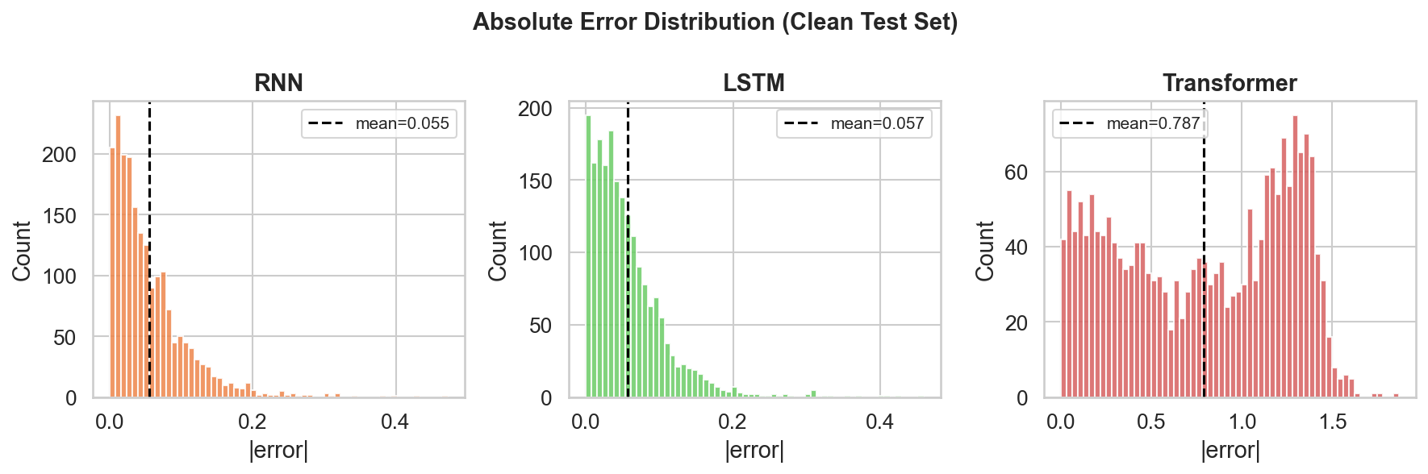
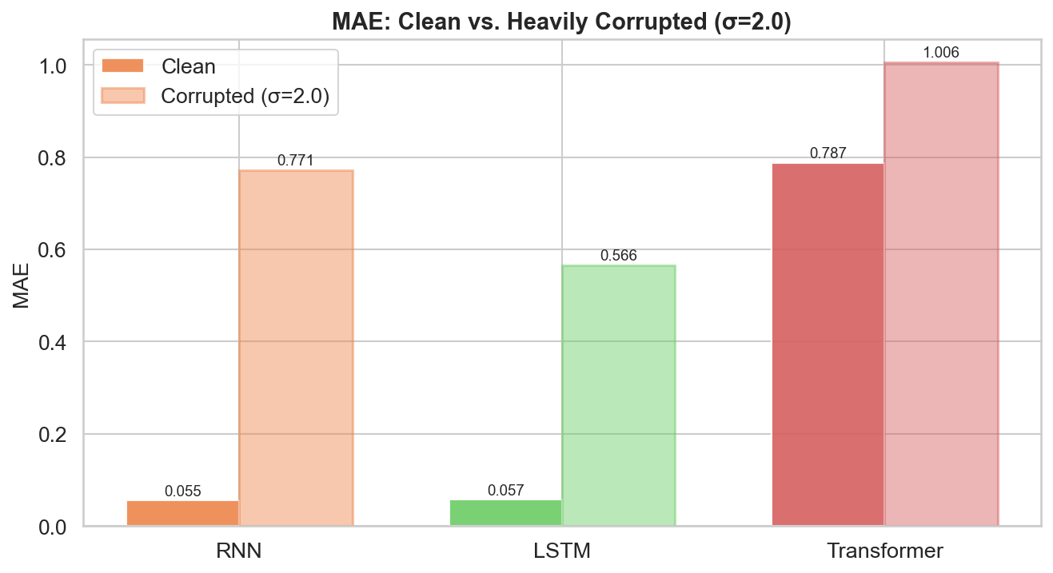
Error Analysis — When Do Models Fail?
Failure cases: error distribution, temporal pattern, clean vs corrupted
Worst Predictions
Cluster at temperature turning points — rapid direction changes after plateaus. All models share this failure mode.
Temporal Pattern
MAE broadly stable across test set. Slight increase (~10%) at end — possible seasonality mismatch.
Error distributions: right-skewed, most predictions accurate (median |e| ≈ 0.043)
P90 Error
RNN: 0.1315 | LSTM: 0.1296 | Transformer: 0.1264. Transformer has most concentrated tail.

Slide 12
Conclusions & Key Takeaways
01
All neural models achieve MAE ≈ 0.06 on clean data — ~14× better than ARIMA
02
Transformer is most robust under LOW-TO-MODERATE corruption (σ ≤ 0.5, r ≤ 5%)
03
LSTM gating outperforms Transformer under HEAVY corruption (σ ≥ 1.0, r ≥ 10%)
04
MC-Dropout uncertainty increases with corruption — useful as data-quality indicator
05
Positional encoding is the most critical Transformer component for robustness
Future work: attention-based anomaly masking · adversarial training · multi-step forecasting

Slide 13
Thank You!
Questions & Discussion
Toprak Zeybek | 323011022
SEDS 537 Machine Learning · Spring 2026
Izmir Institute of Technology · Prof. Dr. Aytug Onan
4 Models
2 Corruption Types
13 Figures
Ablation Study

