Slide 1
Social Media Use & Mental Health
Zeynep B. Sahin – ReDI Data Analytics
Contact: zsahin.de@gmail.com

Slide 2
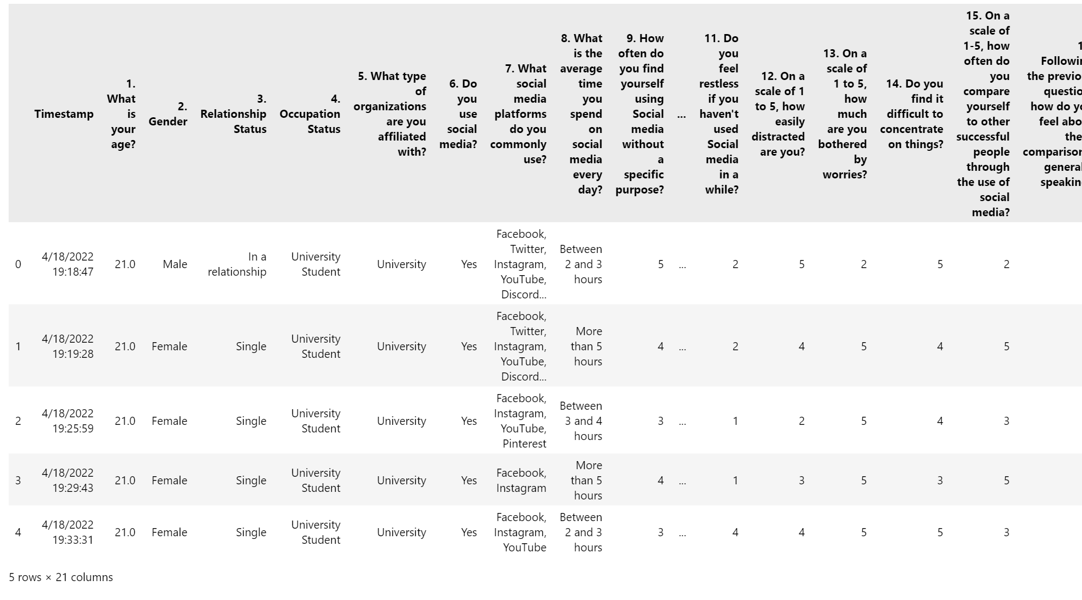
Why This Project:
I studied psychology.
I observe people steam off using social media.
I observe increase of use of social media when I feel blues.
Can there be a relationship between the two?
Used 2023 Dataset that has been collected by some students for statistics course in a university.
Found the datasel through Kaggle.
The dataset includes 481 non-null rows and 21 columns/variables.
Columns include informations about: age, gender, occupation, daily average social media use, and questions regarding ADHD, Anxiety, Low Self-Esteem, Depression scales of participants.
In this project;
Pandas
Numpy
Matplotlib
Seaborn
Sklearn

Slide 3

Why This Project:
Research Questions:
- What is the relationship between mental health and social media use?
- What are the common types of people that uses social media and show signs of mental health problems?
- Can intensity of social media use be an indicator to mental health problems?
Methods:
- Exploratory data analysis
- Correlation
- Logistic regression
- K-means clustering

Slide 4
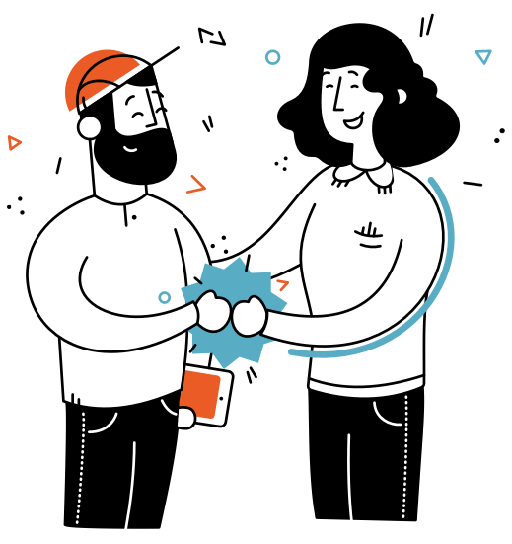
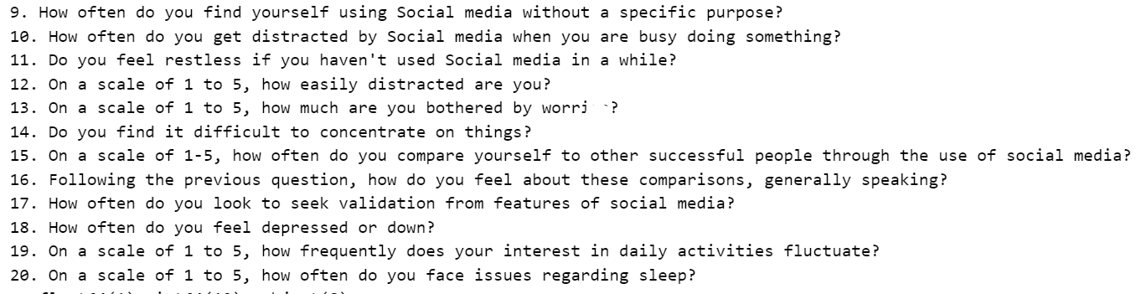
Difficulties During the Process:
Data is clean BUT:
Data collection process is not clear.
Columns names and classifying them.
Deciding to use which variable for measurement.
Deciding to convert categorical variables to nominal variables.
Deciding the statistical methods.
Learning and Applying Advanced Statistical Techniqes:
Applying Logistic Regression
Applying K-Means Clustering
Applying Elbow Method
- ADHD score
- Anxiety score
- Low Self-Esteem score
- Depression Score

Slide 5
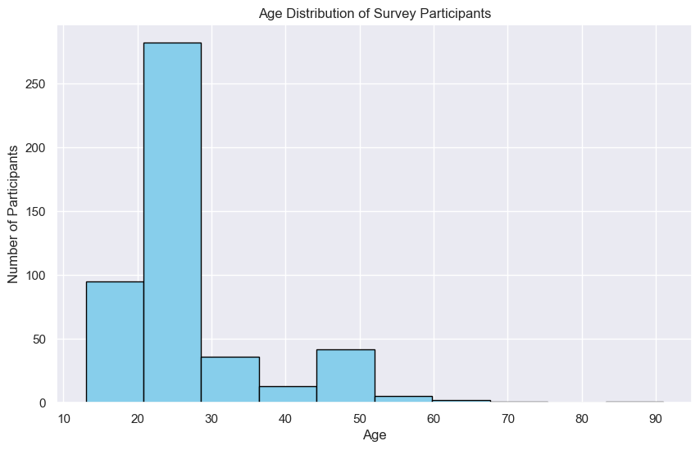
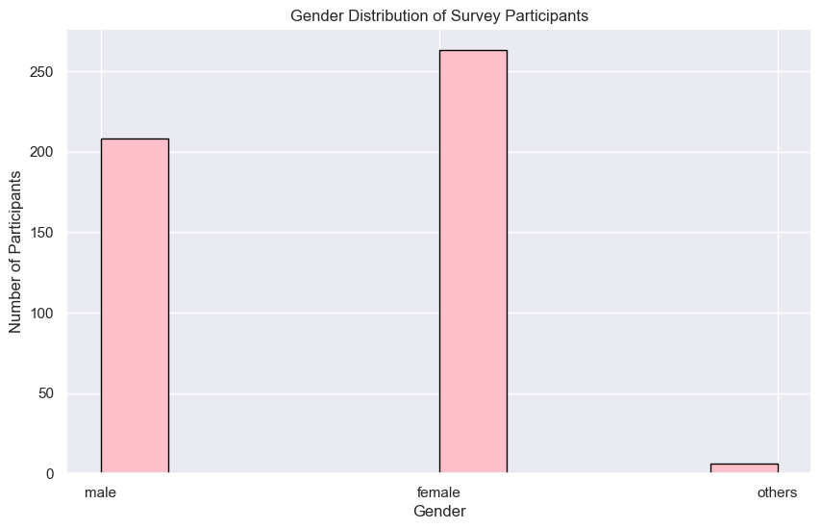
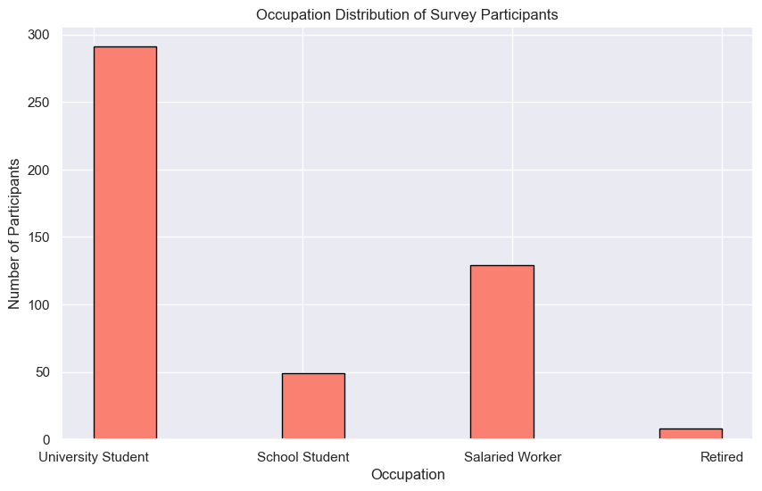
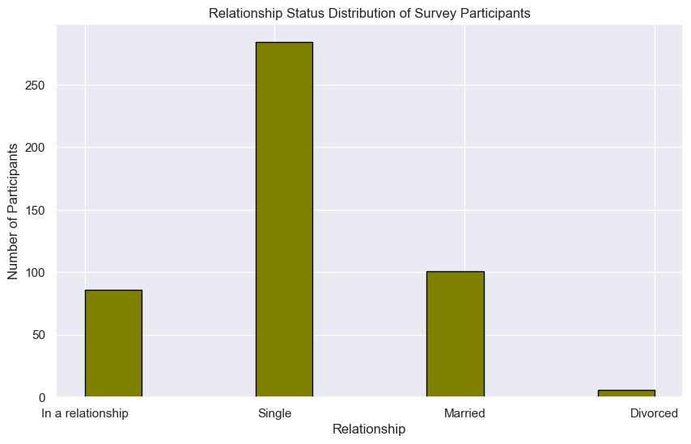
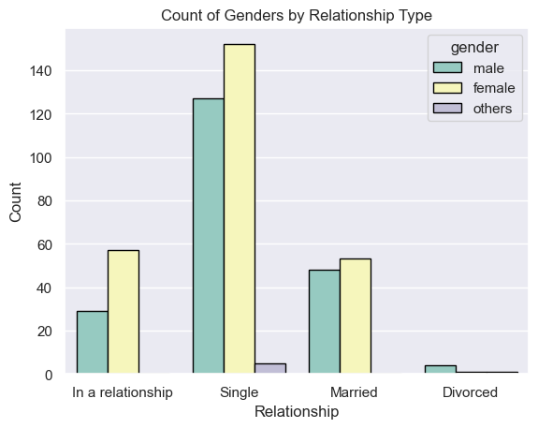
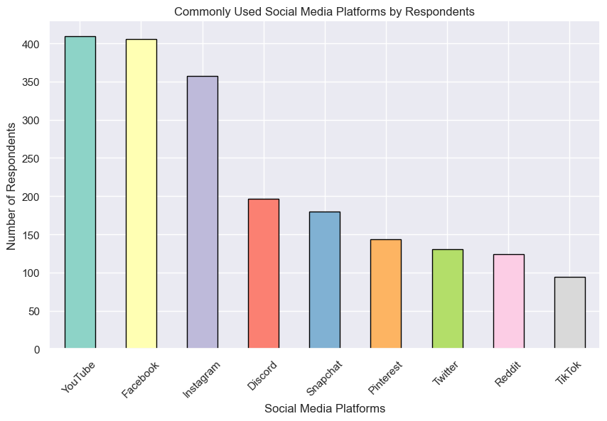
Exploring the Data:
Mean: 26

Slide 6
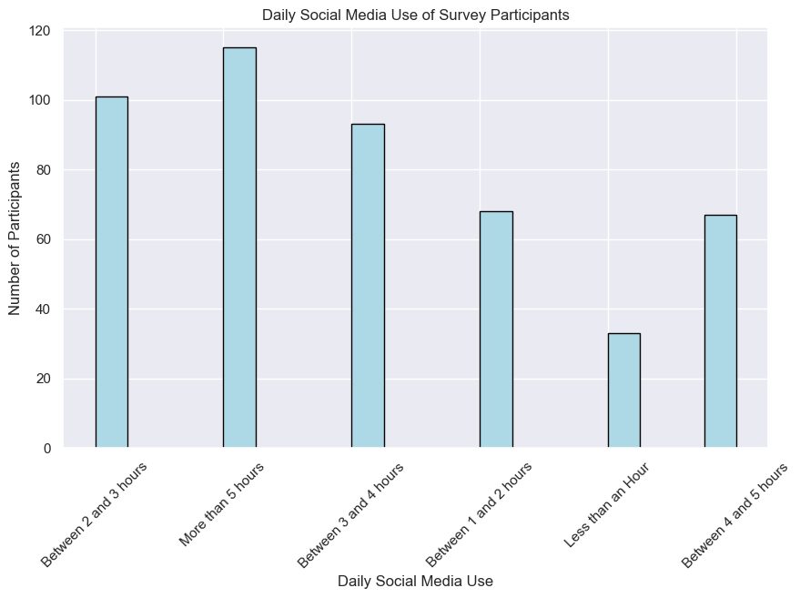
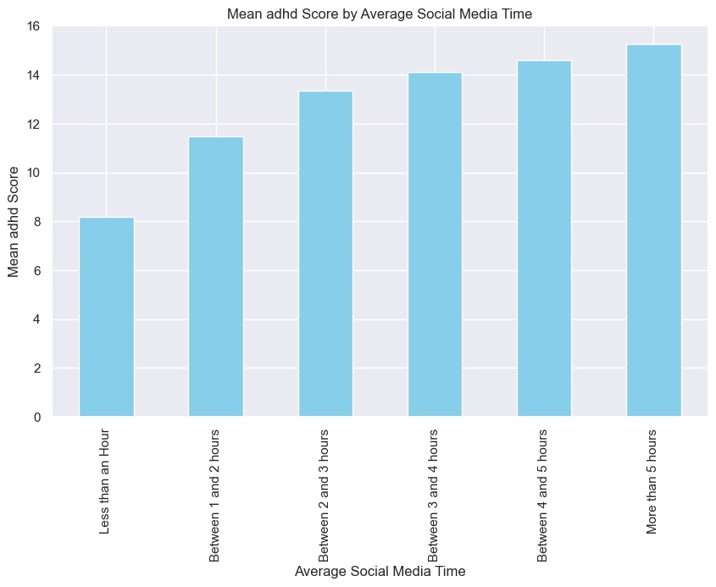
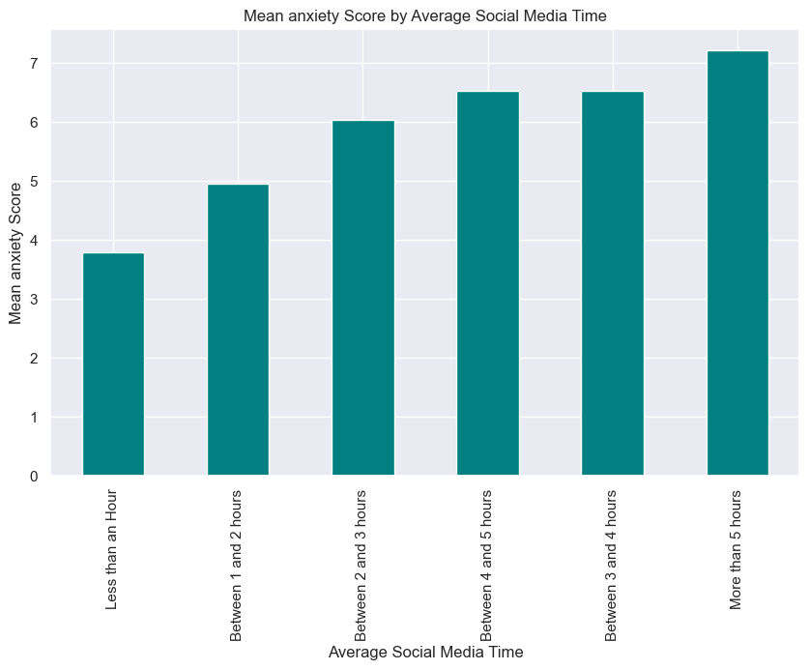
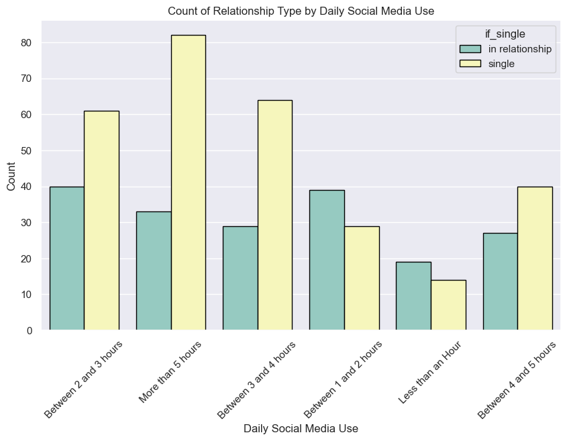
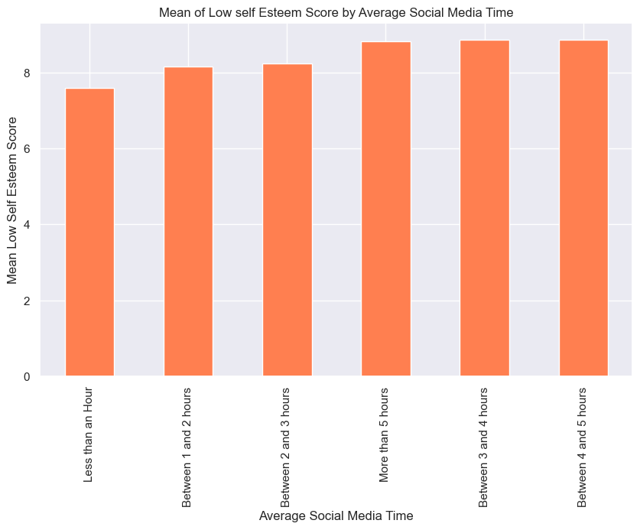
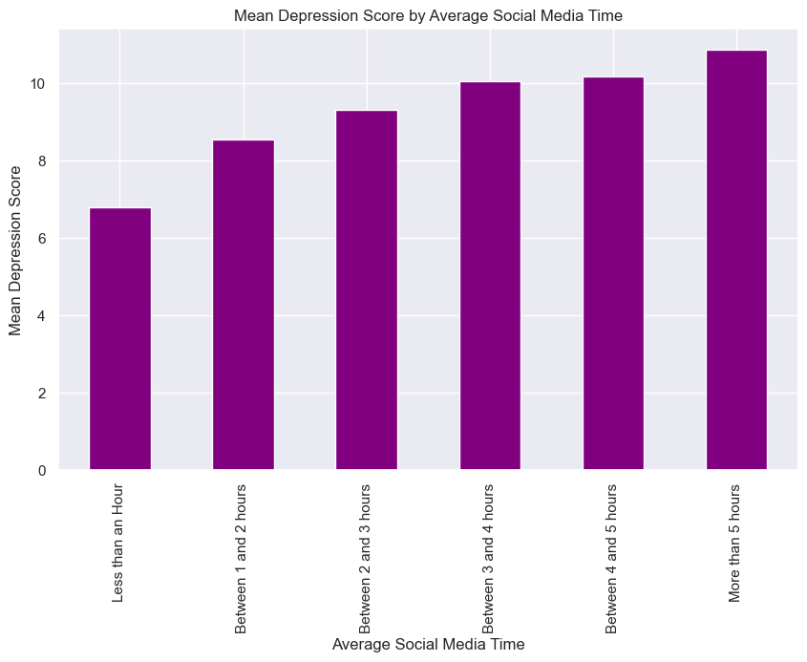
Exploring the Data:

Slide 7
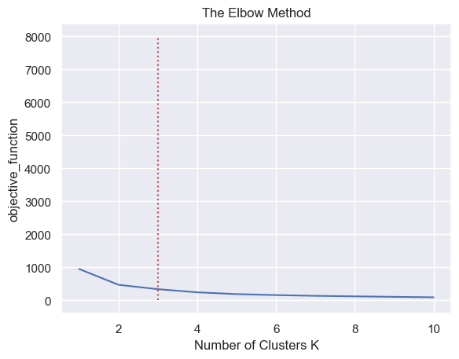
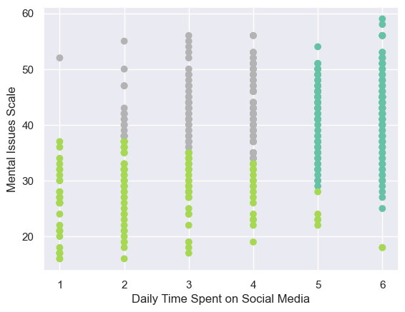

K-Means Clustering & Elbow Method
Regular users
Natives
Exotic birds

Slide 8
Characteristics of 3 Groups:
Natives - Excessive social media users, average of 5 hours daily. - Mostly female and other genders. - Average age is 22 - Mostly university students - Mostly single people - High adhd, high anxiety, low self-esteem, high depression score | Exotic Birds - Average of 1-2 hours of social media use. - Mostly male - Average age is 32 - Mostly salaried workers, university students and retired persons. - Single and married, divorced are concentrated. - Low adhd, low anxiety, relatively high self-exteem, low depression score. | Regular Users - Average of 2-4 hours of social media use. - Mostly female - Average age is 24 - Mostly university students. - Mostly singles. - High adhd, high anxiety, low self-esteem, high depression score.

Slide 9
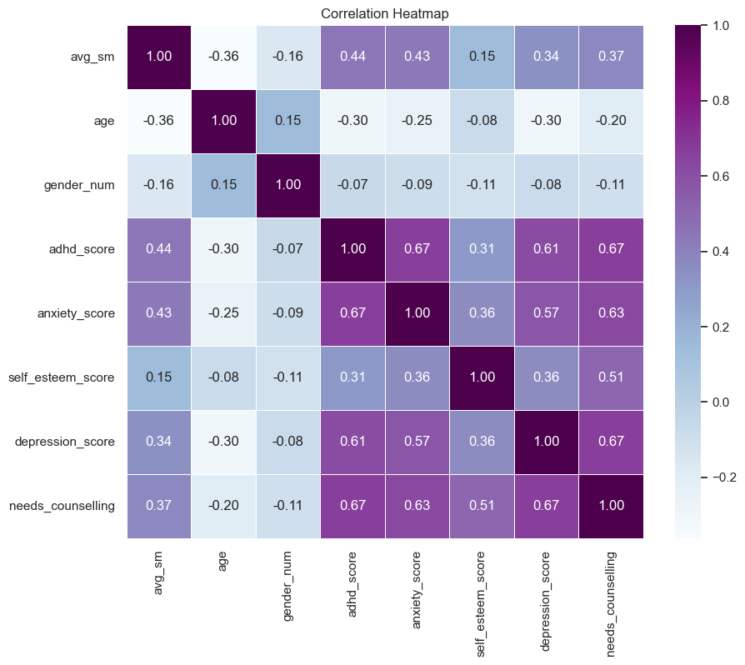
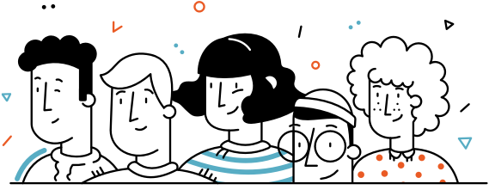
Logistic Regression:
Accuracy of Logistic Regression:
90%

Slide 10
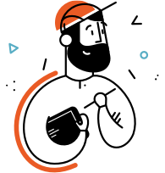
Future Steps:
Extensive, culturally, age-wise varied, and current data is needed.
More survey questions and more participants is needed.
The results can be used for developing strategies for more deliberate social media use.
Protective psychological plans can be applied to most vulnerable group, which is female university students.
Your inputs or questions?
Original code source: https://github.com/zeybus/Social-Media-Usage-and-Mental-Health

