Slide 1

Predicting the Popularity of Movies with Machine Learning Methods
2014510056 Zeynep Köse

Slide 2
INTRODUCTION
This article is about predicting the popularity of movies. A number of features such as cast, genre, budget, production house, and rating affect a movie's popularity. Twitter, YouTube etc. Social media are the main platforms where people can share their views on movies. Traditional features and social media features are two types of features to be used to estimate the popularity of the movie. The estimate of popularity can be measured in terms of Ratings. (Represented by a positive numeric number less than 10 or a label).

Slide 3
DATASET
Description
Data Name: CSM (Conventional and Social Media Movies) Dataset 2014 and 2015 Data Set
Data Link:
https://archive.ics.uci.edu/ml/datasets/CSM+%28Conventional+and+Social+Media+Movies%29+Dataset+2014+and+2015
The dataset retrieved information about movies from diverse sources including movies web site, i.e. IMDB, generic web resource i.e. Wikipedia, and social media including YouTube and Twitter. Beyond that, it also used sentiment analysis libraries to get the sentiment score for different movies. The total dataset contains twelve features and can be split in to two sub-dataset, the conventional features and social media features.

Slide 4
Conventional Features: Conventional Features contain six features in total and those features are typically available on movie resource websites, such as IMDB.
• Genre: There are 19 different types of genre in the dataset, such as Action, Adventure and Drama etc. They were already mapped on to integer value from 1-19 and in our project, they are treated as factor variables to represent different genre.
• Sequel: This variable in integer represents whether the movie is sequel or individual. 1 shows that movie is first release; other n larger than 1 shows that movie is 2nd. e.g. Pirates of Caribbean: Dead Man’s Chest is 2nd in sequel, therefore it is assigned the value of 2.
• Ratings: The value of Ratings ranges between 1 to 10 with 1 being lowest and 10 the highest. These values are collected from IMDB.
• Gross Income, Budget and Number of Screens: Gross world-wide income and Budget for each movie is collected from IMDB. The unit of gross income and budget is USD and they are already converted into USD if they are represented in other currencies. Number of screens on which movie was initially launched in US is also considered.
Social Media Features: Social Media Features also contains six features and those features are collected for each movie.
• Aggregate Actor Followers: Number of followers of actors in one movie on twitter is used. Only the top 3 in cast are considered.
• Number of Views and Comments: Those variables represent the number of views and comments of trailer of movies on YouTube.
• Number of likes and dislikes: Number of Likes and Dislikes of trailers on YouTube are considered.
• Sentiment Score: A signed integer value is used to represent sentiment score. 0 represents neutral sentiment; “+”sign shows the positive sentiment and the value shows the magnitude; “–”sign shows negative sentiment and the value shows the magnitude. The sentiment score is calculated through analysing the sentiments of tweets about one movie.

Slide 5
B. Plots
A data quality report includes tabular reports that describe the characteristics of each feature in an ABT using standard statistical measures of central tendency and variation.
The tabular reports are accompanied by data visualizations:
A histogram for each continuous feature in an ABT.
A bar plot for each categorical feature in an ABT.

Slide 6
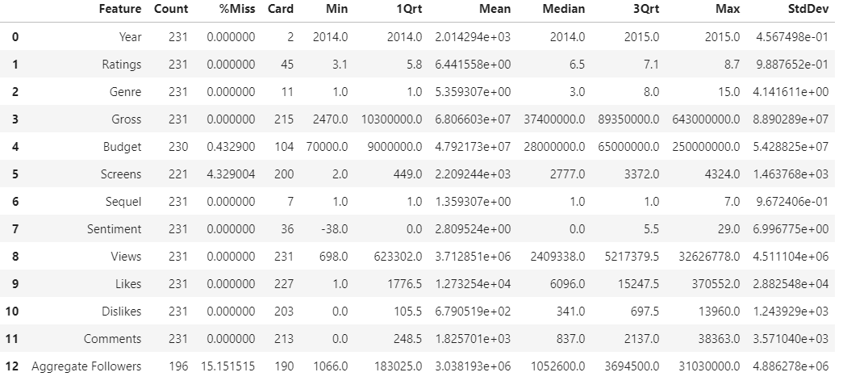
Continuous Features:

Slide 7
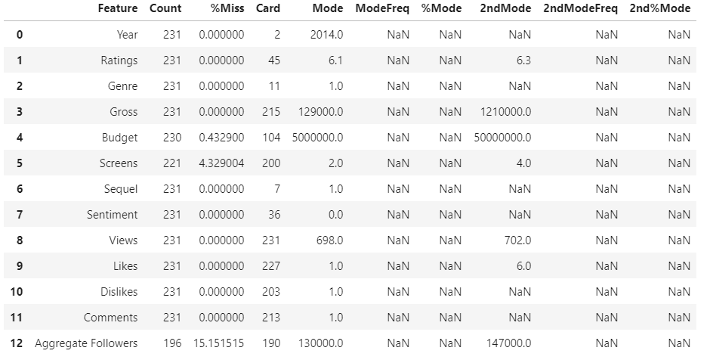
Categorical Features:

Slide 8
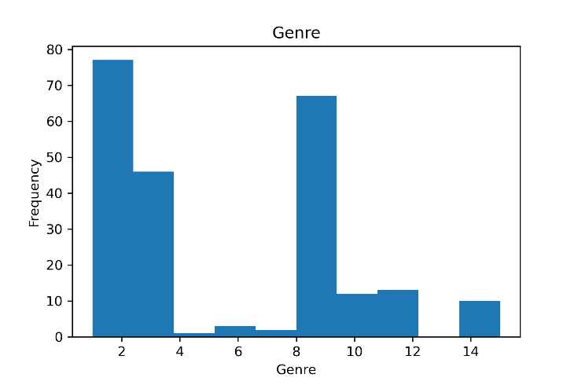
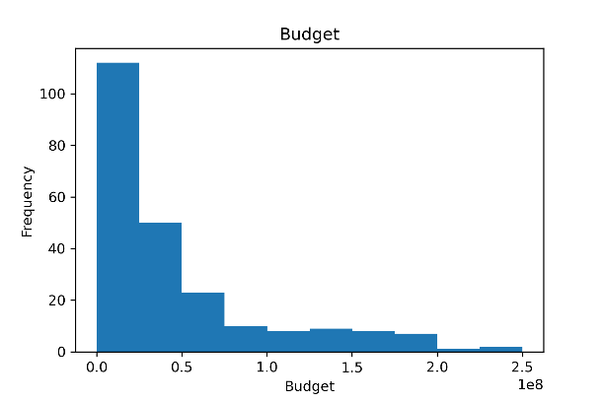
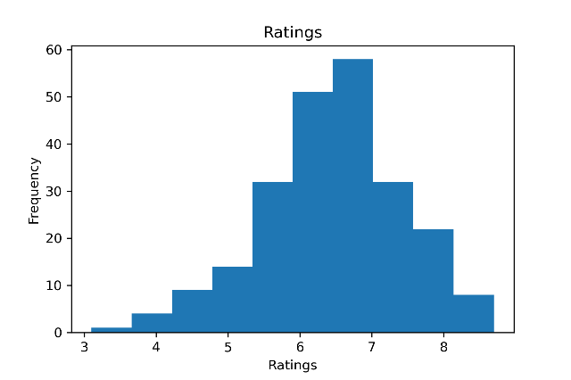
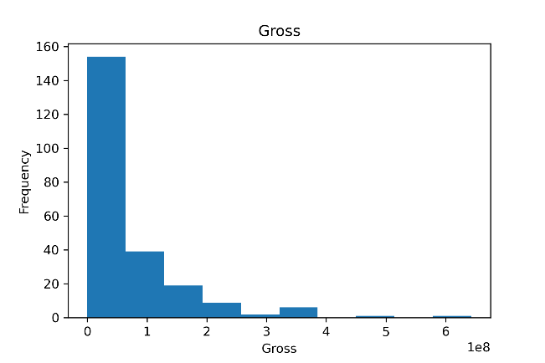

Slide 9
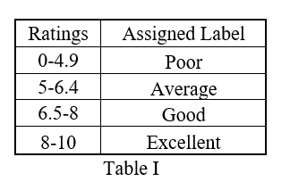
C. Data Preprocess
Table I shows that how we map the Rating to category variable. For methods exclude regression methods, I will use this categorical variable as dependent variable in models and predictions.

Slide 10
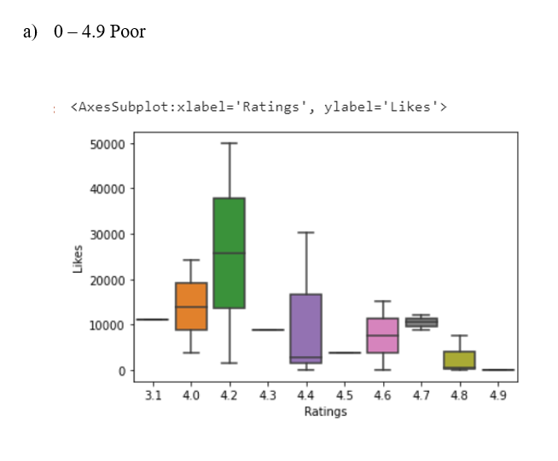
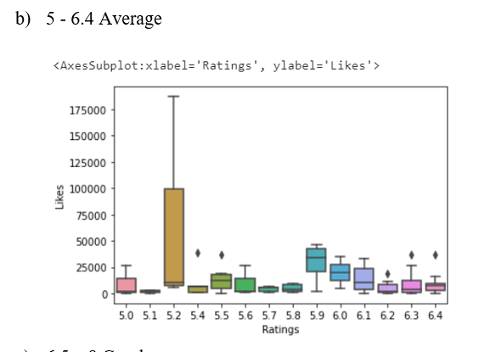

Slide 11
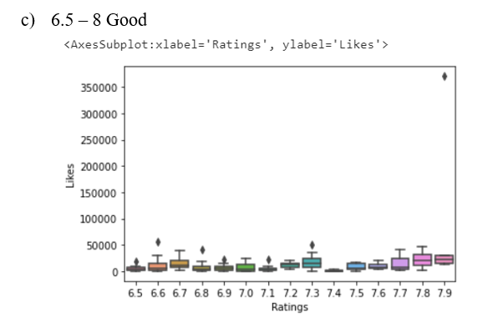
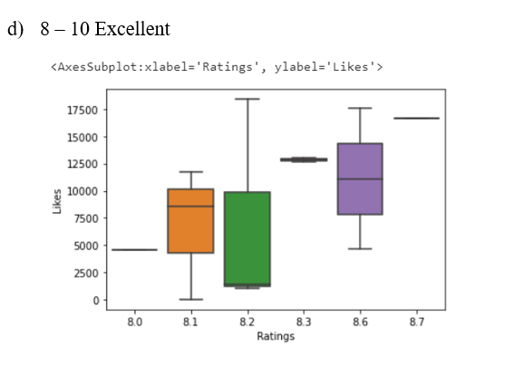

Slide 12
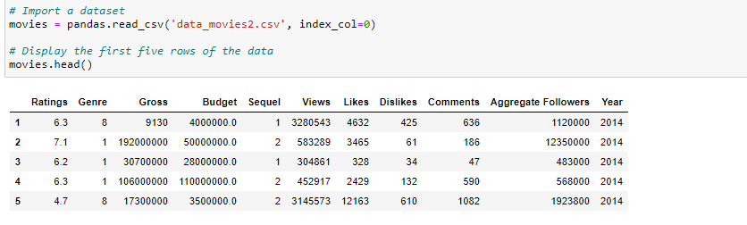
Machine Learning Models Regression Model

Slide 13
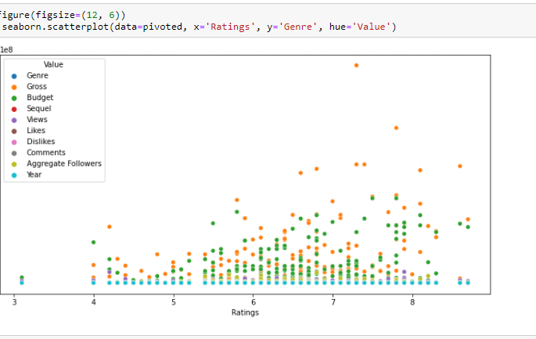
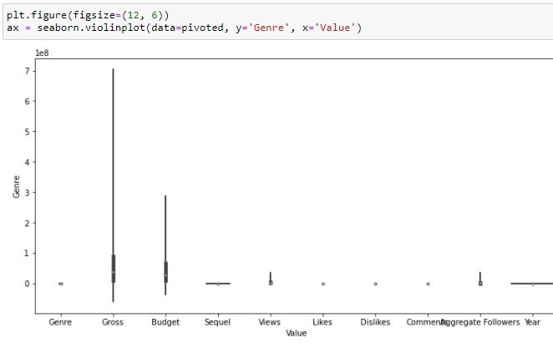
Taking a look at the data
I can quickly visualise the relationships in the data.
The seaborn module provides many common plots.

Slide 14
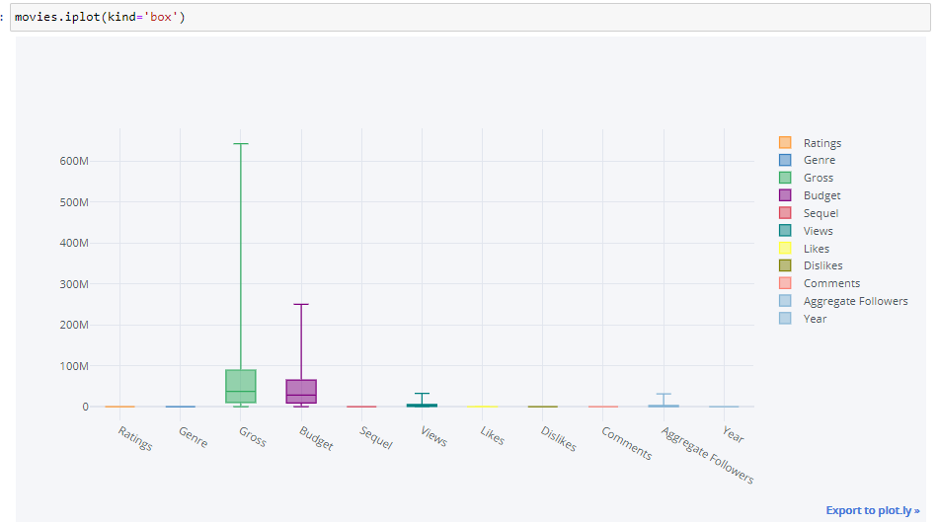
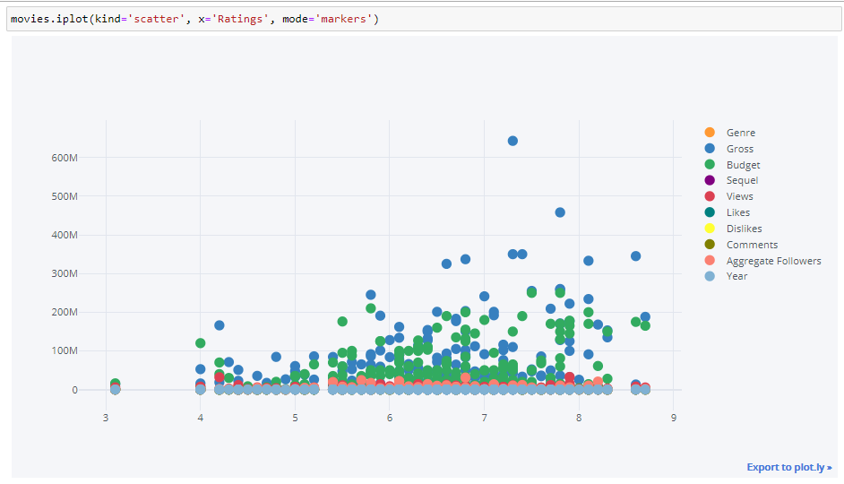

Slide 15
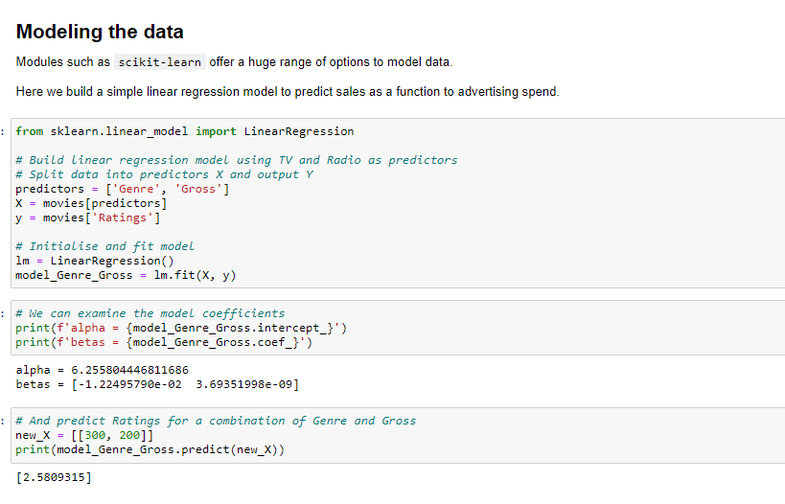

Slide 16
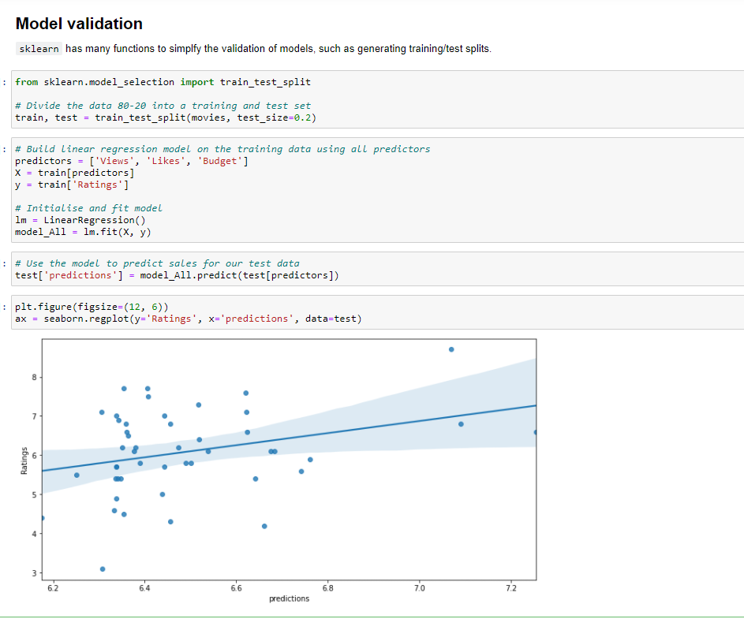

Slide 17
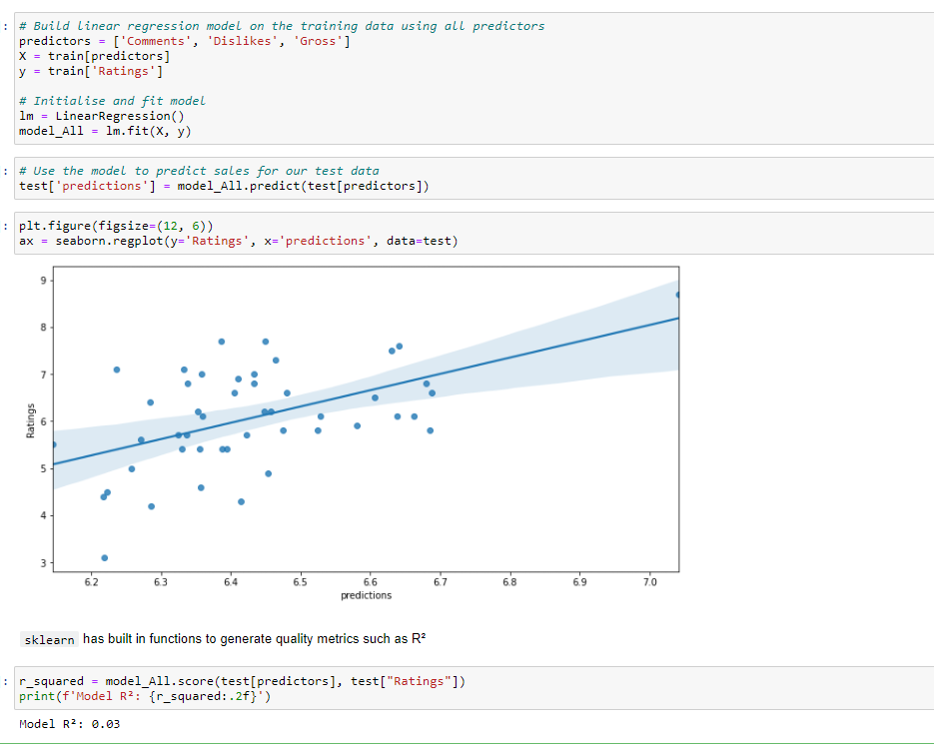

Slide 18
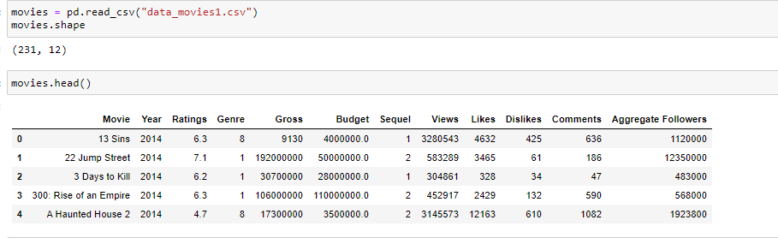
KNN Model

Slide 19
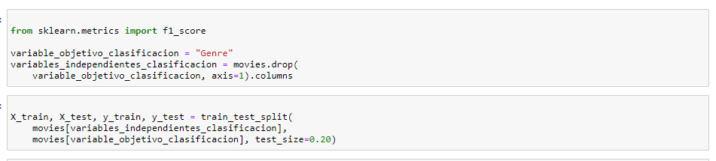
KNN for classification problems I tested KNN for classification, specifically let's assume that we want to predict the genre of a movie based on its popularity.

Slide 20
The most important parameters when using KNeighborsClasifier are:
n_neighbors: The value of K, that is, the number of neighbors to consider when assigning a class.
weights: When it comes to voting, how important is it to give to the neighbors. If we choose car, it assigns the same importance to all the neighbors. If we choose distance, it assigns importance to the neighbors based on the distance from the - neighbors to the point to be classified
metric: The metric when measuring the distance between the points. If Minkowsky distance is used, p can be chosen with the parameter p, which by default is 2 (which computes the Euclidean distance).
In this particular case we know what value to choose from K, since we can assume that the number of categories in the dataset is the total number of movie categories in the training dataset.

Slide 21
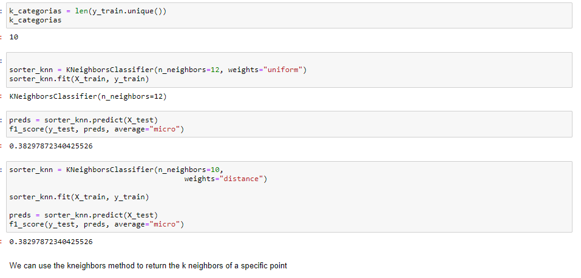

Slide 22
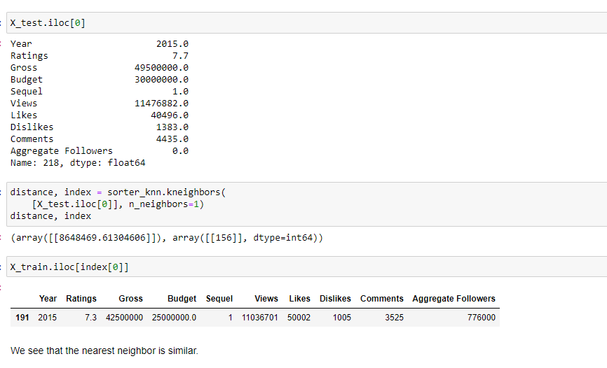

Slide 23
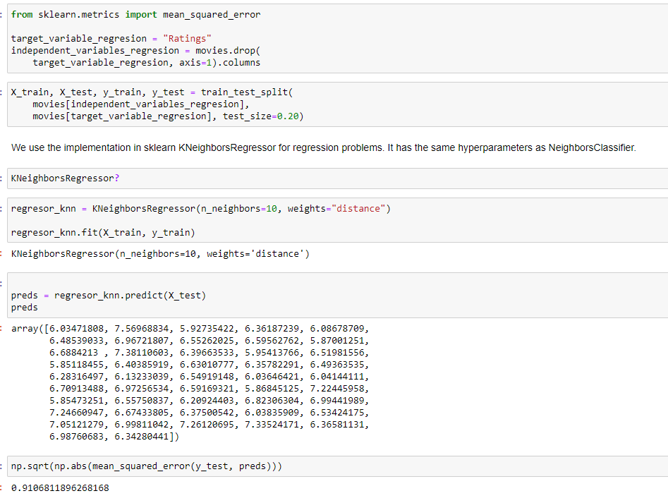
KNN for regression problems
We are now going to use the KNN algorithm for a regression problem, KNN works the same to do regressions, simply that instead of a vote where the most common class among the closest neighbors is the chosen one, an interpolation of the values of the Objective numerical variable of the neighbors.
Specifically, we will estimate a movie's rating.

Slide 24
