Slide 1
SE 2226 TESTING PROJECT
SE 2226
TESTING STACK & METHODOLOGY
Software Testing Project
Selenium IDE
OrangeHRM Automation + Quality Evaluation
JMeter
Jest / Supertest
Deniz Berfin Acar 24070006021 Aslı Zeynep Akhan 23070006010 Helin Güler 23070006014 Şevval Demir 23070006077
Stryker Mutation
Instructor Korhan Karabulut
Cross-Browser
1
Notes:
Open by introducing the overall testing project and explain that the Selenium IDE videos will be inserted into the placeholders in the following slides.

Slide 2
SE 2226 TESTING PROJECT
Presentation Outline
1
1
Functional Testing & GUI Automation
02
2
Structural Testing & Mutation Analysis
3
Performance, Load & Stress
SUT 1
OrangeHRM GUI + non-functional testing
4
Usability & Cross-Browser Compatibility
SUT 2
Library-DB-Express unit + mutation testing
5
Conclusion & Final Verdict
Evidence
Reports, automation videos, and test results
2

Slide 3
SE 2226 TESTING PROJECT
1.Functional Testing & GUI Automation
Test Design Tables — ECP & BVA
Employee ID
Full Name
Class | Input | Expected | Type
EC1 | 1–10 digits | Accepted | Positive
EC2 | Empty | Error message | Negative
EC3 | >10 digits | Error / truncated | Negative
EC4 | Alphabetic | Error message | Negative
EC5 | Special chars | Error message | Negative
Class | Input category | Expected | Type
EC-NAME-01 | 2–50 alphabetic chars | Accepted | Positive
EC-NAME-02 | Empty / null | Error message | Negative
EC-NAME-03 | 1 character | Error message | Negative
EC-NAME-04 | >50 characters | Error / truncated | Negative
EC-NAME-05 | Numeric or special chars | Error message | Negative
EC-NAME-07 | Valid non-Latin characters | Accepted | Positive
ECP groups inputs into valid and invalid classes, so one representative value can test each behavior. These tables focus on Employee ID and Full Name because they are the main fields where format and length errors can occur.
3.Functional Testing & GUI Automation

Slide 4
SE 2226 TESTING PROJECT
1.Functional Testing & GUI Automation
Boundary Value Analysis — Complete BVA Tables
Employee ID
Full Name
Test ID | Value | Description | Expected | Type
BVA-ID-01 | 0 | Below minimum length | Error message | Negative
BVA-ID-02 | 1 | Minimum boundary | Accepted | Positive
BVA-ID-03 | 2 | Just above minimum | Accepted | Positive
BVA-ID-04 | 9 | Just below maximum | Accepted | Positive
BVA-ID-05 | 10 | Maximum boundary | Accepted | Positive
BVA-ID-06 | 11 | Above maximum length | Error message | Negative
Test ID | Value | Description | Expected | Type
BVA-NAME-01 | 1 | Below minimum length | Error message | Negative
BVA-NAME-02 | 2 | Minimum boundary | Accepted | Positive
BVA-NAME-03 | 3 | Just above minimum | Accepted | Positive
BVA-NAME-04 | 49 | Just below maximum | Accepted | Positive
BVA-NAME-05 | 50 | Maximum boundary | Accepted | Positive
BVA-NAME-06 | 51 | Above maximum length | Error message | Negative
Employee ID rule
Full Name rule
Valid input accepts only numeric values with a length between 1 and 10 digits; boundaries 0, 1, 10, and 11 verify the minimum/maximum limits.
Valid input accepts alphabetic names with 2–50 characters; boundary values check just below, at, and just above the accepted length range.
3.Functional Testing & GUI Automation
6

Slide 5
SE 2226 TESTING PROJECT
1.Functional Testing & GUI Automation
Use Case Testing — Add Employee Workflow
TC | Scenario | First | Last | Emp. ID | Login | Photo | Access | Expected Result
TC1 | Successful employee addition | Valid | Valid | Valid | N/A | N/A | Valid | Employee added successfully
TC2 | No middle name | Valid | Valid | Valid | N/A | N/A | Valid | Employee added successfully
TC3 | Add photo | Valid | Valid | Valid | N/A | Valid | Valid | Employee added with photo
TC4 | Add login details | Valid | Valid | Valid | Valid | N/A | Valid | Employee and login created
TC5 | First name empty | Invalid | Valid | Valid | N/A | N/A | Valid | Employee not created
TC6 | Last name empty | Valid | Invalid | Valid | N/A | N/A | Valid | Employee not created
TC7 | Duplicated ID | Valid | Valid | Invalid | N/A | N/A | Valid | Employee not created
TC8 | Weak password | Valid | Valid | Valid | Invalid | N/A | Valid | Employee not created
TC9 | Invalid photo | Valid | Valid | Valid | N/A | Invalid | Valid | Employee not created
The use case table follows the Add Employee workflow from normal completion to alternative failure paths. Positive cases confirm successful PIM creation, while negative cases verify prevention of missing names, duplicate IDs, weak passwords, and invalid photos.
3.Functional Testing & GUI Automation
7

Slide 6
SE 2226 TESTING PROJECT
1.Functional Testing & GUI Automation
Decision Table — Leave Request Logic
Conditions / Actions | R1 | R2 | R3 | R4 | R5 | R6
C1: Request already processed | Y | N | N | N | N | N
C2: Leave type selected | – | Y | Y | Y | Y | N
C3: Leave dates valid | – | Y | Y | Y | N | –
C4: Leave balance sufficient | – | Y | Y | N | – | –
C5: Manager approves | – | Y | N | – | – | –
Actions
A1: Leave is approved |  | ✓
A2: Leave is rejected |  |  | ✓ | ✓
A3: Already processed | ✓
A4: Error message |  |  |  |  | ✓ | ✓
Interpretation: R2 is the only fully approved path. R3–R4 reject the request, R1 returns “already processed,” and R5–R6 trigger validation errors before approval can continue.
3.Functional Testing & GUI Automation
8

Slide 7
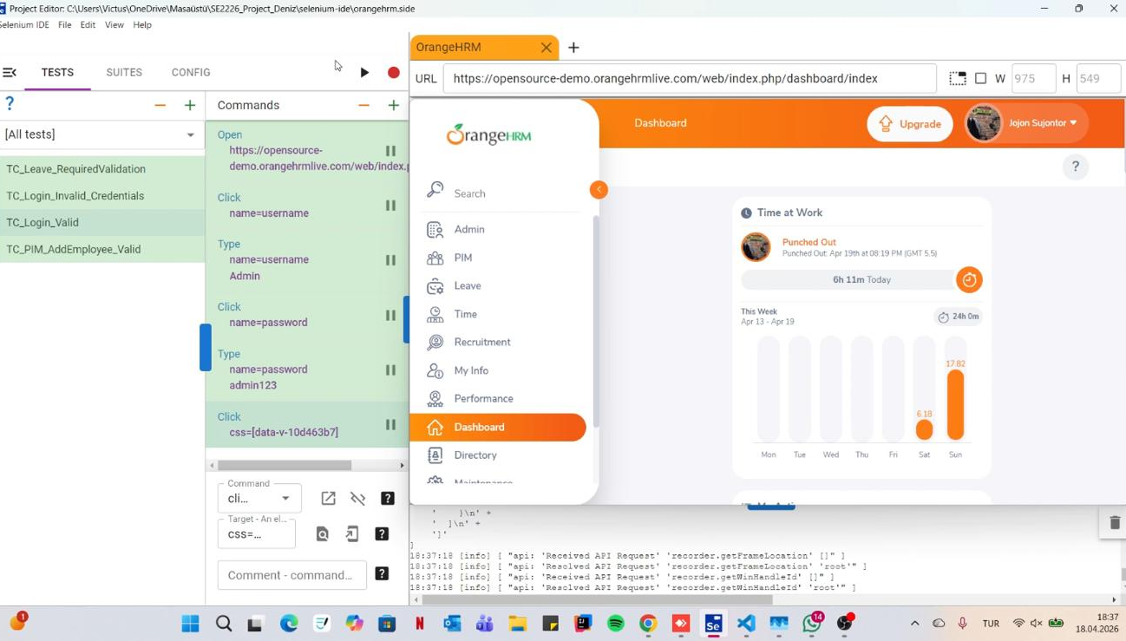
SE 2226 TESTING PROJECT
1.Functional Testing & GUI Automation
▶
Automated Scenario 1 — Login Valid
Validating the system's core authentication flow to ensure secure access for authorized users.
Scenario: Valid Username / Password combination.
Expected: Seamless redirection to the Dashboard across all browser environments.
Regression: High-priority automated script for happy-path verification.
3.Functional Testing & GUI Automation
Notes:
When presenting, play the login recording and point out that Dashboard is the success condition.

Slide 8
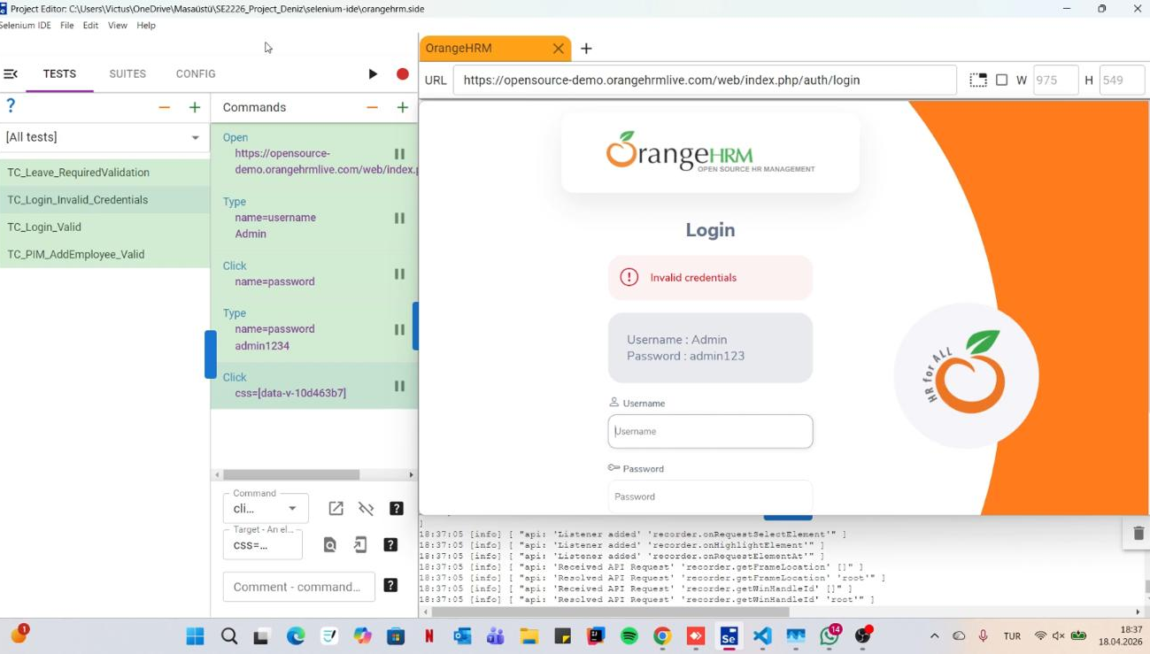
SE 2226 TESTING PROJECT
1.Functional Testing & GUI Automation
▶
Automated Scenario 2 — Invalid Login Prevention
Validating the system's resilience against incorrect credentials and unauthorized access attempts.
Scenario: Invalid Username / Password combination.
Expected: Uniform "Invalid Credentials" alert across browsers.
Regression: High-priority automated script.
3.Functional Testing & GUI Automation
Notes:
When presenting, play the login recording and point out that Dashboard is the success condition.

Slide 9
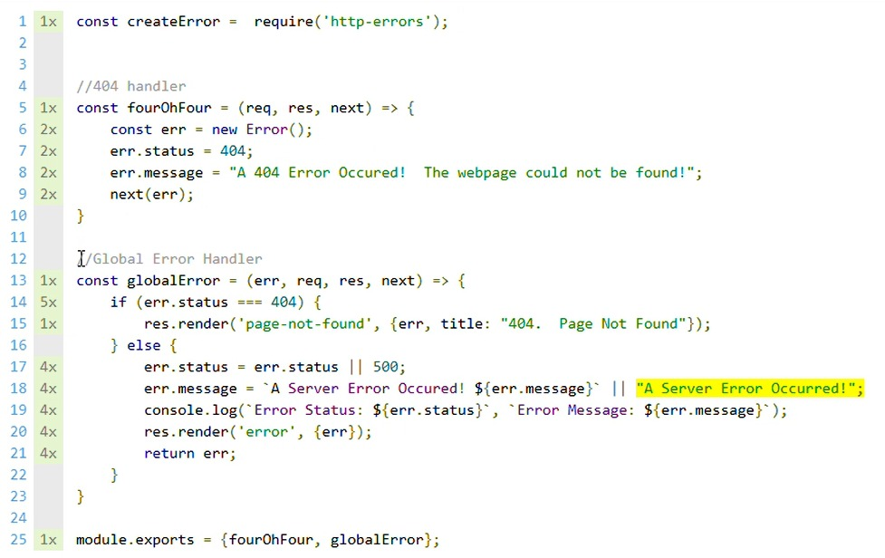
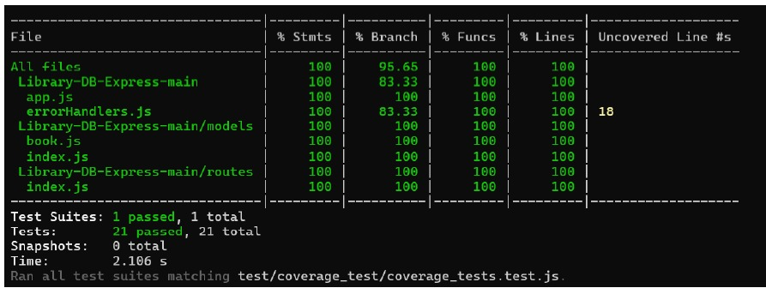
SE 2226 TESTING PROJECT
2.Structural Testing — Coverage Analysis (SUT 2)
Coverage Evidence
Result — Most executable statements were covered by Jest/Supertest tests.
Main limitation — 100% coverage was not reached because the highlighted fallback line is unreachable in normal execution.
Interpretation — The uncovered line belongs to a defensive server-error branch; it is hard to trigger without artificially forcing an internal failure.
Note: Since the highlighted line is unreachable in the current execution flow, 100% code coverage could not be achieved.
4.Structural Testing & Mutation Analysis (SUT 2)
Notes:
Explain that most core functions were consistent, while the main risks were browser-specific UI differences and unstable demo data.

Slide 10
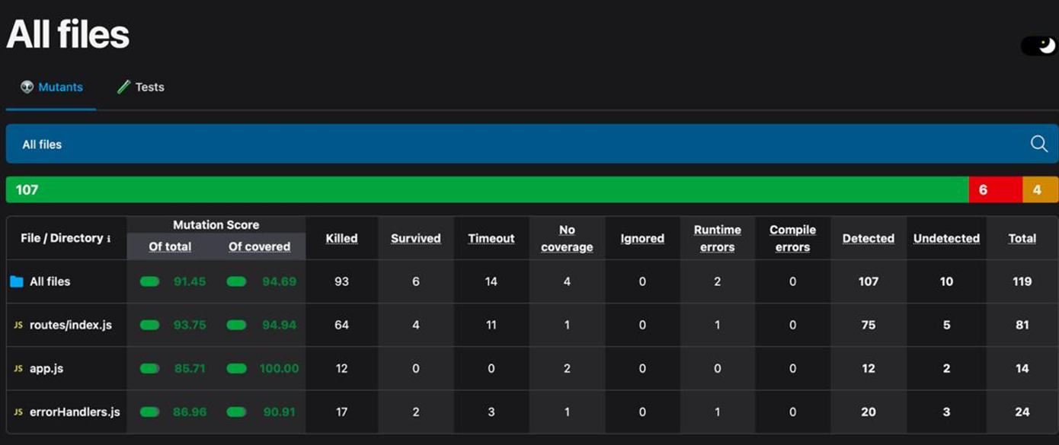
SE 2226 TESTING PROJECT
Structural Testing & Mutation Analysis (SUT 2)
Mutation Testing & Suite Robustness
The Metric: Total Mutation Score of 91.45%.
Results:Killed Mutants: 93 mutants successfully detected and eliminated.
Detection Rate: 94.69% of covered code successfully defended against intentional regressions.
Goal: Moving beyond simple coverage to ensure the test suite has a high fault-detection capability.
4.Structural Testing & Mutation Analysis (SUT 2)
Notes:
Explain that most core functions were consistent, while the main risks were browser-specific UI differences and unstable demo data.

Slide 11
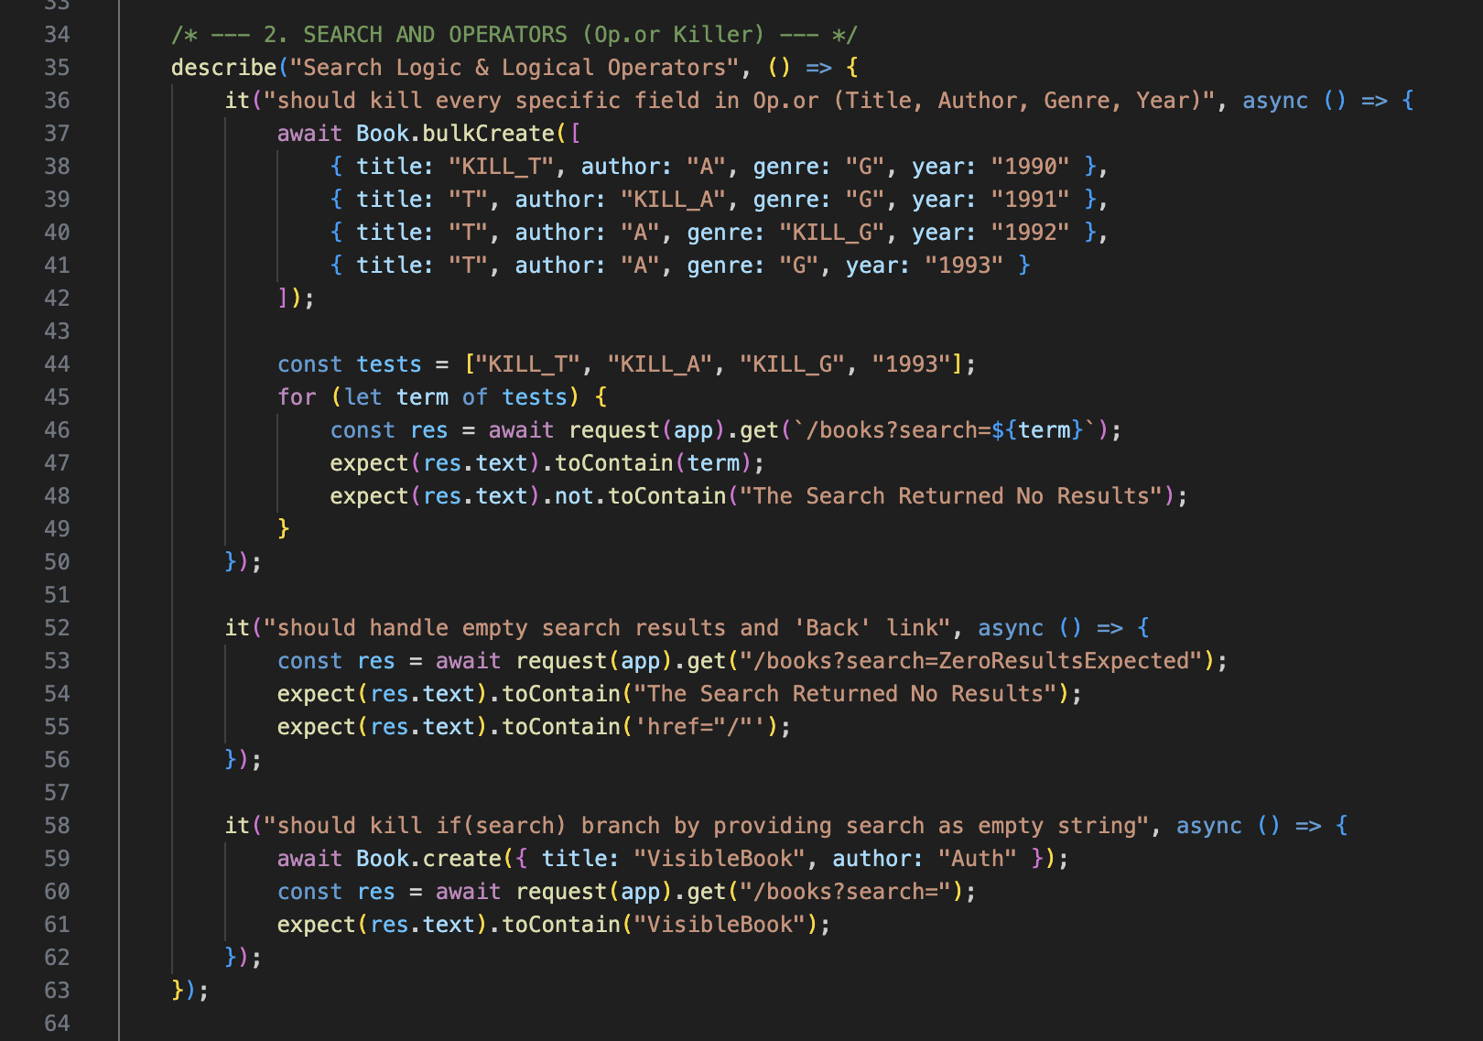
SE 2226 TESTING PROJECT
Structural Testing & Mutation Analysis (SUT 2)
Unit Testing & CRUD Verification
Tools: Jest & Supertest frameworks.
Focus: Direct verification of backend controllers and API logic.
Key Validations:Verified Create, Read, Update, and Delete (CRUD) functionality for the book database. Rigorous testing of search logic and logical operators within the book.js module.
4.Structural Testing & Mutation Analysis (SUT 2)
Notes:
Explain that most core functions were consistent, while the main risks were browser-specific UI differences and unstable demo data.

Slide 12
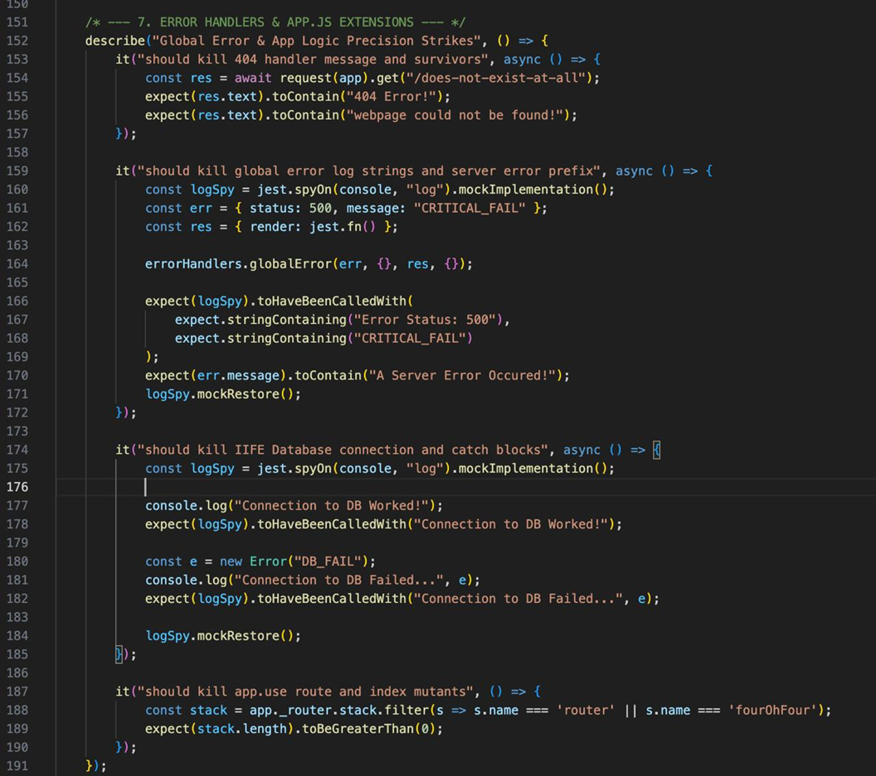
SE 2226 TESTING PROJECT
Structural Testing & Mutation Analysis (SUT 2)
Resilience & Security Verification
Technical Focus: Global Error Handlers and Information Disclosure prevention.
Testing Principle: Testing global error handlers ensures the system operates with the "Graceful Error Handling" principle, preventing sensitive information leakage even during system failures.
Validation: Verified that 404 and 500 error scenarios do not expose stack traces or server internals to the end-user..
4.Structural Testing & Mutation Analysis (SUT 2)
Notes:
Explain that most core functions were consistent, while the main risks were browser-specific UI differences and unstable demo data.

Slide 13
SE 2226 TESTING PROJECT
3.Performance, Load & Stress Testing
Performance, Load & Stress — One-Page Summary
10 users
871 ms
Performance (10–50 users): acceptable response times below 2 seconds.
Load (100 users): average response time reached 5.067 seconds; UX degradation begins.
Breaking point (300 users): ~27 seconds average response time and errors appear.
Stress (600 users): 28.01% error rate, exceeding the 10% failure threshold.
Verdict: safe for low load; risky after 100 users.
20 users
995 ms
50 users
1610 ms
100 users
5067 ms
300 users
27358 ms
400 users
26970 ms
5.Performance, Load, and Stress Testing
Notes:
Use this slide to summarize the performance report. The key story is that the system is stable at low load, degrades at 100 users, reaches breaking point near 300 users, and fails under 600-user stress.

Slide 14
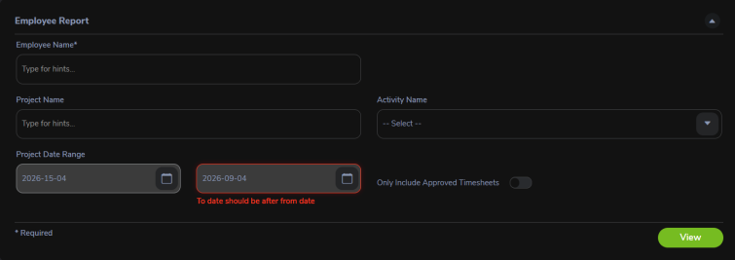
SE 2226 TESTING PROJECT
4.Usability & Cross-Browser Compatibility
Usability Evaluation — Nielsen Heuristics
Usability Evaluation
Overall Rating: 85% (Good usability with minor issues)
Heuristic Strengths:
Visibility of System Status: Clear feedback during record searches (e.g., "1 Record Found").
Match Between System & Real World: Utilizes industry-standard terminology in Recruitment and Leave modules.
User Control & Freedom: Provides confirmation dialogs and "Cancel" options for critical actions.
Identified Issues:
Aesthetic & Minimalist Design: Some pages contain too many input fields, creating a "crowded" interface.
Consistency: Occasional unexpected language shifts (from English to Spanish).
5.Usability & Cross-Browser Compatibility
Notes:
Connect the screenshot evidence to the Nielsen principles: status visibility, real-world match, user control, consistency, error prevention, and recovery.

Slide 15
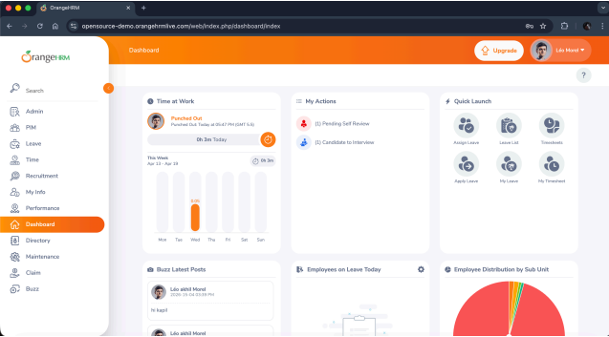
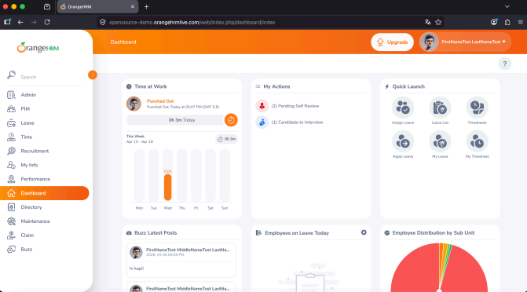
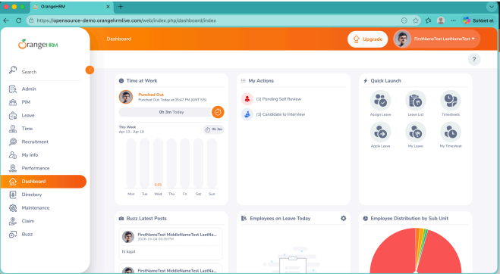
SE 2226 TESTING PROJECT
Chrome:
Cross-Browser Compatibility Analysis
Cross-Browser Compatibility Analysis
Testing Scope: Evaluated OrangeHRM on Chrome (v147), Firefox (v149), and Edge (v147) on macOS.
Overall Compatibility Rating: 94%
Core Stability: Authentication & Navigation: 100% stable logout redirection and invalid credential alerts across all platforms.
Responsiveness: Successful UI rearrangement (RWD) when browser viewports were minimized.
Defect Severity Ratio: Critical/High: 0% (No functional blockers identified). Medium/Low: 100% (Identified issues were purely visual or transient).
Edge:
Firefox:
5.Usability & Cross-Browser Compatibility
Notes:
Connect the screenshot evidence to the Nielsen principles: status visibility, real-world match, user control, consistency, error prevention, and recovery.

Slide 16
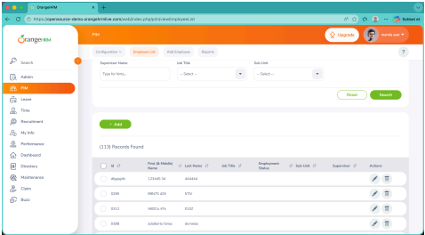
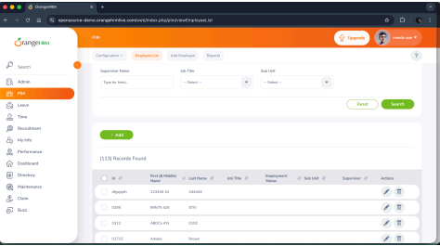
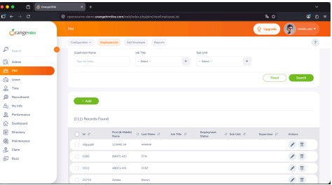
SE 2226 TESTING PROJECT
Firefox:
Compatibility Findings & Technical Risks
Compatibility Anomalies & Findings
Engine-Specific Issues:
Firefox (Gecko Engine): Identified dimmed typography (lighter font tone) and 1-2px row height alignment shifts in tables.
Edge (Chromium): Observed a one-time dashboard chart rendering failure, resolved upon refresh.
External Data Volatility: Fluctuations in record counts (113 vs 111) and profile names were identified as Data Synchronization Risks from the shared demo environment, not browser defects.
Chrome:
Edge:
5.Usability & Cross-Browser Compatibility
Notes:
Connect the screenshot evidence to the Nielsen principles: status visibility, real-world match, user control, consistency, error prevention, and recovery.

Slide 17
SE 2226 TESTING PROJECT
Main Findings & Quality Assessment
SUT 1 (OrangeHRM) Summary:
Functional & Automation:
Core workflows like Login and PIM management are stable and 100% automated via Selenium.
Compatibility:
Achieved 94% compatibility, with minor visual rendering differences in Firefox.
Performance Risk:
High load (100+ users) causes UX degradation, with a critical breaking point at 300 users.
SUT 2 (Library-DB-Express) Summary:
Structural Integrity:
Excellent unit test coverage (95% statements) and a robust 91.45% mutation score.
Security:
Successfully verified "Graceful Error Handling" to prevent data leaks.
Usability Verdict:
85% score; functionally intuitive but requires aesthetic minimalism in crowded modules.
Main Findings & Quality Assessment
Notes:
This slide is the conclusion before the final recommendation slide. Keep it short in the oral presentation.

Slide 18
SE 2226 TESTING PROJECT
5.Final Verdict & Future Recommendations
Critical Constraints:
Environment Stability: The public demo database creates data instability during concurrent testing.
Scalability: Current server architecture is not suitable for high-traffic or long-term endurance.
Recommended Improvements:
Optimize backend resource management to prevent memory leaks identified in endurance tests.Refine UI consistency across browser engines, focusing on Firefox typography. Implement explicit waits in automation scripts to handle dynamic field loading more reliably.
Test Evidence Playlist:
https://www.youtube.com/playlist?list=PLA7jdNyJUyh9hd5oqIkwVSdPIk4ItsIv5&jct=_6cF2tXdfKcUY7WDy-uSRg
Notes:
Use this as a guide slide for the live demo section.

Slide 19
SE 2226 TESTING PROJECT
THANK YOU FOR YOUR LISTENING
Questions?
SE 2226 Software Testing Project
OrangeHRM Automation + Quality Evaluation
Deniz Berfin Acar • Aslı Zeynep Akhan • Helin Güler • Şevval Demir
Notes:
This is the final slide.

