Slide 1
integration project
Automating order processing via Odoo and FakeSMTP
Zeynep Çaysar

Slide 2
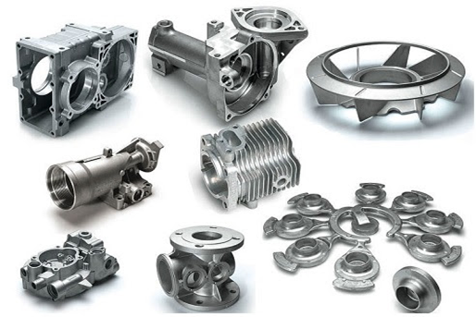
introduction to company
mid-sized manufacturer
custom diecast parts
service areas like automotive, electronic communication, work machines, hand tools, pumps and valves.
source:https://www.rapiddirect.com/blog/automotive-die-casting/

Slide 3
actual problem
challenges
a lot of manual, or hand-done, work for handling orders
uses a mix of spreadsheets for order tracking
Sales, inventory departments are primarily concerned
Efficiency
Scalability
Customer Satisfaction
Data Silos

Slide 4
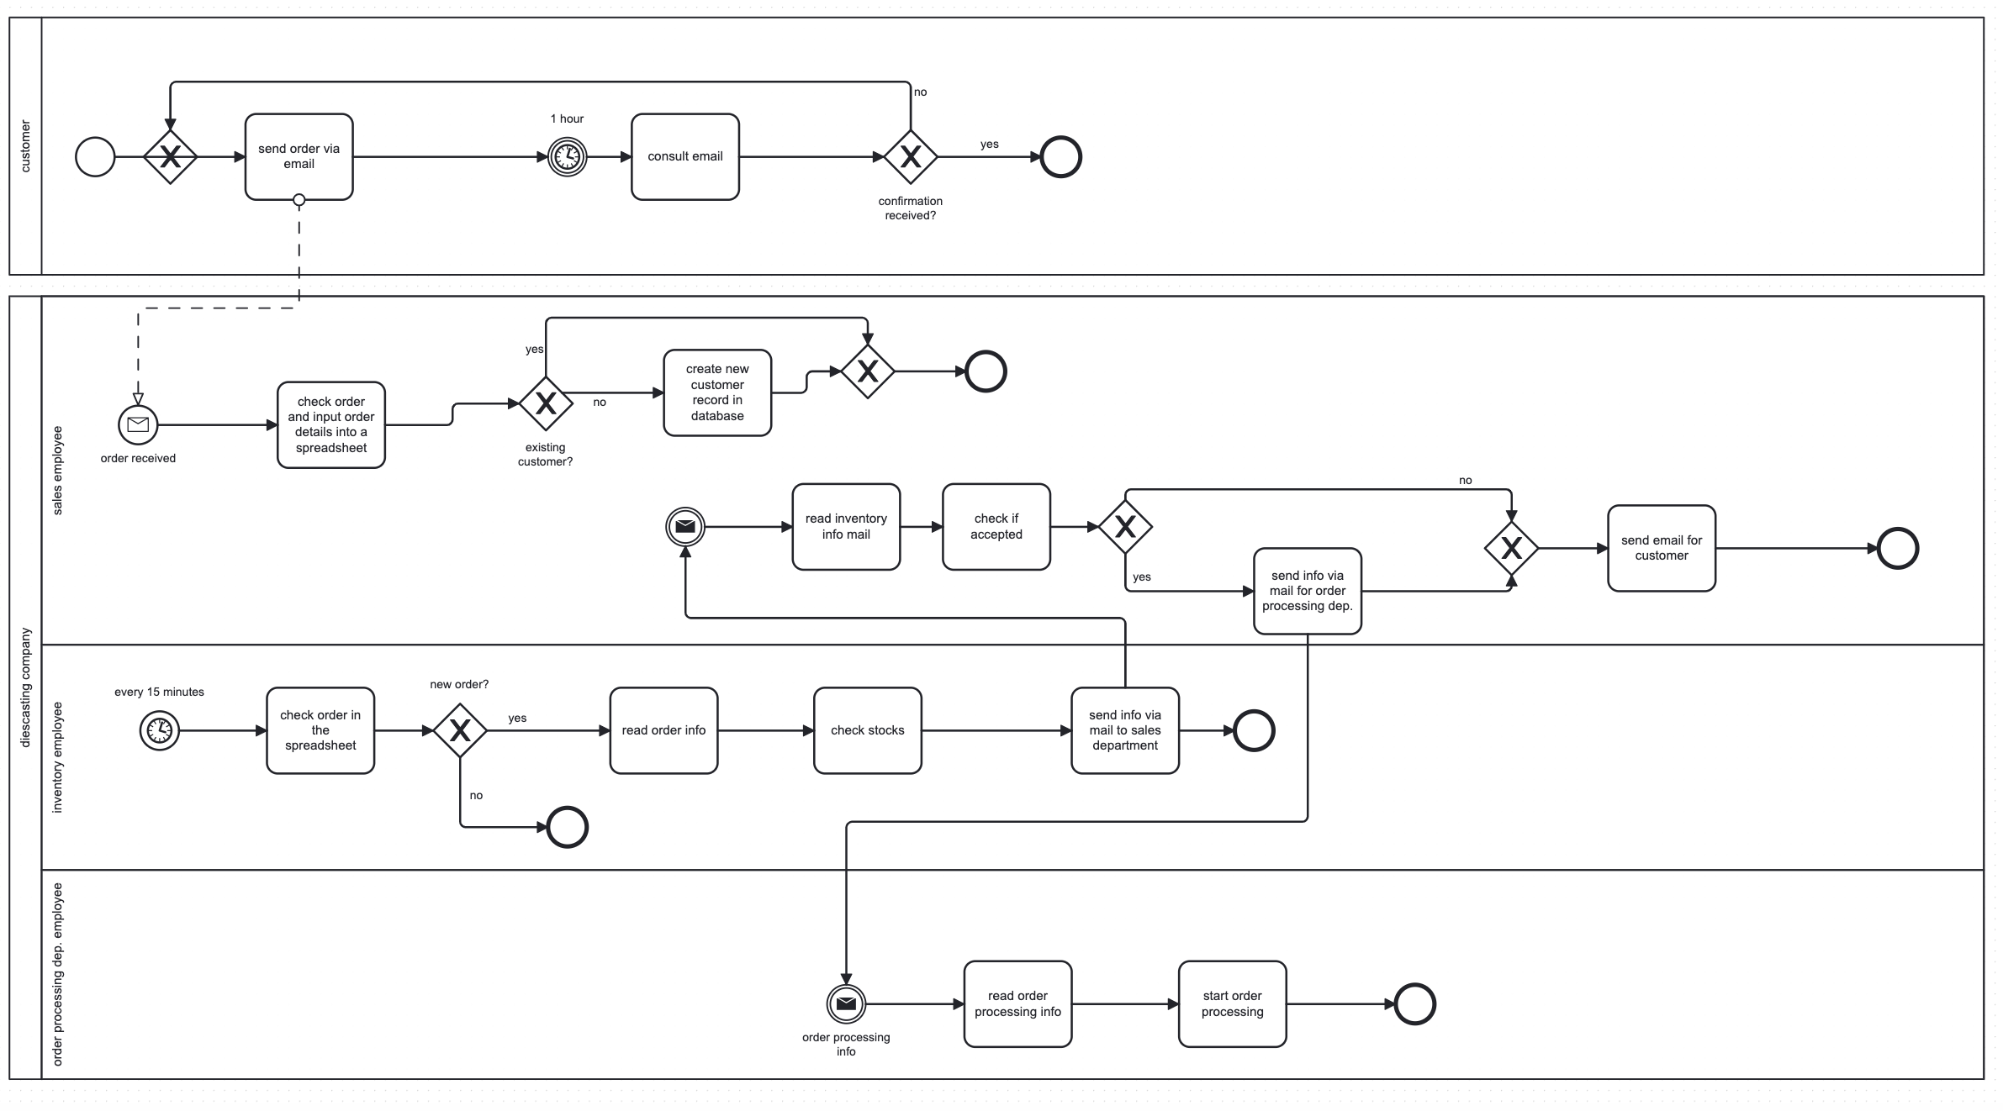
AS-IS process model

Slide 5
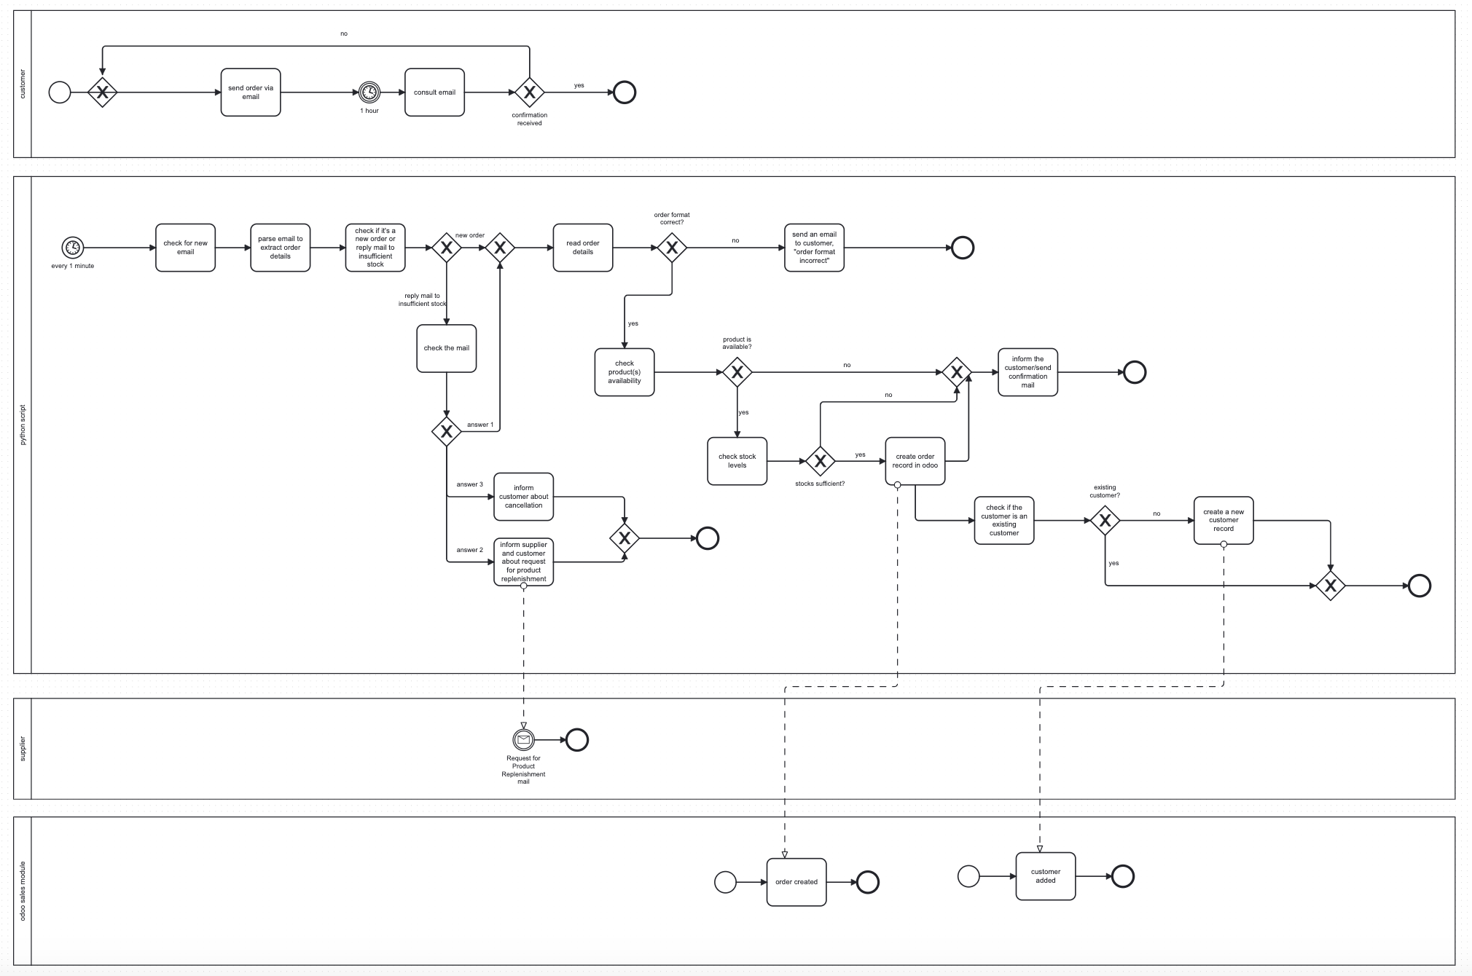
proposition/ TO-BE process model

Slide 6
DEMO

Slide 7
deployment
conclusion
software installation:
python, spacy, odoo, smtp, git
tests
workability
benefits: efficiency, scalability
challenges
areas for improvement
Thank you!

