Slide 1
MECH 307: Project 2
ZEYNEP GÜVENÇ
79232

Slide 2

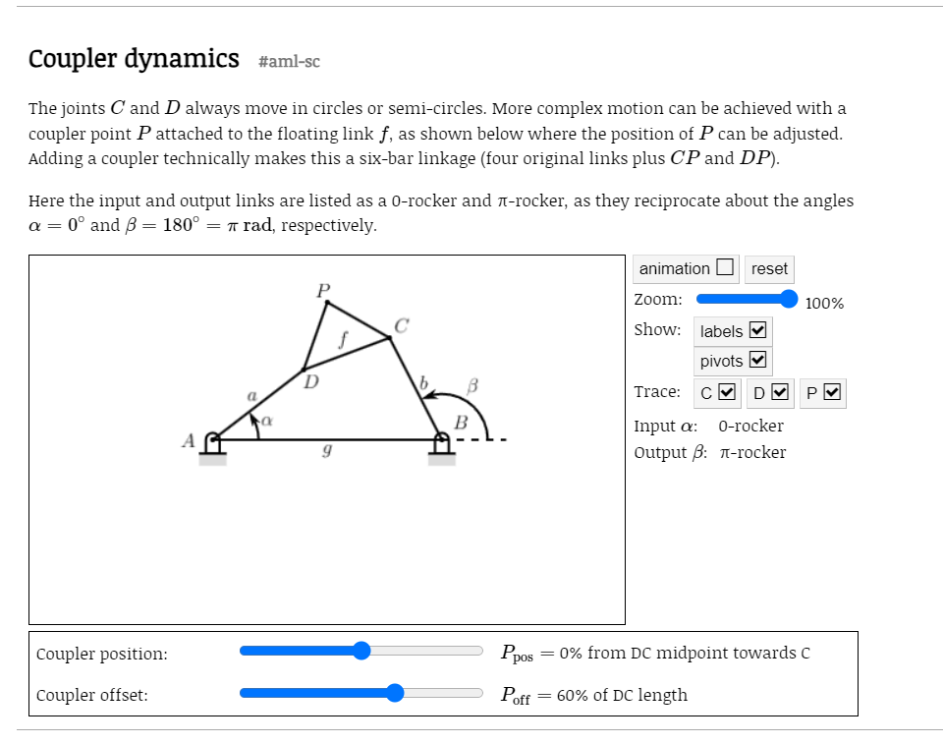
Chosen Mechanism :
I choose coupler dynamic -6 bar mechanism (from https://dynref.engr.illinois.edu/aml.html) as my Project. However my alpha goes 0 to 2 pi . Unliklely given informations in the source.

Slide 3
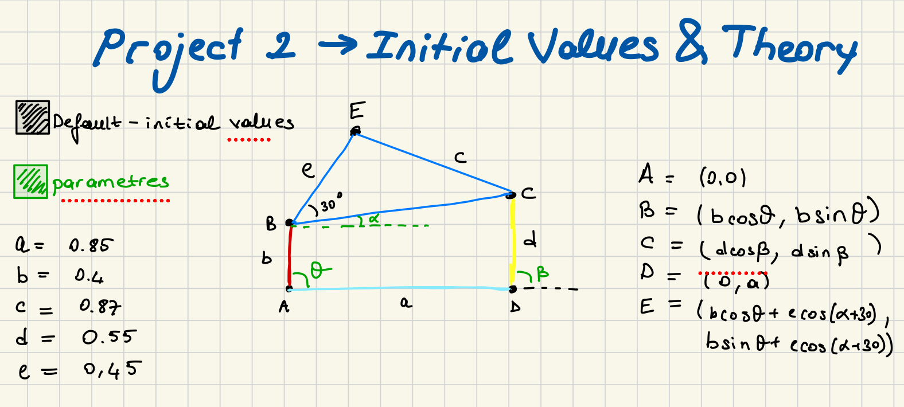

Slide 4
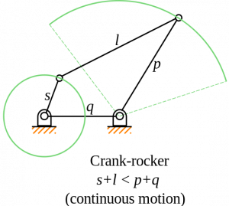
Limitations
I made a 6 bar couple mecahnisim but due to my range. It is can be define as cranck-rocker mechanism as well.

Slide 5
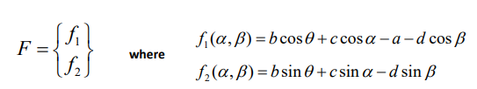
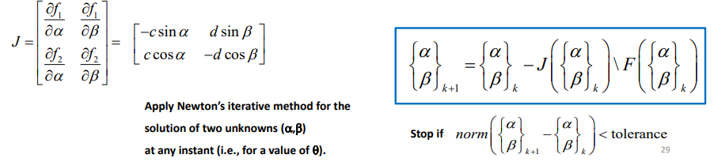
Newton’s Iterative Method
From lecture slides:

Slide 6
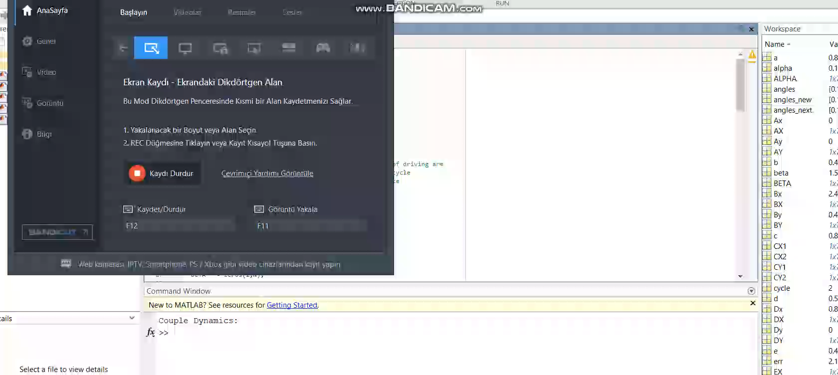
Animation

Slide 7
Plots

Slide 8
Applications
Crank rocker mechanism is a common mechanism, widely used in sewing machine, mixer, shaper and other equipment.(DOI:10.2991/meic-15.2015.32)

Slide 9

Thank you !

