Slide 1
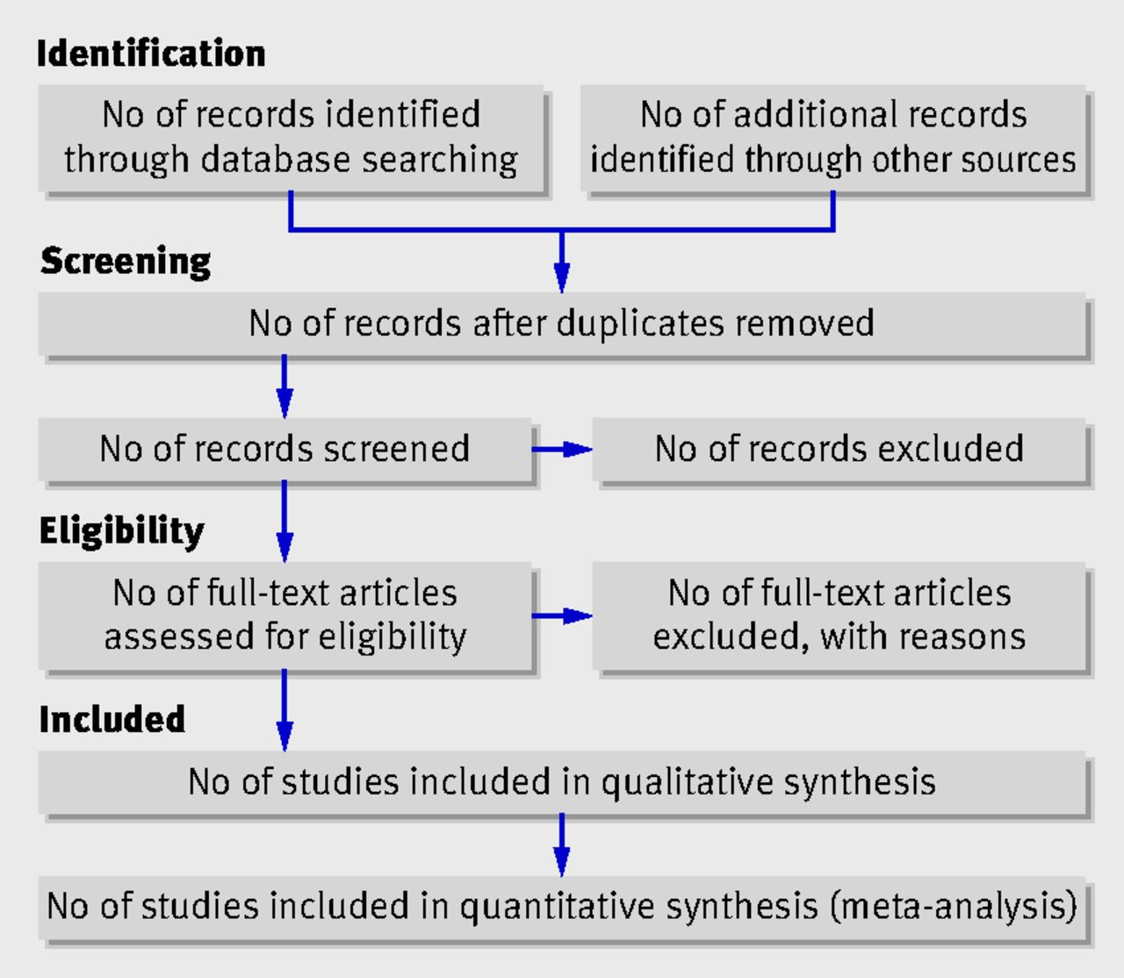

Flow of information through the different phases of a systematic review.
David Moher et al. BMJ 2009;339:bmj.b2535
©2009 by British Medical Journal Publishing Group
Notes:
Flow of information through the different phases of a systematic review.

