Slide 1

Smart Mining Mean Reversion Strategy on AI Infrastructure Commodities
YAP 471 — Computational Finance
Zeynep Yavuz · Nazlı Ceyda Ünsoy · Betül Akçınar

Slide 2
Introduction
We built a systematic trading strategy for commodity ETFs tied to AI infrastructure — copper, lithium, silver, palladium and others.
The core idea is simple: when a metal's price moves too far from its historical average, it tends to come back. We exploit that tendency using a statistical signal called the z-score, combined with a Markowitz portfolio optimiser and a stop-loss layer.
The strategy runs fully automatically. Given a date range and a set of assets, it downloads prices, generates signals, builds a portfolio, manages risk, and reports performance — all without human intervention.
We tested it across four distinct market periods between 2021 and 2025, including the 2022 rate shock, the 2023-24 AI investment surge, and 2024's volatile market. We also ran a grid search over 486 parameter combinations to understand what actually drives performance.

Slide 3
Assets
CPER
US Copper Index Fund
LIT
Global X Lithium & Battery
JIN
Bloomberg Nickel ETN
JJU
Bloomberg Aluminium ETN
SLV
iShares Silver Trust
PPLT
Aberdeen Physical Platinum
PALL
Aberdeen Physical Palladium
GLD
SPDR Gold Shares
One important note: JJN and JJU were delisted by Barclays in June 2023. They are included in the full portfolio analysis up to that point, and separately tested across their available 2021 – 2023 window.

Slide 4
Signal Generation : Mean Reversion
The core idea: if a price has moved too far from its average, it tends to come back.
z-score = ( P_t − μ ) / σ
Then we generate signals based on how far z deviates from zero:
Buy signal: P_t < μ − κσ
Sell signal: P_t > μ + κσ
where κ = 1.645, the 90% confidence interval threshold.

Slide 5
Portfolio Construction : Markowitz Optimization
max μᵀw − (λ/2) wᵀΣw | 0 ≤ wᵢ ≤ 1 ve Σwᵢ = 1
Cash is included as an explicit asset
If nothing looks attractive, the portfolio moves to cash.
No short selling
All weights are between 0 and 1.

Slide 6
Risk Control : Stop-Loss Mechanism
Mean reversion signals don't always arrive in time. A price can keep falling long after the z-score suggests a buy. The stop-loss is a reactive safety net — it limits the damage when the signal is wrong.
If an asset drops more than threshold from its 20-day peak, it is exited immediately.
Cooldown follows — the asset cannot re-enter until the window expires.
The freed weight is redistributed to the remaining portfolio, or to cash if others look poor too.

Slide 7
Backtest
Prices downloaded from Yahoo Finance. Daily adjusted closing prices, 2021 – 2025.
1-day lag on all decisions — weights are computed from yesterday's data and applied today. No look-ahead bias.
Benchmark is a simple equal-weighted 1/N portfolio, rebalanced daily. No parameters, no signal.
We ran a grid search over 486 parameter combinations per period to find what works and what doesn't.
Metrics reported: cumulative return, annualised return, Sharpe ratio, maximum drawdown, Calmar ratio, average cash allocation.

Slide 8
Backtest-Parameter Optimization
Lookback Days — How many trading days the rolling mean and standard deviation are calculated over. Shorter = more sensitive to recent moves. [10,20,30]
Estimation Window — How many days of historical returns are used to estimate expected returns and the covariance matrix for Markowitz. [30,60]
Rebalance Frequency — How often the portfolio weights are recalculated and updated. Daily rebalancing captures signals faster but increases transaction activity.[1, 5, 21]
Risk Aversion (λ) — Controls the return / variance tradeoff in the optimiser. Higher values spread weight more evenly across assets; lower values concentrate on the highest expected return. [0.5, 1.0, 3.5]
Stop-Loss — Maximum allowed drawdown from an asset's 20-day peak before it is exited. [0.05, 0.1, 0.2]
Cooldown Days — How many days an asset must wait before it can re-enter the portfolio after triggering a stop-loss. [1, 5 ,10]

Slide 9
Performances of Metals
The strategy outperforms the buy-and-hold benchmark in 7 out of 8 assets. The largest gains are on assets where the benchmark struggled most — PALL, LIT, and JJU. The only exception is CPER, where copper's structural uptrend made mean reversion signals unreliable.
Note that JJN and JJU were delisted in June 2023 and are evaluated over their available 2021 – 2023 window only. The remaining six assets are assessed across the full five-year period from 2021 to 2025.

Slide 10
Performances of Metals
The strategy held cash for a significant portion of the time across all assets — ranging from 34% for GLD to 86% for JJN. This is not a weakness. High cash allocations correspond directly to periods where the strategy avoided large drawdowns. JJN is the clearest example: while the benchmark lost 61% over its available window, the strategy stayed in cash for most of it and drew down only 16%.
GLD needed the least cash — its secular uptrend was strong enough that the optimiser stayed invested.

Slide 11
Optimal Parameters For Metals
CPER — Copper Lookback 20d · Daily · λ=0.5 · SL 10%
Copper has been trending structurally with AI infrastructure demand. Mean reversion signals fire too often and are unreliable. Only viable inside a diversified portfolio, not as a standalone position.
LIT — Lithium Lookback 10-20d · Monthly · λ=1.0 · SL 10%
The buy-and-hold benchmark lost 65% over five years. Monthly rebalancing combined with heavy cash allocation allowed the strategy to sidestep the worst of the drawdown.
PALL — Palladium Lookback 20-30d · Monthly · λ=0.5 · SL 10%
The benchmark Sharpe was nearly zero. The strategy turned it into +0.82 by holding 74% cash during the 2022 crash and re-entering on the recovery.
JJU — Aluminium Lookback 20d · Daily · λ=3.5 · SL 5% · Cooldown 10d
The strongest result in the entire analysis — a +0.93 Sharpe gap over the benchmark. High risk aversion combined with a tight stop-loss produced the best risk-adjusted outcome of any single asset.
GLD — Gold Lookback 30d · Monthly · λ=0.5 · SL 20%:
Gold's secular uptrend means the strategy stays invested most of the time. A longer lookback and a loose stop-loss prevent premature exits on temporary dips. Low maintenance, consistent returns.
JJN — Nickel Lookback 20d · Daily · λ=1.0 · SL 5% · Cooldown 10d
86% average cash across the 2021–2023 window. The benchmark lost 61% over the same period. The strategy avoided almost all of that by simply not being in the market when conditions were unfavourable.

Slide 12
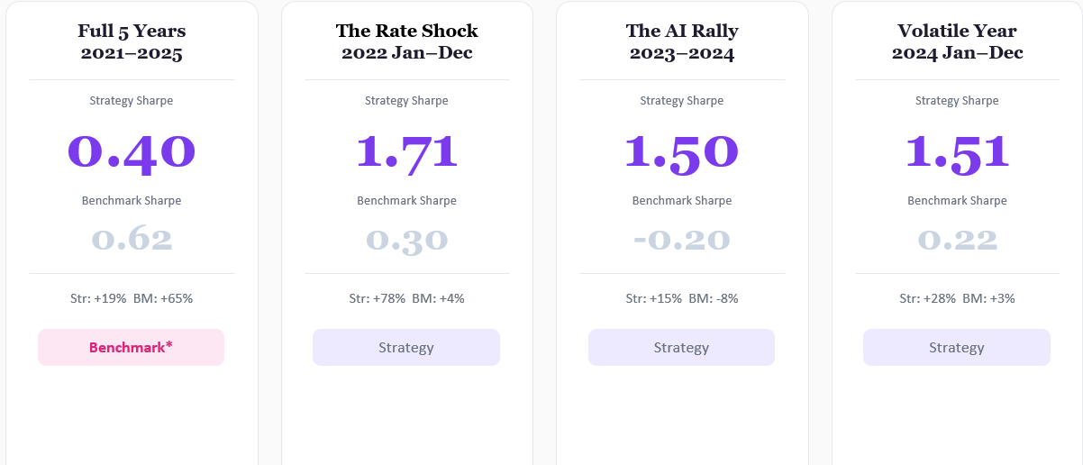
Performance across four market regimes

Slide 13
Full 5 Years

Slide 14
The Rate Shock

Slide 15
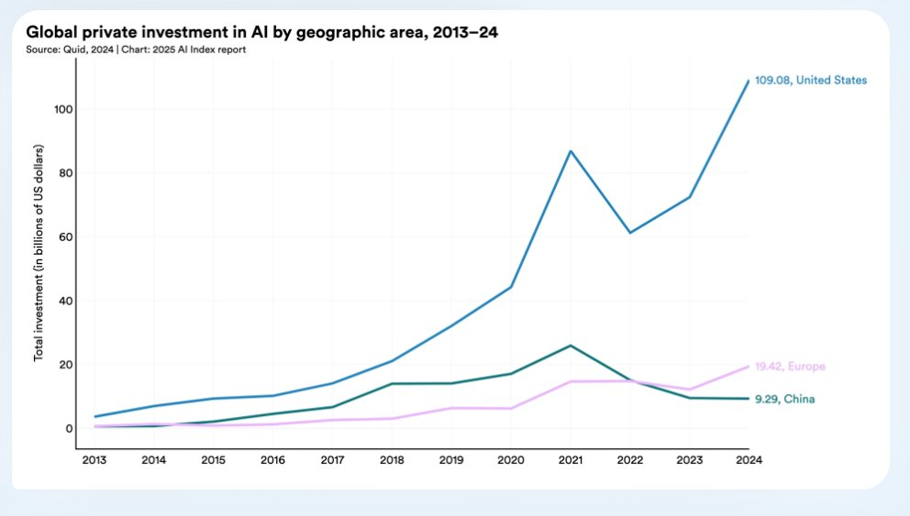
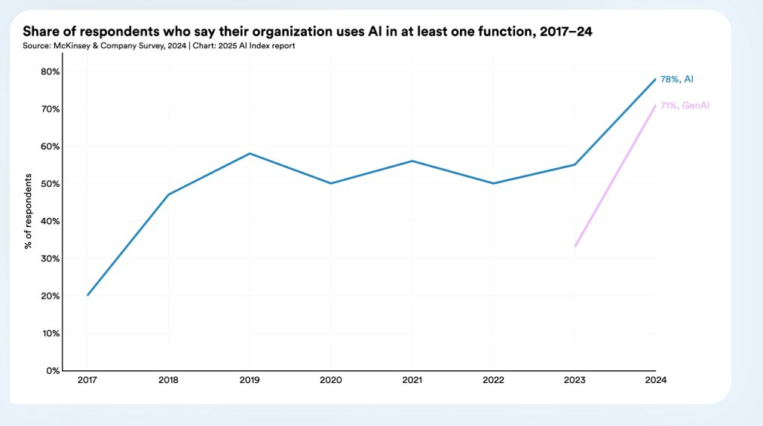
The AI Rally

Slide 16
Volatile Year

