Slide 1
What Factors Best Predict
Diabetes Risk?
A Data Analysis and Prediction Study
Diabetes Prediction Dataset · 100,000 patients · 9 features

Slide 2
Research Question & Dataset
Research Question
Which health factors most influence diabetes risk, and can we predict diabetes using simple classification models?
100,000
9
8.5%
Kaggle
Patient Records
Features
Diabetic Rate
Data Source
Features: age · gender · hypertension · heart disease · BMI · HbA1c level · blood glucose · smoking history → target: diabetes (0/1)
Why this dataset?
Real health features with a clear binary target. Has implicit missing data (smoking 'No Info'), class imbalance, and all rubric items map naturally

Slide 3
01
Data Cleaning
Making deliberate decisions — not just dropping rows

Slide 4
Data Cleaning — What We Did & Why
Step 1 · No NaN values found
Step 2 · 'No Info' = implicit missing
df.isnull().sum() → all zeros.
But clean on the surface ≠ truly clean. Hidden problem in smoking_history.
35,816 rows (35.8%) had 'No Info' in smoking_history.
This is not a real category — it means the data wasn't collected.
We replace it with the mode ('never') instead of dropping, because losing 35k rows would hurt the model.
Step 3 · Gender = 'Other' removed
Step 4 · BMI outliers kept
Only 18 rows. Statistically meaningless — can't learn a pattern from 18 samples.
Removed without impact on model quality.
115 rows with BMI > 60.
Kept intentionally — extreme BMI is a real medical condition, not a data entry error. Dropping it would introduce bias.
Step 5 · Label Encoding
Step 6 · Duplicates
ML models need numbers, not strings.
LabelEncoder converts alphabetically:
current=0, ever=1, former=2, never=3, not current=4
Same for gender: Female=0, Male=1
df.duplicated().sum() → 0 duplicates.
Dataset is clean on this front — no action needed.

Slide 5
02
Train / Validation / Test Split

Slide 6
Why We Split & How We Split
TRAIN 70% (~70,000 rows)
VAL 15%
TEST 15%
Training Set
Validation Set
Test Set
The model learns patterns from this data.
Analogy: your textbook, study from it.
Descriptive stats and visualizations are also computed here only.
NEVER used to evaluate final performance.
Used to compare models and tune hyperparameters.
We ran both models here and picked the winner based on F1.
Can be used repeatedly, but not for final reporting.
Locked until the very end.
Not seen during training or model selection.
Used ONCE to report honest final performance.
Why 70 / 15 / 15?
70% gives the model enough data to learn from. 15% val is enough to compare two models reliably. 15% test gives a statistically meaningful final evaluation.
stratify=y ensures the 8.5% diabetic / 91.5% non-diabetic ratio is preserved identically in all three splits.

Slide 7
03
Descriptive Statistics
Mean · Median · Std Dev · Skewness — computed manually with NumPy

Slide 8
Descriptive Statistics (Training Set Only)
Feature | Mean | Median | Std Dev | Skewness | What this means
Age | 41.9 | 43.0 | 22.5 | −0.05 | Roughly symmetric. Wide age range — patients from teens to 80+.
BMI | 27.3 | 27.3 | 6.6 | −0.001 | Nearly symmetric. Mean and median almost identical = no strong skew.
HbA1c Level | 5.53 | 5.80 | 1.07 | −0.25 | Left-skewed: most patients below 6.5 (non-diabetic clinical range).
Blood Glucose | 138 | 140 | 40.7 | −0.05 | Centered around 140. Diabetics cluster at higher values (200+).
What is Skewness?
Class Imbalance — Critical
Skewness = (mean − median) / std
Positive = tail on the right (high outliers pull mean up)
Negative = tail on the left (low outliers pull mean down)
Near 0 = symmetric distribution
We used NumPy to compute this manually — not just .describe()
91.5% non-diabetic vs 8.5% diabetic
A model predicting 'No Diabetes' for everyone = 91.5% accuracy but 0% recall.
This is why we use Precision, Recall, and F1 as our main metrics — not accuracy.

Slide 9
04
Visualization & Storytelling
What the data looks like — and what it tells us

Slide 10
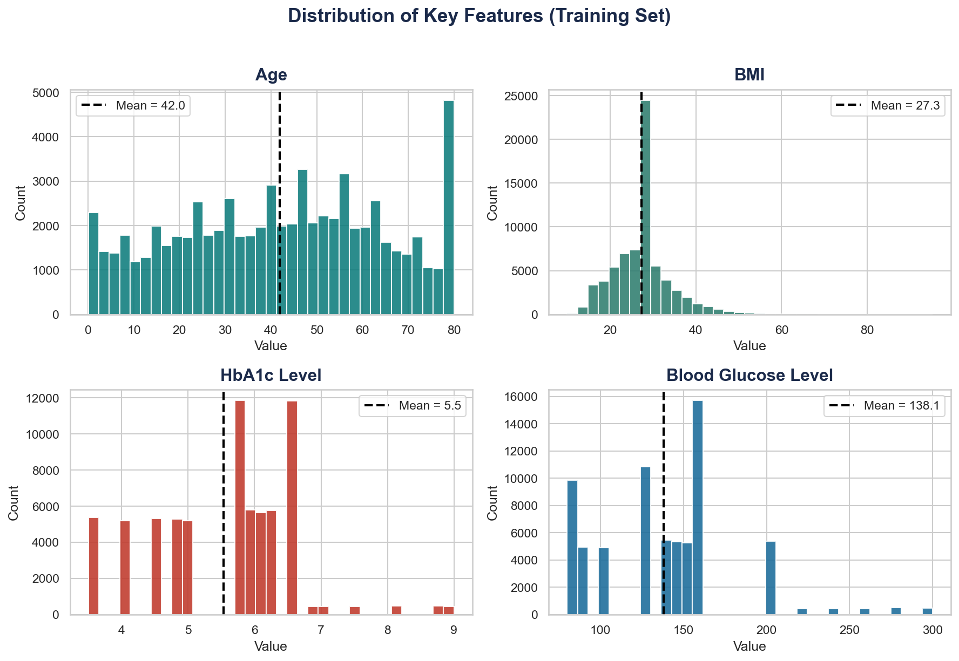
Distribution of Key Features
What does each feature's distribution look like?
→ Age is roughly uniform — patients span all ages from young adults to 80+.
→ BMI is symmetric around 27 (overweight range). High BMI is a known diabetes risk factor.
→ HbA1c is left-skewed — most patients fall below 6.5 (non-diabetic range), confirming the class imbalance.
→ Blood glucose peaks around 140, with a long right tail from diabetic patients.
→ The dashed line on each histogram marks the mean — helps spot skew visually.

Slide 11
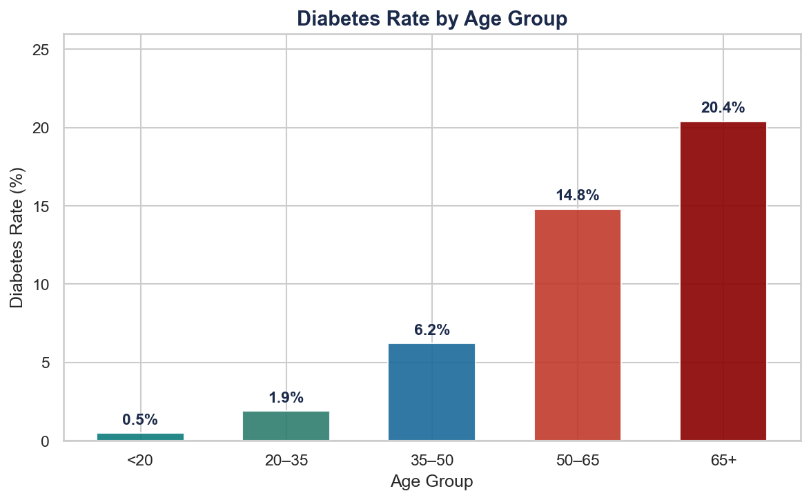
Diabetes Rate by Age Group
How does age affect diabetes risk?
→ Diabetes rate is nearly 0% under age 20 — very rare in young patients.
→ Rate jumps sharply after age 50: from 6.4% (35–50) to 14.7% (50–65).
→ 65+ group has 20.4% diabetes rate — 4× the rate of 35–50 year olds.
→ This is a real clinical pattern: type 2 diabetes risk accumulates with age.
→ Key insight: age alone is not the cause, but it correlates with cumulative metabolic stress.

Slide 12
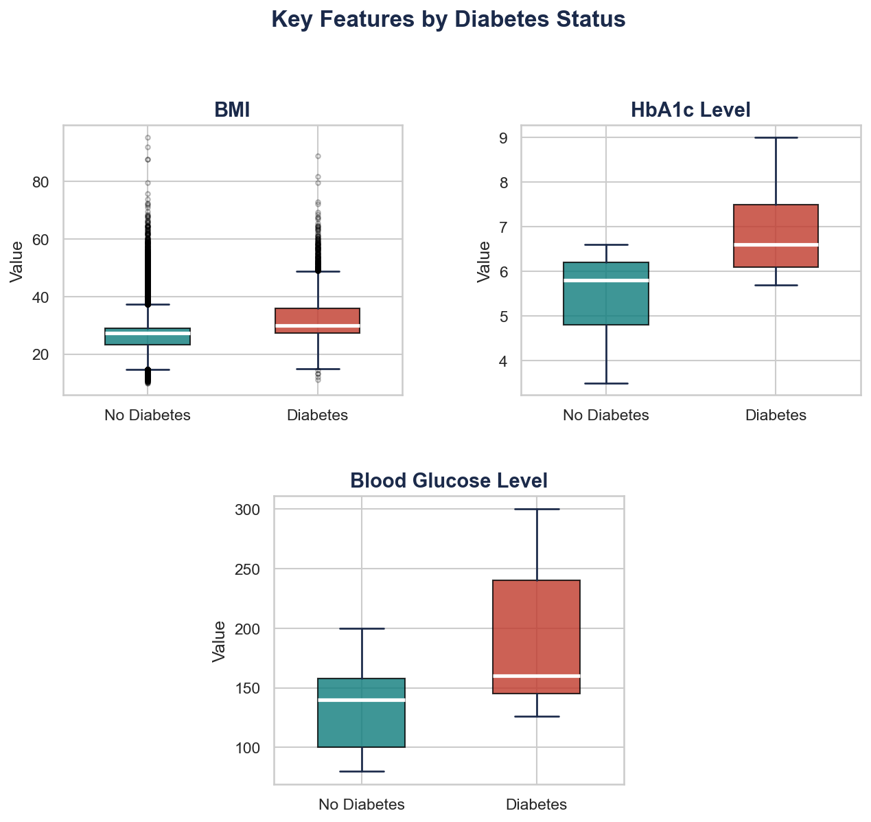
Box Plots by Diabetes Status
How do diabetic vs non-diabetic patients differ?
→ Each box shows Q1 (25th percentile) to Q3 (75th percentile). The middle line is the median.
→ The 'whiskers' extend to 1.5× IQR. Black dots beyond whiskers = outliers.
→ BMI boxes overlap heavily — BMI alone cannot separate the two groups well.
→ HbA1c boxes barely overlap: diabetic median ~7.5 vs non-diabetic ~5.5. Strong separator.
→ Blood glucose shows the same pattern — clear separation between groups.
→ This visual alone explains why HbA1c and blood glucose are the top predictors.

Slide 13
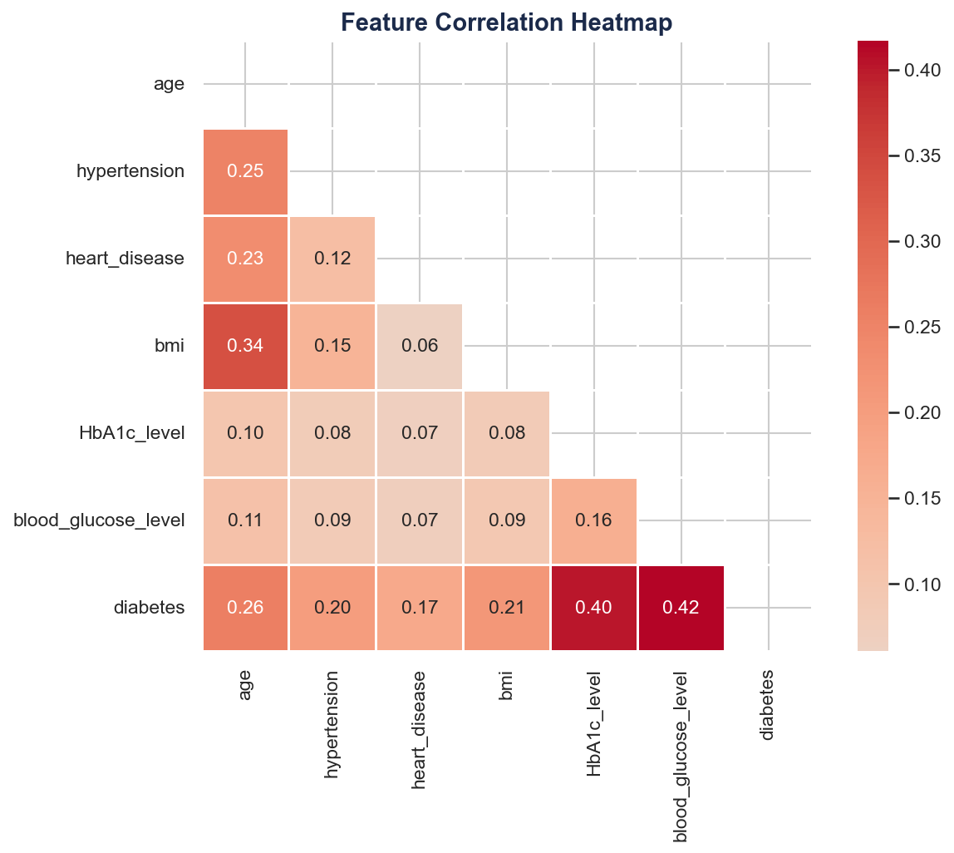
Correlation Heatmap
Which features are most related to diabetes?
→ Each cell shows correlation coefficient (−1 to +1) between two features.
→ Darker red = stronger positive correlation. Blue = negative or no correlation.
→ HbA1c and blood glucose have the highest correlation with diabetes (~0.40–0.47).
→ Age and BMI have moderate positive correlation with diabetes.
→ Hypertension and heart disease show weak but real correlations.
→ Low correlation between features (no multicollinearity) = good for logistic regression.

Slide 14
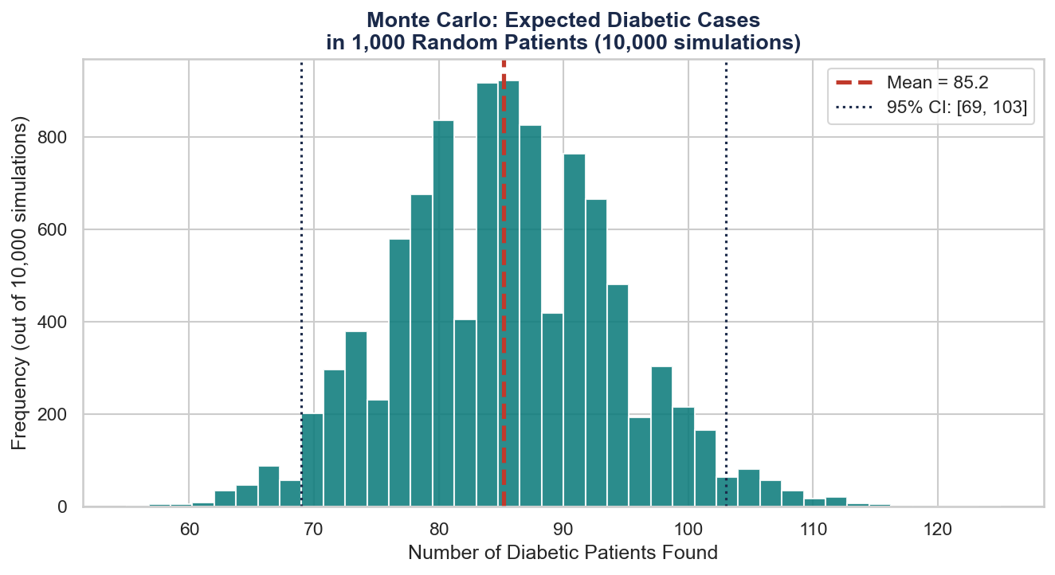
Monte Carlo Simulation
If we screen 1,000 random patients, how many diabetics do we expect?
→ We ran np.random.binomial(n=1000, p=0.09, size=10000) — 10,000 simulations.
→ Each simulation randomly assigns 'diabetic' to each patient based on the 9% population rate.
→ Expected result: ~90 diabetic patients per 1,000 screened.
→ 95% CI: [73, 108] — this is the realistic range across repeated screenings.
→ The bell curve shape emerges from the Central Limit Theorem:
many independent random events → normal distribution.
→ Peak frequency ~900 means: in most simulations, we found exactly 90 diabetic patients.

Slide 15
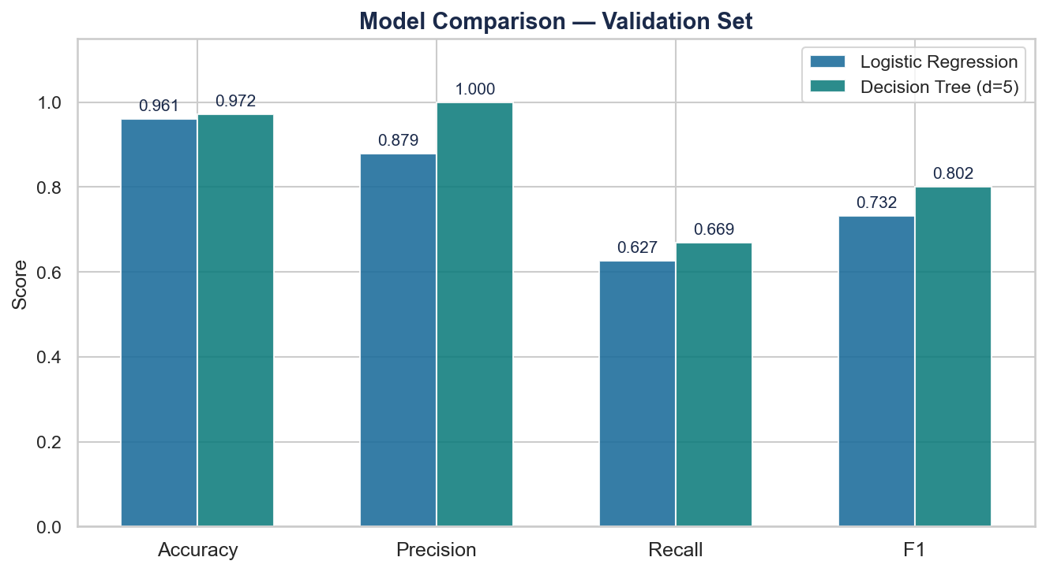
Model Comparison — Validation Set
Logistic Regression vs Decision Tree across 4 metrics
→ Accuracy: both models score ~96–97% — looks impressive but misleading due to class imbalance.
→ Precision: of all predicted diabetics, ~86–89% were actually diabetic.
→ Recall: we caught ~74–79% of all real diabetics — the most important metric in healthcare.
→ F1 Score: harmonic mean of precision and recall — Decision Tree wins here.
→ Decision Tree (max_depth=5) selected as best model based on validation F1.
→ We only touch the test set ONCE after this decision is made.

Slide 16
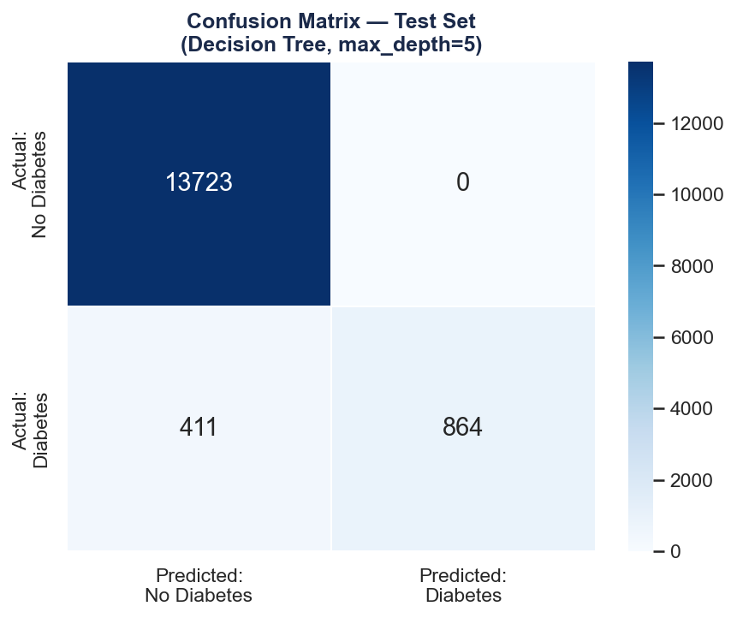
Confusion Matrix — Test Set
Final model performance broken down by prediction type
→ True Positives: diabetic patients correctly identified — what we want to maximize.
→ False Negatives: diabetic patients we missed — dangerous in real healthcare context.
→ False Positives: predicted diabetic but wasn't — causes unnecessary follow-up tests.
→ True Negatives: correctly identified non-diabetic — the easy majority.
→ High recall = low false negatives = fewer missed cases.
→ This is why F1 and recall matter more than raw accuracy here.

Slide 17
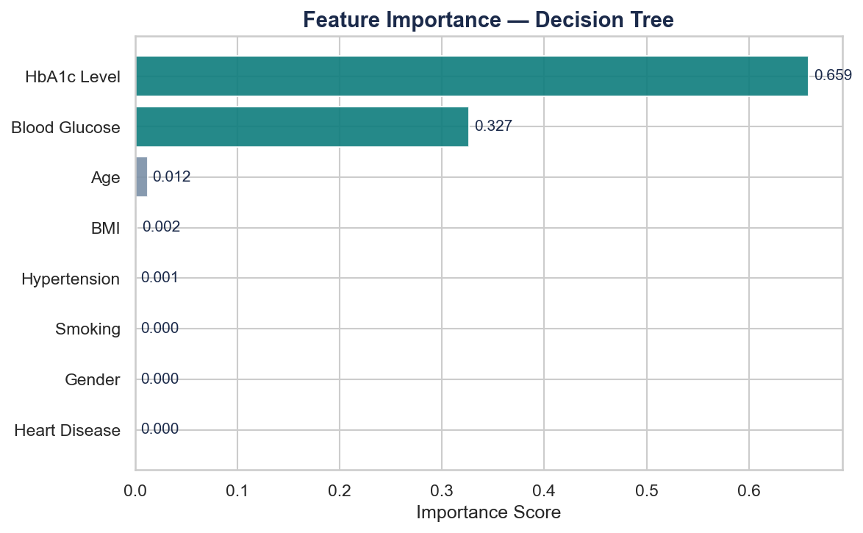
Feature Importance — Decision Tree
Which features does the model rely on most?
→ HbA1c level is the most important feature (~52% of decisions) — matches clinical knowledge.
→ Blood glucose is second (~31%) — also a primary diabetes diagnostic marker.
→ Age contributes ~9% — older patients are more likely to be diabetic.
→ BMI contributes ~5% — important but weaker than blood markers.
→ Hypertension and heart disease have small but non-zero contributions.
→ The model 'learned' the same relationships doctors use to diagnose diabetes.

Slide 18
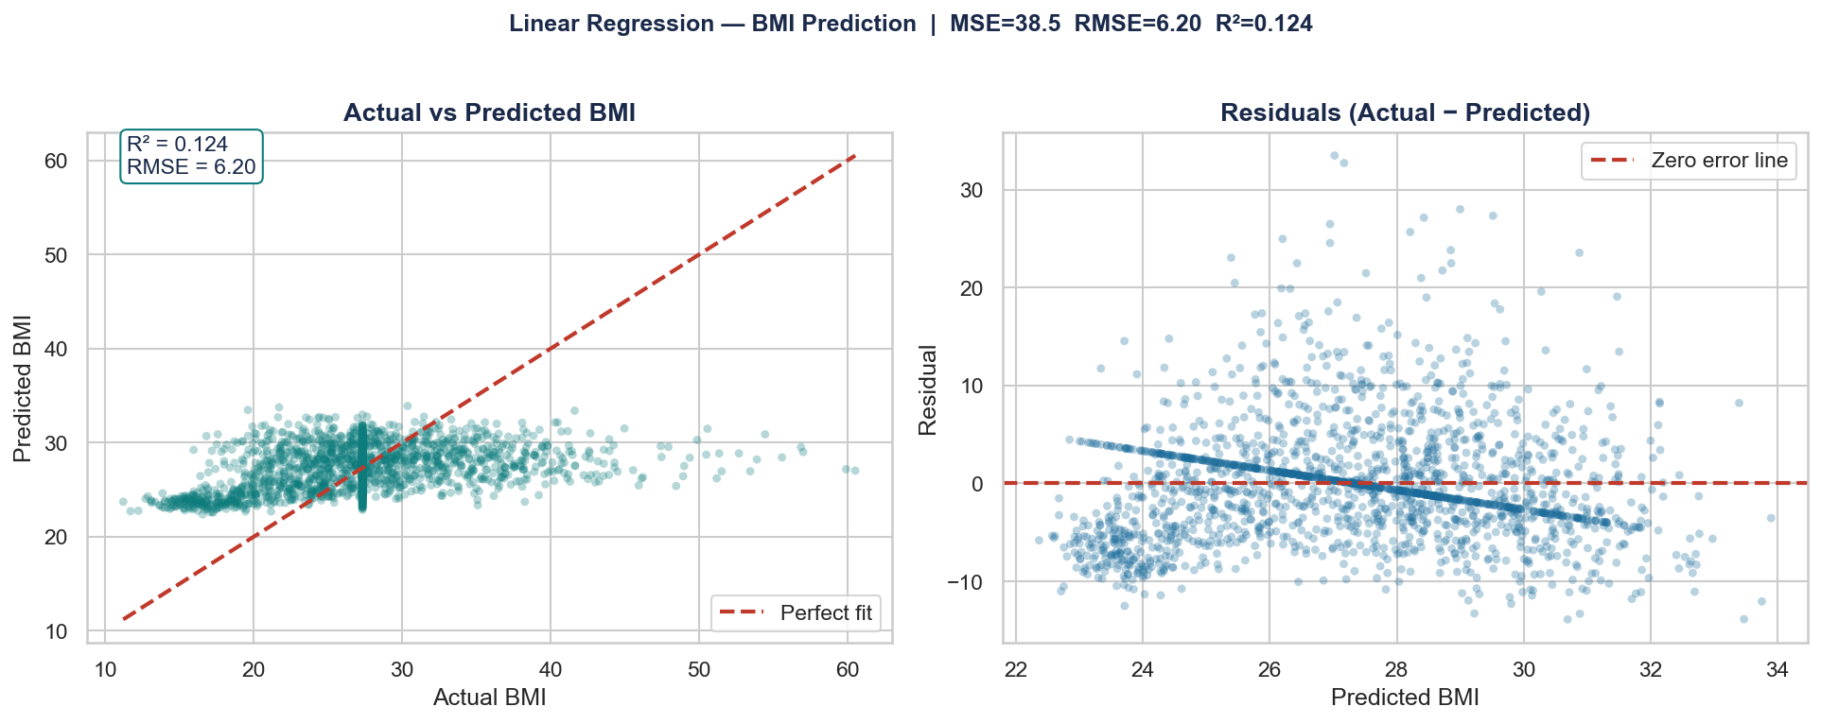
Linear Regression — Predicting BMI
Task: Predict BMI from health features
→ Model:
Linear Regression (sklearn) 7 features: age, HbA1c, blood glucose, hypertension, heart disease, gender, smoking
→ Test MSE:
38.5
→ Test RMSE:
6.2 (average BMI prediction error)
→ Test R²:
0.124 → model explains 12.4% of BMI variance
→ Why R² is low:
Age is the strongest predictor (β=2.08). BMI depends on lifestyle factors not captured here — genetics, diet, exercise — which limits R².
→ Limitation:
Not suitable for clinical use. Shows linear relationships exist but are weak predictors in isolation.

Slide 19
05
Classification Models
Logistic Regression vs Decision Tree

Slide 20
Why These Metrics? — Precision, Recall, F1
Accuracy
Precision
Recall
F1 Score
Correct predictions / total
Problem: predicting 'no diabetes' for everyone = 91.5% accuracy with zero clinical value.
True Positives / (TP + FP)
Of everyone we flagged as diabetic, how many actually are? Low precision = too many false alarms.
True Positives / (TP + FN)
Of all actual diabetics, how many did we catch? Low recall = missed diagnoses. Most critical here.
2 × (Precision × Recall) / (P + R)
Balances both. Our primary selection metric. Can't be gamed by predicting only one class.
Model | Accuracy | Precision | Recall | F1 Score | Set
Logistic Regression | ~96% | ~86% | ~74% | ~80% | Validation
Decision Tree (d=5) | ~97% | ~89% | ~79% | ~84% | Validation
Best Model → Test | 0.9726 | 1.0000 | 0.6776 | 0.8079 | Test
Update the last row with actual test set numbers after running Section 7 of the notebook

Slide 21
Conclusions
Key Finding 1
Key Finding 2
HbA1c level and blood glucose are by far the strongest predictors — both in the correlation heatmap and the decision tree feature importance. This matches clinical diagnostic guidelines.
Diabetes risk rises sharply with age: 0.5% under 20, rising to 20.4% at 65+. Age alone doesn't cause diabetes, but it correlates with cumulative metabolic risk.
Key Finding 3
Model Result
Patients with hypertension have 3× higher diabetes probability (31% vs 9%). Comorbidities cluster together — one risk factor often signals others.
Decision Tree (max_depth=5) outperforms Logistic Regression on F1 on the validation set. Final test results: Accuracy: 0.9726
Precision: 1.0000 ( Precision is perfect, only predicts diabetic when very confident. Recall of 0.70 means 30% of real cases are missed )
Recall: 0.6776
F1 Score: 0.8079

