Slide 1
Project Big Data
Group 2
Houses of Washington DC
27/06/2019
Ceren Akkalyoncu
H. İrem Gökçek
Zeynep Sonkaya
Hidde van Zalm

Slide 2
Dataset: Houses of Washington DC
Various characteristics of the houses located in Washington DC.
Data inspection, mainly on the effects on the prices
Data cleaning
Duplicates, NaN values, exceptional values

Slide 3
Motivation
It is a topic that concerns most people.
We wanted to check the value of the house (its properties) versus its price.

Slide 4
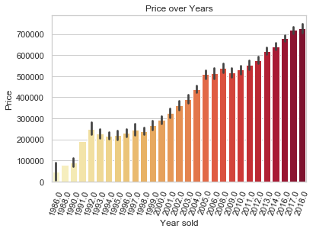
How did the sale price of houses change over time?

Slide 5
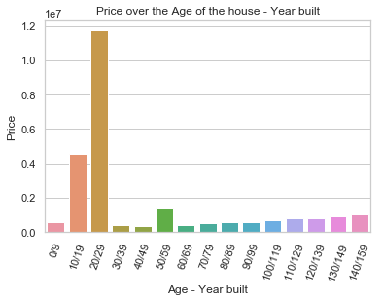
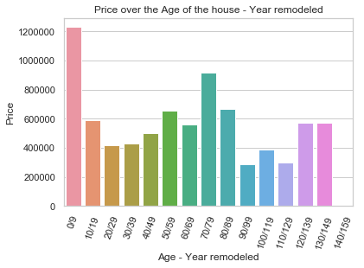
How does the age of the home affect its selling price?

Slide 6
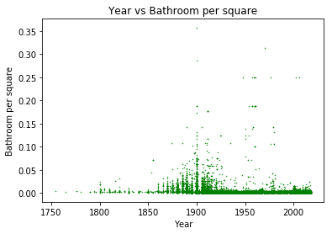
Do older homes have fewer bathrooms per square foot?
We cannot interpret anything since it is not homoscedastic or linear.

Slide 7
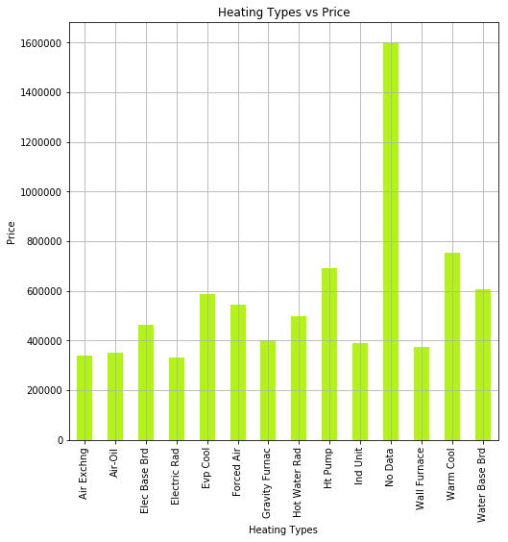
What are some properties of homes that affect sale prices (e.g., heating/cooling/exterior/roof types)?
Chi-square test
p value: 0.0041

Slide 8
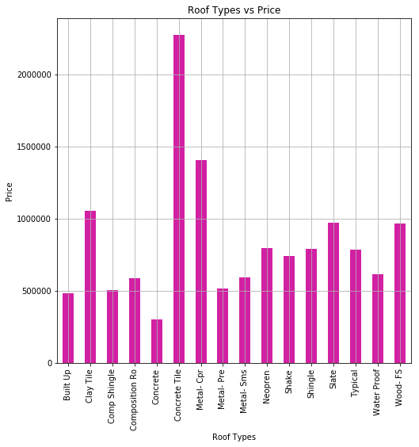
Chi-square test
p value: 0

Slide 9
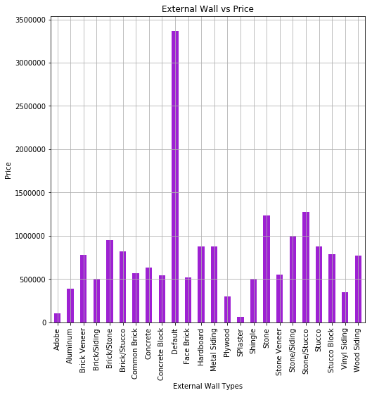
Chi-square test
p value: 0

Slide 10
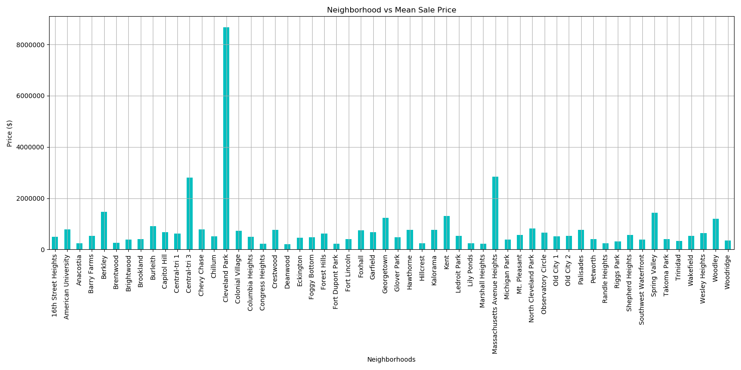
How does the neighborhood of the home affect its sale price?
Mean Price
$931,351.60

Slide 11
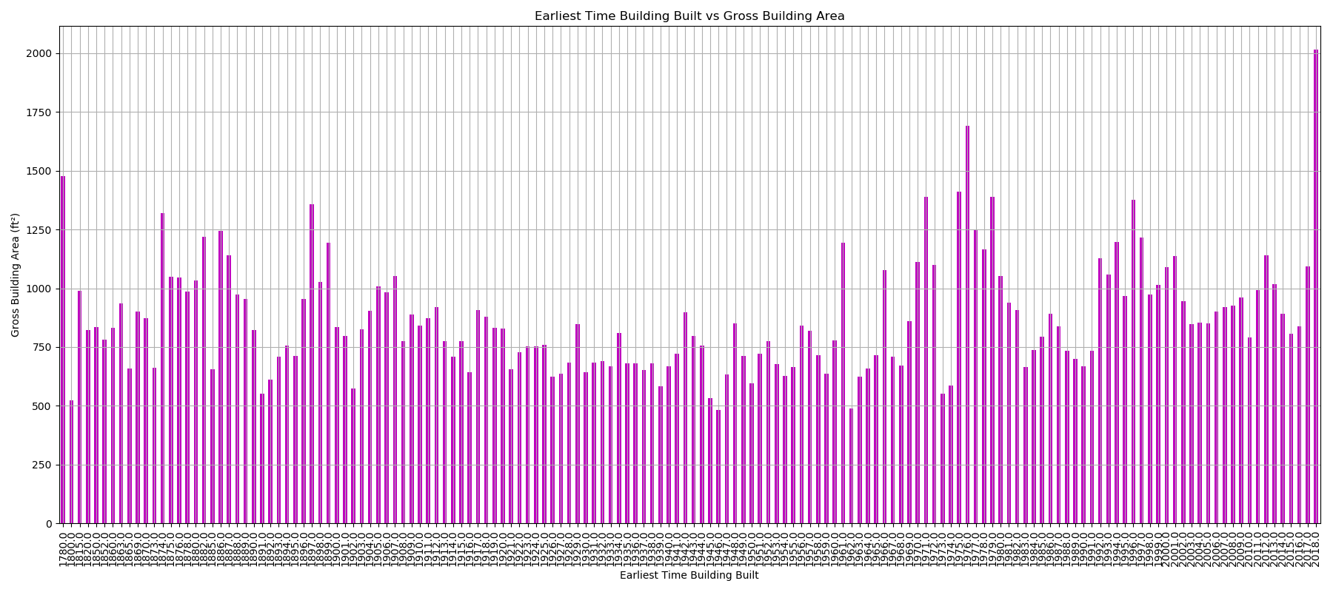
Do newer homes tend to be smaller or larger than older homes?

Slide 12
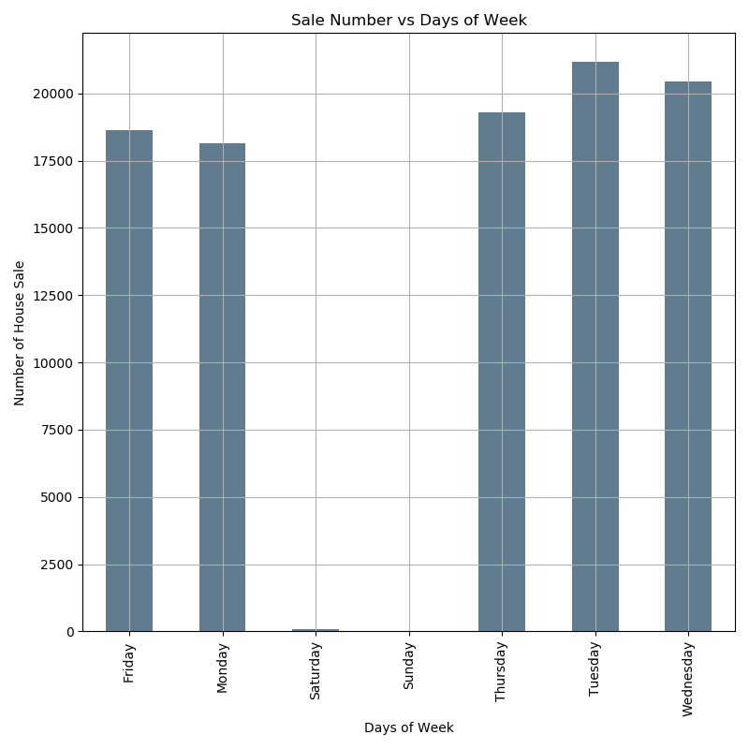
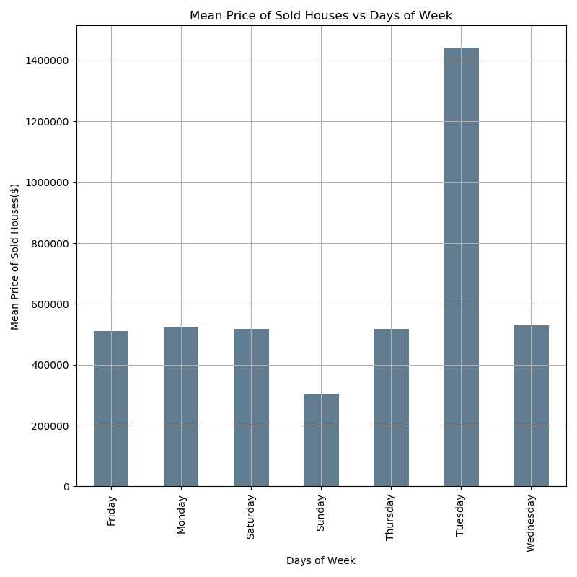
Is there a relation between the weekday that houses are being sold and the number of houses?

Slide 13
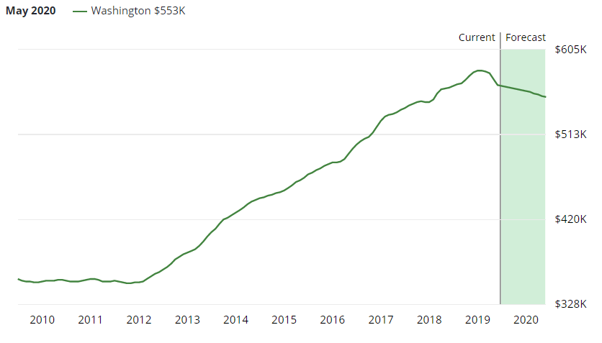
OLS Regression -> Variables and filtering data
Target variable: Housing price
Filter: Houses with, prices => $200,000. Houses with, prices <= $2,000,000.- Houses with rooms, bedrooms and bathrooms Houses with sale date later than 2016 This gives us 7724 houses
Predictor variables: Number of full bathrooms Grade Number of fireplaces Neighbourhood

Slide 14
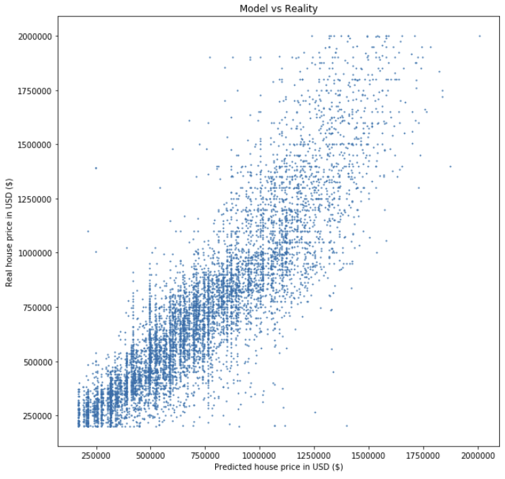
OLS Regression -> Model results
Metrics: R-squared = 0.77
Condition number = 252 (>30)
VIF (>5): Neighbourhood, American University = 83.1
Neighbourhood, Old City 1 = 7.3
No influence points Conditions are satisfied

