Slide 1
Programming Project Improving Dijkstra’s algorithm
Date: October 25
Project Due: November 4, 2019

Slide 2
Dijkstra's Algorithm
input: G = (V,E,c) and source node s and destination node t
// initialization
dist[s] = 0
dist[v] = infinity for all other nodes v
initialize priority queue Q to contain all nodes using dist values as keys. // T_{ins} : time per operation

Slide 3
Dijkstra's Algorithm
while Q is not empty do
u = extract-min(Q) //T_{ex} : time per operation
if u = t, then return dist[t].
for each neighbor v of u do
if dist[v] > dist[u] + c(u,v) then // T_{dec} : time per operation
dist[v] = dist[u] + c(u,v)
decrease-key(Q,v,dist[v])
parent(v) = u

Slide 4
Dijkstra's Algorithm Example
2
iteration
a
b
 | 0 | 1 | 2 | 3 | 4 | 5
Q | abcde | bcde | cde | de | d | Ø
d[a] | 0 | 0 | 0 | 0 | 0 | 0
d[b] | ∞ | 2 | 2 | 2 | 2 | 2
d[c] | ∞ | 12 | 10 | 10 | 10 | 10
d[d] | ∞ | ∞ | ∞ | 16 | 13 | 13
d[e] | ∞ | ∞ | 11 | 11 | 11 | 11
12
8
c
4
10
9
6
3
2
d
e
4
a is source node

Slide 5
Using Array Implementations
O(|V|(T_{ins} + T_{ex}) + |E|•T_{dec})
Implement priority queue with an unsorted array:
T_{ins} = O(1),
T_{ex} = O(|V|),
T_{dec} = O(1)
total time is O(|V|²)

Slide 6
Running Time using Binary Heaps
O(|V|(T_{ins} + T_{ex}) + E•T_{dec})
If priority queue is implemented with a binary heap, then
T_{ins} = T_{ex} = T_{dec} = O(log |V|)
total time is O(|E| log |V|)

Slide 7
Running Time using Fibonacci Heaps
O(|V|(T_{ins} + T_{ex}) + E•T_{dec})
If priority queue is implemented with a Fibonacci heap, then
T_{ex} = O(log |V|)
T_{ins} = T_{dec} = O(1)
total time is O(|V| log |V| + |E|)

Slide 8
Problems with Dijkstra
Visits too many vertices
Visits all the vertices whose distances to s is less than dist[t].

Slide 9
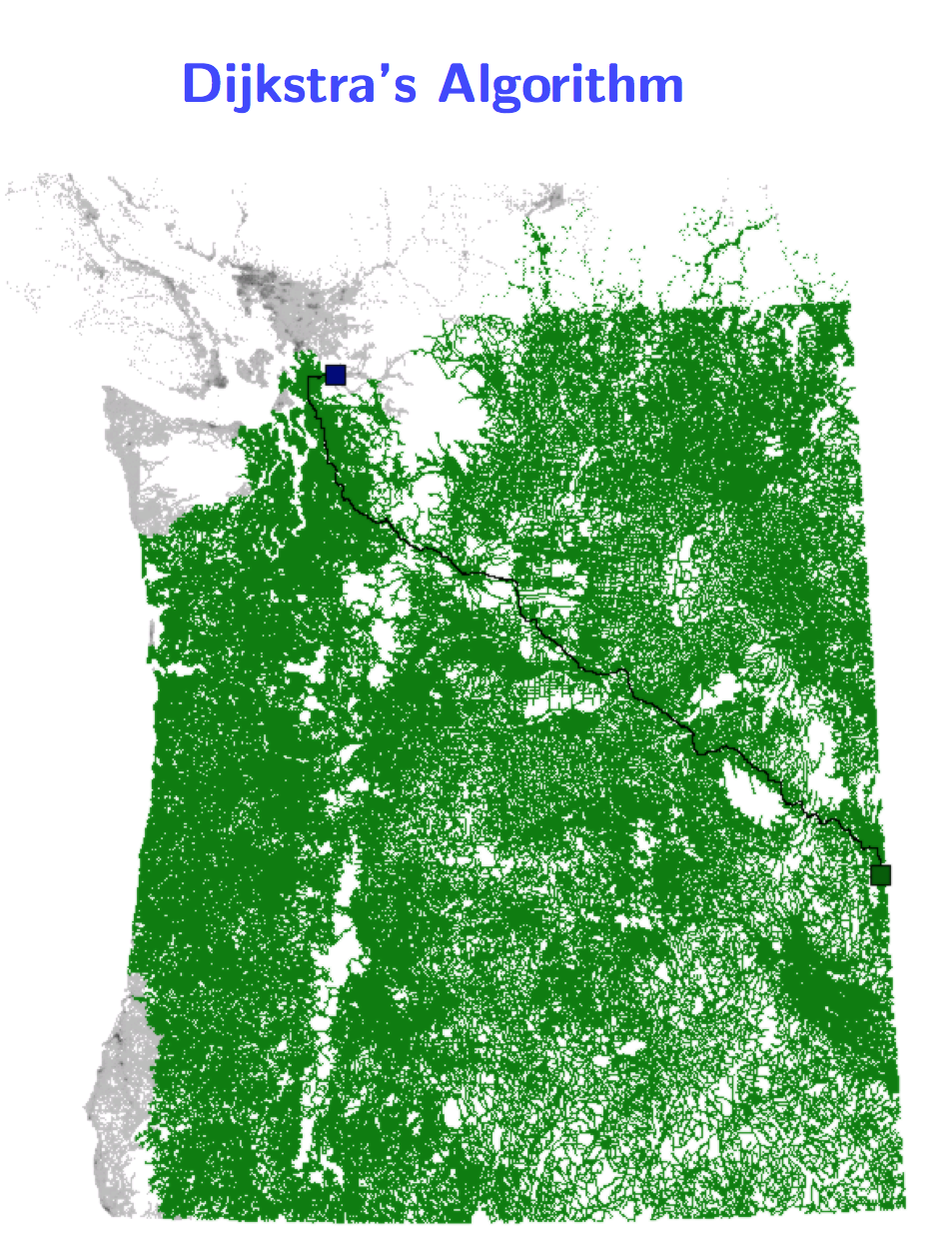

Slide 10
A* algorithm
Also factors in the distance from any node v to t.
Suppose to_t[u] denotes an estimate of the distance from u to t, without going over.
For road networks to_t(u) could be the euclidean distance from u to t.
Clearly, for road network real distance from u to t is greater than to_t(u).
You can’t overestimate. You will get wrong answer.

Slide 11
Wrong result
2
4
6 (estimated)
t
s
3 (estimated)
3
4

Slide 12
Dijkstra's A* Algorithm
input: G = (V,E,c) and source node s and destination node t
// initialization
dist[s] = 0
dist[v] = infinity for all other nodes v
initialize priority queue Q to contain each node u using dist[u] + to_t[u] values as keys. // T_{ins} : time per operation

Slide 13
Dijkstra's Algorithm
while Q is not empty do
u = extract-min(Q) //T_{ex} : time per operation
if u = t, then return dist[t].
for each neighbor v of u do
if dist[v] > dist[u] + c(u,v) then // T_{dec} : time per operation
dist[v] = dist[u] + c(u,v)
decrease-key(Q,v,dist[v] + to_t[v])
parent(v) = u

Slide 14
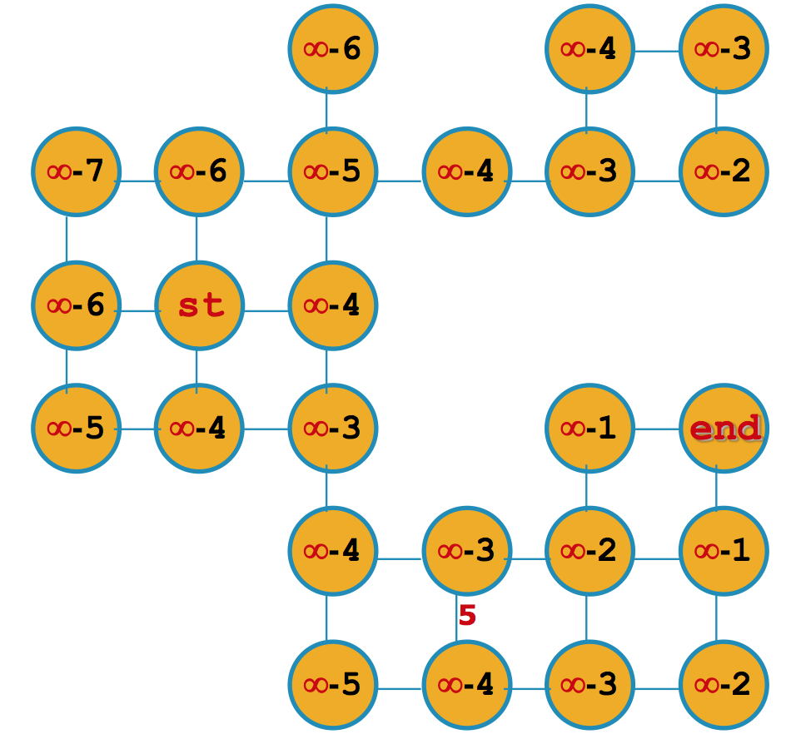
An example
source node : st
destination node: end
to_t[u]: estimated distance to t.

Slide 15
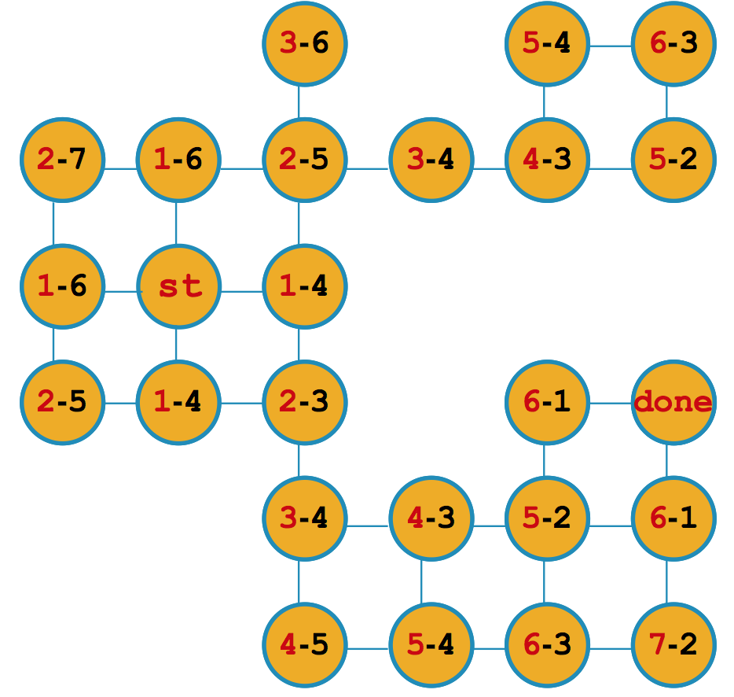
An example
source node : st
destination node: end
to_t[u]: estimated distance to t.
Dijkstra’s algorithm visits all the nodes.

Slide 16
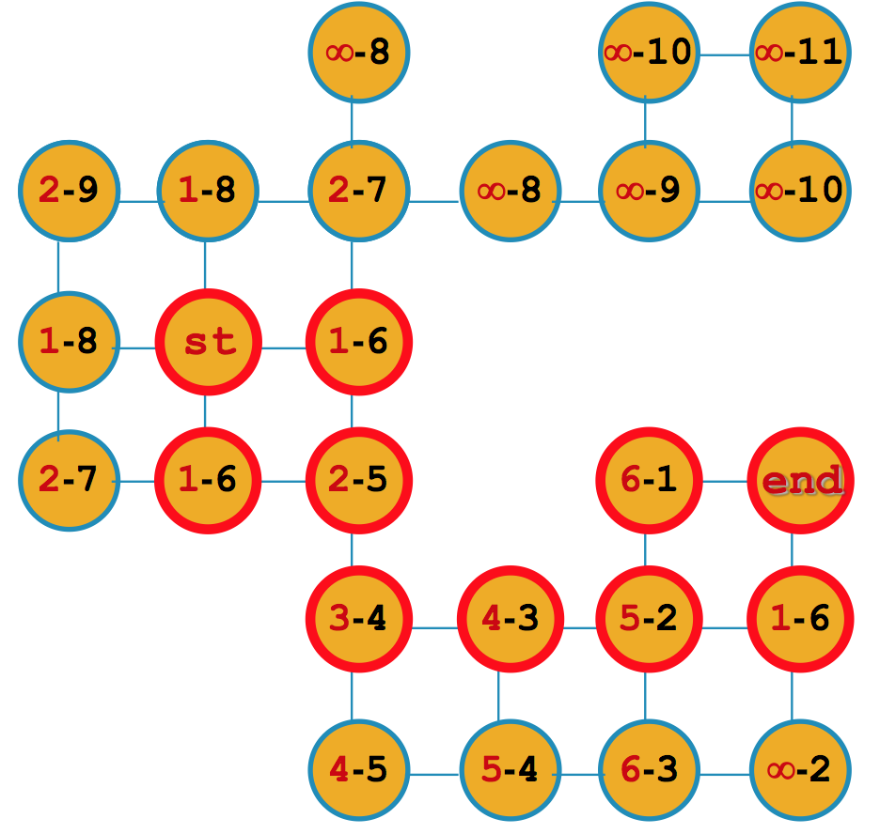
An example
source node : st
destination node: end
to_t[u]: estimated distance to t.
A* algorithm visits the nodes circled red.

Slide 17
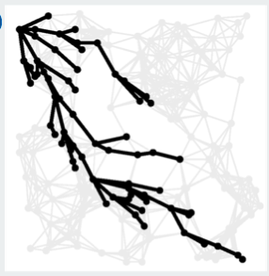
A* search

Slide 18
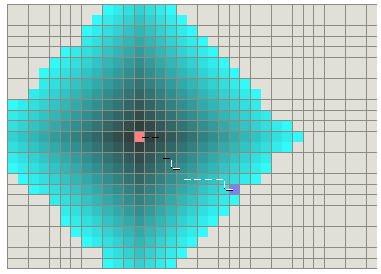
Classical Dijkstra

Slide 19
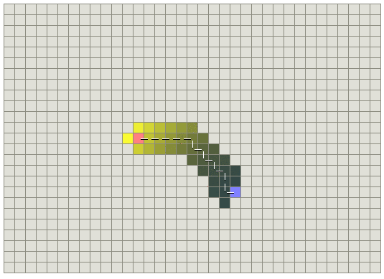
A* search

Slide 20
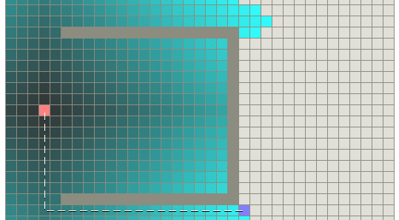
Maps with obstacles Classical Dijkstra

Slide 21
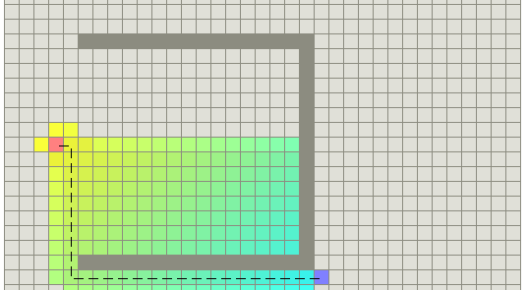
Maps with obstacles A* search

Slide 22
A better way to estimate
Consider an arbitrary vertex z of G=(V,E).
Suppose dist_{z}(v) denotes the shortest paths from z to v for all v in V.
During the computation of the shortest path from a query source s to a query destination t, we can estimate the distance of any node v to t as:
to_t[u] = |dist_{z}[u] – dist_{z}[t]|.
z is called a landmark.

Slide 23
Lower bound estimate
Suppose we pre-compute and store a single source shortest path distance from some source z to all the vertices of the graph. Let dist_{z}[v] denote the shortest path distance from z to v.
u
z
t
Using the triangle inequality we can use to_t(u,t) = |dist_{z}[u] – dist_{z}[t]| for landmark z.

Slide 24
Lower bound estimate
u
z
t
Using the triangle inequality we can use to_t(u,t) = |dist_{z}[u] – dist_{z}[t]| for landmark z.
We can use more than one landmark. In this case to_t[u] = max{|dist_{z}[u] – dist_{z}[t]|, for all landmarks z}
This estimate can be computed in constant time, assuming the number of landmarks to be constant.

Slide 25
Lower bound estimate
t
u
A
Using the triangle inequality we can use to_t(u,t) = |dist_{z}[u] – dist_{z}[t]| for landmark z.
We can use more than one landmark. In this case to_t[u] = max{|dist_{z}[u] – dist_{z}[t]|, for all landmarks z}
This estimate can be computed in constant time, assuming the number of landmarks to be constant.

Slide 26
Landmark Selection
Preprocessing:
Pick a small number of landmarks (about 2-3)
More landmarks: better queries, more space
Query (given s and t)
use
to_t[u] = max{|dist_{z}[u] – dist_{z}[t]|, for all landmarks z}
to estimate the distance from u to t.

Slide 27
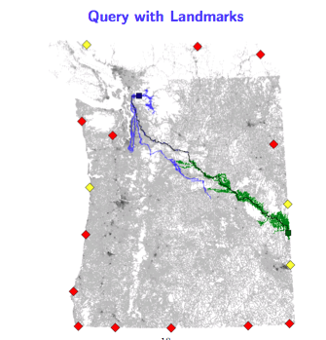
An example

Slide 28
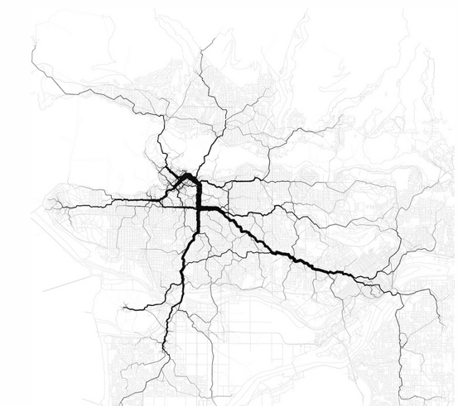
Paths through Vancouver http://www.flickr.com/photos/walkingsf/6755920957/

Slide 29
Project details
The input file is stored in graph1000.txt
The input graph has 1000 vertices. Each vertex has a (x,y) coordinate where x is the latitude and y is the longitude of the vertex.
The distance between two vertices q1 and q2 in meters is given by the following function (in Python):
# straight line distance between two (latitude, longitude) points in meters
def distance(q1, q2):
dlat = 2 * math.pi * (q2[0] - q1[0]) / 360
mlat = 2 * math.pi * (q1[0] + q2[0]) / 2 / 360
dlon = 2 * math.pi * (q2[1] - q1[1]) / 360
return 6371009 * (dlat ** 2 + (math.cos(mlat) * dlon) ** 2) ** 0.5

Slide 30
Output
The program should output two things
First part: Randomly generate 20 query pairs of the form (q1,q2). For each query:
Determine the shortest distance in G from vertex q1 to vertex q2 using Dijkstra’s, A* and Landmark algorithms.
Output the number of vertices Dijkstra’s algorithm has visited.
Output the number of vertices A* algorithm has visited.
Output the number of vertices Landmark algorithm has visited.
Second part: Determine, on an average, what are the savings if A* and Landmark algorithms are used instead of Dijkstra’s algorithm

Slide 31
