Slide 1
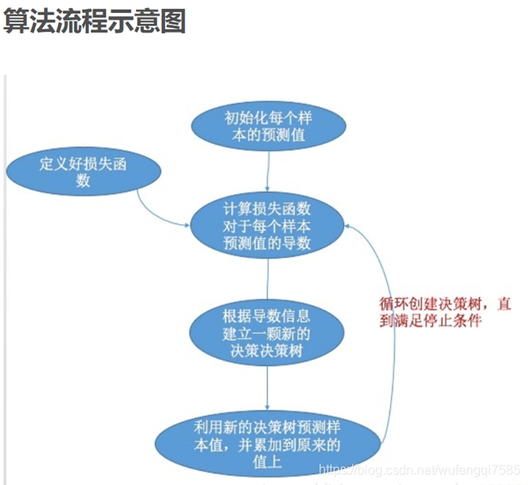
Initialize the predicted values for each sample
Define loss function
Calculate the derivative of the loss function for each sample's predicted value
Establish a new decision tree based on derivative information
Create a decision tree in a loop until the stop condition is met
Using a new decision tree to predict sample values and accumulating them onto the original values

Slide 2
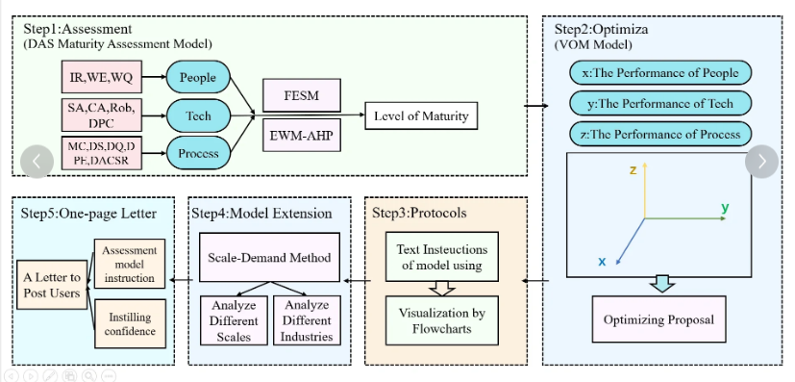
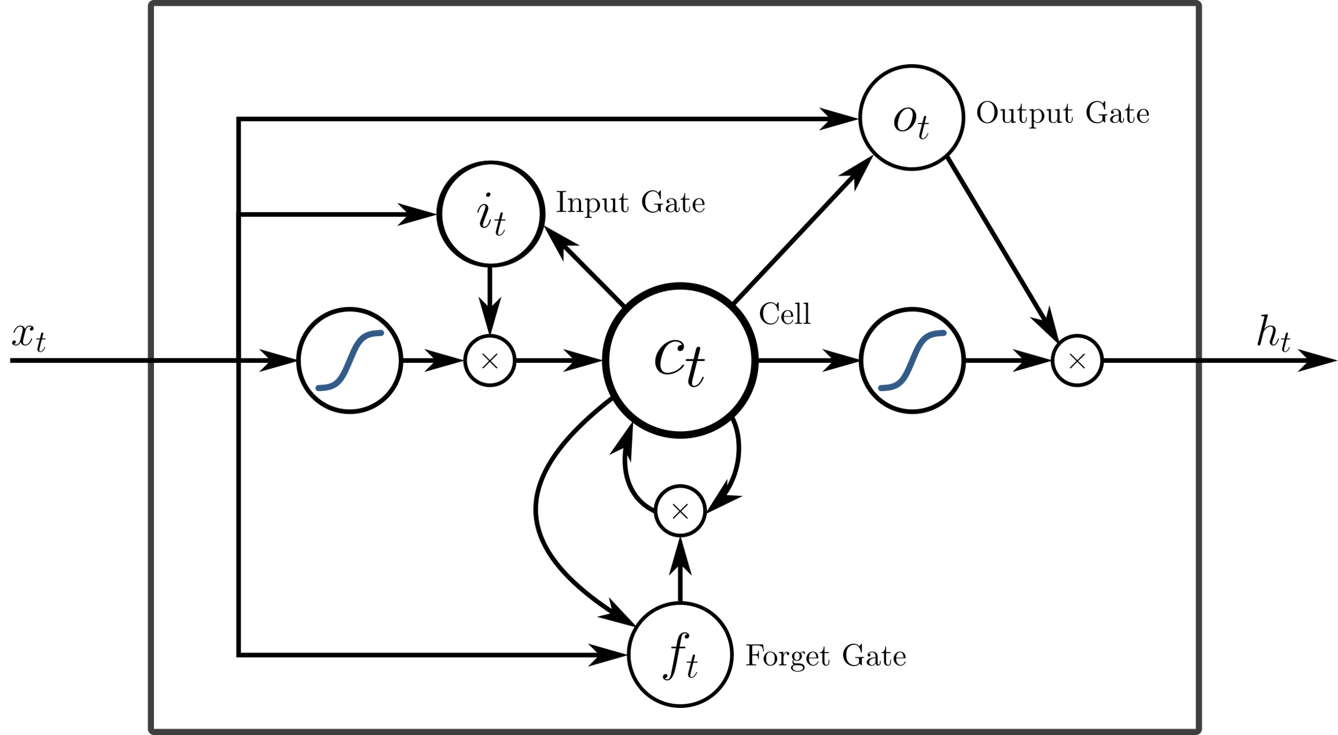
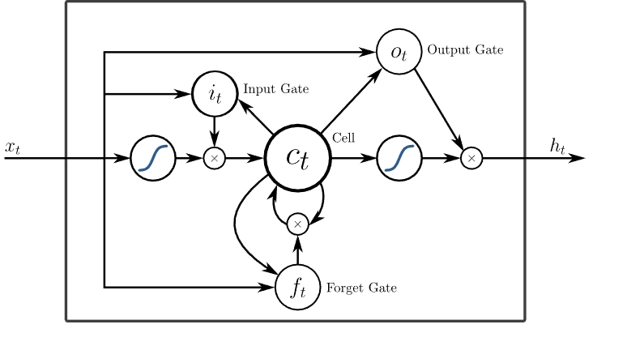
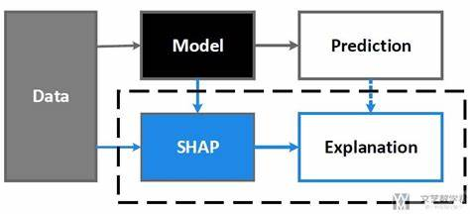
Step1:Data preprocessing
Points earned
Serve
Number of rounds won
Outlier detectionand data clean
Player ace ball
Raw Data
Number of sets won
Serving speed (mph)
Serve metrics
Psychological factors
Unforced errors
Number of servings
Double fault
Break
Technical prowess
Physical reserves
Running distance
To the web
DATA
DATA
Step3:SHAP
Step2:LSTM
DATA
Prediction
Model
Explanation
SHAP

Slide 3
Points earned
Serve
Number of rounds won
Player ace ball
Normalized data
Number of sets won
Serve metrics
Psychological factors
Unforced errors
Number of servings
Double fault
Break
Technical prowess
Physical reserves
Running distance
To the web

Slide 4
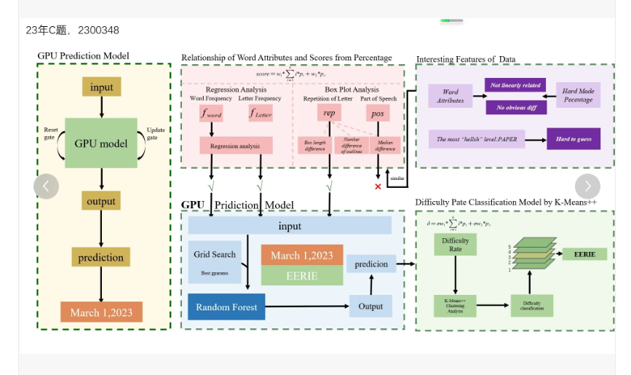
Vinicius Pradoda Fonseca
Helmut Dietl
Zhimin Yang
Database Creation
Select common factors
Feature Engineering
Data
Data
Frequency
Based Features
Momentum Based Features
Classical binary approach
machine learning
(many models)
Combined Features
Model Creation & Evaluation
Interpret results
best model
Model Comparison AcrossFeature Sets and GameIntervals
predict

Slide 5
Question 1 & 2 : mode 1:DMI
Pretreatment
Features determine weights
Data
Cleaning and disposal
6 modes
RF
GBDT
Feature engineering
CatBoost
LightGBM
Serve
Points earned
XGBoost
Adaboost
Number of rounds won
Player ace ball
Normalized data
Number of sets won
Average
Number of servings
Serve metrics
Psychological factors
Unforced errors
Double fault
Break
Technical prowess
Physical reserves
Running distance
Feature weights(Y)
To the web

Slide 6

Question 3 : mode 2: LSTM
LIME
Data
L
S
T
M
Interpreter of the LIME algorithm model
Time
First-shot success rate
other
data
First serve scoring percentage
Interpretable features
- Feature 1
- Feature 2
……
- Feature n
Second-serve scoring rate
V_value
Results

