Slide 1
Methods 3: Multilevel Statistical Modeling and Machine Learning
Week 3: Generalized linear mixed effects models
September 28, 2021
by: Lau Møller Andersen
<nummer>
CC BY Licence 4.0: Lau Møller Andersen

Slide 2

These slides are distributed according to the CC BY 4.0 licence: https://creativecommons.org/licenses/by/4.0/
<nummer>
CC BY Licence 4.0: Lau Møller Andersen

Slide 3
Messages
Practical exercise due 23.59 tomorrow
Make sure to add your GitHub repository – a few are still missing: https://cryptpad.fr/pad/#/2/pad/edit/U21qNTbLgfkRiGZU1bnmDE2o/
Remember, Class 2 (10-12) will be in 1453-116 tomorrow
<nummer>
CC BY Licence 4.0: Lau Møller Andersen

Slide 4
RECAP on pooling
SLEEP STUDY EXAMPLE
https://psyteachr.github.io/stat-models-v1/introducing-linear-mixed-effects-models.html
<nummer>
CC BY Licence 4.0: Lau Møller Andersen

Slide 5
Learning goals and outline –
Linear Mixed Effects Models (LMM)
Why can it be a good idea to do mixed effects modelling?
Understanding the basics of multilevel modelling
  - also known as linear mixed effects modelling
Appreciating the difference between the different levels of effects
  or random and fixed effects, as they are also called
Understanding the concept of pooling (none, complete and partial)
<nummer>
CC BY Licence 4.0: Lau Møller Andersen

Slide 6
Pooling - summary
Complete pooling
  ignoring a categorical predictor (e.g. subject)
No pooling
  model each level of the categorical predictor separately
Partial pooling
  we model both an average and each level of the categorical predictor (e.g. subject)
<nummer>
CC BY Licence 4.0: Lau Møller Andersen

Slide 7
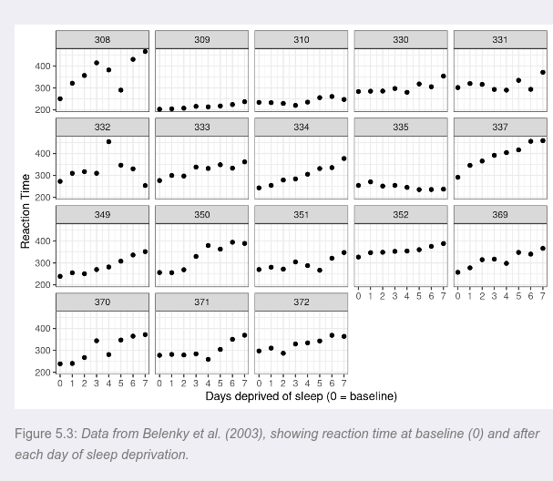
<nummer>
CC BY Licence 4.0: Lau Møller Andersen
(Barr, University of Glasgow)

Slide 8
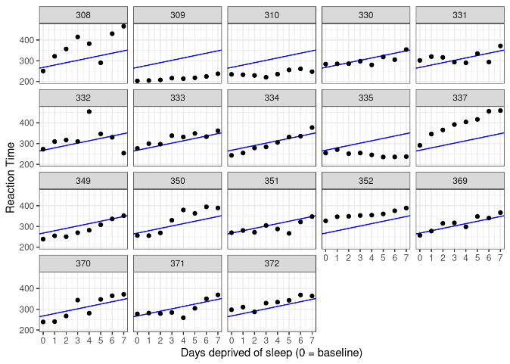
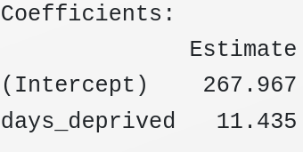

COMPLETE POOLING
!
!
!
!
!
There are some bad fits
<nummer>
CC BY Licence 4.0: Lau Møller Andersen
(Barr, University of Glasgow)

Slide 9
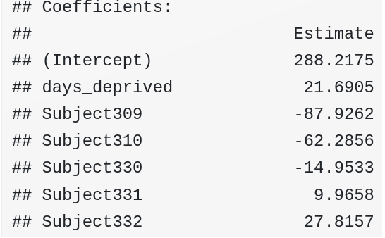
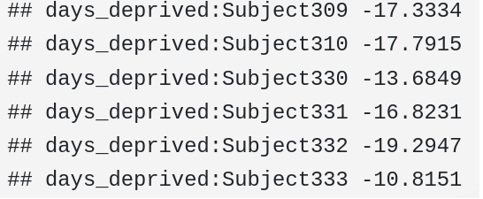
... and the remaining 12 subjects
... and the remaining 12 subjects
NO POOLING
<nummer>
CC BY Licence 4.0: Lau Møller Andersen
(Barr, University of Glasgow)

Slide 10
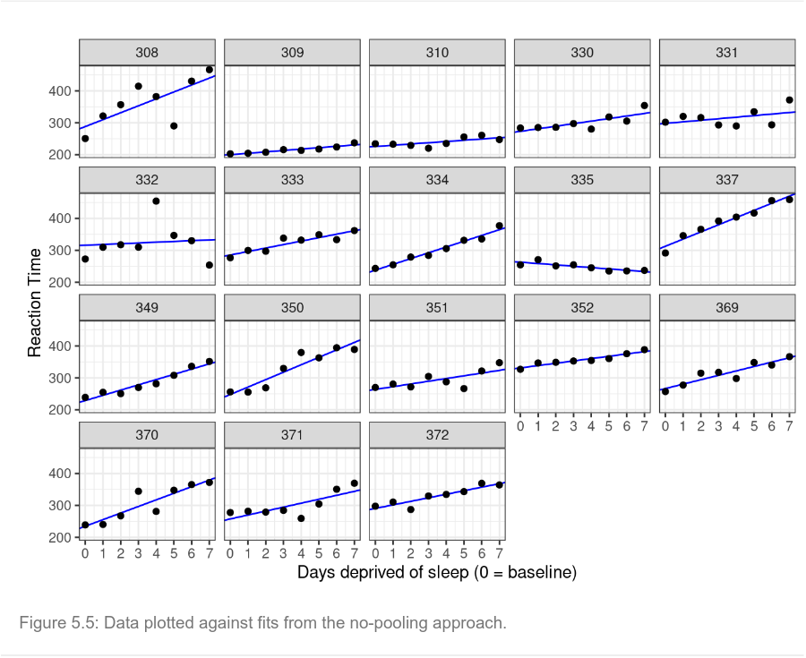
NO POOLING
Good fits now:
What are the limits of this model?
<nummer>
CC BY Licence 4.0: Lau Møller Andersen
(Barr, University of Glasgow)

Slide 11
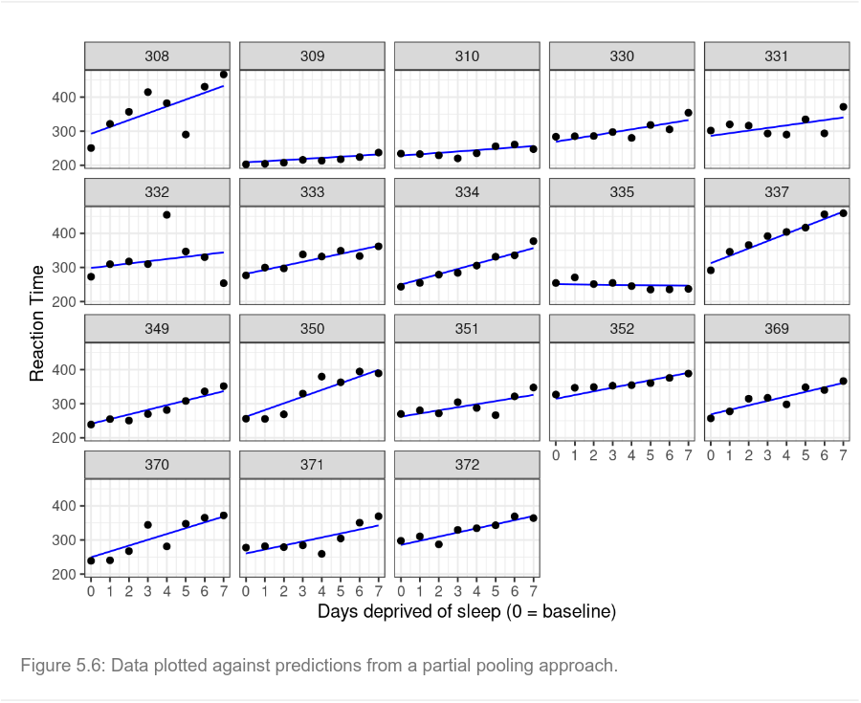
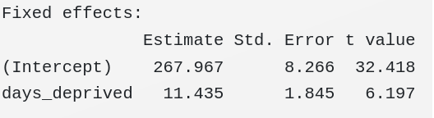
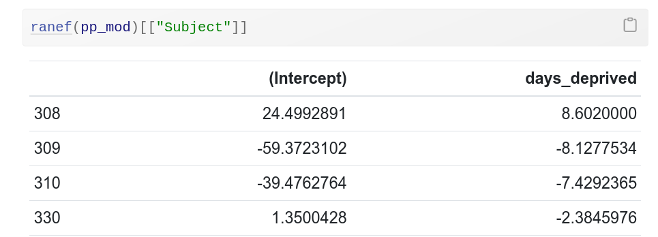

PARTIAL POOLING
<nummer>
CC BY Licence 4.0: Lau Møller Andersen
(Barr, University of Glasgow)

Slide 12
No pooling vs partial pooling
Both model the individual variance – but only one is generalisable outside the subject pool
<nummer>
CC BY Licence 4.0: Lau Møller Andersen
(Barr, University of Glasgow)

Slide 13
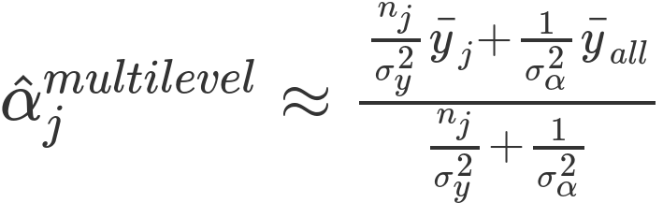
Partial pooling
(Gelman and Hill, 2006 (12.1) )
another scary looking thing...
<nummer>
CC BY Licence 4.0: Lau Møller Andersen

Slide 14
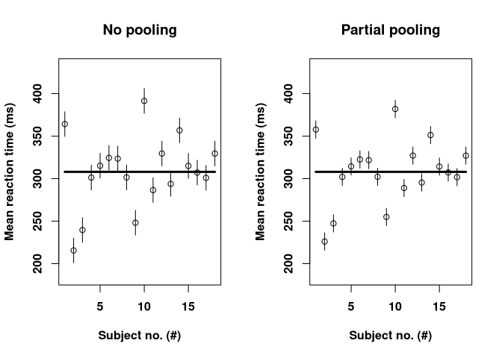
What is the advantage of the partial pooling model?
<nummer>
CC BY Licence 4.0: Lau Møller Andersen

Slide 15
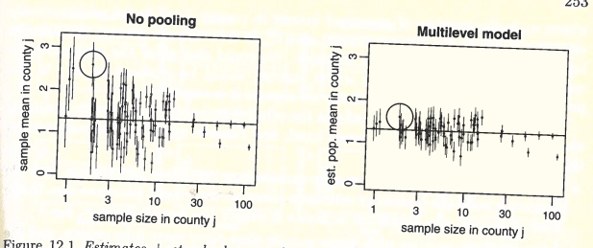
Now with different sample sizes
What is the advantage of the partial pooling model?
(Gelman and Hill, 2006)
<nummer>
CC BY Licence 4.0: Lau Møller Andersen

Slide 16
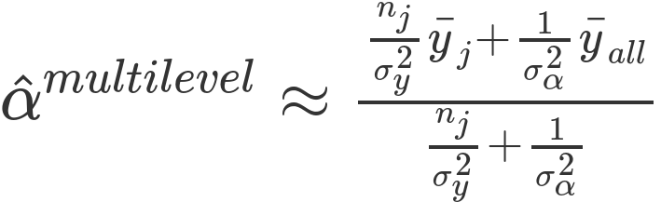
(Gelman and Hill, 2006)
Discuss in small groups
What happens to the estimated mean, â_{j}, when n_{j}:
increases?
decreases?
is 0?
goes towards infinity?
<nummer>
CC BY Licence 4.0: Lau Møller Andersen

Slide 17
Same n for each subject
Different n for each county
(Gelman and Hill, 2006)
<nummer>
CC BY Licence 4.0: Lau Møller Andersen

Slide 18
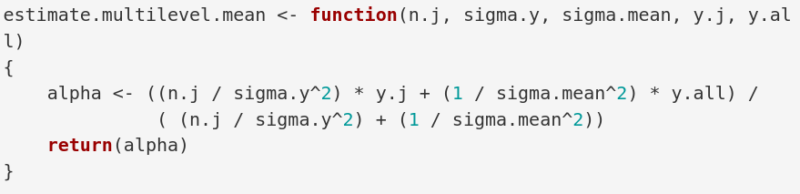
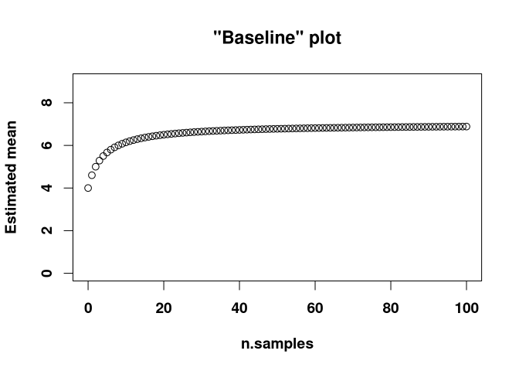
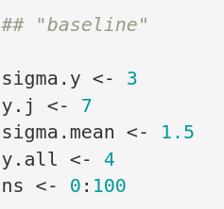
<nummer>
CC BY Licence 4.0: Lau Møller Andersen

Slide 19
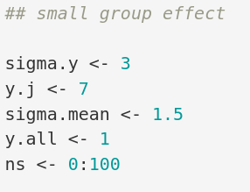
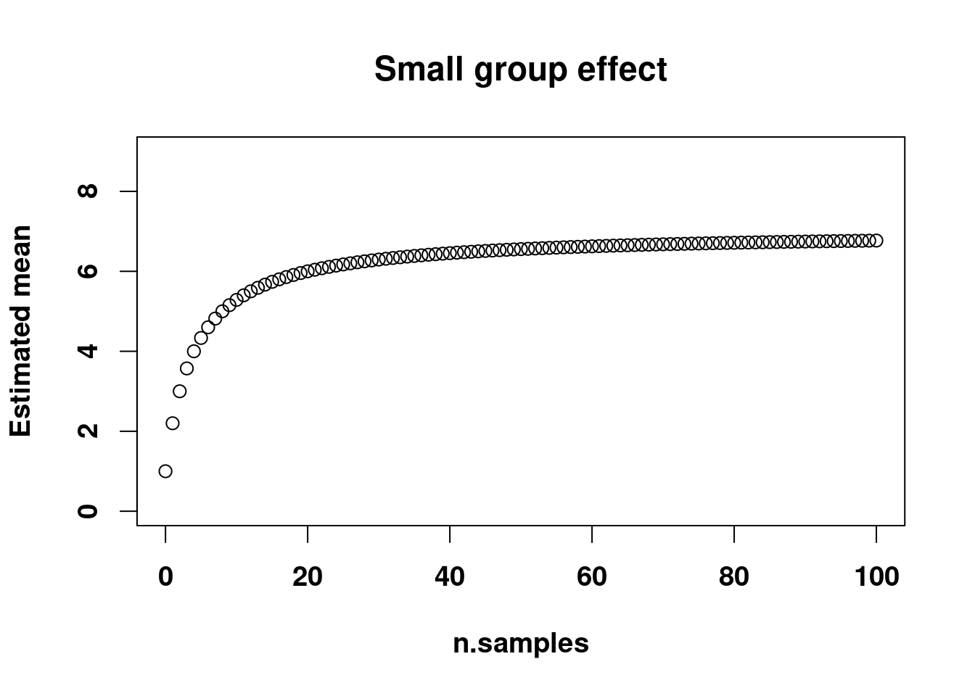
<nummer>
CC BY Licence 4.0: Lau Møller Andersen

Slide 20
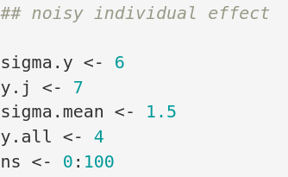
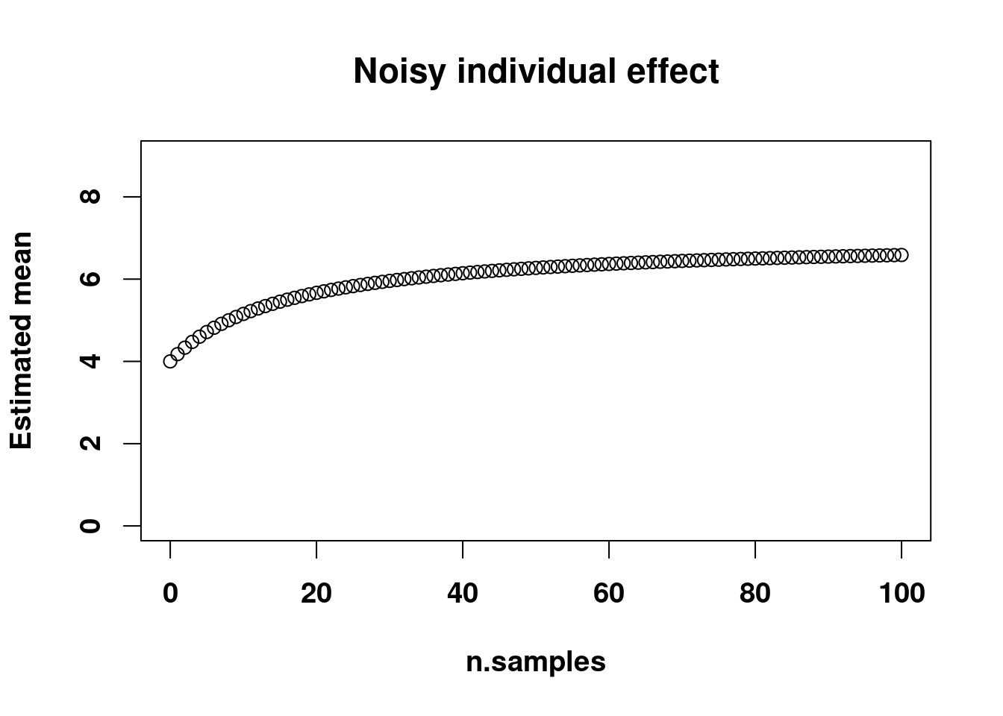
<nummer>
CC BY Licence 4.0: Lau Møller Andersen

Slide 21
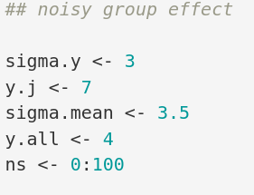
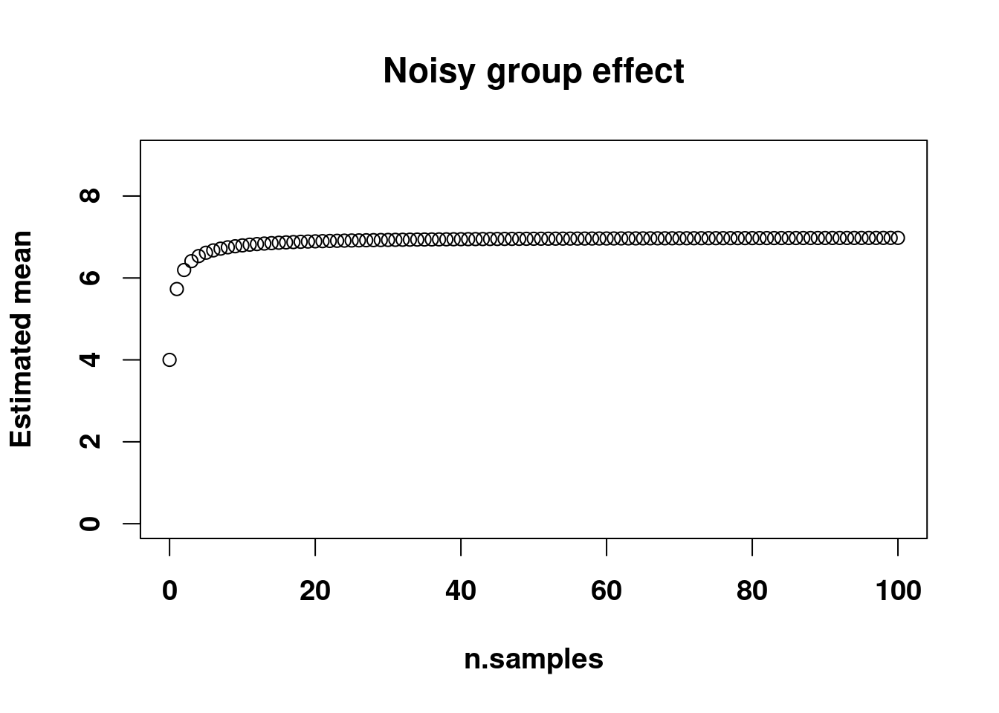
<nummer>
CC BY Licence 4.0: Lau Møller Andersen

Slide 22
FROM LAST WEEK
Motivation for multilevel modelling:
We want to use all the information in the data while fulfilling the assumptions necessary for the residuals
We can add:
Without letting small or uncertain samples unduly affect our group estimate
<nummer>
CC BY Licence 4.0: Lau Møller Andersen

Slide 23
(Gelman and Hill, 2006 (12.1) )
Revisiting equation 12.1
Why is this not very interesting for purposes of fitting models?
<nummer>
CC BY Licence 4.0: Lau Møller Andersen

Slide 24
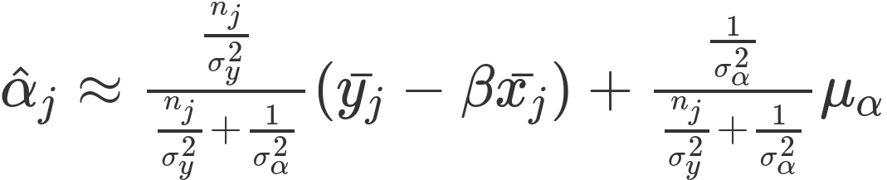
Now with parameters (β)
<nummer>
CC BY Licence 4.0: Lau Møller Andersen

Slide 25
Now on to generalized linear mixed models ...
<nummer>
CC BY Licence 4.0: Lau Møller Andersen

Slide 26
Did you learn?
Linear Mixed Effects Models (LMM)
Why can it be a good idea to do mixed effects modelling?
Understanding the basics of multilevel modelling
  - also known as linear mixed effects modelling
Appreciating the difference between the different levels of effects
  or random and fixed effects, as they are also called
Understanding the concept of pooling (none, complete and partial)
<nummer>
CC BY Licence 4.0: Lau Møller Andersen

Slide 27
... but let’s do a recap of the generalized linear model first
<nummer>
CC BY Licence 4.0: Lau Møller Andersen

Slide 28
Learning goals
Generalized Linear Mixed Effects Models (GLMM)
Understanding that we can extend the scope of our multilevel modelling by using appropriate link functions and data distributions
Understanding the multilevel equivalent of the GLM
<nummer>
CC BY Licence 4.0: Lau Møller Andersen

Slide 29
At least four ingredients needed
(Gelman and Hill, 2006, Chapter 6)
<nummer>
CC BY Licence 4.0: Lau Møller Andersen

Slide 30

Breaking all promises and going back to mtcars
<nummer>
CC BY Licence 4.0: Lau Møller Andersen

Slide 31
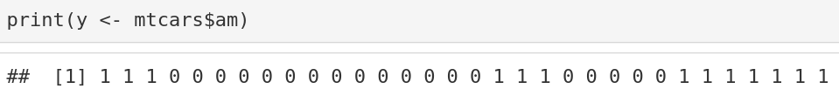
<nummer>
CC BY Licence 4.0: Lau Møller Andersen

Slide 32
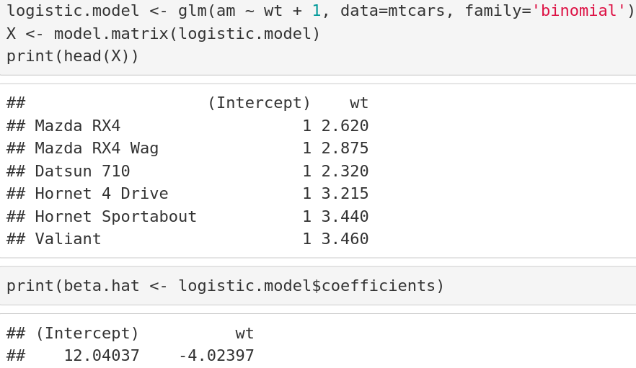
<nummer>
CC BY Licence 4.0: Lau Møller Andersen

Slide 33
<nummer>
CC BY Licence 4.0: Lau Møller Andersen

Slide 34
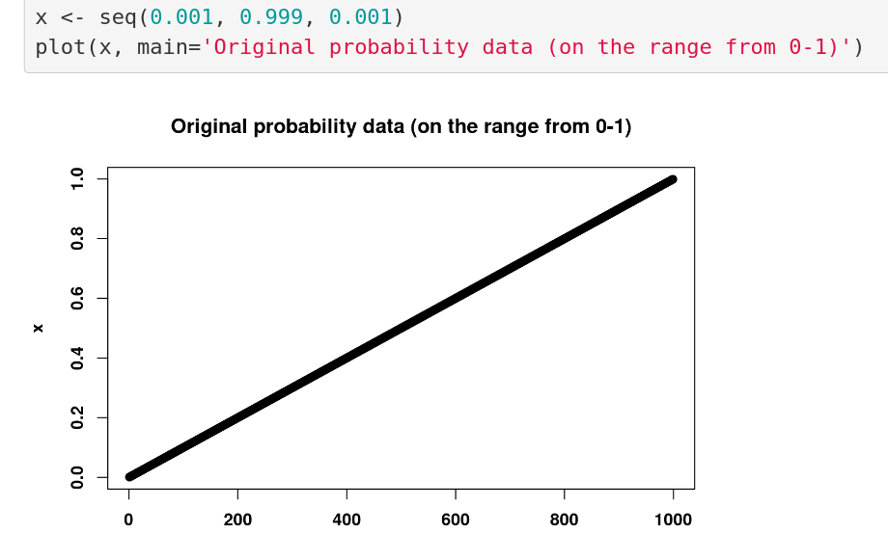
<nummer>
CC BY Licence 4.0: Lau Møller Andersen

Slide 35
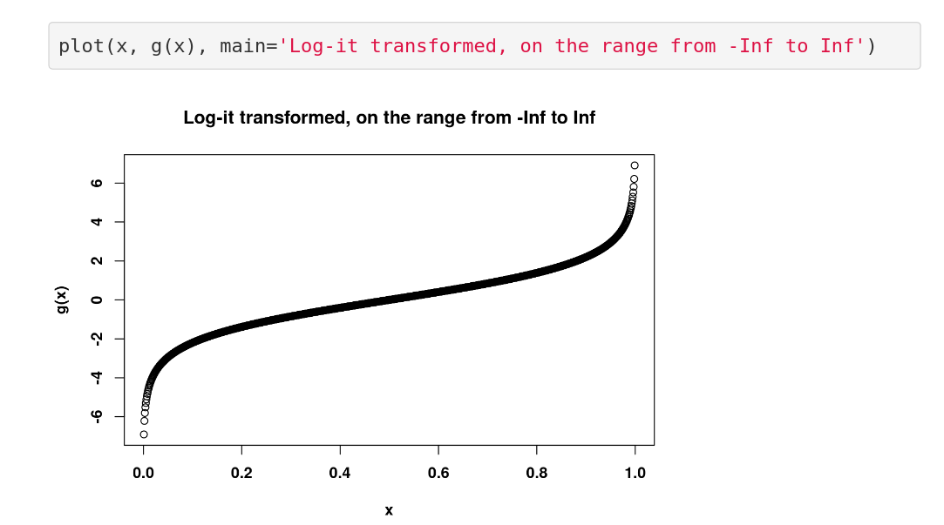
<nummer>
CC BY Licence 4.0: Lau Møller Andersen

Slide 36
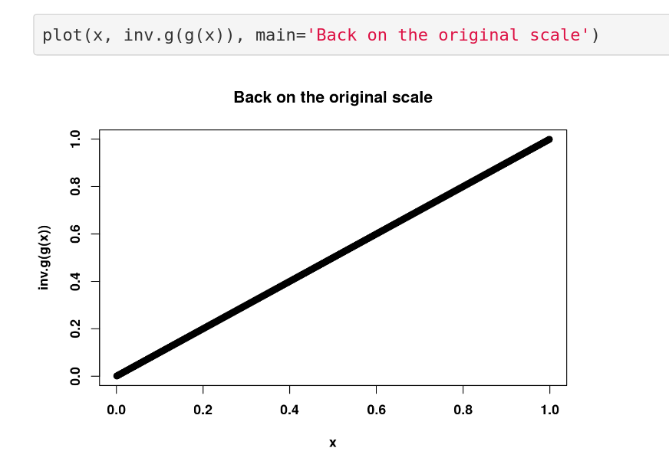
<nummer>
CC BY Licence 4.0: Lau Møller Andersen

Slide 37
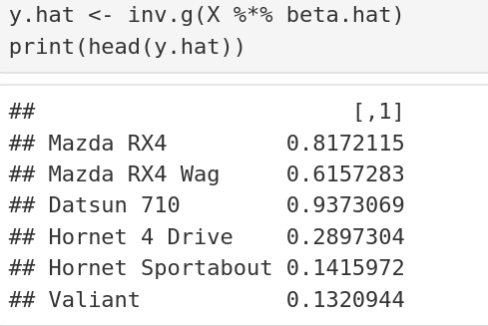
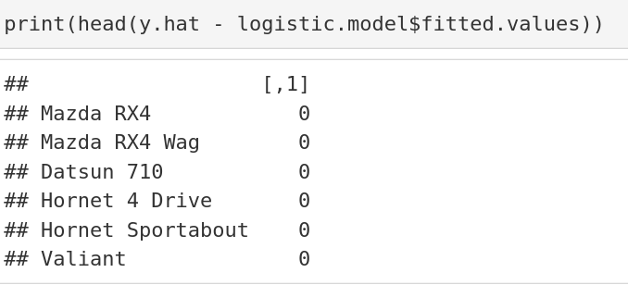
These are the fitted values
<nummer>
CC BY Licence 4.0: Lau Møller Andersen

Slide 38
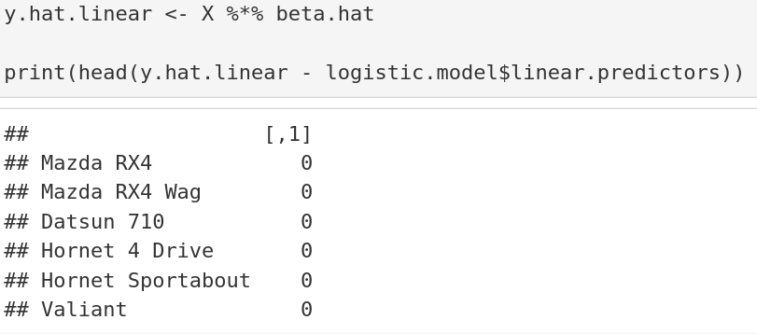
These are the linear predictors
<nummer>
CC BY Licence 4.0: Lau Møller Andersen

Slide 39
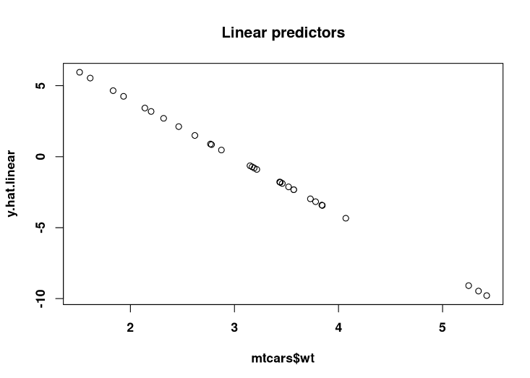
Looks like a “normal” linear regression
<nummer>
CC BY Licence 4.0: Lau Møller Andersen

Slide 40
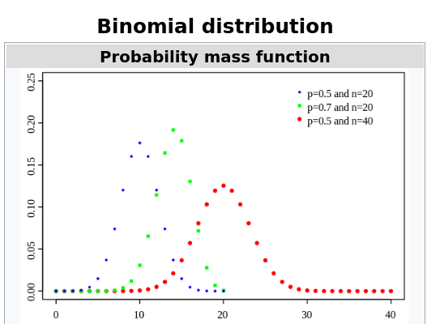
https://en.wikipedia.org/wiki/Binomial_distribution
<nummer>
CC BY Licence 4.0: Lau Møller Andersen

Slide 41
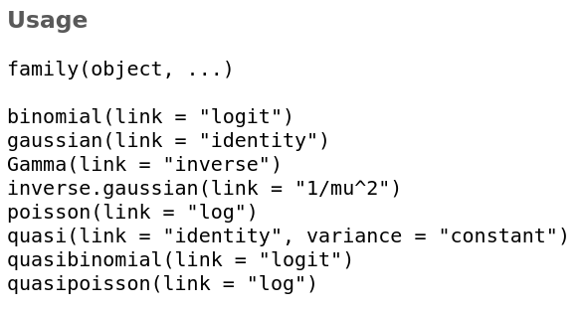
Some link functions
<nummer>
CC BY Licence 4.0: Lau Møller Andersen

Slide 42
Important difference from the general linear model
The least squares solution is the maximum likelihood estimation
<nummer>
CC BY Licence 4.0: Lau Møller Andersen

Slide 43
Important difference from the general linear model
We also make maximum likelihood estimates for logistic regression, but there are no analytical solutions for those
<nummer>
CC BY Licence 4.0: Lau Møller Andersen

Slide 44
Maximum likelihood estimate
<nummer>
CC BY Licence 4.0: Lau Møller Andersen

Slide 45
The general linear mixed model (GLMM)
<nummer>
CC BY Licence 4.0: Lau Møller Andersen

Slide 46
To generalize to non-linear functions
At least four ingredients needed
This time a _{j} added to indicate that all of these are modelled at a second level as well
<nummer>
CC BY Licence 4.0: Lau Møller Andersen

Slide 47
Did you learn?
Generalized Linear Mixed Effects Models (GLMM)
Understanding that we can extend the scope of our multilevel modelling by using appropriate link functions and data distributions
Understanding the multilevel equivalent of the GLM
<nummer>
CC BY Licence 4.0: Lau Møller Andersen

Slide 48
References
Gelman, A., Hill, J., 2006. Data Analysis Using Regression and Multilevel/Hierarchical Models. Cambridge University Press.
<nummer>
CC BY Licence 4.0: Lau Møller Andersen

