Slide 1
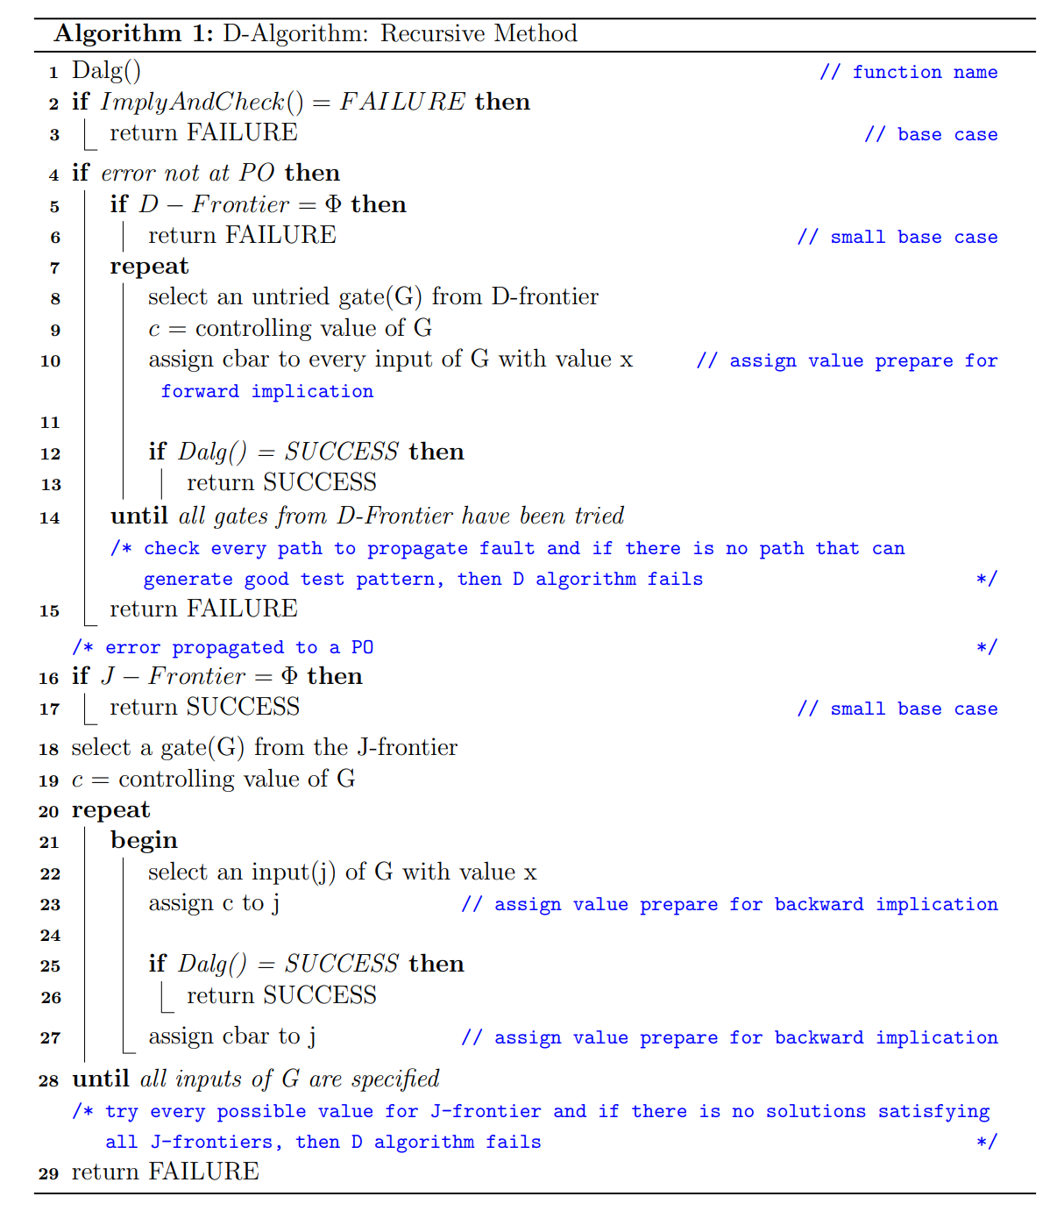

Slide 2
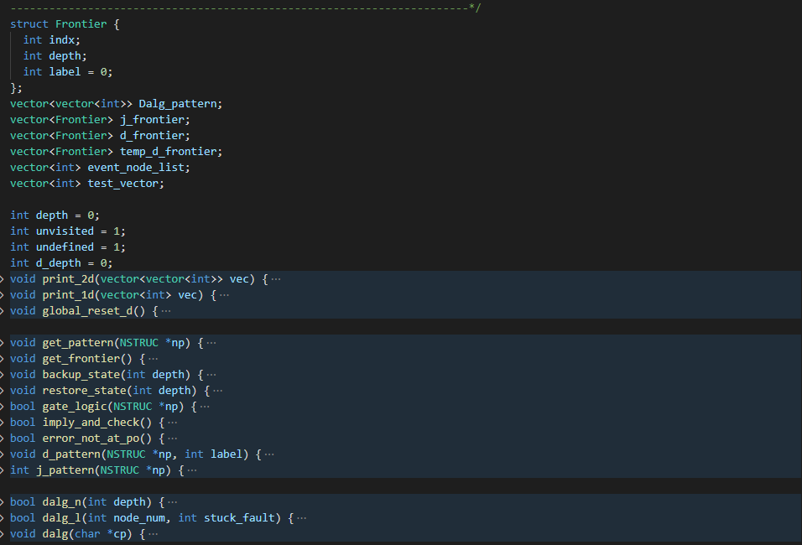

Slide 3
Imply & check
5
8
3
4
7
9
1
6
10
2
Event node list: 4

Slide 4
Imply & check
5
3
8
1
4
7
9
6
10
2
Event node list: 1,2,3,5,6

Slide 5
Imply & check
5
3
8
1
4
7
9
6
10
2
Event node list:

Slide 6
D_frontier
5
13
12
8
3
11
4
7
9
1
6
10
2

Slide 7
D_frontier
5
13
12
8
3
11
4
7
9
1
6
10
2

Slide 8
D_frontier
5
13
12
8
3
11
4
7
9
1
6
10
2

Slide 9
D_frontier
5
13
12
8
3
11
4
7
9
1
6
10
2
Restore previous state and try another d frontier

Slide 10
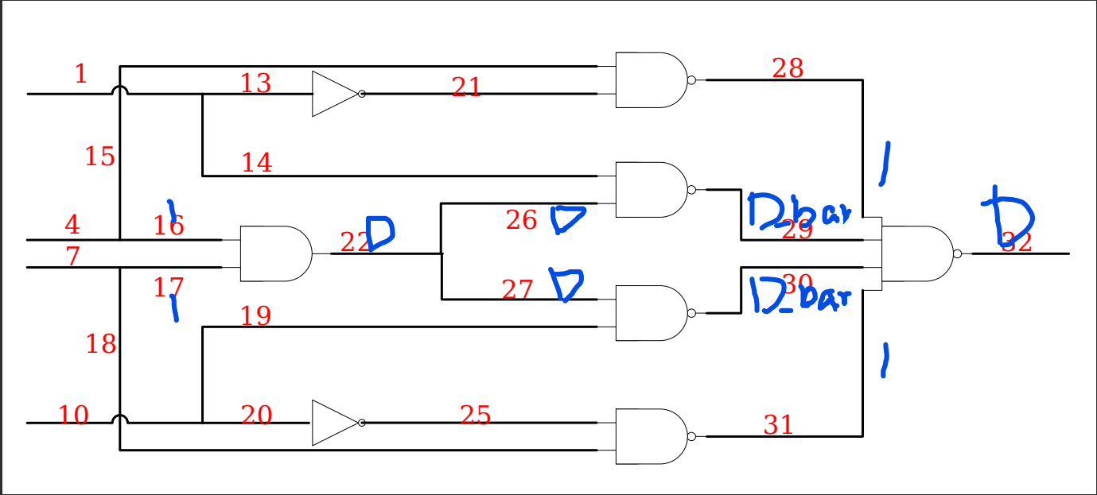
C3 22@0

Slide 11
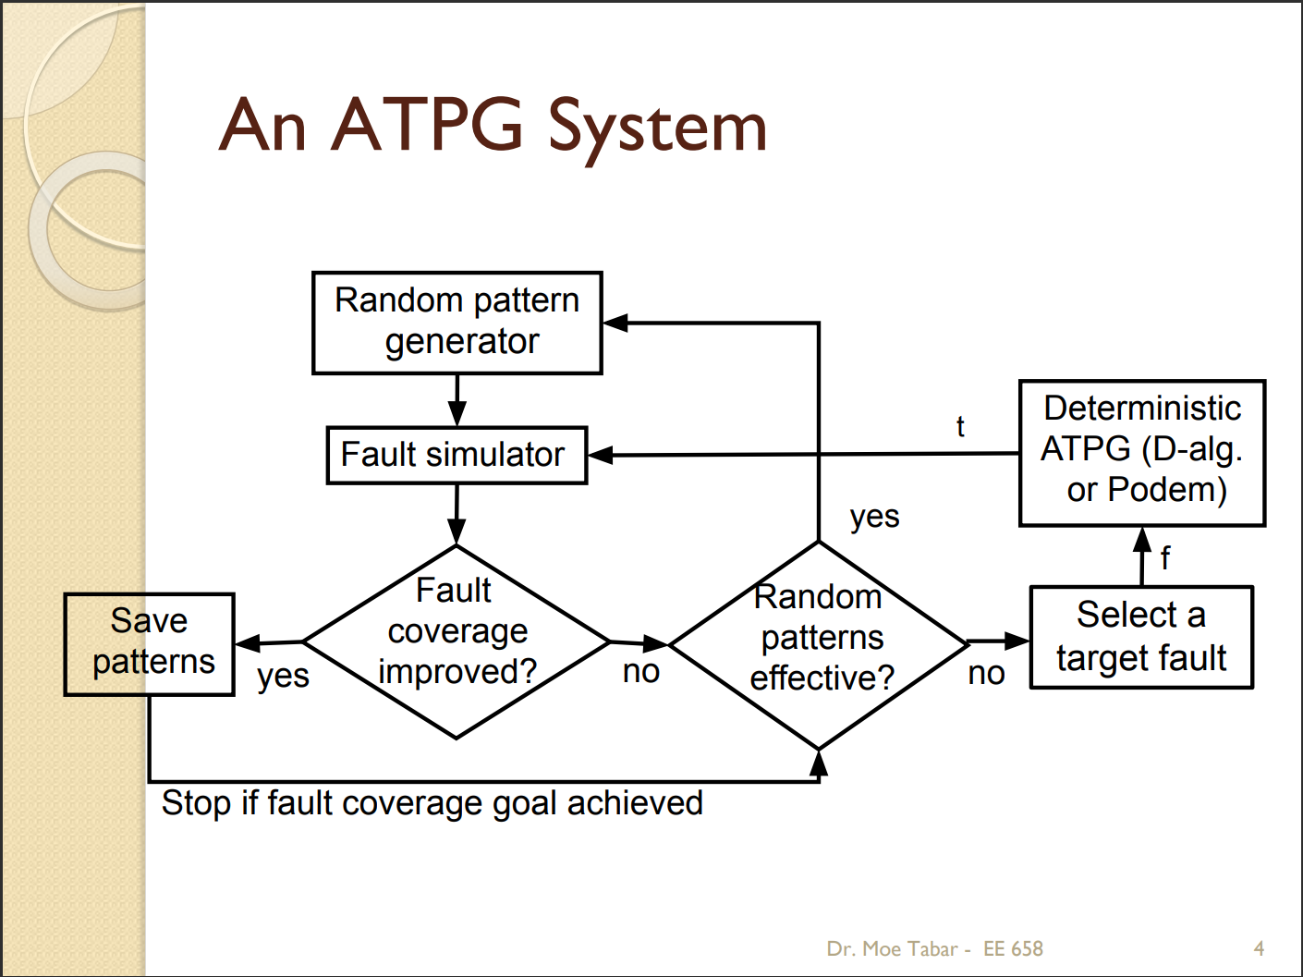
ATPG

Slide 12
Gap point
Fault coverage
<2
<2
<2
PS: Frequency depends on the number of nodes in the circuit
Number of frequency

