Slide 1
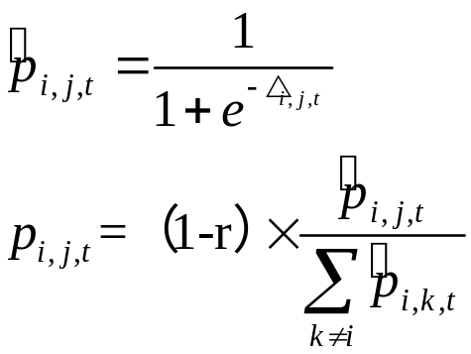
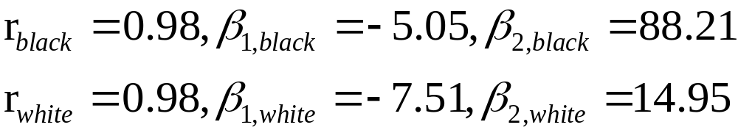
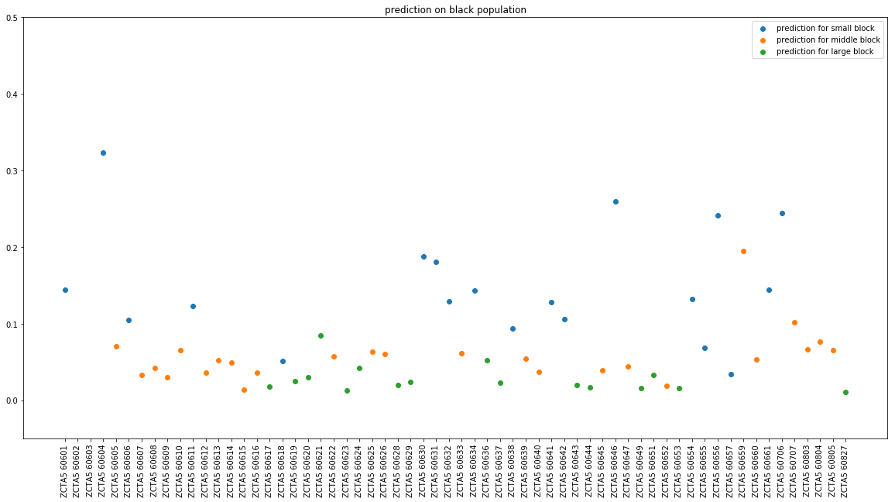
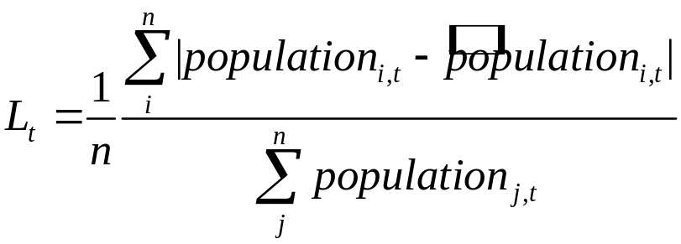
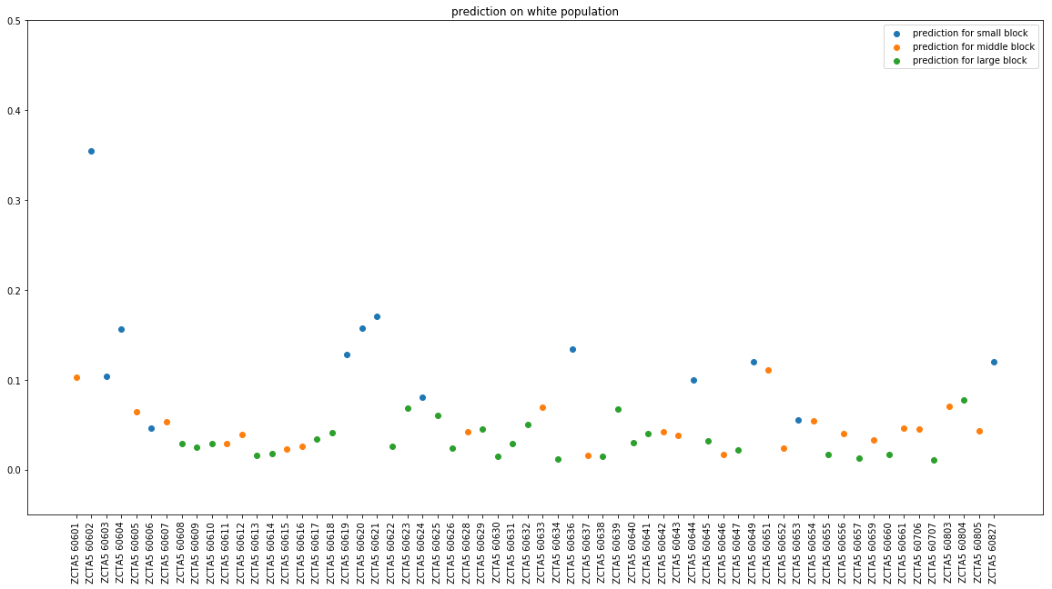
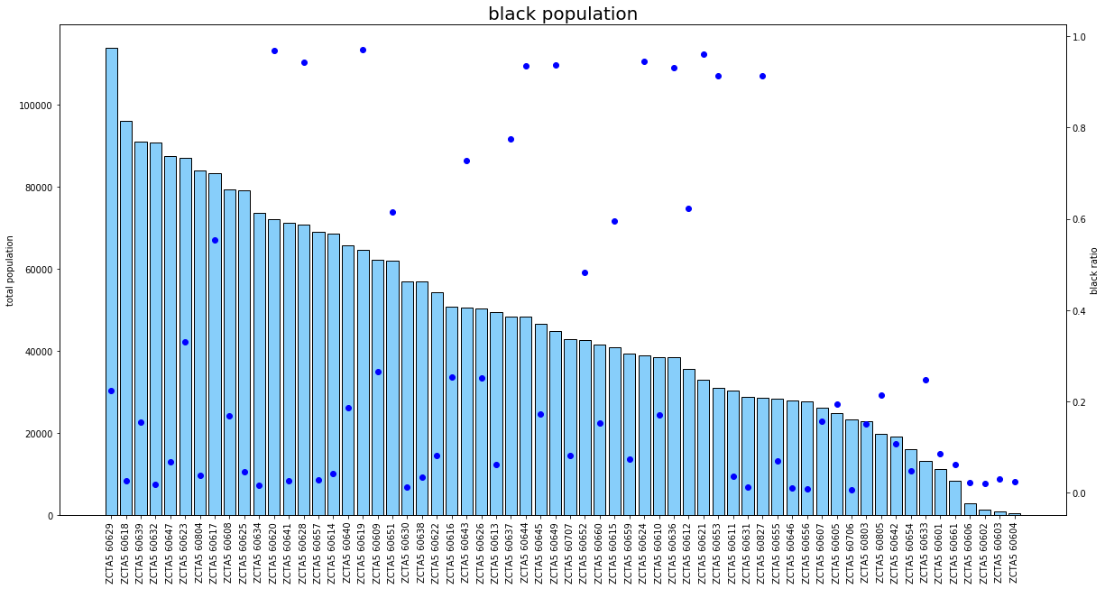
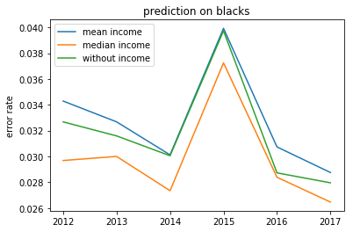
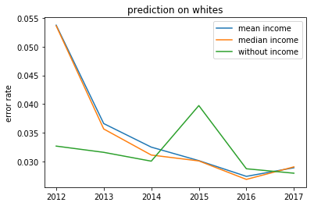
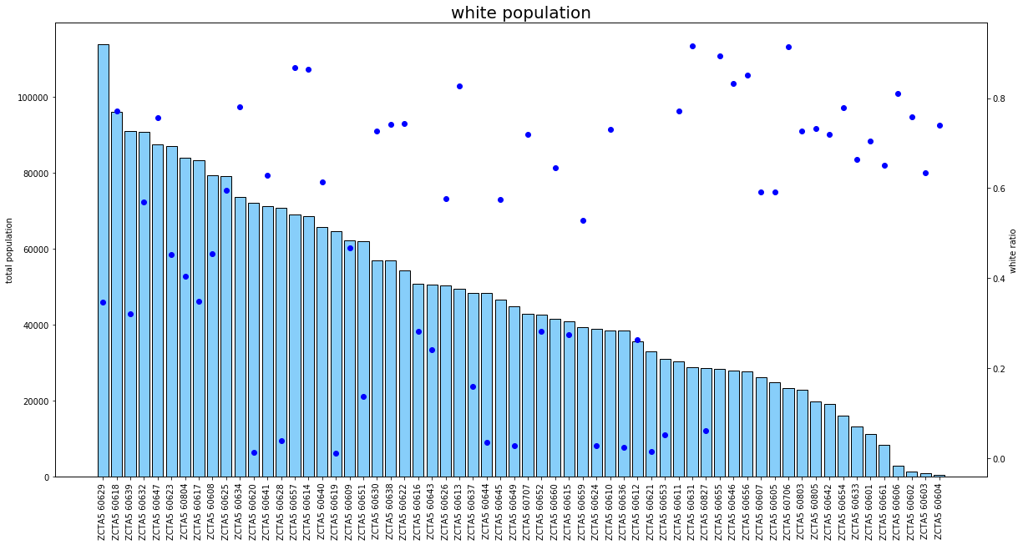
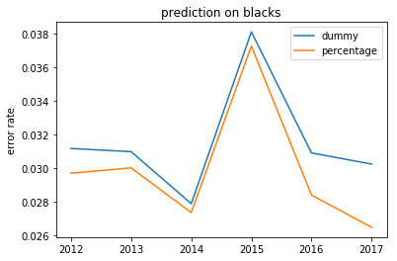
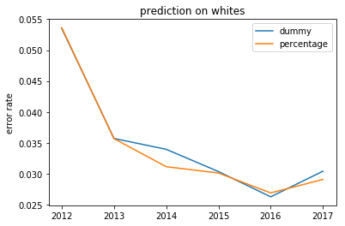
Self Segregation caused by homophily preference research question: What’s the effect of people’s homophily preference on population migration within a city?
Zeyu Xu
University of Chicago
Introduction
Methods
Results
Conclusions
Segregation is a common problem in many cities in United States. Although racial equality has become social consensus and is protected by the law, the segregated community pattern still widely exists in cities. It seems that people segregate themselves by choosing residence.
Theoretical model of segregation
Schelling (1971)- Individual residual preference correlated to rate of race in the community will lead to macro segregated community pattern. Using graphs to test the equilibrium under different tolerance of different race and different initial population composition, Schelling found that the mixed equilibrium only exists under extreme tolerance and limited range of ratio of different races, which means even slightly preference for neighbors of the same race can lead to stable segregation.
Young (1998)-First time applied the theory of stochastic dynamical systems to Schelling‘s segregation model. His major contribution is to make the conclusion that segregated patterns are “stochastically stable”, providing support to Schelling's conclusion based on mathematical theories.
Zhang (2004)-Extended the model to a two-dimensional one and incorporated an endogenous housing price. He proved that preference for similar neighbors quickly lead to clusters of same race and highly segregated residual pattern with both theoretical deduction and computer simulation.
Card, Mas & Rothstein (2008)- Built tipping model and solve it for the tipping point. They found that neighborhoods consist of various races can be stable, since the estimated tipping points, i.e., break point of minority share when whites start to flow out, range from 5% to more than 20%.
Zhang(2011)- Assumed all agents have integration preference and solve the model, proved that people can get stuck with segregation even they are all integrationists as long as they prefer extreme high percentage of same race to extreme low percentage of same race.
Paolillo and Lorenz (2018)- extended the model to the case that agents with two overlapping characters, race and values. Agents are divided into ethnicity-oriented that are tolerant to values but intolerant to different ethnicity, and value-oriented that are tolerant to different ethnicity but intolerant to intolerance (i.e. ethnicity-oriented agents). The result of the paper suggested that the best way to reduce segregation is not to reject those with homophily preference on ethnicity, but to be more tolerant to them.
Innovation of this paper
Simulate with a more abstract model that simulates and makes prediction with numerical vectors of states rather than checkerboard model
Build an explicit rule to compare model predictions with real-world data and judge the quality of models with different parameters
Probability Calculation
Basic model
Parameters:
Blacks have higher coefficient for homophily, which suggests that blacks may be more fond of a segregated community pattern than whites.
Whites and blacks show different attitudes to income of a block. While whites are not sensitive about income of the block, blacks show great concern for both general income level and income structure of the block.
Population Prediction
Loss Function
Intuition
The basic idea of this model is people judge a block by the income level and the percentage of those of the same race. The better the target block, the more likely that people decide to move there.
Notes
I set a parameter r to represent the percentage of people that decide not to move and scale the raw probability to ensure the percentages of people move from each block sum to 1, since we only care about the relative percentage of people that move to each block.
The target of my model is to predict the migration within the city as accurately as possible. Since I don't have the data of migration, the loss function should be based on the transition of population in each block to judge the quality of my model. If the population in the block is large enough, the transition matrix can make accurate prediction. If the population in the block is small, the actual moving population may differ to the prediction greatly since random factors affecting people's migration have significant impact on blocks of small population. I use the weighted prediction error rate rather than average prediction error rate as the judgment criterion to avoid the noise of those blocks of small population.
Bibliography
Data Description
Discussion on Income
Thomas C. Schelling. Dynamic models of segregation. Journal of Mathematical Sociology, 1(2):143 - 186, 1971.
H. Peyton Young. Individual strategy and social structure : an evolutionary theory of institutions. Princeton Univ. Press, 1998.
Zhang Junfu. A dynamic model of residential segregation. The Journal of Mathematical Sociology, 28(3):147, 2004.
Card David, Mas Alexandre, and Rothstein Jesse. Tipping and the dynamics of segregation. The Quarterly Journal of Economics, 123(1):177, 2008.
Zhang Junfu. Tipping and residential segregation: A unified schelling model. Journal of Regional Science, 51(1):167 - 193, 2011.
Rocco Paolillo & Jan Lorenz. How different homophily preferences mitigate and spur ethnic and value segregation: Schelling's model extended. working paper, 2018.
Discussion on Homophily

