Slide 1

Self Segregation caused by homophily preference
Research question: how large is the effect of people’s homophily preference on population migration within a city
Zeyu Xu

Slide 2
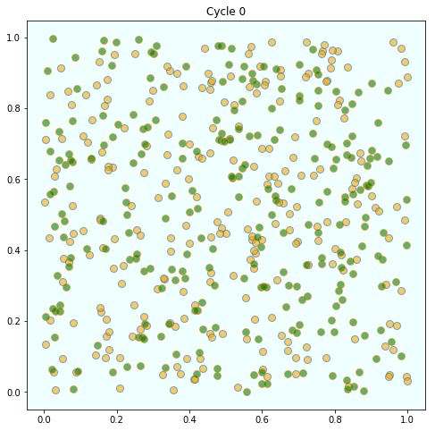
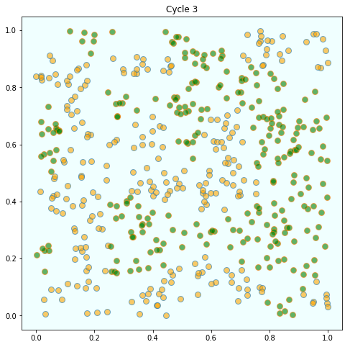
Motivation
Schelling’s Segregation Model: People like to have similar neighbors
cited from https://lectures.quantecon.org/py/schelling.html

Slide 3


Theories of population migration
There are many factors affecting people’s decision on moving, they have different effect at different levels, here’s some important ones.
Income
Climate
Public goods
Homophily
preference
Almost a self-evident truth
Graves(1976)
Environmental considerations are important in migration decision
Tiebout(1956)
Vote with their feet
Schelling (1969)
Micro homophily preference leads to macro segregation

Slide 4
Model
A block-level study: focus on the effect of income and homophily preference, ignore effects of all other variables.
A Markov chain: calculate the probability of moving from one region to another based on the state at that period (income & population composition).

Slide 5
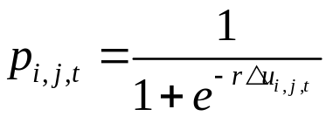
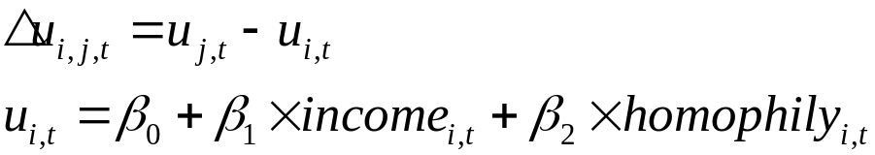




Model
Probability calculation:
Variable interpretation:
: The utility of living in block i at period t
: The average annual income of people living in block i at period t
: The similarity of people in block i to the agent at period t
: The probability that the agent moves from block i to block j at period t

Slide 6
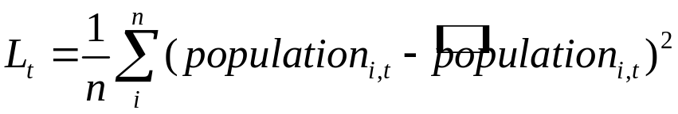






Model
Population mobility pattern:
Loss Function:
Variable interpretation:
: The population (of specific ethnic group) of block i at period t
: The predicted population (of specific ethnic group) of block i at period t
: The number of blocks in Chicago
: The sum of squared error of prediction on population at period t

Slide 7
Database
Source: United States Census Bureau https://www.census.gov/
Population: American Community Survey (5-year survey for year 2011-2013, 5-year estimates for year 2014-2017)
Average annual income: American Community Survey (5-year survey for year 2011-2013, 5-year estimates for year 2014-2017)
The data of year X comes from the survey or estimate from X-4 to X, for example, data of 2011 comes from 2007-2011 American Community Survey

Slide 8


My research plan
01
Finish paper
02
05
Collect and organize data
Solve the model with programming
Use API offered by www.census.gov to collect data and clean up data if necessary
Write code for the model and use data to estimate best parameters by minimizing the sum of loss function every period
03
Draw a map
Calculate the number of people from one block to another and use arrows with numbers to depict the direction of population migration pattern. Make some prediction if possible.
04
Prepare for extension to my thesis
Try to extend the research to a higher level, add more variables, and use different utility function (nonlinear)

Slide 9
Limitation Extension
Focus only on block-level to make model simple, unable to compare the effect with other factors like climate, public goods and so on.
About half data comes from the result of survey while the other half comes from estimates based on survey.
Ignore people moving in and out the city to simplify the question.
1
Use data of higher level to see if the effect becomes weaker
Add more variables to get more accurate estimation
2
Try to find more consistent data
3
Try to internalize income, so that we can simulate the migration with initial state
4

Slide 10
Limitation Extension
Focus only on block-level to make model simple, unable to compare the effect with other factors like climate, public goods and so on.
About half data comes from the result of survey while the other half comes from estimates based on survey.
Ignore people moving in and out the city to simplify the question.
1
Use data of higher level to see if the effect becomes weaker
Add more variables to get more accurate estimation
2
Try to find more consistent data
3
Try to internalize income, so that we can simulate the migration with initial state
4

