Slide 1
Ser-FOX Attention Mask Equivalence
Code-level comparison: original recompute vs current recompute vs KV-cache
same PI semantics
same attention mask
cache removes prefix recompute
One-line message
Current KV-cache is an incremental implementation of the same PI scorer; speedup comes from caching the growing serialized prefix.
Sources: Ser-FOX/serfox_model.py, Ser-FOX/serfox_train.py | local sanity benchmark, 2026-07-07

Slide 2
Main Claim
Separate semantics from implementation cost.
Semantics
Implementation
Measured
- Old recompute and current recompute are equal.
- Current cache path matches recompute up to floating point roundoff.
- Candidate index isolation is unchanged.
- Old path re-encodes prefix every step.
- Cache path builds prefix K/V once.
- After selection, append only [index, value].
max diff
0
cache diff
4.77e-07
CPU speedup
1.25x

Slide 3
What PI Does Each Step
PI still scores all candidate positions in parallel.
prefix_t [quiz][I,y]...
append candidates [I0 I1 ... IR-1]
score all positions
commit [I_k,y_k]
Invariant: candidate index tokens share the same logical frontier and cannot attend to each other.
prefix_{t+1} = prefix_t + [selected_index, selected_value]

Slide 4
Original Recompute Path
Correct but repeats the accumulated prefix work every step.
for step in range(R): idx_app = concat(prefix_t, all_index_tokens) logits = score_parallel_indices(idx_app, R) commit one [index, value] prefix_t = concat(prefix_t, [index, value])
Cost shape
- Full prefix is re-encoded each step.
- Candidate block is encoded each step.
- Prefix length grows by 2 tokens per step.
Code reference: Ser-FOX/serfox_model.py:728 score_parallel_indices

Slide 5
Current KV-cache Path
Same scorer, incremental prefix implementation.
cache = build_prefix_kv_cache(prefix_0) for step in range(R): logits = score_parallel_indices_cached(all_index_tokens, cache) commit one [index, value] cache = append_to_kv_cache(cache, [index, value])
What changed
- Prefix K/V is built once.
- Candidate block reads cached prefix K/V.
- Only committed [index, value] is appended.
Code references: build_prefix_kv_cache:613, append_to_kv_cache:638, score_parallel_indices_cached:814

Slide 6
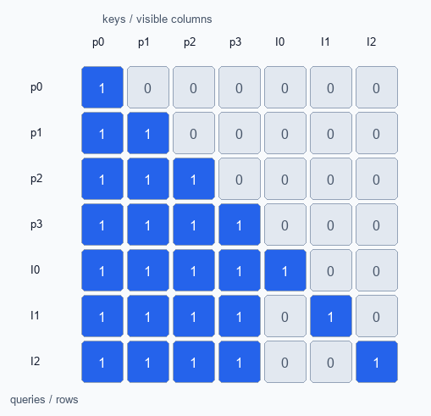
Same Visibility Mask
Prefix causal; candidates see prefix and self only.
Mask rule
- prefix -> prefix: lower triangular causal
- candidate i -> prefix: visible
- candidate i -> candidate i: visible
- candidate i -> candidate j: hidden when i != j
visible = torch.eye(T) # cached PI scoring
Source: build_ste_visible_mask:26 and forward_new_tokens_with_kv:199

Slide 7
Equivalence Calculation
Cached attention computes the same row expression.
Recompute
KV-cache
score(prefix_t + candidates) K,V contain prefix and candidate block
score(candidates, cache(prefix_t)) K_p,V_p come from cache
candidate row attends to: [Q_c K_p^T, Q_c K_c^T masked-to-self]
same logits are concatenated before softmax: [Q_c K_p^T, Q_c K_c^T masked-to-self]
Therefore: score_parallel_indices(prefix+candidates) == score_parallel_indices_cached(candidates, cache(prefix))

Slide 8
Where the Speedup Comes From
PI is unchanged; accumulated prefix work is removed.
Old
Current
recompute prefix_t + all candidates
build prefix K/V once
commit [index, value]
score candidates against cache
repeat with longer prefix
append only [index, value]
Correct wording: KV-cache speeds up accumulation by avoiding repeated prefix encoding; PI candidate scoring remains parallel and semantically identical.

Slide 9
Simple Numerical Validation
Same weights, same inputs, same deterministic trajectory.
Setup
Old vs current recompute
Current recompute vs cache
- CPU only
- B=16
- 3 layers, 4 heads
- embd=128
- quiz=16, response=36
max_abs_diff
max_abs_diff
0
4.77e-07
finite masks equal
finite masks equal
True
True
Interpretation: cache path is numerically equivalent within normal floating point roundoff.

Slide 10
Simple Speed Comparison
CPU toy benchmark; directional, not a formal GPU result.
Result: current recompute ~= old recompute; KV-cache is ~1.25x faster in this local CPU sanity benchmark.
1166.1 ms
1168.0 ms
937.7 ms
old recompute
current recompute
current KV-cache
Takeaway: the speedup is prefix-cache reuse, not a PI semantics change.

Slide 11
What Changed vs What Did Not
Use this split when explaining the code review.
Changed
Did not change
- Added prefix K/V cache construction.
- Added incremental cache append.
- Added cached PI scorer.
- Generation and regeneration can select cache path.
- Single-index visibility rule.
- Candidate index isolation.
- PI position-choice semantics.
- Candidate value logits surface.
Caveats: RoPE and grouped-index scoring are new optional paths; decode-time logit masks are separate from attention masks.

Slide 12
Suggested Explanation
A compact script for alignment discussion.
Our current code is an incremental implementation of the same PI scorer. The original code recomputed the entire serialized prefix plus all candidate index tokens at every step. The new code caches the prefix K/V once, scores the same candidate index block against that cache using the same index-isolating visibility mask, and after selecting one position appends only the committed [index, value] pair. Therefore the mathematical scorer is the same; the speedup comes from eliminating repeated prefix computation.
Bottom line: same PI, same mask, incremental prefix cache.

