Slide 1
HW4
2020 Introduction to Computer Graphics

Slide 2
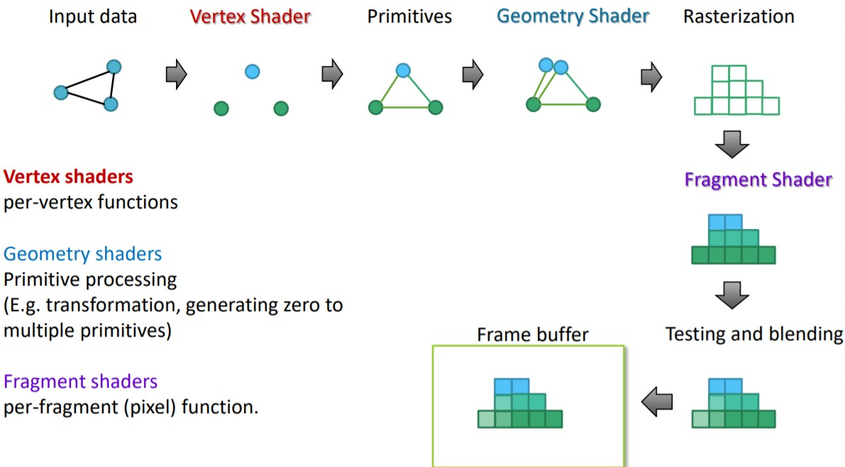
Geometry Shader

Slide 3
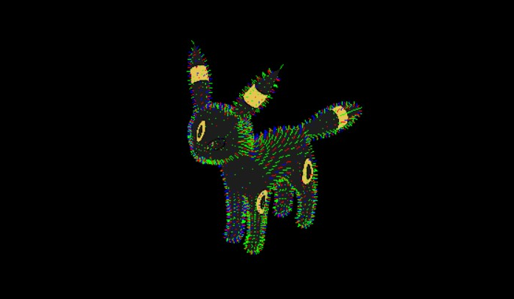
Geometry Shader
Sample code demo (Normal Visualizer)

Slide 4
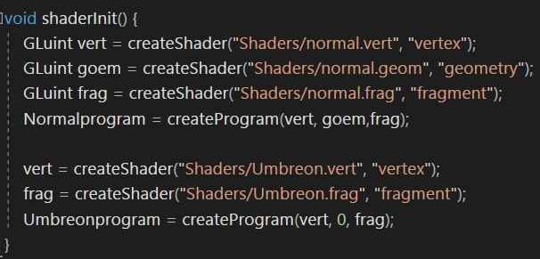
Geometry Shader
GLuint createProgram(GLuint vert, GLuint geom, GLuint frag); If you don’t need the geometry shader, you can put “0” at geom
Code in “main.cpp”

Slide 5
Geometry Shader- declare the type of primitive input
Declare the type of primitive input we're receiving from the vertex shader.
Method：Declaring a layout specifier in front of the ”in” keyword.
layout(primitive values) in;
primitive values | Rendering primitives(glDrawArrays) | Points per primitive
points | GL_POINTS | 1
lines | GL_LINES or GL_LINE_STRIP | 2
lines_adjacency | GL_LINES_ADJACENCY or GL_LINE_STRIP_ADJACENCY | 4
Triangles | GL_TRIANGLES, GL_TRIANGLE_STRIP or GL_TRIANGLE_FAN | 3
triangles_adjacency | GL_TRIANGLES_ADJACENCY or GL_TRIANGLE_STRIP_ADJACENCY | 6

Slide 6
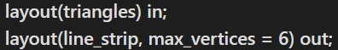
Geometry Shader- declare the type of primitive output
We also need to specify a primitive type that the geometry shader will output.
Method：Declaring a layout specifier in front of the ”out” keyword.
layout(primitive values, max_vertices) out;
primitive values：points, line_strip, triangle_strip
max_vertices：If you exceed this number, OpenGL won't draw
the extra vertices.
Code in “normal.geom”

Slide 7
Geometry Shader- update attributes to geometry shader
We can update some attributes(color, normal) from vertex shader to the geometry shader.
Method： Using an interface block.
Code in vertex shader | Code in geometry shader
out VS_OUT { vec3 normal; //other attributes } vs_out; | in VS_OUT { vec3 normal; //other attributes } gs_in[];
vs_out.normal | gs_in[index].normal (index：index for input vertices)

Slide 8
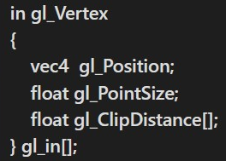
Geometry Shader- gl_in variable
GLSL gives us a built-in variable called gl_in that internally (probably) looks something like this:
Code in “normal.geom”

Slide 9
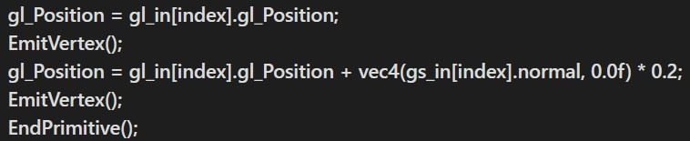
Geometry Shader- EmitVertex /EndPrimitive function
Each time we call EmitVertex(), the vector currently set to gl_Position is added to the output primitive.
Whenever EndPrimitive() is called, all emitted vertices for this primitive are combined into the specified output render primitive.
Code in “normal.geom”
Reference： https://learnopengl.com/Advanced-OpenGL/Geometry-Shader

Slide 10
Load Model
In obj file：(about face information) f vertex position/texture coordinate/normal f 1/1/1 473/2/2 1370/3/3 (3 vertice/primitive) f 1/1/1 473/2/2 1370/3/3 479/4/4 (4 vertice/primitive) f 1//1 473//2 1370//3 (no texture coordinate)
In Object.cpp file, the format of the face information must be f 1/2/3 or f 1//3. (f 1/3 cannot be read.) You can modify Object.cpp or write another code for read obj file.
In geometry shader, you cannot render the object with glDrawArrays(GL_QUADS). You can put the quad into two triangles with another code by yourself.

Slide 11
HW4 - Animation with Three Types of Shaders

Slide 12
Homework 4- Goal
Make a 20 ̴45 seconds video. First 10 ̴30 seconds for playing the video. Last 10 ̴15 seconds for introducing the features of the video and technique you have used.
Theme : Animation with Three Types of Shaders
Must include： (1) At least an object (2) Geometry shader
* You can refer to the examples on the Internet, but you must mention it in the introduction part of the video and cite the original source.

Slide 13
Homework 4- Recording tools
Screen recording : OBS : https://obsproject.com/
Introduce your video : (1) PowerPoint (2) Other video editing tools

Slide 14
Homework 4- Something you can do with Geometry shader
Explosion
Shrinking triangles
Silhouettes
Other creative ideas…

Slide 15
Homework 4- Score
Creativity/ Richness/technical difficulty (40%)
Your code is executable (30%)
Votes from classmates (30%) (We will provide a Google sheet and let you choose 5 best videos )
*Requirements for geometry shader： (1)You should do a different effect from the example code we provided, or your score will be zero. (2) Developing a simple function with Geometry shader can meet the basic requirement.

Slide 16
Homework 4- Upload Format and Rules
Upload your video to Youtube (must be anonymous).
Please hand in your video link and the whole project file as STUDENTID_Name.zip ​ to e3 platform. *If your uploading format doesn’t match our requirement, there will be penalty to your score. (-5%)
DeadLine: 2021/ 1 / 15 23: 59:59
If you submit your homework late, the score will be 0.
Use geometry shader to do this homework, otherwise you’ll get zero points.

