Slide 1
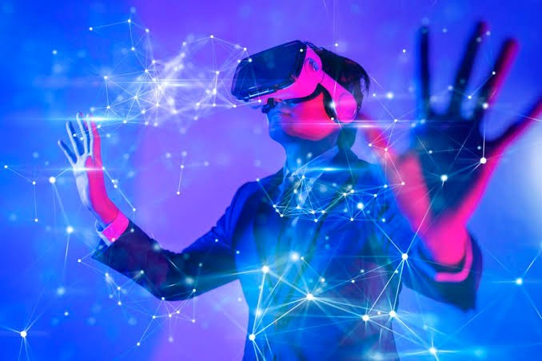
Name : Zia Ur Rehman
Roll No: PIAIC125141
City: Islamabad (Morning)
Batch: 40

Slide 2
What is Metaverse
In the metaverse, users traverse a virtual world that mimics aspects of the physical world using such technologies such as virtual reality (VR), augmented reality (AR), AI, social media and digital currency. The internet is something that people "browse." But, to a degree, people can "live" in the metaverse.

Slide 3
Who uses metaverse?
Many workers traded in-person meetings for Zoom meetings during the COVID-19 pandemic. Tech companies that are focused on metaverse development, such as Meta (formerly known as Facebook) and Microsoft, are using that comfort as a stepping stone to the next version of "virtual meetings."

Slide 4
What are the disadvantages of metaverse?
7 Important Problems & Disadvantages Of The Metaverse
Privacy Issues
Protecting Our Kids
Health Concerns
Access Inequality
Metaverse Laws
Desensitization
Identity Hacking
https://bernardmarr.com/7-important-problems-disadvantages-of-the-metaverse/

Slide 5
The metaverse for business and IT
Immersive entertainment
Business operations
Improved education and training
Enhanced customer experiences
Work meetings
Advertising, branding and marketing pportunities
Digital locations
New revenue streams
A more connected work experience

