Slide 1
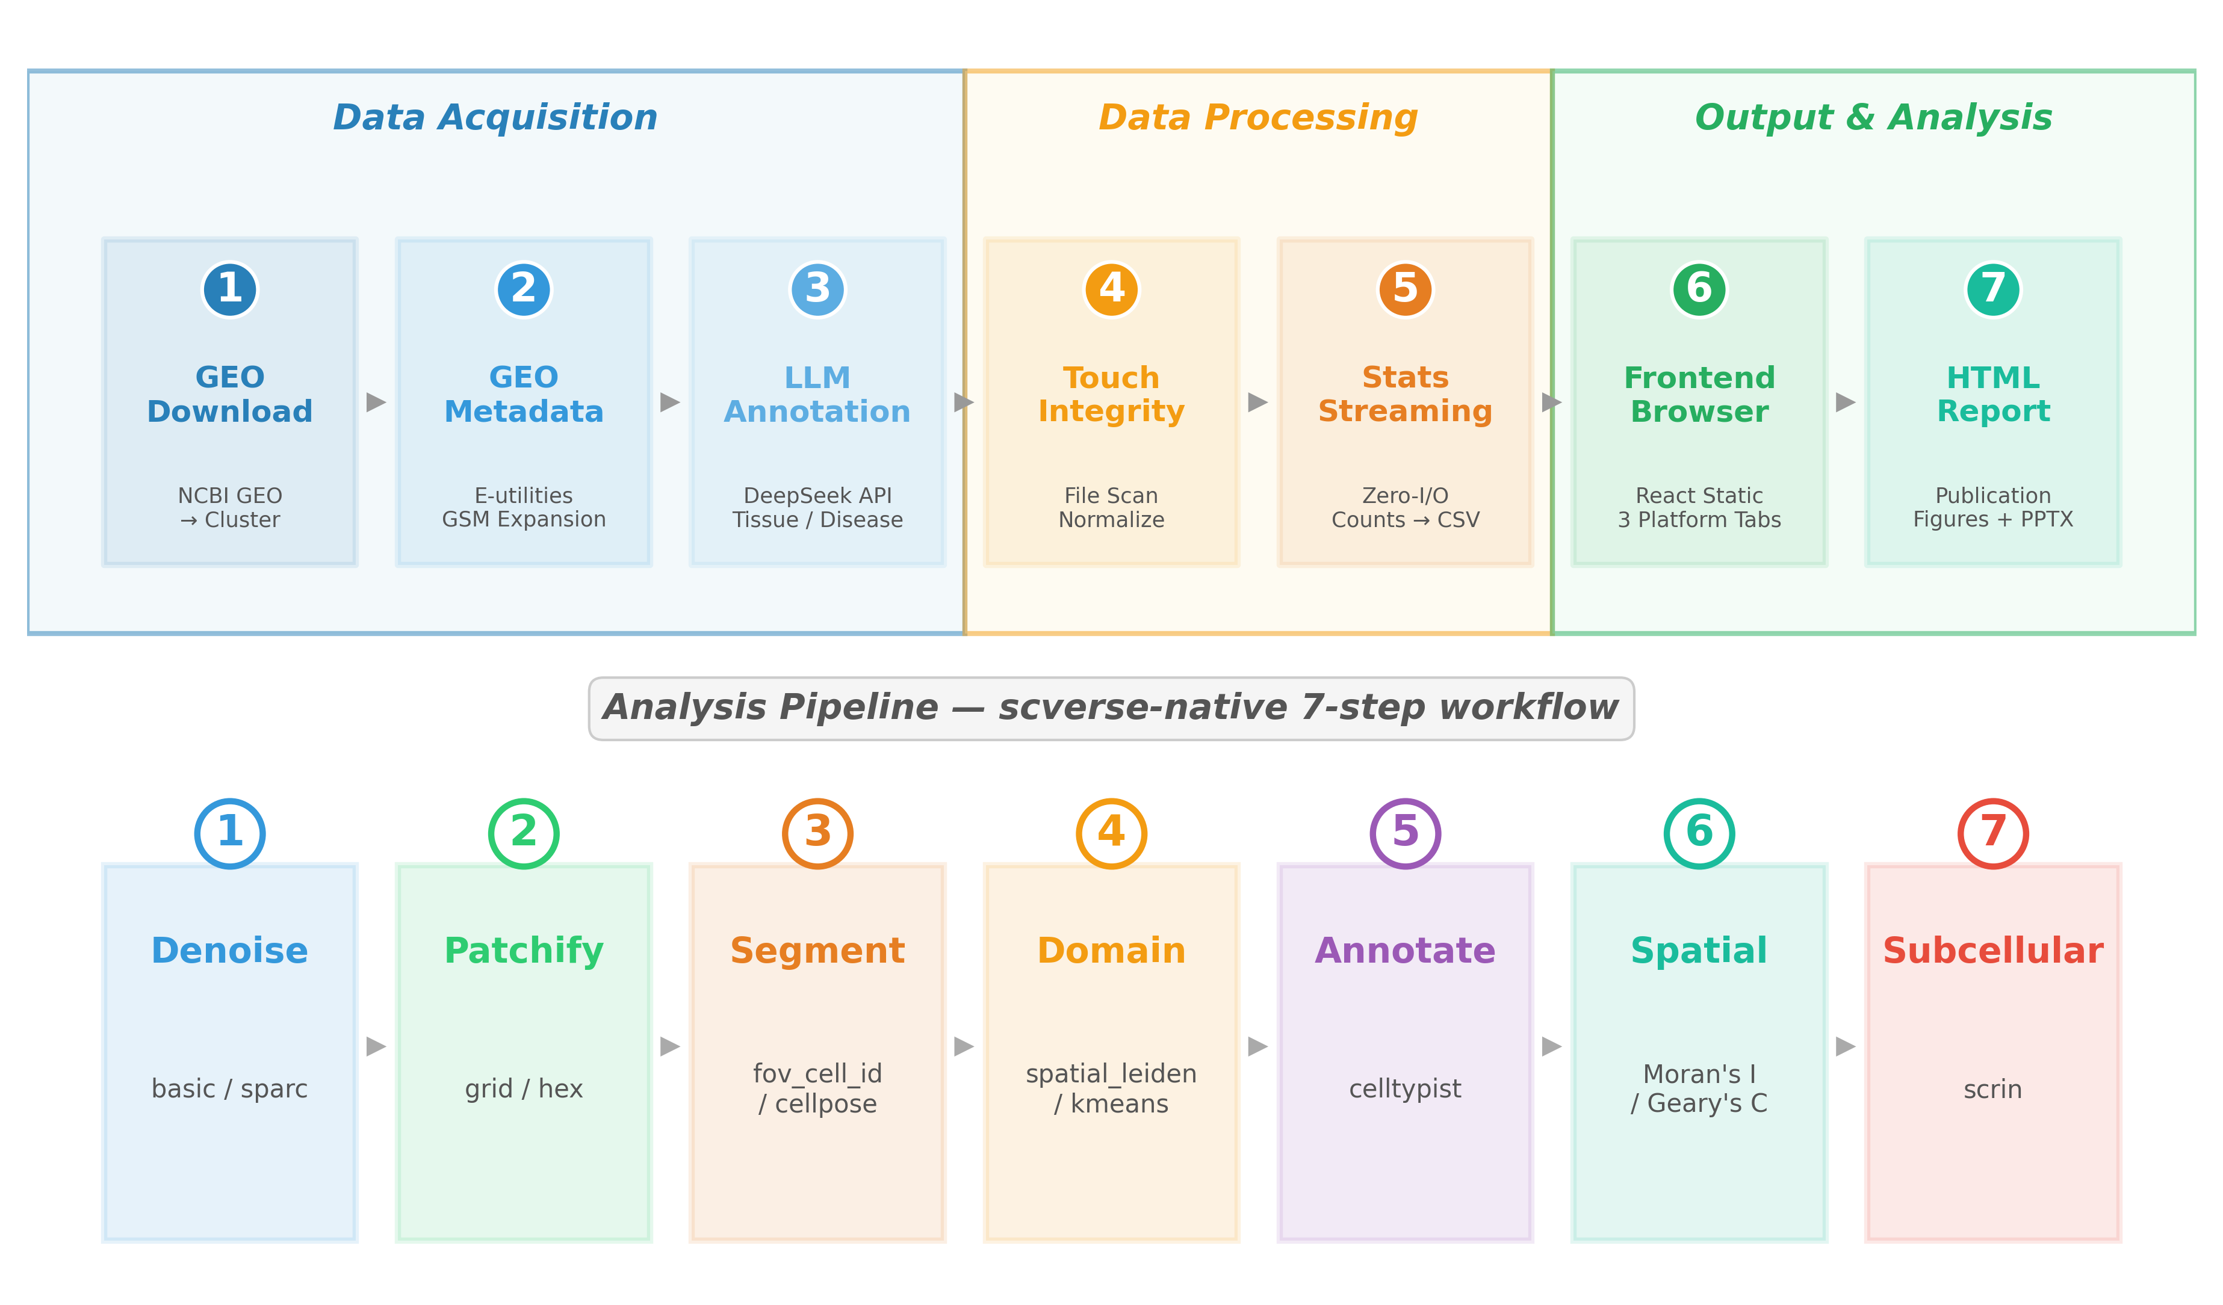
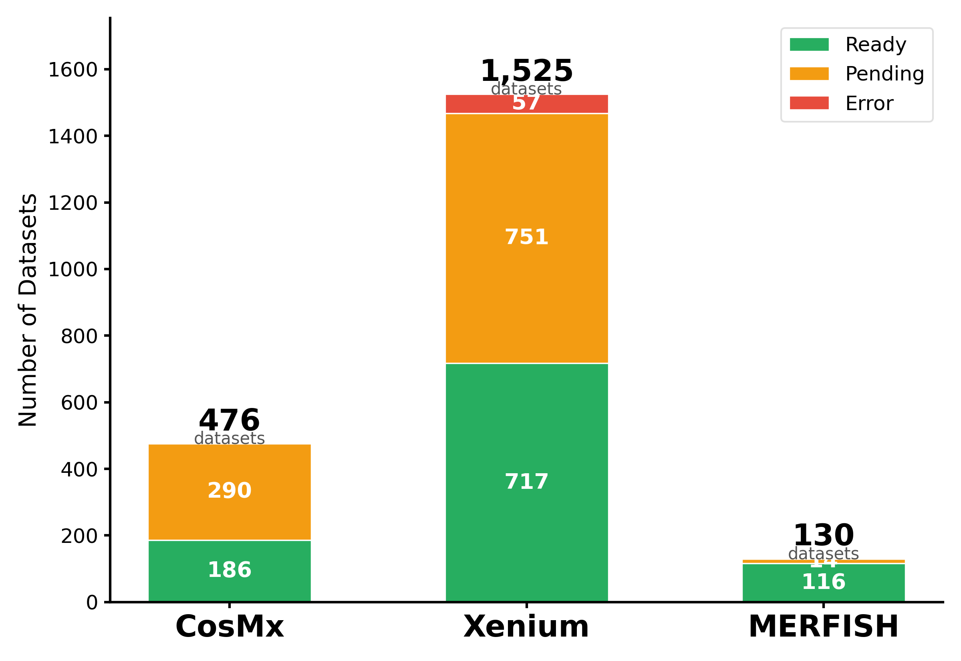
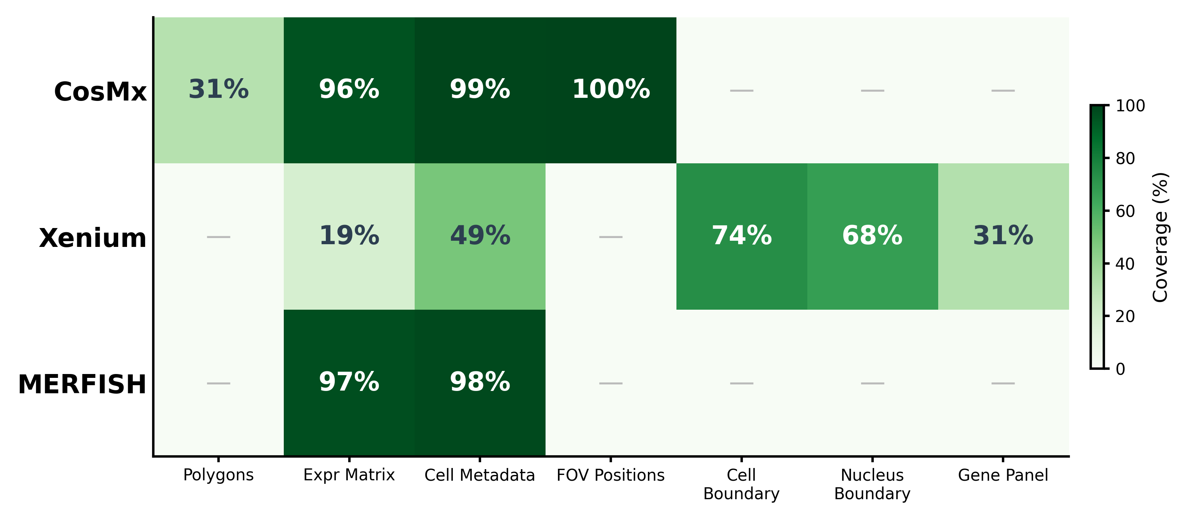
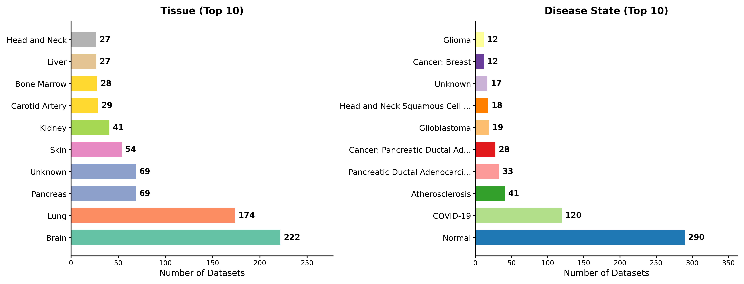
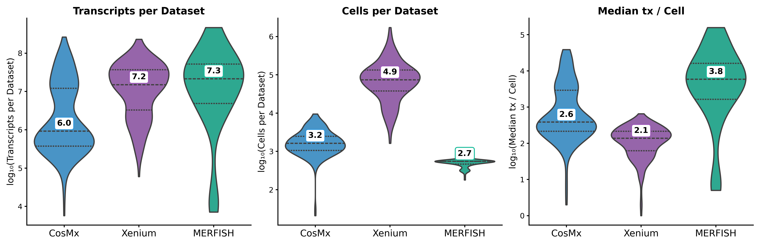
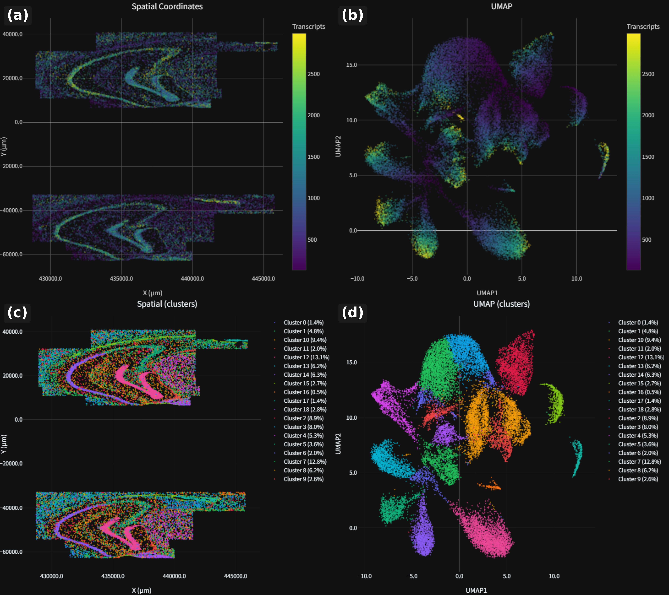
SubCellSpace: A Subcellular Spatial Transcriptomics Database & Analysis Platform
Zhefu Li · Supervisor: Xuerui Yang · Tsinghua University · Jun 2026 · https://github.com/zf-li23/SubCellSpace
1 Platform Construction & Analysis Pipeline
SubCellSpace is a unified subcellular spatial transcriptomics (SPT) platform that supports CosMx (NanoString), Xenium (10x Genomics), and MERFISH (Vizgen) with a single end-to-end pipeline. The platform integrates three major phases:
1. Data Acquisition — GEO metadata curation via NCBI E-utilities (269 GSE series, 4,478 GSM records), LLM-powered tissue/disease annotation (DeepSeek), and automated file integrity checking through the Touch module.
2. Data Processing — Zero-I/O streaming statistics (Stats module) for transcript, cell, and gene counting, followed by the core 6-step scverse-native analysis pipeline: Denoising (basic/SPARC) -> Patchify (grid/hex) -> Segmentation (fov_cell_id/cellpose) -> Domain Detection (spatial_leiden/k-means) -> Clustering (Leiden/Louvain) -> Annotation (celltypist + SCRIN subcellular scoring).
3. Output & Visualization — React + TypeScript static frontend with platform-tabbed browsing, HTML report generation with publication-quality figures, and Slurm HPC deployment for batch processing.
All three platforms share a single pipeline configuration (config/pipeline.yaml), enabling cross-platform comparative analyses at the subcellular level.
Fig 1. End-to-end platform construction pipeline (top) and scverse-native 6-step analysis workflow (bottom)
2 Database Overview: Composition, Coverage, Biology & Quality
Our database encompasses 2,410+ GEO entries across three major SPT platforms. Xenium leads with 1,525 entries (717 ready). CosMx contributes 476 entries (186 ready) from targeted panels. MERFISH has 130 entries (116 ready), with the highest ready ratio.
File completeness varies: CosMx provides expression matrices (96%), cell metadata (99%), and FOV positions (100%). Xenium uniquely offers cell boundaries (74%), nucleus boundaries (60%), and gene panel metadata (31%). MERFISH excels in expression (97%) and cell metadata (98%). The Touch module auto-normalizes all.
Fig 2. Dataset counts
Fig 3. File coverage
The database spans 50+ tissue types and 30+ disease conditions,
providing broad biological coverage. Brain, breast, lung, and lymph
node are most represented, along with normal tissue, various cancers,
and neurodegenerative conditions (Alzheimer's, Parkinson's).
Quality metrics: Xenium achieves the highest transcript counts (181K
median) and broadest gene panels (6,522). MERFISH captures the most
cells (18K median, 550K max). CosMx offers consistent 960-gene panels
with the highest per-cell transcript counts (35,825 median).
3 Case Study: Alzheimer's Mouse Brain
Fig 4. Tissues & diseases
Fig 5. Quality metrics
4 Conclusion & Outlook
Key Achievements
• Unified platform for CosMx, Xenium,
and MERFISH spatial transcriptomics
• 2,410+ GEO datasets curated & processed
(269 GSEs, 4,478 GSM records)
• 50+ tissue types, 30+ disease states
• Single config drives all 3 platforms
• Touch + Stats: data integrity assurance
• React static browser, no backend needed
Future Directions
• Process 3,000+ pending GEO datasets
• Multi-sample integrative analysis
• Spatial multi-omics data support
• Cloud-deployed pipeline (Docker/Singularity)
• Community dataset registry with DOI
Fig 6. GSE263791 — 5xFAD mouse hippocampus
5xFAD Alzheimer's model (821 cells, 41 FOVs, 960 genes). (a) Spatial transcript counts: hippocampal regional differences. (b) UMAP by transcript count. (c) Leiden: 8 cell populations. (d) UMAP cluster validation. Microglia-astrocyte cross-talk in amyloid plaque niches revealed by spatial context.
Data: GEO (NCBI) · Code: github.com/zf-li23/SubCellSpace (MIT) · Tools: scanpy, squidpy, spatialdata, SCRIN, CellTypist · Poster: Tsinghua University SLS Undergraduate Research

