Slide 1
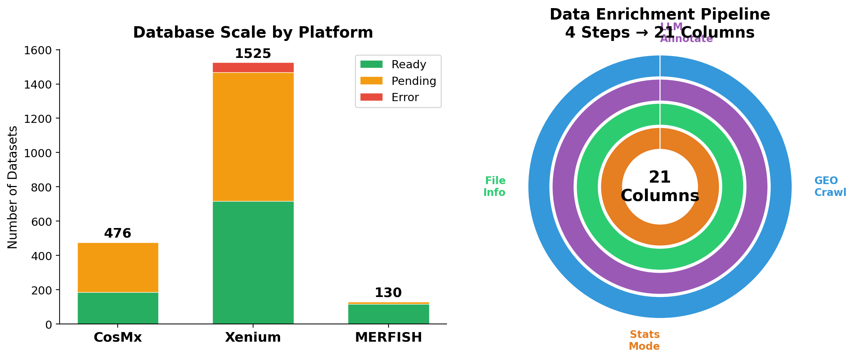
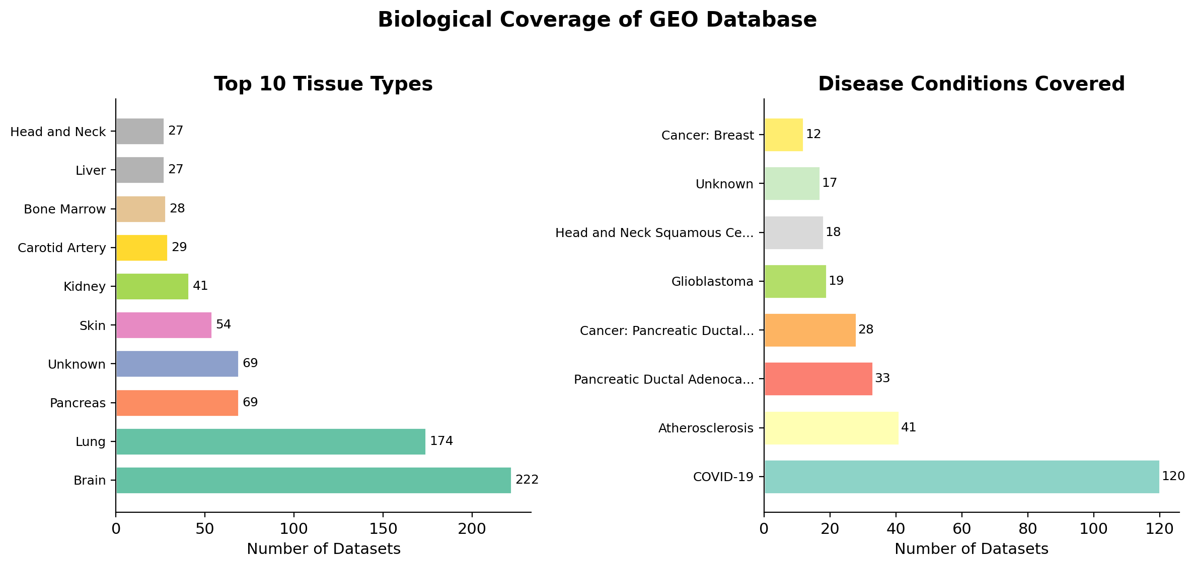
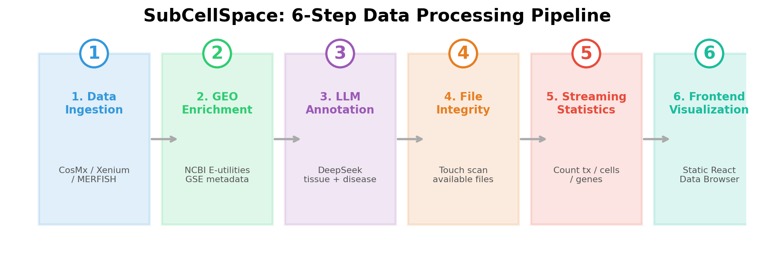
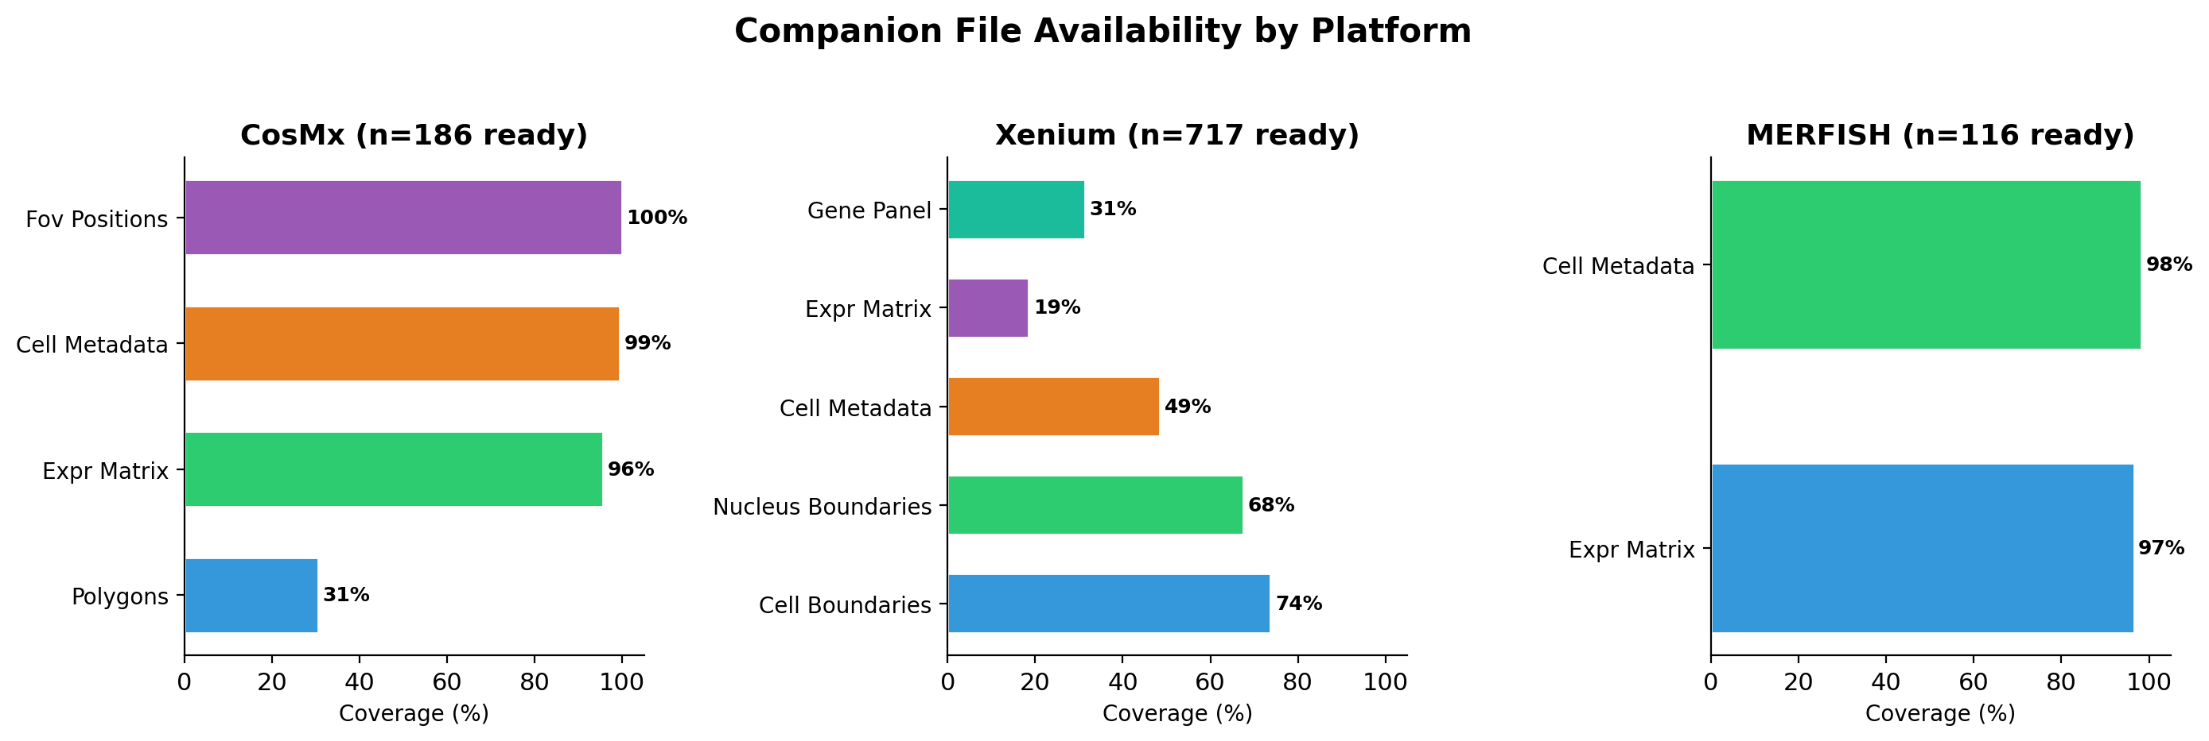
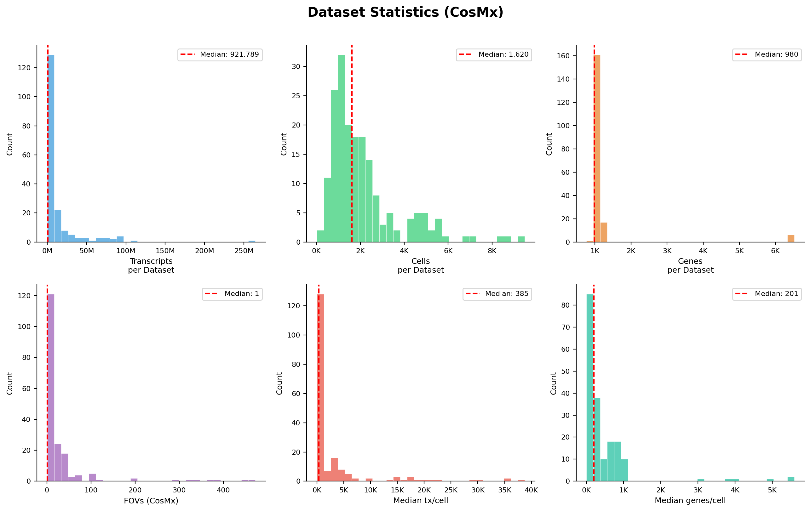
SubCellSpace: A Unified Database for
Subcellular Spatial Transcriptomics
F. Li · School of Life Sciences, Tsinghua University · 2026
Background
Database Scale & Data Enrichment
Biological Coverage
Spatial transcriptomics enables gene expression profiling within
native tissue context. SubCellSpace builds a comprehensive,
scverse-native database from three major platforms:
• NanoString CosMx — High-plex in situ RNA detection
• 10x Genomics Xenium — Subcellular + multimodal imaging
• Vizgen MERFISH — Multiplexed FISH, ultra-high plexity
All data processed through a unified 6-step pipeline with
21 standardized metadata columns per entry.
Data Processing Pipeline
Companion File Availability
Dataset Statistics (CosMx)
Database Summary
Total datasets indexed: 2,131
Ready for analysis: 1,019
Pending download: 1,055
Platform breakdown:
CosMx 476 (186 ready)
Xenium 1,525 (717 ready)
MERFISH 130 (116 ready)
Each entry: 21 columns (GEO metadata,
LLM annotation, file info, statistics)
Tech Stack: Python · scanpy · squidpy · spatialdata · React · TypeScript · Slurm
Data Sources: NCBI GEO · DeepSeek LLM · 10x Genomics · NanoString/Bruker · Vizgen

