Slide 1
Illuminas.com Google Analytics
2018

Slide 2

ILLUMINAS.COM WEBSITE
Website Visitors & Sessions
Pages, sessions & session duration
Website Visitors & Sessions
Bounce Rate
Returning Visitors
New Visitors
61%
Q1
Q3
Q4
Q3
Q1
Q3
64%
Q2
Q1
Q2
1:32
min
Q4
Q2
Q3
Q2
Q3
Q1
62%
Avg. Session Duration across Q2 & Q3
Q4
8743 users
4878 users
Q4
62%
Avg. Pages per Session
Total Sessions
8945 users
2841 users

Slide 3
INSIGHT EXCHANGE
Website Visitors & Sessions
Insight Exchange Visitors & Sessions
Website Visitors & Sessions
Bounce Rate
Returning Visitors
New Visitors
67%
Q1
Q4
Q3
Q1
Q3
71%
Q2
Q2
0:37
min
Q1
Q2
Q1
Q2
Q4
Q3
Q3
82%
Avg. Session Duration across Q2 & Q3
Q3
Q4
88 users
47 users
Q4
65%
Avg. Pages per Session
Total Sessions
92 users
21 users

Slide 4
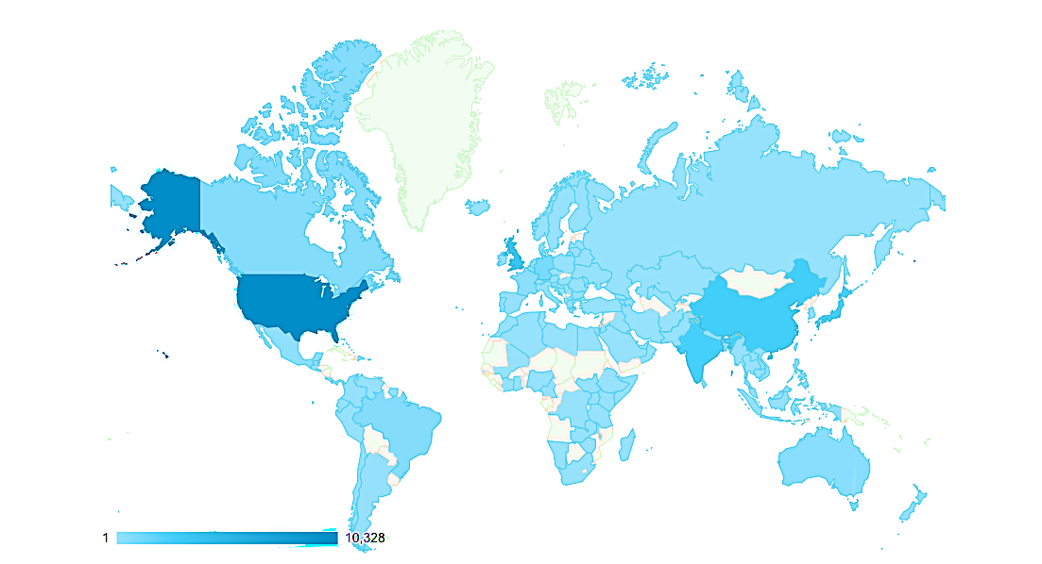
OVERVIEW OF SITE VISITS - ILLUMINAS.COM
Top Countries
Google Search Queries
USA
UK
Japan
India
China
Query | Clicks | Impressions
illuminas | 679 | 1437
Illuminas research | 53 | 77
Illuminas austin | 41 | 93
Illuminas market research | 26 | 42
Illuminas global | 21 | 34
Illuminas partners llp | 14 | 30
consumer behavior towards financial services | 8 | 21
martin cary | 5 | 30
technology positioning | 3 | 102
research glossary | 3 | 50
global sampling | 2 | 18
celebrating 15 years | 1 | 317
Top Pages Visited
1. | Privacy Policy | 5. | Contact Us
2. | Privacy Policy – Chinese | 6. | About Us
3. | Privacy Policy – Japanese | 7. | Solutions
4. | Careers | 8. | Case Studies

Slide 5
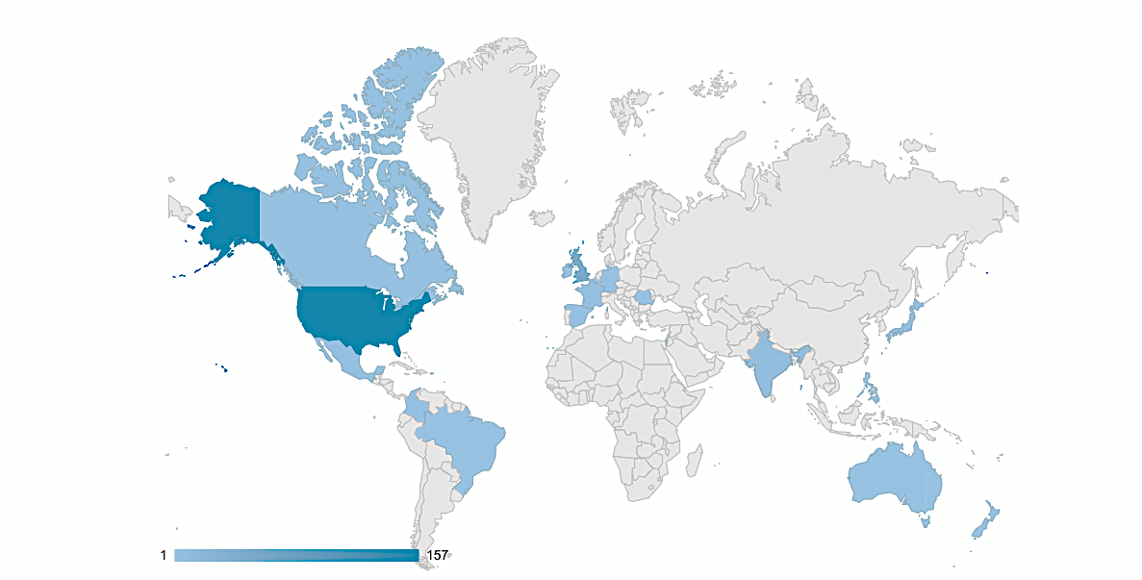
OVERVIEW OF SITE VISITS – INSIGHT EXCHANGE
Top Countries
Google Search Queries
USA
UK
India
Japan
France
Query | Clicks | Impressions
Insight exchange | 1 | 1
amazon | 1 | 1
Top Pages Visited
1. | About Our Community | 5. | Blog
2. | Home | 6. | Virtual Focus Group
3. | Capabilities | 7. | Tech Marketing
4. | Community Profile

Slide 6
EXPLAINING THE METRICS
1 | Number of new & returning visitors: 60-70% is generally perceived as a good number for new visitors.
2 | Website visitors & sessions: One user may scroll through many pages in a session. For example, on March 31, 2018 visitors had 206 sessions, and recorded 343 pages total, with an average of 1.03 pages viewed per session.
3 | Avg. pages per session: The metric shows how many pages people are viewing in their session. This number can be seen as successful if people immediately got the information they needed (ex: our address or email), but would be considered a failure if our goal was for visitors to view many pages of our content)
4 | Avg. session duration: 2-3 minutes is considered to be a "good" amount of time for a session duration. A low number means our visitors may not be spending tons of time browsing news stories, and just gleaning info from the top or getting contact information (unlikely since those would come to solutions email).
5 | Bounce rate: 30% is ideal and could be attributed to poor searchability, or drawing visitors who are not staying for our content, just surface info.
6 | Impressions & Clicks An impression is counted each time your website is shown on a search result page or other site on the Google Network. When someone clicks your website link, Google counts that as a click.

