Slide 1
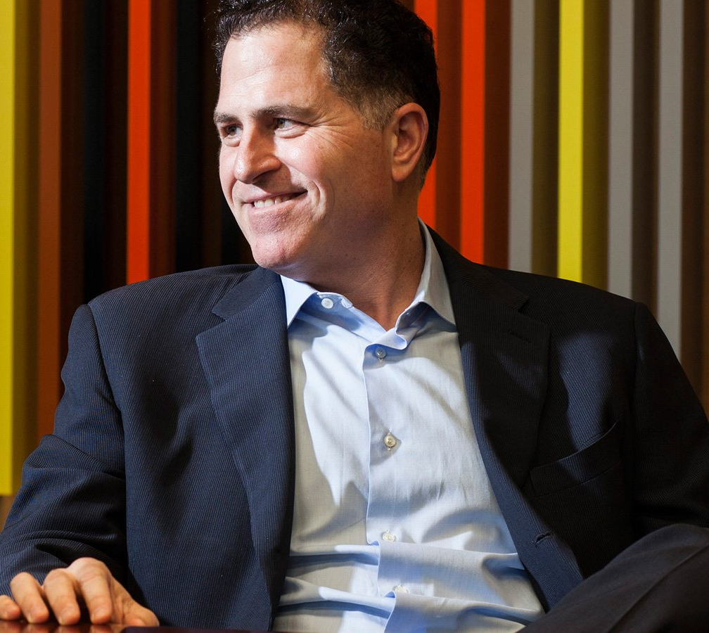
“We believe technology exists to drive human progress”
– Michael Dell

Slide 2
TRANSFORM
IT investments into strategic advantages
Notes:
Combine quote with this panel.

Slide 3
SERVICES
aligned to your IT lifecycle

Slide 4
EXPERT
planning and guidance

Slide 5
SOLUTIONS
deployed right the first time
Notes:
Changed from “technology” to “solutions” for spacing con

Slide 6
PROACTIVE
support with minimal effort

Slide 7
PREDICTIVE
analytics and innovative tools

Slide 8
OPTIMIZE
systems and data for reuse or retirement
Notes:
Peace of mind when retiring systems changed to
Securely retire solutions and data
Protecting customer data and the environment
Confidently retire systems and data
Secure retirement of systems and data Worry-free

Slide 9
EFFECTIVE
training to enable success
Notes:
Effective training to empower success

Slide 10
PARTNERS
around the globe to serve you better
Notes:
GLOBAL Partners to serve you better

Slide 11
GLOBAL
partners to better serve you

Slide 12
LETTING
IT leaders like you…lead

Slide 13
LETTING
IT leaders like you…lead
91
%
Ipsim dolor sit amt si co mit Ipsim dolor sit amt si co mit Ipsim dolor sit amt si co mit
Notes:
Example of data point.

