Slide 1
Illuminas Style Guide

Slide 2




Brand
The Logo
The Illuminas logo is the focal point of our brand. That's why it's so important to use the logo exactly as specified in these guidelines.
Logo on dark
The Glyph
The Illuminas “bowtie”
Logo on colored background

Slide 3

Things to Avoid
NO – Avoid Clashing Orange/Yellow on top of Teal
YES – Use complimentary colors

Slide 4
Color
Primary Colors
Primary colors, are used in the Illuminas logo and should also be used to attract attention to something of importance.
Secondary Colors
Secondary colors are used to provide vibrancy to a design. Use these energetic colors to complement primary colors and break up white space.
TIGER
TEAL
SUNBEAM
DARK BLUE
#FA9849
#00DDD8
#FDAA26
#05374D
GREEN
DARK GREY
#208987
#6E6E6E
LIGHT GREY
#BFBFBF

Slide 5
Gradients
Gradients can also be used to to break up white space and add depth, energy and vibrancy to a design.
Use sparingly, do not overuse gradients.
Tiger
Red
Teal
Aqua

Slide 6
Fonts
Powerpoint: Calibri
AaBbCcDdEeFfGgHhIiJjKkLlMmNn
OoPpQqRrSsTtUuVvWwXxYyZz
0123456789

Slide 7









Icons
Our icon library selection is
designed to be modern, clean and professional

Slide 8
WHITE CONTENT SLIDE 1 COLUMN
Use this layout for content that looks best on white.

Slide 9
WHITE CONTENT SLIDE 2 COLUMN
Use this layout for content that looks best on white.

Slide 10
WHITE CONTENT SLIDE 3 COLUMN
Use this layout for content that looks best on white.

Slide 11
GREY CONTENT SLIDE 1 COLUMN
Use this layout for content that looks best on gray.

Slide 12
GREY CONTENT SLIDE 2 COLUMN
Use this layout for content that looks best on gray.

Slide 13
GREY CONTENT SLIDE 3 COLUMN
Use this layout for content that looks best on gray.

Slide 14
BASIC TABLE
FIELDING | Illuminas will be in data collection for a minimum of 4 weeks in order to capture as many interviews across the broadest representation possible.
QUESTIONNAIRE | Approximately 4 iterations of the initial questionnaire will be made, but additional revision cycles may be necessary based on the design process and may result in additional costs based on the amount of work required to implement the changes.
OPEN ENDS | 2 open-ended questions are included in the survey and 4 unaided brand or other specify questions are included.
PROGRAMMING | Illuminas will be responsible for programming the online survey through Illuminas’ ConfirmIT survey license.
SURVEY REVISIONS | The QNR must be finalized in writing before programming. Any revisions made after programming has begun may result in additional costs.
TRANSLATIONS | None
DATA PROCESSING | Project costs include processing of completed survey interviews (excluding interviews marked as incomplete, terminated, or quota full).
ADVANCED ANALYSIS | None
DATA DELIVERABLES | Illuminas will deliver up to 2 volumes of Excel crosstabs upon request. Each volume can include a maximum of 20 total banner points. Illuminas can also deliver .xlsx or .docx files of verbatim responses to open ended questions, if requested.
REPORTING | Illuminas will deliver a topline report with the pre-test results and a graphical report of up to 50 pages in length with the results from the online survey.
REPORT REVISIONS | Approximately 2 iterations of the report will be made. Additional revision cycles or significant revisions to the data/report structure after the content is reported may result in additional costs based on the amount of work required to implement the changes.
TIMELINE | Final timeline is dependent on complexity of the design, the QNR finalization date, response rates and reporting requirements.
TRAVEL & LODGING | Costs for travel and lodging are not expected or included but would be billed to Shure at cost if requested.

Slide 15
PRICING TABLES SINGLE
Online Survey |  | $0
Design, Setup & up to XX panel interviews
Add International |  | +$0
Add XX interviews in COUNTRY
Add Customers |  | +$0
Add XX customer interviews
Add International Customers |  | +$0
Add XX customer interviews in COUNTRY

Slide 16


PRICING TABLES MULTIPLE
Online Survey
Design, Setup & XX interviews in COUNTRY | $0
Included in research costs:
Project kickoff and weekly status reports
Questionnaire design
HTML invitation design, programming & deployment
Online survey programming, testing & hosting
Customer list processing
Customer sourcing & incentives
Data collection & field monitoring
Up to XXX completed survey interviews
Data processing
Advanced analysis (XXX) IF INCLUDED
Graphical reporting in .PPT (up to XX pages)
Interpretive analysis & executive summary
1 volume/2 volumes of Excel-based crosstabs
Presentation of research results over web conferencing
Focus Groups
Design, Setup & XX Focus Groups in CITY | $0
Add XX groups in CITY | +$0
Included in research costs:
Kickoff meeting & weekly status reports
Recruitment screener & discussion guide design
Respondent sourcing, screening, scheduling & incentives
Moderation of interviews in-person at central facility
Audio & video recording of focus groups
Processing and analysis of all focus groups
Graphical reporting in .PPT (up to XX pages)
Interpretive analysis and executive summary
Transcripts and digital audio/video files
Presentation of research findings using web conferencing
In-Depth Interviews
Design, Setup & XX IDIs in COUNTRY | $0
Included in research costs:
Kickoff meeting & weekly status reports
Screener & discussion guide design
Respondent sourcing, screening, scheduling & incentives
Moderation of interviews over the phone
Audio recording of all interviews
Processing and analysis of all interviews
Graphical reporting in .PPT (up to XX pages)
Interpretive analysis and executive summary
Presentation of research findings using web conferencing

Slide 17
TIMELINE
 | WEEK 1 | WEEK 2 | WEEK 3 | WEEK 4 | WEEK 5 | WEEK 6 | WEEK 7 | WEEK 8
Questionnaire design
Survey programming
Data collection
Data processing
Graphical reporting

Slide 18
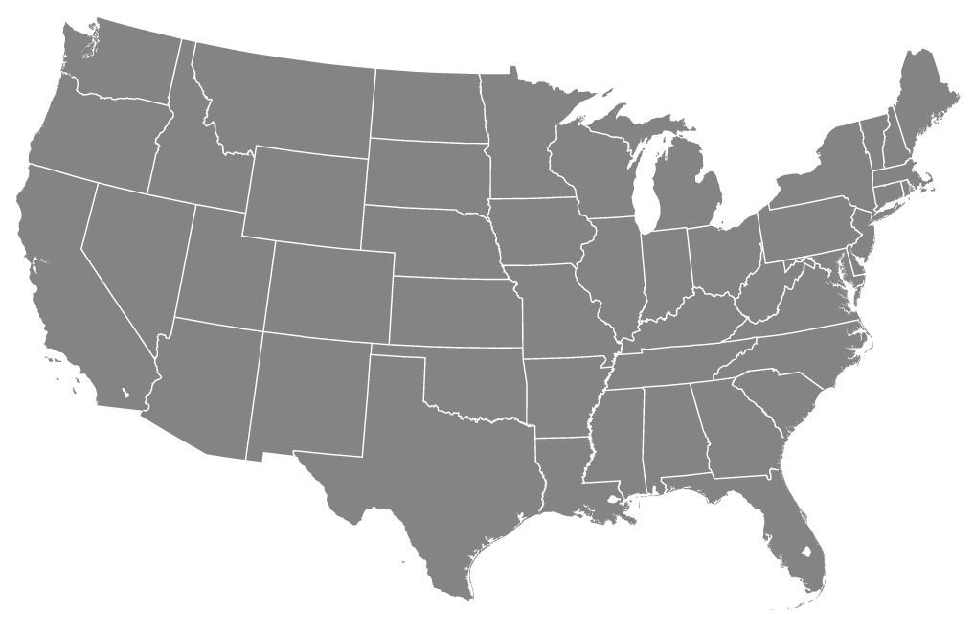



MAPS

Slide 19
CHARTS
Pie Chart
Line Chart

