Slide 1
Bodyfat Analysis
Mengqi Li, Xiangyu Wang, Yiqun Xiao, Zijun Feng

Slide 2
Procedure
Data Cleaning
Model Selection
Statistical Analysis
Model Diagnostics
Conclusion

Slide 3
Introduction

Slide 4
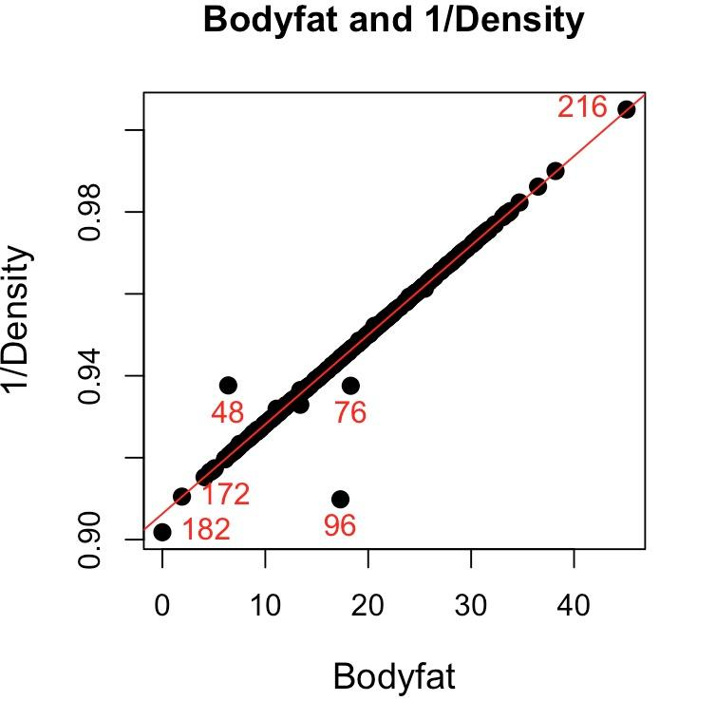
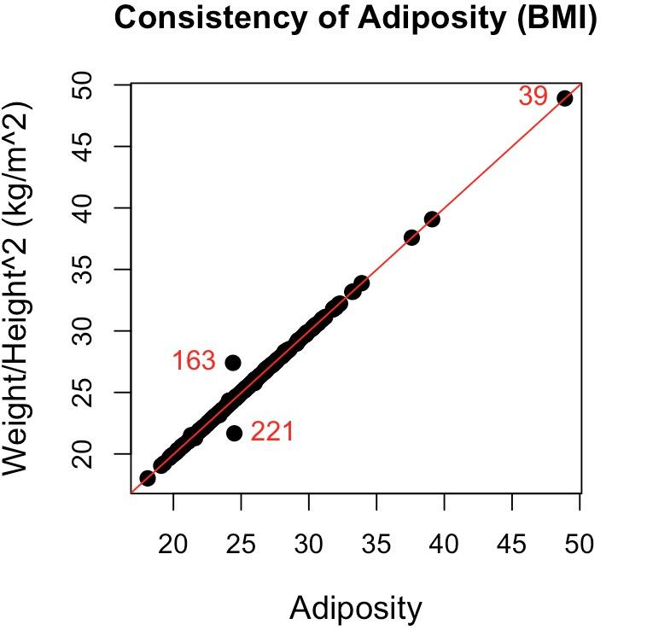
Data Cleaning

Slide 5
Model Selection
14 features
Second order terms are not significant
Best subsets regression
Find best model under each criterion
LOOCV to get RMSE
Choose BIC criteria:
Almost the same accuracy
much less features
3 features in final model:
Weight
Abdomen
Wrist
Number of Features (p) and Accuracy (RMSE) for each Criterion
Criterion | p | RMSE
Adj R2 | 8 | 3.95
Mallows’s Cp | 6 | 3.93
AIC | 7 | 3.93
BIC | 3 | 3.97

Slide 6
Statistical Analysis
Linear regression model:
Body Fat % = -24.4911-0.0913Weight(lbs)+0.8826Abdomen(cm)-1.1954Wrist(cm)
Multiple R-squared: 0.7216
Residual standard error: 3.935
 | 2.5% | 97.5%
(Intercept) | -36.8412955 | -12.14092819
Weight | -0.1358312 | -0.04675787
Abdomen | 0.7798104 | 0.98540479
Wrist | -1.9950146 | -0.39581028
 | P-value
Weight | 7.26e-05
Abdomen | < 2e-16
Wrist | 0.003547

Slide 7
Rule of Thumb
Your bodyfat percentage =
Your abdomen × 0.9 - wrist × 1.2 - weight × 0.1 - 24.5
For a male with circumferences abdomen = 90 cm, wrist = 18 cm and weight = 180 lbs, his predicted body fat percentage is around 16.99%.

Slide 8
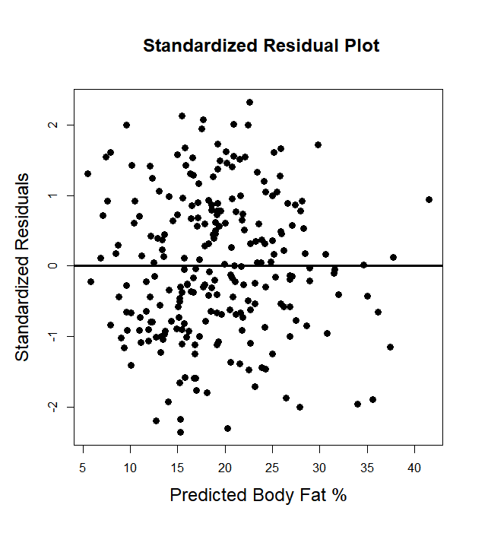
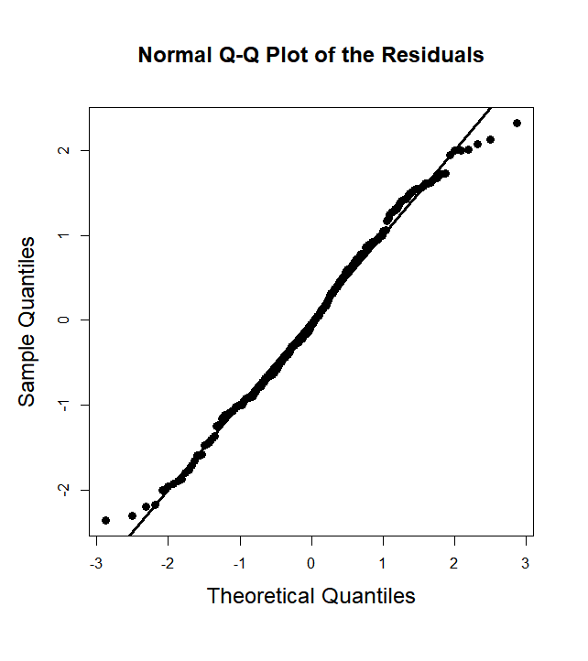
Model Diagnostics
Check for linearity, homoscedasticity, normality

Slide 9
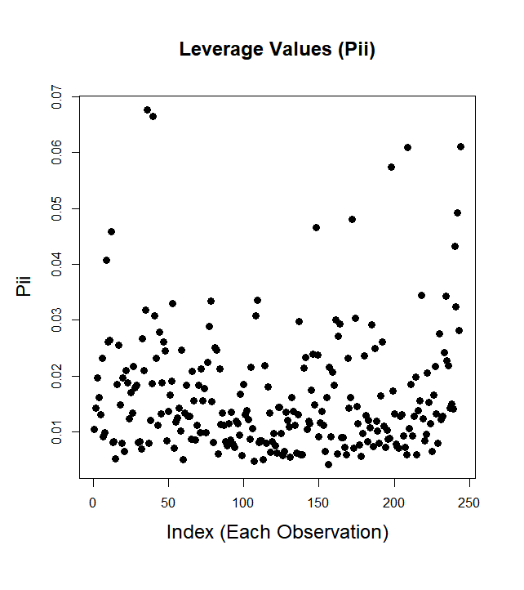
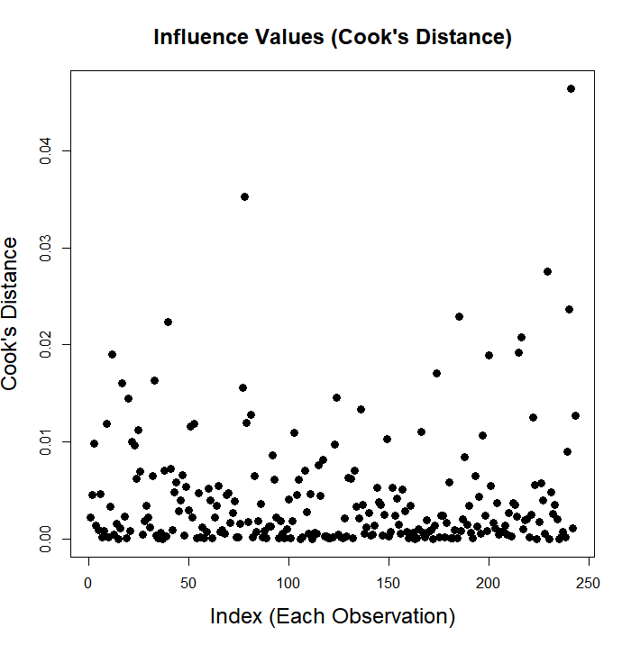
Model Diagnostics
Check for influential points

Slide 10
Model Diagnostics
Check for multicollinearity by calculating VIF values
WEIGHT | ABDOMEN | WRIST
5.6151 | 4.2290 | 2.0898

Slide 11
Strengths & Weakness
Strengths
Use best subsets regression which fits all possible models
Simple and easy to interpret
Weakness
Calculate male bodyfat percentage only
Prediction may be unreliable with extreme input values

Slide 12
Conclusion
· Why we didn’t adapt other algorithms
· Final model
· Applicable to adult men.

