Slide 1

Spotify Music Popularity
Zachary Ferguson
Notes:
Kalli: For our project we chose to look at Spotifys top 200 songs from the years 2020-2021 and how they rank on the popularity scale. Our team includes Kalli Miyuskovich, Lucy Rector, Zach Ferguson, and Johnny Joens

Slide 2
Executive Summary
Problem
Data Source
Conclusions
Measures
What are the factors that affect how popular a song is on Spotify?
Spotify Top 200 Charts (2020-2021) from Kaggle
Multi-linear regression model, collinearity, and residual plots
Methods
Dependent variable (popularity)
Of the independent variables used, energy has the greatest impact on a song's popularity on Spotify
Independent variables (danceability, energy, loudness, spechiness, acousticness, liveness, tempo, duration, and valence)
P-values of independent variables
Multicollinearity/correlation
With an r-squared value of 0.0145, none of the variables examined are strong predictors of a song's popularity on Spotify
Notes:
The problem that we are looking to study is the factors that contribute to how popular a song is on Spotify. Our study begins with the Spotify Top 200 Charts from 2020-2021 dataset that we found on Kaggle. To analyze our data, we used a multi-linear regression model, looked at the collinearity, and created residual plots. The measures that we used was popularity, which was the dependent variable, and independent variables of danceability, energy, loudness, spechiness, acousticness, liveness, tempo, duration, and valence. To come to our conclusion, we measured the variables, their multicollinearity, their p-values and correlation. In the end, we determined that with every 1 point increase in energy, there is a 8.85 point increase in popularity, making energy the factor with the greatest effect on a song's popularity. However, our study did not explain much of the variation in popularity because our coefficient of determination was only 1.45%

Slide 3
Problem Statement
What are the factors that affect a song's popularity?
Which factor has the greatest impact on a song's popularity?
Which factor has the least impact on a song's popularity?
Notes:
There are many things that artists take into consideration when creating a song including danceability, Energy, Loudness, Spechiness, Acousticness, Liveness, Tempo, Duration, and Valence. Knowing which of these factors is most important to their audience can help songwriters and producers craft the best music possible. We wanted to know what factors affect a song's popularity, which factor has the greatest impact on a song's popularity, and which factor has the least impact on a song's popularity.

Slide 4
Data
Datasets:
Kaggle Spotify Top 200 Charts (2020-2021)
Variables Used: Popularity, energy, loudness, speechiness, acousticness, liveness, temp, duration (ms), and valence
Limitations
Spotify Top 200 Charts from only 2020-2021, not every year
Not every single song on Spotify included
Contains the popularity of each song on a scale of 1 –100, scores are not precise decimals
Notes:
We used one data set from Kaggle that was Spotifys top 200 charts from 2020-2021. All the variables that we used were quantitative variables. One of our biggest limitations is that the data is only from 2020-2021, it doesn't include very year. It is also limited because not every song on Spotify's database is included, only the top 200. Our last limitation is that scores are on a scale of 1-100 and are not precise decimals.

Slide 5
Methodology: Data Preparation
Data Preparation:
Removed unnecessary data
Index, Highest Charting Position, Number of Times Charted, Week of Highest Charting, Streams, Artist, Artist Folllowers, Song ID, Weeks Charted, Chord, and Genre
Dependent Variable
Popularity
Independent Variables
Danceability, Energy, Loudness, Spechiness, Acousticness, Liveness, Tempo, Duration (ms), Valence
Notes:
The first step in our analysis was to remove unnecessary data. The purpose of this study is to analyze our chosen dependent variable of how popular a song is on a scale of 1-100. As we hope that this study is able to better help musicians craft music that appeals to their audience, we removed any variables that are out of the control of the artist before the song is released. These include Index, Highest Charting Position, Number of Times Charted, Week of Highest Charting, Streams, Artist, Artist followers, and weeks charted. We also removed chord and genre because these categorical variables would be difficult to run a regression analysis on. Once we determined our sole dependent variable to be popularity, we organized our 9 independent variables in accordance with their associated song.

Slide 6
Variables Explained
Popularity: The popularity of the track. The value will be between 0 and 100, with 100 being the most popular.
Danceability: How suitable a track is for dancing based on a combination of musical elements including tempo, rhythm stability, beat strength, and overall regularity.
Acousticness: A measure from 0.0 to 1.0 of whether the track is acoustic.
Energy: Represents a perceptual measure of intensity and activity.
Instrumentalness: Predicts whether a track contains no vocals.
Liveness: Detects the presence of an audience in the recording. Higher liveness values represent an increased probability that the track was performed live.
Loudness: The overall loudness of a track in decibels (dB). Loudness values are averaged across the entire track.
Speechiness: Detects the presence of spoken words in a track.
Tempo: The overall estimated tempo of a track in beats per minute (BPM).
Duration: Measured in milliseconds (ms)
Valence: A measure from 0.0 to 1.0 describing the musical positiveness conveyed by a track.
Notes:
Here you can see all of the dependent and independent variables explained. *read off*

Slide 7
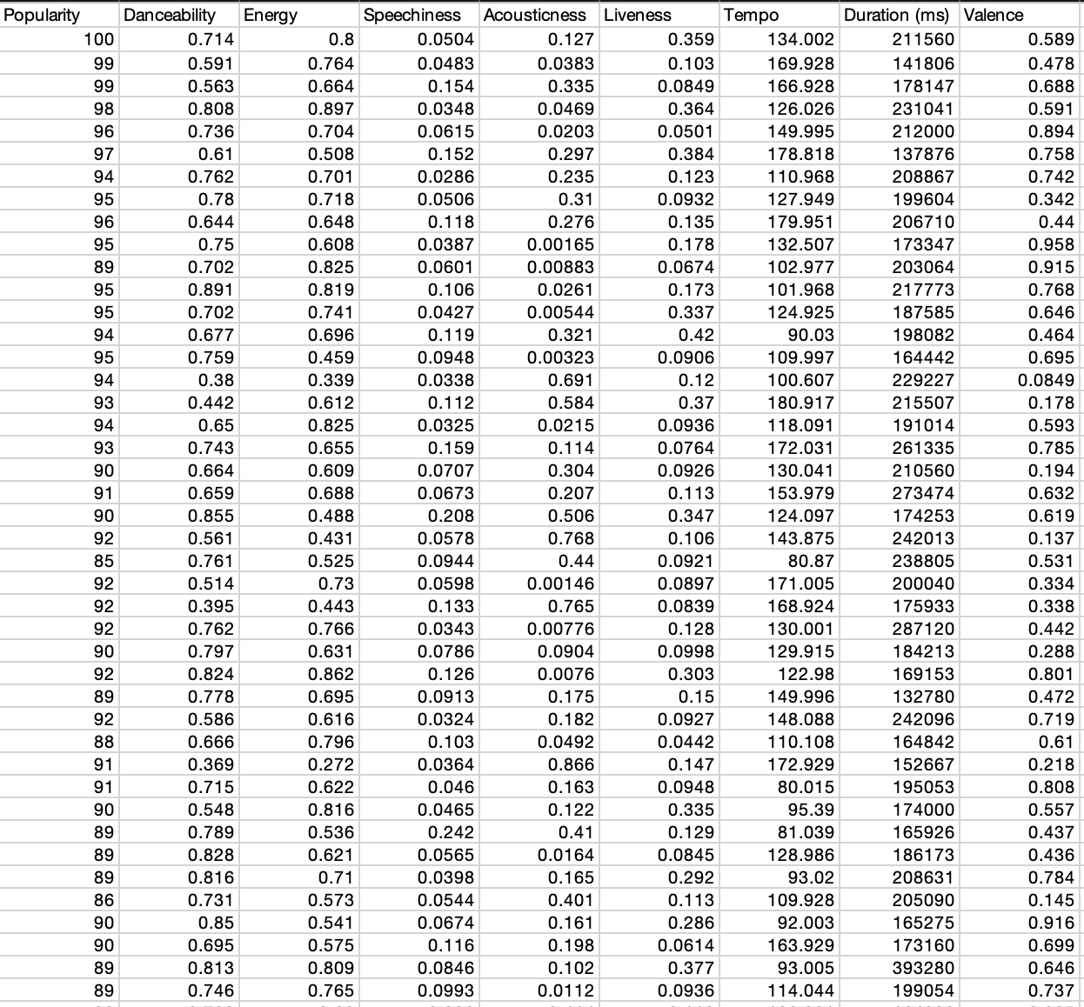
Data Set
Notes:
This is a screenshot of our clean, organized data. The far left collum, or the dependent variable, is song popularity followed by the 9 independent variables that we will be studying.

Slide 8
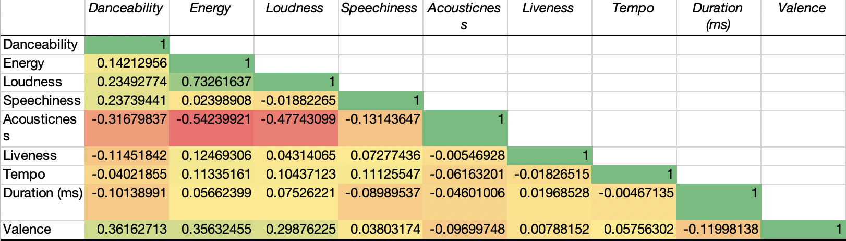
Methodology: Multicollinearity
Removing loudness versus removing energy
Notes:
Our first step before running our regressions was to create a correlation matrix. After creating it we noticed that there is a multicollinearity between Loudness and Energy of 0.73. We then decided to run two regressions between Loudness and Energy to see which one had the higher R-squared value and should be removed.

Slide 9
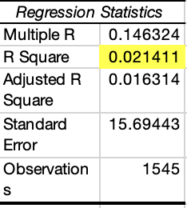
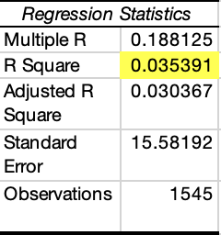
Methodology: Multicollinearity (continued)
Regression Output: Energy Included
Regression Output: Loudness Included
Notes:
After running two regressions with Energy included in one and Loudness included in the other, we found that including Loudness gave the highest R-Squared. This meant that Energy was the variable we decided to include going forward in our study.

Slide 10
Methodology: Backwards Regression
Run regression analyzes on our data
Remove variables with p-values above alpha because they are insignificant
Notes:
The next step in our methodology is to run our regression analysis and create residual plots. After each equation is created, we will look at the p-values of every independent variable and remove the highest one if necessary. We will continue to do this until all p-values are below our alpha of 0.05

Slide 11
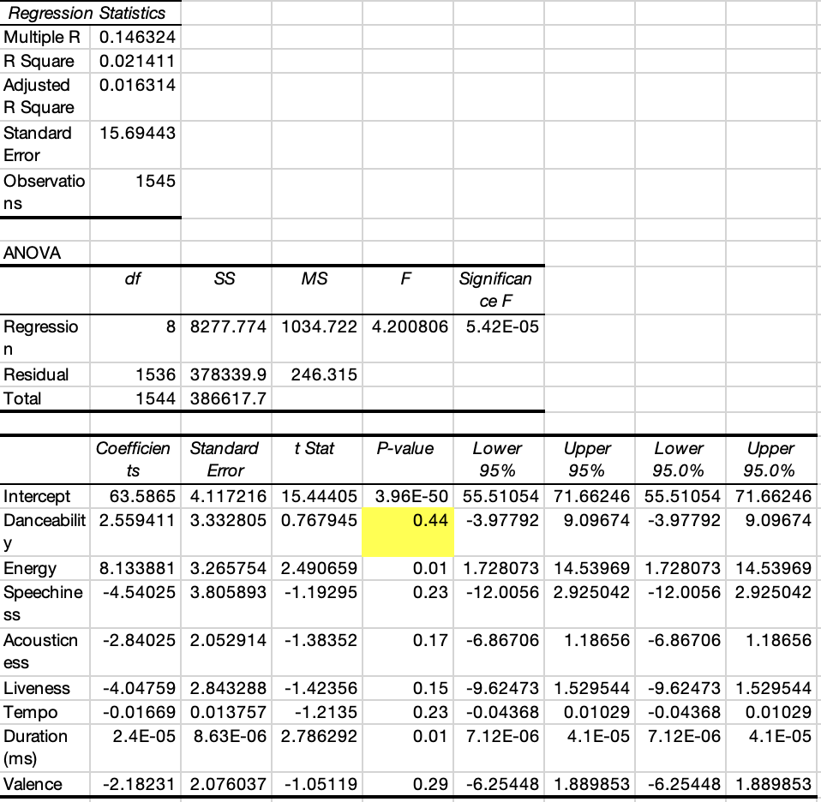
Regression 1
Notes:
When runing our first regression, we noticed that there were multiple p-values exceeding our alpha of 0.05. Danceability has a significantly higher p-value at 0.44 so we decided to remove it first from our data set.

Slide 12
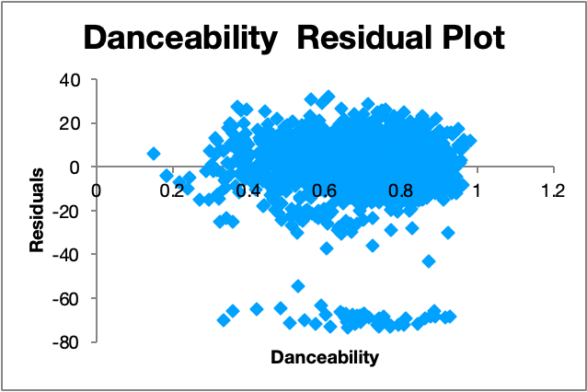
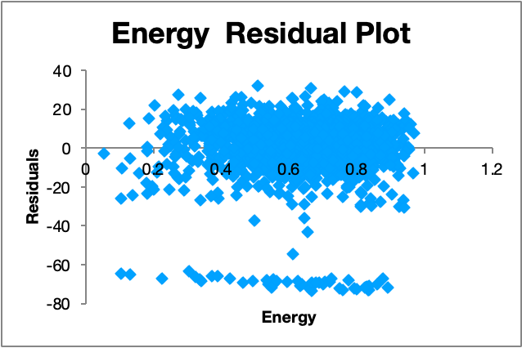
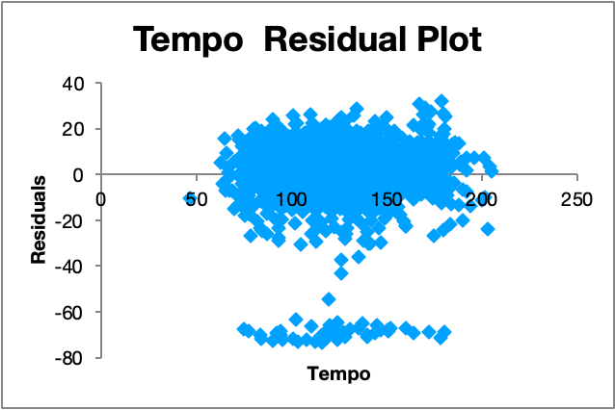
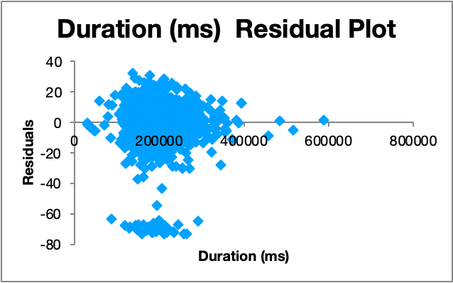
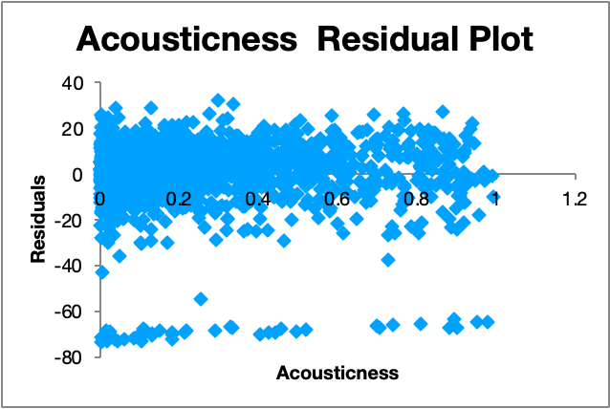
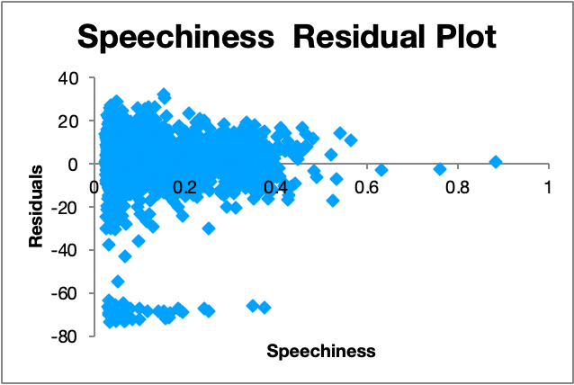
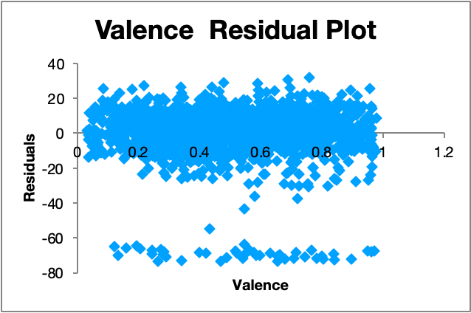
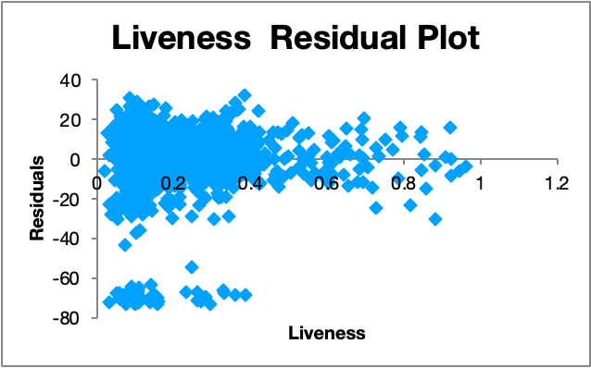
Regression 1: Residual Plots
Notes:
These are the residual plots associated with our first regression analysis. This shows that danceability is far from 0 and should therefore be removed first.

Slide 13
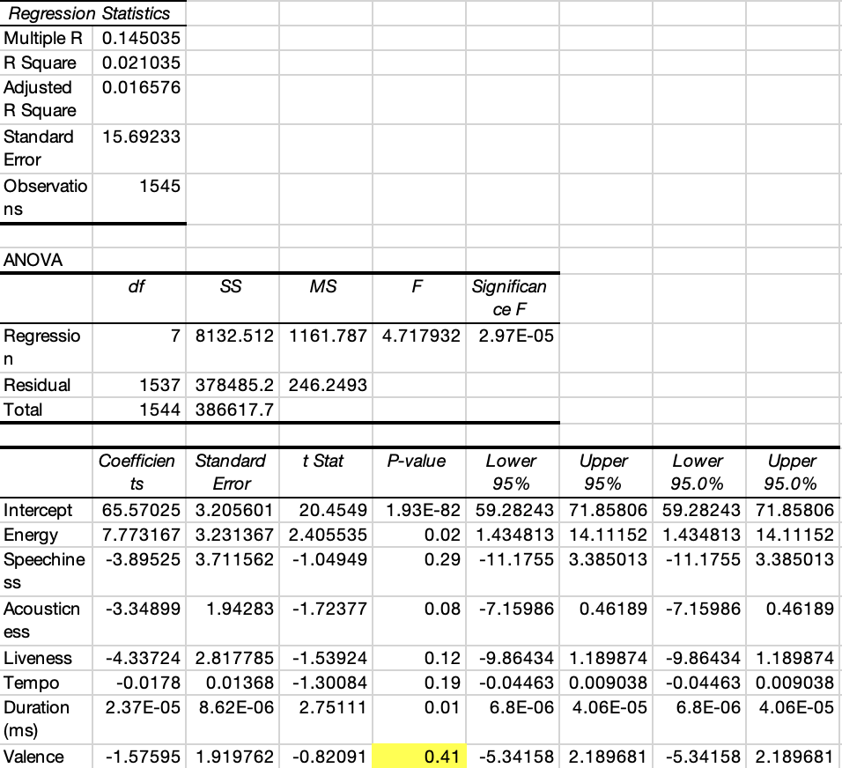
Regression 2
Notes:
After dropping danceabilty, we ran our second regression. The next highest p-value was Varaince at 0.41 so we decided to drop this varaible next from our data set.

Slide 14
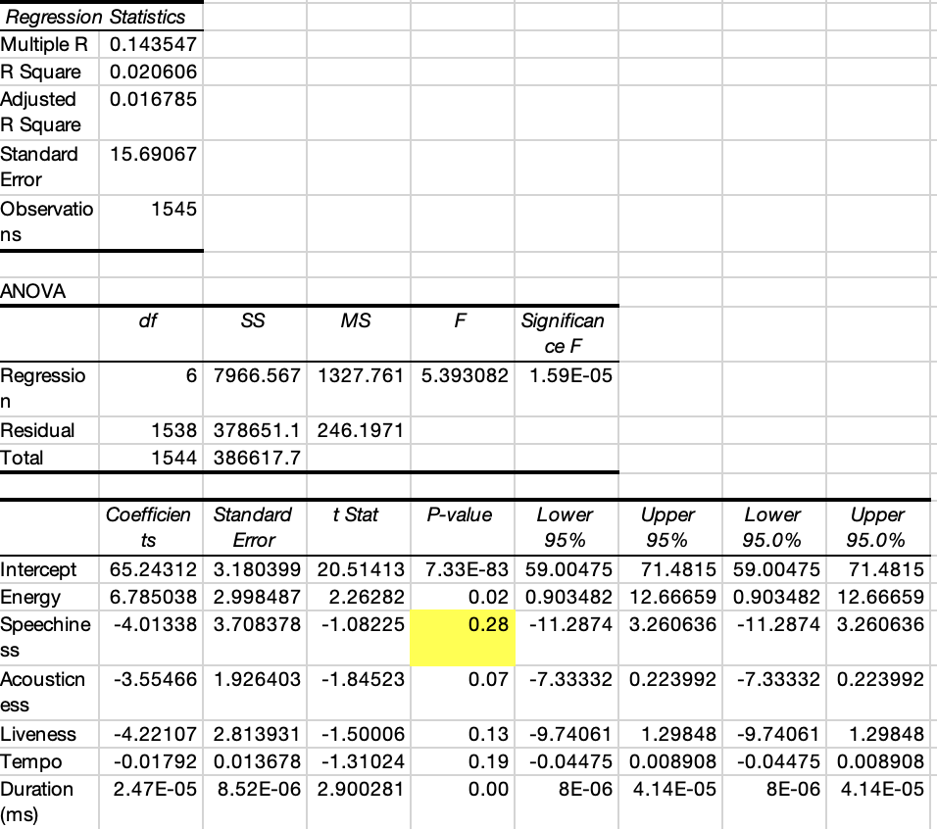
Regression 3
Notes:
Once variance was dropped, we ran our third regression. Speechiness was the highest at 0.28. We then dropped speechiness.

Slide 15
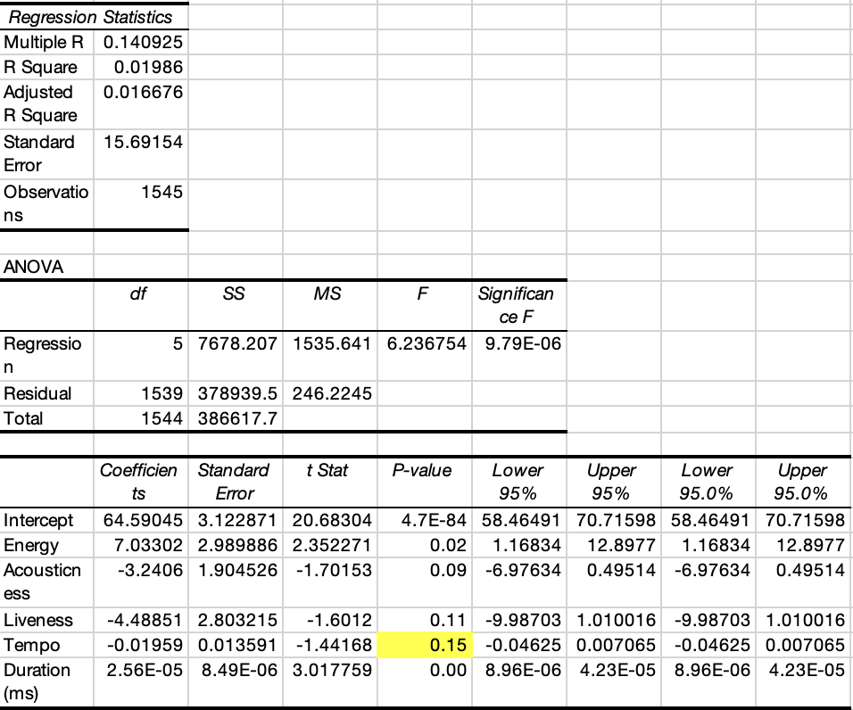
Regression 4
Notes:
During our fourth regression, tempo had the highest p-value of 0.15. We went ahead and dropped that variable from our data set.

Slide 16
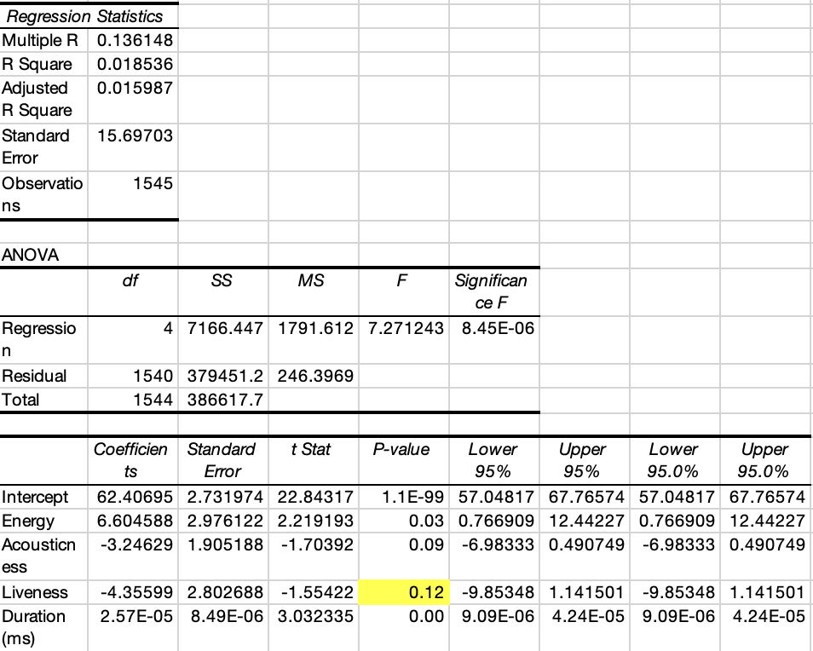
Regression 5
Notes:
In regression five, Liveness had the highest p-value of 0.12, we went ahead and dropped that variable from our data set.

Slide 17
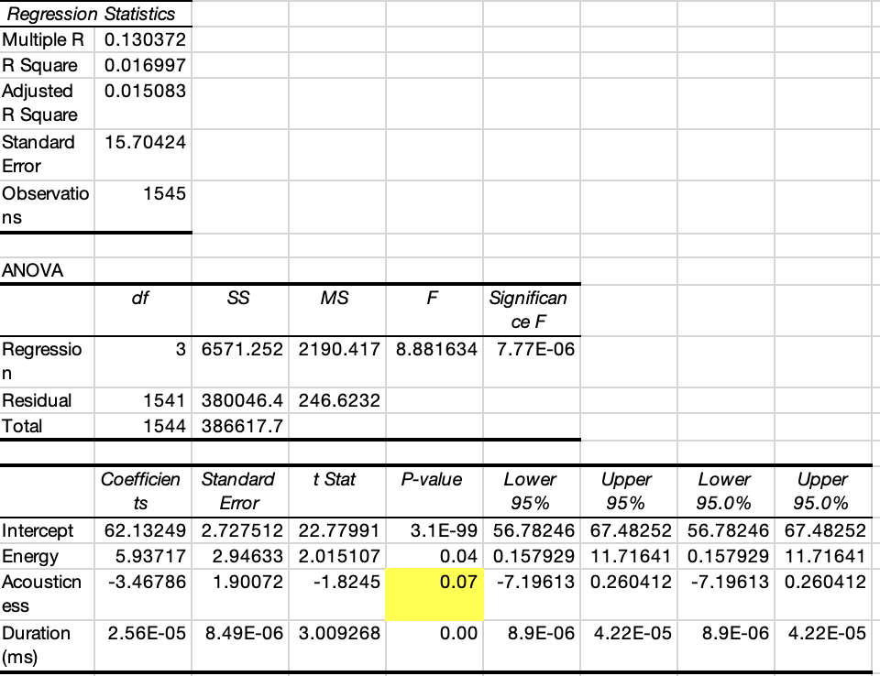
Regression 6
Notes:
Accousticness had the highest p-value of 0.07 in regression six so we dropped that varaible from our data set.

Slide 18
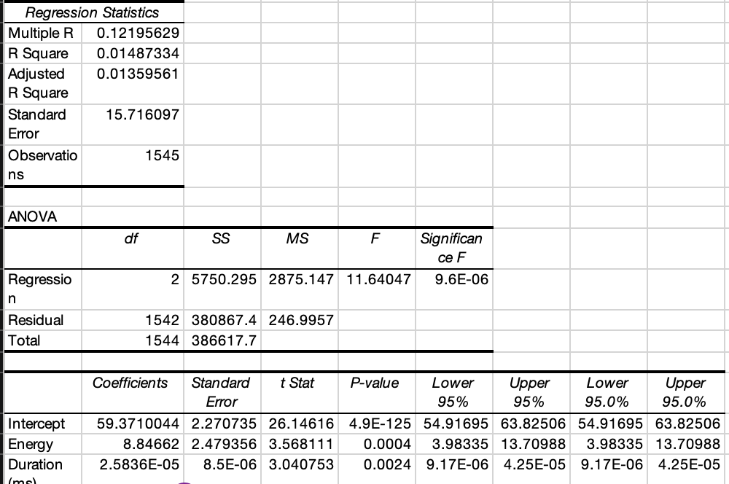
Regression 7
Notes:
Finally, during regression seven, all independent variable p-values were below our alpha of 0.05. We are left with our Energy variable with a p-value of 0.0004 and our Duration (milliseconds) variable with a p-value of 0.0024

Slide 19
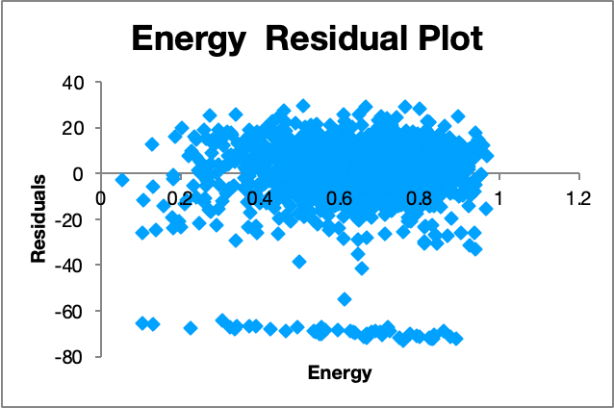
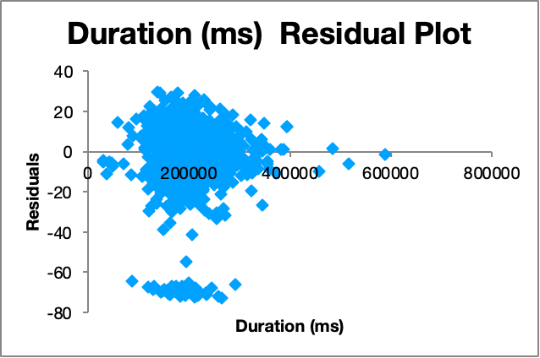
Final Residual Plots
Notes:
We conclude that the energy and duration are both valid residual plots because their p-values are significant and the population of the error term normally distributed, around a mean of 0. There is also a constant variance. Both models do have a grouping below the main one, this is likely caused by a group of songs responsible for large residuals. This class does not give us the tools to examine this and because it is the same on both plots, we can still use them.

Slide 20
Methodology: Backwards Regression
We ultimately removed the following variables due to their p-values being greater than our set alpha of 0.05:
Danceability
Speechiness
Acousticness
Liveness
Tempo
Valence
Notes:
Ultimately, we determined that Danceability, Speechiness, Acousticness Liveness Tempo Valence were all insignificant to our study since they had a p value above the alpha. To come to this conclusion, we had to create 7 regression studies and remove each variable one by one.

Slide 21
Final Model
Popularity = 59.37 + 8.85*EnergyScore + 0.00005*Duration
Notes:
After completing our analysis, we were able to complete our final equation to be popularity = 59.37 + 8.85 times energy + nearly 0 times duration. This means that with every 1 point increase in energy, there is a 8.85 point increase in a song's popularityEnergy is a measure from 0.0 to 1.0 which represents a perceptual measure of intensity and activity. Typically, energetic tracks feel fast, loud, and noisy. Duration is the length of each song, measured in milliseconds.

Slide 22
Conclusion
Energy and duration are the only significant variables in our study and are the only ones included in our parsimonious model because they have p-values less than .05 (alpha)
We have concluded that there is a not a strong linear relationship between a song's Danceability, Energy, Loudness, Spechiness, Acousticness, Liveness, Tempo, Duration, or Valence and its popularity on the Spotify charts. Only 1.49% of the data can be explained by these factors as shown by the R-squared value in the parsimonious model
Notes:
Energy and duration are the only significant variables in our study because they have p-values less than our alpha of 0.05. Therefore, this is our parcimounious model. In our final model, the coefficient of determination is only 0.01487. This means that about 1.49% of the variability in song popularity can be explained by the independent variables that we have chosen to analyze. As a result, this study does not produce a strong linear relationship between a song's popularity on spotify's charts and its Danceability, Energy, Loudness, Spechiness, Acousticness, Liveness, Tempo, Duration, or Valence

Slide 23
Work Cited
https://www.kaggle.com/datasets/sashankpillai/spotify-top-200-charts-20202021

