Slide 1
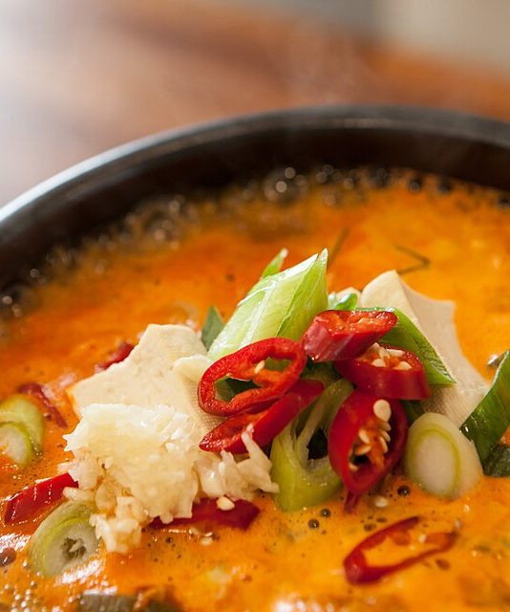
IntentBound
Permission for a
personal agent
that spends
GWDC Seoul, Challenge B
Notes:
0:00–0:30. Mina is building at GWDC and asks her personal agent to order dinner. IntentBound focuses on the moment money is delegated. The agent may choose food, while Mina sets the spending conditions. This is a prototype with simulated merchants; the food photograph does not show a real partner.
Sources and disclosures:
Source: local GWDC Korea Hackathon: FuriosaAI X Bricksum Challenge Brief, Challenge B, page 2.
Source: local project design, 方案设计/01_IntentBound_详细设计方案.md.
Restaurant names, quotes and delivery status are simulated. Food images are illustrative CC0 photographs, not images of these merchants.
Food image: Wikimedia Commons, Doenjang-jjigae 3, https://commons.wikimedia.org/wiki/File:Doenjang-jjigae_3.jpg

Slide 2
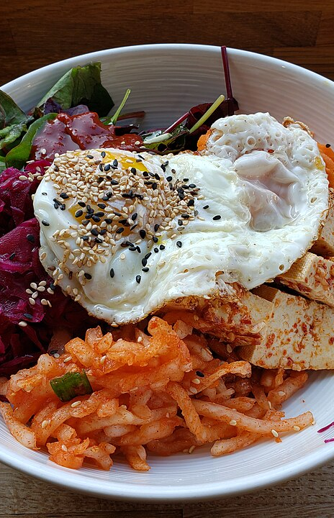
Mina delegates dinner
“A warm meal, no cilantro.
At most 18 test TRX, fees
included. Only my two
approved restaurants.”
Order within ten minutes
A payment receipt shows the payee. Mina also needs evidence that the payee and full price fit her permission.
Notes:
0:30–1:05. Mina's request contains a food preference and a financial boundary. The restaurants, quotes and delivery are demonstration data. The meal preference guides the model. The cap, payee list and expiry must become explicit policy fields that Mina approves. A normal transfer receipt alone does not establish her prior conditions.
Sources and disclosures:
Source: local GWDC Korea Hackathon: FuriosaAI X Bricksum Challenge Brief, Challenge B, page 2.
Source: local project design, 方案设计/01_IntentBound_详细设计方案.md.
Restaurant names, quotes and delivery status are simulated. Food images are illustrative CC0 photographs, not images of these merchants.
Food image: Wikimedia Commons, Brighton Bibimbap (tofu) - Time For Kimchi, https://commons.wikimedia.org/wiki/File:Brighton_Bibimbap_(tofu)_-_Time_For_Kimchi.jpg

Slide 3
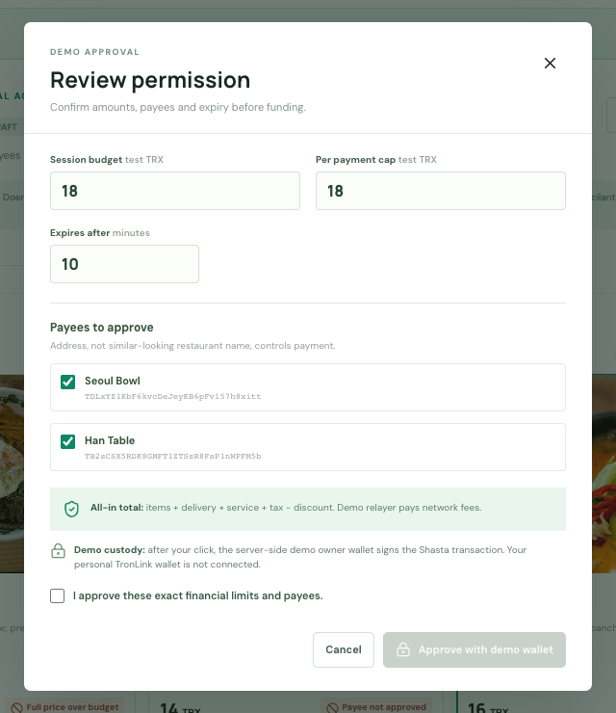
A bounded spending session
18
test TRX, all fees included
Exact payee addresses
Expires after 10 minutes
Stop at any time
Shasta approval confirmed. The server-side demo owner wallet signed this session.
Notes:
1:05–1:40. Mina reviews the all-in cap, exact merchant payee addresses and ten-minute expiry. Kiln drafts the task and recommends a catalog item but cannot expand the approved policy. In the final recorded run, the server-side demo owner wallet funded the Shasta session and emitted SessionCreated. Approval transaction: a5d68a5293e22c1364c2d53fd0d877e6c70b188700b2d1b19a2284bdac93aa67. Mina's personal TronLink is not connected. The screenshot shows the review dialog before the approval transaction in this same recorded run.
Sources and disclosures:
Source: local project design, 方案设计/01_IntentBound_详细设计方案.md.
TRON testnet reference: https://developers.tron.network/docs/networks
Final video evidence: local demo/evidence/shasta-session-evidence.json.
Approval explorer: https://shasta.tronscan.org/#/transaction/a5d68a5293e22c1364c2d53fd0d877e6c70b188700b2d1b19a2284bdac93aa67
Product screenshot: local demo/evidence/shots/02-review.png.

Slide 4
Four decisions from one dinner task
A
19
Fees push the total above 18
TRX
BLOCKED
AttemptRejected, 54d18e2d...33c2fb
B
14
Merchant address is not approved
TRX
BLOCKED
AttemptRejected, 1b545a26...b317a5
C
16
Approved payee, price within limit
TRX
PAID
PaymentExecuted, fe89db22...7ce2ed
D
1
After confirmed Stop
TRX
BLOCKED
AttemptRejected, 9f70dbc9...d2cdd9
Four confirmed Shasta contract events. Restaurant quotes and delivery are simulated.
Notes:
1:40–3:10. Show the final recorded run. A: 15 meal + 2 delivery + 2 service = 19 test TRX, above the 18 cap. The contract emitted AttemptRejected with OVER_LIMIT in 54d18e2de1f80be21f28d42a0bf9f35706730b21578e24a15766012a9733c2fb. B: the 14 TRX payee address was outside the allowlist, so the contract emitted AttemptRejected with MERCHANT_NOT_ALLOWED in 1b545a268a39c3b516cb36838ae7a48ea4b4b917f48c3071c322814e20b317a5. C: the approved Han Table payee received 16 test TRX, with PaymentExecuted in fe89db2251a2d9bcda0e41f5e7bd0f447cb22de7fbd625c96fa42119d67ce2ed. Mina then pressed Stop; the owner revoke transaction was b099c3dc6547faca54ec93c40e39a256e392027f154cdc35215c7c10ae22f297. D: a 1 TRX retry had enough remaining budget, but the revoked session emitted AttemptRejected with REVOKED in 9f70dbc937658e51941d284e82190f6cf475ad6e726e2aa94b4e1dd5a4d2cdd9. No rejection sent money to the merchant. Restaurant menus, quotes and delivery remain simulated.
Sources and disclosures:
Source: local GWDC Korea Hackathon: FuriosaAI X Bricksum Challenge Brief, Challenge B, page 2.
Source: local project design, 方案设计/01_IntentBound_详细设计方案.md.
Final video run: local demo/evidence/shasta-session-evidence.json.
A explorer: https://shasta.tronscan.org/#/transaction/54d18e2de1f80be21f28d42a0bf9f35706730b21578e24a15766012a9733c2fb
B explorer: https://shasta.tronscan.org/#/transaction/1b545a268a39c3b516cb36838ae7a48ea4b4b917f48c3071c322814e20b317a5
C explorer: https://shasta.tronscan.org/#/transaction/fe89db2251a2d9bcda0e41f5e7bd0f447cb22de7fbd625c96fa42119d67ce2ed
D explorer: https://shasta.tronscan.org/#/transaction/9f70dbc937658e51941d284e82190f6cf475ad6e726e2aa94b4e1dd5a4d2cdd9
Revoke explorer: https://shasta.tronscan.org/#/transaction/b099c3dc6547faca54ec93c40e39a256e392027f154cdc35215c7c10ae22f297

Slide 5
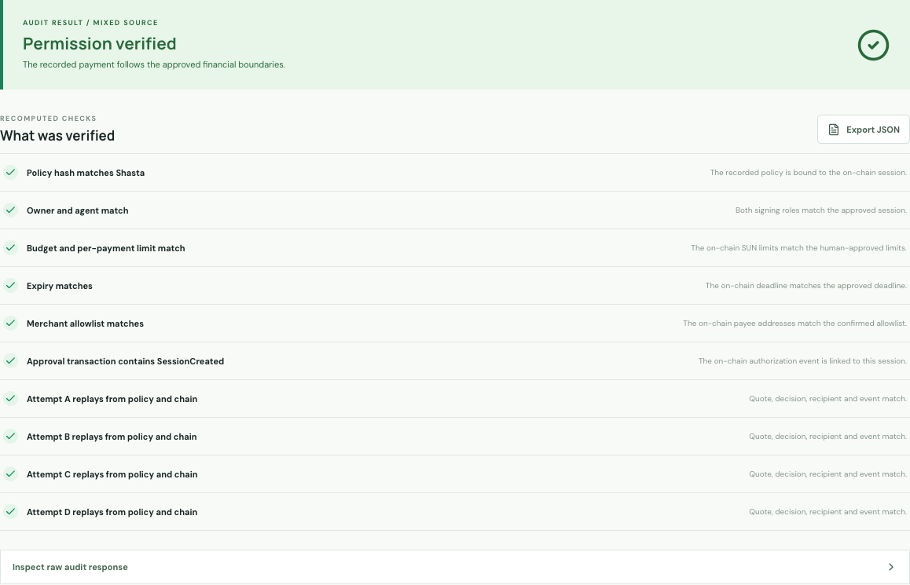
Independent audit of the payment
AUDIT VERDICT
10 / 10
checks pass
Policy, quote, payee and Shasta events match.
PAYMENT RECEIPT
16 test TRX on Shasta
fe89db22...7ce2ed
Session 0xc6ff6c...788b1d
Merchant quotes and fulfillment are simulated. The financial authorization and events are testnet records.
Notes:
3:10–4:05. A read-only visitor can paste session 0xc6ff6c2d326a69a868023cf768edef7a171b6a0756f90161e928bcceab788b1d into Public Audit without a wallet. The final recorded run returned 10 of 10 passed checks: policy hash, owner and agent, caps, expiry, allowlist, approval event, and attempts A through D. The Case C receipt is a real 16 test TRX Shasta payment to the permitted Han Table address. Payment transaction: fe89db2251a2d9bcda0e41f5e7bd0f447cb22de7fbd625c96fa42119d67ce2ed. The auditor queries Shasta records independently. This proves the payment met the financial permission, not that a real restaurant prepared or delivered food.
Sources and disclosures:
Source: local GWDC Korea Hackathon: FuriosaAI X Bricksum Challenge Brief, Challenge B, page 2.
TRON testnet reference: https://developers.tron.network/docs/networks
Final video evidence: local demo/evidence/shasta-session-evidence.json and demo/evidence/shasta-audit.json.
Payment explorer: https://shasta.tronscan.org/#/transaction/fe89db2251a2d9bcda0e41f5e7bd0f447cb22de7fbd625c96fa42119d67ce2ed
Product screenshot captured by presentation/.build/capture_shasta_evidence.mjs for this session.

Slide 6
Measured inference, verified chain
Kiln qwen3-32b. Final recorded dinner run.
Intent draft
Menu choice
Two real calls
261 in
358 in
794
97 out
78 out
total tokens
Code checks price and payee.
Rejections need no extra model call.
Illustrative: 4 x 150 W TDP x 4.162 s = 0.694 Wh. Not measured.
Shasta: 1 payment, 3 recorded refusals, independent audit 10/10.
Dinner is the first case for user-set spending boundaries across personal agents.
Notes:
4:05–5:00. The final video run made two real Kiln qwen3-32b calls. Intent draft: 261 input and 97 output tokens, generation 797d3e47-19cc-4db1-8b36-e81f76110651, 2791 ms end-to-end latency. Menu choice: 358 input and 78 output tokens, generation 124e1bad-a362-421e-85fa-fc65b0d4ed5f, 1371 ms. Total: 794 tokens. The four payment attempts required no extra model call because price, payee and Stop checks run in code and the contract. The energy figure is only a scenario: FuriosaAI lists four RNGD cards for Qwen3-32B-FP8 and 150 W TDP each. Assigning all 600 W for the full 4.162 s API latency gives 0.694 Wh. This is not measured Kiln energy, because deployed hardware, allocated power and inference-only time are unknown; latency includes network and queueing. Do not claim a percentage saving. The final Shasta run recorded one 16 test TRX payment, three on-chain nonpayment decisions and a 10/10 independent audit. Merchant quotes and fulfillment remain simulated. The provider told the team to use qwen3-32b rather than the model in the original brief.
Sources and disclosures:
Source: local GWDC Korea Hackathon: FuriosaAI X Bricksum Challenge Brief, Challenge B, page 2.
Kiln API reference: https://kiln.bricksum.com/docs/en/api-reference
Final run usage: local demo/evidence/kiln-usage-this-run.json.
Final chain and audit: local demo/evidence/shasta-session-evidence.json and demo/evidence/shasta-audit.json.
FuriosaAI Qwen3 deployment table: https://developer.furiosa.ai/latest/en/furiosa_llm/models/qwen3.html
FuriosaAI RNGD TDP: https://developer.furiosa.ai/latest/en/overview/rngd.html
Source: local project design, 方案设计/01_IntentBound_详细设计方案.md.

