Slide 1
COPS: A coroutine-based priority scheduling framework perceived by the operating system
Fangliang Zhao, Donghai Liao, Jingbang Wu
Huimei Lu, Yong Xiang

Slide 2
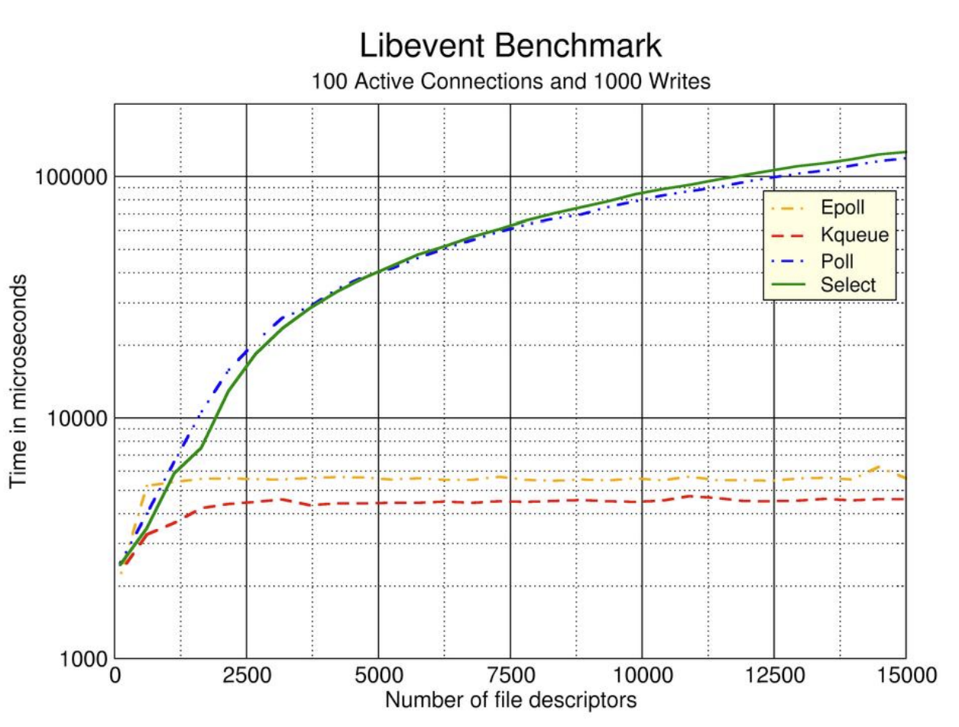
Concurrency matters
“Good” concurrency model achieves high throughput, low latency, and efficient resource utilization.
Fine-tailored model can improve performance by an order of magnitude or more.

Slide 3
What are the problems with existing multi-threading concurrency model?
Nondeterministic, resulting in uncertain access order of shared resources.
Synchronization
Atomics
…

Slide 4
What are the problems with existing multi-threading concurrency model?
Incompatible with asynchronous I/O mechanism
Additional mechanisms(producer-consumer model, zero-copy, etc.)
Complicated asynchronous runtime
Extra syscall interfaces
Hard to code(manually implement event-loop or callback hell)
…

Slide 5
I/O Multiplexing
Select, Poll, Epoll
Need complicated data structure to maintain global I/O states.
Fd_set
Fd_queue
Red-black tree + ready queue
Expose extra syscall.
select
poll
epoll_create, epoll_ctl, epoll_wait,
IOCP
Callback hell.

Slide 6
Userland task
POSIX AIO
Without userland scheduling, os lacks awareness.
User thread management.
Frequent context switching across privilege levels.

Slide 7
Solution: COPS
Benefits from coroutines
Low cost of task switching.
Low resource usage.
Language facilities make programming easy.
Treats coroutines as first-class citizens within OS
Introduces coroutines from user space into kernel.
Employs coroutine as the fundamental task unit to replace thread(decrease kernel complexity).
Offers a unified priority-based scheduling framework across kernel and user space(make kernel aware of userland task).
Supports asynchronous syscall(without extra syscall).

Slide 8
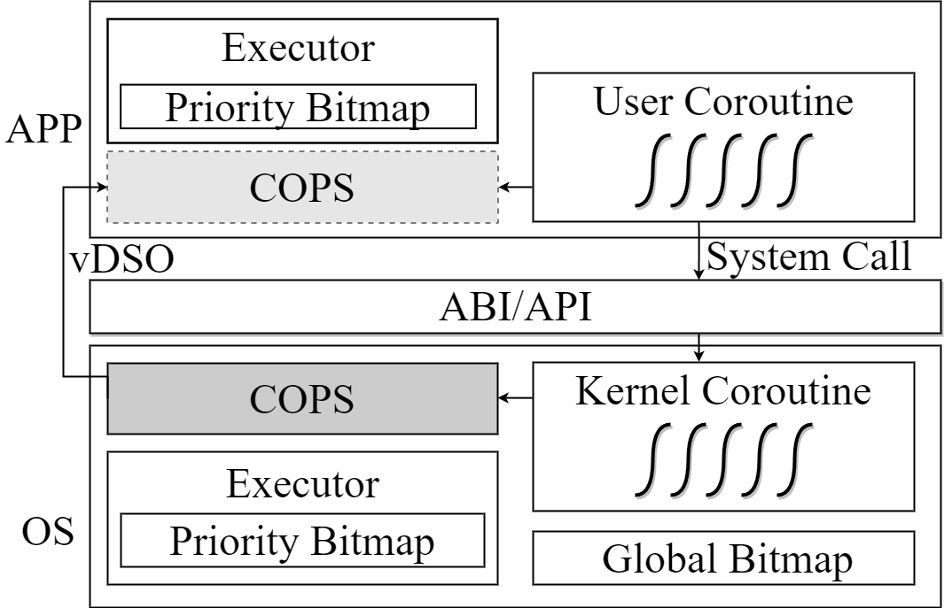
COPS Overview
Separate executor for task management.
Shared scheduling framework via vDSO.
Priority bitmap for cooperative scheduling.
Obtain asynchronous I/O service through syscall.

Slide 9
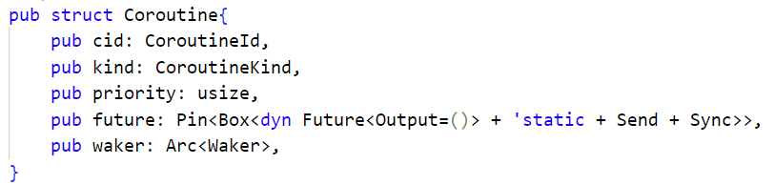
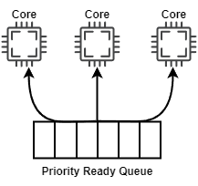
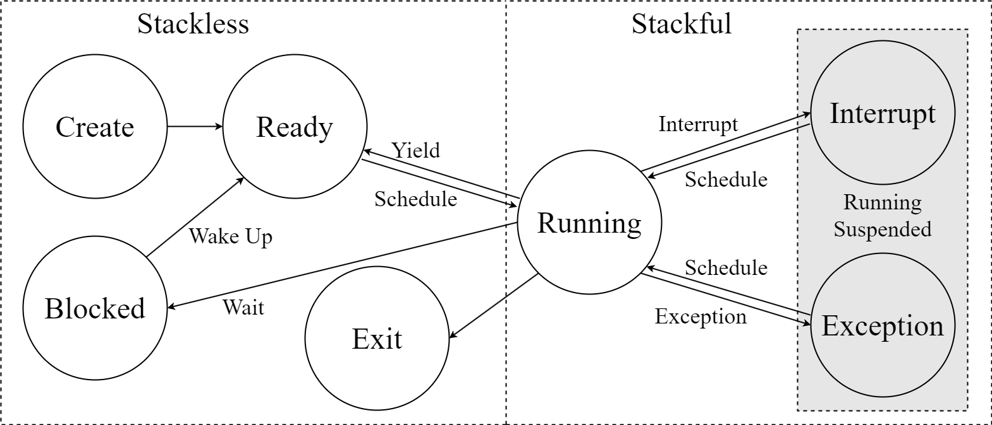
Coroutine Management
Coroutine Control Block
Executor:
Priority ready queues
blocking set
Coroutine state

Slide 10
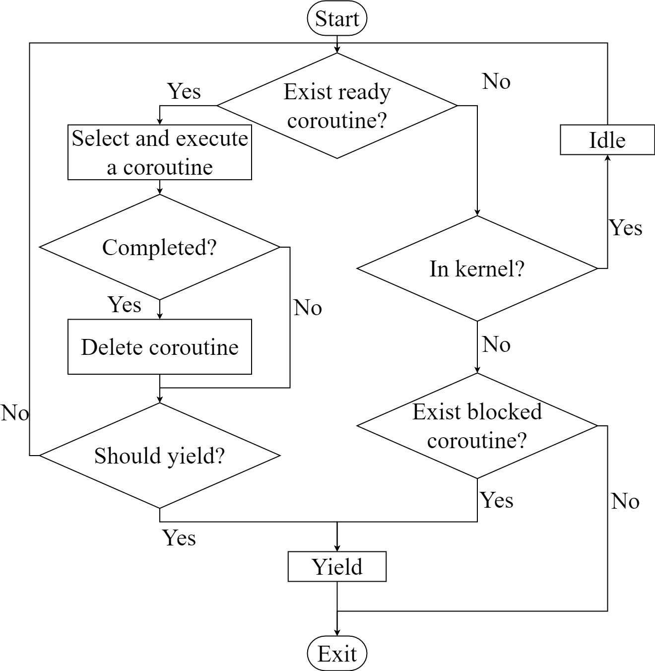
COPS API & Logic
Just define task inner logic without concerning about task execution order.
Function | Return value
spawn(future, priority) | cid
current() | cid
wake_up(cid)
set_priority(cid, priority)
alloc_cpu(cpu num)

Slide 11
COPS’s Global Cooperative Scheduling
Separative priority bitmap in executor for local cooperative scheduling.
Global priority bitmap for global cooperative scheduling between kernel and user processes.
Timer interrupt.
Kernel scan local bitmaps.
Kernel update global bitmap.
Select the highest coroutine in all kernel and user processes.

Slide 12
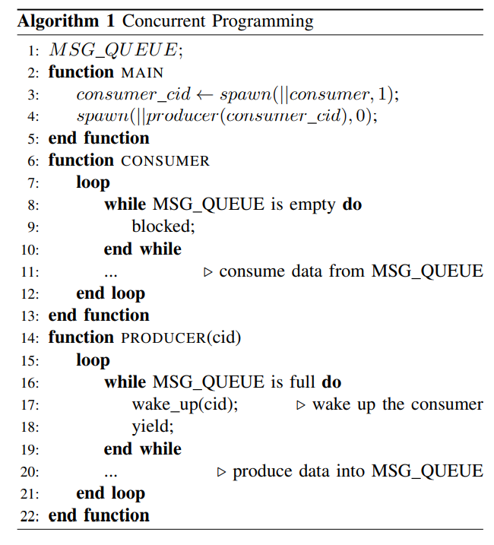
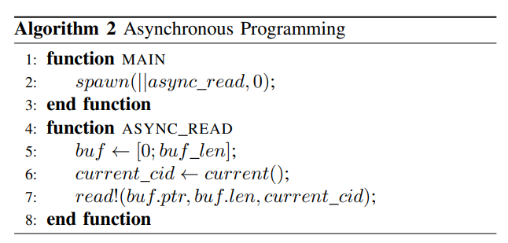
Usage Patterns of COPS
Concurrent Programming
Asynchronous Programming

Slide 13
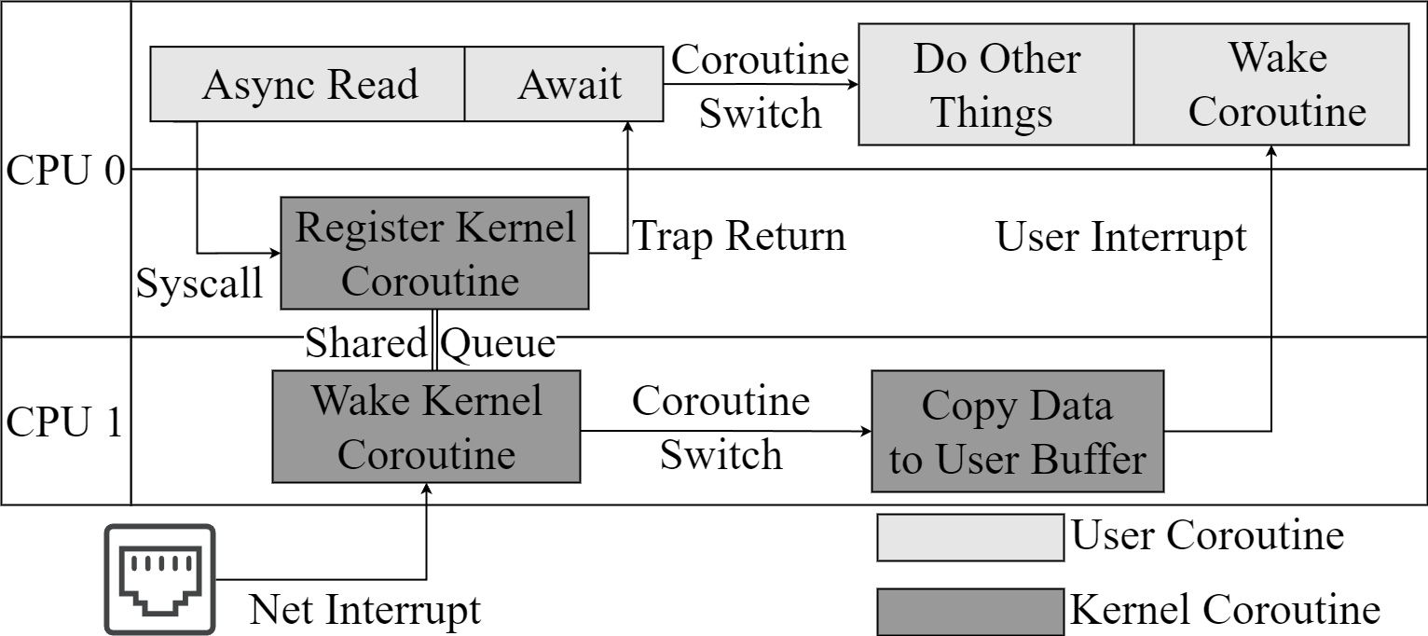
Asynchronous Syscall
CPU0
App Issue asynchronous I/O request
Back to user space
Switch to do other things
CPU1
Receive net interrupt
Execute kernel coroutine
Wake up blocked task on CPU0
3
1
2
6
5
4

Slide 14
Evaluation Questions
Can COPS outperform than multi-threading model?
Throughput
Latency
Memory Usage
Are high priority requests handled first?

Slide 15
Evaluation Setup
Testbed
Web Server built with three component(using Multi-threading / Coroutine)
Request receiver
Request handler
Response Sender
Network Stack | smoltcp
Operating System | rCore-tutorial
FPGA | RISC-V soft IP core | rocket-chip with N extension, 4 Core, 100MHz
 | Ethernet IP core | Xilinx AXI 1G/2.5G Ethernet Subsystem (1Gbps)
 | Zynq UltraScale+ XCZU15EG MPSoC

Slide 16
Evaluation: Thread vs. Coroutine
Server: Kernel(K), User Process(U), Thread(T), Coroutine(C)
KCUC
KCUT
KTUT
KTUC: similar to select, poll, epoll
Client
Package: 15*15 matrix payload
Interval: 100ms
5 seconds

Slide 17
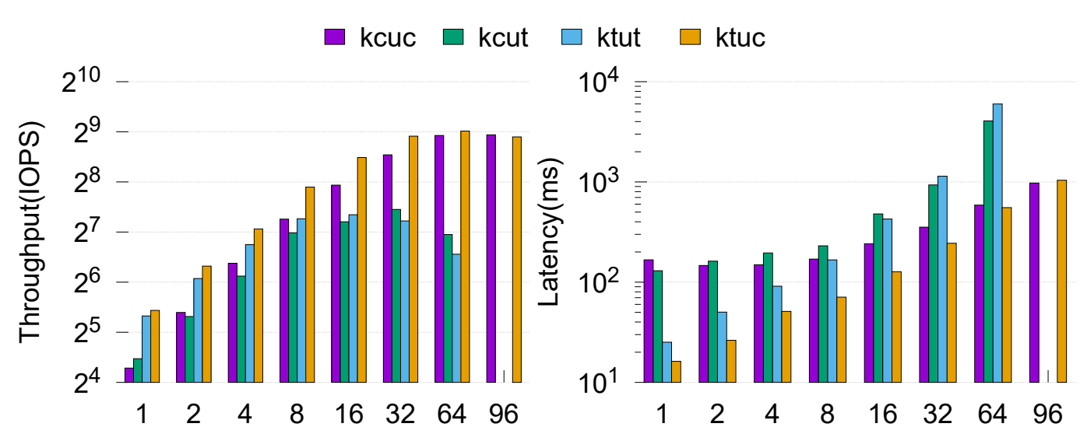
Evaluation: Coroutine vs. Thread
Runtime overhead
Ready Queue across multiply cores is being lock-protected.
Extra core for light workload(as same core allocation as thread model).

Slide 18
Evaluation: Coroutine vs. Thread
Suitable for heavy workload(KCUC vs. KTUC)
Higher throughput
Lower latency

Slide 19
Evaluation: Coroutine vs. Thread
Less memory usage(establish more connections at the same config)
Thread: each component need a kernel stack(0x4000 bytes) and a user stack(0x4000 bytes).
Coroutine:
receiver(120 bytes)
handler(64 bytes)
sender(80 bytes)
kernel syscall coroutine(176 bytes)
 | Memory Usage(bytes)
KTUT | 0x4000 * 2 * 3
KCUC | 0x4000 * 2 + 176 + 120 + 80 + 64
Configuration | Size(bytes) | KCUC | KTUT
Kernel heap | 0x80_0000 | 385 | 186
Kernel frame | 0x1A0_0000
User heap | 0x20_0000

Slide 20
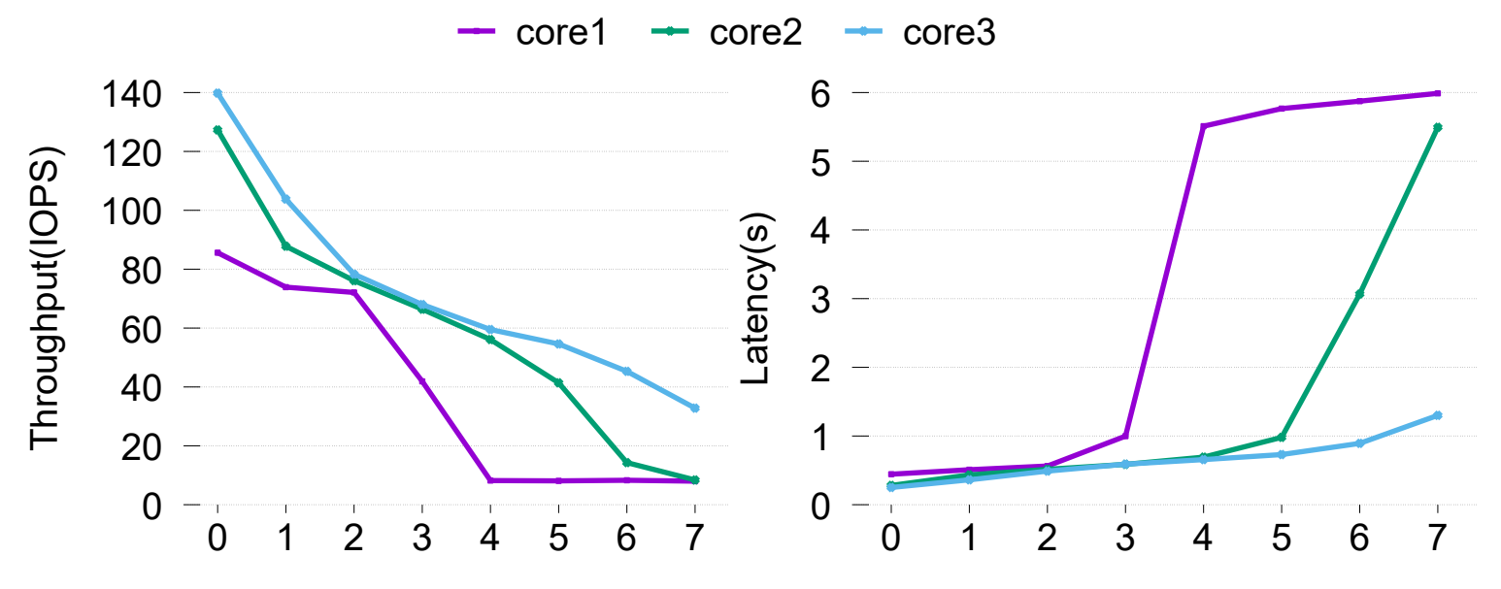
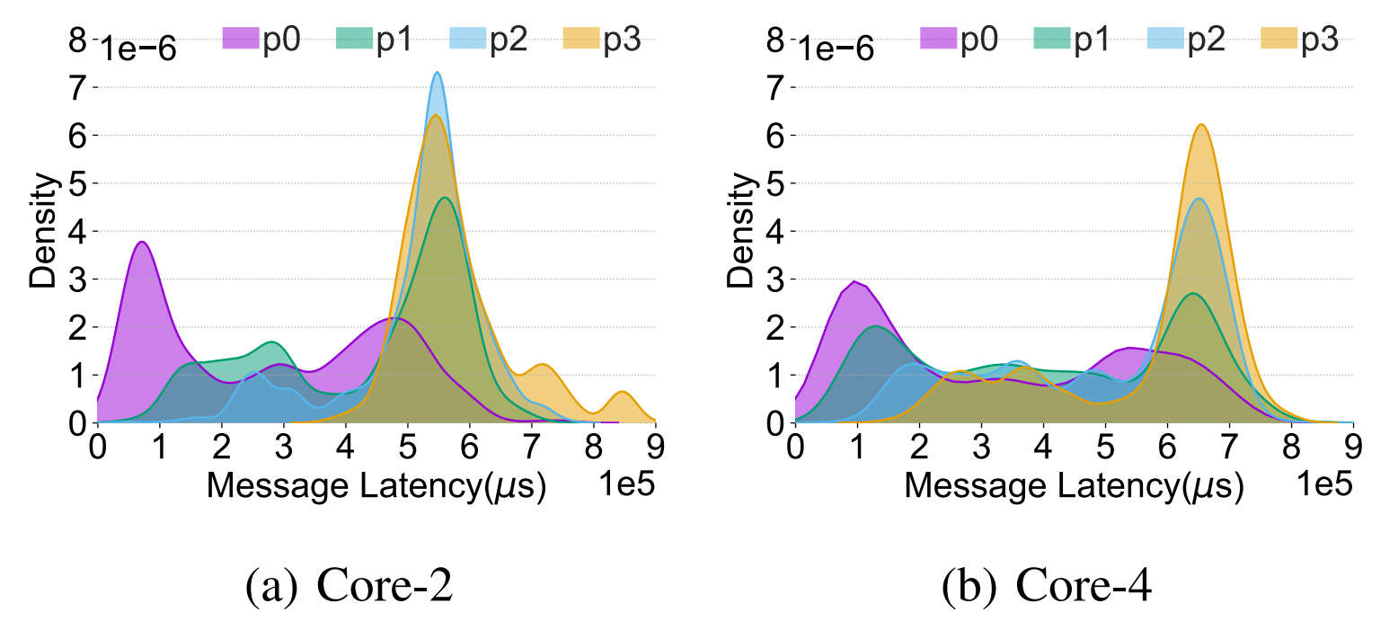
Evaluation: Priority Orientation
Setup
64 connections across 8 priority
Interval: 50ms
5 seconds
Higher priority ->
Higher throughput + lower latency
More resources ->
Lower priority connection is being improved.

Slide 21
Conclusion
COPS improve concurrency by:
Treating coroutines as the first-class citizens within OS to benefit from coroutines.
Employing priority scheduling to provide cooperation and efficient resource utilization.

