Slide 1
Automatic Damping Calculation
Zach Frohock

Slide 2
Overview
The function takes in data files directly from the broadband FMR device, interactively processes them, and outputs figures which provide information about the sample’s damping coefficient
This powerpoint is designed to help someone who knows very little MATLAB use the program. The focus will be on use, not necessarily understanding.
In autodamping.m one can find comments which give additional insight into inputs, outputs, and operational principles. It is suggested to have the file open as well. If you intend to edit the code for your own purpose, reference them.

Slide 3
Toolbox and Version Management
This program requires MATLAB and the optional Curve Fitting Toolbox to be installed.
The program was written on MATLAB Version: 9.6.0.1114505 (R2019a) Update 2, Curve Fitting Toolbox version 3.5.9. The machine runs on Windows 8 version 6.2 with 64-bit Java version 1.8.0_181-b13
  It can certainly run on different versions of any of these pieces of software, but functionality is not necessarily guaranteed

Slide 4
File Management
Once MATLAB and the curve fitting toolbox are installed, make a folder and place the following files within it:
  autodamping.m
  GaussianDerivativeFunction.m
  IPKittelEquation.m
  LorentzianDerivativeFunction.m
  OOPKittelEquation.m
  Data files from the BBFMR
Upon successful execution of the program there will be many .fig files saved to this directory
Navigate to the created directory using the left-hand pane

Slide 5
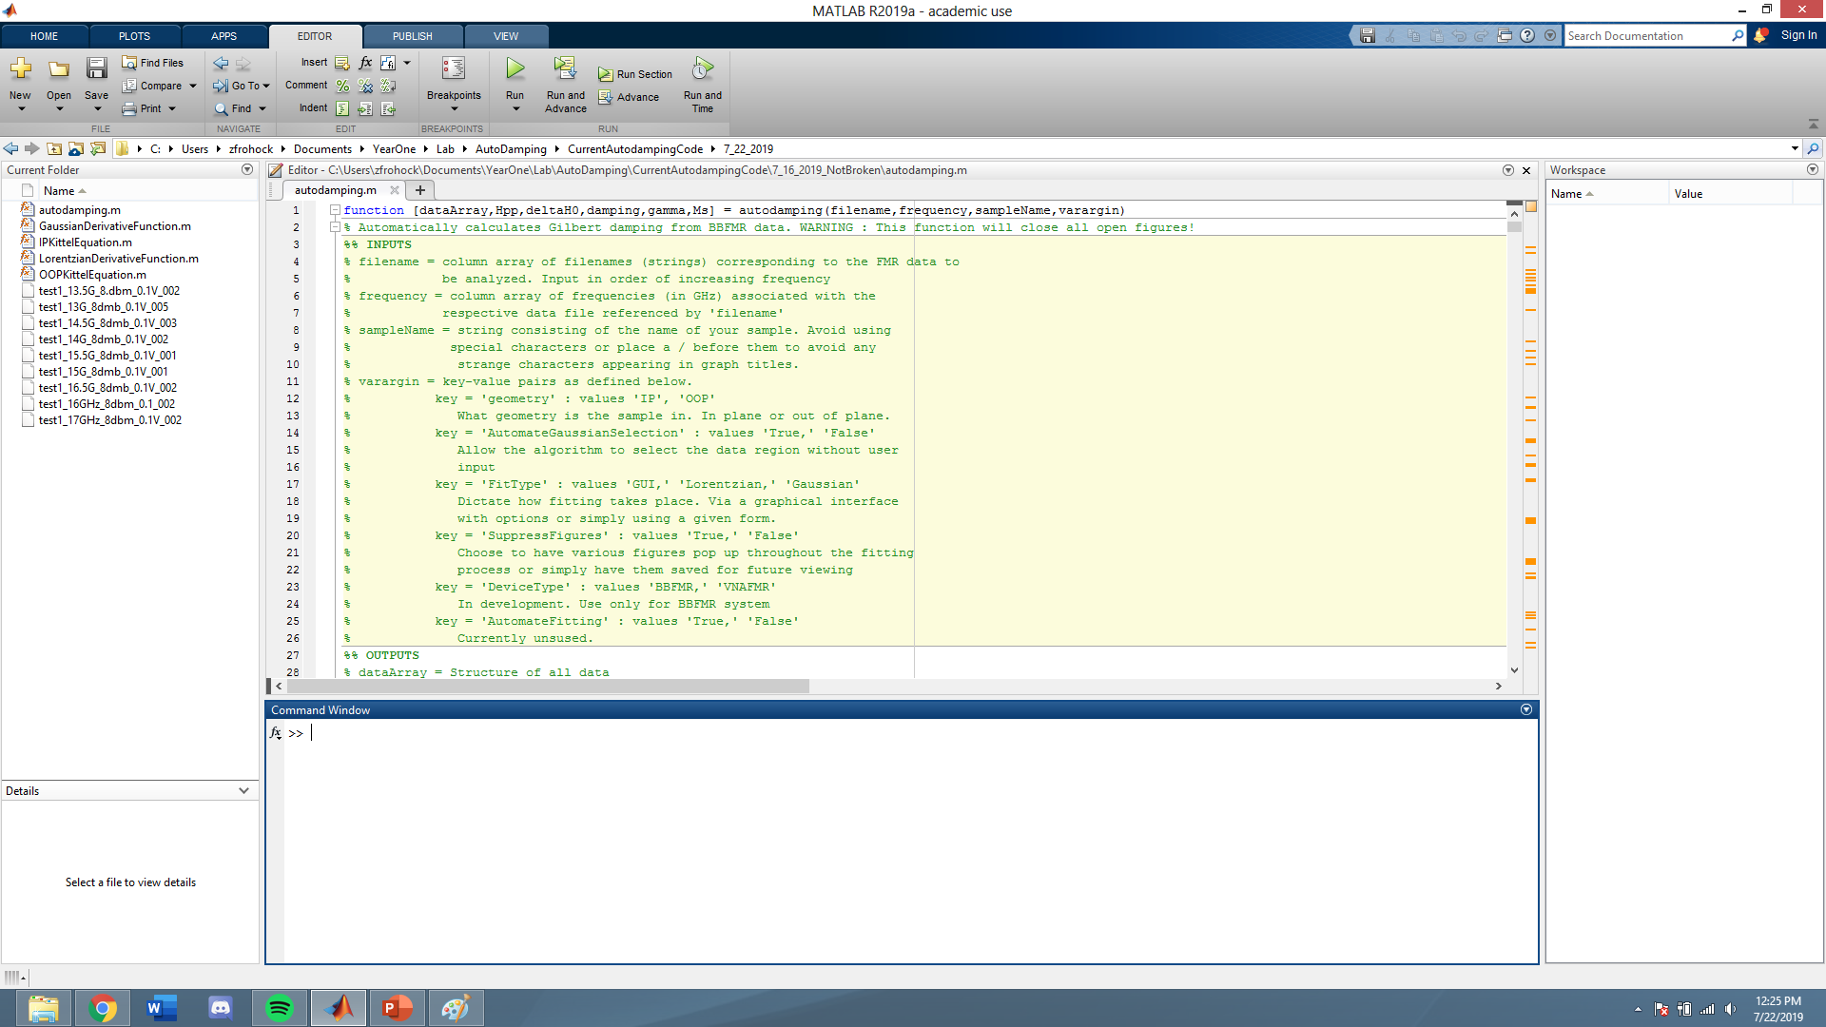
Workspace Example

Slide 6
Function Call and Inputs
In its most basic form, the function we will call will take the following form
[dataArray,Hpp,deltaH0,damping,gamma,Ms] = autodamping(filename,frequency,sampleName);
There are three mandatory inputs: a column cell array of the filenames, a column array of the corresponding frequencies, and a character array of the sample name.
Before we call the program, we must define these variables. For example:
filename={'test1_13G_8dmb_0.1V_005';'test1_13.5G_8.dbm_0.1V_002';'test1_14G_8dmb_0.1V_002';'test1_14.5G_8dmb_0.1V_003';'test1_15G_8dmb_0.1V_001';'test1_15.5G_8dmb_0.1V_001';'test1_16GHz_8dbm_0.1_002';'test1_16.5G_8dmb_0.1V_002';'test1_17GHz_8dbm_0.1V_002’};
frequency = [13;13.5;14;14.5;15;15.5;16;16.5;17];
sampleName = 'exampleName’;
With the inputs defined, we can call the function in the command line
If your sample has been tested with out of plane geometry, use the ‘geometry’ key-value pair to make that distinction. See the next slide for key-value pair info.

Slide 7
Function Call and Input Notes/Troubleshooting
Ensure that the frequency and filenames correspond correctly
Ensure that the filenames and frequencies go in ascending order. The multi-file fitting algorithm has a bias towards increasing linewidth with increasing frequency
The structure containing the filenames must be bookended by curly braces, and both filenames/frequency must have values separated by semicolons
There are many key-value pairs which can be called after the three mandatory inputs. Such inputs modify the behavior of the function, the details of which will be noted as it becomes relevant.
  Adding a key-value pair is accomplished as follows
[dataArray,Hpp,deltaH0,damping,gamma,Ms] = autodamping(filename,frequency,sampleName,’keyName’,’valueName’);

Slide 8
Selecting Fitting Regions
By default, the program uses machine learning to locate the region to which a Lorentzian/Gaussian can be effectively fit. It
Respond to the pop-up prompt. If the algorithm selected a reasonable region, select ‘Yes.’ If it did not, select ‘No.’ You will be asked to select the bounds of the region you would like to fit
The key-value pair ‘AutomateGaussianSelection’ moderates this process. The default is ‘False,’ meaning the prompt/crosshair process repeats for each data file. A value of ‘True’ automatically accepts the algorithms guess for each fitting region. It is recommended to begin a new dataset with it set to ‘False.’

Slide 9
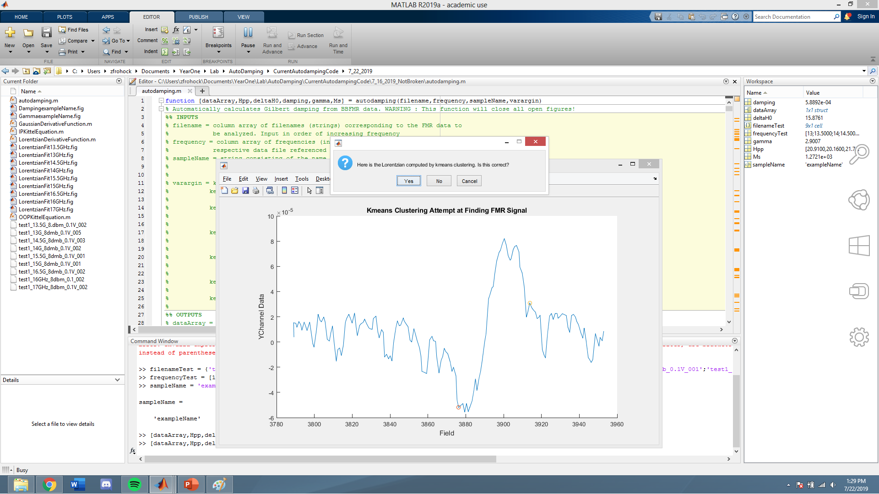
Selecting Fitting Region Dialogue

Slide 10
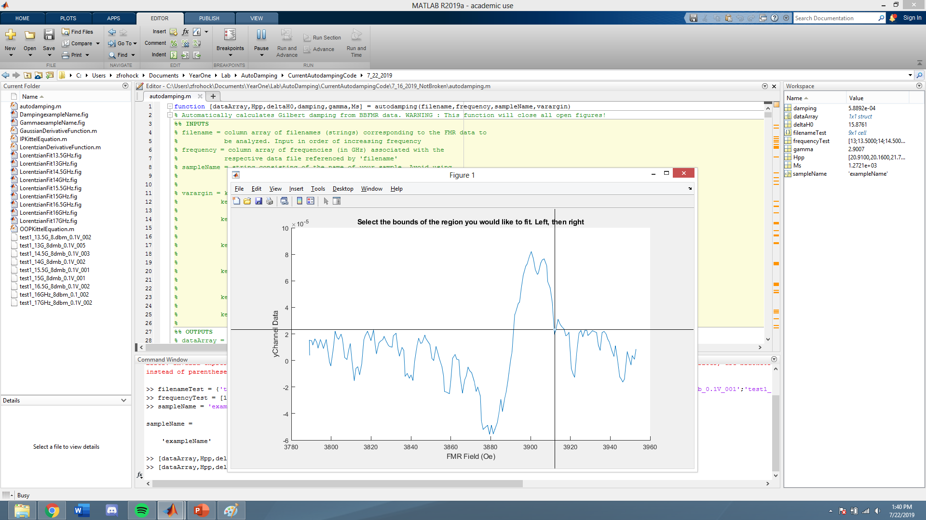
Selecting Fitting Region Crosshair

Slide 11
Fitting Region Selection Notes
The program is built to handle data which has a dip at low field and a peak at higher field. If the peak/dip positions are reversed there will be an error. Recommend multiplying data by negative one.
The process by which the algorithm selects the fitting region automatically is not deterministic. Thus it is possible, but extremely unlikely, that results will not be identical from run to run.

Slide 12
Fit Type Selection
By default, upon being fed the fitting regions, the algorithm with present the user with a choice of using either a Lorentzian or Gaussian fit.
A two-paned graph will appear. On the left is a Lorentzian fit of the first data file (lowest frequency). On the right is a Gaussian fit of the same. Select which fit appears better by selecting either ‘Lorentzian’, or ‘Gaussian.’ If neither fit is reasonable, select ‘Neither.’ What occurs in the case of ‘Neither’ will be discussed later.
Upon selecting a fit type, the algorithm will fit the given curve type to all the provided data files, create a plot of frequency versus linewidth, and create a plot of frequency versus FMR field.

Slide 13
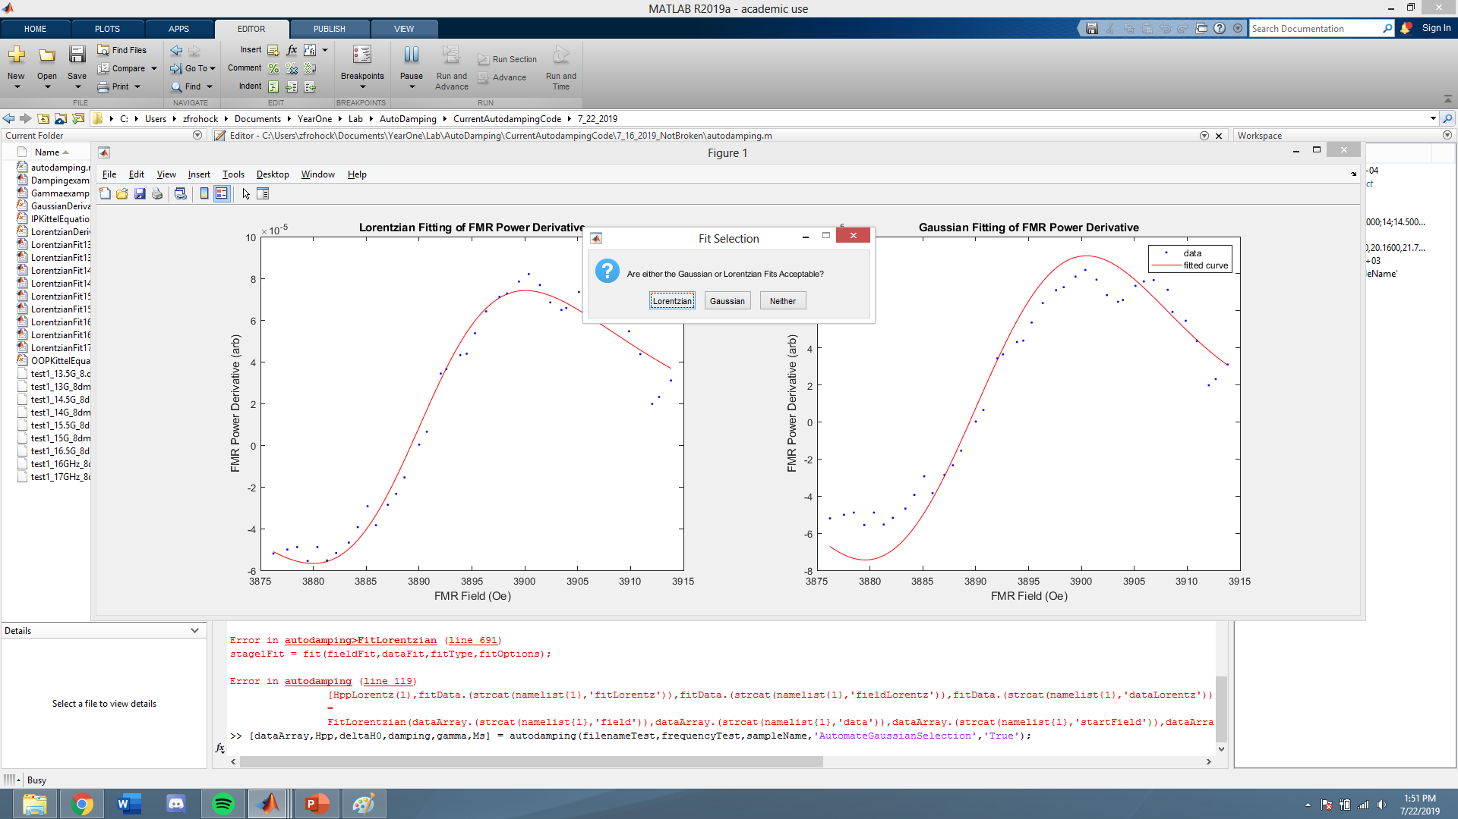
Fit Type Selection Example

Slide 14
Fit Type Selection Notes
It is possible to dictate which fit type will be used via the ‘FitType’ key value pair; either ‘Lorentzian’ or ‘Gaussian.’
As the individual fitting is done, the figures pop up momentarily as they are saved. This can be helpful for quickly determining the quality of the fits. It is possible to disable this and simply save the figures without opening them. To do so, use the key-value pair ‘SuppressFigures’ -> ‘True.’
The figures saved appear in the left-hand panel. Double clicking will open them in the MATLAB viewer. From there it is possible to save them as .jpg files.
It is recommended to check both the individual figure files and the damping figure for reasonability
One can find the calculated values of alpha and gamma (with statistical error) in the upper right corner of their respective figures. They are also output to the command line

Slide 15
Manual Fitting
If neither the Gaussian nor Lorentzian fits are successful, it may be necessary to manually manipulate the initial values and bounds of some or all of the fitting parameters. Selecting ‘Neither’ in the fit type dialogue will launch you into this process.
You will be asked which fit looked better; this dictates which curve you will attempt to manually fit.
Upon curve type selection, a dialogue that contains fields to enter values for the upper bound, lower bound, and initial value for all fitting parameters. The previous values will auto populate, so change only as necessary.
Selecting ‘Ok’ on this dialogue fits the data using the parameters input using the array of data entry boxes.
Once fitting is done, a figure will be displayed. That figure is based on the values entered last. There is no continuous updating. You will be asked whether the fit is acceptable. Selecting ‘Yes’ moves the process on to the next file. Selecting ‘No’ sends you back to the multi-input dialog box. The defaults are now the values entered last time.

Slide 16
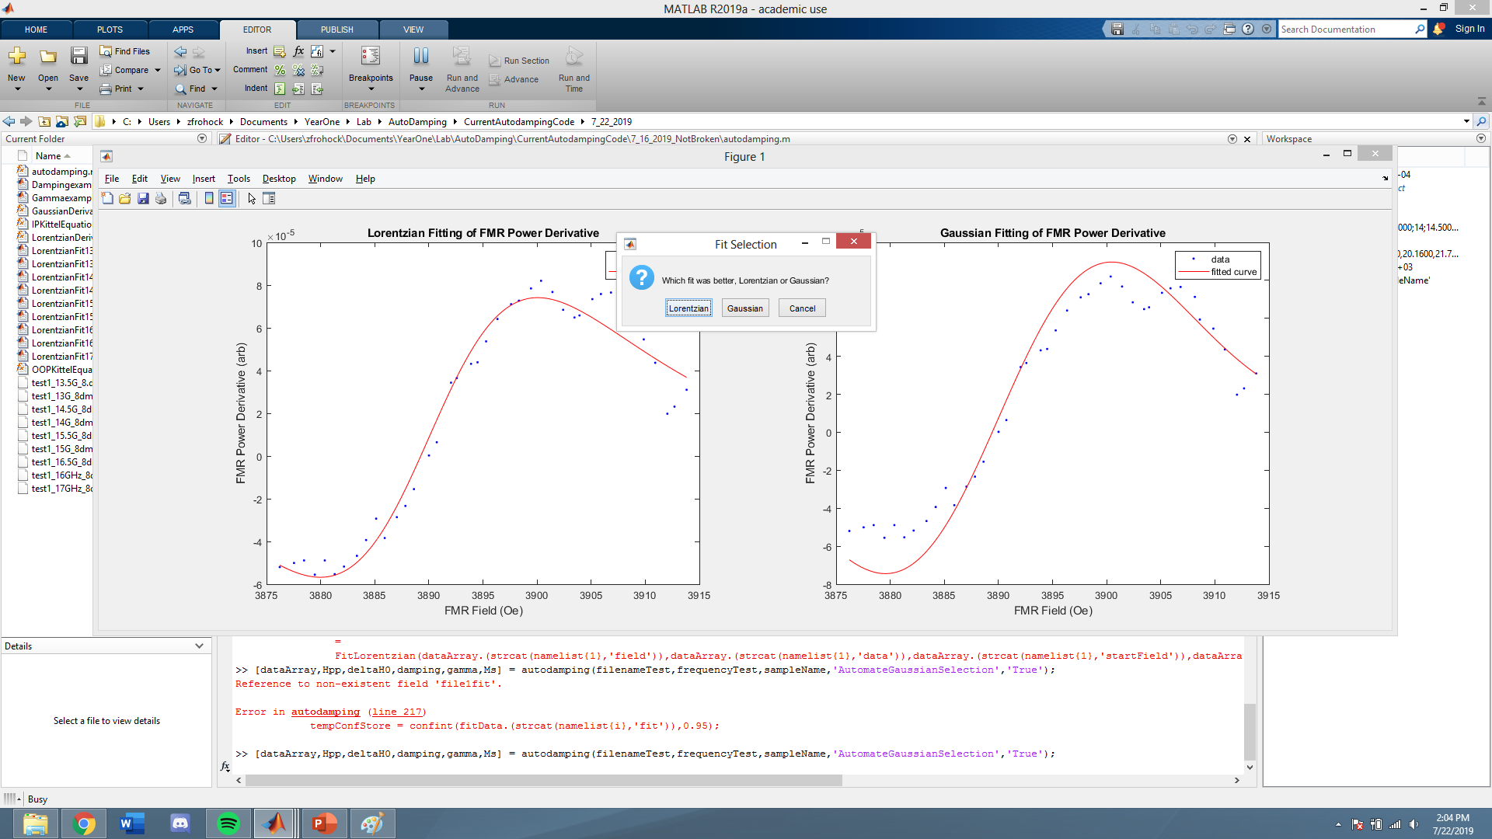
Manual Fitting Curve Selection

Slide 17
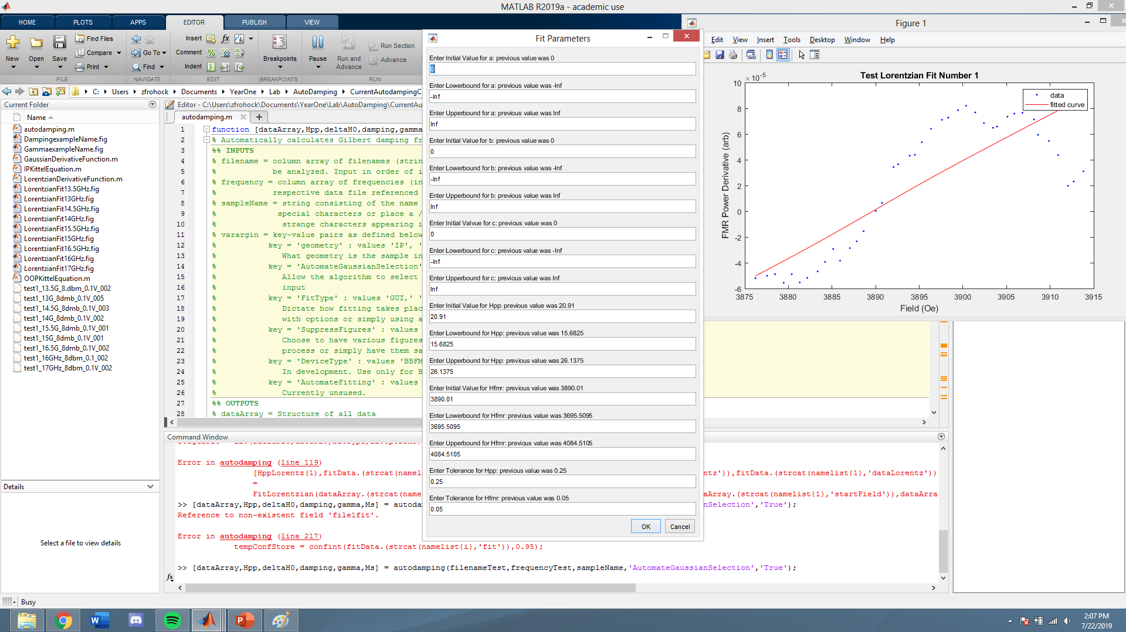
Manual Fitting Process

Slide 18
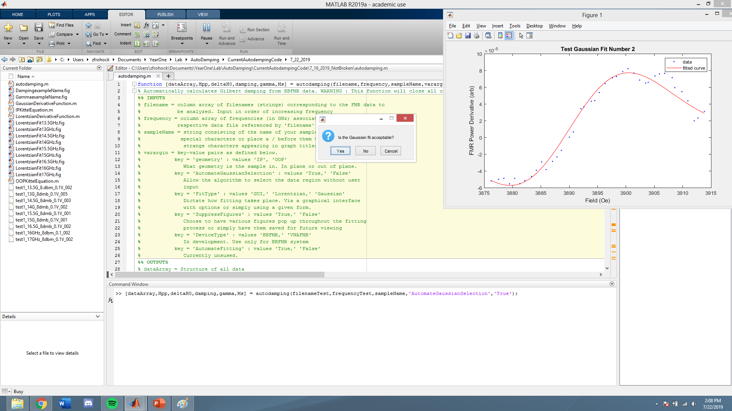
Manual Fitting Confirmation

Slide 19
Manual Fitting Notes
If you must use manual fitting, it is recommended you return to OriginPro. It is a more fully featured program, and this type of manipulation is what it is built for. As written, the autodamping function includes it mostly for completeness.
Extensive testing has not been done, but my results are in general comparable to those achieved with OriginPro. Your success may differ.

Slide 20
Output
The program outputs MATLAB figure files for each data file input in addition to a figure file for damping and gyromagnetic ratio graphs.

Slide 21
General Notes
This program will close all open figure files.
Some elements of the program have not been extensively tested. They are as follows:
  Calculations of the gyromagnetic ratio for out of plane geometries
  Applications of the program to cavity FMR
  High and low temperature FMR data
The program will not work with certain types of FMR data
  VNAFMR data

