Slide 1

Sprint 2 Assignment
Group 2: Zachery Frye, Danielle LaMarche,
Chandler Nimmer, Qianyang Liu

Slide 2
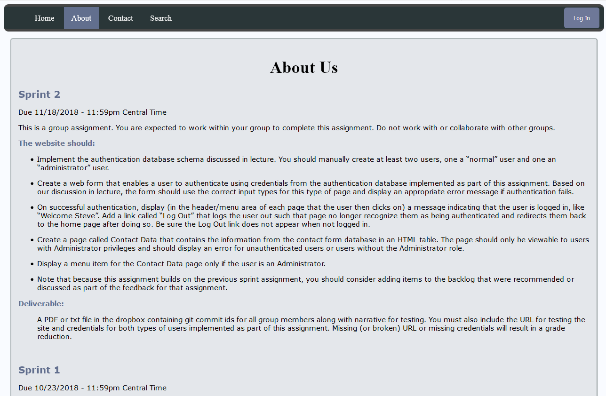
About US

Slide 3
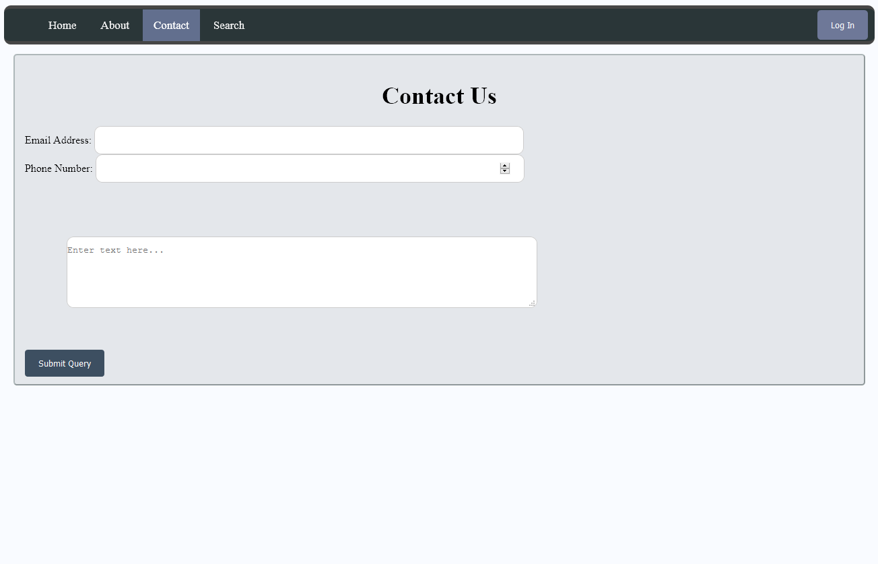
Contact US

Slide 4
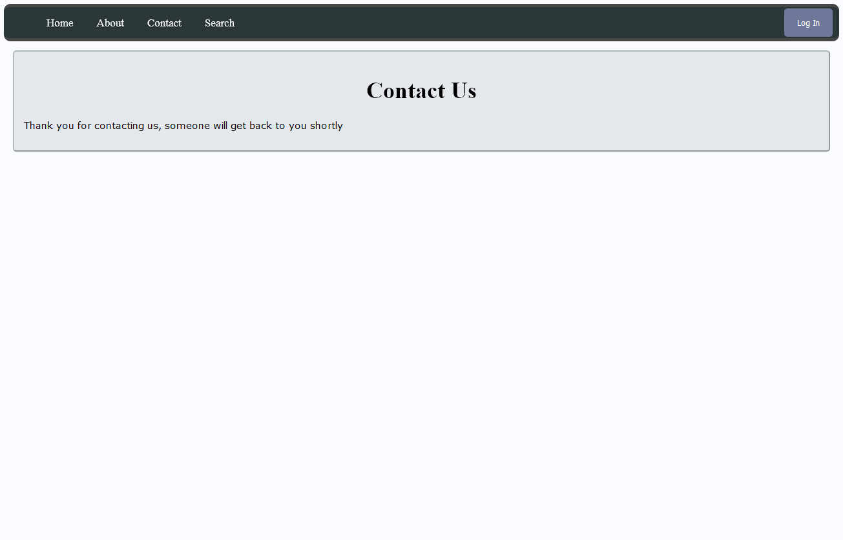
Contact us result

Slide 5
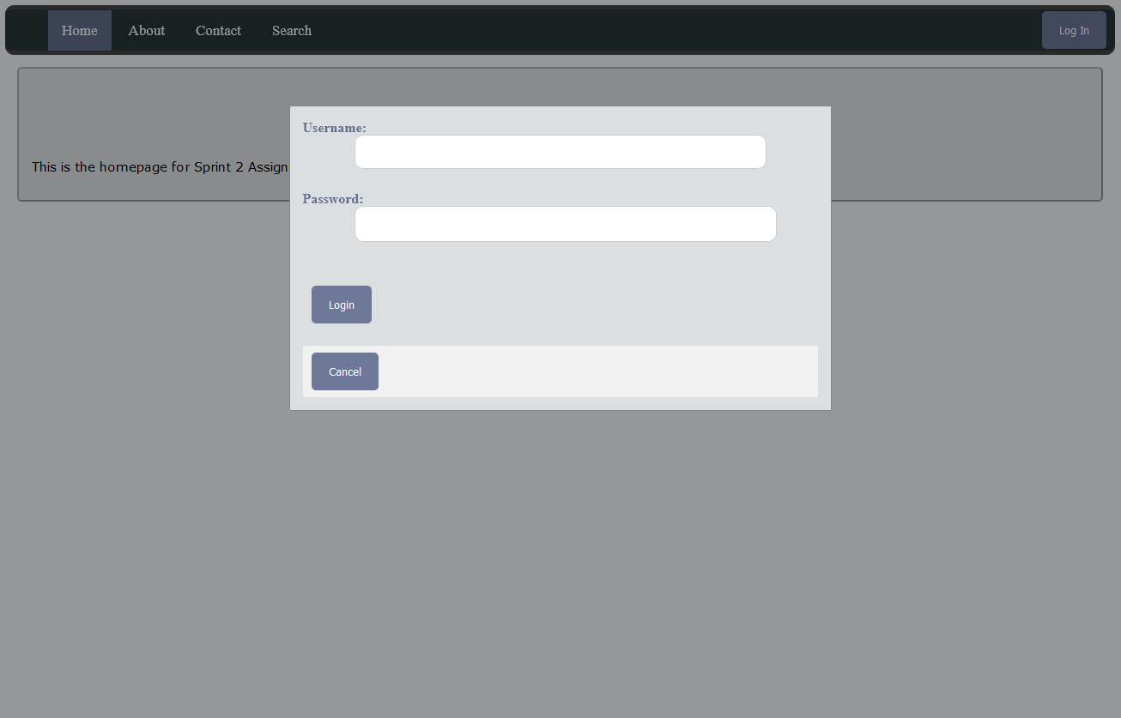
Login Form

Slide 6
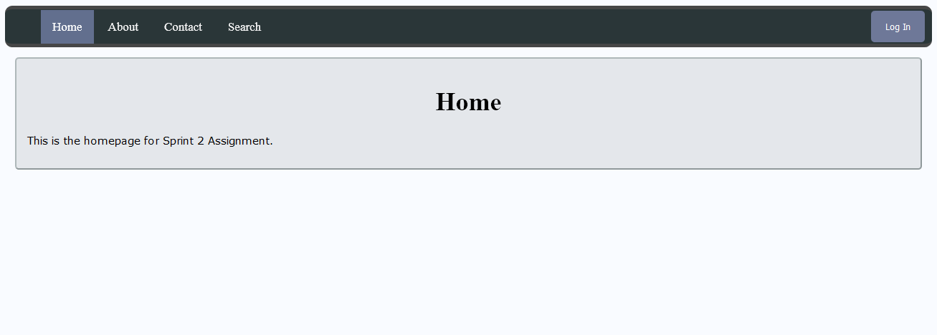
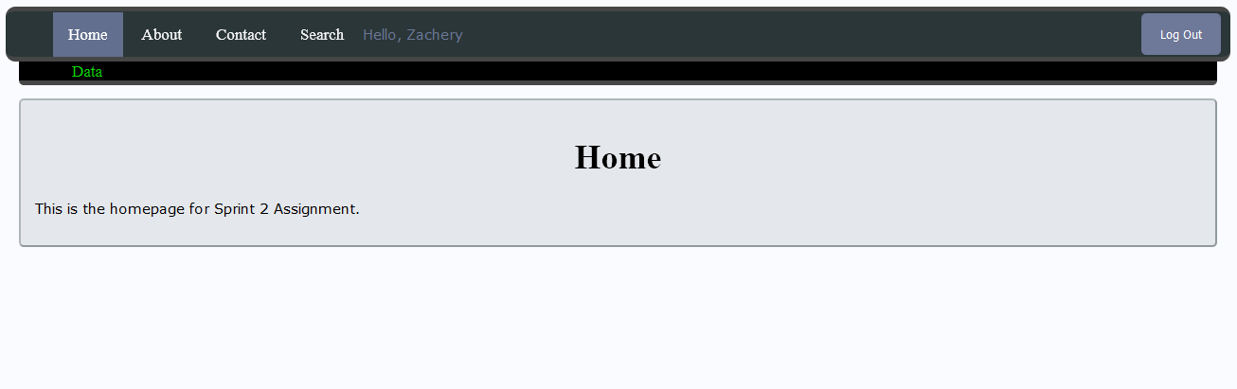

Login Admin

Slide 7
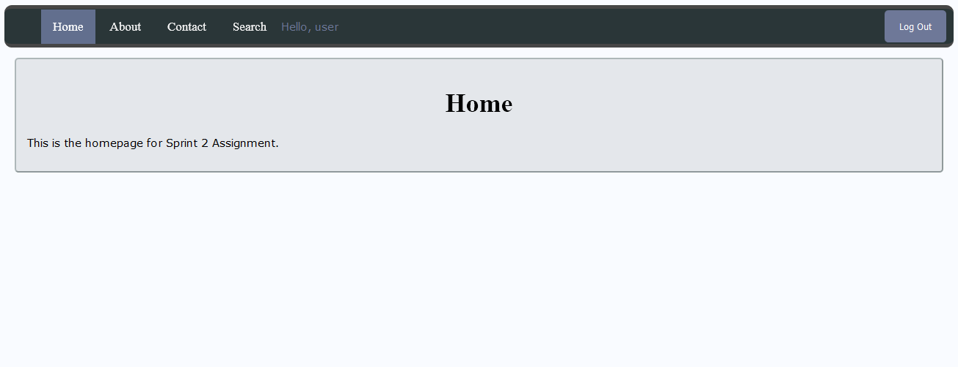
Login User

Slide 8
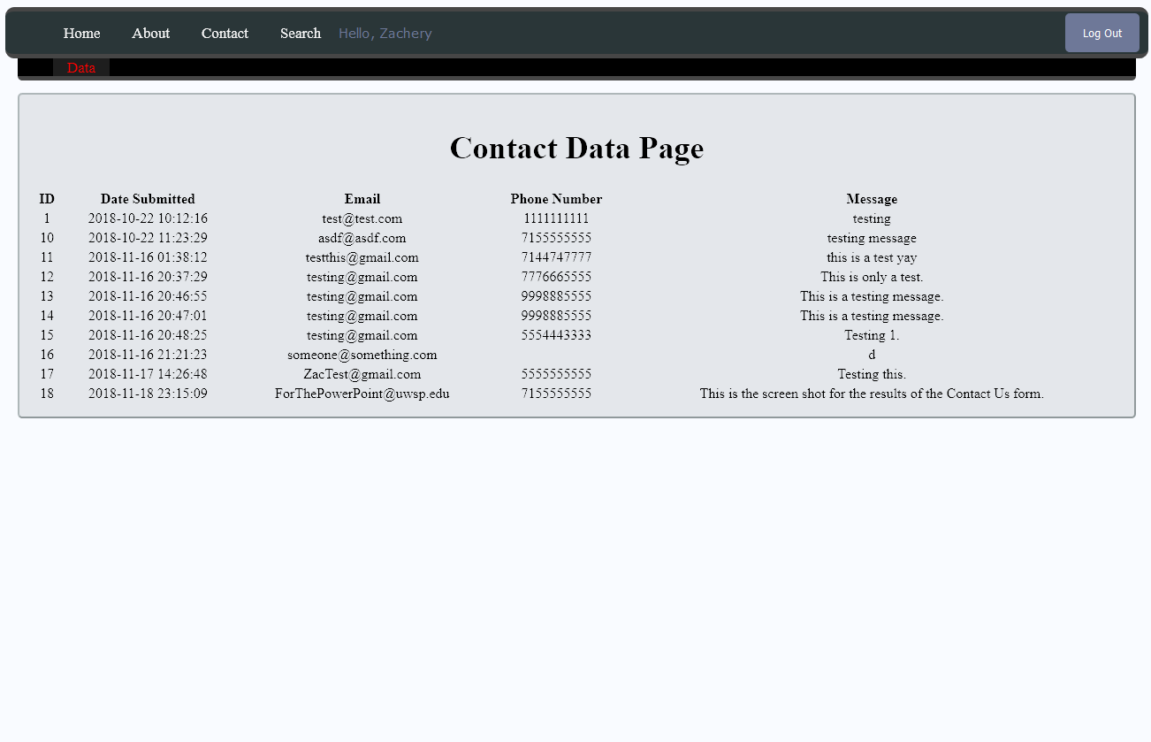
Admin Page

Slide 9

Backlog
Backlog:
Everything was completed.
Future:
Looking forward to the next Sprint.

