Slide 1
Ruby 1.8.7 Certification Preparation
By Sir Flavio, the Vit

Slide 2
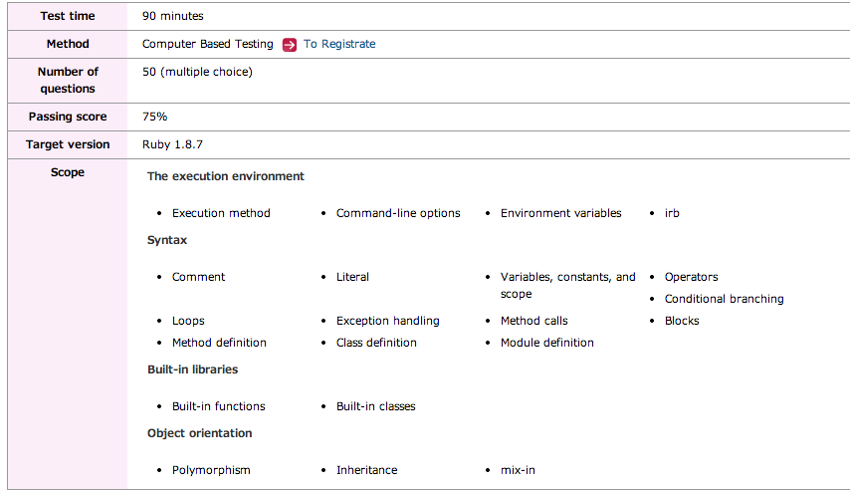
Scope
The execution environment
Execution method Command-line options Environment variables irb
Syntax
Comment Literal Variables, constants, and scope
Operators Conditional branching Loops
Exception handling Method calls Blocks
Method definition Class definition Module definition
Built-in libraries
Built-in functions Built-in classes
Object orientation
Polymorphism Inheritance mix-in

Slide 3
Helpful Links
http://www.ruby.or.jp/en/certification/examination/
http://ruby-doc.org/core-1.8.7/
http://www.minituku.net/
http://rexaminator.com/
http://www.brainbench.com/xml/bb/common/testcenter/consumer/taketest.xml?testId=2967

Slide 4
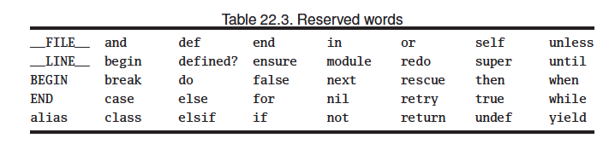
Reserved Keywords

Slide 5
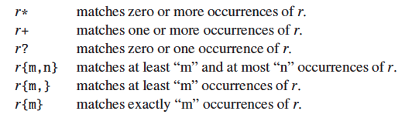
Regex Nightmare

Slide 6
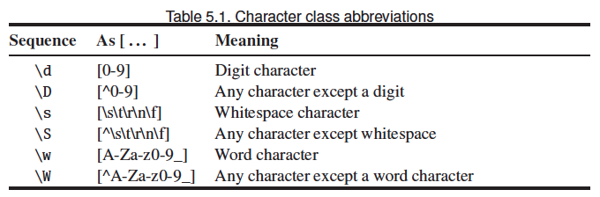

Slide 7
Tricks and traps
Check object type (class hierarchy and mix-ins ): is_a? and kind_of are synonyms
Check exact instance type: instance_of
Converting to array traps:
Not for strings
Ok for ranges
Generates an array of strings using space as delimiter
%w =>no string substitution
%W => string substitution

Slide 8
Tricks and traps
Array select versus each
Select returns array with the elements that the block returned true
Each returns the self array
equal? | eql? | ==
Object_id are equal? | Values and types are equal? | Values are equal?

Slide 9
Tricks and traps
File:
gets versus readline => behave almost the same. The first will return nil at the end of file while the second will throw EOFError

Slide 10
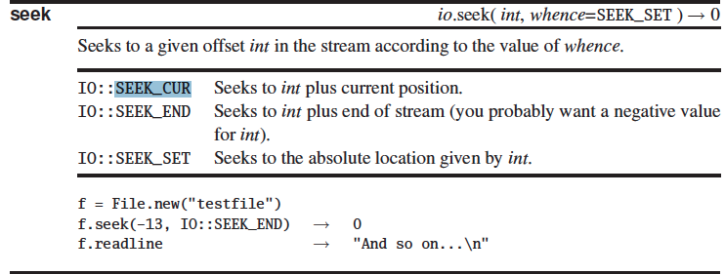
File Reading Tricks

Slide 11
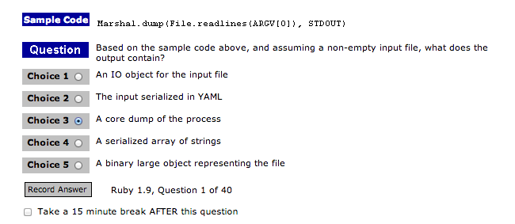

Slide 12
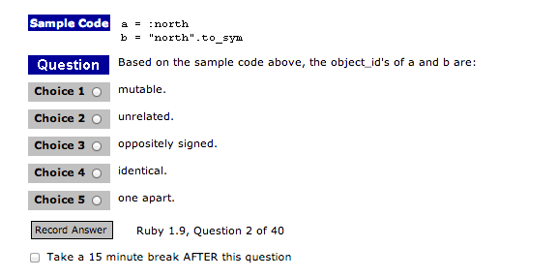
Answer: Identical … Symbol objects with same string are identical.

Slide 13
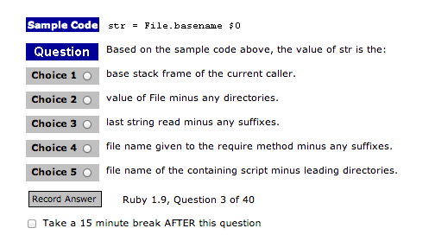

Slide 14
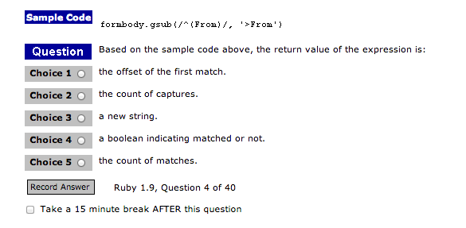
Crap … for sure it it returned a new string. Important to notice is that formbody
is not changed. gsub! In other hand will mutate the original string.

Slide 15
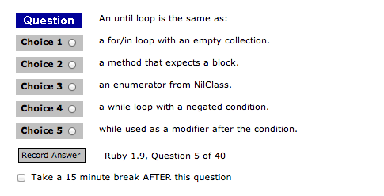
While loop with a negated condition

Slide 16
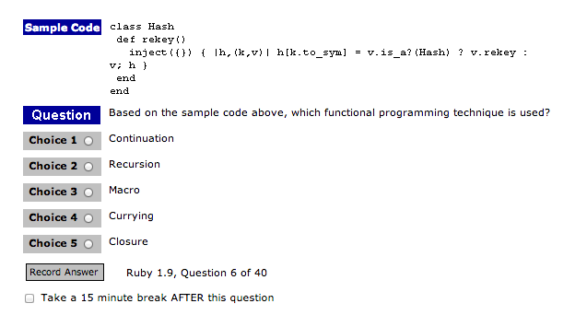
Recursion

Slide 17
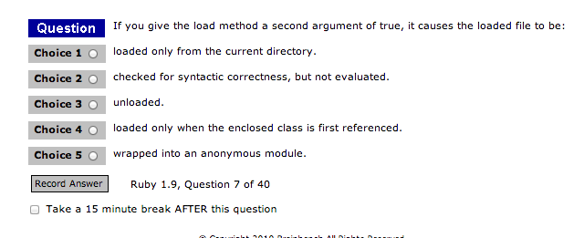

Slide 18
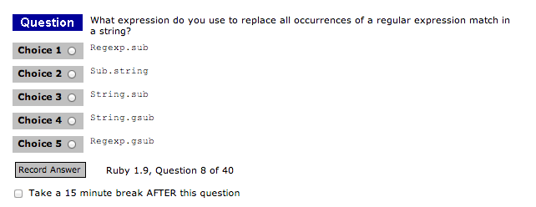
String.gsub

Slide 19
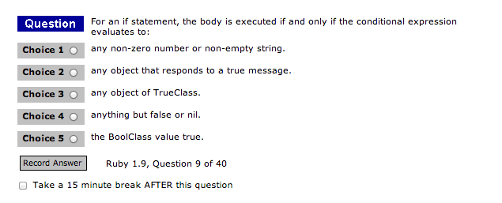
Anything but false or nil

Slide 20
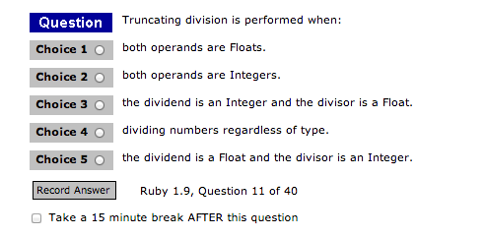
Whenever a float is used, the result will be float, otherwise
Truncation will happen

Slide 21
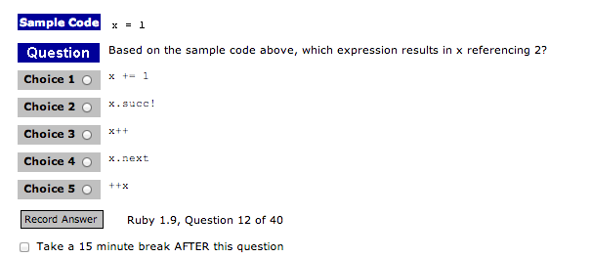
Ruby sucks! There is no x++ x-- ++x –x as in Java and C

Slide 22
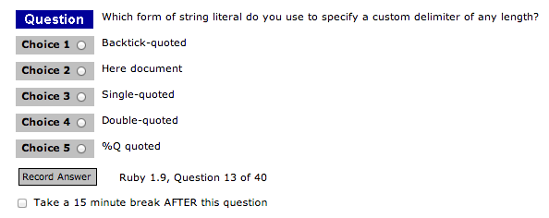

Slide 23
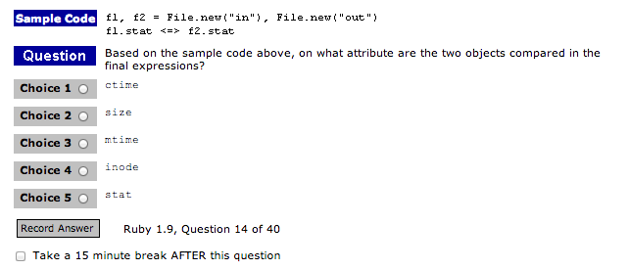
Stat can be used to compare modification times.

Slide 24
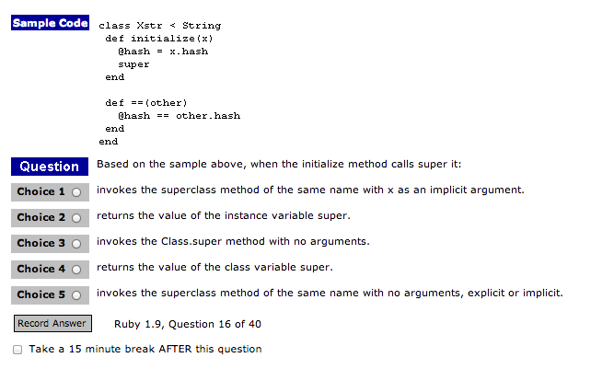

Slide 25
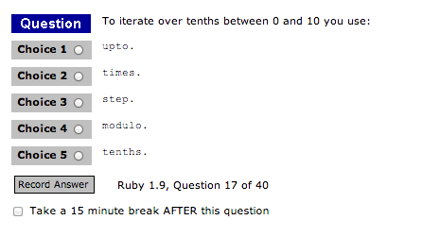
This will iterate over the tenths:
0.step(10,0.1) {|i| puts i}

Slide 26
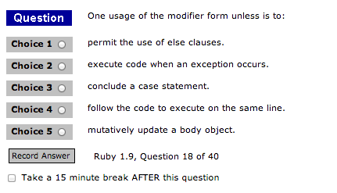

Slide 27
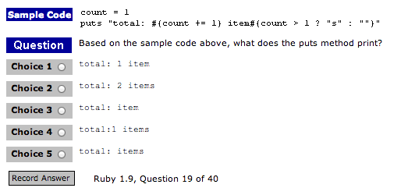

Slide 28
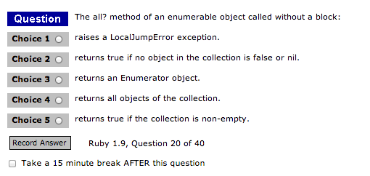

Slide 29
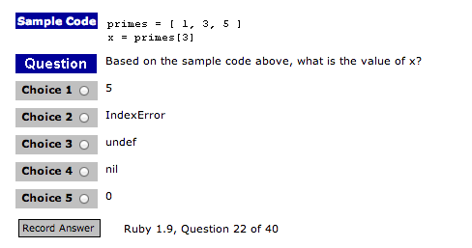

Slide 30
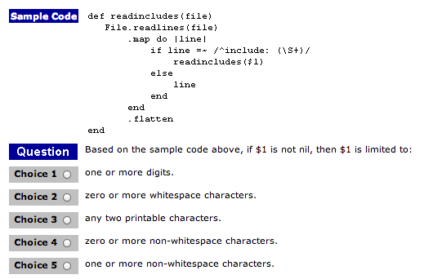

Slide 31
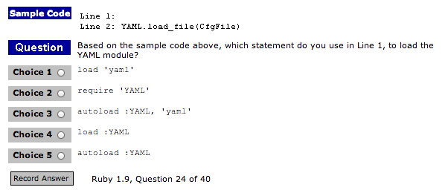

Slide 32
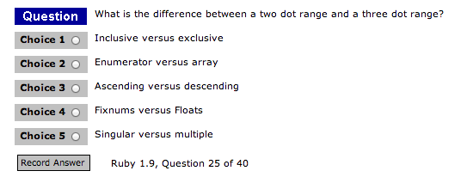

Slide 33
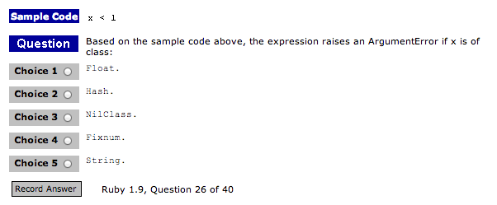

Slide 34
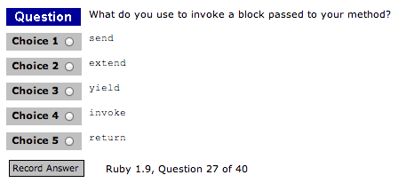

Slide 35
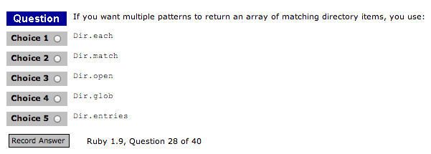

Slide 36
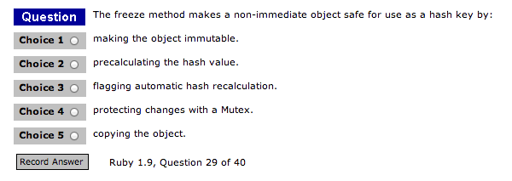

Slide 37
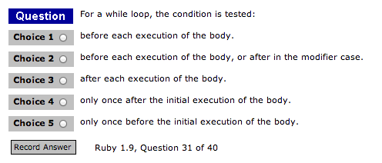

Slide 38
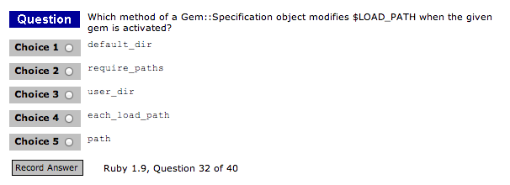

Slide 39
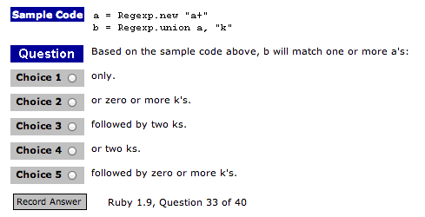

Slide 40
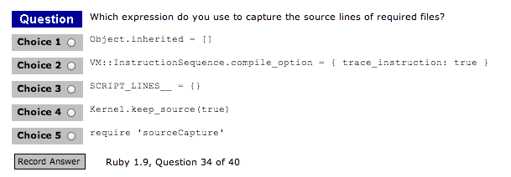

Slide 41
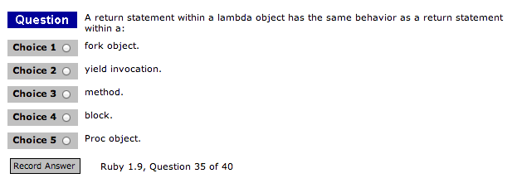
Procs in Ruby are drop in code snippets, not methods. Because of this, the Proc return is the proc_return method’s return, and acts accordingly. Lambdas however act just like methods, as they check the number of arguments and do not override the calling methods return.

Slide 42
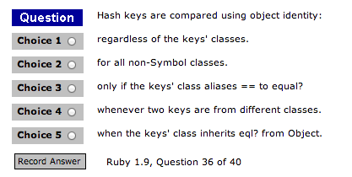

Slide 43
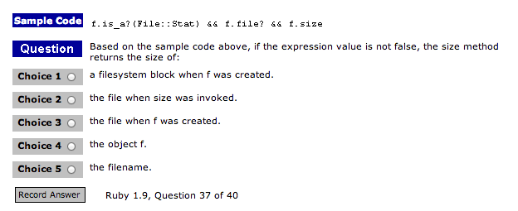

Slide 44
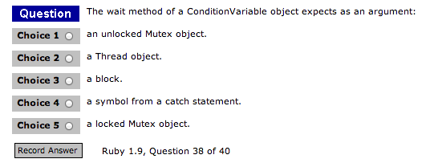

Slide 45
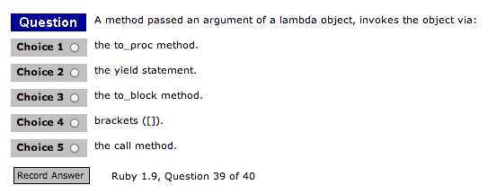

Slide 46
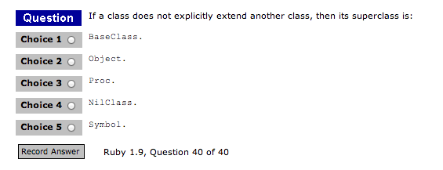

Slide 47
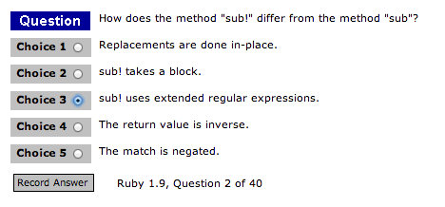

Slide 48
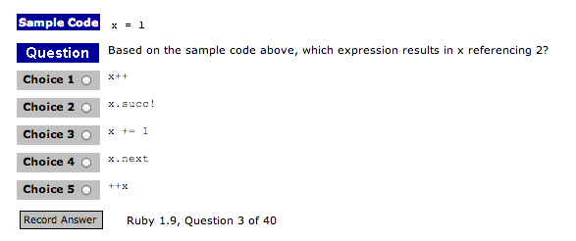

Slide 49
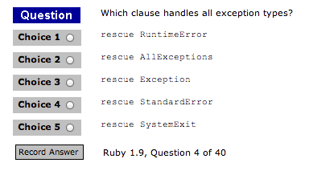

Slide 50
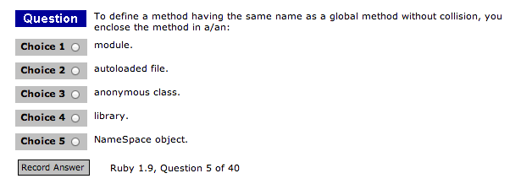

Slide 51
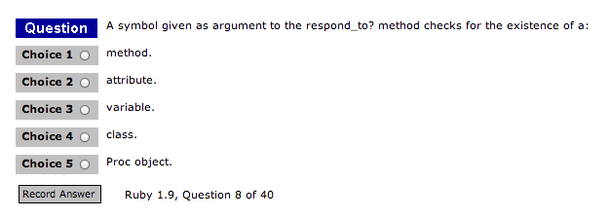

Slide 52
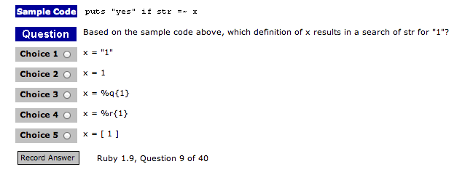

Slide 53
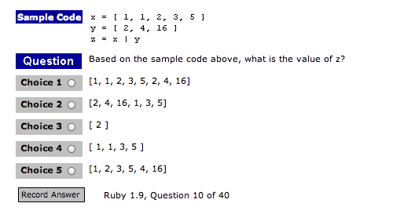

Slide 54
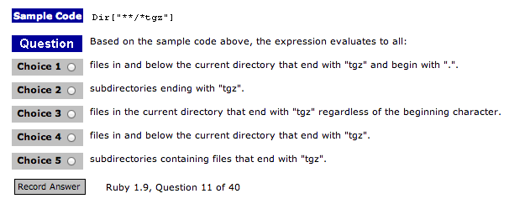

Slide 55
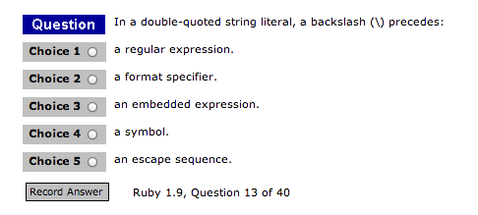

Slide 56


Slide 57


Slide 58


Slide 59


Slide 60


Slide 61


Slide 62


Slide 63


Slide 64


Slide 65


Slide 66


Slide 67


Slide 68


Slide 69


Slide 70


Slide 71


Slide 72


Slide 73


Slide 74


Slide 75


Slide 76


Slide 77


Slide 78


Slide 79


Slide 80


Slide 81


Slide 82


Slide 83


Slide 84


Slide 85


Slide 86


Slide 87


Slide 88


Slide 89


Slide 90


Slide 91


Slide 92


Slide 93


Slide 94


Slide 95


Slide 96


Slide 97


Slide 98


Slide 99


Slide 100


Slide 101


Slide 102


Slide 103


Slide 104


