Slide 1
Sudoku327
An Android App
By
Charles Lowell
Jeffrey Kennedy
Julie Frish
Mark Laubender
Zach Ganger

Slide 2
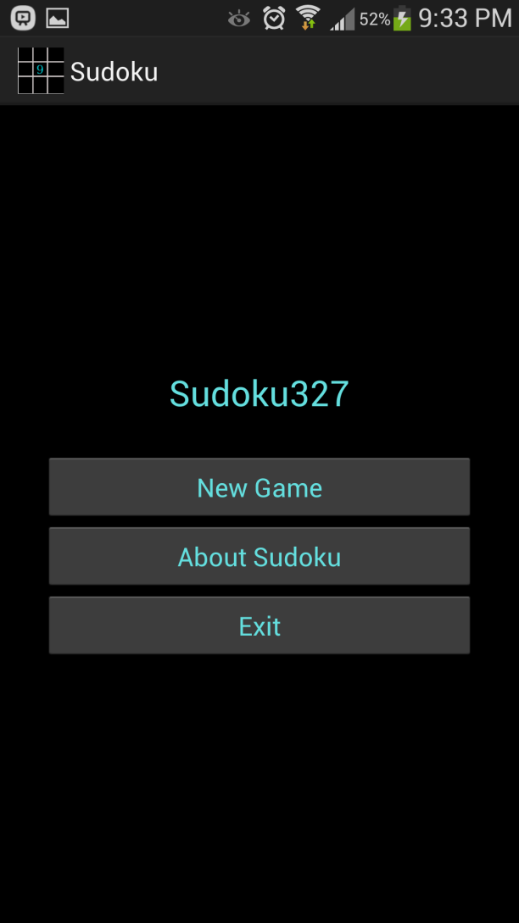
Main Menu
Consists of 3 buttons
Exit
About
New Game

Slide 3
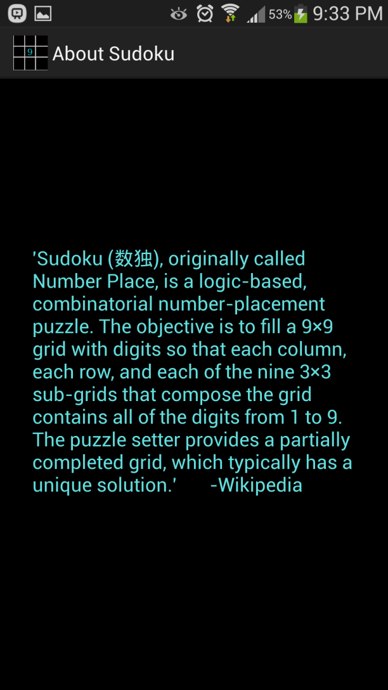
About
A recap of the rules of Sudoku, taken from Wikipedia

Slide 4
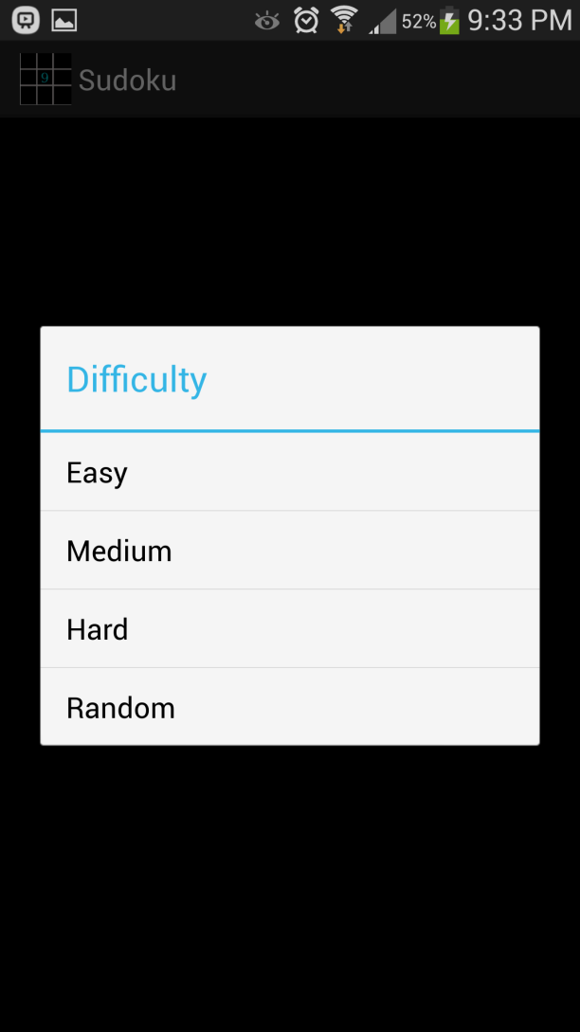
Difficulty Setting
Pushing the “New Game” button on the main menu will bring up a Difficulty alert dialog, where the user can choose his or her desired difficulty level, or choose a puzzle with a random difficulty

Slide 5
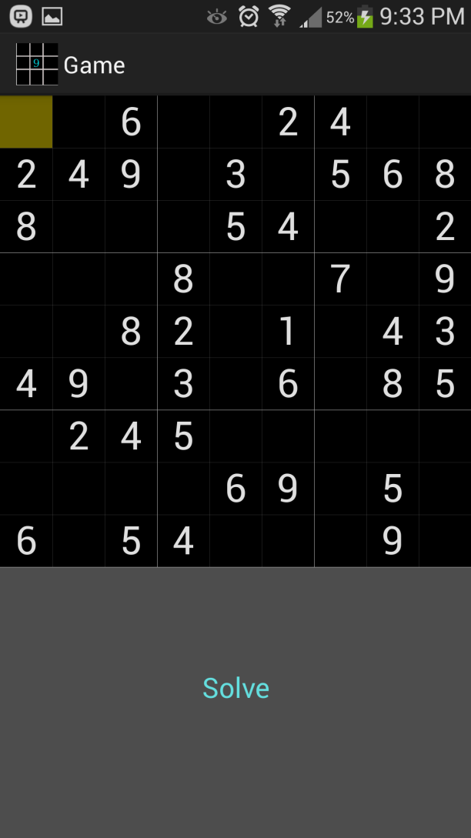
PuzzleView
The main puzzle view consists of a square board on top of a Solve button.

Slide 6
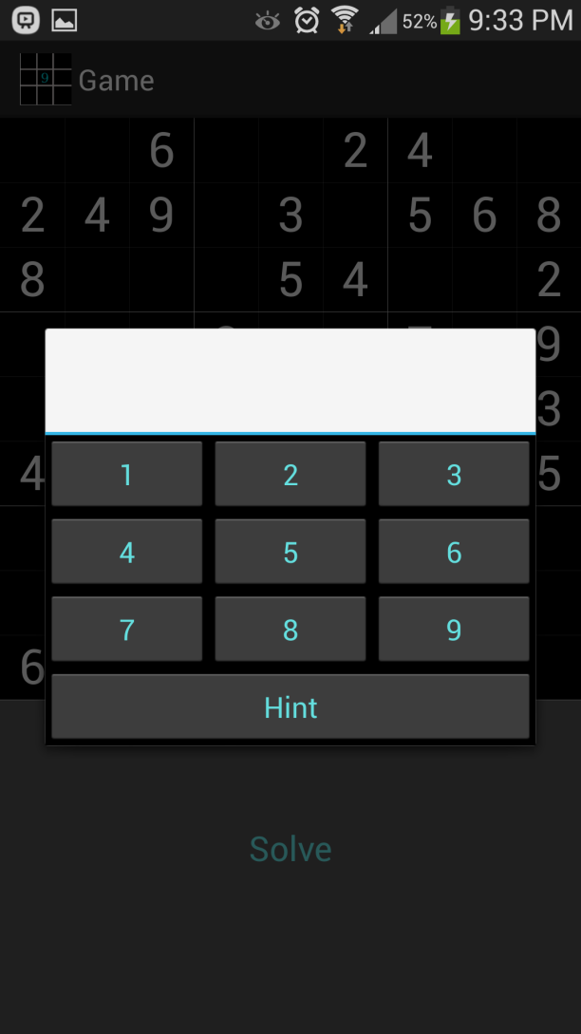
Keypad
Clicking on any one of the eighty-one small squares will bring up a keypad, where the user can either enter the desired number, or choose a hint
A hint will provide the solution to that square only

Slide 7
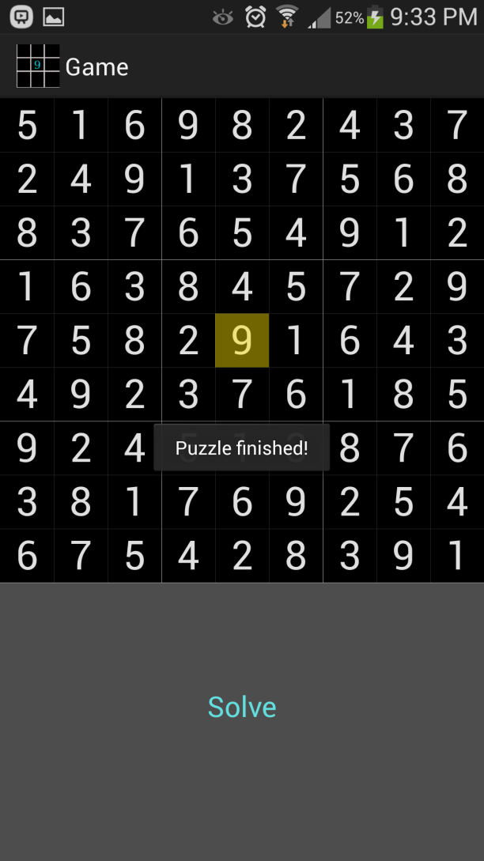
Solve
Clicking the solve button under the puzzle board will automatically fill in the remaining squares in the puzzle.

Slide 8
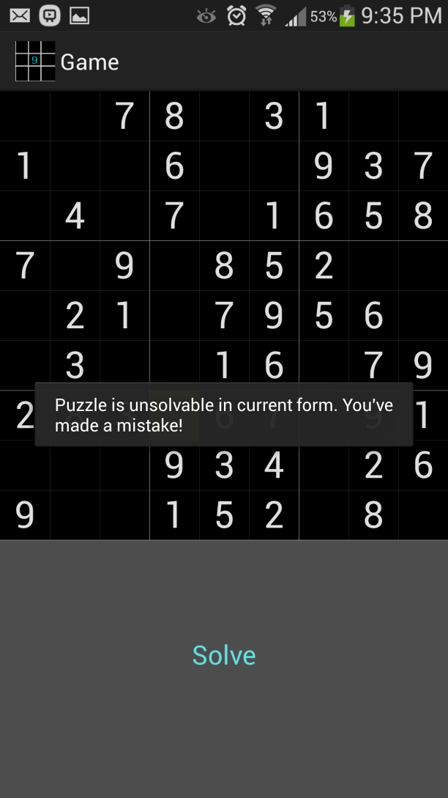
No Solution
If the user has made a mistake in the puzzle and tries to solve, he or she will be prompted with an error message.

Slide 9
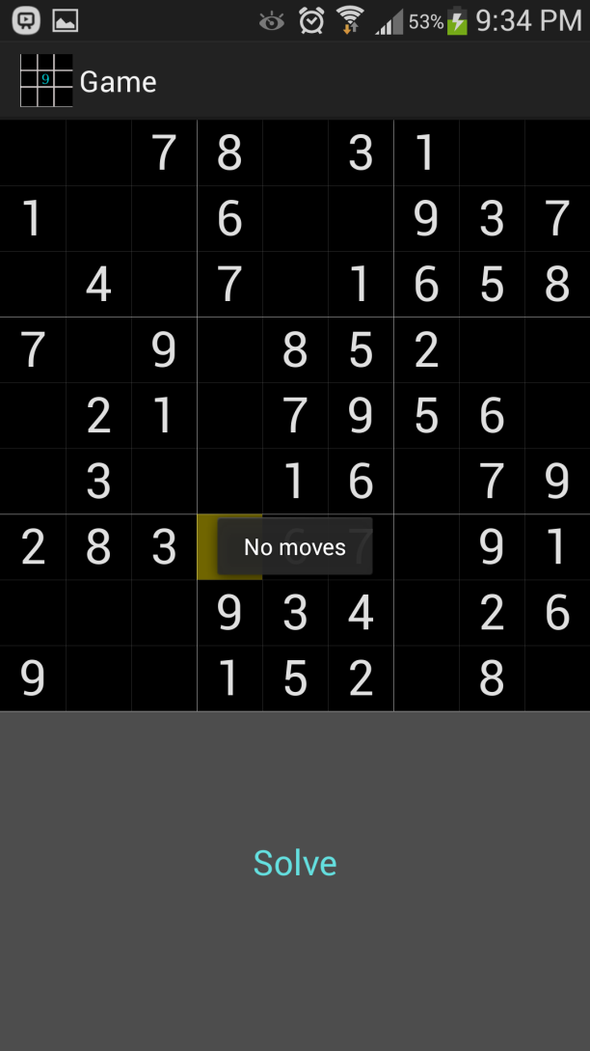
Error checking
If the user has made a mistake filling in the puzzle and there are no valid moves left for a given square, he or she will be prompted with an error message

Slide 10
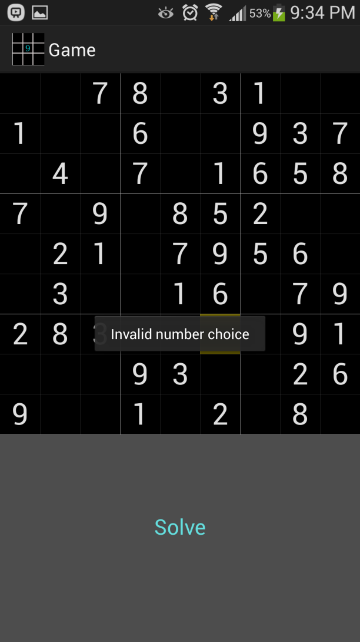
Error Checking
If the user tries to input an invalid number into a square, he or she will be prompted with an error message

Slide 11
Solved!
When the puzzle is finished and is correct, the user will be prompted with a congratulatory message!

Slide 12
Enjoy!
We Hope you liked our App!

