Slide 1
N-Queens Puzzle
CAP 4621 - AI Project - Project #4
By Zachary Gay & Jialin Wang

Slide 2
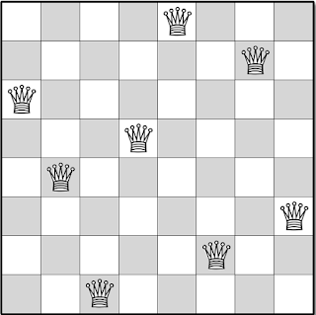
Introduction
The N-Queens is a puzzle where the goal is to place N number of queens on an NxN chessboard without any of the queens threatening each other.
A queen can move any number of squares vertically, horizontally, or diagonally. So if a queen is placed on the same row, column or diagonal as another then the solution is invalid.
Solutions exist for all natural numbers N with the exception of N = 2 or N = 3.
The most efficient method is to model it as a constraint satisfaction problem (CSP) using a minimum-conflict heuristic.

Slide 3
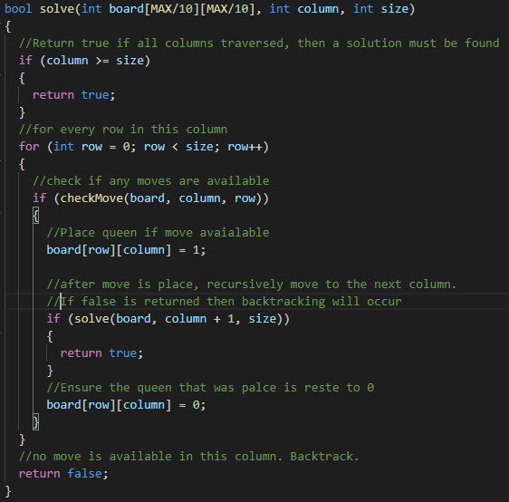
Description of the system
Greets user and receives input for N , the number of queens to place, and which algorithm to use.
Two algorithms implemented:
Backtracking
Local Search w/ Minimum Conflict Heuristic
Backtracking algorithm is recursive based and checks if a move is valid to place a queen.
Local Search is loop based and checks all moves in a given row to reassign the queen to the lowest conflicted column.
Output is printed to terminal to verify the solution.

Slide 4
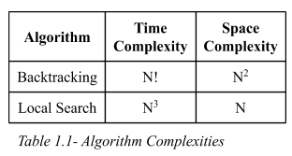
Summary of Experimental Results
The Backtracking algorithm is good when you would like to print every possible solution in the puzzle but significantly suffers at larger values of N.
The Local Search algorithm is good for larger values of N but may take longer to find every possible solution since it is more unpredictable.
To put into perspective on how these time complexities differ, the backtracking algorithm solves N = 29 in ‘106 seconds’ while the local Search algorithm solves N=100 in ‘10 seconds’

Slide 5
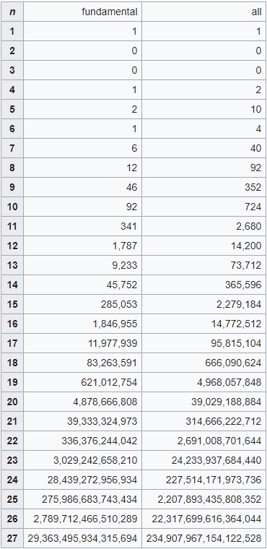
Surprising Discoveries & Conclusion
It was surprising to find just how many possible solutions there are for a given value of N.
It is also interesting to note that the number of solutions for N=6 is less than N=5
It was surprising to see how implementing a minimum conflict heuristic can significantly improve performance.
The main conclusion constructed from this project was how using a minimum conflict heuristic can significantly increase performance when solving constraint satisfaction problems similar to the N-Queens Puzzle.

Slide 6
DEMO

Slide 7
Questions?

Slide 8
THANK YOU

