Slide 1

COMMUNICATION PROTOCOL
of STP-318
2017 . 10 . 20
R & D CENTER
System Development Team
SensorTec Co., ltd
1

Slide 2

■ Sensor Number Define
10
4
8
3
7
2
6
1
5
9
SensorTec Co., ltd R&D Center
2

Slide 3
■ Cable Harness
2
3
- 전방 SRU 4개와 LRU 2개를 LIN.1 통신선에 같이 연결
- SRU 와 LRU 는 LIN 명령이 틀려, 같은 통신선에 붙어도 구분 동작 가능
- 후방 SRU 4개는 LIN.2 통신선에 연결
1
4
LIN.1
9
10
APA
LIN.2
5
6
7
8
SensorTec Co., ltd R&D Center
3

Slide 4
▣ Front CABLE [변경]
FOL
FCL
FCR
FOR
SRU.1
SRU.2
SRU.3
SRU.4
PWR_F
GND
LIN_F
LRU.1
LRU.2
FSL
FSR
SensorTec Co., ltd R&D Center
4
Notes:
RL

Slide 5
▣ Rear CABLE [변경]
PWR_R
GND
LIN_R
SRU.5
SRU.6
SRU.7
SRU.8
ROL
RCL
RCR
ROR
SensorTec Co., ltd R&D Center
5
Notes:
RL

Slide 6
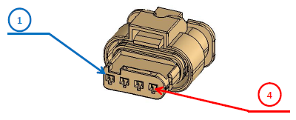
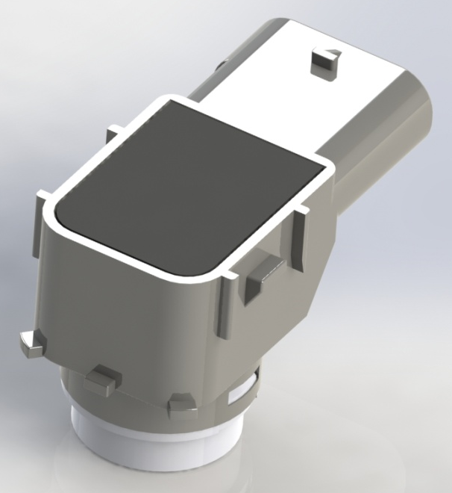
■ PIN MAP
Pin Number | Name | Description
4 | LIN | LIN bus (19200 bps)
3 | ID | ID Setting
2 | GND | Ground
1 | PWR | Power (12 V)
４
１
ID Input | N.C | GND | PWR | LIN
 | USS.1 | USS.2 | USS.3 | USS.4
SensorTec Co., ltd R&D Center
6

Slide 7
■ Access Time Schedule [1]
 | Time | LIN.1 (Front SRU) | LIN.1 (LRU) | LIN.2 (Rear SRU)
1 | 0 ms | 2 Direct & 1, 3 Indirect Sensing
2 |  |  |  | 8 (ID:4) Direct Sensing
3 |  |  | 9, 10 Read, 9, 10 Direct Sensing
4 | 30 ms | 1, 2, 3 Read
5 |  |  |  | 8 (ID:4) Read
6 | 50 ms | 4 Direct Sensing
7 |  |  |  | 6 (ID:2) Direct & 5, 7 (ID:1, 3) Indirect Sensing
8 |  |  | 9, 10 Read, 9, 10 Direct Sensing
9 | 80 ms | 4 Read
10 |  |  |  | 5, 6, 7 (ID:1, 2, 3) Read
11 | 100 ms | 1 Direct Sensing
12 |  |  |  | 7 (ID:3) Direct & 6, 8 (ID:2, 4) Indirect Sensing
13 |  |  | 9, 10 Read, 9, 10 Direct Sensing
14 | 130 ms | 1 Read
15 |  |  |  | 6, 7, 8 (ID:2, 3, 4) Read
16 | 150 ms | 3 Direct & 2, 4 Indirect Sensing
17 |  |  |  | 5 (ID:1) Direct Sensing
18 |  |  | 9, 10 Read, 9, 10 Direct Sensing
19 | 180 ms | 2, 3, 4 Read
20 |  |  |  | 5 (ID:1) Read
21 | 200 ms | Return to 1
7

Slide 8
■ Access Time Schedule [2]
 | Time | LIN.1 (Front SRU) | LIN.1 (LRU) | LIN.2 (Rear SRU)
1 | 0 ms | 1 & 4 Direct Sensing
2 |  |  |  | 6 (ID:2) Direct & 5,7 (ID:1, 3) Indirect Sensing
3 |  |  | 9, 10 Read, 9, 10 Direct Sensing
4 | 30 ms | 1, 4 Read
5 |  |  |  | 5, 6, 7 (ID:1, 2, 3) Read
6 | 60 ms | 2 Direct & 1, 3 Indirect Sensing
7 |  |  |  | 7 (ID:3) Direct & 6, 8 (ID:2, 4) Indirect Sensing
8 |  |  | 9, 10 Read, 9, 10 Direct Sensing
9 | 90 ms | 1, 2, 3 Read
10 |  |  |  | 6, 7, 8 (ID:2, 3, 4) Read
11 | 120 ms | 3 Direct & 2, 4 Indirect Sensing
12 |  |  |  | 5 & 8 (ID:1, 4) Direct Sensing
13 |  |  | 9, 10 Read, 9, 10 Direct Sensing
14 | 150 ms | 2, 3, 4 Read
15 |  |  |  | 5, 8 (ID:1, 4) Read
16 | 180 ms | Return to 1
8

Slide 9
■ Sensing Timing (SRU – 20 ms Access)
20 ms
[ Ultrasonic Sound Burst & Echo Wait ]
(3.2 ms)
(2.7 ms)
2 m Sensing --> 11.64 ms
[Data Read]
5.5 msec
11 msec
[ Noise Check ]
[ Init Sensing Command ]
SensorTec Co., ltd R&D Center
9
Notes:
1.2 m -> 8 msec

Slide 10
■ SRU LIN PID
DEVICE |  | USS.8 | USS.7 | USS.6 | USS.5 | USS.4 | USS.3 | USS.2 | USS.1
ID Pin |  | LIN | PWR | GND | N.C | LIN | PWR | GND | N.C
Init Sensing | PID | 0x80
Data Read | PID | 0x08 | 0x49 | 0xCA | 0x8B | 0x4C | 0x0D | 0x8E | 0xCF
Configuration Request | PID | 0x3C
Configuration Response | PID | 0x7D
RAW Data Upload (for Test JIG) | PID | 0x20 | 0x61 | 0xE2 | 0xA3 | 0x64 | 0x25 | 0xA6 | 0xE7
SensorTec Co., ltd R&D Center
10

Slide 11
■ INIT SENSING
Break + Sync[0x55] + PID[0x80] + TX + RX + CHKSUM
(APS Drive)
Enhanced checksum
PID | 0x80
TX | USS.4(R) | USS.3(R) | USS.2(R) | USS.1(R) | USS.4(F) | USS.3(F) | USS.2(F) | USS.1(F)
 | 0 : OFF 1 : ON | 0 : OFF 1 : ON | 0 : OFF 1 : ON | 0 : OFF 1 : ON | 0 : OFF 1 : ON | 0 : OFF 1 : ON | 0 : OFF 1 : ON | 0 : OFF 1 : ON
RX | USS.4(R) | USS.3(R) | USS.2(R) | USS.1(R) | USS.4(F) | USS.3(F) | USS.2(F) | USS.1(F)
 | 0 : OFF 1 : ON | 0 : OFF 1 : ON | 0 : OFF 1 : ON | 0 : OFF 1 : ON | 0 : OFF 1 : ON | 0 : OFF 1 : ON | 0 : OFF 1 : ON | 0 : OFF 1 : ON
# Sensor_ID.1 ~ 4 억세스는 같으나, Rear Threshold 적용됨
SensorTec Co., ltd R&D Center
11

Slide 12
■ DATA READ
ex) USS.1
Break + Sync[0x55] + PID[0xCF] + D1 + D2 + D3 + CHKSUM
(ECU Drive) (Sensor Drive)
Enhanced checksum
D1 | D2 | D3
LSB | MSB
TOF.1 [usec] |  | Status
Status -> bit.0: Blockage
bit.1: Noise Error
bit.2: Hardware Fault
bit.3: Communication Error
bit.4: Proximity State
bit.5: rsv
bit.6: rsv
bit.7: rsv
SensorTec Co., ltd R&D Center
12

Slide 13
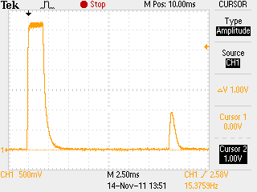
※ TOF to Distance Conversion
Sound speed = 331.5 + (0.60714 * Tc(℃)) ≒ 340m/s
-> at 12 ℃ -> 338.78568 m/s => 33878.568 cm/s
-> at 22 ℃ -> 344.85708 m/s => 34485.708 cm/s
V = d / t , t = TOF / 2 (TOF : Time Of Flight, usec)
d = V * t (at 12 ℃ )
= ( 33878.568 [cm/s] ) x ( TOF * 0.000001 [s] / 2 )
= TOF * 0.016939284 [cm] = TOF / 59.034 ≒ TOF / 59
d = V * t (at 22 ℃ )
= ( 34485.708 [cm/s] ) x ( TOF * 0.000001 [s] / 2 )
= TOF * 0.017242854 [cm] = TOF / 57.995 ≒ TOF / 58
Time Of Flight
[Example]
USSx_Dist[0] = ( USSx_TOF[0] - CIRCUIT_DELAY ) / 59; // [cm] , CIRCUIT_DELAY: 100 ~ 120 usec
SensorTec Co., ltd R&D Center
13

Slide 14
■ PARAMETER TABLE
P.01 ~ P.10 : TH_Dir_Chg (s8)
P.11 ~ P.20 : TH_Dir_Cnt (u8)
P.21 ~ P.30 : TH_Indir_Chg (s8, +128)
P.31 ~ P.40 : TH_Indir_Cnt (u8)
P.41
P.42 | Start_Gain
P.43 | Filter_Value
P.44 | NoiseLevel (AD, Default: 42)
P.45 | Blockage (1 ~ 255, Default : 5)
P.46
P.47
P.48 | Max_RT ( * 100 usec, Default: 18)
P.49 | Drive_Cur
P.50 | End_Gain
P.51
P.52 | K_SQUARE
P.53 | Burst_Frq
P.54 | Serial_Number[0]
P.55 | Serial_Number[1]
P.56 | Serial_Number[2]
P.57 | Serial_Number[3]
P.58
P.59
P.60 | Pulse_Cnt
P.61 | T_F_Adjust (1[L] ~ 4[C] ~ 6[H])
P.62 | Threshold_Select (0: EEP, 1: Const)
P.63 | Test_Mode (0, 1, 2, 3, 4)
P.64 | FW_Ver (Read Only)
★ P.1 ~ P10 & P.21 ~ P.30 are transmitted with +128 added value
SensorTec Co., ltd R&D Center
14

Slide 15
■ SRU PARAMETER WRITE
Break + Sync[0x55] + PID[0x3C] + NAD + PCI + SID + D1 + D2 + D3 + D4 + D5 + CHKSUM
(APS Drive)
classic checksum
PID | 0x3C
NAD | 11 ~ 18 or 19
PCI | 0x03
SID | 0x2E
D1 | P_Addr
D2 | P_Data
D3 | 0x00
D4 | 0x00
D5 | 0x00
SensorTec Co., ltd R&D Center
15

Slide 16
■ PARAMETER TABLE READ
# Request
Break + Sync[0x55] + PID[0x3C] + NAD + PCI [0x01] + SID [0x01] + 0xFF + 0xFF + 0xFF + 0xFF + 0xFF + CHKSUM
(APS Drive)
# Response
classic checksum
Break + Sync[0x55] + PID[0x7D] + NAD + PCI [0x10] + LEN [65] + SID [0x41] + TH.1 + TH.2 + TH.3 + TH.4 + CHKSUM
(APS Drive) (Sensor Drive)
Break + Sync[0x55] + PID[0x7D] + NAD + PCI [0x21] + TH.5 + TH.6 + TH.7 + TH.8 + TH.9 + TH.10 + CHKSUM
(APS Drive) (Sensor Drive)
Break + Sync[0x55] + PID[0x7D] + NAD + PCI [0x22] + TH.11 + TH.12 + TH.13 + TH.14 + TH.15 + TH.16 + CHKSUM
(APS Drive) (Sensor Drive)
Break + Sync[0x55] + PID[0x7D] + NAD + PCI [0x23] + TH.17 + TH.18 + TH.19 + TH.20 + TH.21 + TH.22 + CHKSUM
(APS Drive) (Sensor Drive)
Break + Sync[0x55] + PID[0x7D] + NAD + PCI [0x24] + TH.23 + TH.24 + TH.25 + TH.26 + TH.27 + TH.28 + CHKSUM
(APS Drive) (Sensor Drive)
Break + Sync[0x55] + PID[0x7D] + NAD + PCI [0x25] + TH.29 + TH.30 + TH.31 + TH.32 + TH.33 + TH.34 + CHKSUM
(APS Drive) (Sensor Drive)
SensorTec Co., ltd R&D Center
16

Slide 17
■ PARAMETER TABLE READ
Break + Sync[0x55] + PID[0x7D] + NAD + PCI [0x26] + TH.35 + TH.36 + TH.37 + TH.38 + TH.39 + TH.40 + CHKSUM
(APS Drive) (Sensor Drive)
Break + Sync[0x55] + PID[0x7D] + NAD + PCI [0x27] + 0 + Start_Gain + FilterValue + NoiseLevel+ Blockage + 0 + CHKSUM
(APS Drive) (Sensor Drive)
Break + Sync[0x55] + PID[0x7D] + NAD + PCI [0x28] + 0 + MaxRT + DriveCurrent + End_Gain + 0 + K_Square + CHKSUM
(APS Drive) (Sensor Drive)
Break + Sync[0x55] + PID[0x7D] + NAD + PCI [0x29] + Burst_Frq + SN[0] + SN[1] + SN[2] + SN[3] + 0_ + CHKSUM
(APS Drive) (Sensor Drive)
Break + Sync[0x55] + PID[0x7D] + NAD + PCI [0x2A] + 0_+ Pulse_Cnt_+ TF_adj_+ TH_Const_+ Test_+ FW_Ver + CHKSUM
(APS Drive) (Sensor Drive)
SensorTec Co., ltd R&D Center
17

Slide 18
■ AD DATA Upload (Non Standard Packet)
Break + Sync[0x55] + PID[0xE7] + D1 + D2 + ~ + D256 + CHKSUM
(APS Drive) (Sensor Drive)
Enhanced checksum
PID | 0xE7 (USS.1)
D1 | AD.1
D2 | AD.2
D3 | AD.3
D4 | AD.4
~ | ~
D255 | AD.255
D256 | AD.256
APS Transmit the [Break], [Sync], [PID] Signal and SENSOR Transmit the Rest of Frame [D1 ~ D256] & [Check Sum]
SensorTec Co., ltd R&D Center
18

