Slide 1

COMMUNICATION PROTOCOL
of STP-313
2018 . 1 . 22
SensorTec Co., ltd R&D Center
1

Slide 2
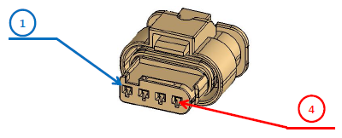
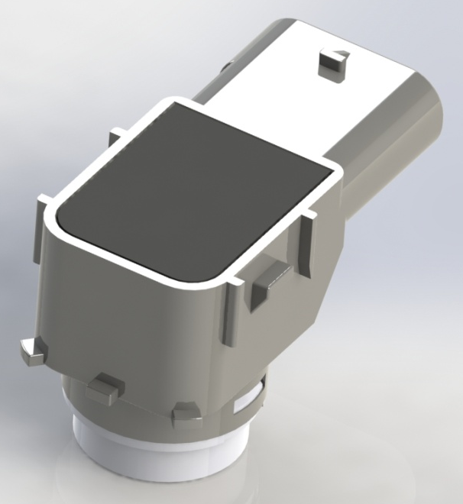
■ PIN MAP
Pin Number | Name | Description
4 | LIN | LIN bus
3 | ID | ID Setting In
2 | GND | Ground
1 | PWR | Power (12 V)
④
①
 | USS.4 | USS.3 | USS.2 | USS.1
ID Input | LIN | POWER | GND | NC
SensorTec Co., ltd R&D Center
2

Slide 3
■ LIN PID
 |  | USS.4 | USS.3 | USS.2 | USS.1
ID Input |  | LIN | POWER | GND | NC
Init Sensing | PID (ID) | 0xC1 (0x01)
Data Read | PID (ID) | 0x9C (0x1C) | 0xDD (0x1D) | 0x5E (0x1E) | 0x1F (0x1F)
Configuration Request | PID (ID) | 0x3C (0x3C)
Configuration Response | PID (ID) | 0x7D (0x3D)
AD Data Read (no standard) | PID (ID) | 0xB4 (0x34) | 0xF5 (0x35) | 0x76 (0x36) | 0x37 (0x37)
SensorTec Co., ltd R&D Center
3

Slide 4
■ INIT SENSING
Break + Sync[0x55] + PID[0xC1] + DATA1+ CHKSUM
(ECU Drive)
PID | 0xC1
DATA1 | Sensor Select
 | Bit.7 | Bit.6 | Bit.5 | Bit.4 | Bit.3 | Bit.2 | Bit.1 | Bit.0
 | USS.4 0 : OFF 1 : RX Only | USS.3 0 : OFF 1 : RX Only | USS.2 0 : OFF 1 : RX Only | USS.1 0 : OFF 1 : RX Only | USS.4 0 : OFF 1 : TX_RX | USS.3 0 : OFF 1 : TX_RX | USS.2 0 : OFF 1 : TX_RX | USS.1 0 : OFF 1 : TX_RX
SensorTec Co., ltd R&D Center
4

Slide 5
■ Data Read
ex) USS.1 Data Read
Break + Sync[0x55] + PID[0x1F] + D1 + D2 + D3 + D4 + D5 + D6 + D7 + CHKSUM
(ECU Drive) (Sensor Drive)
D1 | D2 | D3 | D4 | D5 | D6 | D7
LSB | MSB |  |  | LSB | MSB
ToF.1 [usec] |  | Level.1 | Width.1 | ToF.2 [usec] |  | Status
※ Default TOF value : 0 (no detect)
ECU Transmit the [Break], [Sync], [PID] Signal and SENSOR Transmit the Rest of Frame [D1 ~ D7] & [Check Sum]
TOF.x : 1 usec unit
Width.1 : 16 usec unit
# Status -> bit.0 : Ringing Fault (Blockage)
bit.1 : Noise Error
bit.2 : Hardware Error
bit.3 : Communication Error
bit.4 : Dead zone
SensorTec Co., ltd R&D Center
5

Slide 6
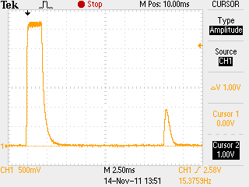
※ ToF to Distance Conversion
Sound speed = 331.5 + (0.60714 * Tc(℃)) ≒ 340m/s
-> at 12 ℃ -> 338.78568 m/s => 33878.568 cm/s
-> at 22 ℃ -> 344.85708 m/s => 34485.708 cm/s
V = d / t , t = TOF / 2 (TOF : 초음파 왕복 시간, usec)
d = V * t (at 12 ℃ )
= ( 33878.568 [cm/s] ) x ( TOF * 0.000001 [s] / 2 )
= TOF * 0.016939284 [cm] = TOF / 59.034 ≒ TOF / 59
d = V * t (at 22 ℃ )
= ( 34485.708 [cm/s] ) x ( TOF * 0.000001 [s] / 2 )
= TOF * 0.017242854 [cm] = TOF / 57.995 ≒ TOF / 58
Time Of Flight
[Example]
USSx_Dist[0] = ( USSx_TOF[0] - CIRCUIT_DELAY ) / 59; // [cm] , CIRCUIT_DELAY: 100 ~ 120 usec
SensorTec Co., ltd R&D Center
6

Slide 7

※ MEASUREMENT DATA
# Width : 16 usec unit
Echo Width (us) = DATA * 16
WIDTH
# Level.n : 8 bit Resolution, 3.3 V Ref
Volt = (DATA * 3.3) / 255
LEVEL
SensorTec Co., ltd R&D Center
7

Slide 8
■ PARAMETER TABLE
P.1 ~ P.10 : TH_Chg (s8)
P.11 ~ P.20 : TH_Cnt (u8)
P.21 | rsv
P.40 | rsv
P.41 | LPF_Factor (Default: 3)
P.42 | Start_Gain
P.43 | Start_FILTER
P.44 | NoiseLevel (AD, Default: 42)
P.45 | Blockage (1 ~ 255, Default : 5)
P.46 | Middle_Gain
P.47 | Middle_FILTER
P.48 | Max_RT (* 100 usec, Default: 23)
P.49 | Drive_Current
P.50 | End_Gain
P.51 | End_FILTER
P.52 | K_SQUARE
P.53 | Burst_Frq
P.54 | Serial_Number[0]
P.55 | Serial_Number[1]
P.56 | Serial_Number[2]
P.57 | Serial_Number[3]
P.58 | TH_Time_Shift (s8)
P.59 | TH_Level_Shift (s8)
P.60 | Pulse_Cnt
P.61 | T_F_Adjust (1[L] ~ 4[C] ~ 6[H])
P.62
P.63 | Record_Mode (0, 1, 2, 3, 4)
P.64 | FW_Ver (Read Only)
★ P.1 ~ P10 & P.58 & P.59 are transmitted with +128 added value
SensorTec Co., ltd R&D Center
8

Slide 9
■ PARAMETER WRITE
Break + Sync[0x55] + PID[0x3C] + NAD + PCI + SID + D1 + D2 + D3 + D4 + D5 + CHKSUM
(ECU Drive)
PID | 0x3C
NAD | 1 ~ 8 or 9
PCI | 0x03
SID | 0x2E
D1 | P_Addr
D2 | P_Data
D3 | 0x00
D4 | 0x00
D5 | 0x00
SensorTec Co., ltd R&D Center
9

Slide 10
■ PARAMETER TABLE READ
# Request
Break + Sync[0x55] + PID[0x3C] + NAD + PCI [0x01] + SID [0x01] + 0xFF + 0xFF + 0xFF + 0xFF + 0xFF + CHKSUM
(Master Drive)
# Response
Break + Sync[0x55] + PID[0x7D] + NAD + PCI [0x10] + LEN [65] + RSID [0x41] + TH.1 + TH.2 + TH.3 + TH.4 + CHKSUM
(Master Drive) (Sensor Drive)
Break + Sync[0x55] + PID[0x7D] + NAD + PCI [0x21] + TH.5 + TH.6 + TH.7 + TH.8 + TH.9 + TH.10 + CHKSUM
(Master Drive) (Sensor Drive)
Break + Sync[0x55] + PID[0x7D] + NAD + PCI [0x22] + TH.11 + TH.12 + TH.13 + TH.14 + TH.15 + TH.16 + CHKSUM
(Master Drive) (Sensor Drive)
Break + Sync[0x55] + PID[0x7D] + NAD + PCI [0x23] + TH.17 + TH.18 + TH.19 + TH.20 + 0 + 0 + CHKSUM
(Master Drive) (Sensor Drive)
Break + Sync[0x55] + PID[0x7D] + NAD + PCI [0x24] + 0 + 0 + 0 + 0 + 0 + 0 + CHKSUM
(Master Drive) (Sensor Drive)
Break + Sync[0x55] + PID[0x7D] + NAD + PCI [0x25] + 0 + 0 + 0 + 0 + 0 + 0+ CHKSUM
(Master Drive) (Sensor Drive)
SensorTec Co., ltd R&D Center
10

Slide 11
■ PARAMETER TABLE READ
Break + Sync[0x55] + PID[0x7D] + NAD + PCI [0x26] + 0 + 0 + 0 + 0 + 0 + 0 + CHKSUM
(Master Drive) (Sensor Drive)
Break + Sync[0x55] + PID[0x7D] + NAD + PCI [0x27] + LPF + StartGain + StartFilter + NoiseLevel + Blockage + Middle_Gain + CHKSUM
(Master Drive) (Sensor Drive)
Break + Sync[0x55] + PID[0x7D] + NAD + PCI [0x28] + MiddleFilter + Max_RT + DriveCurrent + EndGain + EndFilter + Ksquare + CHKSUM
(Master Drive) (Sensor Drive)
Break + Sync[0x55] + PID[0x7D] + NAD + PCI [0x29] + Burst_Frq + SN[0] + SN[1] + SN[2] + SN[3] + 0 + CHKSUM
(Master Drive) (Sensor Drive)
Break + Sync[0x55] + PID[0x7D] + NAD + PCI [0x30] + 0 + PulseCnt_ + TF_adj_ + 0 + TestMode_ + FW_Ver + CHKSUM
(Master Drive) (Sensor Drive)
SensorTec Co., ltd R&D Center
11

Slide 12
■ AD Data READ
# Request
Break + Sync[0x55] + PID[0x3C] + NAD + PCI [0x01] + SID [0x02] + 0xFF + 0xFF + 0xFF + 0xFF + 0xFF + CHKSUM
(Master Drive)
# Response
Break + Sync[0x55] + PID[0x7D] + NAD + PCI [0x80] + LEN [255] + RSID [0x42] + AD.0 + AD.1 + AD.2 + AD.3 + CHKSUM
(Master Drive) (Sensor Drive)
Break + Sync[0x55] + PID[0x7D] + NAD + PCI [0x81] + AD.4 + AD.5 + AD.6 + AD.7 + AD.8 + AD.9 + CHKSUM
(Master Drive) (Sensor Drive)
Break + Sync[0x55] + PID[0x7D] + NAD + PCI [0x82] + AD.10 + AD.11 + AD.12 + AD.13 + AD.14 + AD.15 + CHKSUM
(Master Drive) (Sensor Drive)
~
~
Break + Sync[0x55] + PID[0x7D] + NAD + PCI [0xAA] + AD.250 + AD.251 + AD.252 + AD.253 + AD.254 + AD.255 + CHKSUM
(Master Drive) (Sensor Drive)
SensorTec Co., ltd R&D Center
12

Slide 13
■ AD DATA Read (No Standard)
Break + Sync[0x55] + PID[0x37] + D1 + D2 + ~ + D255 + D256 + CHKSUM
(ECU Drive) (Sensor Drive)
PID | 0x37 (USS.1)
D1 | AD.0
D2 | AD.1
D3 | AD.2
D4 | AD.3
~ | ~
D255 | AD.254
D256 | AD.255
ECU Transmit the [Break], [Sync], [PID] Signal and SENSOR Transmit the Rest of Frame [D1 ~ D256] & [Check Sum]
SensorTec Co., ltd R&D Center
13

