Slide 1

Early Identification of Disengaging Students in Online Courses
Final project report: from the problem to the answers and the decisions they support
A final report on finding students who drift away from online courses early enough to help them.
Lecturers:
Dr. Nguyễn Trần Minh Thư
MSc. Phạm Minh Tú
Team N04:
25C12002 – Lê Ngọc Trúc Huỳnh
25C12003 – Phan Trần Khanh
25C12031 – Dương Tấn Huỳnh Phong
MTH045 – The Science of Data Analytics
University of Science · November 2026
Notes:
(~119 seconds)
Thank you for your time. We are team N04 of the course MTH045, The Science of Data Analytics, and this is our final project report: early identification of disengaging students in online courses. In the next half hour we tell the story of one data analytics project, from the business question to the last result, including the turns it took.
The project is about one kind of student. Picture a student in week five of an online course. She has not failed anything and has not withdrawn, so on paper she is fine. But she has stopped opening the course, and by the time her name reaches anyone, the weeks in which help still works are gone. Our aim was to find such students early enough for staff to act, with a factual reason beside each name.
The talk follows the analytics lifecycle over our five milestones, the five delivery stages of the course project: the problem and its questions in Milestone 1, the data in Milestone 2, its preparation in Milestone 3, the method in Milestone 4 and the evidence in Milestone 5. On each slide you will see the result; where the plan changed, we say so, and one slide near the end collects every turn. The detail behind each slide sits in the appendix of this deck, and the grey line at the top right of a slide names the appendix slides to look at. Let us start with why timing is the problem.

Slide 2
INTRODUCTION
Detail on appendix slides A1–A9
2
Noticed Too Late
Staff notice a student who has stopped taking part only after the early weeks, when help is easiest.
Early weeks, when help is easiest
Program manager sees counts
after the semester
Lecturers become sure
around week 5 or 6
Support office meets the student
on the academic warning list
Week 1
Week 2
Week 3
Week 4
Week 5
Week 6
Week 7
Week 8
…
Semester end
After the semester
Key: the orange band marks the early weeks; grey markers mark the moment each group of staff notices.
Basis: a published study of predictive learning analytics at the Open University finds the window for effective support of a student at risk short, two to four weeks (Herodotou et al., 2019); the moments staff notice come from simulated stakeholder interviews.
Setting
Disengagement
The gap
A Vietnamese university expands online and blended learning on its learning management system (LMS); one program has about 1,200 students (assumed: the university is a case scenario).
A student misses a task, opens the course less often and falls silent before a fail or a withdrawal is recorded.
The records show these traces weeks before any final result.
Every moment of notice falls after the early weeks, so by the time anyone acts the student has been drifting for weeks.
Help comes when it is hardest to give.
Notes:
(~171 seconds)
The headline of this slide: staff notice a student who has stopped taking part only after the early weeks, when help is easiest.
The timeline runs from week 1 to the end of the semester and beyond. The orange band covers weeks 1 to 4, the early weeks when help is easiest. That band is not our guess: a published study of predictive learning analytics at the Open University, by Herodotou and colleagues in 2019, finds the window for effective support of a student at risk short, two to four weeks, and published work places the useful moment for support in the first weeks of a course, so the band starts at week 1. The three grey markers show when each group of staff notices a student who has stopped taking part. Lecturers become sure around week five or six. The support office meets the student only when the name reaches the academic warning list, at the end of the semester. The program manager sees counts after the semester. Every marker falls after the band.
The three cards below give the setting and the opportunity. Setting: a Vietnamese university is expanding online and blended learning on its learning management system, the LMS, and one program has about 1,200 students; the university is a case scenario set by the brief of our course, MTH045, so the figure of 1,200 students is an assumption too. Disengagement: a student misses a task, opens the course less often and falls silent before a fail or a withdrawal is recorded, and the records show these traces weeks before any final result. The gap: every moment of notice falls after the early weeks, so by the time anyone acts the student has been drifting for weeks, and help comes when it is hardest to give.
One honest point on the basis line at the foot of the slide: the moments when staff notice come from interviews in which generative AI played the stakeholders. They shape our requirements, but they still need confirming with real staff. The traces in the records are the opportunity; next, what the university wants to achieve with them.

Slide 3
PART 1 · THE PROBLEM (MILESTONE 1)
Detail on appendix slides A10–A12
3
Business Goal and SMART Goal
The goal is more students passing their courses, not a model or a dashboard, and the SMART Goal makes it measurable with assumed values.
Business Goal: improve successful course completion in the program's online and blended courses by identifying students who stop taking part early enough to support them within the semester.
An outcome for the organisation; a model, a list or a dashboard is only a means.
70% → 75%
Completion in the pilot courses, from the assumed baseline to the assumed target.
SMART Goal (specific, measurable, achievable, relevant, time-bound): raise the course completion rate of students enrolled after the add-drop period in the pilot courses from their recounted baseline (assumed 70%) by five percentage points (assumed target 75%) by the end of the 2027–2028 academic year.
Assumed
What the goal cannot show
Students who are contacted may have passed anyway, so a rise in completion shows progress, not why.
Whether contact itself helps is tested only in the randomised pilot.
Pilot design
• Pilot courses: about four courses with about 600 enrolments (assumptions), fixed in advance and compared with similar courses outside the pilot.
• Baseline: completion of the same courses in 2024–2025 and 2025–2026, recounted under Circular 83/2026, the new national rule for counting withdrawals, so that approved leave and transfers do not count.
Notes:
(~179 seconds)
We started from the business, not from a model. The lead line says it: the goal is more students passing their courses, not a model or a dashboard, and the SMART Goal makes it measurable with assumed values.
The top box is the Business Goal: improve successful course completion in the program's online and blended courses by identifying students who stop taking part early enough to support them within the semester. Beneath it is the reminder we kept throughout: this is an outcome for the organisation, and a model, a list or a dashboard is only a means to it.
The second box turns it into a SMART Goal, that is specific, measurable, achievable, relevant and time-bound: raise the course completion rate of students enrolled after the add-drop period in the pilot courses from their recounted baseline, assumed 70 percent, by five percentage points, to an assumed 75 percent, by the end of the 2027–2028 academic year. Counting only students enrolled after the add-drop period keeps out those who leave during that period, the first two weeks, while students may still register for or drop a course.
The pilot design says how the goal will be read. About four pilot courses with about 600 enrolments are fixed in advance and compared with similar courses outside the pilot. The baseline is the completion of the same courses in 2024–2025 and 2025–2026, recounted under Circular 83/2026, the new national rule for counting withdrawals, so that approved leave and transfers do not count. The orange tile shows 70 to 75 percent and is marked Assumed, because the case university gives no real completion rate; the university's recount replaces both numbers. At the assumed 70 percent baseline, about 180 of the 600 enrolments would not complete, by failing or withdrawing; five points means about 30 more passes, roughly one in six of those 180, a load that fits the weekly capacity staff reported (Appendix A10).
The grey card states the limit we keep for the whole talk: students who are contacted may have passed anyway, so a rise in completion shows progress, not why. Whether contact itself helps is tested only in the randomised pilot. To reach the goal, we first needed questions the data could answer.

Slide 4
PART 1 · THE PROBLEM (MILESTONE 1)
Detail on appendix slides A13–A19
4
Four Questions, Four Analytics Levels
Four questions climb the analytics levels, and each answer may claim only what its level allows.
Unit of analysis: one student's enrolment in one module run (one offering of a module). AQ: analytical question. Decisions: D1 whom to contact, D2 where to place support time, D3 whether to extend.
AQ4 – Prescriptive
AQ3 – Predictive
Who ranks first on a list as long as staff can contact, overall and by student group (for the fairness check)?
Serves D1.
Reads as: an option to test, because it comes from observational data.
AQ2 – Diagnostic
How well do data up to day 13 or 27 (end of week 2 or 4) estimate non-completion, against the early-sign rule?
Serves D1.
Reads as: a forecast, valid only on data the model never saw.
AQ1 – Descriptive
Which signs by week 4 go with later non-completion, within module run?
Serves D2, and gives the reasons for D1.
Reads as: an association.
What share pass, fail or withdraw, and in which week do non-completers first miss a task?
Serves D2 and D3.
Reads as: what happened.
Run on the data
Run on the data
Run on the data
Ranking answered
Key: every rung was run on the data; AQ4 is answered for its ranking, while its contact part has no data. Data cut-offs: day 13 (end of week 2) for the week-3 list; day 27 (end of week 4) for the week-5 list. Early-sign rule: a missed or late task, or a week with no activity.
Notes:
(~167 seconds)
This slide turns the goal into four analytical questions, one per level of analysis, and the lead line gives the rule behind the staircase: each answer may claim only what its level allows.
The line above the cards fixes the vocabulary. Every question is about the same unit: one student's enrolment in one module run: a module is a course in the dataset we use, and a run is one offering of a module. AQ stands for analytical question. And the questions serve three decisions: D1, whom to contact; D2, where to place support time; D3, whether to extend the approach.
Read the cards from left to right. AQ1 is descriptive: what share pass, fail or withdraw, and in which week non-completers first miss a task. It serves D2 and D3 and reads as what happened. AQ2 is diagnostic: which signs by week 4 go with later non-completion, comparing students within the same module run. It serves D2 and gives the reasons for D1, and it reads as an association, never a cause.
AQ3 is predictive: how well data up to day 13 or day 27, the end of week 2 or week 4, estimate non-completion, against the early-sign rule, which flags a missed or late task or a week with no activity (Slide 7). It serves D1 and reads as a forecast, valid only on data the model never saw. AQ4 is prescriptive: who ranks first on a list as long as staff can contact, overall and by student group, so that fairness can be checked. It also serves D1, and because it comes from observational data it reads only as an option to test.
The status at the foot of each card is the outcome at the end of the project: AQ1, AQ2 and AQ3 were run on the data; AQ4 is answered for its ranking, while its contact part has no data. The key also fixes the two data cut-offs, day 13 for the week-3 list and day 27 for the week-5 list, and repeats the early-sign rule, which Slide 7 builds. First, the data.

Slide 5
PART 2 · THE DATA (MILESTONE 2)
Detail on appendix slides A20–A29
5
Seven Candidates Screened
Of seven public candidates, only OULAD passes every gate, so we chose it for fit, not for ease.
Six must-have gates decide first: a dated outcome, dated tasks, dated activity, at least three runs in time order, an open licence and an anonymised ID; ten criteria then score 0–2 each (20 at most). UCI: the University of California, Irvine, repository; XuetangX, HarvardX: massive open online courses.
Candidate | Score (of 20) | Gates failed | Decision
OULAD | 12 | none | Selected, on condition
UCI 697 (dropout) | 10 | dated outcome, tasks, activity | Rejected
UCI 320 (school pupils) | 6 | dated outcome, tasks, activity, runs | Rejected
UCI 856 (one survey) | 7 | dated outcome, tasks, activity, runs | Rejected
XuetangX | 8 | dated outcome, tasks, licence | Rejected
HarvardX | 8 | dated outcome, tasks, activity, runs, licence | Rejected
xAPI-Edu-Data | 4 | dated outcome, tasks, activity, runs | Rejected
Key: orange row = selected; red cell = a gate failed.
OULAD, the Open University Learning Analytics Dataset: the only candidate that records a dated withdrawal, dated submissions and daily clicks.
Why 12 of 20, and the condition: scores count only what the documentation states, so OULAD gets 12. Chosen on three conditions its files confirmed: pass and fail told apart, enough runs per module, one ID per student (Appendix A20).
Notes:
(~150 seconds)
The lead line gives the result of the data search: of seven public candidates, only OULAD passes every gate, so we chose it for fit, not for ease.
We wrote the data requirements before searching, so that the choice could not bend toward a convenient dataset. The line above the table states them. Six must-have gates decide first: a dated outcome, dated tasks, dated activity, at least three runs in time order, an open licence and an anonymised student ID. Only then do ten criteria score each candidate from 0 to 2, so 20 at most.
The table lists the seven candidates with their score, the gates they fail and the decision. The three named UCI come from the University of California, Irvine, repository, and the number beside each is its number in that repository: 697 on dropout, 320 on school pupils and 856 a single survey. XuetangX and HarvardX are massive open online courses, and the last is xAPI-Edu-Data. Read the red cells: every candidate but one fails the dated-outcome gate, because it holds grades or totals but no date at which a student withdrew, and without that date no early list can be tested. Their scores run from 4 to 10, and all six are rejected.
The orange row is OULAD, the Open University Learning Analytics Dataset: about 32,600 enrolments in 22 runs of seven distance-learning modules in 2013 and 2014, and the only candidate that records a dated withdrawal, dated submissions and daily clicks. Its score is only 12 of 20, because scores count only what the documentation states. So we chose it on three conditions its files had to confirm: pass and fail are told apart, each module has enough runs, and one student keeps one ID. The files confirmed all three (Appendix A20). Once the data were in, however, the files showed problems their documentation did not mention.

Slide 6
PART 2 · THE DATA (MILESTONE 2)
Detail on appendix slides A30–A33
6
Three Quality Issues That Change the Method
Of nineteen logged quality issues, three are serious enough to change the method.
Issue log: 19 issues, each rated against the four analytical questions: High = ignoring it would change a rate, the target (the outcome predicted) or a feature (an input computed per enrolment); Medium = it shifts a number by an amount we can measure; Low = otherwise.
High issue
Change in method
18 of 24 exams have no result rows, so counting exams would make every student of those modules miss one.
A task means a TMA or a CMA only (TMA: tutor-marked assignment; CMA: computer-marked assessment, a quiz).
Few tasks fall due by the cut-offs: no 2013 run has a task due by day 13, and 7 of 9 have one due by day 27.
The early-sign rule needs an activity part: a week with no click.
The data are seven UK modules of 2013–2014.
The scope is stated with every result, and students are compared within module.
Key: the orange row marks the issue that reshapes the early-sign rule (Slide 7).
Medium and Low issues: duplicate click rows are kept and tested, activity after unregistration is cut, missing values are grouped as "Missing", outliers are kept; nothing is deleted or imputed (Appendix A30).
Notes:
(~168 seconds)
The lead line: of nineteen logged quality issues, three are serious enough to change the method.
We profiled all 10.9 million rows of the seven tables and logged nineteen issues, each rated against the four questions. The line at the top gives the scale. High means that ignoring the issue would change a rate, the target, which is the outcome we predict, or a feature, an input we compute for each enrolment. Medium means it shifts a number by an amount we can measure, and Low covers the rest. The diagram pairs each High issue, on the left, with the change in method it forced, on the right.
First, 18 of 24 exams have no result rows. Counting exams would make every student of those modules appear to miss one, so in this project a task means only a TMA, a tutor-marked assignment, or a CMA, a computer-marked assessment, which is a quiz.
Second, the orange row: few tasks fall due by the cut-offs. No 2013 run has a task due by day 13, and 7 of 9 have one due by day 27. A rule built on tasks alone would stay silent in the weeks when a list is needed, so the early-sign rule needs an activity part, a week with no click. This issue reshapes the rule on the next slide.
Third, the data are seven UK modules of 2013 and 2014. We state that scope with every result, and we compare students only within a module, never across modules that differ in design.
The card at the bottom covers the Medium and Low issues, and nothing is deleted or imputed: duplicate click rows are kept and tested against a copy without them, activity after unregistration, the day a student withdraws, is cut at that day, missing values are flagged or grouped as "Missing", and outliers are kept as recorded. For example, 7.4 percent of the click rows are exact duplicates, and removing them leaves the comparison of early clicks between students who complete and those who do not practically unchanged. Now the rule that the orange issue forced.

Slide 7



PART 3 · PREPARATION (MILESTONE 3)
Detail on appendix slides A34–A37
7
The Early-sign Rule
Few tasks fall due in the first weeks, so the early-sign rule also counts a week without activity.
Early-sign rule (final): by the data cut-off, any one of three parts
Milestone 1 rule
Two or more assessed tasks missed or late by week 4.
Missed task
a TMA or CMA due by the cut-off, not submitted
No click in the last 7 days
no platform activity in the seven days before the cut-off
Late TMA
a TMA submitted late
1 of 22
runs has two or more tasks due by day 27.
Key: the orange part is the activity part added for the data. TMA: tutor-marked assignment; CMA: computer-marked quiz. Cut-off: day 13 for the week-3 list, day 27 for the week-5 list.
One rule serves OULAD and the pilot. AQ2, the diagnostic question, tests these three parts and two more activity signs: activity below the run median and no click before the start.
Reach: the rule flags 20.2% of 28,069 enrolments at day 13 and 28.8% of 27,535 at day 27.
One or more tasks fall due by day 27 in 16 of 22 runs, and by day 13 in only 1; no 2013 run has a task due by day 13.
Notes:
(~179 seconds)
This is one of the clearest turns in the project, and the lead line gives the reason: few tasks fall due in the first weeks, so the early-sign rule also counts a week without activity.
On the left is the rule Milestone 1 planned: two or more assessed tasks missed or late by week 4. The big number shows why it could not work: only 1 of the 22 runs has two or more tasks due by day 27. The line below adds the detail: one or more tasks fall due by day 27 in 16 of 22 runs, and by day 13 in only 1, and no 2013 run has a task due by day 13. So the planned rule would stay silent almost everywhere, exactly when a list is needed.
On the right is the final early-sign rule. By the data cut-off, a student is flagged for any one of three parts. Missed task: a TMA or CMA due by the cut-off and not submitted. Late TMA: a tutor-marked assignment submitted late. Late CMAs are left out: almost half of all CMA submissions are late, and counting them would raise the share flagged at day 27 from 28.8 to 41.2 percent. And, in orange, no click in the last 7 days: no platform activity in the seven days before the cut-off. The orange part is the one the data forced on us. As the key says, the cut-off is day 13 for the week-3 list and day 27 for the week-5 list.
The cards at the bottom complete the picture. One rule serves both the analysis on OULAD and the later pilot, so what we test is what staff would use. AQ2, the diagnostic question, tests these three parts and two more activity signs: activity below the run median, that is in the less active half of its run, and no click before the start. And the reach: the rule flags 20.2 percent of 28,069 enrolments at day 13 and 28.8 percent of 27,535 enrolments at day 27.
This rule is also the benchmark any model has to beat. A rule, and a model, can only be tested properly if they see no future data, which is the next slide.

Slide 8

PART 3 · PREPARATION (MILESTONE 3)
Detail on appendix slides A38–A43
8
Leakage Control
Leakage, using information that would not yet exist when the list is made, is blocked in four ways, and a test shows the date check catches it.
Registration
Clicks up to day 27
Tasks due by day 27
Later clicks
Withdrawal day
Final result
Day 0: module start
Data cut-off: day 27 (the same rule holds at day 13)
Key: grey = events before the cut-off that may feed a feature (an input per enrolment); red cross = events after it, which never enter. TMA = tutor-marked assignment.
Form of leakage | Case in OULAD | Control
Target leakage | Final result, withdrawal day, later activity, TMA marks | Features only from events dated up to the cut-off
Train–test contamination | 2014 test-year medians and scales shape inputs | Learned on the 2013 training runs only
Student leakage | 1,586 test enrolments at day 27 of students seen in 2013 | Kept, as in real use; without them the gain holds
Temporal leakage | A random split that mixes the two years | Train on 9 runs of 2013, test on 13 of 2014
Proof the check works: with the date filter off, exactly the enrolments with later clicks change, no others (26,755 of 28,069 at day 13; 25,663 of 27,535 at day 27).
Notes:
(~206 seconds)
The lead line: leakage, using information that would not yet exist when the list is made, is blocked in four ways, and a test shows the date check catches it. A list made in week three may use only what is known in week three; later information makes a model look far better than it can be in practice.
The timeline runs from day 0, the module start, to the data cut-off at day 27; the same rule holds at day 13. The grey events before the cut-off, registration, clicks up to day 27 and tasks due by day 27, may feed a feature, an input per enrolment. The red crosses after it, later clicks, the withdrawal day and the final result, never enter.
The table lists the four forms of leakage, the case each takes in OULAD and our control. Two terms first: the training set is the data used to build the model, the 2013 runs, and the test set is the data held apart to score it, the 2014 runs. Target leakage: the final result, the withdrawal day, later activity and TMA marks would reveal the outcome, so features come only from events dated up to the cut-off. Train–test contamination: medians and the values that put inputs on one scale, computed with 2014 included, would let the test year's own values shape the model's inputs, so they are learned on the 2013 training runs only. Student leakage: 1,586 test enrolments at day 27 belong to students already seen in 2013, so the test and training data share some students; they stay in, as returning students would in real use on a later run, and without them the model's gain over the rule still holds. Temporal leakage: a random split would mix the two years, so we train on 9 runs of 2013 and test on 13 runs of 2014.
This is also where generative AI helped most, as a critic: an AI leakage audit of our preparation code found eight errors that our own checks had passed, including a check that always passed and so could catch nothing. We fixed each one.
The green box shows that the date check works. As a test, we switched the date filter off on purpose: exactly the enrolments with clicks after the cut-off changed, and no others, 26,755 of 28,069 at day 13 and 25,663 of 27,535 at day 27. Most enrolments have later clicks, so most changed; what matters is that no other record did, so a real leak would not go unseen. Next, how to judge a list.

Slide 9


PART 4 · METHOD (MILESTONE 4)
Detail on appendix slides A44–A49
9
Judging a List by Capacity
A list is judged by how many later non-completers it reaches against the most a list of its length could reach.
Worked example: 20 students, a list of 5
Capacity k: 3 or 5 contacts per 20 students, that is 15% or 25% of a run; the main operating point is 5 per 20 at day 27.
Recall at capacity: the share of a run's non-completers who are on its list.
Normalised recall: recall divided by the most a list of length k can reach, k non-completers (5 in the example, hence 4 of 5); across the training runs this ceiling is 46% to 100% of a run's non-completers.
Why not "precision of at least 50%" (Milestone 1): precision is the share of the list who do not complete; with non-completion near 45%, a random list already reaches about 45%.
Recall = 4 of 9 non-completers.
Normalised recall = 4 of 5, the most a list of 5 can reach.
Key: orange figure = later non-completer; navy box = on the list. Illustration, not data.
What else is judged: whether later non-completers are ranked first, whether predicted risks match the observed rates (calibration), and whether the list helps the decision.
Notes:
(~154 seconds)
Before running any model, we fixed how a list would be judged, and the lead line states the rule: a list is judged by how many later non-completers it reaches against the most a list of its length could reach.
The length of a list is set by how many students staff can contact, not by a probability threshold. The first card on the right fixes that capacity, k: 3 or 5 contacts per 20 students, that is 15 or 25 percent of a run. The main operating point is 5 per 20 at day 27.
The worked example on the left is an illustration, not data. There are twenty students; the orange figures are the nine who will not complete, and the navy box is a list of five. Four of the nine are on the list, so recall, the share of a run's non-completers who are on its list, is 4 of 9. But a list of five can hold at most five non-completers, so normalised recall divides by that ceiling: 4 of 5, where 1 would be the best list possible. Across the training runs this ceiling is 46 to 100 percent of a run's non-completers, which is why we normalise.
This replaced the Milestone 1 target of a precision of at least 50 percent. Precision is the share of the list who do not complete, and with non-completion near 45 percent a random list already reaches about 45 percent, so the target said almost nothing. The last card lists what else is judged: whether later non-completers are ranked first, whether predicted risks match the observed rates, which is called calibration, and whether the list helps the decision.
The plan also fixed, in advance, gate S1: to replace the simple rule, a model's list had to find more non-completers than the rule's list on the 13 test runs of 2014, by more than chance. Then we ran it.

Slide 10
PART 5 · EVIDENCE (MILESTONE 5)
Detail on appendix slides A50–A53
10
What We Ran: Level 2 for AQ3 and AQ4
Every question now has real results: AQ1 and AQ2 on both years, and AQ3 and AQ4 by one test of a model frozen on 2013 and scored once on the 13 runs of 2014.
AQ1 · descriptive
AQ2 · diagnostic
AQ3 · predictive
AQ4 · prescriptive
Answered
Answered
Answered
Partial
Key: filled orange = Answered; light orange = Partial, the ranking is answered while the contact part has no data. Level 2 = the brief's optional level: running the model test fixed in Milestone 4. Penalised logistic model = a regression that shrinks weak signs.
Lists of 5 per 20 students, day 27, 13 test runs of 2014
List | Non-completers listed | Share of all non-completers | Share of list not completing
Penalised logistic model (primary) | 2,868 | 41.5% | 72.5%
Early-sign rule, ranked by number of signs | 2,786 | 40.3% | 70.4%
Model using background only | 2,244 | 32.5% | 56.7%
Random list (expected) | 1,738 | 25.1% | 43.9%
Gate S1 (model replaces rule) met: normalised recall 72.5% (= last column: each list is shorter than its run's non-completers) vs 70.4% for the rule, ahead in 11 of 13 runs; the model ranks, the rule is the fallback.
Notes:
(~208 seconds)
The lead line: every question now has real results, AQ1 and AQ2 on both years, and AQ3 and AQ4 by one test of a model frozen on 2013 and scored once on the 13 runs of 2014.
In Milestone 5 we ran the optional prototype test that the brief calls Level 2, exactly as Milestone 4 had fixed it. The four tiles give the outcome per question: AQ1 descriptive, AQ2 diagnostic and AQ3 predictive are Answered, in filled orange; AQ4 prescriptive is Partial, in light orange, because its ranking is answered while its contact part has no data.
The model was developed only on the 2013 runs, frozen, and scored once on the 13 runs of 2014: 15,724 enrolments at day 27, of whom 6,911 did not complete. In development no more complex model beat the penalised logistic model, a regression that shrinks weak signs, so it stayed.
The table compares four lists of 5 per 20 students. Read the third column, the share of all non-completers on the list. One row needs a word: the background-only model uses module, start month, previous attempts, credits studied, education and how early the student registered, but no activity. The model's lists hold 2,868 non-completers, 41.5 percent; the early-sign rule, ranked by number of signs, 2,786, or 40.3 percent; a model that knows only the students' background 2,244, or 32.5 percent; and a random list is expected to hold 1,738, or 25.1 percent. The last column, the share of the list that does not complete, runs from 72.5 percent for the model and 70.4 percent for the rule to 56.7 percent for the background-only model and 43.9 percent for a random list. Background alone does much worse than behaviour.
The orange box gives the verdict on gate S1: met. The model's normalised recall is 72.5 percent against 70.4 percent for the rule, and it is ahead in 11 of the 13 runs, a small margin but beyond chance. Normalised recall equals the last column here because each list of five per twenty is shorter than its run's number of non-completers, so the best possible list would hold only non-completers. This share means something here because it is compared with the rule and with a random list on the same runs, 43.9 percent, not with a fixed target like the 50 percent of Milestone 1. Which list to use? The model ranks the list, and the early-sign rule, which finds 97 percent of the model's hits, is the fallback whenever the model cannot run. Now the answers question by question, starting with the size of the problem.

Slide 11
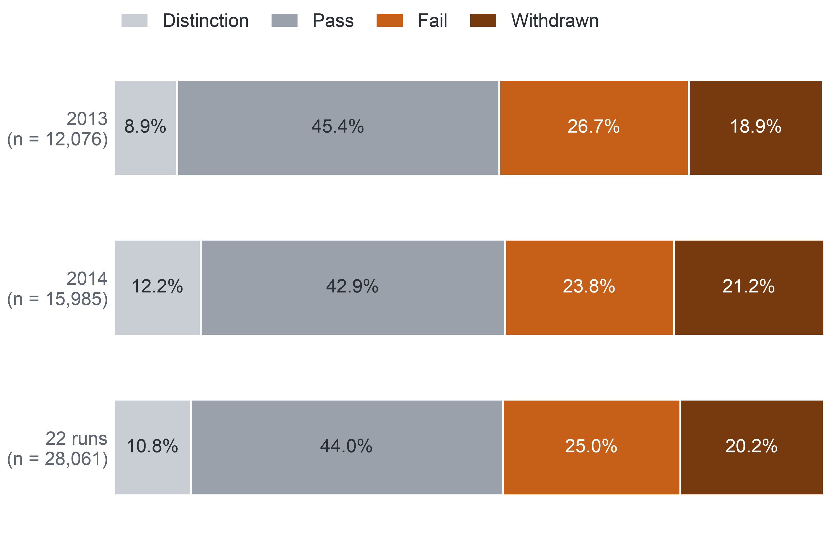
PART 5 · EVIDENCE (MILESTONE 5)
Detail on appendix slides A54–A59
11
AQ1: How Many Do Not Complete
Close to half of the enrolments still registered at day 14 do not complete, a quarter by failing and a fifth by withdrawing, and the two years agree.
45.3%
Final outcome, enrolments registered at day 14 (%)
(44.7–45.8) of the 28,061 enrolments still registered at day 14, over 22 runs, did not complete: 12,700.
2013: 45.7% (44.8–46.6) of 12,076.
2014: 44.9% (44.2–45.7) of 15,985.
Success criterion met: two independent counts, from the prepared and the raw data, agree exactly.
Confidence: high for OULAD 2013–2014; validity for the university's courses remains open.
Key: AQ1 = descriptive question (outcome shares and timing). Day 14 = end of the add-drop period. Non-completion = Fail or Withdrawn. Intervals = 95% confidence intervals. OULAD = Open University Learning Analytics Dataset.
Notes:
(~157 seconds)
AQ1, the descriptive question, measures the size of the problem, and the lead line gives the answer: close to half of the enrolments still registered at day 14 do not complete, a quarter by failing and a fifth by withdrawing, and the two years agree.
The big number: of the 28,061 enrolments still registered at day 14, over 22 runs, 45.3 percent, that is 12,700, did not complete, with a 95 percent confidence interval, the range that holds the true rate with 95 percent confidence, of 44.7 to 45.8 percent. The key gives the definitions: day 14 is the first day after the add-drop period, the first two weeks, days 0 to 13, and non-completion means a fail or a withdrawal. By year, the rate is 45.7 percent of 12,076 enrolments in 2013 and 44.9 percent of 15,985 in 2014.
The bars split each year into its final outcomes: grey for distinction and pass, orange for fail, dark brown for withdrawn. About a quarter fail and a fifth withdraw in both years. Behind this average the runs differ strongly, from 24.9 to 58.3 percent, so one target for every course would hide where the problem sits.
Two further lines say how far to trust the number. The success criterion is met: two independent counts, one from the prepared data and one from the raw files, agree exactly. Confidence is high for OULAD in 2013 and 2014, while validity for the university's courses remains open; for the university, this is a hypothesis to recheck on its own records before D2, the decision on where to place support time, and D3, whether to extend the approach, rely on it.
The timing finding matters most for an early list: fewer than one in five non-completers had missed a task by week 4, 19.6 percent in 2013 and 14.7 percent in 2014. Missed tasks alone come too late, which is why the rule also watches activity. Next, which signs go with non-completion.

Slide 12
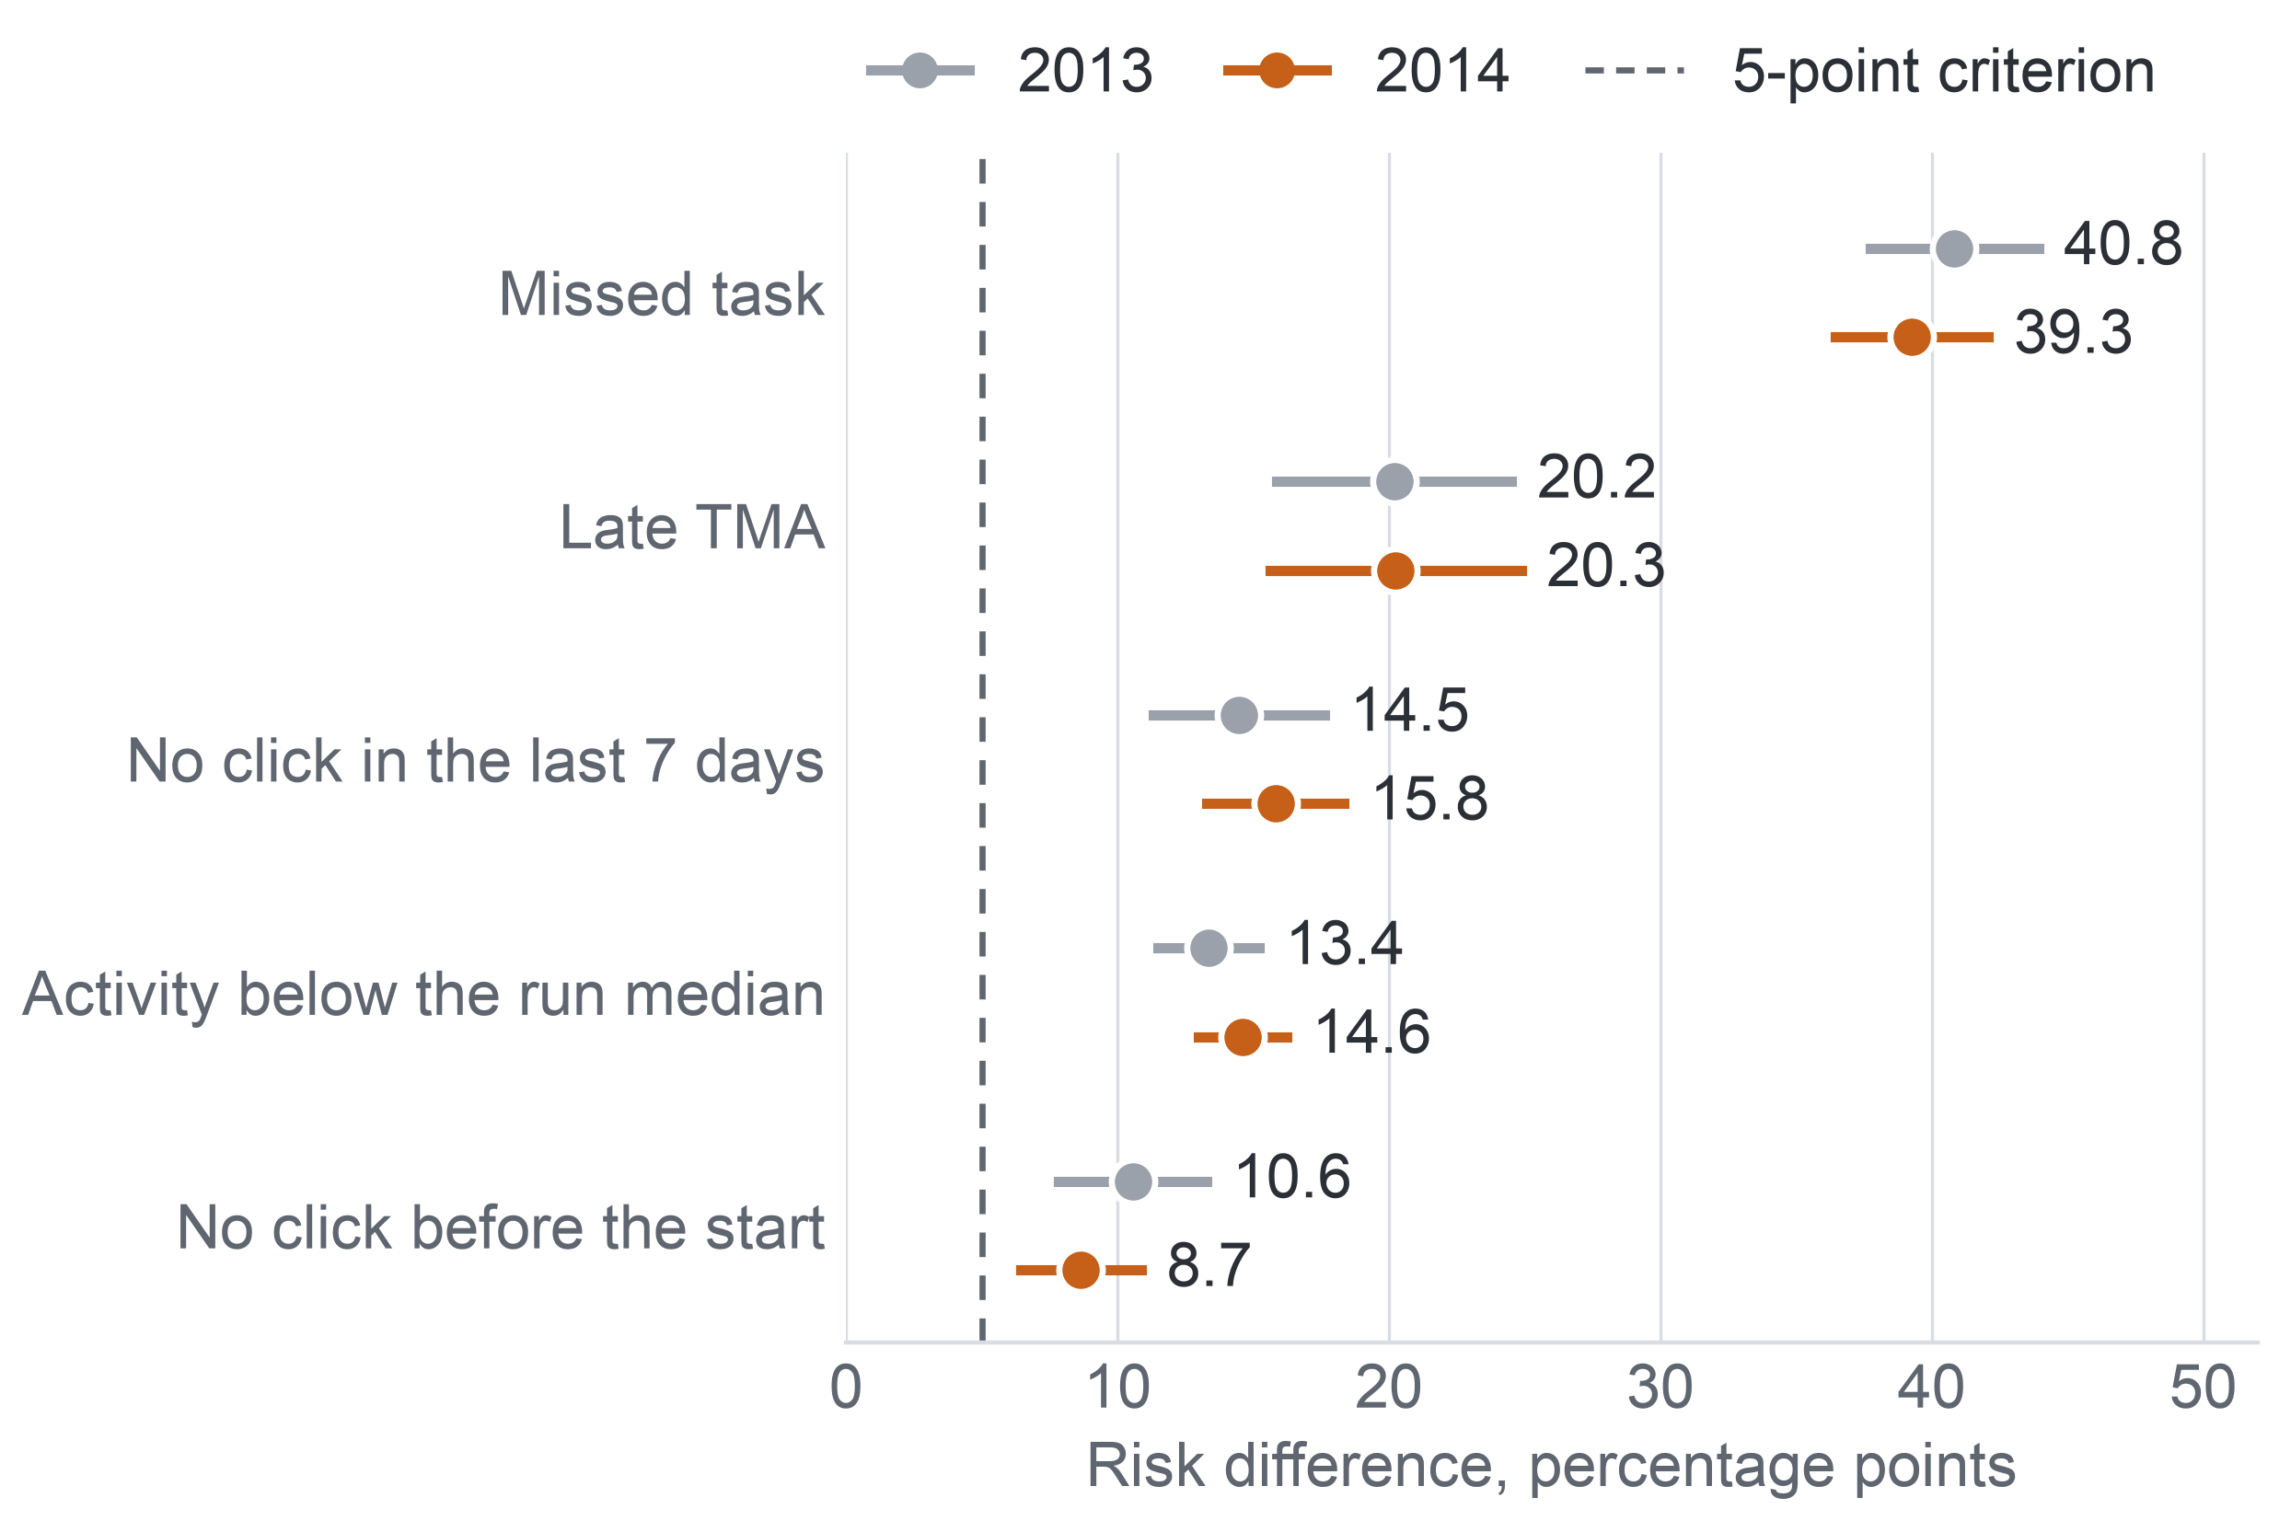
PART 5 · EVIDENCE (MILESTONE 5)
Detail on appendix slides A60–A63
12
AQ2: Five Early Signs
All five early signs, inactivity included, go with later non-completion within module run, by similar amounts in 2013 and 2014.
Extra later non-completion with each sign at day 27
The five signs: the rule's three parts (Missed task, Late TMA, No click in the last 7 days, that is days 21–27) and two activity signs tested only here: Activity below the run median (clicks on days 0–27) and No click before the start (day 0).
Risk difference: the extra percentage points of later non-completion among enrolments with the sign against those without, within module run, adjusted for the other signs.
Population: registered at day 27; 11,811 enrolments in 2013 (44.4% non-completion) and 15,724 in 2014 (44.0%); task signs on 9,960 and 12,585.
Criterion: at least 5 points, an interval excluding 0, and the same direction (more non-completion with the sign) in two-thirds of modules.
These are associations, not causes.
Key: dot = risk difference; whisker = 95% interval; dashed line = the 5-point criterion; TMA = tutor-marked assignment. Task signs on runs with a task due by day 27; click signs on all runs.
Notes:
(~151 seconds)
The second question, AQ2, asks which early signs go with later non-completion, and the lead line gives the answer: all five early signs, inactivity included, go with later non-completion within module run, by similar amounts in 2013 and 2014.
The five signs are the rule's three parts, a missed task, a late TMA and no click in the last 7 days, that is days 21 to 27, plus two activity signs tested only here: activity below the run median, counted over days 0 to 27, and no click before the start, day 0.
How to read the chart: each dot is a risk difference, the extra percentage points of later non-completion among enrolments with the sign against those without, within the same module run and adjusted for the other signs, so that each dot shows that sign alone. Grey dots are 2013, orange dots 2014, and the whiskers are 95 percent intervals. The population is everyone registered at day 27: 11,811 enrolments in 2013, with 44.4 percent non-completion, and 15,724 in 2014, with 44.0 percent. Task signs are measured only on runs with a task due by day 27, which covers 9,960 and 12,585 enrolments.
The dashed line marks our criterion, fixed in advance: at least 5 points, an interval excluding zero, that is wholly above zero, and the same direction, higher non-completion with the sign, in at least two-thirds of modules. All five signs clear it in both years. A missed task stands out, adding about 40 points in both years. A late TMA adds about 20. The three activity signs add roughly 9 to 16 points each.
These are associations, not causes: they explain why a name is on the list, not that removing a sign would keep the student. For the contact decision they become the reason printed beside each name, which staff check before they call. Next, the ranked list itself.

Slide 13
PART 5 · EVIDENCE (MILESTONE 5)
Detail on appendix slides A64–A79
13
AQ3 and AQ4: The Ranked List
A model built on 2013 ranks the 2014 students slightly better than the early-sign rule, and its list gives a reason beside each name; it is a rank, not a probability.
AQ3 – Predictive: Answered
AQ4 – Prescriptive: Partial
Both cut-offs: lists of 5 per 20 hold 38.6% of later non-completers at day 13 and 41.5% at day 27, so waiting two more weeks adds little.
Model and rule: they share most names; each list holds 903 students the other does not, and of the students only the model picks, 59.7% do not complete; of those only the rule picks, 50.6%.
Probability: the predicted risks match the observed rates (calibration) in only 5 of the 13 runs, so staff see ranks and reasons.
Order: per 20 students (the size of one tutor group), the top-ranked student is a later non-completer 92.4% of the time, the fifth 57.6%, the sixth 55.2%; from the seventh on, 47.3% or less, close to the base rate of 44.0% (2014 non-completion at day 27).
Reasons: for 80.7% of listed students the main reason is behaviour (low activity, a missed task or a late submission).
Fairness: the fairness check (a group reached over 10 points less well than other students) found none of the three groups fixed in advance disadvantaged (students with a declared disability; in the most deprived band; with no deprivation band recorded).
Neither answer says who should make contact or whether contact helps, and the order of risk is not shown to match the need for help.
Notes:
(~191 seconds)
The third and fourth questions turn the signs into a list. The lead line: a model built on 2013 ranks the 2014 students slightly better than the early-sign rule, gives a reason beside each name, and its score is a rank, not a probability. The second line sets the limit: neither answer says who should make contact or whether contact helps, and the order of risk is not shown to match the need for help: the students most at risk may not be those who gain most from a contact.
The left card answers AQ3, the predictive question, which is Answered. Both cut-offs: lists of 5 per 20 hold 38.6 percent of later non-completers at day 13 and 41.5 percent at day 27, so waiting two more weeks adds little and the week-3 list is almost as good. Model and rule: they share most names, and each list holds 903 students the other does not; of the students only the model picks, 59.7 percent do not complete, against 50.6 percent of those only the rule picks. Probability: the predicted risks match the observed rates, which is calibration, in only 5 of the 13 runs, so staff should see ranks and reasons, not probabilities.
The right card answers AQ4, the prescriptive question, which is Partial. Order: counted per 20 students, the size of one tutor group, the top-ranked student is a later non-completer 92.4 percent of the time, the fifth-ranked 57.6 percent and the sixth-ranked 55.2 percent; from the seventh on it is 47.3 percent or less, close to the base rate of 44.0 percent, the share of 2014 enrolments still registered at day 27 that did not complete. We tested lists of five, and since the sixth-ranked student is still clearly above chance, five to six per twenty is where effort pays.
Reasons: for 80.7 percent of listed students the main reason is behaviour, that is low activity, a missed task or a late submission, rather than background. Fairness: the check, which flags any group reached more than 10 points less well than other students, found none of the three groups fixed in advance disadvantaged: students with a declared disability, students in the most deprived band, and students with no deprivation band recorded. What these data cannot say is whether contact helps; that needs the pilot. Before the take-home, a look back at how the plan changed.

Slide 14
CONCLUSIONS
14
What Changed Along the Way
The plan of Milestone 1 did not survive the data; each turning point was recorded, tested and turned into a rule the next milestone could rely on.
Milestone | What happened | What we did | Where it stands
1 | No real staff: AI played the five stakeholders | 51 quotes checked against transcripts; a validation round | Confirm with real staff before a pilot
2–3 | Duplicate clicks, missing exam results, documentation unlike the files | Nineteen issues logged, each with a decision | Duplicates barely matter: the early-click comparison stays the same
2–3 | The Milestone 1 rule could fire in 1 of 22 runs | New early-sign rule: missed task, late TMA or 7 silent days | Resolved; one rule for analysis and pilot
3 | AI leakage audit found eight errors our checks missed | Reproduced, fixed; every check shown to catch an error | Resolved; all 22 data checks pass
3–5 | A 50% precision target: a random list reaches about 45% | Questions revised; lists judged within capacity | AQ1–AQ3 answered; AQ4 in part
5 | No tuning measure in the plan; the 2014 test set grew from the 9 runs with a 2013 twin to all 13, unrecorded until Milestone 5 | Log loss chosen and disclosed; both changes in the Change Log | Gate S1 met under log loss and under recall
Key: AQ = analytical question; gate S1 = the threshold a model must pass to replace the early-sign rule; Change Log = the record of every change with its reason; log loss = how far the predicted risks fall from the actual outcomes.
Notes:
(~193 seconds)
The plan of Milestone 1 did not survive the data, and the lead line says how we handled that: each turning point was recorded, tested and turned into a rule the next milestone could rely on. The table has one row per turning point, read from what happened, through what we did, to where it stands.
Milestone 1: we had no real staff, so generative AI played the five stakeholders. We checked all 51 key quotes against the transcripts and ran a validation round, in which the AI stakeholders confirmed the agreed design; the requirements still need confirming with real staff before a pilot.
Milestones 2 and 3, first row: the data brought duplicate clicks, missing exam results and documentation unlike the files. We logged nineteen issues, each with a decision, and the duplicates barely matter: the early-click comparison stays the same. Second row: the Milestone 1 rule could fire in only 1 of 22 runs, so we built the early-sign rule, a missed task, a late TMA or seven silent days. That is resolved, with one rule for the analysis and the pilot.
Milestone 3: an AI leakage audit of our preparation code found eight errors our checks had missed. We reproduced and fixed each one and showed that every check can catch an error; all 22 data checks now pass. Milestones 3 to 5: the 50 percent precision target proved meaningless, since a random list reaches about 45 percent, so all four questions were revised and lists are judged within capacity. AQ1 to AQ3 are answered, and AQ4 in part.
Milestone 5: the plan had not named the measure for tuning the model, that is for choosing the strength of its penalty on the 2013 runs. We tuned it on log loss, a standard measure of how far predicted risks fall from the actual outcomes, a choice made after the tuning results under both log loss and recall were known, and we disclose it. The 2014 test set also grew from the 9 runs that have a 2013 twin to all 13 runs of 2014, a change not recorded until Milestone 5; the 9 runs are still reported apart, and the gain holds on them too. Both changes sit in the Change Log, the record of every change with its reason, and gate S1 is met whether the model is tuned on log loss or on recall. Now, the take-home.
Source: self-assessment, Section 1, Table 1.1; Milestone 5 report, Sections 3.2, 7, 10 and 13.

Slide 15
CONCLUSIONS
15
Take-home
Three things to take home: what to watch, how long a list should be, and what to prove first.
1
Watch for inactivity, not only missed tasks.
Fewer than one in five future non-completers had missed a task by week 4; inactivity shows earlier.
2
Size the list to the people who will call.
5 to 6 names per 20 students, each with the reason it is there.
3
Read scores as ranks; pilot before scaling.
Risks are not reliable probabilities; only a randomised pilot shows whether contact helps.
Take-home: watch for inactivity, size the list to capacity, and prove that contact works before scaling.
Notes:
(~135 seconds)
Three things to take home: what to watch, how long a list should be, and what to prove first.
First, watch for inactivity, not only missed tasks. About 45 percent of students still registered after the add-drop period do not complete, and fewer than one in five of them have missed a task by week 4. Inactivity shows earlier: each of the three activity signs, such as a week without platform activity, goes with roughly 9 to 16 more points of later non-completion, and they can be seen even in runs where no task is yet due.
Second, size the list to the people who will call. The top-ranked student in each group of twenty was a future non-completer more than nine times in ten, and from the seventh on the list was hardly better than chance. So five to six names per twenty is where effort pays, each with the reason it is there, which staff check before they call.
Third, read scores as ranks, and pilot before scaling. The model's risks are not reliable probabilities in every course, and no open dataset shows whether calling helps. So our recommendation is staged: recount the results on the university's own records; classify the list's risk before use, because Vietnam's Law on Artificial Intelligence, No. 134/2025/QH15, requires a person to keep control of every decision of an AI system, and Decision 33/2026/QĐ-TTg lists systems that assess or rank learners among the high-risk uses of AI in education; and run a randomised pilot with every contact and outcome logged.
The line at the bottom puts it in one sentence: watch for inactivity, size the list to capacity, and prove that contact works before scaling.

Slide 16
Thank you. Questions?
Early Identification of Disengaging Students in Online Courses – team N04
Take-home: watch for inactivity, size the list to capacity, and prove that contact works before scaling.
Data: Open University Learning Analytics Dataset (Kuzilek, Hlosta and Zdrahal), CC BY 4.0.
Notes:
(~46 seconds)
Thank you for your time. In short: an early list should watch for inactivity as well as missed tasks, be as long as the staff who will call can manage, and be tried in a randomised pilot before it is used more widely.
Every number in the talk comes from the Open University Learning Analytics Dataset, by Kuzilek, Hlosta and Zdrahal, published under the CC BY 4.0 licence. We are happy to take questions on any step, from the data we chose to the pilot we propose; the appendix slides hold the detail behind every number.

Slide 17
Appendix (1/2)
Detail slides the talk points to; not presented.
A1 The Surprising Number
A2 Our Answer in Brief
A3 How the Talk Is Built
A4 Educational Context
A5 Withdrawal Is a Regulated Measure
A6 Why Early Matters: What Studies Report
A7 Stakeholders and Their Decisions
A8 What Staff Asked For
A9 Scope and Objective
A10 Is the Target Achievable?
A11 Key Performance Indicators
A12 Three Decisions, Three Kinds of Evidence
A13 How Each Level May Be Read
A14 Quality Check of the Questions
A15 How the Questions Changed
A16 What the Data Forced Us to Change
A17 Questions Mapped to Decisions
A18 Data Requirements, Stated First
A19 Six Must-Have Gates
A20 Why OULAD, and on What Condition
A21 Provenance and Licence
A22 OULAD at a Glance
A23 Seven Tables and Their Keys
A24 Coverage over Years and Runs
A25 Key Variables
A26 Requirement–Data Fit
A27 Gaps Only the University Can Fill
A28 Outcome Balance and Skewed Activity
A29 The Populations Behind Every Number
A30 Duplicates, Missing Values and Invalid Records
A31 Time Coverage and Representativeness
A32 Sensitive Fields and Privacy
A33 Who Counts: the Add-drop Rule
A34 Three Rules That Govern Preparation
A35 Preparation Decision Matrix
A36 Ten Scripted Steps
A37 Derived Variables and Encoding
A38 The Final Versioned Dataset
A39 From Questions to Technical Tasks
A40 Method Selection: AQ1 and AQ2
A41 Method Selection: AQ3 and AQ4
A42 Eight Criteria and the Tie-break

Slide 18
Appendix (2/2)
Detail slides the talk points to; not presented.
A43 Why a Ranking, Not a Threshold
A44 Evaluation Plan
A45 The AQ2 Success Criterion
A46 Validation Design
A47 Gate S1 and the Calibration Condition
A48 Fairness and Rule FR1
A49 Leakage and Interpretability in the Evaluation
A50 What the Frozen Protocol Fixes
A51 How We Read the Findings
A52 Traceability Matrix: From Goal to Data
A53 Traceability Matrix: From Method to Decision
A54 AQ1: Modules, Runs and Start Months
A55 AQ1: The Denominator Matters
A56 AQ1: The Year Comparison Depends on the Add-drop Rule
A57 AQ1: Non-completion by Group of Students
A58 AQ1: When Non-completers First Miss a Task
A59 AQ2: How We Tested the Signs
A60 AQ2: Consistent Across Modules
A61 AQ2: Sensitivity Runs
A62 AQ2: Activity Works as a Gradient
A63 AQ2: What the Signs Mean for the List
A64 Answers by Question
A65 Decision D1: Whom to Contact
A66 Decision D2: Where Support Time Goes
A67 Decision D3: Whether to Extend
A68 Three Kinds of Limit
A69 Limitation Log
A70 Measurement and Model Limits
A71 Future Work in Order
A72 Next at the University: Recount and Replace Assumptions
A73 Risk Classification and Human Control
A74 The Randomised Pilot
A75 Generative AI: Roles and One Rule
A76 AI Decision Log
A77 What AI Changed, and What We Rejected
A78 Conclusions, Firmest First
A79 What We Cannot Conclude, and Open Problems

Slide 19
APPENDIX A1: INTRODUCTION
19
The Surprising Number
Nearly half of the enrolments still registered after the add-drop period did not complete, yet fewer than one in five of these non-completers had missed a task by week 4.
How many do not complete
How many show it by week 4
45.3%
19.6% and 14.7%
of the 28,061 enrolments still registered at day 14 did not complete (95% interval 44.7–45.8%), over all 22 module runs.
of the non-completers of 2013 (5,515) and of 2014 (7,185) had missed a task by the end of week 4.
So a list built on missed tasks alone comes too late for most of them.
Share of the non-completers who had missed a task (%), day-14 population
Key: data = OULAD (Open University Learning Analytics Dataset), our open stand-in: 22 module runs (one offering of a module) of seven UK distance-learning modules, 2013–2014. Day 14 = end of the add-drop period. Non-completion = a fail or a withdrawal. Task = an assessed assignment or quiz, never the exam.
Notes:
(~66 seconds) Here it is. Of the 28,061 enrolments still registered at day 14, the end of the add-drop period, 45.3 percent did not complete: they failed or withdrew. That is nearly one in two, over all 22 module runs of our data. Now the surprise. The obvious early warning is a missed assignment, and non-completers do miss tasks: 78.1 percent in 2013 and 72.7 percent in 2014 missed one at some point, the grey bars. But look at the orange bars. By the end of week 4, only 19.6 percent of the non-completers of 2013, and 14.7 percent of those of 2014, had missed one. If staff wait for missed work, most of the students who will not finish are still invisible. That gap runs through this whole talk, and it begins with how late students are noticed today.
Source: Milestone 5 report, Abstract, Section 11.2 and Appendix XII, Tables A.29 and A.31.

Slide 20
APPENDIX A2: INTRODUCTION
20
Our Answer in Brief
Early records give staff a ranked list with a factual reason beside each name; a model built on 2013 ranks the 2014 students slightly better than the rule, and whether contact helps needs a pilot.
Key terms
Non-completion: a fail or a withdrawal.
Early sign: a record dated by the data cut-off, such as a task missed or a week without any platform activity.
Data cut-offs: day 13 (end of week 2) gives the data for the week-3 list; day 27 (end of week 4) gives the data for the week-5 list.
Add-drop period: the first weeks in which students may still register or drop; on our data it ends at day 14.
Size
List
Signs
45.3%
41.5%
5 of 5
of the 28,061 enrolments still registered at day 14 did not complete.
of later non-completers on model lists of 5 per 20 students, against 40.3% for the early-sign rule (13 runs of 2014).
early signs, from tasks and from activity, go with later non-completion in both years; a missed task adds 40.8 (2013) and 39.3 (2014) percentage points.
Still open: risks are reliable as ranks, not as probabilities, in 8 of 13 runs; the effect of contact is untested.
Notes:
(~79 seconds) Here is the whole talk on one slide. Four terms first. Non-completion is a fail or a withdrawal. An early sign is a record dated by the data cut-off, like a missed task or a silent week. The cut-offs are day 13 for the week-3 list and day 27 for the week-5 list, and the add-drop period ends at day 14 on our data. Of the 28,061 enrolments still registered then, 45.3 percent did not complete. All five early signs go with later non-completion in both years, a missed task by 40.8 and 39.3 percentage points. And a model built on 2013, tested once on the 13 runs of 2014, puts 41.5 percent of later non-completers on lists of five per twenty students, slightly more than the early-sign rule's 40.3 percent. So staff get a ranked list with a factual reason beside each name. Still open: the risks hold as ranks, not as probabilities, and whether contact helps. Here is how the talk builds it.
Source: Milestone 5 report, Abstract and Sections 2.1, 3, 10, 11.2, 11.3 and 11.4.

Slide 21
APPENDIX A3: INTRODUCTION
21
How the Talk Is Built
The talk follows the project's chain of eleven links, from the stakeholder problem to the decisions, in six parts and the conclusions.
Part 1 · The Problem
Milestone 1
1 Stakeholder problem
2 Measurable goal
3 Analytical questions
Context, goal, KPIs, decisions D1–D3 and questions AQ1–AQ4.
Part 2 · The Data
Milestones 2–3
5 Selected open dataset
6 Actual data fit and gaps
Requirements first, then the dataset, its fit and its quality.
4 Required data
Part 3 · Preparation
Milestone 3
Who counts, the early-sign rule, and no future information in an early sign.
7 Prepared data
Part 4 · Method
Milestone 4
How each question is answered and judged, fixed before any result.
8 Candidate methods
9 Evaluation design
Part 5 · Evidence
Milestone 5
AQ1 and AQ2 answered on 2013 and 2014; AQ3 and AQ4 by one test on 2014.
10 Findings and limitations
Part 6 · Integration and Use
Milestone 5
What each decision can use now, limits, next steps and the use of AI.
11 Educational decision support
Key: numbered boxes = the eleven links of the project chain, in the order the talk follows them. D1–D3 = the three decisions: whom to contact, where to place support time, whether to extend the approach. AQ1–AQ4 = the four analytical questions. KPI = key performance indicator.
Notes:
(~68 seconds) The talk follows the chain our project followed, eleven links across five milestones, in six parts. Part one, the problem: the context, the goal, three decisions we call D1 to D3, and four analytical questions, AQ1 to AQ4. Part two, the data: what the questions require, the dataset we chose, how well it fits and its quality. Part three, preparation: who counts, the early-sign rule, and how we keep future information out. Part four, the method: how each question is answered and judged, all fixed before any result. Part five, the evidence: AQ1 and AQ2 answered on 2013 and 2014, and AQ3 and AQ4 answered by one test on 2014. Part six, use: what each decision can rely on now, the limits, the next steps and how we used AI. Then the conclusions. We begin part one with the educational context.
Source: Milestone 5 report, Section 1.2 and Figure A.1 (Appendix I).

Slide 22



APPENDIX A4: PART 1 · THE PROBLEM (MILESTONE 1)
22
Educational Context
The university already holds the records that could show students drifting away, but has not decided which questions they should answer.
Setting
What it observes
Records it holds
A Vietnamese university expands online and blended learning on its LMS, the web platform where lecturers publish materials, quizzes and assignments.
We work with one undergraduate program of about 1,200 students in a faculty of about 4,000.
In several of the program's online and blended courses, students take part less as the semester goes on.
Some do not complete the course.
LMS activity, enrolment and result records, assignment and quiz results, grades and student surveys.
Which questions these should answer, and which decisions they should support, is still open.
Stakes: withdrawal is a regulated quality measure in Vietnam, capped at 10% a year and 15% in the first year (Appendix A5), while a program may teach up to 30% of its volume in online classes.
Key: every figure about the university (program and faculty size) is a scenario assumption of the course brief. LMS = learning management system.
Notes:
(~65 seconds) Part one starts with the setting. The university in our project is Vietnamese and is moving more teaching onto its learning management system, the LMS, where lecturers publish materials, quizzes and assignments. We work with one undergraduate program of about 1,200 students in a faculty of about 4,000; like every figure about the university, these are scenario assumptions from the course brief. In several of the program's online and blended courses, students take part less as the semester goes on, and some do not complete. The university already holds the records that could describe this: LMS activity, enrolments, results, grades and surveys. What it has not decided is which questions these records should answer, or which decisions they should support. And withdrawal is more than a teaching worry: it is regulated, as the next slide shows.
Source: Milestone 5 report, Section 1 and Appendix I.

Slide 23
APPENDIX A5: PART 1 · THE PROBLEM (MILESTONE 1)
23
Withdrawal Is a Regulated Measure
Vietnamese regulation caps withdrawal, so a university needs an exact record of each student's status and an early view of who is drifting away.
10%
15%
30%
Cap on the annual withdrawal rate (Circular 01/2024).
Cap on the first-year withdrawal rate; a university above it may not raise its enrolment quota.
Share of a full-time or work-study program that may be taught in online classes (2021 training regulation).
Circular 83/2026, in force from 15 November 2026
What follows for our project
• Replaces Circular 01/2024 and keeps both caps.
• Students on approved leave, and those who transfer to another program or institution, no longer count as withdrawn.
• Completion means passing the course, and withdrawal follows Circular 83/2026, so the university's baseline is recounted under its rule.
• Our open stand-in data record neither leave nor transfer, so there they count as withdrawal.
Basis: the two Circulars and the 2021 training regulation are cited through Vietnamese news reports (2021, 2024 and 2026), which are secondary sources.
Notes:
(~63 seconds) A university with records but no questions might still wait; regulation is why it cannot. Circular 01/2024 caps the annual withdrawal rate at 10 percent and the first-year rate at 15 percent, and a university above the first-year cap may not raise its enrolment quota. Circular 83/2026, in force from 15 November 2026, keeps both caps and no longer counts approved leave or transfers as withdrawal. At the same time, a program may now teach up to 30 percent of its volume online. Together these rules make withdrawal a measured quality indicator and require an exact record of each student's status. That is why our completion measure follows Circular 83/2026, and why we note that our stand-in data cannot separate leave or transfer from withdrawal. Next, what published research says about timing.
Source: Milestone 5 report, Section 1 and Appendix I (news reports of the Circulars, 2024 and 2026, and of the 2021 training regulation).

Slide 24
APPENDIX A6: PART 1 · THE PROBLEM (MILESTONE 1)
24
Why Early Matters: What Studies Report
Published studies agree that non-completion online is common and that the useful moment for support lies in the first weeks of a course.
How common non-completion is
When support is most useful, by week of the course
A review of 110 articles, 2013–2023
Week 1
Week 2
Week 3
Week 4
Week 5
Week 6
Week 7
Week 8
Dropout in online higher education is a significant concern, with several contributors acting at once (Rahmani et al., 2024).
Massive open online courses: about half of enrolled students never show up, and the first two weeks are critical (Jordan, 2015).
A review of 40 studies, 2010–2018
The window for effective support of a student at risk is short: it lasts two to four weeks (Herodotou et al., 2019, at the Open University).
Completion in online courses is about 8 to 14 points below face-to-face courses (Muljana and Luo, 2019).
Best point for an early warning in a blended first-year statistics course (Howard et al., 2018).
A Vietnamese review, 2024
Key: each grey bar spans the weeks a study names; the orange text gives a length of time, not weeks of the course.
Dropout among university students is about 20–30% (Lê et al., 2024).
So a useful signal must arrive early, and the time to act on it is short.
Notes:
(~69 seconds) Regulation raises the stakes; published studies tell us when to act. On the left, how common the problem is. A 2024 review of 110 articles treats online dropout as a significant concern with several causes. A review of 40 studies puts completion in online courses about 8 to 14 points below face-to-face courses. And a Vietnamese review puts university dropout at about 20 to 30 percent. On the right, timing, week by week. In massive open online courses, about half of enrolled students never show up, and the first two weeks are critical. The window for effective support is short: two to four weeks. And in one blended first-year statistics course, weeks five to six were the best point for an early warning. So a useful signal must arrive early, and the time to act on it is short. Who could act on it?
Source: Milestone 5 report, Appendix I; Rahmani et al. (2024); Muljana and Luo (2019); Lê et al. (2024); Jordan (2015); Herodotou et al. (2019); Howard et al. (2018).

Slide 25
APPENDIX A7: PART 1 · THE PROBLEM (MILESTONE 1)
25
Stakeholders and Their Decisions
Three groups of staff each take one decision, and all of them asked for a short list with a factual reason beside each name.
D1 – Whom to contact
D2 – Where to place support time
D3 – Whether to extend the approach
At each review point. Course lecturers, lecturer-advisors (lecturers who advise a student class) and the support office decide.
Each semester. The program manager decides.
Leadership decides with legal staff and the data office.
Operational and reversible
Set each semester
Close to irreversible
Review point: a moment in week 3 or week 5 when staff decide whom to contact.
Students: the subject of every data use; they decide whether to accept help.
What all three groups need
• A list at weeks 3 and 5, with a factual reason beside each name.
• About 30–40 contacts a week for the support office, and three to five for each lecturer-advisor.
• Support only, with no automated step.
Source of the needs: simulated interviews with AI on both sides (five stakeholders, 51 key statements, six themes); they motivate the design and are never evidence.
Notes:
(~64 seconds) Three groups of staff could act on such a signal, and each owns one decision. D1 is whom to contact at each review point, in week three or week five. Course lecturers, lecturer-advisors, who are lecturers advising a student class, and the support office take it, and it is reversible. D2 is where the program manager places support time each semester. D3 is whether leadership, with legal staff and the data office, extends the approach, which is close to irreversible. Students are the subject of every data use, and they decide whether to accept help. All three groups asked for the same thing: a short list at weeks three and five, with a factual reason beside each name, within the time they have. Where did these needs come from? That deserves its own slide.
Source: Milestone 5 report, Sections 1.1 and 2.1, and Appendix I, Table A.1.

Slide 26
APPENDIX A8: PART 1 · THE PROBLEM (MILESTONE 1)
26
What Staff Asked For
Simulated interviews set the shape of the list, short, timed and with a reason for each name, but they are never evidence.
How the needs were established: in Milestone 1, generative AI played both the stakeholder and the interviewer, followed by a validation round; we verified every transcript and kept 51 key statements, each labelled as an opinion, an assumption or scenario information.
Six themes that recur across five stakeholders
How we settled where they differed
• Students are noticed late.
• Disengagement starts early, often with a missed quiz or assignment.
• Capacity is small: about 30–40 contacts a week for the support office, three to five per lecturer-advisor.
• Contact helps when it comes from someone the student knows.
• The data must be trusted: linked records, correct status, a lawful purpose.
• Support only: no labels, no effect on grades, no evaluation of lecturers.
• Lists at two review points, week 3 and week 5.
• A factual reason beside each name, checked by a member of staff.
• Contact from the lecturer or the student's lecturer-advisor; the support office takes the harder cases.
• No step is automated.
• The validation round added: completion means passing; review points avoid registration and examination weeks; the target runs over a full academic year.
Status: simulated stakeholder views; they set the timing and the length of the lists, and every finding rests on the data or on published work. Lecturer-advisor: a lecturer who advises a student class.
Notes:
(~66 seconds) We have to be honest about these needs. We could not interview real staff, so in Milestone 1 generative AI took both sides of every interview: an isolated AI persona answered as the stakeholder, and an AI interviewer asked our questions, followed by a validation round. We checked every transcript and kept 51 key statements, each labelled as an opinion, an assumption or scenario information. Six themes recur, on the left: detection comes late, disengagement starts early, capacity is small, contact works from someone known, the data must be trusted, and use is for support only. On the right, how we settled where stakeholders differed: two review points, a checked reason per name, contact by someone the student knows, nothing automated. These views shaped the design; they are never evidence. With the needs set, we drew the boundary.
Source: Milestone 5 report, Section 1.1 and Appendix I.

Slide 27
APPENDIX A9: PART 1 · THE PROBLEM (MILESTONE 1)
27
Scope and Objective
We aim to turn records the university already holds into a short, timely contact list with an observed reason for each name, for decisions staff can take within a semester.
Objective: a short, timely list of students to contact at each review point, with an observed reason for each name, and patterns that show the program where and when students are lost.
In scope
Out of scope, and why
• Students enrolled in the program's online and blended courses after the add-drop period, the first weeks in which students may still register or drop.
• One semester at a time.
• Decisions staff can take within a semester: whom to contact, when, by whom and with which offer.
• Completion means passing the course; withdrawal follows Circular 83/2026, which excludes approved leave and transfers.
• Assessment rules: a lecturer cannot change them during a semester.
• Admissions and financial aid: university policy.
• Students' circumstances outside the course: beyond the university's control.
• The evaluation of lecturers: it would stop lecturers from using the results.
• Any automated decision: every contact stays a decision of a member of staff.
Condition: no open dataset of Vietnamese courses exists, so OULAD (Open University Learning Analytics Dataset, UK, 2013–2014) stands in, and every result must be re-checked on the university's records before it supports a decision.
Notes:
(~67 seconds) Knowing who needs what, we drew the boundary of the project. Our objective, at the top, has two parts: a short, timely list at each review point with an observed reason beside each name, and patterns that show the program where and when it loses students. In scope are students enrolled after the add-drop period, one semester at a time, and only decisions staff can take within that semester. Completion means passing the course, and withdrawal follows Circular 83/2026. Out of scope, each for a reason: assessment rules, admissions and aid, students' lives outside the course, the evaluation of lecturers, and any automated decision, so a person always decides. One condition runs through everything: we analyse OULAD, an open UK dataset, as a stand-in, so every result needs a re-check on the university's records. Now, the goal behind it all.
Source: Milestone 5 report, Section 1.2 and Appendix I.

Slide 28
APPENDIX A10: PART 1 · THE PROBLEM (MILESTONE 1)
28
Is the Target Achievable?
At the assumed baseline, five more points means about one in six non-completers passing after support, which fits staff capacity but stays an assumption.
Worked example
The goal against the five SMART criteria
600
Criterion | How the goal meets it
Specific | One measure (completion), one population (enrolled after add-drop) and one set of pilot courses, fixed in advance.
Measurable | Completion and its denominator are read from the academic management system at the end of each semester (the primary KPI).
Achievable | About 30 more passes in 600 enrolments; reaching them fits the weekly capacity staff reported (worked example on the left).
Relevant | Measures the Business Goal directly and answers the program manager's and the support office's needs.
Time-bound | Contact runs from Semester 2 of 2026–2027; the target is read on the pilot courses over the 2027–2028 year.
enrolments in about four pilot courses (assumed)
about 180
end without a pass at the assumed 70% completion
about 30
more passes give five more points: one in six of the 180
Key: the one-in-six share is an assumption, not an estimate; no data in the project measure the effect of contact, so the pilot tests it. KPI = key performance indicator.
Notes:
(~67 seconds) Here is the arithmetic behind achievable. At the assumed 70 percent baseline, about 180 of 600 enrolments end without a pass. Five more points means about 30 more passes, roughly one in six of those 180 students passing after support. Reaching 30 students over a year fits the weekly capacity staff described. But that one in six would then pass is an assumption, not an estimate: nothing in our data measures what contact achieves, which is exactly why the pilot exists. The table on the right checks the other criteria: one measure and one population, read each semester from the academic records, tied directly to the goal, and timed from Semester 2 of 2026–2027 to the 2027–2028 year. A full year, because the simulated program manager doubted five points in one semester. How do we watch progress along the way?
Source: Milestone 5 report, Section 2 and Appendix II, Table A.2.

Slide 29
APPENDIX A11: PART 1 · THE PROBLEM (MILESTONE 1)
29
Key Performance Indicators
One primary KPI measures the goal and two secondary KPIs show during the semester whether contact happens; on OULAD only their non-contact parts can be computed.
KPI | Definition | When and from where | On OULAD
Primary: completion rate | Passes over enrolments after the add-drop period; leave and transfer leave the denominator. | End of each semester; academic records. | Proxy: enrolments still registered at day 14, 28,061 over 22 runs.
Secondary 1: early-sign contact rate | Students meeting the early-sign rule at the end of week 4 who are contacted by the end of week 5, over students meeting it. | Week 6; LMS, academic and contact records. | Sign part only: the rule flags 28.8% of 27,535 enrolments at day 27.
Secondary 2: follow-up rate | Listed students contacted within seven days, over students listed. | A week after each review point; contact record. | Pilot only: no contact record exists.
Early-sign rule: by the data cut-off, a tutor-marked assignment (TMA) or computer-marked assessment (CMA) due but not submitted, a TMA submitted late, or no platform activity in the previous seven days; the one rule of the project, on OULAD and in the pilot (Slide 7).
Key: KPI = key performance indicator. OULAD = Open University Learning Analytics Dataset, our open stand-in. Day 14: registration closes two weeks after a run starts; day 27 = end of week 4. LMS = learning management system. Last column: green = computed as a proxy; orange = part computed; grey = pilot only.
Notes:
(~67 seconds) A goal read once a year needs indicators staff can watch. The primary KPI, key performance indicator, is the completion rate after add-drop. On OULAD it has a proxy: an enrolment counts if it is still registered at day 14, because registration closes two weeks after a run starts. That gives 28,061 enrolments over 22 runs. Secondary KPI 1 asks whether students meeting the early-sign rule at week 4 are contacted by week 5. The rule, at the bottom, flags a task due and not submitted, an assignment submitted late, or a week with no platform activity. On OULAD only its sign part can be computed: the rule flags 28.8 percent of 27,535 enrolments at day 27. Secondary KPI 2, follow-up within seven days, needs a contact record, so only the pilot measures it. These indicators serve three decisions.
Source: Milestone 5 report, Section 2.1, Table 2.1, and Appendix II.

Slide 30
APPENDIX A12: PART 1 · THE PROBLEM (MILESTONE 1)
30
Three Decisions, Three Kinds of Evidence
The more reversible a decision, the simpler the evidence it can start with: D1 can start with a staff-checked rule, D3 needs a pilot and legal approval.
Easy to reverse (two-way door)
Hard to reverse (one-way door)
D1 – Whom to contact at each review point
D2 – Where to place support time each semester
D3 – Whether to extend the approach and link data routinely
Who: course lecturers, lecturer-advisors and the support office.
Kind: operational, repeated at every review point; a contact that does not help can be followed by another.
Evidence needed: a list that reaches more later non-completers than the early-sign rule at the same length; each name checked by staff.
Who: the program manager.
Kind: management control, with judgement about courses and staff; staff can be moved again next semester.
Evidence needed: a pattern repeated over several semesters, correct records and agreement with staff.
Who: university leadership, legal staff and the data office.
Kind: strategic, with no earlier case; it changes the university's data practice and students' trust.
Evidence needed: pilot results, legal approval, and completion and the KPIs (key performance indicators) measured before and after the pilot.
Two-way door
Two-way door
Close to a one-way door
Key: a two-way door is a decision that can be reversed quickly; a one-way door is nearly irreversible. Early-sign rule: a missed or late task, or a week with no platform activity, by the data cut-off. Review point: week 3 or week 5.
Notes:
(~67 seconds) These indicators feed three decisions, and how reversible each is sets how much evidence it needs. Read the arrow from left to right, from easy to reverse to hard to reverse. D1, whom to contact, is operational and repeated at every review point; if a contact does not help, another can follow. So D1 can start with the early-sign rule, checked by staff, and a model replaces the rule only if its list reaches more later non-completers at the same length. D2, where support time goes, moves scarce staff, so it needs a pattern that repeats over semesters, not one difficult term. D3, extending the approach and linking data routinely, changes the university's data practice and students' trust; it is close to a one-way door, so it needs pilot results and legal approval. Next, the questions that supply this evidence.
Source: Milestone 5 report, Section 2.1 and Appendix II, Table A.3.

Slide 31
APPENDIX A13: PART 1 · THE PROBLEM (MILESTONE 1)
31
How Each Level May Be Read
The analytics level of a question fixes what its answer may claim: a diagnostic answer is an association, and a prescriptive answer on observational data is an option to test.
Question and level | Evidence reached | What the answer states | What the answer does not state
AQ1 – Descriptive: completion and timing | Real results, 2013 and 2014 | Outcome shares and the week of the first missed task, with denominator and 95% interval. | Why a module or run has a higher rate; any rate for the university's own courses.
AQ2 – Diagnostic: early signs by week 4 | Real results, 2013, replicated on 2014 | Which signs go with later non-completion within module runs, by how many points. | That a sign causes non-completion, or that removing a sign would raise completion.
AQ3 – Predictive: estimate at weeks 2 and 4 | Single test, 13 runs of 2014 | How well a model ranks students against the rule. | A reliable probability for each run.
AQ4 – Prescriptive: ranking under capacity | Ranking, from the AQ3 scores | Who ranks first on a list, with a reason per name. | Whom contact helps, or which contact works: options for a randomised pilot.
Every finding in this talk is held to this table: an association is never read as a cause.
Key: AQ = analytical question. Observational data = records of what students did, with no assigned treatment. Orange = real results.
Notes:
(~73 seconds) This table is the reading rule we hold every finding to. A descriptive answer, AQ1, states outcome shares and timing, with denominator and interval, but not why a module has a higher rate, and not any rate for the university. A diagnostic answer, AQ2, states which signs go with later non-completion and by how many points; it never says a sign causes non-completion or that removing it would raise completion. AQ3, tested once on the 13 runs of 2014, states how well a model built on 2013 ranks students against the rule, but not a reliable probability for each run. AQ4 states who ranks first on a list of fixed capacity, never whom contact helps; that is an option for a randomised pilot. The strongest temptation in this project is to read an association as a cause, and this table is there to stop it. Next, were the questions themselves well formed?
Source: Milestone 5 report, Section 3 and Appendix XI, Table A.26.

Slide 32
APPENDIX A14: PART 1 · THE PROBLEM (MILESTONE 1)
32
Quality Check of the Questions
All four questions are clear, specific, scoped and data-oriented; they differ only in how far the data can answer them.
Criterion | Test | AQ1 | AQ2 | AQ3 | AQ4
Clear | Asks one thing a reader can restate | Met | Met | Met | Met
Specific | Names its measure and groups | Met | Met | Met | Met
Scoped | Fixes its population and period | Met | Met | Met | Met
Data-oriented | Names its data | Met | Met | Met | Met
Answerable | Those data can settle it | Answered for 2013 and 2014 | Answered, as an association | Answered by a single test on 2014 | Ranking part only; contact has no data
Final status: Answered when results answer all of a question; Partial when they answer its core while a named part waits; Deferred when the design is complete but no result exists; Dropped when abandoned. AQ1, AQ2 and AQ3 are Answered, AQ4 is Partial, and no question is dropped.
Key: AQ = analytical question; AQ1 descriptive, AQ2 diagnostic, AQ3 predictive, AQ4 prescriptive (ranking under staff capacity). Cell colours: green = met or answered; orange = answerable in part.
Notes:
(~68 seconds) Before answering the questions, we checked that they were worth answering. The course brief asks every question to be clear, specific, scoped, data-oriented and answerable. Clear means it asks one thing a reader can restate; specific, it names its measure and groups; scoped, it fixes its population and period; data-oriented, it names its data; answerable, those data can settle it. In their final wording all four pass the first four checks. They differ only in the last row. AQ1 and AQ2 are answered for 2013 and 2014, AQ2 as an association. AQ3 is answered by a single test on the 2014 runs. For AQ4 only the ranking is answerable, because no data record a contact, so AQ4 is Partial and its contact part waits for a pilot rather than being filled with assumptions. None of this wording is where we started.
Source: Milestone 5 report, Sections 3 and 3.1, Table 3.1, and Appendix III, Table A.4.

Slide 33
APPENDIX A15: PART 1 · THE PROBLEM (MILESTONE 1)
33
How the Questions Changed
Every question was narrowed by what the data lack, each change traces to a finding in the data, and no question was dropped.
AQ | At Milestone 1 | What the data showed | Final question | Action
AQ1 | Outcome shares by course, delivery mode and year of study | OULAD has no delivery mode or year of study (YELLOW) | By module, run, start month and year | Modify
AQ2 | Signs in weeks 1–4 with attendance, across modes and years | No in-class sessions, so no attendance (YELLOW) | Signs by week 4, compared within each module | Modify
AQ3 | Estimate at weeks 2 and 4 against a two-task rule | Few tasks fall due by the data cut-offs (YELLOW) | Against the early-sign rule, built on 2013, applied to 2014 | Modify
AQ4 | List, order and contact; precision of at least 50% | No contact data; base rate about 45% (RED) | Ranking under capacity, overall and by group | Modify + Defer
Unchanged: the Business Goal, the SMART Goal and the three decisions; the data narrowed how each question is measured, not what the project aims for.
Key: AQ1 descriptive, AQ2 diagnostic, AQ3 predictive, AQ4 prescriptive. OULAD = Open University Learning Analytics Dataset. Ratings of the data fit: YELLOW = narrow the question; RED = a key concept or intervention is missing. Modify = narrow how it is measured; Defer = keep a part for the pilot. Early-sign rule: a missed or late task, or a week with no activity. Base rate: share that do not complete.
Notes:
(~67 seconds) Every question changed since Milestone 1, and each change traces to something the data lack. AQ1 compared delivery modes and years of study; OULAD records neither, so it now compares modules, runs, start months and years. AQ2 included attendance at class sessions; there are none, so the signs are compared within each module. AQ3 was to beat a rule of two missed tasks, but too few tasks fall due in the first weeks, so it now competes with the early-sign rule, built on 2013 and tested on 2014. AQ4 asked for a contact plan with at least 50 percent precision; there are no contact data, so it became a ranking, and its contact part waits for the pilot. Yellow means narrow the question; red, something key is missing. No question was dropped. Here are the changes that touched everything.
Source: Milestone 5 report, Section 3.2, Table 3.2, and Appendix III, Tables A.5 and A.6.

Slide 34
APPENDIX A16: PART 1 · THE PROBLEM (MILESTONE 1)
34
What the Data Forced Us to Change
Six changes came straight from the data; none of them touched the goal or the decisions.
Setting
Time
Who counts
Before: a Vietnamese university.
After: OULAD module runs as an open stand-in; the pilot uses the university's records.
Why: no open Vietnamese course data exist.
Before: a semester, weeks 1–5.
After: a module run counted in days; cut-offs on day 13 (week-3 list) and day 27 (week-5 list).
Why: OULAD dates events in days from the run start.
Before: students enrolled after the add-drop period.
After: enrolments still registered at day 14; 58 late registrants removed.
Why: registration closes two weeks after a run starts (Appendix A33).
Comparisons
Early-sign rule
List quality
Before: by delivery mode and year of study.
After: by module and run; fairness by deprivation band and disability.
Why: OULAD records neither field.
Before: two or more missed or late tasks.
After: a missed or late task, or no platform activity in the last seven days.
Why: two tasks fall due by day 27 in only 1 of 22 runs (Slide 7).
Before: a precision of at least 50%.
After: lift over the run's base rate and normalised recall.
Why: about 45% do not complete, so a random list already reaches about 45% precision.
Key: OULAD = Open University Learning Analytics Dataset. Lift = share of non-completers on the list ÷ share in the whole run (1 = chance). Normalised recall = share of later non-completers the list reaches ÷ the most a list of that length can reach.
Notes:
(~66 seconds) These six changes from our change log reach every question. OULAD stands in for the university's courses, while the university's records stay the target of the pilot. A semester becomes a module run counted in days, with cut-offs at day 13 and day 27. Enrolled after add-drop becomes still registered at day 14, which also removes 58 late registrants. Comparisons by mode and year of study become comparisons by module and run. The early-sign rule gains its activity part, because two tasks fall due by day 27 in only one of 22 runs. And a precision floor of 50 percent rewards nothing when about 45 percent do not complete anyway, so we judge a list by lift and normalised recall. None of this touched the goal or the decisions. So how do the questions plug into the decisions?
Source: Milestone 5 report, Sections 2.1 and 3.2, and Appendix III, Table A.8.

Slide 35
APPENDIX A17: PART 1 · THE PROBLEM (MILESTONE 1)
35
Questions Mapped to Decisions
Each decision draws on different questions: D1 on the list and its reasons, D2 on patterns, D3 on a measure.
AQ1
Descriptive: outcome shares and timing
D1 – Whom to contact at each review point
Uses: the list and its order (AQ3, AQ4); the reason beside each name (AQ2).
Now: a ranked list with reasons; the rule as fallback.
AQ2
Diagnostic: early signs by week 4
D2 – Where to place support time
AQ3
Predictive: a model against the early-sign rule
Uses: the patterns of AQ1 and AQ2 and the primary KPI.
Now: a hypothesis on where support time goes first.
AQ4
Prescriptive: a ranked list within capacity
D3 – Whether to extend the approach
Uses: AQ1's count of completion and the KPIs in pilot and comparison courses.
Now: a way to measure; the decision waits for the pilot.
KPIs
Completion rate and the two contact rates
Key: orange boxes and lines = questions answered on the 2013 and 2014 runs (AQ4 for its ranking); white boxes and grey lines = KPIs measured only in the pilot. KPI = key performance indicator. Early-sign rule: a missed or late task, or a week with no platform activity.
Notes:
(~70 seconds) To close part one, here is how the four questions feed the three decisions. D1, whom to contact, needs a list and its order, which come from AQ3 and AQ4, and a reason beside each name, which comes from AQ2. D2, where the program manager places support time, draws on AQ1 and AQ2 and on the completion KPI. D3, whether to extend, needs AQ1's way of counting completion and the KPIs, measured in pilot and comparison courses. Follow the orange lines: all four questions now serve the decisions, and D1 has a ranked list with a reason per name, with the early-sign rule as its fallback. The KPIs themselves are measured only in the pilot. So the problem, the goal, the decisions and the questions are set. Part two turns to the data, and it starts with what we required of them before we searched.
Source: Milestone 5 report, Abstract, Section 3, Table 3.1, and Appendix II, Table A.3.

Slide 36
APPENDIX A18: PART 2 · THE DATA (MILESTONE 2)
36
Data Requirements, Stated First
We wrote what each question needs from the university's records before searching, so the questions chose the data and not the reverse.
Unit: one student's enrolment in one course and semester.
Population: students still enrolled after the add-drop period.
Outcome: the final result, with the date of any withdrawal.
Time: each list uses only data up to its cut-off, so every event needs a date.
Question | Outcome or measure | Required variables | Time and grain | Decision
AQ1 Descriptive | Pass, fail or withdrawal; first missed week | Identifiers; enrolment dates; final result; dated withdrawal; task dates | Four semesters; week | D2, semester end
AQ2 Diagnostic | Non-completion with and without each sign | AQ1 variables; dated activity; missed and late tasks | Weeks 1–4; day | D2; reasons in D1
AQ3 Predictive | Non-completion by the end of the semester | Timestamped activity and submissions; background at enrolment | Cut-offs: ends of weeks 2 and 4; runs in time order | D1, weeks 3 and 5
AQ4 Prescriptive | Recall within staff capacity; outcome after contact | AQ3 output; capacity (assumed); contact record (to create) | Each review point | D1
Key: top row = needs shared by all four questions; AQ = analytical question; D1 = whom to contact; D2 = where to place support time; orange cell = a record no dataset holds, declared a gap before the search.
Notes:
(~63 seconds) Part two turns to the data, and it starts before any search. We wrote down what the questions need, in the terms of the university's own records, so that the questions would choose the data and not the reverse. The top row is shared by all four: the unit is one student's enrolment in one course and semester; the population is everyone still enrolled after add-drop; the outcome is the final result with a dated withdrawal. Time is the strictest part: each list may use only data recorded up to its cut-off, one week before the list, so every event needs a date. The matrix adds what each question needs on top, down to a contact record for AQ4 that does not exist yet, marked in orange. These needs became six gates.
Source: Milestone 5 report, Section 4 and Table 4.1, and Appendix IV, Table A.9.

Slide 37





APPENDIX A19: PART 2 · THE DATA (MILESTONE 2)
37
Six Must-Have Gates
Six gates decide first and scores only inform, so a dataset that fails any gate is out whatever its total.
G1 · Dated outcome
A final result that separates pass, fail and withdrawal, with the date of each withdrawal.
G2a · Dated tasks
Due dates and dated submissions, because missed and late tasks are early signs.
G2b · Dated activity
Platform activity per student by day or week, to compare the first weeks.
G3 · History
At least three runs of the same courses in time order, so a model can be tested on a later run.
G4 · Access
An open licence for academic use, documentation and verifiable provenance.
G5 · Linkage
Anonymised data with a student identifier that persists across tables and runs.
Rule
Optional, not a gate
Gap declared before the search
Gates decide, scores inform: a score of 0–2 on each of the brief's ten criteria never rescues a failed gate.
Delivery mode, year of study, attendance, leave or transfer: their absence only narrows a question.
No dataset would hold a contact record or weekly staff capacity.
Notes:
(~64 seconds) From the requirement matrix we derived six must-have gates, numbered G1 to G5 with G2 in two parts. G1, a dated outcome that separates pass, fail and withdrawal. G2a and G2b, dated tasks and dated activity, because the early signs are built from them. G3, at least three runs of the same courses in time order, so that a model can be tested on a later run. G4, an open licence with documentation and provenance. And G5, an anonymised identifier that persists across tables and runs. The rule was strict: gates decide and scores only inform, so no total can rescue a failed gate. Delivery mode, year of study and attendance were useful but optional. And before searching, we declared one gap: no dataset would hold contacts or staff capacity. Then we searched.
Source: Milestone 5 report, Sections 4 and 4.1, and Appendix IV.

Slide 38


APPENDIX A20: PART 2 · THE DATA (MILESTONE 2)
38
Why OULAD, and on What Condition
OULAD was chosen for its fit with the questions, not for ease of access, and only after its files confirmed the facts its documentation left open.
Three facts checked in the files
Why OULAD, not ease
Confirmed
It alone has a final result for every enrolment, including a dated withdrawal, dated submissions and daily clicks per page.
Its 12 of 20 is modest because scores count only what the documentation states; five candidates score higher on quality feasibility.
The results separate pass from fail, and 10,063 of the 10,156 withdrawals carry their date (dated-outcome gate).
Confirmed
A student keeps one identifier across tables and runs; 3,538 students appear in more than one run (identifier gate).
Limits of the choice
UK distance-learning modules of 2013–2014, chosen partly because many students failed them, so rates are likely above a typical program's.
No delivery mode, year of study, attendance, or leave and transfer status.
Met in part
Enough runs for testing: five of seven modules have three or four runs (history gate). So the model test uses all 13 runs of 2014, with the 4 runs that have no earlier twin reported apart.
Key: green = confirmed; orange = met in part. Twin = an earlier run of the same module and start month.
Notes:
(~64 seconds) OULAD's twelve is modest because the scores counted only what its documentation states, and that documentation leaves facts open. So the choice was made for fit, not ease of access: five candidates scored higher on quality feasibility, yet none could show when a student stopped taking part. We made the selection conditional on three facts and checked them in the files. Do the results separate pass from fail? Yes. Does a student keep one identifier across runs? Yes. Does each module have enough runs for testing? Partly: five of the seven modules have three or four runs. That is why the predictive test uses all thirteen runs of 2014, with the four runs that have no earlier twin reported apart. The choice also brings limits, on the right. Next, where our copy comes from.
Source: Milestone 5 report, Section 4.1 and Appendices IV and V.

Slide 39
APPENDIX A21: PART 2 · THE DATA (MILESTONE 2)
39
Provenance and Licence
Our copy of OULAD is a pinned public release under an open licence, so anyone can rebuild every number from the same files.
Item | Record
Dataset | Open University Learning Analytics Dataset (OULAD)
Authors | J. Kuzilek, M. Hlosta and Z. Zdrahal, Knowledge Media Institute, The Open University
Copy and version | figshare deposit, doi:10.6084/m9.figshare.5081998.v1, version 1
Accessed | 6 November 2026
Raw files | One archive of 46,750,706 bytes holding seven tables in CSV (comma-separated values) format
Integrity | Size and SHA-256 checksum of the archive and of each table pinned; all seven tables matched, and every checksum was confirmed again before preparation
Licence | Creative Commons Attribution 4.0 (CC BY 4.0): academic use and sharing with attribution
Privacy | Anonymised by the publisher with k-anonymity, k = 5; we make no attempt at re-identification and enter no record into public AI tools
Key: SHA-256 = a checksum (a file fingerprint) that changes if a single byte changes; k-anonymity with k = 5 = every combination of identifying attributes is shared by at least five students.
Notes:
(~64 seconds) Having chosen OULAD, we made sure anyone can obtain exactly the same files. Our copy is version 1 of the figshare deposit by Kuzilek, Hlosta and Zdrahal at the Open University's Knowledge Media Institute, accessed on 6 November 2026. We pinned the size and SHA-256 checksum of the archive and of each of its seven tables; all matched, and they were checked again before preparation, so a rebuild either matches byte for byte or stops. The licence is Creative Commons Attribution 4.0, which allows academic use and sharing with attribution. The publisher anonymised the data with k-anonymity at k equal to five: every combination of identifying attributes is shared by at least five students. We never try to re-identify anyone, and no record goes into public AI tools. So what does the copy contain?
Source: Milestone 5 report, Section 4.1 and Appendix IV, Table A.11.

Slide 40
APPENDIX A22: PART 2 · THE DATA (MILESTONE 2)
40
OULAD at a Glance
OULAD gives every enrolment a final result, with dated tasks and daily clicks, over 22 runs of seven UK modules.
OULAD, the Open University Learning Analytics Dataset, holds 22 runs of seven distance-learning modules of the Open University in the UK, coded AAA to GGG, from 2013 and 2014.
A run is one offering of a module, named by year and start month (B = February, J = October); days count from day 0, the run's start.
Final results of all 32,593 enrolments of 28,785 students (number of enrolments)
Key: greys = completion (Distinction, a pass with honours, and Pass); orange and brown = non-completion (Fail, Withdrawn).
9 runs
13 runs
16 of 22
in 2013: six modules, 13,529 enrolments
in 2014: all seven modules, 19,064 enrolments
runs have a task other than the exam due by day 27
Notes:
(~67 seconds) OULAD holds twenty-two runs of seven distance-learning modules of the Open University in the UK, coded AAA to GGG, in 2013 and 2014. A run is one offering of a module, named by year and start month, B for February and J for October, and days count from day zero, the start of the run. There are 32,593 enrolments of 28,785 students, and every one has a final result: 12,361 passes, 10,156 withdrawals, 7,052 fails and 3,024 distinctions. A distinction is a pass with honours, so completion means pass or distinction; the warm colours are the two ways of not completing. Nine runs fall in 2013 and thirteen in 2014. And one fact matters later: a task other than the exam falls due by day 27 in only 16 of the 22 runs. Next, the tables behind these counts.
Source: Milestone 5 report, Section 5 and Appendix V, Table A.12.

Slide 41
APPENDIX A23: PART 2 · THE DATA (MILESTONE 2)
41
Seven Tables and Their Keys
Seven tables join on module, run and student, and every link between them holds, so no record is lost in a join.
Table (plain meaning) | Rows | One row is
courses (runs) | 22 | a module run, with its length in days
assessments (tasks) | 206 | a task with its type (TMA, CMA or exam) and due day
vle (platform pages) | 6,364 | a page of the learning platform
studentInfo (enrolments) | 32,593 | an enrolment, with background attributes and final result
studentRegistration (dates) | 32,593 | an enrolment's registration and unregistration day
studentAssessment (submissions) | 173,912 | a submitted task, with its day and score
studentVle (clicks) | 10,655,280 | one student's clicks on one page in one day; no key
Key: vle = virtual learning environment, the learning platform; TMA = tutor-marked assignment; CMA = computer-marked assessment (a quiz). Orange rows = the enrolment tables at the centre of every join; every submission, task, click record and page has its parent row.
Notes:
(~65 seconds) Behind those counts sit seven tables. At the centre, in orange, student information and student registration each hold one row per enrolment, 32,593, with the background, the final result, and the registration and unregistration days. Around them, the courses table has one row per run; the assessments table lists 206 tasks with their type and due day, where a TMA is a tutor-marked assignment and a CMA a computer-marked quiz; student assessments hold 173,912 submissions with their day and score; the platform pages table has 6,364 pages; and the click table, by far the largest, holds 10,655,280 rows of daily clicks, with no documented key. What matters most: every link holds, so results, tasks and activity join for the same student and run without losing a record. Next, how the runs spread over the years.
Source: Milestone 5 report, Section 5 and Appendix V, Table A.12.

Slide 42
APPENDIX A24: PART 2 · THE DATA (MILESTONE 2)
42
Coverage over Years and Runs
2013 holds 9 runs of six modules and 2014 holds 13 runs of all seven, so some test runs have no earlier twin, and tasks fall due late.
2013 February
2013 October
2014 February
2014 October
2013: development
AAA
AAA 2013J
AAA 2014J
9 runs of six modules, 13,529 enrolments.
7 of the 9 runs have a task due by day 27; none has one by day 13.
BBB
BBB 2013B
BBB 2013J
BBB 2014B
BBB 2014J
CCC
CCC 2014B
CCC 2014J
2014: single test
13 runs of all seven modules, 19,064 enrolments.
Module CCC and the February runs of EEE and GGG appear only here, so they test transfer to runs a model has not seen.
DDD
DDD 2013B
DDD 2013J
DDD 2014B
DDD 2014J
EEE
EEE 2013J · first task day 33
EEE 2014B
EEE 2014J
FFF
FFF 2013B
FFF 2013J
FFF 2014B
FFF 2014J
GGG 2013J · first task day 61
Tasks fall due late
GGG
GGG 2014B
GGG 2014J
Over all 22 runs, a task other than the exam falls due by day 27 in 16 runs and by day 13 in only 1.
Key: a filled cell is a run, named by year and start month (B = February, J = October); empty = no run. Orange = a run only in 2014; grey = a 2013 run with no task due by day 27.
Notes:
(~65 seconds) Now the coverage, because it fixes how any model can be tested. Each row is a module, each column a start month in a year. The nine runs of 2013 cover six modules and 13,529 enrolments; the thirteen runs of 2014 cover all seven and 19,064. Module CCC, and the February runs of EEE and GGG, exist only in 2014, outlined in orange, so a model built on 2013 has never seen them. And tasks fall due late. In 2013, seven of nine runs have a task due by day 27; the October runs of EEE and GGG set their first task on day 33 and day 61, shown in grey. Over all 22 runs, a task falls due by day 27 in sixteen and by day 13 in only one. Which variables carry the analysis?
Source: Milestone 5 report, Sections 5 and 6.2, and Appendices V and VI.

Slide 43
APPENDIX A25: PART 2 · THE DATA (MILESTONE 2)
43
Key Variables
A short data dictionary names the variables every question rests on; two of them serve only the fairness checks.
Variable (name in OULAD) | Meaning | Used by
Final result (final_result) | Pass, Distinction, Fail or Withdrawn | Target of all four
Module and run (code_module, code_presentation) | Module AAA–GGG; run by year and start month | All four
Registration days (date_registration, date_unregistration) | Registration and unregistration day, counted from day 0 | Populations; withdrawal timing
Tasks (assessment_type, date, date_submitted) | Kind of task (TMA, CMA, exam), due day and submission day | AQ1–AQ3
Clicks (sum_click, date) | Clicks of one student on one page in one day | AQ2, AQ3
Background (num_of_prev_attempts, studied_credits) | Earlier attempts at the module; credits studied in the run | AQ2, AQ3
Group attributes (imd_band, disability) | Deprivation band of the home area; declared disability | Group checks only, never a predictor
Key: TMA = tutor-marked assignment; CMA = computer-marked assessment (a quiz). AQ1 descriptive, AQ2 diagnostic, AQ3 predictive, AQ4 prescriptive ranking question. Grey row = audit only. The full data dictionary travels with the Final Project Package.
Notes:
(~63 seconds) From the tables, a short list of variables carries every question. The final result is the target of all four. Module and run codes key every table. Registration and unregistration days, counted from day zero, decide who is enrolled at each cut-off and when a withdrawal happened. Task type, due day and submission day give missed and late tasks. Daily clicks give the activity signs. Earlier attempts and credits studied adjust the association model and enter the predictors. And the last row, in grey, matters ethically: the deprivation band of the home area and declared disability serve only the group checks, never as predictors. Each code name sits beside its plain meaning, and the full dictionary travels with our Final Project Package. So how well do these variables fit each question?
Source: Milestone 5 report, Section 5, Table 5.1, and Appendix V.

Slide 44
APPENDIX A26: PART 2 · THE DATA (MILESTONE 2)
44
Requirement–Data Fit
No question fits OULAD in full: three are narrowed and AQ4 lacks its key concept, yet every question keeps a core the data can answer.
Question | Fit | Missing or weak in OULAD | Handling | Action | Status
AQ1 Descriptive | YELLOW | Year of study, delivery mode; exam results in only 2 of 7 modules | TMA and CMA only; day-14 population rule; both years | Modify | Answered
AQ2 Diagnostic | YELLOW | Attendance; the several-modules sign in 2013 | Signs up to day 27; several-modules sign on 2014 only | Modify | Answered
AQ3 Predictive | YELLOW | A task-only rule fires in 1 of 22 runs at day 13 | Early-sign rule with an inactivity part; test on 2014 | Modify | Answered
AQ4 Prescriptive | RED | Contacts, staff capacity, outcomes after contact | Ranking part only; contact to the pilot | Modify + Defer | Partial
Key: GREEN = the data are enough (none); YELLOW = the question is narrowed or its claim changed; RED = a key concept, variable or intervention is missing. TMA = tutor-marked assignment; CMA = computer-marked assessment. Partial = the ranking is answered; the contact part has no data.
Missing values keep a category and are never imputed; missing variables are never simulated; no question is dropped.
Notes:
(~69 seconds) With the variables known, we rated each question against them in Milestone 3: green if the data are enough, yellow if the question must be narrowed, red if a key concept is missing. No question is green. AQ1 is yellow: no year of study or delivery mode, and exam results exist in only two of seven modules, so a task means an assignment or a quiz. AQ2 is yellow: no attendance, and the several-modules sign exists almost only in 2014. AQ3 is yellow: a task-only rule fires in one of 22 runs at day 13, hence the inactivity part. AQ4 is red: no contacts, no capacity, no outcome after contact, so only its ranking stays. All four were modified and none dropped; today AQ1, AQ2 and AQ3 are answered, and AQ4 is partial, its contact part deferred. Which gaps can only the university fill?
Source: Milestone 5 report, Section 5.1, Table 5.2, and Appendix V, Table A.13.

Slide 45

APPENDIX A27: PART 2 · THE DATA (MILESTONE 2)
45
Gaps Only the University Can Fill
We never impute a missing value or simulate a missing variable, so three parts of the proposal wait for the university's own records.
Class of gap | Cases in OULAD | Handling
Missing value | Deprivation band (1,111 enrolments); registration day (45); TMA score (173) | A "Missing" category or an indicator; no imputation
Recorded absence | No click row; no submission row | Zero counts after the joins
Missing variable | Year of study, delivery mode, attendance, leave or transfer, contacts, staff capacity | Never imputed or simulated; questions narrowed or the contact part deferred
Missing target | None: every enrolment has a final result | Supervised target available
Key: TMA = tutor-marked assignment. Orange row = the class only new records can close.
Needs the university's records
Contact part of AQ4
Group comparisons
Contact parts of the KPIs
AQ4, the ranking question: which contact works for which student, and whether contact raises completion: a randomised pilot with logged contacts.
By year of study, delivery mode or attendance; on OULAD they become comparisons by module, run and start month.
The two secondary key performance indicators (KPIs) need a record of each contact.
Notes:
(~64 seconds) The fit ratings point to four kinds of gap, and each is handled differently. A missing value, such as the 1,111 enrolments without a deprivation band, keeps its own category or an indicator; we never impute it. A recorded absence, no click on a day or no submission, is real information and becomes a zero after the join. A missing variable, such as year of study, attendance or any contact, was never collected, and we never simulate it, because invented values would turn assumptions into apparent evidence. There is no missing target. So three parts of the proposal wait for the university's records: the contact part of AQ4, comparisons by year of study, delivery mode or attendance, and the contact parts of the secondary KPIs. Next, what the data look like up close.
Source: Milestone 5 report, Section 5.1 and Appendix V, Table A.14.

Slide 46
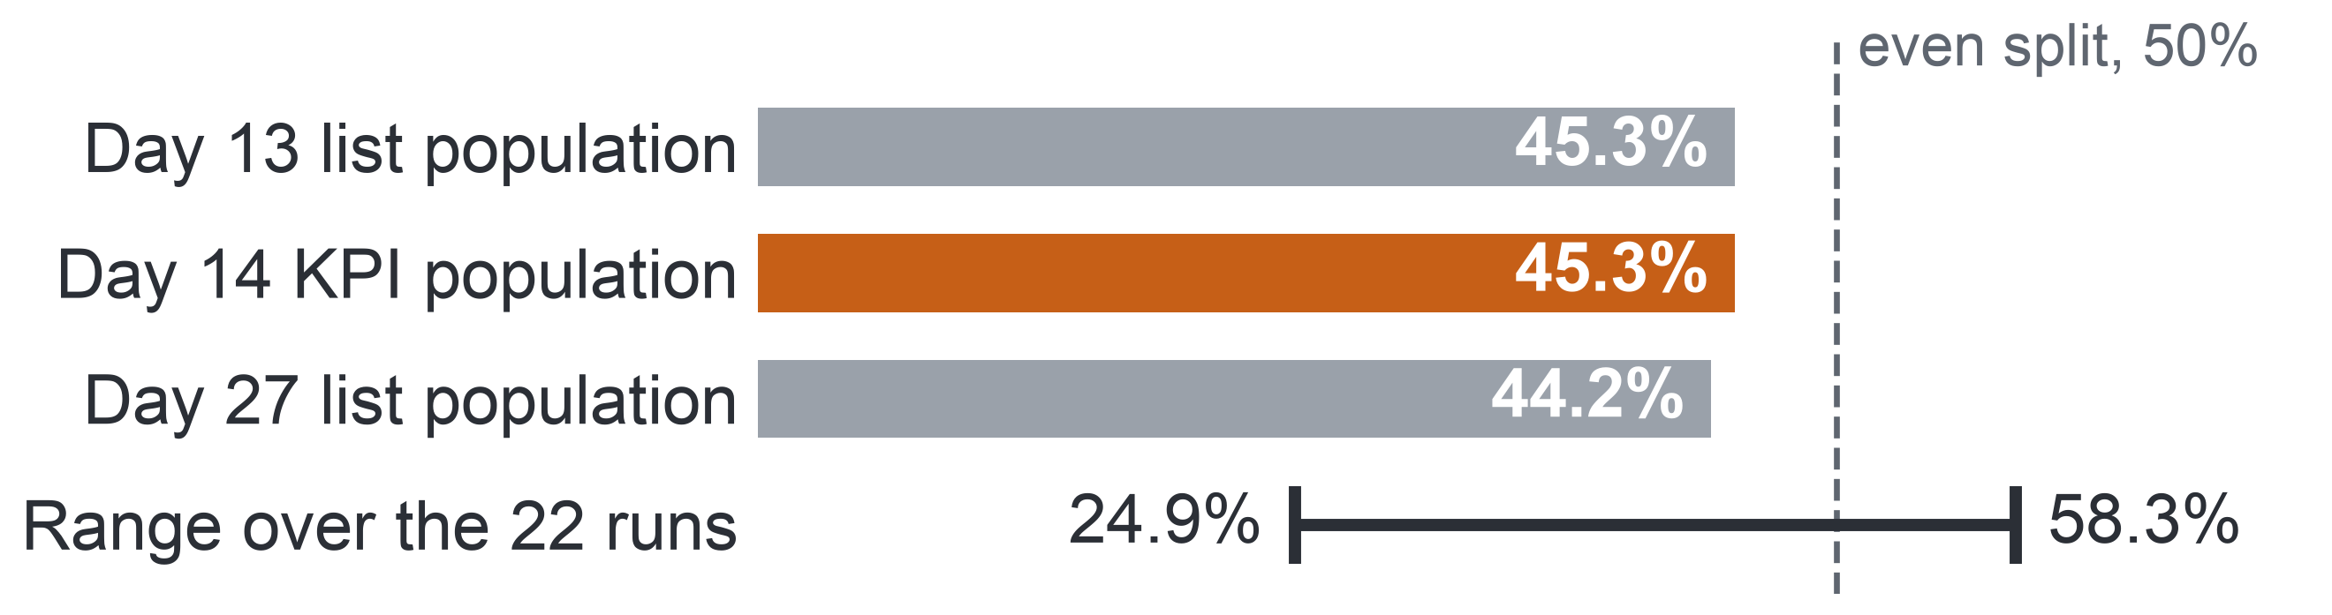
APPENDIX A28: PART 2 · THE DATA (MILESTONE 2)
46
Outcome Balance and Skewed Activity
Completers and non-completers are close in number, so no resampling is needed, while activity is so skewed that counts enter models as logarithms.
Non-completion (Fail or Withdrawn), share of enrolments
602
3,365
median clicks
with no click
2,503
6,977
Key: orange = the KPI population, the 28,061 enrolments still registered at day 14 (54.7% completed); grey = enrolments registered at the list cut-offs, day 13 and day 27; line = lowest and highest run.
outliers
in one record
Mix by module: withdrawal is highest in the CCC runs (43–46%); GGG has the fewest withdrawals but the most failures.
Key: clicks per enrolment over a run. 602 and 6,977 count clicks, the others enrolments; outliers lie beyond the upper fence of the interquartile range; one record = one student, one page, one day.
Profile: all 10.9 million rows of the seven raw tables, not a sample; 13 figures recounted by separate code, all 13 in agreement.
Decision: no resampling or reweighting; counts enter models as logarithms; no value is removed; AQ1, the descriptive question, reports Fail and Withdrawn apart.
Notes:
(~64 seconds) Before answering anything, we needed to know which features of the data could change a conclusion. In Milestone 3 we profiled all 10.9 million rows, not a sample, and recounted thirteen figures with separate code; all thirteen agreed. Two shapes matter. First, balance: of the 28,061 enrolments still registered at day 14, 54.7 percent completed, and non-completion is 45.3 percent at day 13 and 44.2 at day 27, so the two classes are close in size and no resampling is needed, even though runs range from 24.9 to 58.3 percent. Second, skew: the median enrolment has 602 clicks, 3,365 have none, 2,503 are outliers, and one record reaches 6,977 clicks in a day. These are real students, so we remove nothing and use logarithms. Every later number belongs to a defined population, shown next.
Source: Milestone 5 report, Section 6 and Appendix VI.

Slide 47
APPENDIX A29: PART 2 · THE DATA (MILESTONE 2)
47
The Populations Behind Every Number
Every later number refers to one of seven populations, set by year and by the day a student is counted as enrolled.
Population | Enrolments | Non-completers | Used by
All 2013 enrolments (9 runs) | 13,529 | 6,959 (51.4%) | AQ1, second denominator
2013, registered at day 14 | 12,076 | 5,515 (45.7%) | AQ1, primary denominator
2013, registered at day 13 | 12,080 | 5,519 | AQ3 development, day 13
2013, registered at day 27 | 11,811 | 5,245 (44.4%) | AQ2; AQ3 development, day 27
2013, day 27, 7 runs with a task due | 9,960 | – | AQ2 task-based signs
2014, registered at day 14 | 15,985 | 7,185 (44.9%) | AQ1, primary denominator
2014 test (13 runs), day 13 and day 27 | 15,989 and 15,724 | day 27: 6,911 (44.0%) | AQ2 replication; AQ3 and AQ4 test
Split rule: models are developed on the 9 runs of 2013 and tested once on the 13 runs of 2014; AQ1 and AQ2 describe both years.
Key: registered at day d = registered by day d and not unregistered by it; day 14 = end of the add-drop window on OULAD; day 13 and day 27 = cut-offs of the week-3 and week-5 lists. AQ1 descriptive, AQ2 diagnostic, AQ3 predictive, AQ4 prescriptive ranking question. Orange rows = the AQ1 primary denominators and the single test population.
Notes:
(~62 seconds) Here are those populations, so that any later figure can be checked. Model development uses the nine runs of 2013, the thirteen runs of 2014 are kept for a single test, and the descriptive and diagnostic questions describe both years. Each year has a primary population, the students still registered at day 14: in 2013, 45.7 percent of 12,076 did not complete; in 2014, 44.9 percent of 15,985. Over all 2013 enrolments the rate is higher, 51.4 percent, because it also counts those who left before day 14. At day 27, the list population is 11,811 in 2013 and 15,724 in the 2014 test, and the task-based signs use the 9,960 enrolments of the seven runs with a task due. Keep this table in mind. Now, the quality problems.
Source: Milestone 5 report, Section 6, Table 6.1.

Slide 48
APPENDIX A30: PART 2 · THE DATA (MILESTONE 2)
48
Duplicates, Missing Values and Invalid Records
Every other issue gets a stated rule, and the two whose size is known become sensitivity runs instead of silent choices.
Issue | Evidence | Severity | Decision
Duplicate click rows | 787,170 rows (7.39%) repeat another exactly, carrying 3.19% of clicks | Medium | Keep every row, sum by day; a de-duplicated twin of each click feature
Late CMAs | 32,991 of 69,956 CMAs late; counting them would raise the share the rule flags at day 27 from 28.8% to 41.2% | Medium | The rule uses TMA lateness; late CMAs in a sensitivity run
Missing deprivation band | 1,111 enrolments (3.41%), who pass in 65.7% of cases against 46.6% | Medium | Kept as its own "Missing" group; never imputed
Activity after unregistration | 98,745 clicks and 588 submissions after the student left | Medium | Truncated at the unregistration day
Banked results | 1,909 results carried over from an earlier attempt, dated −1 | Medium | Known at registration, never timed
Outliers | 2,503 enrolments beyond the upper fence; one record of 6,977 clicks | Low | Every value kept; logarithms in model inputs
Key: TMA = tutor-marked assignment; CMA = computer-marked assessment (a quiz); orange rows = issues kept visible as a sensitivity run; upper fence = the outlier bound from the interquartile range.
Notes:
(~65 seconds) Below the High issues, every other issue received a stated rule, and two of them could move a number by a known amount. Duplicate click rows are 7.39 percent of rows but carry only 3.19 percent of clicks; we cannot tell double logging from repeat visits, so we keep them and test a de-duplicated twin. Counting late computer-marked quizzes would raise the share the rule flags at day 27 from 28.8 to 41.2 percent, and what a late quiz meant in those years is undocumented, so the rule uses assignment lateness and the wider version is a sensitivity run. Missing deprivation bands relate to the outcome, 65.7 against 46.6 percent passing, so they stay a group of their own. Activity after leaving is cut, banked results are never timed, and outliers stay. Next, time and representativeness.
Source: Milestone 5 report, Section 6.1, Table 6.2, and Appendix VI, Table A.15.

Slide 49
APPENDIX A31: PART 2 · THE DATA (MILESTONE 2)
49
Time Coverage and Representativeness
The run structure leaves one honest test, train on 2013 and test on 2014, and the narrow sample means every result needs a re-check at the university.
Time coverage
Representativeness
Busiest weeks: weekly clicks peak in week 3, so the cut-offs at day 13 and day 27 fall in the weeks of highest activity.
One earlier run: each module has at most one earlier run of the same start month, so the only test on a later run is to train on 2013 and test on 2014.
Chosen modules: the publisher chose modules partly because many students failed them, so rates are likely above a typical program's.
Distance learners: 70.4% are under 35, and 63.1% study 60 credits or fewer.
Uneven mix: women are 11.5% of the enrolments of EEE and 88.4% of those of BBB.
Unseen module: module CCC appears only in the test year.
Train: 2013
9 runs of six modules
Test once: 2014
13 runs: 9 with a twin in 2013, 4 unseen
Key: D1 = whom to contact; D2 = where to place support time; D3 = whether to extend the approach. Twin = an earlier run of the same module and start month.
Results describe OULAD: groups are compared within module, and each result is re-checked on the university's records before decisions D1–D3.
Notes:
(~66 seconds) Quality is one question; coverage in time is another. Weekly clicks peak in week 3, so the cut-offs at day 13 and day 27 fall in the busiest weeks, which is good for early signs. But each module has at most one earlier run of the same start month, so the only honest test on a later run, the way the university would use a model next semester, is to train on 2013 and test on 2014. Of the thirteen test runs, nine have a twin in 2013 and four test transfer. Representativeness is the bigger limit: modules chosen partly because many students failed them, and gender mixes that swing widely by module. So results describe OULAD, groups are compared within module, and every result is rechecked before any of the three decisions. What about sensitive fields?
Source: Milestone 5 report, Section 6.2 and Appendix VI.

Slide 50

APPENDIX A32: PART 2 · THE DATA (MILESTONE 2)
50
Sensitive Fields and Privacy
We keep six sensitive attributes for the fairness audit and out of the predictors, because bias cannot be audited without knowing group membership.
Attribute | Role | Known group size
Gender | Audit only | Women 11.5% of EEE, 88.4% of BBB
Age band | Audit only | Aged 55 or over: 216 enrolments
Declared disability | Audit only; fairness group | 3,164 enrolments
Deprivation band | Audit only; fairness group | 1,111 with a missing band, its own group
Region | Audit only | –
Highest education | Predictor, also audited | Postgraduates: 313 enrolments
Why we keep them
Bias can enter through proxies, other fields that carry the same information, so removing the attributes hides bias instead of preventing it.
A published fairness study on OULAD reproduced a gap of five to six percentage points in favour of male students.
Privacy
Under Vietnam's Personal Data Protection Law, re-identifying de-identified data is prohibited, so OULAD is never linked to another source.
In a pilot, a declared disability is health information and needs the student's consent.
Key: orange row = the one attribute used as a predictor. Deprivation band = the deprivation level of the home area, not of the student.
Notes:
(~61 seconds) Coverage leads to fairness. OULAD holds six sensitive attributes: gender, age band, declared disability, deprivation band, region and highest education. Five serve only the audit and never enter a predictor set; highest education is a predictor whose groups are audited too. Why not delete them? Because a model can learn group membership through other fields, so removing the attributes hides bias instead of preventing it, and bias cannot be audited without knowing who belongs to which group. The need is concrete: a published fairness study on OULAD reproduced a gap of five to six percentage points in favour of male students. On privacy, Vietnam's Personal Data Protection Law forbids re-identifying de-identified data, so OULAD is never linked to any other source. Now preparation, starting with who counts.
Source: Milestone 5 report, Section 6.2 and Appendix VI, Table A.16; the fairness study and the law are in its reference list.

Slide 51
APPENDIX A33: PART 3 · PREPARATION (MILESTONE 3)
51
Who Counts: the Add-drop Rule
We count only students still registered at day 14, because that is when registration closes on OULAD.
University rule: the completion rate counts students enrolled after the add-drop period.
OULAD proxy: an enrolment counts when it is still registered at day 14, because registration closes two weeks after a run starts.
Day 13 (end of week 2): week-3 list
28,069 enrolments
Day 27 (end of week 4): week-5 list
27,535 enrolments
days
Day 0
Day 7
Day 21
Day 14: the completion KPI
28,061 enrolments
Key: the orange marker is the KPI (key performance indicator) population; grey markers are the populations of the two lists.
One population rule: an enrolment counts on day d when the student registered by day d and had not unregistered by it. It removes the 58 late registrants (days 16–167) from the KPI population and gives each list the students it can name on its day.
The denominator alone can move a run's rate by up to 13.6 points (Appendix A55).
Notes:
(~67 seconds) Preparation starts with who counts, a choice that looks technical but moves every rate. At the university, the completion rate counts only students enrolled after the add-drop period, because those who leave during add-drop never really started. OULAD has no add-drop field, but registration closes two weeks after a run starts, so an enrolment counts if it is still registered at day 14. On the timeline, that leaves 28,061 enrolments for the KPI, in orange. Fifty-eight enrolments registered later, as late as day 167, so the rule is stated for every day: registered by day d and not unregistered by it. The same rule gives 28,069 enrolments for the week-3 list and 27,535 for the week-5 list. Later we will see the denominator alone move a run's rate by up to 13.6 points. The second rule concerns the early sign.
Source: Milestone 5 report, Sections 2.1, 6 and 11.2, Tables 2.1 and 6.1, and Appendices III, V and VII.

Slide 52
APPENDIX A34: PART 3 · PREPARATION (MILESTONE 3)
52
Three Rules That Govern Preparation
Preparation deletes or imputes nothing, dates every feature by its cut-off, and learns every parameter from the training runs alone.
1 · Delete or impute nothing
2 · Date every feature
3 · Learn from training runs only
Nothing recorded is deleted or imputed in the prepared views.
Why: Every count traces back to the raw files; only model fitting fills or scales values.
Check: Missing counts and value ranges are the same after preparation as before.
Every feature uses only events dated on or before its cut-off, day 13 or day 27.
Why: No information from after the moment of the list can reach a model.
Check: A recount without the date filter differs only where later clicks exist.
Every learned parameter, such as a median or a scale, comes from the 2013 training runs alone.
Why: The 2014 runs stay an independent test.
Check: Parameters stay unchanged when test rows are altered.
Before any record changed, each issue got a decision, its reason and a check that fails if the decision is not carried out: 22 checks, all passing.
Notes:
(~67 seconds) With who counts and what counts as a sign fixed, three rules govern the whole preparation. First, nothing recorded is deleted or imputed in the prepared views, so every count traces back to the raw files. Second, every feature uses only events dated on or before its cut-off, so nothing from after the moment of the list can reach it. Third, every learned value, such as a median or a scale, comes from the 2013 training runs alone, so the 2014 runs stay an independent test. Each rule has a check that would catch a breach: missing counts unchanged, a recount without the date filter, parameters that ignore test rows. Before any record changed, each issue received a decision, its reason and such a check: 22 checks, all passing. Next, the matrix that applies these rules need by need.
Source: Milestone 5 report, Sections 7 and 7.2, and Appendix VII, Tables A.17 and A.20.

Slide 53
APPENDIX A35: PART 3 · PREPARATION (MILESTONE 3)
53
Preparation Decision Matrix
Every preparation need has one decision, and one check that fails if the decision is not carried out.
Need | Decision | Check that would fail
Population | Flags for days 13, 14 and 27; views keep those enrolled | Populations equal the profile
Missing values | "Missing" category or indicator; no imputation | Counts unchanged; filling from training rows
Duplicates, keys, joins | All rows kept; clicks summed by day; left joins | Unique keys; totals reconcile; no row lost
Invalid values, outliers | Labels corrected; carried-over results untimed; values kept | Every category in its set; ranges unchanged
Activity after withdrawal | Truncated at the unregistration day | No click or submission counted after it
Derived features | Assignment and quiz tasks; early-sign rule; run-median activity | Features recomputed by separate code
Time, encoding | Cut-offs at days 13 and 27; transforms learned on training rows | Date-filter recount; parameters stable
Sensitive attributes, split | Audit columns outside predictors; train 2013, test 2014 | No audit predictor; no run in both parts
Notes:
(~64 seconds) Building on those three rules, here is the decision matrix in full, one row per need. Population: flags for who is enrolled at days 13, 14 and 27, and each feature view keeps only those enrolled at its cut-off. Missing values: a Missing category or an indicator, never an invented value. Duplicates and joins: every click row kept, clicks summed by day, and left joins from the enrolment table so no student drops out. Invalid labels corrected, results carried over from an earlier attempt never timed, every value kept. Activity after withdrawal cut. Derived features from assignments and quizzes only. Transforms learned on training rows, sensitive columns outside the predictors, 2013 to train and 2014 to test. The right-hand column names the check that would fail. Next, the pipeline that carries this out.
Source: Milestone 5 report, Section 7, Table 7.1, and Appendix VII, Table A.17.

Slide 54
APPENDIX A36: PART 3 · PREPARATION (MILESTONE 3)
54
Ten Scripted Steps
Preparation runs in ten scripted steps with no manual step, and no join loses or multiplies a row.
The ten steps, in order
4 Keys and duplicates
10,655,280 click rows into 1,808,119 enrolment-days
5 Missing values
1,111 missing bands; doubtful records flagged
1 Load and check
raw tables against SHA-256 checksums
2 Select
the populations at days 13, 14 and 27
3 Standardise
3,516 deprivation band labels fixed
6 Invalid values
98,745 clicks recorded after withdrawal left out
7 Integrate
286,898 enrolment-task rows
8 Build features
at day 13 and at day 27
9 Analysis views
the prepared views for each question
10 Save
with a dictionary, lineage and version record
Key: orange = steps that change the grain of the data (one row per enrolment and day, or per enrolment and task).
Joins that keep every row: integration starts from the enrolment table, one row for each of the 32,593 enrolments, and adds each other table by a left join after summing it to the enrolment; all 25 joins kept their input rows, and the 3,365 enrolments with no click stay in.
Notes:
(~68 seconds) The matrix is carried out by a pipeline of ten scripted steps, with no manual step; follow the arrows. It checks the raw tables against their checksums and selects the populations. It corrects 3,516 deprivation band labels written in a second form, and sums 10,655,280 click rows into 1,808,119 enrolment-day records. It flags uncertain records, leaves out the 98,745 clicks recorded after a student withdrew, integrates 286,898 enrolment-task rows, builds the features at both cut-offs, writes the analysis views and saves them with a dictionary, lineage and a version record. Integration always starts from the enrolment table, one row per enrolment, with left joins, so no enrolment is lost and none is multiplied: all 25 joins kept their input rows. An inner join would have dropped the 3,365 silent enrolments, whose silence is itself a sign. Next, what the pipeline derives.
Source: Milestone 5 report, Section 7 and Appendix VII; Milestone 3 report, pipeline steps table.

Slide 55
APPENDIX A37: PART 3 · PREPARATION (MILESTONE 3)
55
Derived Variables and Encoding
We derive activity, task and rule variables dated to each cut-off, giving 19 usable predictors encoded so that a model can handle an unseen module.
Derived variable | Meaning, at cut-off c
Clicks before the start | Clicks before day 0
Clicks and active days | Clicks, and days with a click, from day 0 to c
Activity against the run | (clicks + 1) ÷ (median clicks of the same run + 1)
No click in the last 7 days | No click on days c − 6 to c
Missed tasks | A TMA or CMA due by c, due on or after the registration day, not submitted
Late tasks | Submitted after the due day but by c, counted by type
Early-sign rule | A missed task, a late TMA, or no click in the last 7 days
Never used
Activity after the cut-off, the withdrawal day, the final result, and TMA marks, which have no release day.
Predictor set
19 usable predictors, 23 parameters once module and start month are coded.
The mean CMA mark is set aside: known for only 1.4% (day 13) and 5.2% (day 27) of training rows, below the 10% required.
Encoding
Counts as log(1 + count); transforms refitted in each development fold; module terms coded so an unseen module gets the average effect.
Key: c = cut-off day (13 or 27); TMA = tutor-marked assignment; CMA = computer-marked assessment (a quiz); fold = the 2013 runs with one run held out.
Notes:
(~67 seconds) From the pipeline come the variables the questions use. Activity is counted before the start and up to the cut-off, and also against the median of the same run, so each student is compared with their own cohort. It records a week without clicks, missed tasks, late tasks, and the early-sign rule itself. Two timing details protect validity and fairness: a late registrant is never charged with tasks set before joining, and tutor-marked marks are never used, because we cannot know when a student saw them. The primary set holds 19 usable predictors, 23 parameters after coding; the mean quiz mark was set aside, known for too few training rows. Counts enter as logarithms, refitted in each fold, and an unseen module gets the average effect. Since every feature looks back from a cut-off, leakage is the next risk.
Source: Milestone 5 report, Section 7.1 and Appendix VII, Table A.18.

Slide 56
APPENDIX A38: PART 3 · PREPARATION (MILESTONE 3)
56
The Final Versioned Dataset
The prepared dataset is named and versioned, passes all 22 checks, and rebuilds byte for byte from the public download.
OULAD-N04-prepared-1.0
Check | Raw data → prepared data | Result
Enrolments | 32,593 enrolments of 28,785 students and their outcome mix: identical | Pass
Populations | 28,069 at day 13; 28,061 at day 14; 27,535 at day 27, equal to the profile | Pass
Clicks | 39,506,354 kept; 98,745 after withdrawal left out | Pass
Missing values | Deprivation band 1,111; registration day 45; TMA score 173: identical | Pass
Joins | 25 joins, rows in equal rows out | Pass
Features | Six features recomputed by separate code: 0 differences in 55,604 rows | Pass
Documented: a data dictionary gives each of the 88 prepared variables its source, transformation, role and sensitivity.
Stored: as Parquet files, a column-based file format.
Rebuilt: one command, from the pinned figshare download; two runs give byte-identical files.
Shared: the CC BY 4.0 licence (Creative Commons Attribution) allows sharing with attribution.
No invented data: synthetic records appear only in unit tests, never in a view or a finding.
Key: TMA = tutor-marked assignment; days 13 and 27 = list cut-offs; day 14 = the KPI population.
Notes:
(~64 seconds) All that preparation ends in one named dataset, OULAD-N04-prepared-1.0, and all 22 validation checks pass. The table shows the main before-and-after comparisons: the 32,593 enrolments and their outcome mix are unchanged; the populations at days 13, 14 and 27 equal the profile; clicks after withdrawal are the only clicks left out; every missing value is still missing; and six features recomputed from the raw files by separate code differ in none of the 55,604 feature rows. Each of the 88 prepared variables is documented with its source, transformation, role and sensitivity. One command rebuilds everything from the pinned public download, byte for byte, and the licence lets us share it with attribution. Synthetic records exist only to test code. With the data side closed, we turn to method: from questions to technical tasks.
Source: Milestone 5 report, Section 7.2 and Appendix VII, Tables A.20 and A.21.

Slide 57
APPENDIX A39: PART 4 · METHOD (MILESTONE 4)
57
From Questions to Technical Tasks
Each question's purpose fixes its technical task and how its result may be read.
Question
Technical task
How its result may be read
AQ1
Descriptive
Aggregation and rate comparison
States what happened, with its denominator and 95% interval.
AQ2
Diagnostic
Association within module run
An association, never a cause: a regression that captures associations describes.
AQ3
Predictive
Binary classification at day 13 and day 27
Judged on runs the model has not seen: explaining data well does not mean predicting well.
AQ4
Prescriptive
Ranking under a fixed capacity
A decision option for staff, untested until a pilot.
Key: AQ1–AQ4 = the four analytical questions; the level under each names its analytics type. Capacity = 3 or 5 contacts per 20 students. Reading rules after Shmueli (2010): explanatory power does not imply predictive power.
Designed at Level 1 (the compulsory level: method and evaluation design) in Milestone 4; AQ1 and AQ2 then ran on 2013 and 2014, and AQ3 and AQ4 ran once as the Level 2 prototype.
Notes:
(~64 seconds) With the versioned dataset in hand, we turn from data to method, all of it fixed in Milestone 4 before any result existed. The first step is purpose: each question's purpose fixes its technical task and how its result may be read. AQ1 is aggregation, rates and shares that state what happened. AQ2 is association within module run; a regression used this way describes how a sign and an outcome move together, so it is never read as a cause. AQ3 is binary classification at day 13 and day 27, and because explaining data well does not mean predicting well, it must be judged on runs it has never seen. AQ4 is ranking under a fixed capacity, which can only give a decision option. Next, the methods chosen for the first two questions.
Source: Milestone 5 report, Section 8 and Appendix VIII, Table A.22.

Slide 58
APPENDIX A40: PART 4 · METHOD (MILESTONE 4)
58
Method Selection: AQ1 and AQ2
AQ1 needs no model, only grouped rates with intervals, and AQ2 needs a within-run association model that makes no causal claim.
 | AQ1 – Descriptive | AQ2 – Diagnostic
Analytics type and task | Descriptive: aggregation and rate comparison. | Diagnostic: association within module run.
Baseline | Pooled rate; rate over all enrolments; rate without enrolments flagged for an unknown withdrawal or registration day. | Unadjusted rate difference per sign.
Candidate methods | Grouped rates with 95% intervals. | Logistic regression with run fixed effects and sign × module terms; mixed-effects logistic regression.
Primary proposal | Grouped rates with Wilson intervals; cumulative first missed week by outcome; year difference with a Newcombe interval. | The fixed-effects logistic regression, robust standard errors; effects as average risk differences, odds ratios beside them.
Rationale | A descriptive question needs no model; the denominator decides the rate. | Every run is observed, so fixed effects suit; 6 modules are too few for a random effect; no causal claim.
Key: AQ1 = descriptive question (outcome shares and timing); AQ2 = diagnostic question (early signs, association only). Wilson / Newcombe interval = 95% interval of a rate / of a difference of two rates. Run fixed effects = a term per module run, so students are compared only within their run. Risk difference = extra percentage points of later non-completion with a sign. Orange row = primary proposal.
Notes:
(~66 seconds) Here is the first half of the Model and Method Selection Matrix. AQ1 is descriptive, so it needs no model. Its baselines are other ways of counting: the pooled rate, the rate over all enrolments and the rate without flagged enrolments, because the denominator decides the rate. The proposal is grouped rates with Wilson intervals, the week of the first missed task by outcome, and a year difference with a Newcombe interval. AQ2 compares students within each run. Its baseline is the plain difference in non-completion with and without a sign; the proposal is a logistic regression with a fixed effect per run and sign-by-module terms, reported as average risk differences in points. We set aside a random-effects model, because six modules are too few to estimate the spread between them. Now the predictive and prescriptive questions.
Source: Milestone 5 report, Section 8.1, Table 8.1, and Appendix VIII.

Slide 59
APPENDIX A41: PART 4 · METHOD (MILESTONE 4)
59
Method Selection: AQ3 and AQ4
AQ3 proposes an interpretable penalised logistic model that must beat the early-sign rule, and AQ4 a top-k list per run with the signs behind each name.
 | AQ3 – Predictive (proposal, run in Level 2) | AQ4 – Prescriptive (proposal, run in Level 2)
Analytics type and task | Predictive: binary classification at day 13 and day 27. | Prescriptive: ranking under a fixed capacity.
Baseline | Early-sign rule ranked by its number of signs; background-only logistic model; random list. | Random list; rule-ranked list of the same length.
Candidate methods | Penalised logistic regression; gradient-boosted trees; discrete-time survival as an extension. | Top-k per run from the AQ3 scores; risk tiers from capacity.
Primary proposal | Penalised logistic regression on the 19 primary predictors (23 parameters), unless a challenger wins by a margin fixed in advance. | Top-k per run, with the signs behind each name.
Rationale | Interpretable reasons for staff; about 230 non-completers per parameter; classes close in size; transfer to a later run. | Capacity is fixed; no contact data, so no ranking by expected benefit; a member of staff decides.
Key: AQ3 = predictive question (model against the early-sign rule); AQ4 = prescriptive question (ranking under capacity). Early-sign rule = flags a task due and not submitted, a tutor-marked assignment submitted late, or no click in the 7 days before the cut-off. Penalised = coefficients shrunk to avoid overfitting. Top-k = the k highest-ranked students of a run; capacity = 3 or 5 contacts per 20 students. Orange row = primary proposal.
Notes:
(~63 seconds) The second half covers the two questions whose proposal the Level 2 prototype later ran. For AQ3 the baselines matter most: the early-sign rule ranked by its number of signs, a model that uses background only, and a random list. A model earns its place only if it beats what staff could do without it. The proposal is a penalised logistic regression on 19 predictors, 23 parameters once module and start month are coded. Staff must see why a student is listed, and with about 230 non-completers per parameter the simple model is well supported. Gradient-boosted trees can still win, but only by a margin fixed in advance. AQ4 takes the top k of each run from the AQ3 scores, with the signs behind each name. How did we choose between candidates?
Source: Milestone 5 report, Section 8.1, Table 8.1, and Appendix VIII.

Slide 60
APPENDIX A42: PART 4 · METHOD (MILESTONE 4)
60
Eight Criteria and the Tie-break
Every candidate is judged on the course's eight criteria, and ties go to the simpler, more interpretable method, because decisions about people call for it.
The eight course criteria
When candidates tie
1
Fit to the question
2
Fit to the data
Start from a rule: a simple heuristic often delivers much of the gain.
Does it directly give the output the question needs?
Do size, feature types and time structure suit it?
Prefer the simpler: when many models reach about the same error, choose the simpler one.
3
Assumptions
4
Interpretability
What does it require, and do the data roughly meet it?
How much of its logic must the users understand?
Count the upkeep: complexity is costly to maintain.
Interpretable by design: for high-stakes decisions about people, prefer a model interpretable by design to a black box explained afterwards.
5
Complexity against the baseline
6
Robustness and reproducibility
What does a more complex method add?
Can it be rerun stably and kept free of leakage?
7
Ethics and fairness
8
Actionability
For AQ3, the predictive question: penalised logistic regression first; boosted trees only as challenger.
Could its errors harm a group; does it use a sensitive attribute?
Does its output support the decision it serves?
Notes:
(~61 seconds) Behind both halves of the matrix sit the eight criteria the course makes compulsory: fit to the question, fit to the data, assumptions, interpretability, complexity against the baseline, robustness and reproducibility, ethics and fairness, and actionability. When candidates tie, four findings from the literature on prediction systems decide. A simple heuristic often delivers much of the gain, so predictive work starts from a rule baseline. When many models reach about the same error, the simpler one costs nothing. Complexity is costly to maintain. And for high-stakes decisions about people, a model interpretable by design is preferable to a black box explained afterwards. That is why penalised logistic regression, not a boosted ensemble, is our primary proposal for AQ3. But why do we need a ranking at all?
Source: Milestone 5 report, Section 8.1 and Appendix VIII.

Slide 61
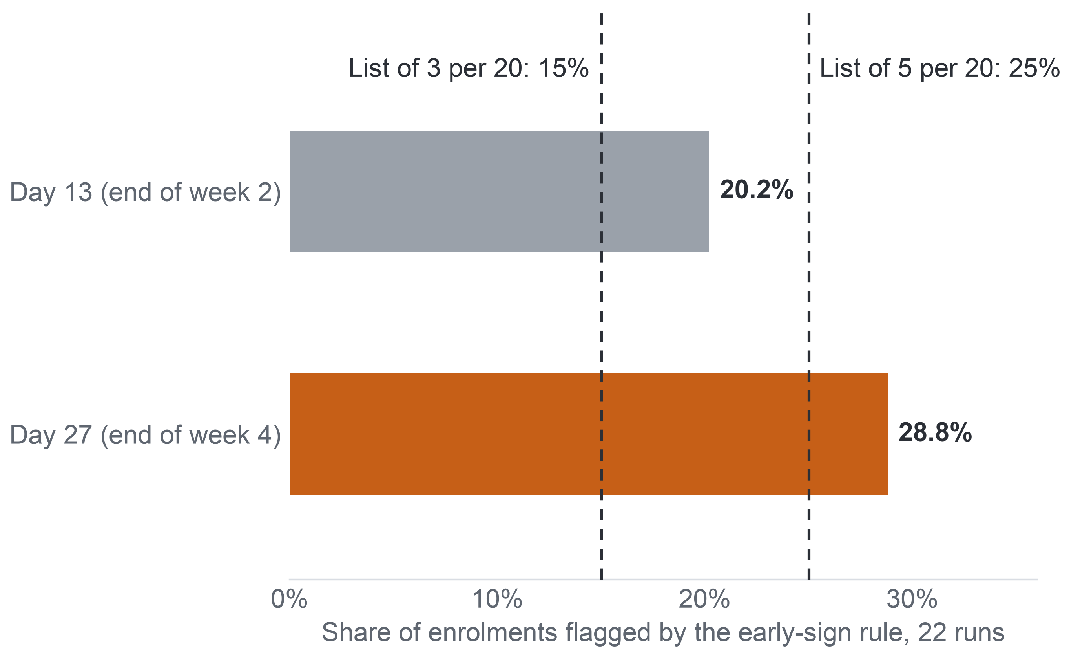
APPENDIX A43: PART 4 · METHOD (MILESTONE 4)
61
Why a Ranking, Not a Threshold
The early-sign rule flags more students than staff can contact, so the list must be ranked to fit capacity.
The rule flags more students than a list can hold
Staff need an order
The rule names more students than a list of 15% or 25% of a run can hold, so someone must decide who comes first.
Risk, not benefit
No data record a contact or its outcome, so the list cannot rank by the expected benefit of a contact.
A person decides
The list orders by risk and shows its reasons; a member of staff decides. Risk as need stays untested until a randomised pilot.
Key: bar = share of the enrolments registered at the cut-off that the early-sign rule flags (a task due and not submitted, a tutor-marked assignment submitted late, or no click in the 7 days before the cut-off). Dashed lines = list lengths at 3 or 5 contacts per 20 students, scenario values.
Notes:
(~64 seconds) Why rank instead of simply flagging? The early-sign rule already names students at risk without any model: 20.2 percent of enrolled students at day 13 and 28.8 percent at day 27, over the 22 runs. Staff capacity, in our scenario, is three or five contacts per twenty students, that is 15 or 25 percent of a run. So the rule names more students than a list can hold, and someone has to decide who comes first. A ranking does that. But a ranking by risk is not a ranking by benefit. No data record a contact or what happened after it, so we cannot say who would gain most from a call. The list orders by risk, shows its reasons, and a member of staff decides. How would we judge such a list?
Source: Milestone 5 report, Section 8 and Appendices VIII and IX.

Slide 62
APPENDIX A44: PART 4 · METHOD (MILESTONE 4)
62
Evaluation Plan
Each question has a primary metric, a baseline, a validation and a success criterion fixed before any code ran.
Question | Primary metric | Baseline | Validation | Success criterion
AQ1 – Descriptive | Non-completion rates and outcome shares with 95% intervals | Pooled rate; rate over all enrolments; rate without flagged enrolments | Two independent aggregation paths: prepared views and raw tables | Both paths agree to the enrolment; every rate carries its denominator and interval
AQ2 – Diagnostic | Average risk difference of each sign within module run, 95% interval | Unadjusted rate difference | 9 runs of 2013; sensitivity runs; replication on the 13 runs of 2014 | At least 5 points, interval excluding 0, same direction in at least two-thirds of modules
AQ3 – Predictive | Pooled normalised recall at capacity (day 27, 5 per 20) | Rule-ranked list; background-only model; random list | Leave-one-run-out folds in 2013; one logged test on all 13 runs of 2014 | Gate S1: the model's list must beat the rule's list
AQ4 – Prescriptive | Normalised recall at capacity | Random list; rule-ranked list | As AQ3, a list per test run | Gate S1 met by the list, and fairness rule FR1 passed or its flags reviewed
Key: AQ1–AQ4 = the four analytical questions. Normalised recall = recall divided by the most a list of its length can reach. Rule-ranked list = the early-sign rule's flags ordered by their number of signs. S1 = the single gate of the predictive model; FR1 = the fairness review rule. Orange column = the success criterion, fixed in Milestone 4.
Notes:
(~59 seconds) With the list metric defined, here is the Evaluation Plan, fixed in Milestone 4 before any code ran, so no threshold could bend to a result. AQ1 succeeds when two independent ways of counting agree to the enrolment and every rate carries its denominator and interval. AQ2 calls a sign a consistent association at five points or more, with an interval excluding zero and the same direction in two-thirds of the modules. AQ3 is developed on 2013 and tested once on all thirteen runs of 2014, and one gate, S1, decides: the model's list must beat the rule's list. AQ4 must pass the same gate plus the fairness rule FR1. We take the AQ2 criterion first, because AQ2 is the question with results.
Source: Milestone 5 report, Section 9, Table 9.1, and Section 9.1.

Slide 63
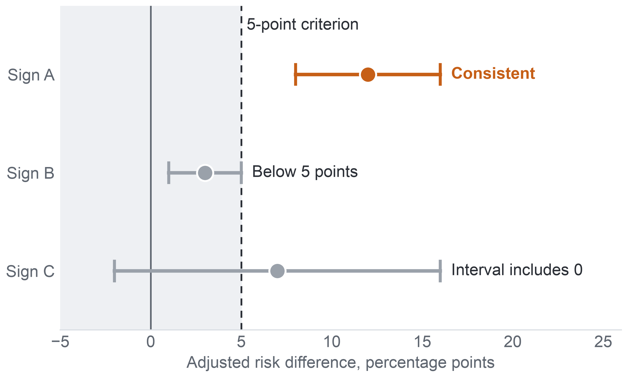
APPENDIX A45: PART 4 · METHOD (MILESTONE 4)
63
The AQ2 Success Criterion
A sign counts as a consistent association only when its adjusted difference is at least 5 points, its interval excludes 0 and its direction holds in two-thirds of modules.
All three conditions must hold
How the criterion sorts three signs (illustration, not data)
1
Risk difference, adjusted for the other signs, of at least 5 percentage points.
2
95% interval of the risk difference excluding 0.
3
Same direction in at least two-thirds of the modules where the sign is defined.
Why 5 points: the smallest gap worth staff attention, a convention fixed in Milestone 4. It is lenient at a base rate near 44%, so the size of each estimate distinguishes the signs.
Why no p-values: a p-value does not measure the size of an effect; p-values are reported but take no part in the verdict.
Key: dot = adjusted risk difference of an invented sign; whisker = its 95% interval; dashed line = the 5-point criterion; grey band = below 5 points. Risk difference = extra percentage points of later non-completion with the sign, within module run. AQ2 = the diagnostic question on early signs.
Notes:
(~63 seconds) Zooming in on AQ2. A sign counts as a consistent association only if three things hold together. Its risk difference, adjusted for the other signs, is at least five percentage points. Its 95 percent interval excludes zero. And it points the same way in at least two-thirds of the modules where it is defined. The three illustrative intervals show the logic: only the first passes; the second is too small, and the third has an interval that reaches below zero. Five points is the smallest gap we treat as worth staff attention, a convention fixed in Milestone 4. It is lenient at a base rate near 44 percent, so the size of each estimate, not the pass, tells the signs apart. P-values take no part. Now the stricter design, for AQ3.
Source: Milestone 5 report, Sections 9 and 9.1, Table 9.1, and Appendix IX.

Slide 64




APPENDIX A46: PART 4 · METHOD (MILESTONE 4)
64
Validation Design
Development and model choice stay inside 2013, and the 13 runs of 2014 are scored once by a model frozen in advance.
2013: 9 runs
leave-one-run-out folds
Freeze 1
question, splits, metrics, baselines
Model choice
challenger rule on the folds
Freeze 2
final model; test access recorded
2014: 13 runs
scored once: 15,724 enrolments at day 27
Inside each fold
Challenger rule
Test populations
Every learned step (filling, scaling, tuning) is refitted; students who also appear in the held-out run are removed from its training data.
Fold results only choose between candidates; they are never reported as performance.
Trees or the extended set replace the primary model only with a gain of at least 0.03 in pooled normalised recall (about 89 more non-completers listed) and a gain in 7 of 9 folds, fixed before any fold result.
9 paired runs (10,801 enrolments) test a later run of a known module; 4 unpaired runs (4,923) test transfer; both also reported apart. The 1,586 test enrolments of students seen in 2013 stay in, and are removed in a sensitivity analysis.
Key: AQ3 = the predictive question. Fold = one 2013 run held out while the model learns from the other 8. Paired run = a 2014 run whose module and start month also ran in 2013. Normalised recall = recall divided by the most a list of its length can reach.
Notes:
(~64 seconds) A predictive claim lives or dies on unseen data, so the validation for AQ3 keeps development and test apart in time. All development happens inside the nine runs of 2013, one run held out at a time, and every step that learns, filling, scaling and tuning, is redone inside each fold. A challenger such as boosted trees replaces the primary model only with a gain of at least 0.03 in pooled normalised recall, about 89 more non-completers listed, and a gain in seven of nine folds, a margin fixed before any fold result. Then two freezes and one test: the model is frozen and scored once on all thirteen runs of 2014. Nine paired runs test a later run of a known module; four unpaired runs test transfer. What must the model achieve there?
Source: Milestone 5 report, Section 9.1 and Appendix IX.

Slide 65
APPENDIX A47: PART 4 · METHOD (MILESTONE 4)
65
Gate S1 and the Calibration Condition
One gate decides whether a model replaces the rule's order, and probabilities are shown only if calibration holds.
Pass: the model's order
reported with the number of extra non-completers listed
Gate S1: all three must hold
Pooled normalised recall above the rule list's.
95% paired two-level bootstrap interval of the difference above 0.
One-sided sign-flip test over the 13 per-run differences: p below 0.05.
Model list against rule-ranked list
All 13 test runs of 2014
Day 27, 5 contacts per 20 students
Fail: the rule's order stays
an acceptable outcome
S2: precision at capacity
S3: calibration
The share of the list who do not complete. Reported, not a gate: recall, precision and lift at capacity re-express the same listed non-completers, so S1 alone decides.
Probabilities are shown only if calibration-in-the-large lies between −0.2 and 0.2 and the slope between 0.8 and 1.2; otherwise staff see ranks and reasons only. Never recalibrated on 2014.
Key: S1–S3 = the success criteria of the predictive model (AQ3), fixed in Milestone 4. Normalised recall = recall divided by the most a list of its length can reach. Rule-ranked list = the early-sign rule's flags ordered by their number of signs.
Notes:
(~60 seconds) Here is the gate, S1, the single success criterion for AQ3. On all thirteen test runs, at day 27 with five contacts per twenty students, the model's pooled normalised recall must exceed the rule list's. Beating it means two things: the paired two-level bootstrap interval of the difference lies above zero, and a one-sided sign-flip test over the thirteen per-run differences gives p below 0.05. The gate sets no minimum gain, so a pass would be reported with the number of extra non-completers listed. If the model fails, the rule's order stays, which is an acceptable outcome. Precision, S2, is reported but decides nothing. Calibration, S3, decides only whether staff see probabilities; otherwise they see ranks and reasons. A good list must also be fair.
Source: Milestone 5 report, Section 9.1 and Appendix IX, Table A.23.

Slide 66
APPENDIX A48: PART 4 · METHOD (MILESTONE 4)
66
Fairness and Rule FR1
The list is audited for equal recall across groups, and a clear gap sends the group to human review, not to an automatic verdict.
Group attributes stay out of the predictors and serve only the audit, because bias cannot be audited without group membership.
Criterion: equal recall at capacity, so a struggling student has the same chance of being listed whatever the group.
Rule FR1 (fairness review rule): flag a group for human review when its recall is more than 10 points below the other students' and the Holm-adjusted (corrected for several tests) one-sided interval of the gap lies below 0.
No flag means no evidence of a gap at that precision, not proof that the list is fair.
A flag calls for review of why the gap arises, not rejection of the model.
Confirmatory groups in the 2014 test at day 27 (enrolments)
1,488
1,486
610
declared disability
most deprived band (0–10%)
missing deprivation band
Confirmatory: fixed in advance, each with at least 400 test enrolments. Aged 55 or over: 118, too few; the gap is reported as "insufficient data, not cleared". Deprivation band = band of the Index of Multiple Deprivation of the student's home area.
FR1 threshold
10 points
0
10
20
30
Key: the bar is the largest recall gap, in percentage points, allowed before human review. Recall at capacity = share of a group's non-completers who make the list. No recall values exist yet.
Notes:
(~62 seconds) A list can be accurate overall and still miss one group, so the design audits fairness with one criterion: equal recall at capacity. The main harm of a list is missing a student who struggles, so a struggling student should have the same chance of being listed whatever the group. Rule FR1 flags a group for human review when its recall falls more than ten points below the other students' and the Holm-adjusted interval of the gap lies below zero. The confirmatory groups are declared disability, 1,488 test enrolments, the most deprived band, 1,486, and the missing band, 610. Students aged 55 or over, 118, are too few and stay not cleared. No flag means no evidence of a gap, not proof of fairness. What else protects the evaluation?
Source: Milestone 5 report, Section 9.2 and Appendix IX, Table A.24.

Slide 67
APPENDIX A49: PART 4 · METHOD (MILESTONE 4)
67
Leakage and Interpretability in the Evaluation
No 2014 outcome enters any AQ3 choice, and each listed student's reasons come from the same model that ranks the student.
What a lecturer would see (illustration, not data)
Leakage controls of the evaluation
1. Choices fixed on 2013. Predictors, candidates, selection rule and gate were fixed in Milestone 4 on the 2013 runs alone.
Student, rank 1 of the run's list
1
Task due, not submitted
No click, days 21–27
Clicks below run median
2. Refit inside each fold. Filling, scaling and tuning are redone, so no held-out run informs its own prediction.
Reasons shown are reasons used: each name's signs come from the same model that ranks the student.
3. Folds only choose. Fold results are never reported as performance, because a score that guided a choice flatters the chosen model.
No coefficient is read as a cause: a sign that raises a rank is a reason to look, not an explanation.
Documented: a model card for the model and a datasheet for its data.
Key: AQ3 = the predictive question (model against the early-sign rule). Leakage = information that would not exist at the moment of use. Fold = one 2013 run held out in development. Model card and datasheet = standard documents of a model's and a dataset's use and limits.
Notes:
(~60 seconds) Two last protections. On leakage: the predictors, the candidates, the selection rule and the gate were all fixed in Milestone 4 on 2013 alone, so no 2014 outcome touches any choice. Every learned step is refitted inside each fold, so no held-out run informs its own prediction. And fold results only choose between candidates; they are never reported as performance, because a score that guided a choice flatters the chosen model. On interpretability: the mock row shows what a lecturer would see, a rank and the signs behind it. Those reasons come from the same model that ranks the student, and no coefficient is read as a cause. The model would carry a model card, its data a datasheet. So what did we actually run?
Source: Milestone 5 report, Section 9.2 and Appendix IX.

Slide 68
APPENDIX A50: PART 5 · EVIDENCE (MILESTONE 5)
68
What the Frozen Protocol Fixed, and How It Ran
The protocol left no modeling choice open: three baselines and four configurations were fixed on 2013, and the 2014 outcomes were opened once.
ID | Role | Method | Predictors
B1 | Baseline | Random list | –
B2 | Baseline | Early-sign rule, ranked by its number of signs | Rule columns
B3 | Baseline | Background-only logistic model | Module, start month, attempts, credits, education, registration lead
M1 | Primary | Penalised logistic regression | Primary set
M2 | Challenger | Penalised logistic regression | Extended set
M3 | Challenger | Gradient-boosted trees | Primary set
M4 | Challenger | Gradient-boosted trees | Extended set
Eight steps
1
Reproduce the input; check hashes
2
Fit the baselines
3
Fit the candidates
4
Apply the split and folds
5
Evaluate all; report unfavourable results
6
Error and subgroup analysis
7
Compare with the Level 1 proposal
8
Record the experiment log
One logged test: 2014 outcomes opened once, after the models were frozen with a hash.
Key: B = baseline; M = model configuration. Primary set = the 19 primary predictors; extended set = the primary set plus 10 further predictors. Early-sign rule = flags a missed task, a late tutor-marked assignment or no click in the 7 days before the cut-off. Orange row = B2, the benchmark the contact decision needs; bold M1 = the model chosen. Ties go to the simpler one.
Notes:
(~85 seconds) The prototype was fully specified before it ran, so we had no modeling choice of our own left to make. It compared three baselines, a random list, the early-sign rule ranked by its number of signs, and a background-only logistic model, against four configurations: penalised logistic regression and gradient-boosted trees, each on the primary and on the extended predictor set. Ties go to the simpler configuration. Notice baseline B2, the rule's own list: even if no model wins, measuring it tells the contact decision how good the simple rule is. The protocol runs in eight steps, from checking every file's hash to the experiment log, and the 2014 outcomes are opened once, after the second freeze. That closes the method. Now the evidence, starting with how to read it. In development no challenger met the margin fixed in advance: the boosted trees and the extended set changed pooled recall by at most 0.002, so M1, the penalised logistic model on the primary set, stayed. The models were frozen with a hash before the 2014 outcomes were opened, once.
Source: Milestone 5 report, Section 10 and Appendix X, Table A.25.

Slide 69
APPENDIX A51: PART 5 · EVIDENCE (MILESTONE 5)
69
How We Read the Findings
A number means different things at different analytics levels, so every finding carries its level and confidence.
Question | Evidence reached | What the answer states | What it does not state
AQ1 – Descriptive | Results on 2013, 2014 and the 22 runs pooled | Outcome shares and first missed week, with denominator and 95% interval | Why a module or run has a higher rate; any rate for the university's own courses
AQ2 – Diagnostic | Results on 2013, replicated on 2014 | Which signs go with later non-completion within module runs, by how many points | That a sign causes non-completion, or that removing it would raise completion
AQ3 – Predictive | Single test, 13 runs of 2014 | How well the model ranks students against the rule | A reliable probability for each run
AQ4 – Prescriptive | Ranking from the AQ3 scores | Who ranks first on a list, with a reason per name | Whom contact helps, or which contact works
Key: AQ1–AQ4 = the four analytical questions; every finding is an effect size with its 95% interval and population; orange column = what the answer does not state.
Confidence high: two independent computations verify the counts on the stated population, not for the university's courses.
Confidence moderate: estimates keep their direction under the checks but rest on observational data or a model with a known weakness.
Confidence not applicable: the contact part of AQ4 has no data to test; it waits for a randomised pilot.
Notes:
(~72 seconds) Before the first number, a reading guide, because the same number means different things at different analytics levels. AQ1 states what happened on a population, with its denominator and interval; it does not say why. AQ2 states which signs go with later non-completion within module runs; it never says a sign causes it. AQ3 states how well a model built on 2013 ranks the 2014 students against the rule, as a rank and not a probability; AQ4 states who ranks first on a list of fixed capacity, never whom contact helps. Every finding is an effect size with its 95 percent interval and its population. Confidence follows the same logic. High means two independent computations agree on the stated population, which says nothing about the university. Moderate means the direction holds under checks but rests on observational data or a known weakness. Next, the whole chain in one matrix.
Source: Milestone 5 report, Section 11 and Appendix XI, Table A.26.

Slide 70
APPENDIX A52: PART 5 · EVIDENCE (MILESTONE 5)
70
Traceability Matrix: From Goal to Data
Each question traces in one row from the goal and its KPI to the data we actually had, with GAP where OULAD lacks a variable.
All rows share one Business Goal: improve successful course completion by identifying students who stop taking part early enough to support them within the semester. SMART Goal: raise completion after the add-drop period in the pilot courses by five percentage points (assumed 70% to 75%) by the end of 2027–2028.
Question | Goal and KPI | Final question, short | Level | Required data | Actual dataset and variables
AQ1 | Primary KPI | Outcome shares; first missed week | Descriptive | Dated result, tasks | 22 runs, day 14: 28,061; GAP: delivery mode, year of study
AQ2 | Primary KPI; KPI 1 | Signs by week 4, within module | Diagnostic | Signs, weeks 1–4 | Day 27: 11,811 (2013) and 15,724 (2014); GAP: attendance
AQ3 | KPI 1 (the rule to beat) | Weeks 2 and 4 against the rule | Predictive | Enrolment at cut-off | 19 predictors; 2014 test
AQ4 | KPIs 1–2: GAP | Ranked list per group of 20 students | Prescriptive | Capacity; contacts | GAP: contacts
Key: AQ1–AQ4 = the four analytical questions. KPI = key performance indicator; primary KPI = completion rate of enrolments after the add-drop period; KPI 1 = early-sign contact rate; KPI 2 = follow-up rate. GAP (red) = a link without data in OULAD (Open University Learning Analytics Dataset). SMART = specific, measurable, achievable, relevant, time-bound.
Notes:
(~64 seconds) The course asks us to show the whole chain for each question, and the Final Project Traceability Matrix does it in two halves. This first half runs from the goal to the data. All four rows share one Business Goal and one SMART Goal. AQ1 feeds the primary KPI and is met by 28,061 enrolments registered at day 14 over 22 runs, with a gap where OULAD has no delivery mode or year of study. AQ2 feeds the primary KPI and KPI 1, met by 11,811 and 15,724 enrolments at day 27, with attendance missing. AQ3 is tied to the rule it must beat, with 19 predictors and 2014 as its test. AQ4's link to the contact KPIs is a gap, because no contact is recorded. The second half continues from method to decision.
Source: Milestone 5 report, Sections 2.1 and 11.1, Table 11.1, and Appendix XI, Table A.27.

Slide 71
APPENDIX A53: PART 5 · EVIDENCE (MILESTONE 5)
71
Traceability Matrix: From Method to Decision
Every link from method to decision now holds evidence: AQ1–AQ3 are answered, AQ4 for its ranking.
Question | Preparation | Method and rationale | Evaluation / result | Decision | Status
AQ1 | Day-14 rule; TMA, CMA | Grouped rates; no model needed | Paths agree; 45.3% | D2, D3 | Answered
AQ2 | Dated by day 27 | Logistic, run effects | 5 of 5 signs, both years | D2; D1 | Answered
AQ3 | Refit per fold | Penalised logistic; reasons | S1 met: 0.725 vs 0.704 | D1 | Answered
AQ4 | 3 or 5 per 20 | Top-k with reasons | FR1: 0 of 3 flagged | D1 | Partial
Key: AQ1–AQ4 = the four analytical questions. Grey = the link holds evidence. TMA, CMA = tutor- and computer-marked tasks. S1 = the gate a model must pass to replace the rule; FR1 = the fairness review rule. Decisions: D1 whom to contact, D2 where to place support time, D3 whether to extend. Status: Answered = real results answer all of the question; Partial = the core is answered while a named part waits for data; no question is dropped.
Notes:
(~71 seconds) The second half follows the same rows from preparation to decision. AQ1 rests on the day-14 rule and on tutor- and computer-marked tasks, uses grouped rates, passes its check and gives 45.3 percent; it informs where support time goes and how the university would measure an extension. AQ2 rests on signs dated by day 27 and the fixed-effects logistic model, and all five signs pass in both years; it informs support time and gives the reasons on the contact list. AQ3 rests on refits per fold and the penalised logistic model with its reasons; gate S1 is met, 0.725 against 0.704, and it informs the order of the contact list. AQ4 takes three or five per twenty from those scores, and the fairness rule flags none of its three groups; it is partial, because whether contact helps has no data. Now let us open the AQ1 row.
Source: Milestone 5 report, Section 11.1, Table 11.2, and Appendix XI, Tables A.27 and A.28.

Slide 72
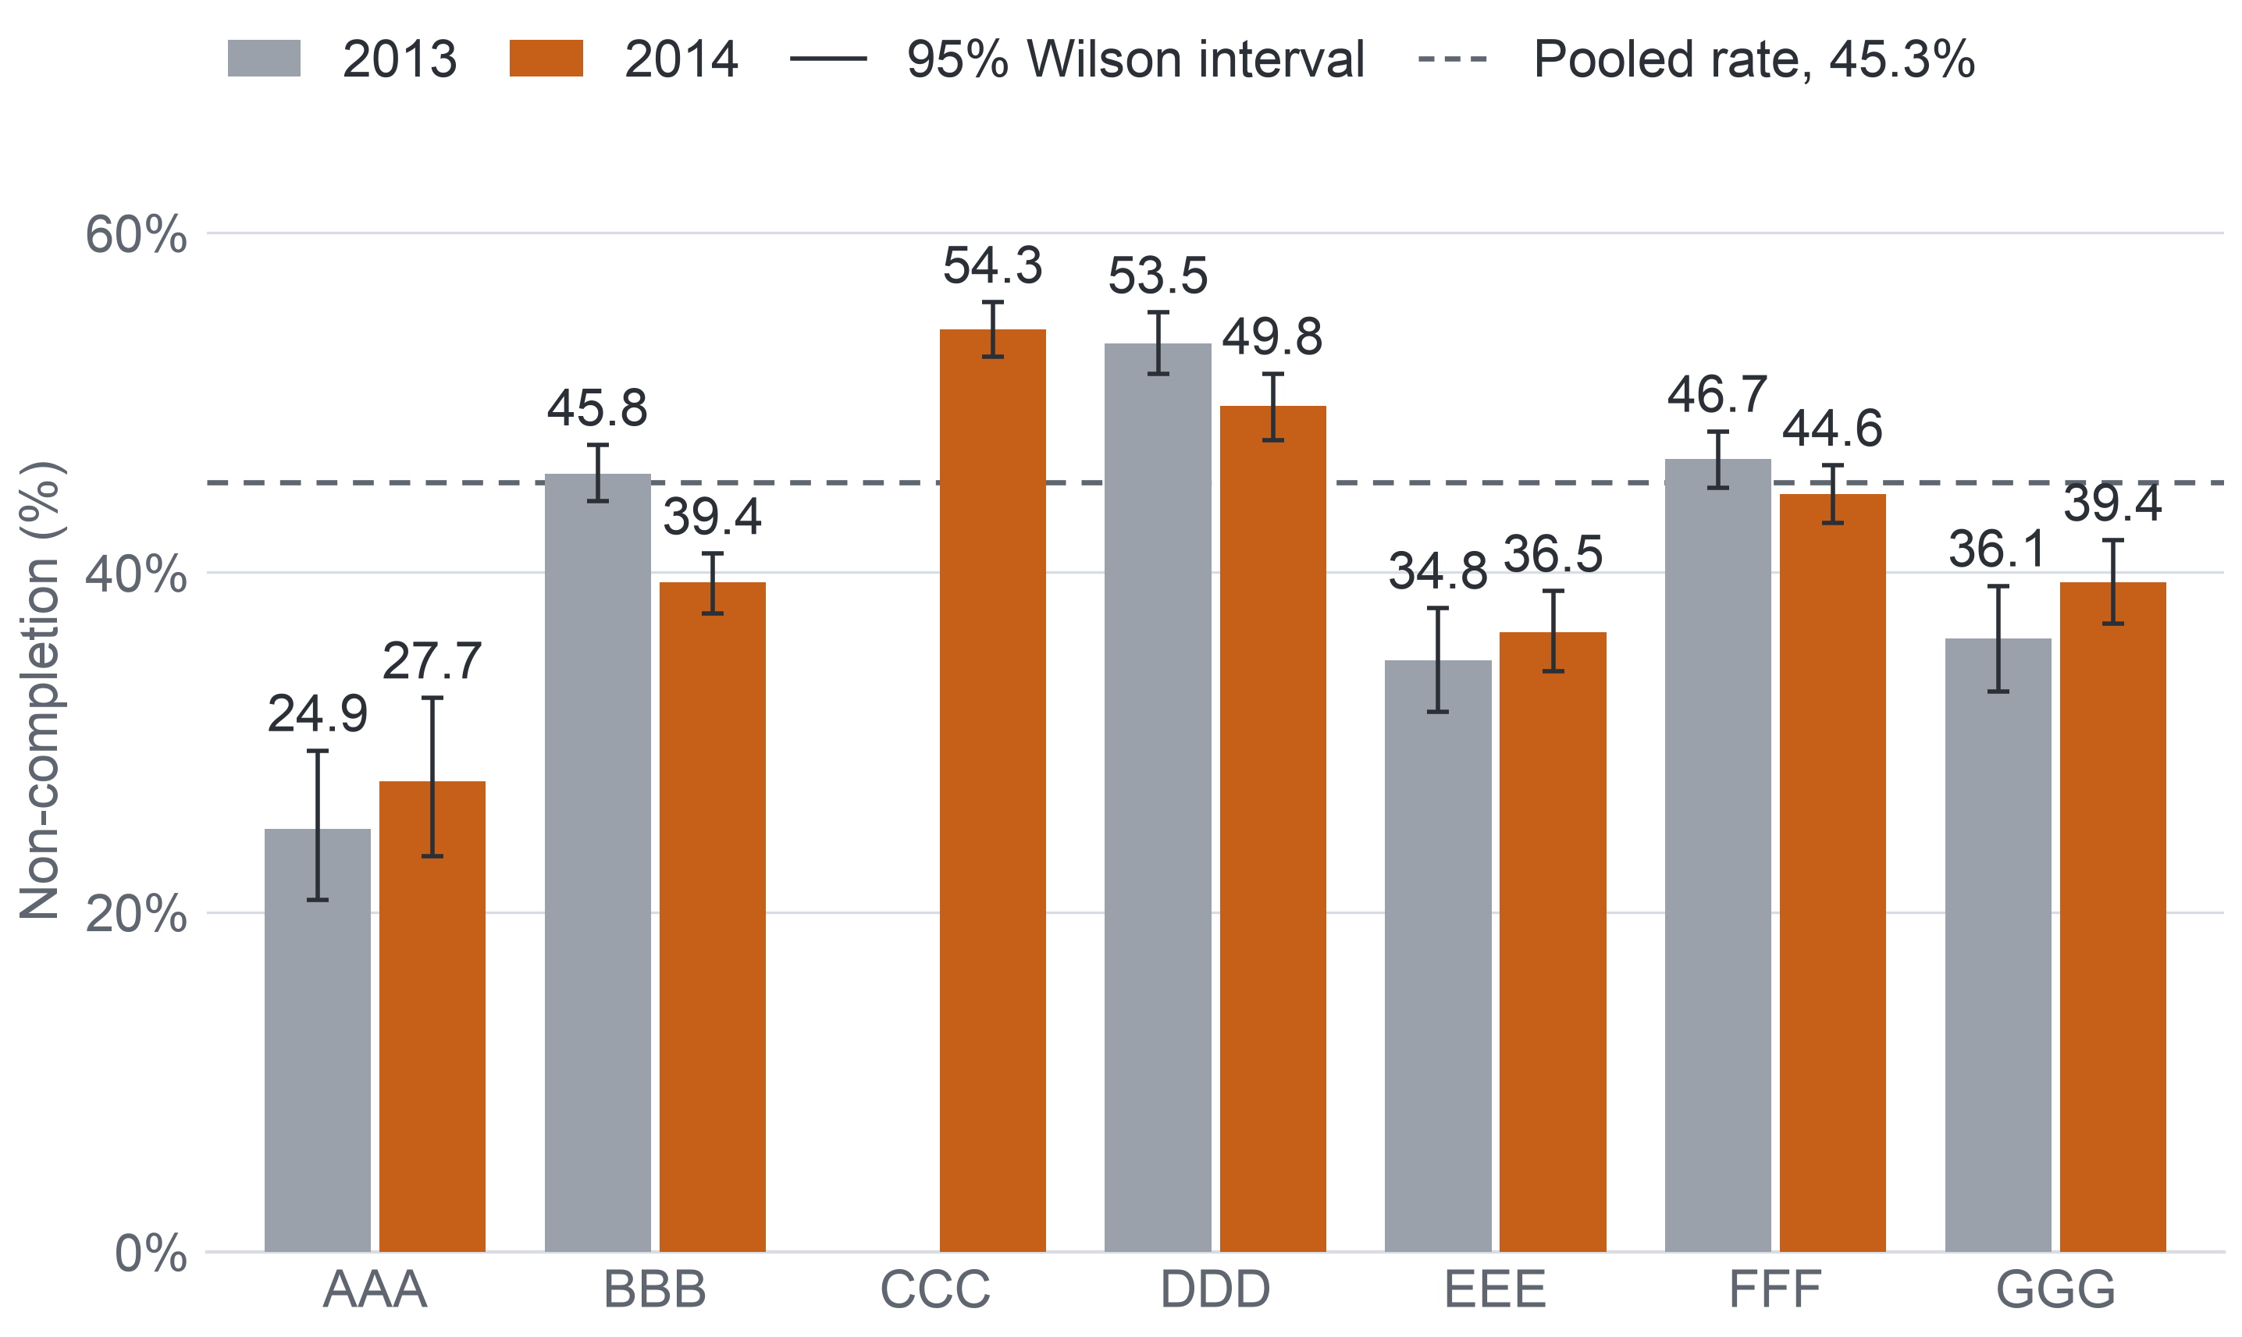
APPENDIX A54: PART 5 · EVIDENCE (MILESTONE 5)
72
AQ1: Modules, Runs and Start Months
Non-completion ranges from about a quarter to over half between modules and runs, and February runs lose more students than October runs in both years.
Non-completion per module, students registered at day 14
Modules, both years: lowest AAA, 26.3% of 720; highest CCC, 54.3% (2014 only).
Runs, all 22: from 24.9% (AAA 2013J) to 58.3% (CCC 2014B).
Start month: February 51.6% against October 42.4% in 2013; 49.6% against 41.6% in 2014.
How students leave: in GGG 2013, 4.3% withdrew and 31.7% failed; in CCC, 33.1% withdrew and 21.3% failed.
So: a hypothesis for decision D2, where support time would go first, to be checked on the university's records.
Key: bar = rate in %; whisker = 95% Wilson interval; CCC ran only in 2014. AAA–GGG = anonymised module codes of OULAD (Open University Learning Analytics Dataset).
Key: AQ1 = descriptive question. Run = one offering of a module, named by year and start month (B = February, J = October).
Notes:
(~64 seconds) That 45.3 percent is an average over very different courses. The chart shows each module in each year, with its interval and the pooled line. Over both years, module AAA has the lowest rate, 26.3 percent, and CCC, which ran only in 2014, the highest, 54.3. Across all 22 runs, run rates span from 24.9 percent in AAA's October 2013 run to 58.3 percent in CCC's February 2014 run. February runs lose more students than October runs in both years: 51.6 against 42.4 percent in 2013, 49.6 against 41.6 in 2014. And students leave differently: in GGG in 2013 only 4.3 percent withdrew while 31.7 failed; in CCC, 33.1 percent withdrew. For the program manager that is a hypothesis about where support time would go first. But there is a trap in these rates.
Source: Milestone 5 report, Section 11.2 and Appendix XII, Figure A.2 and Table A.30.

Slide 73
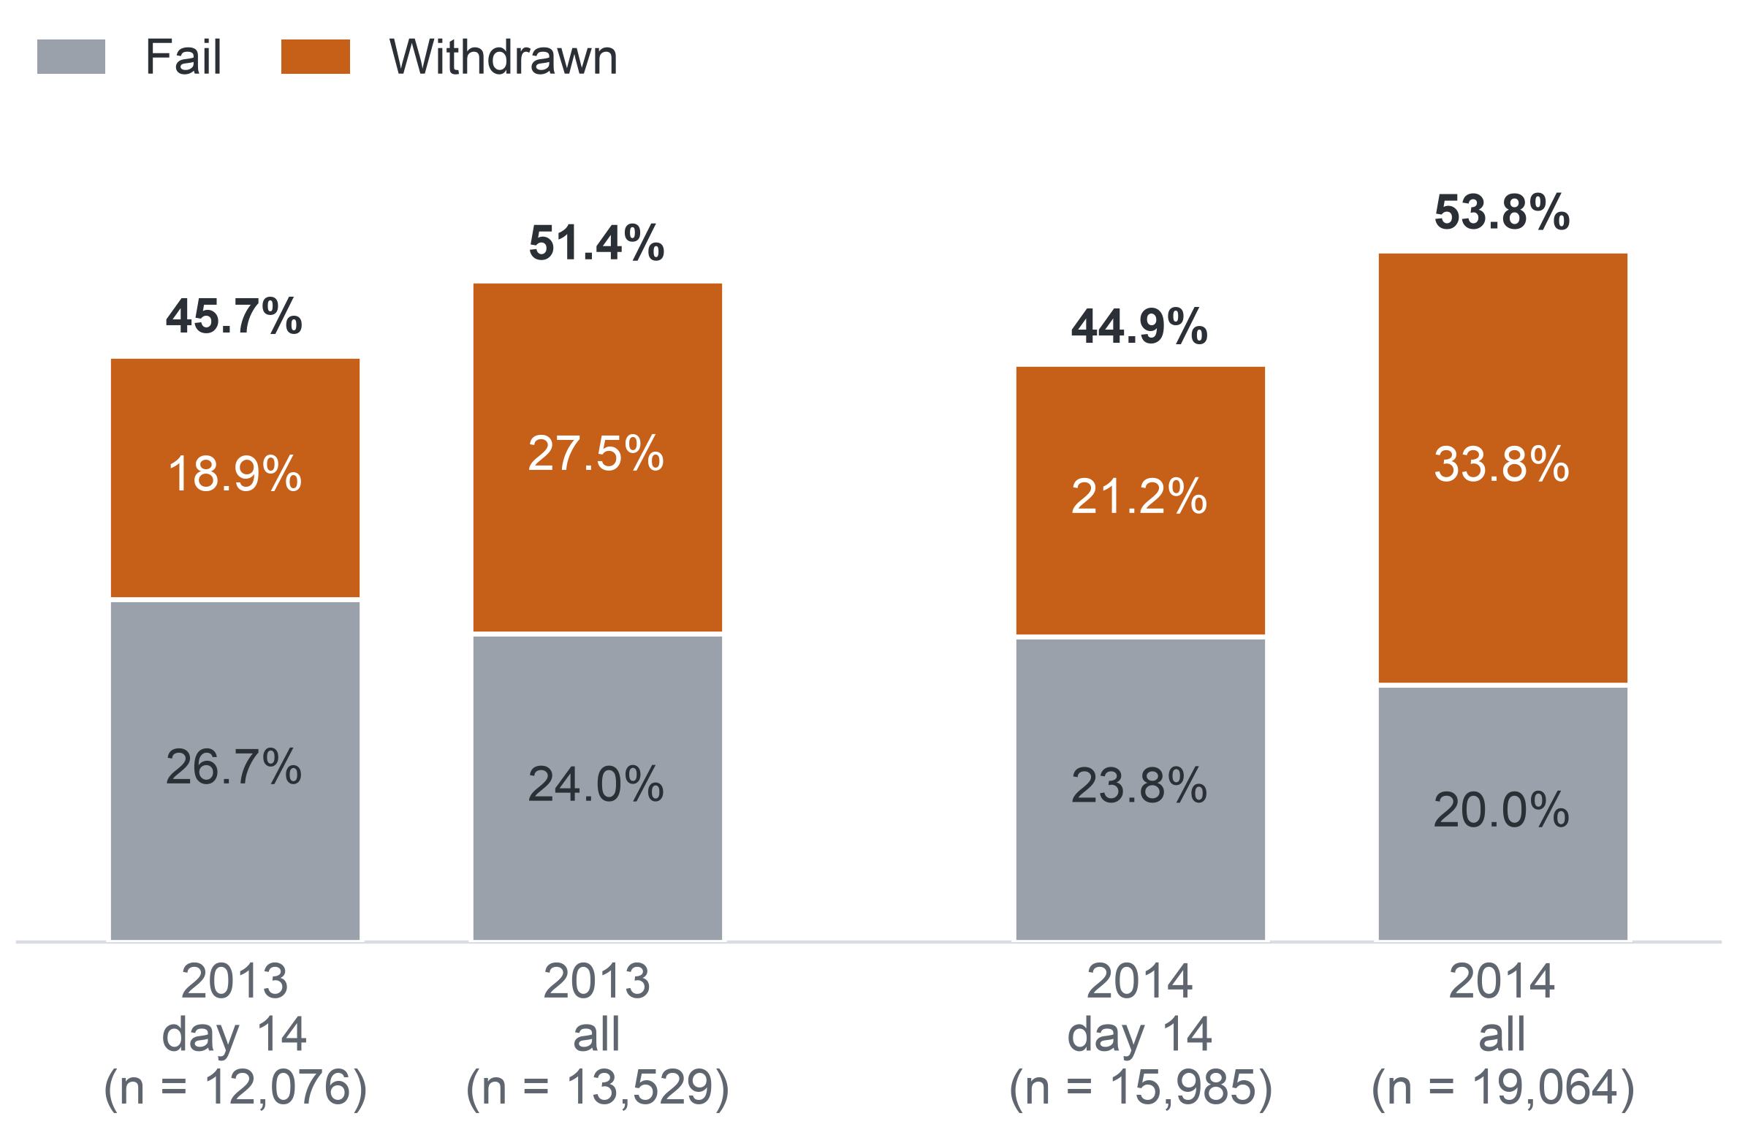
APPENDIX A55: PART 5 · EVIDENCE (MILESTONE 5)
73
AQ1: The Denominator Matters
Counting all enrolments instead of those registered at day 14 lifts non-completion above half, almost entirely through early withdrawals.
Non-completion under two denominators, %
The failed share barely moves
The extra non-completers are early withdrawals.
One run: 13.6 points
BBB 2014J: 36.2% of 1,791 at day 14; 49.7% of all 2,292.
Flagged records change nothing
Without unknown withdrawal or registration days: 45.6% (2013) and 44.6% (2014) at day 14.
So
Key: day 14 = enrolments still registered at the end of the add-drop period (the KPI population); all = every enrolment, including those who left before day 14. Bar = Fail plus Withdrawn; bold = non-completion. KPI = key performance indicator.
Every rate must name its denominator; the KPI fixes the add-drop rule.
Notes:
(~62 seconds) Here is the trap. Count over every enrolment instead of those still registered at day 14, and non-completion jumps above half: 51.4 percent in 2013 and 53.8 in 2014. The extra students are nearly all early withdrawals. The withdrawn share rises from 18.9 to 27.5 percent in 2013 and from 21.2 to 33.8 percent in 2014, while the failed share barely moves. In a single run the shift is larger still: in BBB's October 2014 run, 36.2 percent of those registered at day 14 did not complete, against 49.7 percent of all enrolments, 13.6 points for the same students. Dropping the enrolments with an unknown withdrawal or registration day leaves the day-14 rates at 45.6 and 44.6 percent. So every figure must state its denominator. Next, the year comparison.
Source: Milestone 5 report, Section 11.2 and Appendix XII, Tables A.29 and A.32.

Slide 74
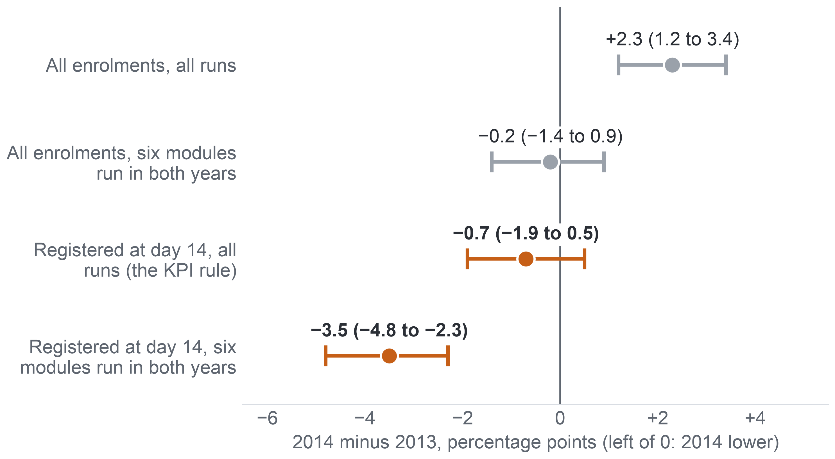
APPENDIX A56: PART 5 · EVIDENCE (MILESTONE 5)
74
AQ1: The Year Comparison Depends on the Add-drop Rule
Over all enrolments 2014 looks worse than 2013, but among students registered at day 14 it is no worse, because more 2014 students left before day 14.
Change in non-completion from 2013 to 2014
The rise comes from CCC
Over all enrolments the +2.3 points come from module CCC, which ran only in 2014 (non-completion 62.2% of its enrolments); the six shared modules show −0.2.
Why the years flip
16.2% of 2014 enrolments against 10.7% of 2013 were not registered at day 14, so more 2014 non-completers left before the KPI counts them.
So
No general rise among the students the KPI counts; a yearly figure must state its add-drop rule.
Key: dot = 2014 minus 2013 in points; whisker = 95% Newcombe interval, and one that crosses 0 shows no clear difference. Grey = over all enrolments; orange = registered at day 14 (the KPI rule). KPI = key performance indicator (completion after add-drop).
Notes:
(~62 seconds) The denominator matters most when we compare years. Over all enrolments, non-completion was 2.3 points higher in 2014, and that rise comes from module CCC, which ran only in 2014; in the six modules that ran in both years the difference is minus 0.2. Among students registered at day 14, 2014 was 0.7 points lower, and 3.5 points lower in the six shared modules. Same data, opposite stories. The reason: 16.2 percent of 2014 enrolments, against 10.7 percent in 2013, were not registered at day 14, so more of the 2014 students who would not complete left before the KPI counts them. We find no general rise among the students the KPI counts. That is why the KPI fixes the add-drop rule. Next, how rates differ between groups of students.
Source: Milestone 5 report, Section 11.2 and Appendix XII, Table A.32.

Slide 75
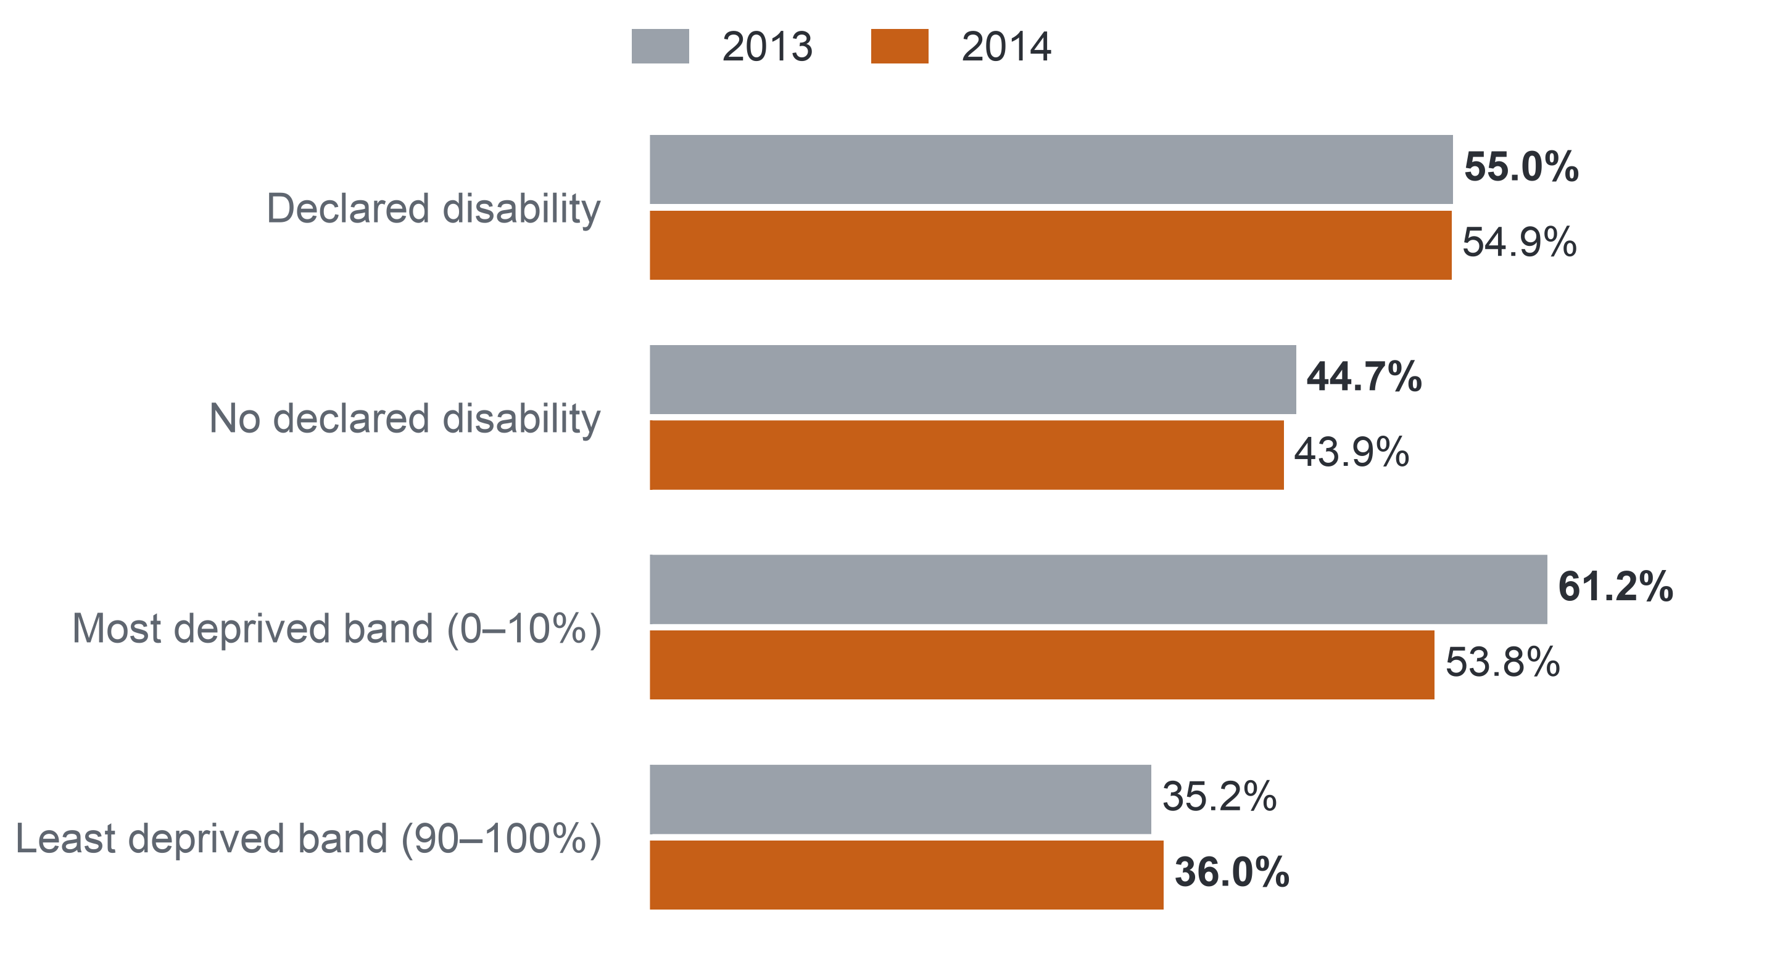
APPENDIX A57: PART 5 · EVIDENCE (MILESTONE 5)
75
AQ1: Non-completion by Group of Students
Non-completion is higher for students with a declared disability and rises with deprivation, which is why these groups anchor the fairness audit.
Non-completion by group, students registered at day 14 (%)
Described, not explained
The rates are not adjusted for any other difference, so they say nothing about why the groups differ.
Too few to compare
Students aged 55 or over: 76 in 2013 and 122 in 2014, too uncertain for any comparison.
So
These are the groups where a list could fail students most: the confirmatory groups of the fairness audit (Appendix A48).
Key: bar length = non-completion (Fail or Withdrawn) in the group. Groups: declared disability 1,157 (2013) and 1,519 (2014); most deprived band 1,196 and 1,512; least deprived band 969 and 1,299. Deprivation band = Index of Multiple Deprivation band of the student's home area.
Notes:
(~62 seconds) One more descriptive pattern, on the same day-14 population, before the timing result. Students with a declared disability did not complete in 55.0 percent of enrolments in 2013 and 54.9 percent in 2014, against 44.7 and 43.9 percent of other students. Non-completion falls from the most deprived home areas to the least deprived: from 61.2 to 35.2 percent in 2013, and from 53.8 to 36.0 percent in 2014. These are descriptions without adjustment; they say nothing about why. Students aged 55 or over are too few for any comparison. But these gaps show where a list could fail students most, which is why disability and the deprivation bands are the groups the fairness audit checks. Now the finding that shaped the design: when do non-completers first miss a task?
Source: Milestone 5 report, Sections 9.2 and 11.2, and Appendix XII.

Slide 76
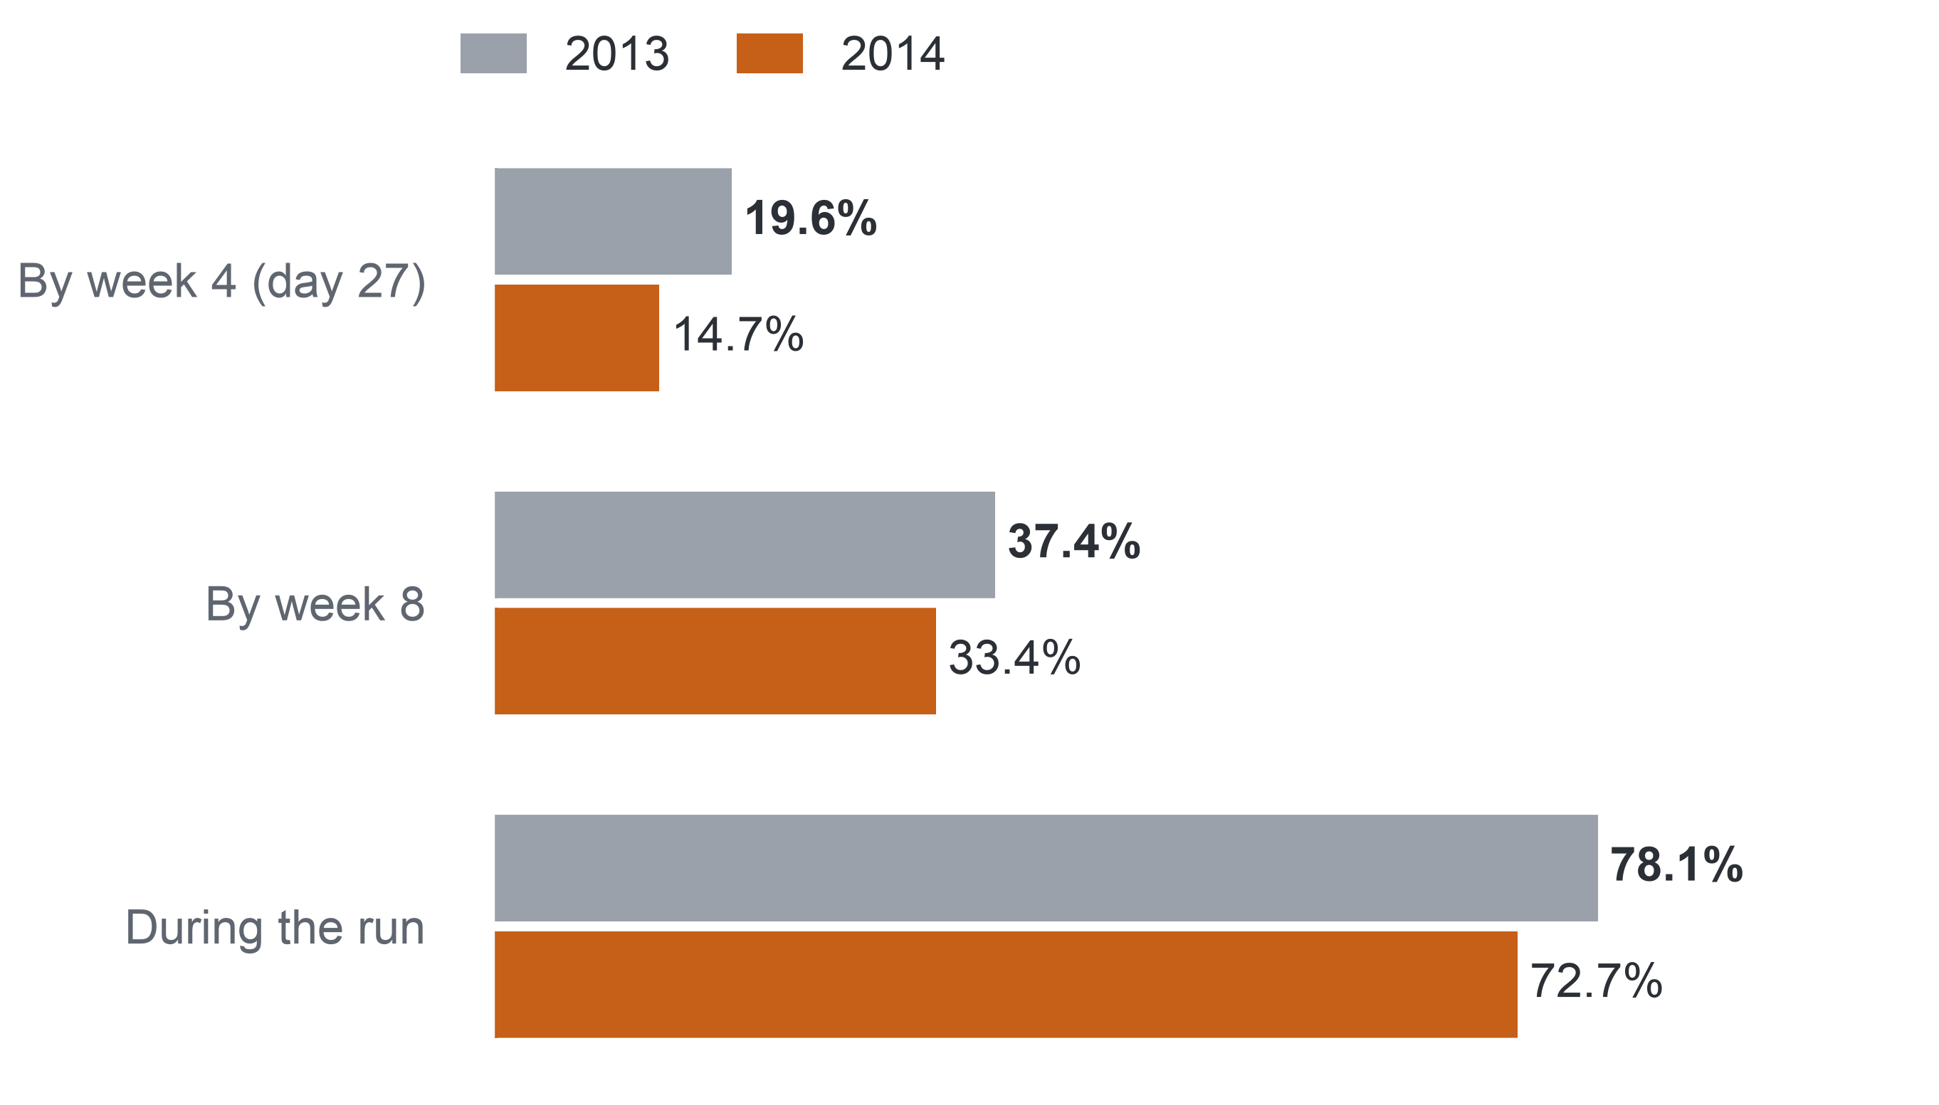
APPENDIX A58: PART 5 · EVIDENCE (MILESTONE 5)
76
AQ1: When Non-completers First Miss a Task
Most non-completers miss a task at some point, but under one in five has missed one by week 4, when the list is made.
Non-completers who had missed a task (TMA or CMA), %
Completers rarely miss early
Under 1% by week 4; 21.9% (2013) and 19.4% (2014) during the run.
Late for most
The median non-completer first misses a task in week 9 in both years; six of the 22 runs had no task due by day 27.
So
A rule on tasks alone comes too late, which is why the early-sign rule also counts inactivity. Confidence: high for OULAD.
Key: population = non-completers registered at day 14, 5,515 in 2013 and 7,185 in 2014. TMA = tutor-marked assignment; CMA = computer-marked assessment; missed = fell due with no submission. Week 4 ends on day 27. OULAD = Open University Learning Analytics Dataset.
Notes:
(~66 seconds) This is the result that turned our design. Missing a task separates the two groups sharply: 78.1 percent of non-completers in 2013 and 72.7 percent in 2014 missed a tutor- or computer-marked task at some point, against about one in five completers. But look at the timing. By the end of week 4, when the week-5 list is drawn, only 19.6 and 14.7 percent of non-completers had missed one, and by week 8 still only 37.4 and 33.4 percent. Their median first missed week is week 9. In six of the 22 runs no task was even due by day 27. So a rule on tasks alone comes too late for most non-completers, which is why the early-sign rule also counts inactivity. Does inactivity go with non-completion? AQ2 tests that, starting with how we tested the signs.
Source: Milestone 5 report, Section 11.2 and Appendix XII, Table A.31.

Slide 77
APPENDIX A59: PART 5 · EVIDENCE (MILESTONE 5)
77
AQ2: How We Tested the Signs
We compared each early sign within its own module run, adjusted for the other signs, on 2013 and again, unchanged, on 2014.
Task signs: runs with a task due by day 27 (9,960 and 12,585 enrolments)
Population
Registered at day 27: 11,811 enrolments in the 9 runs of 2013 (44.4% did not complete) and 15,724 in the 13 runs of 2014 (44.0%), module CCC included.
Missed task
a TMA or CMA due by day 27, not submitted by then
Late TMA
a TMA due by day 27, submitted after its deadline
Model and result
Logistic regression with a fixed effect for each run, background terms and sign × module terms. Result: a risk difference in percentage points, each sign adjusted for the other four; an association, not an effect.
Click signs: every run (11,811 and 15,724 enrolments)
No click in the last 7 days
no platform click on days 21–27
Activity below the run median
clicks on days 0–27 below the median of the same run
Criterion, fixed in Milestone 4
At least 5 points, a 95% interval excluding 0, and the same direction in at least two-thirds of the modules; p-values take no part.
No click before the start
no click before day 0, the start of the run
Key: AQ2 = the diagnostic question (which early signs go with later non-completion); TMA = tutor-marked assignment; CMA = computer-marked assessment; run = one offering of a module.
Notes:
(~67 seconds) Missed tasks came too late for most non-completers, so the diagnostic question, AQ2, asks what else shows by day 27. We took the enrolments still registered at day 27: 11,811 in the nine runs of 2013, and 15,724 in the thirteen runs of 2014, where we reran the same model unchanged. Each sign is dated on or before day 27. Task signs exist only in runs with a task due by then; click signs exist in every run. The model is a logistic regression with a fixed effect for each run, so a student is compared only with others in the same run, and each sign is adjusted for the other four. Each result is a risk difference in percentage points: an association, not an effect. The verdict rule was fixed in Milestone 4. Here is what the signs show.
Source: Milestone 5 report, Section 11.3, Section 9, Table 9.1, and Appendix XIII.

Slide 78
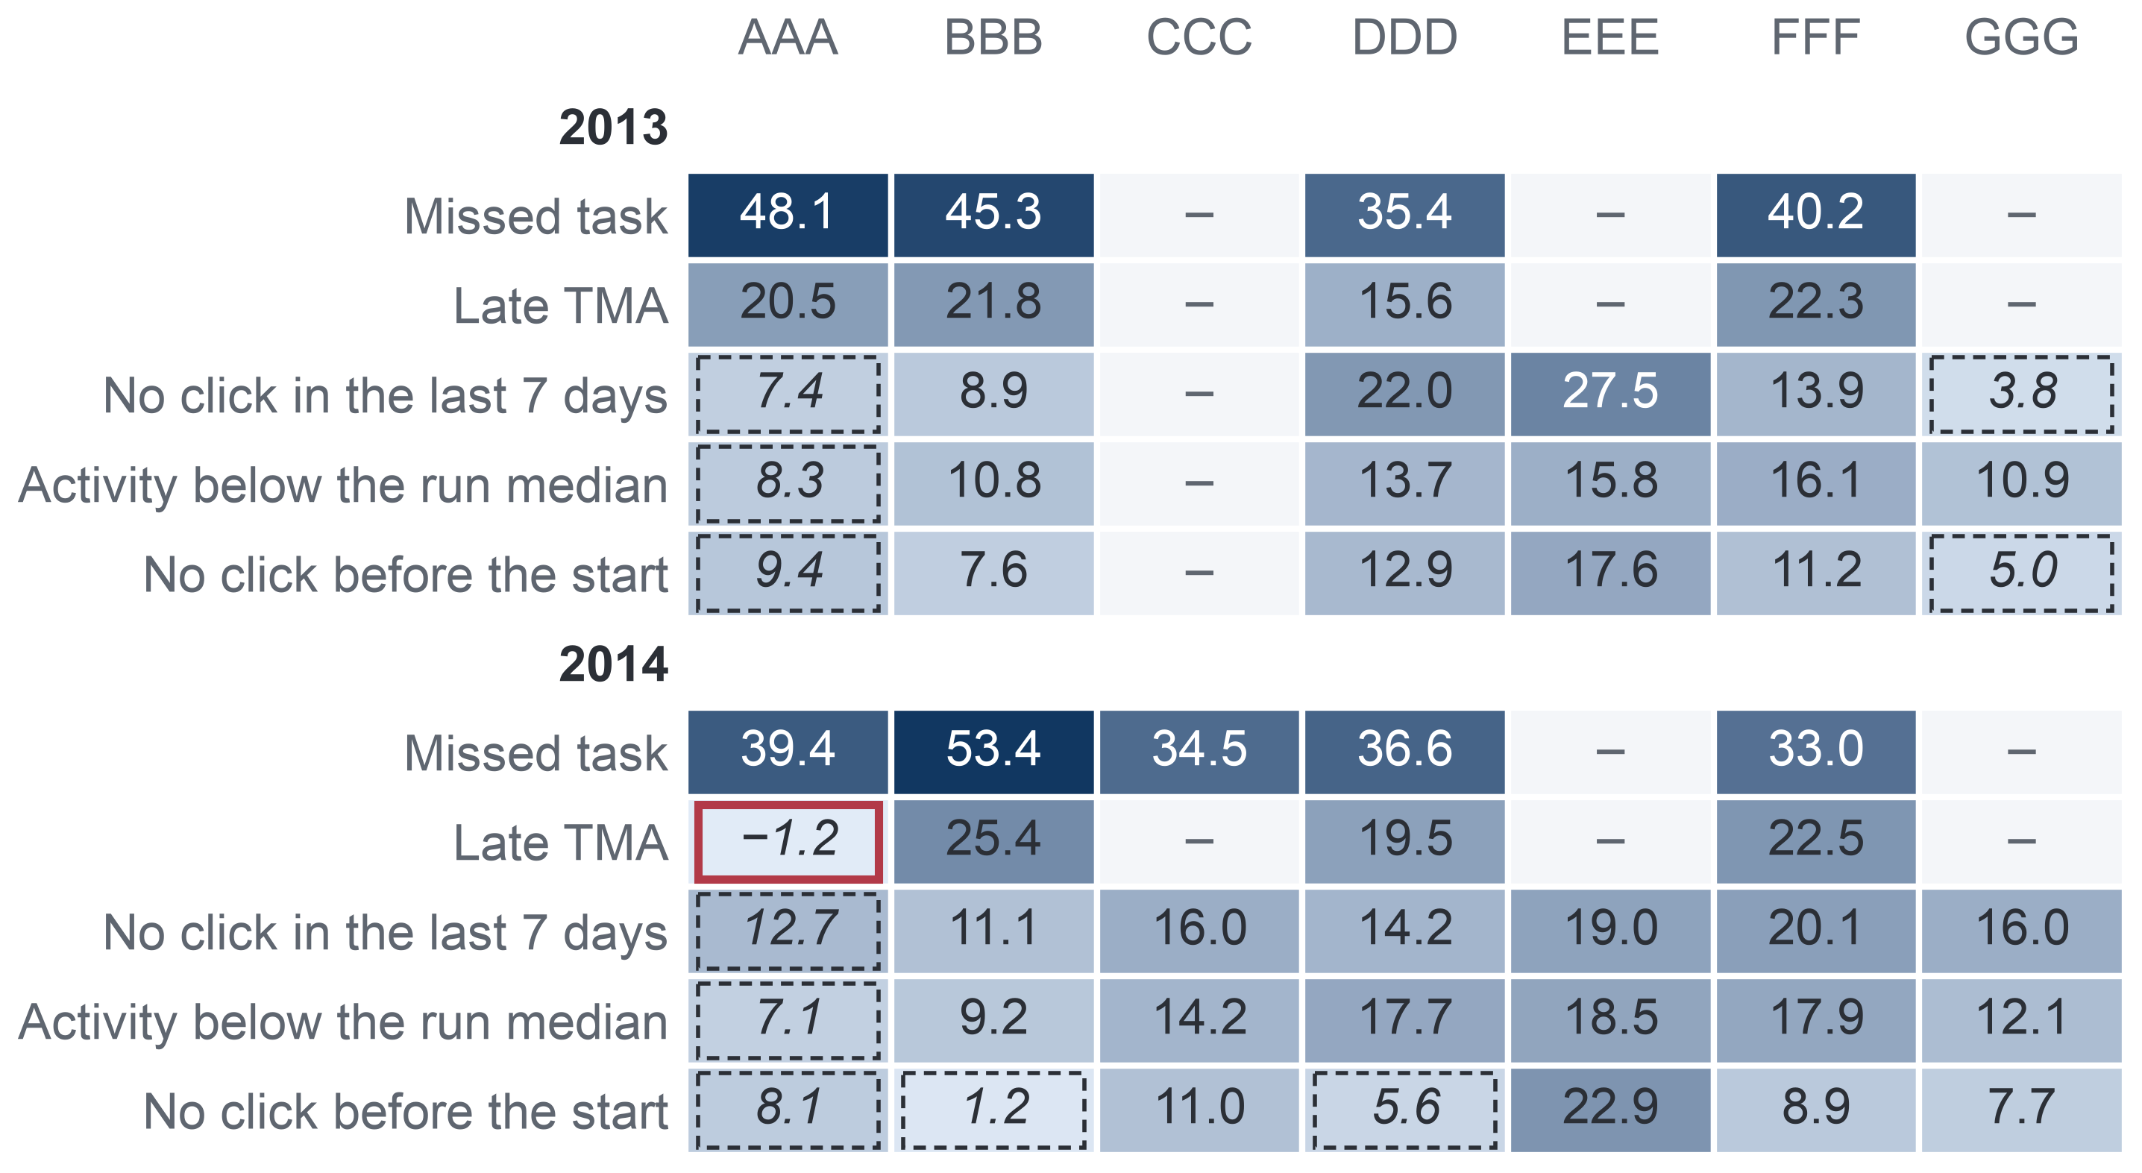
APPENDIX A60: PART 5 · EVIDENCE (MILESTONE 5)
78
AQ2: Consistent Across Modules
Each sign points the same way in every module in 2013 and in 29 of 30 module estimates in 2014, but its size varies between modules.
Risk difference by module, points, adjusted for the other signs
Direction holds
2013: every sign keeps its direction in every module where it is defined (4 of 4 for the task signs, 6 of 6 for the click signs). 2014: 29 of 30 module estimates.
One wide exception
A late TMA (tutor-marked assignment) in AAA 2014: −1.2 points on 348 enrolments, interval −14.4 to 12.1, which includes 0. No CCC student had a late TMA by day 27.
Size varies
No click in the last 7 days goes with 27.5 points in EEE but 3.8 in GGG (2013). Intervals that include 0 lie mostly in the small module AAA: no evidence there, not evidence of no information. Consistency means the same direction, not the same size.
Key: darker cell = larger risk difference; – = sign not defined (no task due by day 27) or module not run; italic with dashed frame = 95% interval includes 0; red frame = the one estimate in the opposite direction. AAA–GGG = the seven anonymised modules of the Open University Learning Analytics Dataset.
Notes:
(~67 seconds) Two years agreeing is encouraging; the next test is module by module. In this heat table each cell is one sign in one module, and the darker the cell, the larger the risk difference. In 2013 every sign points the same way in every module where it is defined. In 2014, 29 of the 30 module estimates do. The one exception is a late TMA in the small module AAA: minus 1.2 points on 348 enrolments, with an interval from minus 14.4 to plus 12.1, so it tells us little either way. What does vary is size: no click in the last seven days goes with 27.5 points in EEE but only 3.8 in GGG. So consistency means the same direction, not the same size, and a new run may differ. Next, did our own analysis choices drive these results?
Source: Milestone 5 report, Section 11.3 and Appendix XIII, Table A.34.

Slide 79
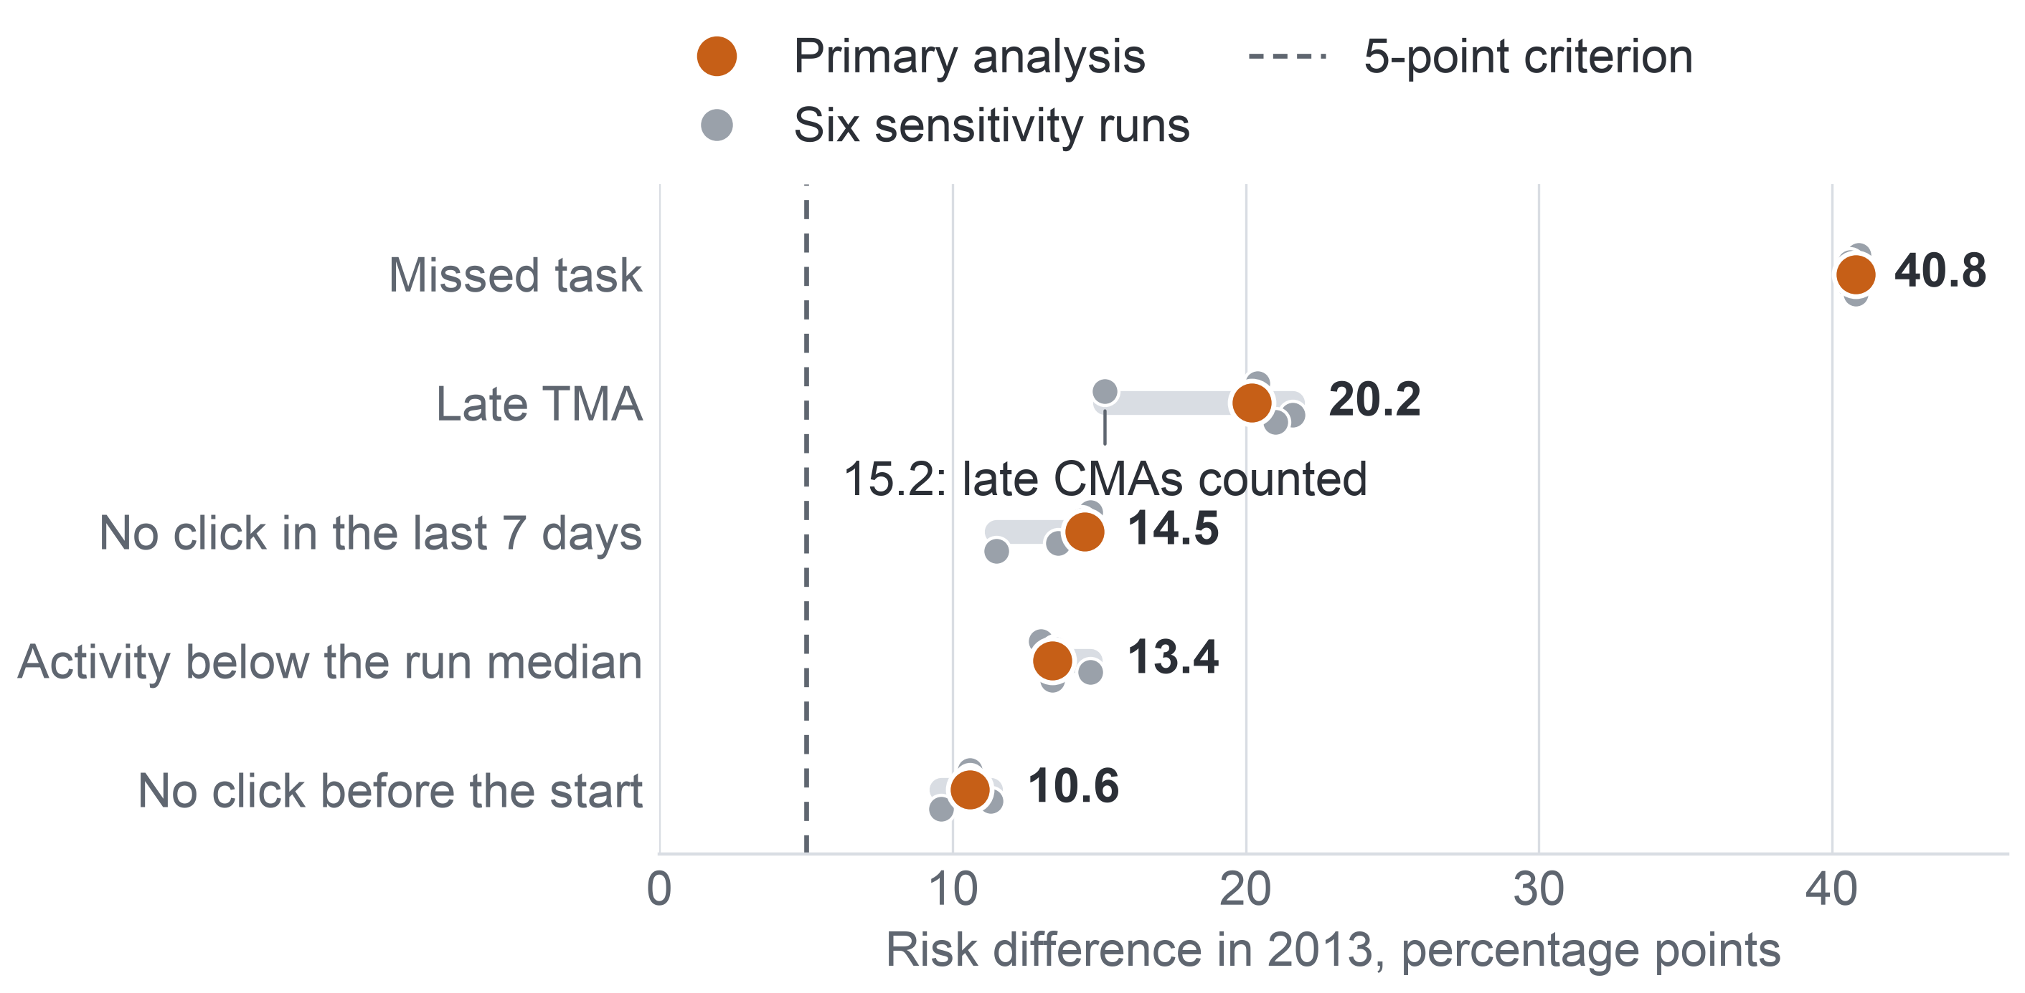
APPENDIX A61: PART 5 · EVIDENCE (MILESTONE 5)
79
AQ2: Sensitivity Runs
Six sensitivity runs in each year change no verdict: every sign stays above 5 points with an interval excluding 0.
Each sign under the primary analysis and six sensitivity runs, 2013
Largest shift
Counting late CMAs lowers the late sign from 20.2 to 15.2 points, because by day 27 a late CMA occurs only in DDD 2013B, in 85.65% of its enrolments.
2014 agrees
The same six runs leave every 2014 verdict unchanged: the smallest estimate under any of them is 6.9 points, with a lowest interval bound of 4.3.
All 22 runs pooled
Key: sensitivity run = the same model with one analysis choice changed: de-duplicated clicks; late CMAs (computer-marked assessments) counted as late, beside late TMAs (tutor-marked assignments); flagged enrolments removed; the 2 runs with no task due removed; low activity cut at half the run median; one sign effect for all modules. The grey band spans all seven estimates.
On 27,535 enrolments registered at day 27, the five signs go with 39.8, 20.6, 14.7, 14.0 and 9.4 points and meet the criterion in every module.
Notes:
(~62 seconds) Next, were these results an artefact of our choices? We reran the 2013 model six times, each time changing one choice: removing duplicate clicks, counting late computer-marked tasks as late, dropping uncertain records, dropping the two runs with no task due, cutting low activity at half the median, and forcing one sign effect for all modules. On the chart, the orange dot is the primary estimate and the grey dots are the variants; every dot stays to the right of the five-point line. The biggest move is the late sign, from 20.2 to 15.2, because only one run had late computer-marked tasks by day 27, in 85.65 percent of its enrolments. In 2014 the smallest estimate under any variant is 6.9 points. One model check, though, found a real weakness.
Source: Milestone 5 report, Appendix XIII, Table A.35 and the sections on sensitivity runs and on the comparison of the two years.

Slide 80
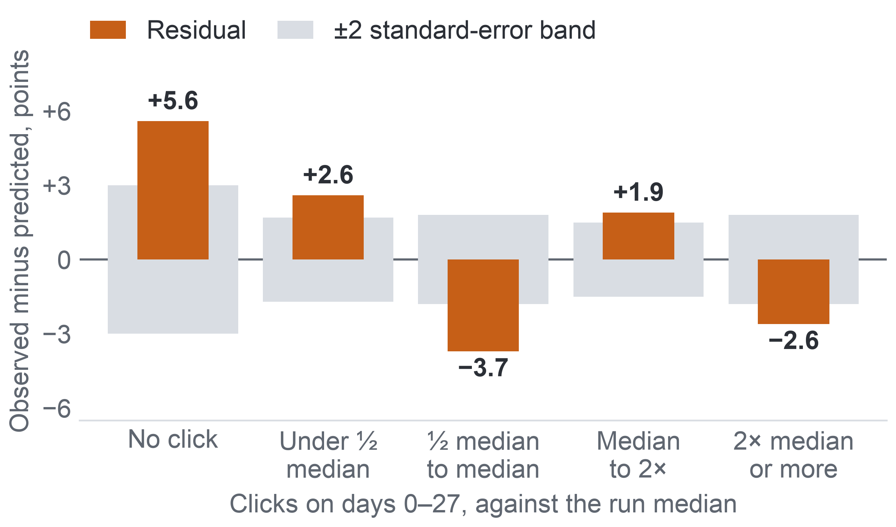
APPENDIX A62: PART 5 · EVIDENCE (MILESTONE 5)
80
AQ2: Activity Works as a Gradient
The yes-or-no click signs miss a graded activity pattern; with clicks as a continuous measure, the below-median sign falls below the criterion in 2014 while the other four still meet it.
Model error by activity level, 2013
Risk difference, planned → with clicks as a continuous adjustment, points
Sign | 2013 | 2014
Missed task | 40.8 → 37.3 | 39.3 → 35.6
Late TMA | 20.2 → 19.5 | 20.3 → 19.5
No click in the last 7 days | 14.5 → 9.3 | 15.8 → 10.7
Activity below the run median | 13.4 → 5.8 | 14.6 → 5.9: same direction in 4 of 7 modules, criterion not met
No click before the start | 10.6 → 8.9 | 8.7 → 6.5
Key: residual = observed minus predicted non-completion; all five levels lie outside their band. 11,811 enrolments.
Key: continuous adjustment = log(1 + clicks on days 0–27) added to the model; TMA = tutor-marked assignment.
Chosen after seeing the residuals, so the added run qualifies the verdict; the planned estimates remain the primary result. Design consequence: the AQ3 model (the predictive question) uses continuous click measures.
Notes:
(~66 seconds) One model check found a real weakness. Observed against predicted non-completion by activity level, the model is off in all five levels. Students with no click at all in four weeks did not complete 5.6 points more often than predicted; students between half the median and the median, 3.7 points less often. The yes-or-no sign treats everyone under the median alike, yet non-completion keeps falling as activity rises. So, after seeing this, we added one run with clicks as a continuous measure. The misfit disappears in 2013 and shrinks in 2014. The click signs shrink, and the below-median sign falls to 5.8 points in 2013 and 5.9 in 2014, where it no longer meets the criterion. The other four still do. Chosen after looking, this run qualifies the verdict. So what do the signs mean for a list?
Source: Milestone 5 report, Section 11.3 and Appendix XIII, Table A.36 and the section on sensitivity runs and model checks.

Slide 81
APPENDIX A63: PART 5 · EVIDENCE (MILESTONE 5)
81
AQ2: What the Signs Mean for the List
The signs give each name on a contact list a factual reason staff can check and show that the early-sign rule needs its activity part, but they do not show that contact would help.
40.8 points
19.6%
6 of 22 runs
The strongest sign, a missed task, in 2013 (39.3 in 2014).
of 2013 non-completers (Fail or Withdrawn) had missed a task by week 4; 14.7% in 2014.
had no task due by day 27, while the click signs are defined in every run.
The signs can
The signs cannot
Give each listed name a factual reason that a member of staff checks against the record.
Show that each part of the early-sign rule (missed task, late tutor-marked assignment, no click in the last 7 days) carries information on its own, inactivity included.
Suggest, as a hypothesis, where early support could go.
Show a cause: a student who stops clicking may already have decided to leave.
Show that contacting a flagged student helps.
Justify treating a group differently: the missed-task sign holds in each of the 15 groups of 2013, as a description.
Confidence: moderate. Two years agree, but the click signs rest on a known misfit, and unrecorded reasons could explain the associations.
Notes:
(~67 seconds) Let us put timing and signs together, because this is the turning point of the project. A missed task is the strongest sign, 40.8 points in 2013. Yet by week 4 it has appeared for only 19.6 percent of the students who will not complete, and in six of the 22 runs nothing was even due. A week without clicks can be measured in every run. So the early-sign rule must keep its activity part. What can the signs do? They give each name on a list a factual reason that a member of staff can check, and each part of the rule carries information on its own. What can they not do? Show a cause: a student who stops clicking may already have decided to leave. So confidence is moderate. Now, the two questions still waiting for their test.
Source: Milestone 5 report, Sections 11.2 and 11.3, Appendix XII, Table A.31, and Appendix XIII, Table A.33 and the sections on groups of students and on what AQ2 means for the project.

Slide 82
APPENDIX A64: PART 5 · EVIDENCE (MILESTONE 5)
82
Answers by Question
We can describe the size and timing of non-completion, name its early signs and rank students slightly better than the rule; we cannot say whether contact helps.
Question | Evidence and method | Main finding | Confidence | Implication for decision
AQ1, descriptive | 22 runs, day 14: 28,061 enrolments; rates under two denominators | 45.3% did not complete; runs 24.9–58.3%; under 20% of non-completers missed a task by week 4 | High for OULAD 2013–2014; KPI proxy | D2 hypothesis; tasks alone come too late
AQ2, diagnostic | Day 27: 11,811 and 15,724; logistic, run fixed effects | Five signs consistent in both years; missed task 40.8 and 39.3 points | Moderate; association | D1 reasons; contact to test
AQ3, predictive | Train 2013: 11,811; test 2014: 15,724; penalised logistic, gate S1 | S1 met: 0.725 vs 0.704; 41.5% of non-completers on lists of 5 per 20 | Moderate; ranks only, calibration fails in 8 of 13 runs | D1 order; the rule as fallback
AQ4, prescriptive ranking | AQ3 scores, 2014: 15,724; top-k per run; FR1 | 1st contact 92.4%, 7th 47.3% non-completers; FR1: none flagged | Moderate; no contact data | D1 list of up to about 6 per 20, not a contact plan
Key: orange = answered on data; blue = answered for the ranking, contact part without data. D1 = whom to contact; D2 = where support time goes; S1 = the gate a model must pass to replace the early-sign rule; FR1 = the fairness review rule; KPI = key performance indicator; OULAD = Open University Learning Analytics Dataset.
Notes:
(~87 seconds) The four answers, each read at its own level. AQ1, descriptive: 45.3 percent of the enrolments registered at day 14 did not complete, runs ranged from 24.9 to 58.3 percent, and fewer than one in five non-completers had missed a task by week 4; high confidence for OULAD. AQ2, diagnostic: five signs consistent in both years, a missed task at 40.8 and 39.3 points; moderate confidence, because these are associations. AQ3, predictive: gate S1 met, 0.725 against 0.704, with 41.5 percent of non-completers on lists of five per twenty; moderate confidence, ranks only, because calibration fails in 8 of 13 runs. AQ4, the ranking: the first contact finds a non-completer 92.4 percent of the time, the seventh 47.3, and the fairness rule flags no group; moderate, with no contact data. Read across the rows: we can describe the problem and name its early signs, and rank students slightly better than the rule, but we cannot say whether contact helps. The last column is what matters to staff, so let us take the decisions one by one, starting with whom to contact.
Source: Milestone 5 report, Section 11.5, Table 11.3, and Appendix XIV, Tables A.38 and A.39.

Slide 83
APPENDIX A65: PART 6 · INTEGRATION AND USE (MILESTONE 5)
83
Decision D1: Whom to Contact
For whom to contact, the AQ3 model ranks the list with the signs shown as reasons, and the early-sign rule, which holds 97% of the model's hits, is its fallback.
Decided by: course lecturers, lecturer-advisors and the support office, at each review point; a reversible decision
Evidence now
Decision option
Check before adoption
AQ2: a missed task goes with 40.8 more points of non-completion (37.7–43.9) in 2013, and each part of the rule carries information on its own.
AQ3, AQ4: model lists of 5 per 20 hold 41.5% of later non-completers (rule 40.3%, random 25.1%); gate S1 met; FR1 flags no group.
Build the pilot's week-3 and week-5 lists from the AQ3 ranking, at most about 6 per 20 students, shown as ranks with behavioural reasons.
A member of staff checks every name; the early-sign rule, ordered by its number of signs, is the fallback.
The model's order still holds on the university's own records, recounted before the pilot.
Contact raises completion against usual support: a randomised pilot, with the contact person and the offer left open.
28.8%
Why ranking matters: the rule flags 28.8% of the 27,535 enrolments registered at day 27 across the 22 runs, more than a list of 5 per 20 students (25%) can hold, so the list is ordered by the number of signs.
Key: early-sign rule = a task due but not submitted, a late TMA (tutor-marked assignment) or no click in the last 7 days; S1 = the gate the AQ3 model (predictive question) must pass to replace the rule's order, met on the 2014 test; FR1 = the fairness review rule; AQ2–AQ4 = the diagnostic, predictive and ranking questions.
Notes:
(~79 seconds) Starting with D1, whom to contact, a decision of the lecturers, the lecturer-advisors and the support office, and a reversible one. The evidence now supports a ranked list: the AQ3 model, built on 2013 and tested once on 2014, puts 41.5 percent of later non-completers on lists of five per twenty, against 40.3 for the rule and 25.1 for a random list, and the fairness rule flags no group. So the option is to build the pilot's week-3 and week-5 lists from the model's ranking, at most about six per twenty students, shown as ranks with behavioural reasons, and a member of staff checks every name. The early-sign rule stays as the fallback: it is interpretable, computable from records the university already holds, and it delivers 97 percent of the model's hits. Two checks come first: whether the model's order holds on the university's own records, and whether contact helps at all, which only a randomised pilot can show. Next, where support time goes.
Source: Milestone 5 report, Section 11.5, Appendices VIII and IX, and Appendix XIV, Table A.40.

Slide 84
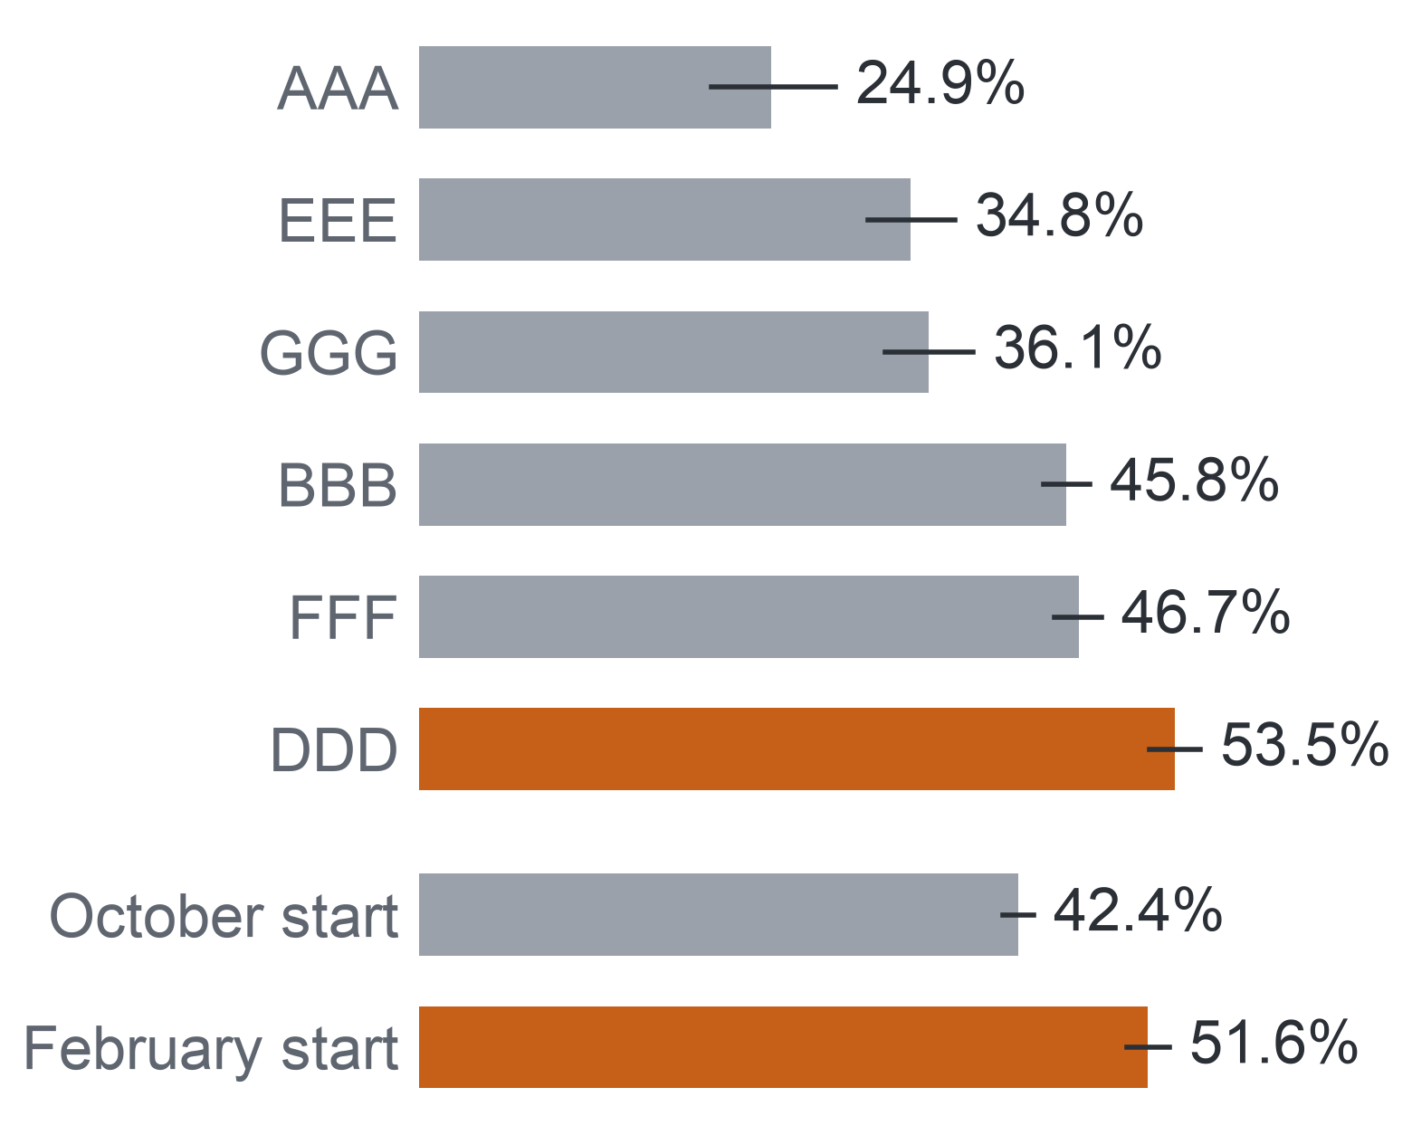
APPENDIX A66: PART 6 · INTEGRATION AND USE (MILESTONE 5)
84
Decision D2: Where Support Time Goes
Support time could go first where non-completion and early signs are highest, as a hypothesis to check on the university's own records.
Decided by: the program manager, for the time of the support office and the lecturer-advisors; each semester
Where losses concentrate, 2013
Evidence now
Decision option, a hypothesis
Check before adoption
AQ1: non-completion from 24.9% to 57.5% between the runs of 2013; February runs 51.6% against October runs 42.4%.
AQ2: no click on days 21–27 in 54.8% of GGG 2013J but 7.6% of DDD 2013B.
Place early support time first in the courses and intakes with the highest non-completion and the highest share of early signs, measured on the university's own records.
Caution: high risk marks where losses concentrate, not where support helps most.
The pattern repeats in the university's courses over several semesters.
The baseline is recounted under the add-drop rule: only students still registered at day 14 count.
Key: bar = non-completion among students registered at day 14, 2013 (modules AAA–GGG of the Open University Learning Analytics Dataset, then all runs by start month); line = 95% Wilson interval; orange = above 50%. AQ1, AQ2 = the descriptive and diagnostic questions.
Notes:
(~63 seconds) From D1 to D2, the program manager's choice of where support time goes each semester. In the 2013 runs of OULAD, non-completion ranged from 24.9 to 57.5 percent, February intakes lost more than October ones, 51.6 against 42.4 percent, and the share of students with no click in the last week before day 27 ranged from 7.6 percent in one run to 54.8 in another. So the option is to place early support time first where both non-completion and early signs are highest. But it is a hypothesis, for two reasons. OULAD is not the university, so the pattern must repeat in its own courses over several semesters, under one add-drop rule. And a high-risk course shows where losses concentrate, not where support would help most. Finally, the largest decision, D3.
Source: Milestone 5 report, Section 11.5, Appendix XII, Table A.30, and Appendix XIV, Table A.40. Run codes: B = February start, J = October start.

Slide 85
APPENDIX A67: PART 6 · INTEGRATION AND USE (MILESTONE 5)
85
Decision D3: Whether to Extend
For extending the approach, the project offers a measurement method, a gate and a fairness audit, not a verdict; extension waits for a pilot result.
Decided by: leadership with the legal and data office, on the pilot's results; close to a one-way door
What the project offers
Extend only if all three hold
Evidence now
The denominator alone can move a completion rate by up to 13.6 points.
AQ3 meets its gate and AQ4 its fairness rule on OULAD, which is not the university.
No evidence on the effect of contact exists.
A measure
one completion rule (the AQ1 method)
1. A completion gain
against comparison courses
A gate
S1, fixed in advance
2. Legal approval
Vietnam's rules on high-risk AI
An audit
fairness by rule FR1
3. Staff capacity
confirmed for the lists
Key: D3 = whether to extend the approach to all courses and link data routinely; S1 = the gate to replace the early-sign rule; FR1 = the fairness review rule; AQ1 = the descriptive question; AI = artificial intelligence.
Even a negative pilot result shows, at small scale, which part of the path fails.
Notes:
(~71 seconds) D3 is the decision closest to a one-way door: extending the approach to all courses and linking data routinely. Here the project offers tools rather than a verdict. First, a way to count completion by one rule in pilot and comparison courses, which matters because the denominator alone can move a rate by up to 13.6 points. Second, a gate a model must pass, fixed in advance. Third, a fairness audit. On OULAD, AQ3 meets its gate and AQ4 its fairness rule, but OULAD is not the university, and nothing yet shows that contact helps. So extension waits for three conditions: a completion gain against comparison courses, legal approval under Vietnam's rules on high-risk AI, and confirmed staff capacity. Even a negative pilot is valuable, because it shows at small scale which part of the path fails. That brings us to the limits of everything we have shown.
Source: Milestone 5 report, Section 11.5, Appendix XII and Appendix XIV, Table A.40.

Slide 86
APPENDIX A68: PART 6 · INTEGRATION AND USE (MILESTONE 5)
86
Kinds of Limit
We keep three kinds of limit apart, because each calls for a different next step.
No evidence found
No data to test
Measurement
A comparison was made and showed no clear difference: for example, the year difference over all enrolments in the six shared modules, −0.2 points (−1.4 to 0.9).
OULAD and every screened dataset lack the data: contacts and their outcomes, delivery mode, year of study, attendance, staff capacity.
The AQ3 risks hold as ranks, not probabilities (calibration fails in 8 of 13 runs).
Next step: no claim; reported as uncertain
Next step: collect in the randomised pilot
Next step: ranks and reasons only; a later review point
Three conditions on every answer
Scope
Confounding
Ethics
UK distance-learning modules of 2013–2014; instructional conditions change what predicts success.
The effect of contact cannot be known from these data.
A flag must not become a label: predictive analysis can carry bias and stereotyping.
Key: OULAD = Open University Learning Analytics Dataset, our open stand-in for the university's records.
Notes:
(~78 seconds) Every answer we gave has a boundary, and we sort the boundaries into three boxes, because each needs a different next step. "No evidence found" means we compared and saw no clear difference, such as the year difference within the six shared modules over all enrolments; we make no claim. "No data to test" means neither OULAD nor any dataset we screened holds the data: contacts, delivery mode, year of study, attendance, staff capacity. Only the pilot can create them. "Measurement" means a result that holds only in part: the AQ3 risks hold as ranks, not probabilities, because calibration fails in 8 of the 13 runs, and non-completers who still look active at week 4 are rarely listed; the next step is a later review point. On top of that, three conditions hang over every answer: two years of UK distance learning, confounding that hides the effect of contact, and a flag that must never become a label. Here is the full log.
Source: Milestone 5 report, Section 12 and Appendix XV, Table A.41.

Slide 87
APPENDIX A69: PART 6 · INTEGRATION AND USE (MILESTONE 5)
87
Limitation Log
Each limit is logged with its kind and its handling, so a reader knows where each answer can and cannot be used.
Limitation | Kind | Handling
Year difference over all enrolments in shared modules; small-module click signs (intervals include 0) | No evidence found | No claim; reported as uncertain
Contact and its outcome; delivery mode, year of study, attendance; staff capacity | No data to test | Randomised pilot
Several-modules sign before 2014; approved leave and transfer | No data to test | Described on 2014; university recount
AQ3 probabilities (calibration fails in 8 of 13 runs); active non-completers rarely listed | Measurement | Ranks and reasons only; a later review point
2014 runs described before the AQ3 test | Scope | Design fixed on 2013; tuning recorded
Binary click signs; below-median sign weak in 2014 once adjusted; KPI proxy and denominator | Measurement | Continuous click measures in AQ3; one add-drop rule
UK distance learning of 2013–2014; observational design | Scope and causal | Re-check on the university's records; options as hypotheses
Key: kind colours: red = no evidence found; blue = no data to test; violet = measurement; teal = scope, or scope and causal. Several-modules sign = tasks missed in more than one module at once; KPI = key performance indicator; add-drop rule = only students still registered at day 14 count; AQ3, AQ4 = the predictive and ranking questions.
Notes:
(~86 seconds) Following those three boxes, here is the log. Where we saw no clear difference, such as the year difference in shared modules over all enrolments, or click signs in the smallest module, we make no claim. Contacts, delivery mode, year of study, attendance and capacity have no data anywhere, so they go to the pilot. The several-modules sign has almost no cases before 2014, and leave or transfer cannot be told apart from withdrawal, so the university must recount. The AQ3 risks hold as ranks only, and active non-completers are rarely listed at week 4, so staff see ranks and reasons and a later review point is tested in the pilot. The 2014 runs had been described for AQ1 and AQ2 before the AQ3 test, so the design was kept fixed on 2013 and the tuning choice is recorded. Then measurement: the click signs are binary, the below-median sign is weak in 2014 once adjusted, and the KPI is a proxy. And the largest: two years of UK distance learning, observed rather than randomised. Next, a closer look at measurement.
Source: Milestone 5 report, Section 12, Table 12.1, and Appendix XV, Table A.41.

Slide 88
APPENDIX A70: PART 6 · INTEGRATION AND USE (MILESTONE 5)
88
Measurement and Model Limits
Several design values are assumptions and several estimates are lenient, so the sizes of the estimates matter more than the verdicts.
Limit | What it means | What it affects
KPI proxy | Completion of a module run stands for course completion; approved leave or transfer counts as withdrawal. | The baseline completion rate
Denominator | Who counts as enrolled moves a run's rate by up to 13.6 points. | Every year comparison
Capacity assumed | 3 or 5 contacts per 20 students; runs stand in for each lecturer-advisor's groups. | List lengths of D1 and AQ4
Lenient criterion | 5 points at a base rate near 44%. | AQ2 verdicts: sizes separate the signs
Runs held fixed | Intervals treat the runs as fixed; module estimates span 3.8 to 27.5 points. | How far a later run may differ
Run length | A module run lasts 234 to 269 days, longer than a semester. | The meaning of “week 4” at the university
No minimum gain | Gate S1 sets no minimum size of gain. | The pass: 82 more non-completers on 3,955 list places
Fairness trade-off | Fairness criteria cannot all hold when base rates differ. | One criterion: equal recall at capacity
Key: KPI = key performance indicator; D1 = whom to contact; AQ2 = the diagnostic question; AQ4 = the ranking question; S1 = the gate a model must pass to replace the early-sign rule.
Notes:
(~65 seconds) Following the log, a closer look at measurement and model limits. The KPI is a proxy: a module run stands for a course, and approved leave or transfer counts as withdrawal; and the denominator alone moves a rate by up to 13.6 points. Capacity is assumed, three or five per twenty, with runs standing in for each lecturer-advisor's groups. Our five-point criterion is lenient when the base rate is near 44 percent, so the sizes, not the verdicts, separate the signs. The intervals treat runs as fixed, so a new run may vary more. A module run lasts 234 to 269 days, longer than a semester. Gate S1 sets no minimum gain. And fairness criteria cannot all hold at once when base rates differ, so we fixed one. Next, the work that would lift these limits.
Source: Milestone 5 report, Section 12, Appendix XII, Appendix XIII, Table A.34, and Appendix XV, sections on measurement and on model and analysis limits.

Slide 89
APPENDIX A71: PART 6 · INTEGRATION AND USE (MILESTONE 5)
89
Future Work in Order
One step can run on OULAD as it stands; four need the university, and the last, a randomised pilot, alone can show whether contact helps.
On OULAD now
At the university
4. Risk classification and consent
5. Randomised pilot
2. Model check at the university
3. Transfer to the university
1. Later review point
Does contact raise completion? Which contact and offer work? KPI 1 contact part and KPI 2.
Data: Contact record: time, person, offer, outcome
Depends on: Steps 3 and 4
Do the ranking, its small gain over the rule and its fairness hold for the university's courses? Calibration per course.
Data: The university's records of step 3
Depends on: Step 3
Baseline completion under the add-drop rule; the rule on the university's task calendar; AQ1 and AQ2 re-checked.
Data: Two years of the university's records
Depends on: Data access approved
Is the list a high-risk use, and what human control does it need? Do students accept activity-based contact?
Data: Legal review; consultation with students
Depends on: Step 3
Does a list after the second assessed task reach the non-completers who still look active at week 4?
Data: OULAD views extended to the later cut-off, design fixed first
Depends on: The AQ3 protocol
Key: AQ1–AQ4 = the descriptive, diagnostic, predictive and ranking questions; AQ3 protocol = the frozen protocol of the Level 2 prototype; add-drop rule = only students still registered at day 14 count; OULAD = Open University Learning Analytics Dataset; KPI 1 = early-sign contact rate; KPI 2 = follow-up rate.
Notes:
(~63 seconds) The limits translate directly into work, in order. One step runs on OULAD as it stands: a later review point, after the second assessed task, for the non-completers who still look active at week 4 and whom the AQ3 lists rarely reach, designed and fixed before it is tested. Then four steps need the university. Step two checks the model on its records: whether the ranking, its small gain over the rule and its fairness hold for its courses, and calibration per course. Step three recounts the baseline under the add-drop rule and re-checks AQ1 and AQ2. Step four is a legal risk classification and consultation with real students. Step five is the randomised pilot, which finally answers whether contact raises completion. Let us look at the university steps in turn.
Source: Milestone 5 report, Section 12.1 and Appendix XV, Table A.42.

Slide 90
APPENDIX A72: PART 6 · INTEGRATION AND USE (MILESTONE 5)
90
Next at the University: Recount and Replace Assumptions
At the university, the baseline is recounted under the add-drop rule, the early-sign rule is checked on its task calendar, and every assumed value is replaced by its records.
Five assumed values to replace
Step 3: transfer to the university
Recount baseline completion under the add-drop rule: the denominator alone moves a rate by more than ten points.
Check the early-sign rule on the university's task calendar.
Re-check the AQ1 and AQ2 results.
Baseline completion rate
Capacity figures
The university's records
its own counts replace each value
One-week data delay
Data needed
List lengths: 3 or 5 per 20
Two years of the university's enrolment, task and platform records, with access approved by the legal and data office.
Ten-point fairness gap of FR1
Not imputed or simulated
Acceptance of activity-based contact was voiced only by simulated students, so real students in Vietnam must be asked.
Contacts, attendance and year of study: invented values would turn assumptions into apparent evidence.
Key: add-drop rule = only students still registered at day 14 count; FR1 = the fairness review rule; AQ1, AQ2 = the descriptive and diagnostic questions.
Notes:
(~63 seconds) Step three moves to the university. First, recount the baseline completion rate under the same add-drop rule we used, because, as AQ1 showed, the denominator can move a rate by more than ten points. Second, check the early-sign rule against the university's own task calendar. Third, re-check the AQ1 and AQ2 patterns on two years of its records. Along the way, five assumed values get replaced: the baseline rate, the staff capacity, the one-week data delay, the list lengths and the ten-point fairness gap. We do not impute or simulate contacts, attendance or year of study, because invented values would look like evidence. And one more honest point: only simulated students said they would accept contact based on their activity, so real students must be asked. Then come the legal duties.
Source: Milestone 5 report, Section 12.1 and Appendix XV, Table A.42 and the text after it.

Slide 91
APPENDIX A73: PART 6 · INTEGRATION AND USE (MILESTONE 5)
91
Risk Classification and Human Control
A contact list built from a model is likely a high-risk use of AI in education under Vietnamese law, so it needs a risk classification first, and staff keep the final say.
Law on Artificial Intelligence, No. 134/2025/QH15
Decision 33/2026/QĐ-TTg
Applies from 1 March 2026: human control and the ability to intervene over every decision of an AI system.
Lists among high-risk uses in education AI systems that automatically assess or rank learners, and those that monitor or analyse learner behaviour.
Step 3: transfer
records recounted
Step 4: risk classification
legal review and consultation with students, before any contact
Step 5: pilot
staff keep the final say on every contact
Personal data
Ethics
A declared disability is health information, so the pilot needs the student's consent to use it.
Predictive analysis carries a potential for bias and stereotyping, so a flag leads to support, expires with the run and never becomes a label.
Key: AI = artificial intelligence. Arrows from the two legal texts point to the step they require.
Notes:
(~62 seconds) Following the transfer step, the law. Vietnam's Law on Artificial Intelligence applies from 1 March 2026 and requires human control, and the ability to intervene, over every decision of an AI system. A 2026 government decision lists among high-risk uses in education systems that rank learners and systems that analyse learner behaviour. A contact list built from a model is likely to fall in that class. So step four is a risk classification first, with legal review and consultation with students, and staff keep the final say on every contact. A declared disability is health information, so the pilot needs consent to use it. Ethically, a flag leads to support and expires with the run; it never follows a student as a label. That brings us to the pilot itself.
Source: Milestone 5 report, Sections 12 and 12.1, Appendix VI and Appendix XV.

Slide 92
APPENDIX A74: PART 6 · INTEGRATION AND USE (MILESTONE 5)
92
The Randomised Pilot
Only a randomised pilot among flagged students can separate the effect of contact from the reasons students are flagged, and its contacts are logged before any model is retrained.
Contact
person and offer logged
Flagged students
in the pilot courses; time zero at the eligibility cut-off
Outcome logged
time, person, offer, outcome
Completion compared
contact against usual support
Random assignment
Usual support
no extra contact
Why random
What it answers
One rule
Timing
Only random assignment separates the effect of contact from the reasons a student was flagged.
Whether contact raises completion; which contact and offer work; the contact part of KPI 1 and KPI 2.
Contacts logged with their outcomes before any model is retrained, or a model would learn its own influence.
Steps 3 and 4 complete before contact begins in Semester 2 of 2026–2027.
Key: KPI 1 = early-sign contact rate; KPI 2 = follow-up rate (the two secondary key performance indicators); steps 3 and 4 = the transfer to the university and the risk classification.
Notes:
(~63 seconds) And step five, the pilot. Among the flagged students in the pilot courses, some are randomly assigned to contact and the rest receive usual support, with time zero at the eligibility cut-off. Why randomise? Because flagged students differ from others in ways we cannot see; only random assignment separates the effect of contact from the reasons they were flagged. The pilot logs every contact: when, by whom, which offer, and what happened, which also measures the contact parts of our two secondary KPIs. One subtle rule: contacts are logged before any model is retrained, or the model would learn its own influence. Steps three and four must be complete before contact starts in Semester 2 of 2026–2027. Before we conclude, one more part of our process to account for: generative AI.
Source: Milestone 5 report, Section 12.1 and Appendix XV, Table A.42 and the text after it.

Slide 93
APPENDIX A75: PART 6 · INTEGRATION AND USE (MILESTONE 5)
93
Generative AI: Roles and One Rule
AI proposed and challenged, and we verified; it was never a source of data, statistics, licence information or results.
AI proposed
We verified with
One rule
Simulated stakeholder
Quotes against transcripts
AI is never a source of data, statistics, licence information or results; every fact it offered was checked against a saved source, the data files or code we ran.
No AI produced a metric value, threshold or result.
Research and code assistant
Literature against saved copies with verbatim quotations
Critic
Code against fixtures (small inputs with known answers) and independent recounts
Writing partner
Critics confined to the brief and the data
Guidance followed: UNESCO (United Nations Educational, Scientific and Cultural Organization) holds that generative AI cannot be trusted to be accurate and that its information should never be accepted at face value.
Notes:
(~64 seconds) We used generative AI in every milestone, and we owe you an account of how. It played four roles: a simulated stakeholder in Milestone 1, which is why we always call the interviews simulated; a research and code assistant; a critic of our plans; and a writing partner. In every role one rule held: AI was never a source of data, statistics, licence information or results. We matched each check to what could go wrong: quotes against transcripts, literature against saved copies with exact quotations, code against fixtures and independent recounts, and critics confined to the brief and the data. No AI produced a metric value, a threshold or a result. This follows UNESCO's guidance never to accept generative AI's output at face value. Here is what that looked like milestone by milestone.
Source: Milestone 5 report, Sections 13, 13.1 and 13.2, and Appendix XVI.

Slide 94
APPENDIX A76: PART 6 · INTEGRATION AND USE (MILESTONE 5)
94
AI Decision Log
Each milestone records what AI was used for, how we checked its output and what we decided.
Milestone | AI used for | Our check | Our decision
1 Problem | Simulated stakeholders and a reviewer: 12 critiques | Each quote checked against its transcript; 9 accepted, 2 in part, 1 rejected | Cut-offs moved to the end of weeks 2 and 4; the interviews count as simulated
2 Data | Requirement critic and selection reviewer: 22 critiques | No dataset fact without the official source | Gates require a dated withdrawal and dated tasks
3 Preparation | Code assistant and a separate leakage auditor: 8 findings | Fixture tests; 13 of 13 numbers equal to an independent recount | All eight findings acted on
4 Method | Three isolated reviewers: 24 critiques | Each checked against design facts and arithmetic | Switching rule with a margin fixed in advance; gate S1 fixed on all 13 test runs
5 Evidence | Evidence extraction, AQ1 and AQ2 code, drafting and review | 369 statements checked against 32 sources, 0 errors; 2014 associations re-estimated by separate code, 35 of 35 agree | 66 critiques: 42 accepted, 14 in part, none rejected, 10 handled in finishing
Key: S1 = the gate a model must pass to replace the early-sign rule; AQ1, AQ2 = the descriptive and diagnostic questions; fixture = a small input with a known answer; no AI produced a metric value, threshold or result.
Notes:
(~64 seconds) Behind that rule is a decision log for every milestone. In Milestone 1, a reviewer gave twelve critiques; we accepted nine, two in part, and rejected one. In Milestone 2, critics pushed the gates to require a dated withdrawal and dated tasks. In Milestone 3, every script was kept only after review, thirteen of thirteen numbers matched an independent recount, and all eight findings of the leakage auditor were acted on. In Milestone 4, three isolated reviewers led us to fix a switching rule and the single gate in advance. In this milestone, 369 extracted statements were checked against 32 sources with no errors, the 2014 estimates were re-estimated by separate code, 35 of 35 agreeing, and the full draft drew 66 critiques. What did AI actually change, and what did we refuse?
Source: Milestone 5 report, Section 13.1 and Appendix XVI, Table A.43.

Slide 95
APPENDIX A77: PART 6 · INTEGRATION AND USE (MILESTONE 5)
95
What AI Changed, and What We Rejected
AI helped most when it had to argue from the data, and the decisions stayed ours.
Where it helped
What we rejected
Decisions that stayed ours
The Milestone 3 auditor found tasks due before registration counted as missed, and a leakage check that could not fail, that is, one that would pass even with leakage.
The Milestone 4 reviewer found that the 2013 runs hold 6 modules, not 7, which made the AQ2 criterion a share of modules.
Removing early identification from the Business Goal.
An imbalance argument for precision–recall curves: non-completion is 44–46%.
Looking at the outcomes of repeat test students, which would break the independent test.
Keep the 2014 runs out of every AQ3 choice.
One early-sign rule for OULAD and the pilot.
Run the AQ3 model once on 2014, as frozen on 2013.
State every association as an association.
Every result in the report comes from code we reran and checked.
Key: leakage check = a test that information from after the cut-off does not enter the predictors; AQ2 = the diagnostic question; AQ3, AQ4 = the predictive and ranking questions; OULAD = Open University Learning Analytics Dataset.
Notes:
(~62 seconds) Looking back, AI helped most when it had to argue from our data rather than from general advice. In Milestone 3 the auditor found real errors: tasks due before registration counted as missed, and a leakage check that could never fail. In Milestone 4 a reviewer noticed that the 2013 runs hold six modules, not seven, which changed our AQ2 criterion. Rejections mattered as much. We kept early identification in the Business Goal, did not use an imbalance argument when the classes are near half and half, and refused to look at repeat students' outcomes, which would have broken the test. And the key choices were ours: protect 2014, keep one rule, run the model once as frozen, and report associations as associations. With that, we can draw our conclusions.
Source: Milestone 5 report, Section 13.2 and Appendix XVI.

Slide 96
APPENDIX A78: CONCLUSIONS
96
Conclusions, Firmest First
On OULAD, an early list cannot rest on missed tasks alone, and the early signs can serve as reasons that staff check beside each name.
1. High confidence, OULAD 2013–2014
45.3% of the enrolments registered at day 14 did not complete; runs varied from 24.9% to 58.3%; the year comparison depends on the add-drop rule; most non-completers first missed a task after week 4.
All five early signs go with later non-completion in both years, a missed task by 40.8 and 39.3 points, in the same direction across modules, with one wide exception. These are associations.
2. Moderate confidence
3. Moderate confidence, ranks only
A penalised logistic model built on 2013 ranks the 2014 students slightly better than the rule and passes gate S1; lists of 5 per 20 hold 41.5% of later non-completers, no fairness group flagged.
Key: tiers run from the firmest finding at the top; the label of each tier is its confidence level. OULAD = Open University Learning Analytics Dataset; add-drop rule = only students still registered at day 14 count; S1 = the gate a model must pass to replace the early-sign rule.
Notes:
(~70 seconds) Let us draw it together, firmest first. With high confidence on OULAD: 45.3 percent of the enrolments still registered at day 14 did not complete, runs ranged from 24.9 to 58.3 percent, any year comparison depends on the add-drop rule, and most non-completers first missed a task after week 4. Two independent computations agree on these counts. With moderate confidence: all five early signs go with later non-completion in both years, a missed task by 40.8 and 39.3 points, in the same direction across modules; they are associations, useful as reasons, not causes. And with moderate confidence, as ranks only: a penalised logistic model built on 2013 ranks the 2014 students slightly better than the rule and passes its single gate, and lists of five per twenty hold 41.5 percent of later non-completers with no fairness group flagged. Just as important is what we cannot conclude.
Source: Milestone 5 report, Sections 11.2, 11.3, 11.4 and 14.

Slide 97
APPENDIX A79: CONCLUSIONS
97
What We Cannot Conclude, and Open Problems
Three claims stay out of reach of these data, and each maps to an open problem with a planned answer.
We cannot conclude that… | Because | Open problem and planned answer
the signs cause non-completion | A regression capturing associations is descriptive, not causal. | Treat the signs as reasons to check, never as causes.
a model's risk is a reliable probability for each run | Calibration fails in 8 of the 13 test runs, so the model holds as a rank, not a probability. | Show ranks and reasons; check calibration per course on the university's records.
contacting a listed student raises completion | No data record contact, and questions of effectiveness need a randomised experiment. | A randomised pilot with contacts and outcomes logged.
Key: orange column = the planned answer; calibration = whether predicted risks match the observed rates.
Over all three: every result describes UK distance-learning modules of 2013–2014 and is recounted on the university's records, after a risk classification of the list.
Notes:
(~67 seconds) Equally firm is what we cannot say. We cannot say the signs cause non-completion: a regression that captures associations describes them; it does not explain them. So the signs stay reasons to check, never causes. We cannot say that a model's risk is a reliable probability for each run, because calibration fails in 8 of the 13 test runs; staff see ranks and reasons, and calibration is checked per course on the university's records. And we cannot say that contacting a listed student raises completion, because no data record a contact, and questions of effectiveness need a randomised experiment; that is the pilot. Over all three sits the scope: UK distance-learning modules of 2013 and 2014, to be recounted on the university's own records after a risk classification of the list. If you remember one thing, make it this.
Source: Milestone 5 report, Sections 12, 12.1 and 14.

