Slide 1

Early Identification of Disengaging Students in Online Courses
Final project report: from the problem to the integrated answer
A final report on finding students who drift away from online courses early enough to help them.
Lecturers:
Dr. Nguyễn Trần Minh Thư
MSc. Phạm Minh Tú
Team N04:
25C12002 – Lê Ngọc Trúc Huỳnh
25C12003 – Phan Trần Khanh
25C12031 – Dương Tấn Huỳnh Phong
MTH045 – The Science of Data Analytics
University of Science · November 2026
Notes:
(~29 seconds) Good morning, teachers and friends. We are team N04, and this is our final presentation: Early Identification of Disengaging Students in Online Courses. Over five milestones we followed one chain, from a problem staff describe, to the data, their preparation, the method, the evidence, and the decisions it can support. Let's start with the moment a drifting student is finally noticed. [click]

Slide 2
INTRODUCTION
2
Noticed Too Late
Staff notice a student who has stopped taking part only after the window in which help works best.
Window for effective support (weeks 2–4)
Program manager sees counts
after the semester
Lecturers become sure
around week 5 or 6
Support office meets the student
on the academic warning list
Week 1
Week 2
Week 3
Week 4
Week 5
Week 6
Week 7
Week 8
…
Semester end
After the semester
Key: the orange band marks the window for effective support; grey markers mark the moment each group of staff notices.
Basis: the window of weeks 2–4 comes from a published study of predictive learning analytics at the Open University (Herodotou et al., 2019); the moments staff notice come from simulated stakeholder interviews.
Setting
Disengagement
Stakes
A Vietnamese university expands online and blended learning on its learning management system (LMS); one program has about 1,200 students (a scenario assumption).
A student misses a task, opens the course less often and falls silent before a fail or a withdrawal is recorded.
Circular 01/2024 caps withdrawal at 10% a year and 15% in the first year; Circular 83/2026 keeps these caps from 15 November 2026. Withdrawal, one part of non-completion, is therefore a regulated quality measure.
Notes:
(~45 seconds) Picture a student in an online course. She misses one assignment, logs in less, then goes quiet. Nothing is recorded yet: no fail, no withdrawal. When does anyone notice? In our setting, the lecturer becomes sure around week five or six. The program manager sees the numbers after the semester. The support office meets these students on the warning list, at the very end. But published work puts the window for effective support between week two and week four. Everyone who could help arrives after it closes. So here is our answer in brief. [click]
Source: Milestone 5 report, Section 1; Herodotou et al. (2019).

Slide 3
INTRODUCTION
3
Our Answer in Brief
Early records give staff a factual reason beside each name now; whether a model ranks better, and whether contact helps, still needs one held-out test on the 2014 runs and a randomised pilot.
Key terms
Non-completion: a fail or a withdrawal.
Early sign: a record dated by the data cut-off, such as a task missed or a week without any platform activity.
Data cut-offs: day 13 (end of week 2) gives the data for the week-3 list; day 27 (end of week 4) gives the data for the week-5 list.
Add-drop period: the first weeks in which students may still register or drop; on our data it ends at day 14.
Size
Timing
Signs
45.3%
Under 1 in 5
5 of 5
of the 28,061 enrolments still registered at day 14 did not complete.
non-completers had missed a task by week 4 (day 27).
early signs, from tasks and from activity, go with later non-completion in both years; a missed task adds 40.8 (2013) and 39.3 (2014) percentage points.
Still open: the prediction model and the ranked list are designed, not run; the effect of contact is untested.
Notes:
(~59 seconds) [pause] Here's the whole talk on one slide. Non-completion means a fail or a withdrawal. An early sign is something in the records by the end of week four, like a missed task or a week with no activity. Of the twenty-eight thousand sixty-one enrolments still registered at day fourteen, forty-five point three percent did not complete. Fewer than one in five of them had missed a task by week four, so a list built on missed tasks alone comes too late. Yet all five early signs go with later non-completion in both years. That gives staff a factual reason beside each name today. Not yet measured: whether a model beats a simple rule, and whether contact helps. Now, how we got here. [click]
Source: Milestone 5 report, Sections 2.1, 3, 10, 11.2, 11.3 and 11.4.

Slide 4
PART 1 · THE PROBLEM (MILESTONE 1)
4
Stakeholders, Needs and Decisions
Three groups of staff each take one decision, and all of them asked for a short list with a factual reason beside each name.
D1 – Whom to contact
D2 – Where to place support time
D3 – Whether to extend the approach
At each review point. Course lecturers, lecturer-advisors (lecturers who advise a student class) and the support office decide.
Each semester. The program manager decides.
Leadership decides with legal staff and the data office.
Operational and reversible
Set each semester
Close to irreversible
Review point: a moment in week 3 or week 5 when staff decide whom to contact.
What all three groups need
• A list at weeks 3 and 5, with a factual reason beside each name.
• About 30–40 contacts a week for the support office, and three to five for each lecturer-advisor.
• Support only, with no automated step.
Source of the needs: simulated interviews with AI on both sides (five stakeholders, 51 key statements, six themes); they motivate the design and are never evidence.
Notes:
(~47 seconds) Three groups take three decisions. D1 is whom to contact at each review point, in week three or five; lecturers, lecturer-advisors and the support office take it, and it's reversible. D2 is where the program manager puts support time. D3 is whether leadership extends the approach, which is close to irreversible. Their needs come from simulated interviews where AI played both sides, so they shaped the design but are never evidence. All asked for the same thing: a short list at weeks three and five, with a factual reason beside each name. Next, the goal behind these decisions. [click]
Source: Milestone 5 report, Sections 1.1 and 2.1, and Appendix I.

Slide 5
PART 1 · THE PROBLEM (MILESTONE 1)
5
Business Goal and KPIs
Success is more students passing, measured by one completion KPI and two contact KPIs.
Business Goal: improve successful course completion by identifying students who stop taking part early enough to support them within the semester.
70% → 75%
Completion in the pilot courses, from the assumed baseline to the target.
SMART Goal (specific, measurable, achievable, relevant, time-bound): completion after add-drop in the pilot courses rises five points from the recounted baseline by the end of 2027–2028, in about four pilot courses with about 600 enrolments (assumptions).
Assumed
On OULAD
OULAD (Open University Learning Analytics Dataset) is our public data. Primary KPI: a proxy at day 14 (28,061 enrolments). KPI 1: sign part only (28.8% flagged at day 27). Contact parts: pilot only.
Primary KPI
Secondary KPI 1
Secondary KPI 2
Completion rate after add-drop.
Students flagged by the early-sign rule (a missed or late task, or a silent week) at week 4 and contacted by the end of week 5.
Listed students contacted within seven days.
Proxy on OULAD
Sign part on OULAD
Pilot only
Tags: green = measured on OULAD; grey = pilot only. KPI: key performance indicator.
Notes:
(~43 seconds) Those decisions serve one business goal: more students completing their courses, because we spot those who stop taking part in time. The SMART goal makes it measurable: five more points of completion in about four pilot courses by the end of the 2027–2028 year, from an assumed baseline of seventy percent that the real recount replaces. The primary KPI is the completion rate after add-drop. The two secondary KPIs ask whether contact happens, so they can be measured only in a pilot. Next, the questions that feed the decisions. [click]
Source: Milestone 5 report, Sections 2 and 2.1, Table 2.1; 70% and 75% are assumptions that the university's recount replaces.

Slide 6
PART 1 · THE PROBLEM (MILESTONE 1)
6
Four Analytical Questions
Four questions climb the analytics levels, and each answer may claim only what its level allows.
Unit of analysis: one student's enrolment in one module run (one offering of a module). AQ: analytical question.
AQ4 – Prescriptive
AQ3 – Predictive
Who ranks first on a list of fixed capacity, overall and by group?
Serves D1.
Reads as: an option to test, because it comes from observational data.
AQ2 – Diagnostic
How well do data up to days 13 and 27 estimate non-completion, against the early-sign rule (built on 2013, applied to 2014)?
Serves D1.
Reads as: a forecast, valid only on data the model never saw.
AQ1 – Descriptive
Which signs by week 4 go with later non-completion, within module run?
Serves D2, and gives the reasons for D1.
Reads as: an association.
What share pass, fail or withdraw, and in which week do non-completers first miss a task?
Serves D2 and D3.
Reads as: what happened.
Run on the data
Run on the data
Design only
Design only
Key: orange rungs were run on the data, white rungs are designs. Data cut-offs: day 13 (end of week 2) for the week-3 list; day 27 (end of week 4) for the week-5 list. Decisions: D1 whom to contact, D2 where to place support time, D3 whether to extend. Early-sign rule: a missed or late task, or a week with no activity.
Notes:
(~48 seconds) To serve the decisions, we asked four analytical questions on one unit: a student's enrolment in one course run. AQ1 is descriptive: how many complete, and when do non-completers first miss a task? AQ2 is diagnostic: which signs by week four go with later non-completion? "Go with" means an association, never a cause. AQ3 is predictive: can a model beat a simple early-sign rule? AQ4 is prescriptive: who should top a list staff can handle? Each list sees only data up to its cut-off: day thirteen for week three, day twenty-seven for week five. Where would the data come from? [click]
Source: Milestone 5 report, Section 3 and Table 3.1.

Slide 7

PART 2 · THE DATA (MILESTONE 2)
7
Data Requirements
We wrote what the data must contain before searching, so the questions chose the data and not the reverse.
Six must-have gates
Every question needs
One enrolment as the unit, the population enrolled after add-drop, and the final result with a dated withdrawal.
A dated outcome
Dated tasks
Dated activity
At least three time-ordered runs
Every event needs a date
An open licence with provenance
Each list may use only data recorded up to its cut-off, so every event must carry its date.
A persistent anonymised identifier
Known gap, declared before the search: no dataset records staff contacts.
Key: a ticked box is a must-have gate; the grey box is a known gap.
Notes:
(~46 seconds) In Milestone two, before searching, we wrote down what the data must contain, so the questions choose the data. Every question needs the enrolment, the final result and a dated withdrawal. Above all, every event needs a date, because a week-three list may only see what happened before its cut-off. That gave six must-have gates: a dated outcome, dated tasks, dated activity, at least three runs in time order, an open licence, and a stable anonymised identifier. We also declared one gap in advance: no dataset would record staff contacts. With these gates, we went searching. [click]
Source: Milestone 5 report, Section 4 and Table 4.1.

Slide 8
PART 2 · THE DATA (MILESTONE 2)
8
Dataset Search and Selection
Of seven public candidates, only OULAD passes every gate, so we chose it for fit, not for ease.
Each candidate is scored 0–2 on the brief's ten criteria (20 at most); the must-have gates decide first. UCI: the University of California, Irvine, Machine Learning Repository.
Candidate | Score (of 20) | Gates failed | Decision
OULAD | 12 | none | Selected
UCI 697 | 10 | dated outcome, tasks, activity | Rejected
UCI 320 | 6 | dated outcome, tasks, activity, runs | Rejected
UCI 856 | 7 | dated outcome, tasks, activity, runs | Rejected
XuetangX | 8 | dated outcome, tasks, licence | Rejected
HarvardX | 8 | dated outcome, tasks, activity, runs, licence | Rejected
xAPI-Edu-Data | 4 | dated outcome, tasks, activity, runs | Rejected
Key: orange row = selected; red cell = a gate failed.
OULAD, the Open University Learning Analytics Dataset: the only candidate with a dated withdrawal, dated submissions and daily clicks; version 1, accessed 6 November 2026, CC BY 4.0 licence, anonymised, and we never re-identify anyone.
Why only 12 of 20: OULAD scores 1 of 2 on most criteria, but no other candidate shows when a student stopped.
Notes:
(~47 seconds) No open dataset of Vietnamese courses exists, so we needed a stand-in. We screened seven candidates from open repositories, among them the UCI repository, and scored each from zero to two on the brief's ten criteria, with the gates deciding first. OULAD, the Open University Learning Analytics Dataset, scores only twelve of twenty, but every other candidate lacks a dated outcome and dated tasks. OULAD alone records a dated withdrawal, dated submissions and daily clicks. So we chose it for fit, not for ease. It's openly licensed and anonymised, and we never re-identify anyone. So what's inside? [click]
Source: Milestone 5 report, Section 4.1, Table 4.2 and Appendix IV, Table A.10.

Slide 9
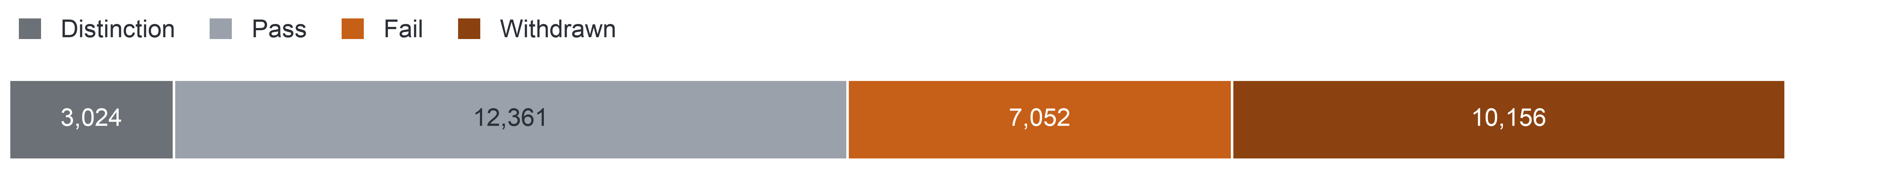
PART 2 · THE DATA (MILESTONE 2)
9
OULAD and Its Fit
OULAD dates every outcome, task and click, but lacks delivery mode, year of study, attendance and any contact record.
OULAD holds 22 runs of seven UK distance-learning modules (AAA–GGG): in 2013, 9 runs of six modules with 13,529 enrolments; in 2014, 13 runs of all seven modules with 19,064 enrolments.
Module runs are named by year and start month (B = February, J = October); days count from day 0, the run's start.
Final results of all 32,593 enrolments of 28,785 students (number of enrolments)
Key: greys = completion (Distinction, Pass); orange and brown = non-completion (Fail, Withdrawn).
Two rates: over all 32,593 enrolments, 17,208 (52.8%) did not complete; among the 28,061 still registered at day 14 (the add-drop rule, Slide 11), 45.3% did not complete.
Fit of the data with each question
AQ1: YELLOW No year of study or delivery mode.
AQ2: YELLOW No attendance record.
AQ3: YELLOW A task-only rule rarely fires early.
AQ4: RED No contact data: ranking part only.
Fit rating: GREEN = the data are enough; YELLOW = the question is narrowed; RED = a key concept, variable or intervention is missing. Nothing is imputed or simulated, and no question is dropped.
Notes:
(~48 seconds) OULAD covers twenty-two runs of seven distance-learning modules at the Open University in the UK, in 2013 and 2014. A run is one offering of a module, our counterpart of a semester. It holds thirty-two thousand five hundred ninety-three enrolments, each with a final result; completion means pass or distinction. Nine runs fall in 2013 and thirteen in 2014. In Milestone three we rated each question against these data. AQ1 to AQ3 are yellow: we narrowed them, because OULAD has no delivery mode, year of study or attendance. AQ4 is red: no contact record, so only its ranking part stays. [click]
Source: Milestone 5 report, Sections 5 and 5.1, Table 5.2.

Slide 10
PART 3 · PREPARATION (MILESTONE 3)
10
Data Quality
Of nineteen quality issues, three are serious enough to change the method.
We profiled all 10.9 million rows of the seven raw tables and recounted 13 figures independently; all 13 agree.
Issue log: 19 issues, rated High (would change a rate, the target or a feature), Medium (changes a measure by a known amount) or Low.
High issue
Change in method
18 of 24 exams have no result rows.
A task means a TMA or a CMA only (TMA: tutor-marked assignment; CMA: computer-marked assessment, a quiz).
Few tasks fall due by the cut-offs.
The early-sign rule needs an activity part.
The data are seven UK modules of 2013–2014.
The scope is stated, and students are compared within module run.
Key: the orange bar marks the issue that reshapes the early-sign rule (Slide 12).
Duplicate click rows (Medium)
Skewed activity
They are 7.39% of click rows and carry 3.19% of clicks, so each click feature has a de-duplicated twin that tests their effect.
The median is 602 clicks and 3,365 enrolments have no click, so counts enter as logarithms and no value is removed.
Notes:
(~61 seconds) [checkpoint 1: on time if this slide starts by 7:00] Next, quality: nineteen issues, and three serious enough to change the method.
[if behind by more than 30 seconds: skip to the last sentence] We profiled all ten point nine million rows, and recounted thirteen key figures with separate code; all thirteen agreed. We rated each issue by whether ignoring it would change a rate, the target or a feature. First, eighteen of twenty-four exams have no result rows, so a task means an assignment or a quiz, never the exam. Second, few tasks fall due in the first weeks; keep that one in mind for later. Third, these are seven UK modules from two years, so we compare students only within the same module. Clicks are very skewed, with a median of six hundred two, so we use logarithms and remove nothing.
Two of these facts forced changes. [click]
Source: Milestone 5 report, Sections 6 and 6.1, Table 6.2.

Slide 11
PART 3 · PREPARATION (MILESTONE 3)
11
Who Counts: the Add-drop Rule
We count only students still registered at day 14, because that is when registration closes on OULAD.
University rule: the completion rate counts students enrolled after the add-drop period.
OULAD proxy: an enrolment counts when it is still registered at day 14, because registration closes two weeks after a run starts.
Day 13 (end of week 2): week-3 list
28,069 enrolments
Day 27 (end of week 4): week-5 list
27,535 enrolments
days
Day 0
Day 7
Day 21
Day 14: the completion KPI
28,061 enrolments
Key: the orange marker is the KPI population; grey markers are the populations of the two lists.
One population rule: an enrolment counts on day d when the student registered by day d and had not unregistered by it. It removes the 58 late registrants (days 16–167) from the KPI population and gives each list the students it can name on its day.
The denominator alone can move a run's rate by up to 13.6 points (Slide 20).
Notes:
(~43 seconds) The first change is about who counts. At the university, the completion rate counts only students enrolled after the add-drop period, because those who leave during add-drop never really started. OULAD has no add-drop field, but registration closes two weeks after a run starts. So an enrolment counts if it's still registered at day fourteen. That leaves twenty-eight thousand sixty-one enrolments for the KPI. Fifty-eight enrolments registered even later, so the same rule defines the lists at day thirteen and day twenty-seven. The second change is about the early sign. [click]
Source: Milestone 5 report, Sections 1.2, 2.1, 6, 6.1 and 11.2, Tables 2.1, 6.1 and 6.2, and Appendices III and VII.

Slide 12



PART 3 · PREPARATION (MILESTONE 3)
12
The Early-sign Rule
Few tasks fall due in the first weeks, so the early-sign rule also counts a week without activity.
Early-sign rule (final): by the data cut-off, any one of three parts
Milestone 1 rule
Two or more assessed tasks missed or late by week 4.
Missed task
a TMA or CMA due by the cut-off, not submitted
No click in the last 7 days
no platform activity in the seven days before the cut-off
Late TMA
a TMA submitted late
1 of 22
runs has two or more tasks due by day 27.
Key: the orange part is the activity part added for the data. TMA: tutor-marked assignment; CMA: computer-marked quiz.
One rule serves OULAD and the pilot. AQ2 tests these three parts and two more activity signs: activity below the run median and no click before the start.
Late quizzes stay out: the meaning of a late CMA in 2013–2014 is not documented, and counting them would raise the share flagged at day 27 from 28.8% to 41.2%; they become a sensitivity run.
At day 27 the rule flags 28.8% of 27,535 enrolments.
One or more tasks fall due by day 27 in 16 of 22 runs, and by day 13 in only 1; no 2013 run has a task due by day 13.
Notes:
(~48 seconds) In Milestone one, interviews said the first sign is usually a missed quiz or assignment, so our rule was two or more tasks missed or late by week four. The data said no. Two tasks fall due by day twenty-seven in only one of twenty-two runs; even one task, in only sixteen. A task-only rule can't fire in many runs. So the final early-sign rule has three parts: a task due and not submitted, an assignment submitted late, or no platform activity in the last seven days. One rule serves OULAD and the pilot. Next, keeping the future out. [click]
Source: Milestone 5 report, Sections 2.1 and 6.1, and Appendices III and VI.

Slide 13

PART 3 · PREPARATION (MILESTONE 3)
13
Preparation and Leakage Control
Every feature uses only events dated on or before its cut-off, and every learned value comes from 2013 alone.
Leakage: using information that would not exist at the moment of prediction.
Registration
Clicks up to day 27
Tasks due by day 27
Later clicks
Withdrawal day
Final result
Day 0
Data cut-off: day 27 (the same rule holds at day 13)
Key: grey = events left of the cut-off that may feed a feature; red cross = events right of it that never enter.
Governing decisions
Leakage blocked by
Result: one versioned prepared dataset
Nothing recorded is deleted or imputed.
Every feature uses only events up to its cut-off.
Every learned parameter comes from the training runs.
The timing rule, learning on 2013 only and the split by year.
1,586 test enrolments at day 27 of students already seen in 2013 are marked as repeat students.
19 usable predictors, 23 parameters once module and start month are coded.
All 22 validation checks pass; 32,593 enrolments and their outcome mix are unchanged.
Six features recomputed from raw by separate code differ in none of 55,604 feature rows; 88 variables are documented, and one command rebuilds it.
Notes:
(~58 seconds) Preparation guards against leakage: using information that wouldn't exist when the list is made.
[if behind by more than 30 seconds: skip to the last sentence] So every feature uses only what was recorded by its cut-off. Two more rules govern the pipeline: nothing recorded is deleted or imputed, and every learned value comes from the 2013 runs alone, so the 2014 runs stay unseen. On the timeline, everything right of the line is crossed out: later clicks, the withdrawal day, the final result. We also split by year, and flag one thousand five hundred eighty-six test enrolments of students already seen in 2013. All twenty-two validation checks pass, and features rebuilt from raw by separate code match in all fifty-five thousand six hundred four rows.
Now, which method for which question? [click]
Source: Milestone 5 report, Sections 7, 7.1 and 7.2.

Slide 14
PART 4 · METHOD (MILESTONE 4)
14
Methods by Question
Each question gets the simplest method that fits its level, judged against a baseline it must beat.
Question | Method | Baseline it must beat
AQ1 – Descriptive | Grouped rates with Wilson intervals (the 95% interval of a share), on two denominators: registered at day 14, and all enrolments. | Pooled rate: the rate over all enrolments.
AQ2 – Diagnostic | Logistic regression with run fixed effects (a term per module run, so students are compared only within their module run) and sign × module terms; effects as average risk differences (the difference in later non-completion, in percentage points, with and without a sign). | Unadjusted rate difference.
AQ3 – Predictive | Penalised logistic regression on the 19 predictors (background, clicks before and after day 0, activity against the run median, recent inactivity, missed and late tasks); challenger: gradient-boosted trees. | The early-sign rule ranked by its number of signs; a background-only model (module, start month, previous attempts, credits, education, registration lead; no activity); a random list.
AQ4 – Prescriptive | Top-k list per run (the k highest-ranked students) from the AQ3 scores, with the signs behind each name. | A random list; a rule-ranked list.
Key: the orange column is the baseline each method must beat. Eight course criteria guide each choice; ties go to the simpler, more interpretable method.
Notes:
(~48 seconds) In Milestone four we chose a method for each question without training any model. The rule: the simplest method that fits, and always a baseline to beat. AQ1 needs no model, only rates with Wilson intervals. AQ2 uses a logistic regression with a term for each run, so students are compared only within their own run, and it reports risk differences in percentage points. AQ3 proposes a penalised logistic regression, because staff need a reason beside each name, and it must beat the early-sign rule. AQ4 cuts those scores into a short list per run. How do we judge it? [click]
Source: Milestone 5 report, Sections 7.1, 8 and 8.1, Table 8.1, and Appendix VIII.

Slide 15


PART 4 · METHOD (MILESTONE 4)
15
Judging a Contact List
A list is judged by how many later non-completers it reaches against the most a list of its length could reach.
Worked example: 20 students, a list of 5
Capacity k: 3 or 5 contacts per 20 students, that is 15% or 25% of a run; the main operating point is 5 per 20 at day 27.
Recall at capacity: the share of a run's non-completers who are on its list.
Normalised recall: recall divided by the most a list of length k can reach. A list of k can hold at most k non-completers; in the training runs that ceiling is 46% to 100% of a run's non-completers.
Lift: the share of non-completers on the list divided by the run's base rate (the share of the run who do not complete); 1 = chance.
Why rank: the rule names 28.8% at day 27, more than a list of 15% or 25% can hold.
Why not "precision of at least 50%" (Milestone 1): with non-completion near 45%, a random list already reaches about 45% precision.
Recall = 4 of 9 non-completers.
Normalised recall = 4 of 5, the most a list of 5 can reach.
Lift = (4 of 5) ÷ (9 of 20) = 1.8.
Key: orange figure = later non-completer; navy box = on the list. Illustration, not data.
Notes:
(~49 seconds) Capacity fixes the list length: three or five per twenty. A toy example: twenty students, nine won't complete, a list of five. If four of our five are right, recall is four of nine. But five is the most a list of five can reach, so normalised recall is four of five, because that ceiling ranges from forty-six to one hundred percent between runs. Lift compares the list with the run's base rate; one means chance. And we must rank: the rule names twenty-eight point eight percent at day twenty-seven, more than any list holds. So when is a model good enough? [click]
Source: Milestone 5 report, Sections 8 and 9, and Appendix III, Table A.8.

Slide 16

PART 4 · METHOD (MILESTONE 4)
16
Validation and Gate S1
The model is built on 2013 and scored once on all 13 runs of 2014, under a protocol frozen in advance.
2013: build and choose
2014: score once
Leave-one-run-out folds on the 9 runs of 2013: each run is held out in turn.
A challenger replaces the primary model only with a gain of at least 0.03 in pooled normalised recall, and in 7 of 9 folds.
The frozen model is scored once on the 13 runs of 2014.
Paired runs: the 9 test runs whose module and start month also ran in 2013; the other 4 are unpaired. Both groups are also reported apart.
Key: lock = protocol frozen before any 2014 outcome is used. Frozen protocol: evaluation choices fixed in advance, so the test runs are scored once.
Gate S1: the success test the model must pass to replace the rule
Calibration
AQ2 criterion
Probabilities are shown only if predicted risks match observed rates: intercept between −0.2 and 0.2, slope between 0.8 and 1.2.
A risk difference of at least 5 points, an interval excluding 0, and the same direction in at least two-thirds of modules; p-values take no part.
Recall: its pooled normalised recall must exceed the early-sign rule list's.
Paired bootstrap interval: model and rule compared on the same runs, resampled; it must lie above 0.
Sign-flip test: how often per-run gains this favourable would appear by chance; p must be below 0.05.
Notes:
(~63 seconds) The key word is "once". Under gate S1, the model's list must clearly beat the rule's list on the 2014 runs, or the simple rule stays.
[if behind by more than 30 seconds: skip to the last sentence] Clearly means an interval above zero and a test below zero point zero five, scored once on all thirteen runs. Every choice before that is made on the nine runs of 2013, holding out one run at a time. A more complex challenger replaces the primary model only with a gain of at least zero point zero three in normalised recall, in at least seven of nine folds. The test year even includes a module, CCC, that the model has never seen. And probabilities are shown only if calibration holds, that is, if predicted risks match observed rates.
A good list also has to be fair. [click]
Source: Milestone 5 report, Sections 9 and 9.1, Table 9.1, and Appendix IX.

Slide 17
PART 4 · METHOD (MILESTONE 4)
17
Fairness and Interpretability
The list is audited for equal recall across groups, and every name carries the reasons of the ranking that listed it.
Group attributes stay out of the predictors and are kept only for the audit, because bias cannot be audited without group membership.
Criterion: equal recall at capacity.
Rule FR1 (fairness review rule): flag a group for human review when its recall is more than 10 points below the other students' and the Holm-adjusted (corrected for several tests) one-sided interval of the gap lies below 0.
No flag means no evidence of a gap at that precision, not proof that the list is fair.
Reasons come from what ranks the student: the rule's signs today, the model only if it passes gate S1; no coefficient is read as a cause.
Confirmatory groups in the 2014 test at day 27 (enrolments)
1,488
1,486
610
declared disability
most deprived band (0–10%)
missing deprivation band
Confirmatory groups: fixed in advance for the audit, each with at least 400 test enrolments. Deprivation band: band of the Index of Multiple Deprivation of the student's home area.
FR1 threshold
10 points
0
10
20
30
Key: the bar is the largest recall gap, in percentage points, allowed before human review. No recall values exist yet.
Notes:
(~48 seconds) A list could still miss a whole group. Group attributes stay out of the predictors, but we keep them for the audit, because bias can't be audited without knowing group membership. Rule FR1 flags a group for human review when its recall is more than ten points below the other students', and the interval of that gap, corrected for several tests, lies below zero. We check three groups in the test year. No flag means no evidence of a gap, not proof of fairness. And each name's reasons come from the model that ranked it. So what have we run? [click]
Source: Milestone 5 report, Sections 6.2 and 9.2, and Appendices VI and IX.

Slide 18
PART 5 · EVIDENCE (MILESTONE 5)
18
What We Ran
We answered AQ1 and AQ2 on both years; AQ3 and AQ4 remain complete designs with no model trained.
AQ1
AQ2
AQ3
AQ4
Answered
Answered
Deferred
Deferred
Key: filled orange = Answered, the results answer all of the question; grey outline = Deferred, the design is complete and no result exists yet. No question is dropped.
Why AQ3 and AQ4 are deferred: Level 1, the compulsory level of the course brief (method and evaluation design), is complete. Level 2, the optional experiment, was not run, because the 2014 runs are the only independent test and are kept for one complete run of the frozen protocol.
AQ1 and AQ2
AQ3 and AQ4
Run as fixed in Milestone 4, on the 9 runs of 2013 and again on the 13 runs of 2014. No predictive model is trained, and nothing in the AQ3 design changed.
Designed in full. No model is trained, so no model metric exists; the 13 runs of 2014 are kept as the one independent test.
Notes:
(~48 seconds) [checkpoint 2: on time if this slide starts by 14:00] A word on status. Level one, the compulsory level, is complete: the modeling strategy and the evaluation design. AQ1 and AQ2 need no predictive model, so we ran them as Milestone four fixed them, on the nine runs of 2013 and again on the thirteen runs of 2014. AQ3 and AQ4 are designed in full, but no model has been trained, so there's no model metric in this talk. That's our choice of scope: the 2014 runs are our only independent test, and we keep them for one complete run of the frozen protocol. First, the size of the problem. [click]
Source: Milestone 5 report, Sections 3, 10 and 11, Table 3.1.

Slide 19
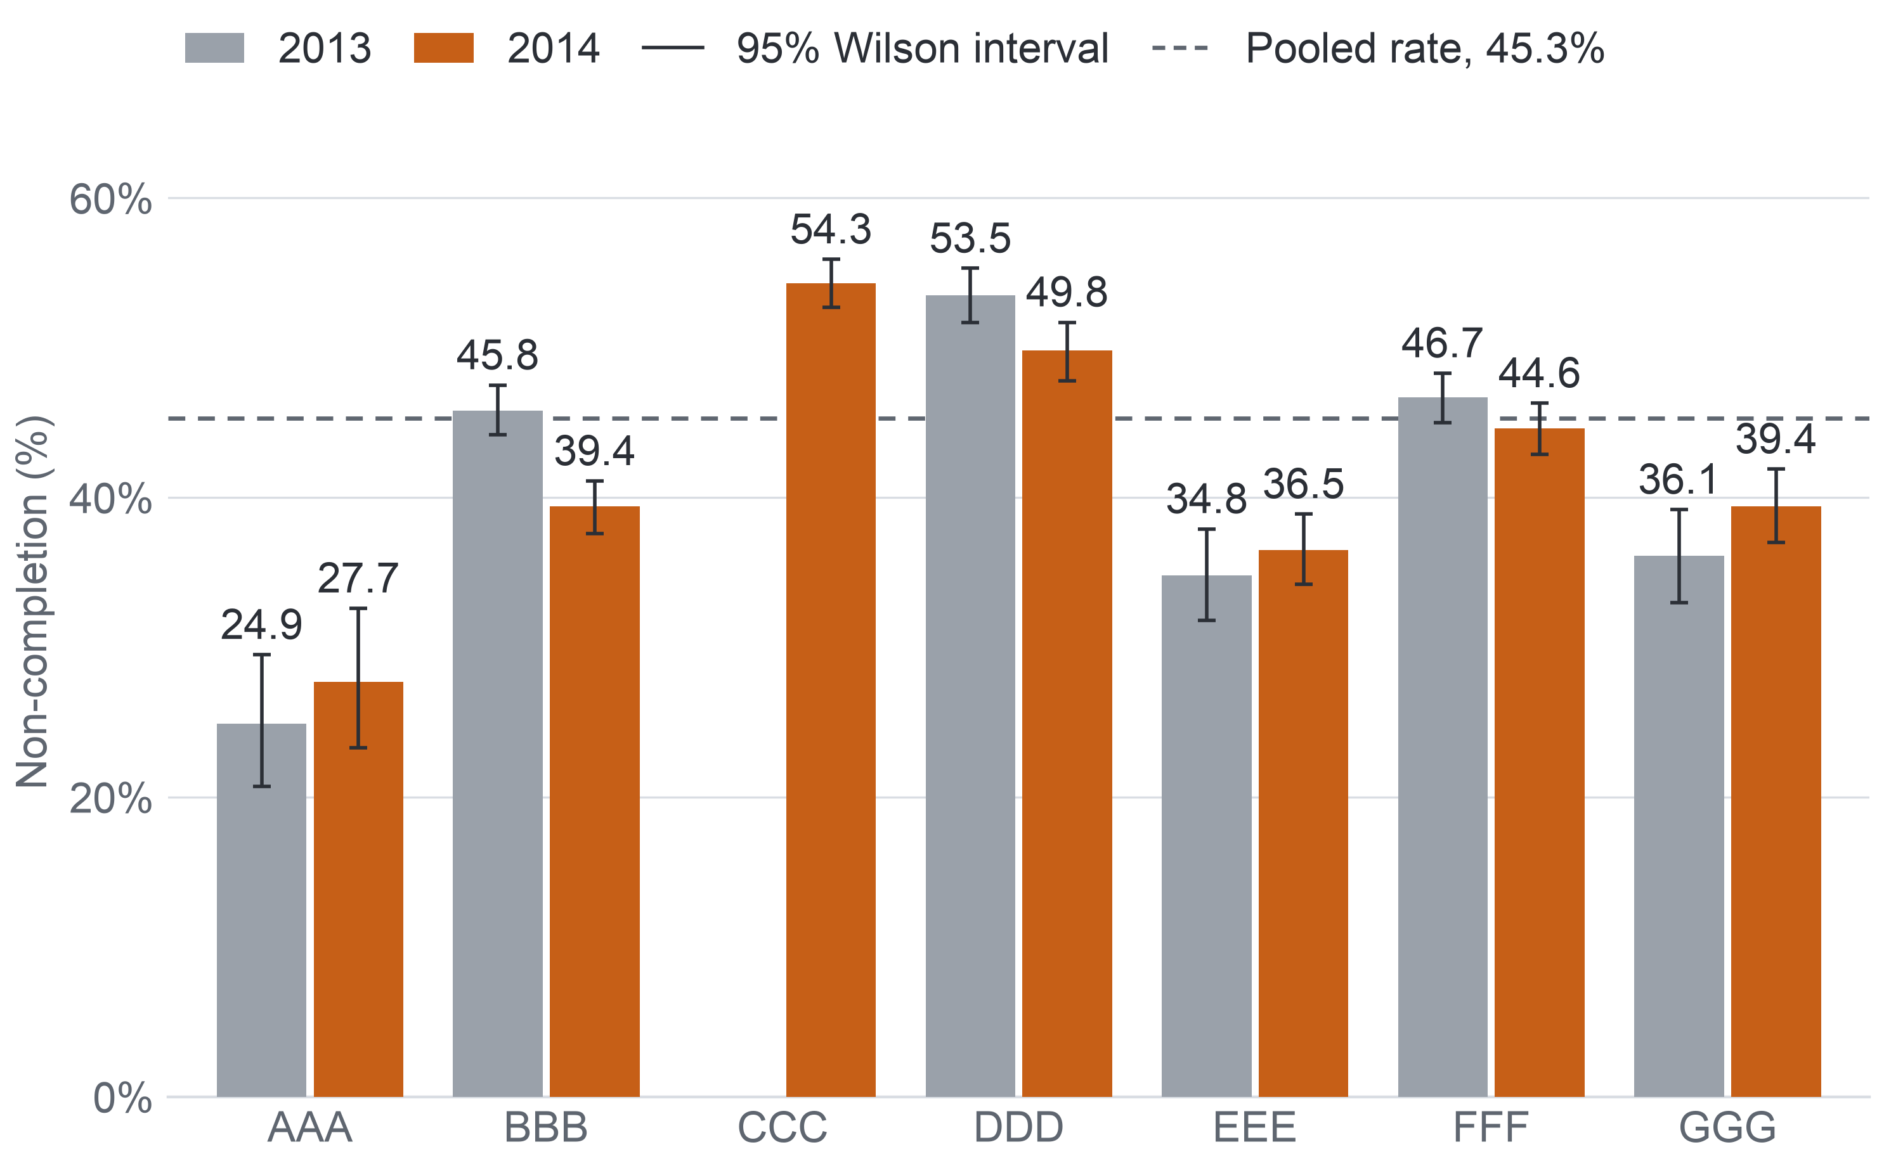
PART 5 · EVIDENCE (MILESTONE 5)
19
AQ1: How Many Do Not Complete
Close to half of the students still registered at day 14 do not complete, and the two years agree.
Non-completion per module, students registered at day 14
45.3%
(44.7–45.8) of 28,061 enrolments did not complete: 12,700.
2013: 45.7% (44.8–46.6) of 12,076.
2014: 44.9% (44.2–45.7) of 15,985.
About a quarter failed and a fifth withdrew.
Modules, both years pooled: 26.3% (AAA) to 54.3% (CCC, 2014 only).
February above October: 51.6% against 42.4% in 2013, 49.6% against 41.6% in 2014.
Check: prepared views and raw tables agree in all 176 outcome cells.
CCC ran only in 2014. Bar = rate in %; whisker = 95% Wilson interval (the 95% interval of a rate).
Notes:
(~47 seconds) Of the twenty-eight thousand sixty-one enrolments still registered at day fourteen, forty-five point three percent did not complete, with a narrow interval, forty-four point seven to forty-five point eight. The two years agree: forty-five point seven in 2013, forty-four point nine in 2014. Roughly a quarter failed and a fifth withdrew. Bars are modules by year; the dashed line is the pooled rate. Modules range from twenty-six point three percent in AAA to fifty-four point three in CCC. Two independent computations agree in all one hundred seventy-six outcome cells. But one choice moves these rates a lot. [click]
Source: Milestone 5 report, Section 11.2, Figure 11.1 and Appendix XII, Tables A.30 and A.32.

Slide 20
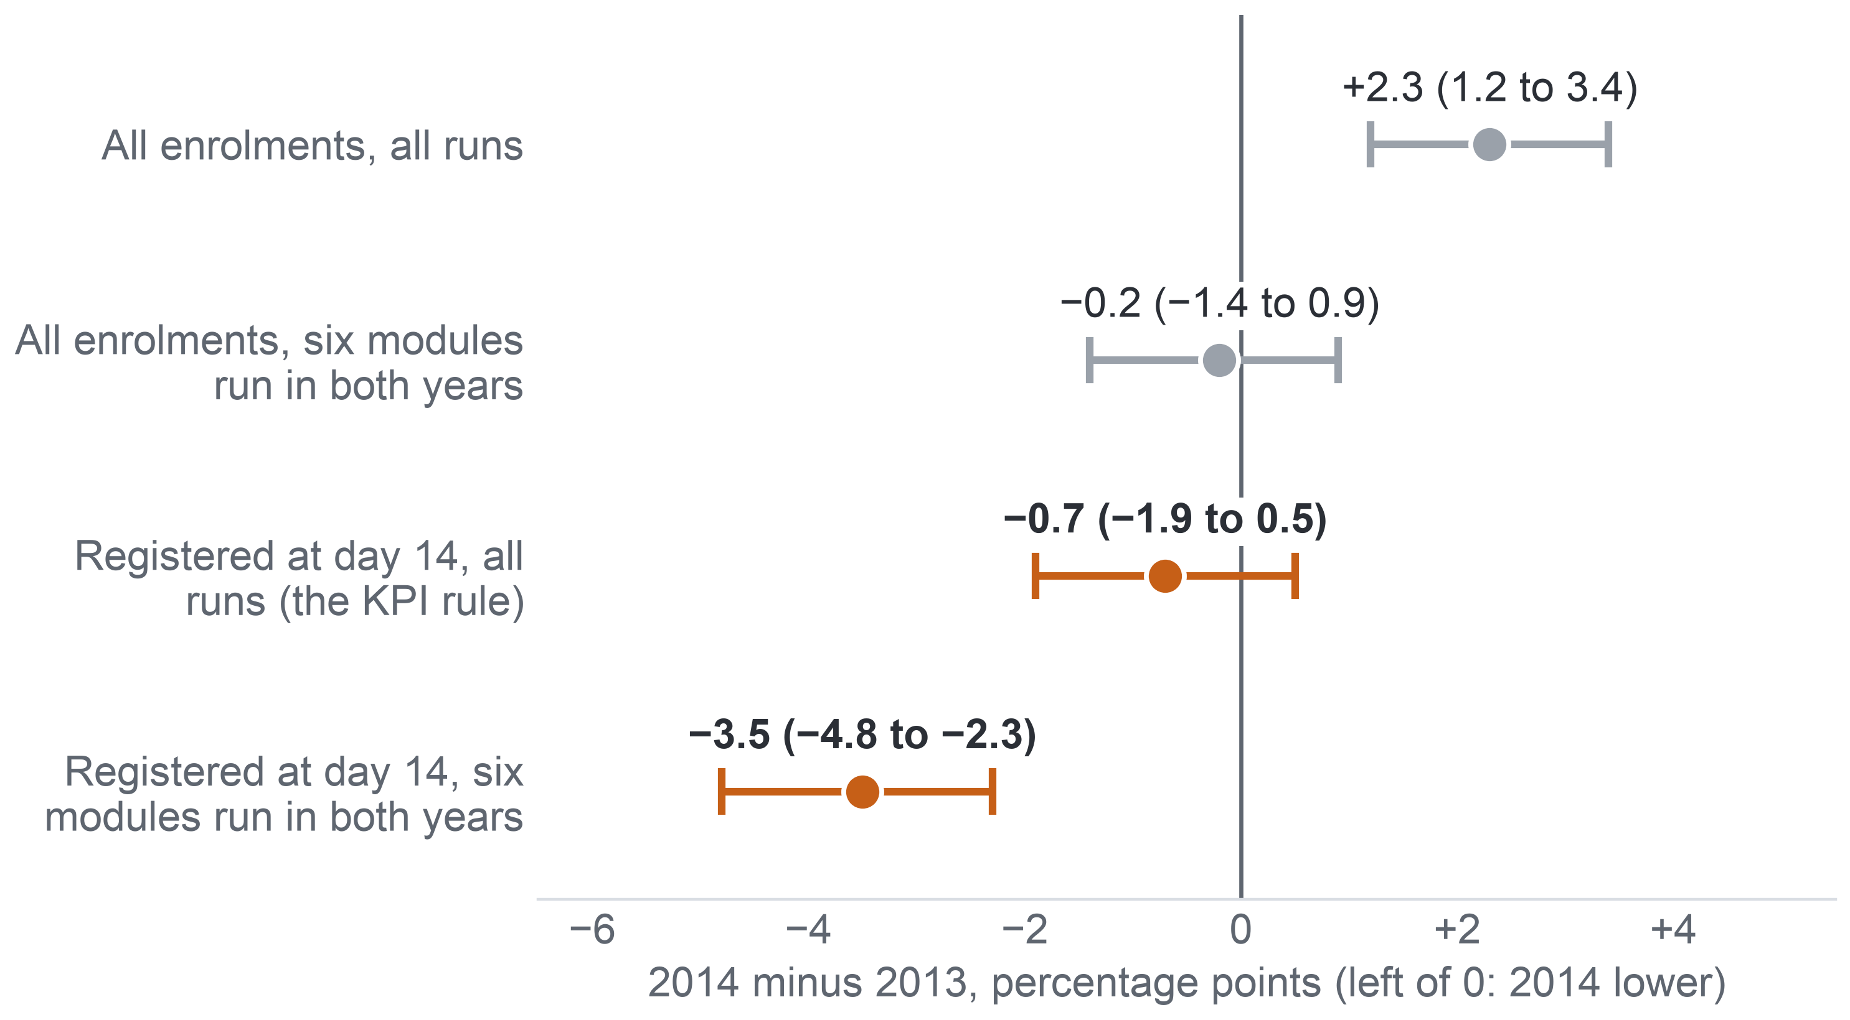
PART 5 · EVIDENCE (MILESTONE 5)
20
AQ1: The Denominator Matters
Who counts as enrolled can move a run's rate by 13.6 points and reverse the year comparison, so the KPI must fix the add-drop rule.
Change in non-completion from 2013 to 2014
Runs differ
Run rates span 24.9% (AAA 2013J) to 58.3% (CCC 2014B).
The denominator moves rates
BBB 2014J: 49.7% over all enrolments, 36.2% among those registered at day 14.
Why the years flip
16.2% of 2014 enrolments against 10.7% of 2013 were not registered at day 14.
Key: dot = 2014 minus 2013 in points; whisker = 95% interval, and one that crosses 0 shows no clear difference. Grey = over all enrolments; orange = registered at day 14 (the KPI rule). Each is shown for all runs and for the six modules run in both years.
Notes:
(~48 seconds) Runs differ, from twenty-four point nine percent in AAA 2013J to fifty-eight point three in CCC 2014B, and the denominator alone moves one run's rate by up to thirteen point six points. Now the years. Count every enrolment, and 2014 looks worse by two point three points. Count only those registered at day fourteen, and 2014 is slightly better, with an interval including zero. In the six modules run in both years, it's three point five points better. Same data, opposite stories, because more 2014 enrolments left before day fourteen: sixteen point two percent against ten point seven. Now, timing. [click]
Source: Milestone 5 report, Section 11.2 and Appendix XII, Table A.32.

Slide 21
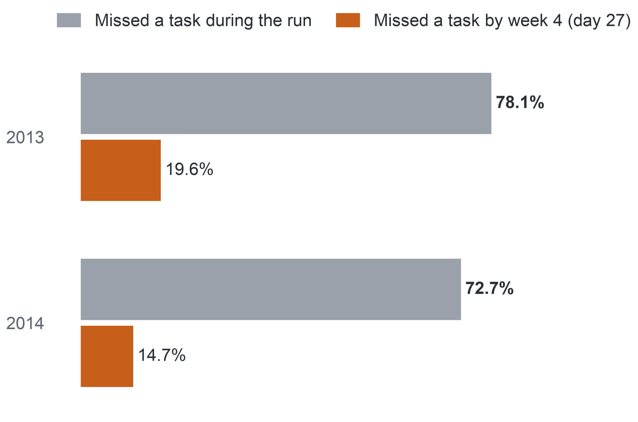
PART 5 · EVIDENCE (MILESTONE 5)
21
AQ1: When Non-completers First Miss a Task
Most non-completers miss a task at some point, but under one in five has missed one by week 4.
Share of non-completers who missed a task (TMA or CMA), %
What staff expected
The first sign is usually a missed quiz or assignment (simulated interviews).
So
A rule on tasks alone comes too late for most non-completers, which is why the early-sign rule counts inactivity.
Confidence
High for OULAD 2013–2014: the first missed week agrees for all 32,593 enrolments in two independent computations. Validity for the university's courses remains open.
Population: non-completers registered at day 14, 5,515 in 2013 and 7,185 in 2014. Bar length = share of them, on a scale from 0 to 100%. Completers: about one in five missed a task during the run.
Notes:
(~61 seconds) [pause] Now the moment this talk was built around. Staff told us the first sign is usually a missed quiz or assignment. And missing a task does separate the groups: seventy-eight point one percent of non-completers in 2013, and seventy-two point seven in 2014, missed a task at some point, against about one in five completers. [point at the accent bars] Now look at the short bars. By the end of week four, when the week-five list is made, only nineteen point six percent of non-completers in 2013, and fourteen point seven in 2014, had missed one. A list built on missed tasks alone arrives too late for most of the students it should reach. That's why our rule also counts a silent week. So, does silence matter? [click]
Source: Milestone 5 report, Section 11.2, Appendix I and Appendix XII, Table A.31.

Slide 22
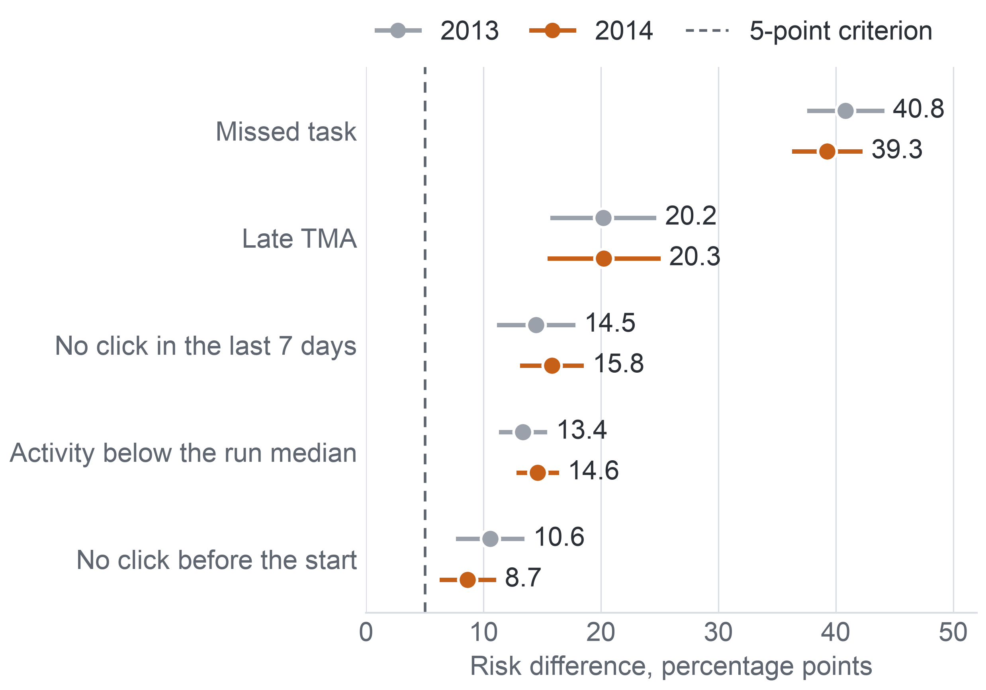
PART 5 · EVIDENCE (MILESTONE 5)
22
AQ2: Five Early Signs
All five early signs, inactivity included, go with later non-completion within module run, by similar amounts in 2013 and 2014.
Extra later non-completion with each sign at day 27
The five signs: the rule's three parts (Missed task, Late TMA, No click in the last 7 days, that is days 21–27) and two activity signs tested only here: Activity below the run median (clicks on days 0–27) and No click before the start (day 0).
Risk difference: the extra percentage points of later non-completion among enrolments with the sign against those without, within module run, adjusted for the other signs.
Population: registered at day 27; 11,811 enrolments in 2013 (44.4% non-completion) and 15,724 in 2014 (44.0%); task signs on 9,960 and 12,585.
Criterion: at least 5 points, an interval excluding 0, and the same direction in two-thirds of modules.
These are associations, not causes.
Key: dot = risk difference; whisker = 95% interval; dashed line = the 5-point criterion. Task signs on runs with a task due by day 27; click signs on all runs.
Notes:
(~49 seconds) AQ2 answers that. Each dot is a risk difference: how many more percentage points of non-completion among students with the sign than without it, within the same run. A missed task: forty point eight in 2013, thirty-nine point three in 2014. A late assignment: twenty point two and twenty point three. No click in the last seven days: fourteen point five and fifteen point eight. Activity below the run median: thirteen point four and fourteen point six. No click before the start: ten point six and eight point seven. All five clear the five-point line in both years. How firm is this? [click]
Source: Milestone 5 report, Sections 9 and 11.3, Table 9.1, Figure 11.2 and Appendices VIII and XIII, Table A.33.

Slide 23


PART 5 · EVIDENCE (MILESTONE 5)
23
AQ2: How Far the Signs Hold
The signs keep their direction across modules and checks, but the click signs are coarse, and every result is an association, not a cause.
Years agree: no sign moves by more than two points between the years.
13.4 → 5.8
points for Activity below the run median (2013) once clicks enter as a continuous adjustment, the check that shrinks the click signs.
Sensitivity runs agree: each sign keeps its direction under six sensitivity runs (repeats of an estimate under a changed choice), in both years.
Modules agree, with one exception: each sign keeps its direction in every module except a late TMA in AAA 2014 (−1.2 points on 348 enrolments, interval −14.4 to 12.1, which includes 0); no CCC student had a late TMA by day 27.
2014: 14.6 → 5.9 points under the same check; the sign then keeps its direction in only 4 of 7 modules and no longer meets the criterion. The other four signs still meet it.
Key: tick = check passed; amber mark = passed with one exception.
Confidence: moderate. Two years agree, but the yes-or-no click signs miss part of a graded activity gradient (a known misfit), and unrecorded reasons could explain the associations.
Notes:
(~49 seconds) We tried to break this result. Between the years, no sign moves by more than two points, and each keeps its direction in every module and under six sensitivity runs. One small exception: a late assignment in AAA in 2014, on three hundred forty-eight students, with an interval including zero. One real weakness: our click signs are yes or no. With clicks added as a continuous measure, below-median activity shrinks to five point eight points in 2013, and in 2014 it no longer meets our criterion. The other four signs still do. So confidence is moderate, and these are associations, not causes. [click]
Source: Milestone 5 report, Sections 9 and 11.3, Table 9.1, and Appendix XIII, Tables A.34 to A.36.

Slide 24
PART 6 · INTEGRATION AND USE (MILESTONE 5)
24
Traceability Matrix
For AQ1 and AQ2 every link from goal to decision holds evidence; for AQ3 and AQ4 the chain stops at the evaluation design.
Question | Goal and KPI | Data | Preparation | Method | Evaluation | Decision | Status
AQ1 | Primary KPI | 22 runs; day 14: 28,061 | Day-14 rule | Grouped rates | Two computations agree; 45.3% | D2, D3 | Answered
AQ2 | Primary KPI; KPI 1 (sign part) | Day 27: 11,811 and 15,724 | Dated by day 27 | Logistic, run effects | 5 of 5 signs, both years | D2, D1 | Answered
AQ3 | Early-sign rule (the baseline) | 19 predictors; 2014 test | Refit per fold | Penalised logistic | S1 planned; N.A. | D1 | Deferred
AQ4 | KPIs 1–2, contact parts: GAP | Contacts: GAP | 3 or 5 per 20 | Top-k with signs | S1, FR1; N.A. | D1 | Deferred
Key: grey = the link holds evidence (data, rule or result); blue = designed, not run; red on white = GAP (a link without evidence) or N.A. (no result exists); orange column = status.
GAP marks only what OULAD lacks: delivery mode, year of study, attendance and contacts. KPI 1's sign part (the rule's flags) is computed on OULAD; its contact part needs the pilot. Decisions: D1 whom to contact, D2 where to place support time, D3 whether to extend. S1: the gate a model must pass to replace the rule; FR1: the fairness review rule.
Notes:
(~43 seconds) The Traceability Matrix puts all four side by side. Each row follows one question from goal to decision. In the first two rows every link holds evidence. AQ1 rests on twenty-eight thousand sixty-one enrolments and feeds D2 and D3. AQ2 rests on both years and five of five signs, and feeds D2 and the reasons for D1. GAP marks only what OULAD lacks: delivery mode, year of study, attendance, contacts. The last two rows stop at the evaluation design, marked N.A. So what would AQ3 and AQ4 give? [click]
Source: Milestone 5 report, Sections 2.1 and 11.1, Tables 2.1, 11.1 and 11.2.

Slide 25
PART 6 · INTEGRATION AND USE (MILESTONE 5)
25
AQ3 and AQ4: Expected Outputs
AQ3 and AQ4 would give a ranked, capacity-limited list with reasons, and the simple rule stays if the model does not beat it.
AQ3 would give: a risk rank per enrolment at days 13 and 27, and a probability only if calibration holds; gate S1 answers it on the 13 runs of 2014.
If the model does not beat the rule: the rule's order stays, and its list is measured as a baseline.
AQ4 would give: a list of 3 or 5 per 20 students per run, with the signs behind each name. It is answered when it meets S1 (the gate to replace the rule), rule FR1 (the fairness review) passes or its flags are reviewed, and the assumption that the order of risk matches the order of need is stated as untested.
Neither says who should make contact or whether contact helps.
Status: Deferred; expected outputs, no model metric.
Expected output – not a result
Missed task
No click in the last 7 days
Late TMA
Missed task
Missed task
Late TMA
No click in the last 7 days
Key: tag = the sign behind the name. The card shows the form of the output only: no names and no numbers.
Notes:
(~48 seconds) For AQ3 and AQ4 we can show only the shape of the answer; this card is a mock-up with no data. AQ3 would give each enrolment a risk rank, with a probability only if calibration holds. Gate S1 decides it once, on the 2014 runs. If the model doesn't beat the rule, the rule's order stays. AQ4 would cut the ranking to three or five names per twenty students, each with its signs, and must also pass the fairness rule or have its flags reviewed. Neither says who should call, or whether calling helps. So what can decisions use today? [click]
Source: Milestone 5 report, Sections 11.1 and 11.4, and Appendix XIV.

Slide 26
PART 6 · INTEGRATION AND USE (MILESTONE 5)
26
Decision Support
The early-sign rule is the candidate list for whom to contact; the patterns are a hypothesis for where support goes; the design is a method for whether to extend.
D1 – Whom to contact (reversible)
D2 – Where support time goes
D3 – Whether to extend (close to irreversible)
What it gets
A hypothesis: support time first where non-completion and early signs are highest.
What it still needs
A check on the university's records.
What it gets
The early-sign rule as the candidate list: interpretable, computable from records the university already holds, and each part goes with later non-completion in 2013 and in 2014. A member of staff checks every name.
What it still needs
Ranking within capacity, because the rule names 28.8% at day 27.
What it gets
A measurement method, a gate and a fairness audit.
What it still needs
A pilot result: extension waits for it.
Key: orange = usable now (D1); grey = not usable yet: D2 waits for a check on the university's records, D3 for a pilot result.
Decision option: a statement from observational data offered as a hypothesis for the pilot, not a proven remedy.
Notes:
(~48 seconds) D1, whom to contact, is reversible, so it can start with the early-sign rule: computable from records the university already holds, and each part went with later non-completion in both years. A staff member checks every name; nothing is automated. Since the rule names more students than staff can reach, ranking within capacity is the next test. D2 gets a hypothesis: put early support time first where non-completion and early signs are highest, to check on the university's records. D3 gets a measurement method, a gate and a fairness audit, and waits for a pilot. How did AI help? [click]
Source: Milestone 5 report, Sections 2.1, 8, 11.4 and 11.5, Table 11.3.

Slide 27
PART 6 · INTEGRATION AND USE (MILESTONE 5)
27
Generative AI Use
AI proposed and challenged, and we verified; it was never a source of data, statistics or results.
AI proposed
We verified with
One rule
Simulated stakeholder
Quotes against transcripts
AI is never a source of data, statistics, licence information or results; every fact it offered was checked against a saved source, the data files or code we ran.
No AI produced a metric value, threshold or result.
Research and code assistant
Literature against saved copies
Critic
Code against fixtures (small inputs with known answers) and independent recounts
Writing partner
Critics confined to the brief and the data
Where it helped most
Decisions that stayed ours
A critic found tasks due before registration counted as missed, and a leakage check that could not fail, that is, one that would pass even with leakage.
Keep 2014 out of every AQ3 choice; one early-sign rule; AQ3 and AQ4 as designs; every association stated as an association.
Notes:
(~46 seconds) We used generative AI in four roles: simulated stakeholder, research and code assistant, critic, and writing partner. One rule held in all four: AI was never a source of data, statistics or results. Everything it offered, we checked against a saved source, the data, or code we ran. It helped most as a critic: in Milestone three it caught tasks due before a student registered being counted as missed, and a leakage check that could never fail. The key decisions stayed ours, such as keeping 2014 out of every AQ3 choice. So, what can we conclude? [click]
Source: Milestone 5 report, Sections 13, 13.1 and 13.2.

Slide 28
CONCLUSIONS
28
Conclusions
On OULAD, an early list cannot rest on missed tasks alone, and the early signs can serve as reasons that staff check beside each name.
1. High confidence, OULAD 2013–2014
45.3% of the enrolments registered at day 14 did not complete; runs varied from 24.9% to 58.3%; the year comparison depends on the add-drop rule; most non-completers first missed a task after week 4.
2. Moderate confidence
All five early signs go with later non-completion in both years, a missed task by 40.8 and 39.3 points, in the same direction across modules, with one wide exception. These are associations.
3. Design only
A penalised logistic model judged once against the rule, and a capacity-limited list audited for fairness; outputs are expected, not measured.
Not concluded: that the signs cause non-completion, that a model ranks better than the rule, or that contact raises completion.
Key: tiers run from the firmest finding at the top; the label of each tier is its confidence level or status.
Notes:
(~59 seconds) [checkpoint 3: the last two slides must start by 22:00] Let's bring it together, firmest first. [pause] One, with high confidence for OULAD: forty-five point three percent of students still registered at day fourteen did not complete, in both years. Runs varied from twenty-four point nine to fifty-eight point three percent, the year comparison depends on the add-drop rule, and most non-completers first missed a task after week four. Two, with moderate confidence: all five early signs, silence included, go with later non-completion in both years, a missed task by forty point eight and thirty-nine point three points. That's an association. Three, for AQ3 and AQ4 we have the right design, not a result. What we can't conclude: that the signs cause non-completion, that a model beats the rule, or that a call helps. [click]
Source: Milestone 5 report, Sections 11.2, 11.3, 11.4 and 14.

Slide 29
CONCLUSIONS
29
Limitations, Open Problems and Take-home
We keep apart what showed no evidence, what has no data to test and what is not yet tested, and each open problem has the step that answers it.
Kind | Limitation | Response
No evidence found | Year difference over all enrolments in the six shared modules: −0.2 points (−1.4 to 0.9); click signs in small modules: intervals include 0. | No claim; uncertain.
No data to test | Contact and its outcome; delivery mode, year of study, attendance; capacity. | Randomised pilot.
Not yet tested | AQ3 and AQ4 results. | Single AQ3 test, design unchanged.
Measurement | Yes-or-no click signs; the KPI proxy and its denominator. | Continuous measures; one add-drop rule.
Scope and causal | UK distance learning of 2013–2014; an observational design. | University recount; options as hypotheses.
A flag must not become a label, because predictive analysis can carry bias and stereotyping.
Next step 1: on OULAD
The single AQ3 test under the frozen protocol, then the AQ4 list and its fairness audit.
Next step 2: at the university
Recount the baseline under the add-drop rule, replace assumed values, and do the risk classification the law requires.
Next step 3: randomised pilot
Among flagged students, contacts logged with their outcomes before any model is retrained.
Take-home: a missed task comes too late; count silence too, and test contact before trusting it.
Notes:
(~61 seconds) Three kinds of limits stay apart. "No evidence found": we compared and saw no clear difference, like the year difference in shared modules. "No data to test": no screened dataset holds it, like any record of contact. "Not yet tested": AQ3 and AQ4. And our results describe UK distance learning in 2013 and 2014. Three next steps. First, the single AQ3 test, then the AQ4 list and its fairness audit. Second, a recount on the university's own records, and the risk classification the law requires. Third, a randomised pilot, because only random assignment separates the effect of a call from the reasons a student was flagged. [pause] If you remember one thing: a missed task comes too late; count silence too, and test contact before you trust it. [click]
Source: Milestone 5 report, Sections 12, 12.1 and 14, Table 12.1, and Appendix XII, Table A.32.

Slide 30
Thank you. Questions?
Early Identification of Disengaging Students in Online Courses – team N04
Take-home: a missed task comes too late; count silence too, and test contact before trusting it.
Data: Open University Learning Analytics Dataset (Kuzilek, Hlosta and Zdrahal), CC BY 4.0.
Notes:
(~31 seconds) We began with students noticed too late, and staff who asked for a short list with a reason beside each name. Records dated by week four can give those reasons now, as long as silence counts beside missed tasks. Whether a model ranks better, and whether a call helps, are the next test and the pilot. Thank you. We're happy to take your questions.

