Slide 1

Early Identification of Disengaging Students in Online Courses
Final project report: from the problem to the integrated answer
A final report on finding students who drift away from online courses early enough to help them.
Lecturers:
Dr. Nguyễn Trần Minh Thư
MSc. Phạm Minh Tú
Team N04:
25C12002 – Lê Ngọc Trúc Huỳnh
25C12003 – Phan Trần Khanh
25C12031 – Dương Tấn Huỳnh Phong
MTH045 – The Science of Data Analytics
University of Science · November 2026
Notes:
(~63 seconds) Good morning, teachers and friends. We are team N04, and this is our final presentation: Early Identification of Disengaging Students in Online Courses. Picture a student in week five of an online course. She has not failed anything and she has not withdrawn, so on paper she is fine. But she has stopped opening the course, and by the time her name reaches anyone, the weeks in which help still works are gone. Our project is about that student. Over five milestones we followed one chain, from the people who need to act, to the data, their preparation, the method, the evidence, and the decisions it can support. We will be clear about what we answered and what is still a design. We start with the number that surprised us most.
Source: Milestone 5 report, title page.

Slide 2
INTRODUCTION
2
The Surprising Number
Nearly half of the enrolments still registered after the add-drop period did not complete, yet fewer than one in five of these non-completers had missed a task by week 4.
How many do not complete
How many show it by week 4
45.3%
19.6% and 14.7%
of the 28,061 enrolments still registered at day 14 did not complete (95% interval 44.7–45.8%), over all 22 module runs.
of the non-completers of 2013 (5,515) and of 2014 (7,185) had missed a task by the end of week 4.
So a list built on missed tasks alone comes too late for most of them.
Share of the non-completers who had missed a task (%), day-14 population
Key: data = OULAD (Open University Learning Analytics Dataset), our open stand-in: 22 module runs (one offering of a module) of seven UK distance-learning modules, 2013–2014. Day 14 = end of the add-drop period. Non-completion = a fail or a withdrawal. Task = an assessed assignment or quiz, never the exam.
Notes:
(~66 seconds) Here it is. Of the 28,061 enrolments still registered at day 14, the end of the add-drop period, 45.3 percent did not complete: they failed or withdrew. That is nearly one in two, over all 22 module runs of our data. Now the surprise. The obvious early warning is a missed assignment, and non-completers do miss tasks: 78.1 percent in 2013 and 72.7 percent in 2014 missed one at some point, the grey bars. But look at the orange bars. By the end of week 4, only 19.6 percent of the non-completers of 2013, and 14.7 percent of those of 2014, had missed one. If staff wait for missed work, most of the students who will not finish are still invisible. That gap runs through this whole talk, and it begins with how late students are noticed today.
Source: Milestone 5 report, Abstract, Section 11.2 and Appendix XII, Tables A.29 and A.31.

Slide 3
INTRODUCTION
3
Noticed Too Late
Staff notice a student who has stopped taking part only after the early weeks, when help is easiest.
Early weeks, when help is easiest
Program manager sees counts
after the semester
Lecturers become sure
around week 5 or 6
Support office meets the student
on the academic warning list
Week 1
Week 2
Week 3
Week 4
Week 5
Week 6
Week 7
Week 8
…
Semester end
After the semester
Key: the orange band marks the early weeks; grey markers mark the moment each group of staff notices.
Basis: a published study of predictive learning analytics at the Open University finds the window for effective support of a student at risk short, two to four weeks (Herodotou et al., 2019); the moments staff notice come from simulated stakeholder interviews.
Setting
Disengagement
The gap
A Vietnamese university expands online and blended learning on its learning management system (LMS); one program has about 1,200 students (a scenario assumption).
A student misses a task, opens the course less often and falls silent before a fail or a withdrawal is recorded.
The records show these traces weeks before any final result.
Every moment of notice falls after the early weeks, so by the time anyone acts the student has been drifting for weeks.
Help comes when it is hardest to give.
Notes:
(~70 seconds) Why invisible? Because of when anyone looks. Our project is set in a Vietnamese university that is expanding online and blended learning, in one program of about 1,200 students, a scenario assumption. A student who stops taking part misses a task, opens the course less, and goes silent before any fail or withdrawal is recorded. Now the timeline. A published study at the Open University finds the window for effective support short: two to four weeks. The orange band marks the early weeks, when help is easiest. In our simulated interviews, lecturers become sure only around week five or six, the support office meets these students on the warning list, and the program manager sees counts after the semester. Those interviews were AI on both sides: design, never evidence. Every moment of notice falls after those early weeks. So here is our answer in brief.
Source: Milestone 5 report, Section 1 and Appendix I; Herodotou et al. (2019).

Slide 4
INTRODUCTION
4
Our Answer in Brief
Early records give staff a factual reason beside each name now; whether a model ranks better, and whether contact helps, still needs one held-out test on the 2014 runs and a randomised pilot.
Key terms
Non-completion: a fail or a withdrawal.
Early sign: a record dated by the data cut-off, such as a task missed or a week without any platform activity.
Data cut-offs: day 13 (end of week 2) gives the data for the week-3 list; day 27 (end of week 4) gives the data for the week-5 list.
Add-drop period: the first weeks in which students may still register or drop; on our data it ends at day 14.
Size
Timing
Signs
45.3%
Under 1 in 5
5 of 5
of the 28,061 enrolments still registered at day 14 did not complete.
non-completers had missed a task by week 4 (day 27).
early signs, from tasks and from activity, go with later non-completion in both years; a missed task adds 40.8 (2013) and 39.3 (2014) percentage points.
Still open: the prediction model and the ranked list are designed, not run; the effect of contact is untested.
Notes:
(~67 seconds) Here is the whole talk on one slide. Four terms first. Non-completion is a fail or a withdrawal. An early sign is a record dated by the data cut-off, like a missed task or a silent week. The cut-offs are day 13 for the week-3 list and day 27 for the week-5 list, and the add-drop period ends at day 14 on our data. Of the 28,061 enrolments still registered then, 45.3 percent did not complete, and fewer than one in five non-completers had missed a task by week 4. Yet all five early signs go with later non-completion in both years, a missed task by 40.8 and 39.3 percentage points. So staff get a factual reason beside each name today. Still open: the model, the ranked list and the effect of contact. Here is how the talk builds it.
Source: Milestone 5 report, Abstract and Sections 2.1, 3, 10, 11.2 and 11.3.

Slide 5
INTRODUCTION
5
How the Talk Is Built
The talk follows the project's chain of eleven links, from the stakeholder problem to the decisions, in six parts and the conclusions.
Part 1 · The Problem
Milestone 1
1 Stakeholder problem
2 Measurable goal
3 Analytical questions
Context, goal, KPIs, decisions D1–D3 and questions AQ1–AQ4.
Part 2 · The Data
Milestones 2–3
5 Selected open dataset
6 Actual data fit and gaps
Requirements first, then the dataset, its fit and its quality.
4 Required data
Part 3 · Preparation
Milestone 3
Who counts, the early-sign rule, and no future information in an early sign.
7 Prepared data
Part 4 · Method
Milestone 4
How each question is answered and judged, fixed before any result.
8 Candidate methods
9 Evaluation design
Part 5 · Evidence
Milestone 5
AQ1 and AQ2 answered on 2013 and 2014; what AQ3 and AQ4 would give.
10 Findings and limitations
Part 6 · Integration and Use
Milestone 5
What each decision can use now, limits, next steps and the use of AI.
11 Educational decision support
Key: numbered boxes = the eleven links of the project chain, in the order the talk follows them. D1–D3 = the three decisions: whom to contact, where to place support time, whether to extend the approach. AQ1–AQ4 = the four analytical questions. KPI = key performance indicator.
Notes:
(~66 seconds) The talk follows the chain our project followed, eleven links across five milestones, in six parts. Part one, the problem: the context, the goal, three decisions we call D1 to D3, and four analytical questions, AQ1 to AQ4. Part two, the data: what the questions require, the dataset we chose, how well it fits and its quality. Part three, preparation: who counts, the early-sign rule, and how we keep future information out. Part four, the method: how each question is answered and judged, all fixed before any result. Part five, the evidence: AQ1 and AQ2 answered on 2013 and 2014, and what AQ3 and AQ4 would produce. Part six, use: what each decision can rely on now, the limits, the next steps and how we used AI. Then the conclusions. We begin part one with the educational context.
Source: Milestone 5 report, Section 1.2 and Figure 1.1.

Slide 6



PART 1 · THE PROBLEM (MILESTONE 1)
Detail in the appendix: A1, A2
6
Educational Context
The university already holds the records that could show students drifting away, but has not decided which questions they should answer.
Setting
What it observes
Records it holds
A Vietnamese university expands online and blended learning on its LMS, the web platform where lecturers publish materials, quizzes and assignments.
We work with one undergraduate program of about 1,200 students in a faculty of about 4,000.
In several of the program's online and blended courses, students take part less as the semester goes on.
Some do not complete the course.
LMS activity, enrolment and result records, assignment and quiz results, grades and student surveys.
Which questions these should answer, and which decisions they should support, is still open.
Stakes: withdrawal is a regulated quality measure in Vietnam, capped at 10% a year and 15% in the first year (Appendix A1), while a program may teach up to 30% of its volume in online classes.
Key: every figure about the university (program and faculty size) is a scenario assumption of the course brief. LMS = learning management system.
Notes:
(~65 seconds) Part one starts with the setting. The university in our project is Vietnamese and is moving more teaching onto its learning management system, the LMS, where lecturers publish materials, quizzes and assignments. We work with one undergraduate program of about 1,200 students in a faculty of about 4,000; like every figure about the university, these are scenario assumptions from the course brief. In several of the program's online and blended courses, students take part less as the semester goes on, and some do not complete. The university already holds the records that could describe this: LMS activity, enrolments, results, grades and surveys. What it has not decided is which questions these records should answer, or which decisions they should support. And withdrawal is more than a teaching worry: it is regulated, as the next slide shows.
Source: Milestone 5 report, Section 1 and Appendix I.

Slide 7
PART 1 · THE PROBLEM (MILESTONE 1)
Detail in the appendix: A3
7
Stakeholders and Their Decisions
Three groups of staff each take one decision, and all of them asked for a short list with a factual reason beside each name.
D1 – Whom to contact
D2 – Where to place support time
D3 – Whether to extend the approach
At each review point. Course lecturers, lecturer-advisors (lecturers who advise a student class) and the support office decide.
Each semester. The program manager decides.
Leadership decides with legal staff and the data office.
Operational and reversible
Set each semester
Close to irreversible
Review point: a moment in week 3 or week 5 when staff decide whom to contact.
Students: the subject of every data use; they decide whether to accept help.
What all three groups need
• A list at weeks 3 and 5, with a factual reason beside each name.
• About 30–40 contacts a week for the support office, and three to five for each lecturer-advisor.
• Support only, with no automated step.
Source of the needs: simulated interviews with AI on both sides (five stakeholders, 51 key statements, six themes); they motivate the design and are never evidence.
Notes:
(~64 seconds) Three groups of staff could act on such a signal, and each owns one decision. D1 is whom to contact at each review point, in week three or week five. Course lecturers, lecturer-advisors, who are lecturers advising a student class, and the support office take it, and it is reversible. D2 is where the program manager places support time each semester. D3 is whether leadership, with legal staff and the data office, extends the approach, which is close to irreversible. Students are the subject of every data use, and they decide whether to accept help. All three groups asked for the same thing: a short list at weeks three and five, with a factual reason beside each name, within the time they have. Where did these needs come from? That deserves its own slide.
Source: Milestone 5 report, Sections 1.1 and 2.1, and Appendix I, Table A.1.

Slide 8
PART 1 · THE PROBLEM (MILESTONE 1)
8
Scope and Objective
We aim to turn records the university already holds into a short, timely contact list with an observed reason for each name, for decisions staff can take within a semester.
Objective: a short, timely list of students to contact at each review point, with an observed reason for each name, and patterns that show the program where and when students are lost.
In scope
Out of scope, and why
• Students enrolled in the program's online and blended courses after the add-drop period, the first weeks in which students may still register or drop.
• One semester at a time.
• Decisions staff can take within a semester: whom to contact, when, by whom and with which offer.
• Completion means passing the course; withdrawal follows Circular 83/2026, which excludes approved leave and transfers.
• Assessment rules: a lecturer cannot change them during a semester.
• Admissions and financial aid: university policy.
• Students' circumstances outside the course: beyond the university's control.
• The evaluation of lecturers: it would stop lecturers from using the results.
• Any automated decision: every contact stays a decision of a member of staff.
Condition: no open dataset of Vietnamese courses exists, so OULAD (Open University Learning Analytics Dataset, UK, 2013–2014) stands in, and every result must be re-checked on the university's records before it supports a decision.
Notes:
(~67 seconds) Knowing who needs what, we drew the boundary of the project. Our objective, at the top, has two parts: a short, timely list at each review point with an observed reason beside each name, and patterns that show the program where and when it loses students. In scope are students enrolled after the add-drop period, one semester at a time, and only decisions staff can take within that semester. Completion means passing the course, and withdrawal follows Circular 83/2026. Out of scope, each for a reason: assessment rules, admissions and aid, students' lives outside the course, the evaluation of lecturers, and any automated decision, so a person always decides. One condition runs through everything: we analyse OULAD, an open UK dataset, as a stand-in, so every result needs a re-check on the university's records. Now, the goal behind it all.
Source: Milestone 5 report, Section 1.2 and Appendix I.

Slide 9
PART 1 · THE PROBLEM (MILESTONE 1)
Detail in the appendix: A4
9
Business Goal and SMART Goal
The goal is more students passing their courses, not a model or a dashboard, and the SMART Goal makes it measurable with assumed values.
Business Goal: improve successful course completion in the program's online and blended courses by identifying students who stop taking part early enough to support them within the semester.
An outcome for the organisation; a model, a list or a dashboard is only a means.
70% → 75%
Completion in the pilot courses, from the assumed baseline to the assumed target.
SMART Goal (specific, measurable, achievable, relevant, time-bound): raise the course completion rate of students enrolled after the add-drop period in the pilot courses from their recounted baseline (assumed 70%) by five percentage points (assumed target 75%) by the end of the 2027–2028 academic year.
Assumed
What the goal cannot show
Students who are contacted may have passed anyway, so a rise in completion shows progress, not why.
Whether contact itself helps is tested only in the randomised pilot.
Pilot design
• Pilot courses: about four courses with about 600 enrolments (assumptions), fixed in advance and compared with similar courses outside the pilot.
• Baseline: completion of the same courses in 2024–2025 and 2025–2026, recounted under Circular 83/2026 so that approved leave and transfers do not count.
Notes:
(~64 seconds) Part one continues with business understanding. Our Business Goal is an outcome for the university: more students completing their courses, because we spot those who stop taking part early enough to support them within the semester. It does not say build a model or launch a dashboard; those are only means. The SMART Goal, specific, measurable, achievable, relevant and time-bound, makes it checkable: five more points of completion in the pilot courses by the end of 2027–2028. The scenario gives no real rate, so the 70 percent baseline and the 75 percent target are assumptions that the university's recount replaces. The pilot covers about four courses and about 600 enrolments, fixed in advance and compared with similar courses. And the limit: the goal measures progress, not whether contact caused it. Is five points realistic?
Source: Milestone 5 report, Section 2 and Appendix II; 70% and 75% are assumptions that the university's recount replaces.

Slide 10
PART 1 · THE PROBLEM (MILESTONE 1)
10
Key Performance Indicators
One primary KPI measures the goal and two secondary KPIs show during the semester whether contact happens; on OULAD only their non-contact parts can be computed.
KPI | Definition | When and from where | On OULAD
Primary: completion rate | Passes over enrolments after the add-drop period; leave and transfer leave the denominator. | End of each semester; academic records. | Proxy: enrolments still registered at day 14, 28,061 over 22 runs.
Secondary 1: early-sign contact rate | Students meeting the early-sign rule at the end of week 4 who are contacted by the end of week 5, over students meeting it. | Week 6; LMS, academic and contact records. | Sign part only: the rule flags 28.8% of 27,535 enrolments at day 27.
Secondary 2: follow-up rate | Listed students contacted within seven days, over students listed. | A week after each review point; contact record. | Pilot only: no contact record exists.
Early-sign rule: by the data cut-off, a tutor-marked assignment (TMA) or computer-marked assessment (CMA) due but not submitted, a TMA submitted late, or no platform activity in the previous seven days; the one rule of the project, on OULAD and in the pilot (Slide 21).
Key: KPI = key performance indicator. OULAD = Open University Learning Analytics Dataset, our open stand-in. Day 14: registration closes two weeks after a run starts; day 27 = end of week 4. LMS = learning management system. Last column: green = computed as a proxy; orange = part computed; grey = pilot only.
Notes:
(~67 seconds) A goal read once a year needs indicators staff can watch. The primary KPI, key performance indicator, is the completion rate after add-drop. On OULAD it has a proxy: an enrolment counts if it is still registered at day 14, because registration closes two weeks after a run starts. That gives 28,061 enrolments over 22 runs. Secondary KPI 1 asks whether students meeting the early-sign rule at week 4 are contacted by week 5. The rule, at the bottom, flags a task due and not submitted, an assignment submitted late, or a week with no platform activity. On OULAD only its sign part can be computed: the rule flags 28.8 percent of 27,535 enrolments at day 27. Secondary KPI 2, follow-up within seven days, needs a contact record, so only the pilot measures it. These indicators serve three decisions.
Source: Milestone 5 report, Section 2.1, Table 2.1, and Appendix II.

Slide 11
PART 1 · THE PROBLEM (MILESTONE 1)
11
Three Decisions, Three Kinds of Evidence
The more reversible a decision, the simpler the evidence it can start with: D1 can start with a staff-checked rule, D3 needs a pilot and legal approval.
Easy to reverse (two-way door)
Hard to reverse (one-way door)
D1 – Whom to contact at each review point
D2 – Where to place support time each semester
D3 – Whether to extend the approach and link data routinely
Who: course lecturers, lecturer-advisors and the support office.
Kind: operational, repeated at every review point; a contact that does not help can be followed by another.
Evidence needed: a list that reaches more later non-completers than the early-sign rule at the same length; each name checked by staff.
Who: the program manager.
Kind: management control, with judgement about courses and staff; staff can be moved again next semester.
Evidence needed: a pattern repeated over several semesters, correct records and agreement with staff.
Who: university leadership, legal staff and the data office.
Kind: strategic, with no earlier case; it changes the university's data practice and students' trust.
Evidence needed: pilot results, legal approval, and completion and the KPIs (key performance indicators) measured before and after the pilot.
Two-way door
Two-way door
Close to a one-way door
Key: a two-way door is a decision that can be reversed quickly; a one-way door is nearly irreversible. Early-sign rule: a missed or late task, or a week with no platform activity, by the data cut-off. Review point: week 3 or week 5.
Notes:
(~67 seconds) These indicators feed three decisions, and how reversible each is sets how much evidence it needs. Read the arrow from left to right, from easy to reverse to hard to reverse. D1, whom to contact, is operational and repeated at every review point; if a contact does not help, another can follow. So D1 can start with the early-sign rule, checked by staff, and a model replaces the rule only if its list reaches more later non-completers at the same length. D2, where support time goes, moves scarce staff, so it needs a pattern that repeats over semesters, not one difficult term. D3, extending the approach and linking data routinely, changes the university's data practice and students' trust; it is close to a one-way door, so it needs pilot results and legal approval. Next, the questions that supply this evidence.
Source: Milestone 5 report, Section 2.1 and Appendix II, Table A.3.

Slide 12
PART 1 · THE PROBLEM (MILESTONE 1)
Detail in the appendix: A5, A6
12
Four Questions, Four Analytics Levels
Four questions climb the analytics levels, and each answer may claim only what its level allows.
Unit of analysis: one student's enrolment in one module run (one offering of a module). AQ: analytical question.
AQ4 – Prescriptive
AQ3 – Predictive
Who ranks first on a list of fixed capacity, overall and by group?
Serves D1.
Reads as: an option to test, because it comes from observational data.
AQ2 – Diagnostic
How well do data up to days 13 and 27 estimate non-completion, against the early-sign rule (built on 2013, applied to 2014)?
Serves D1.
Reads as: a forecast, valid only on data the model never saw.
AQ1 – Descriptive
Which signs by week 4 go with later non-completion, within module run?
Serves D2, and gives the reasons for D1.
Reads as: an association.
What share pass, fail or withdraw, and in which week do non-completers first miss a task?
Serves D2 and D3.
Reads as: what happened.
Run on the data
Run on the data
Design only
Design only
Key: orange rungs were run on the data, white rungs are designs. Data cut-offs: day 13 (end of week 2) for the week-3 list; day 27 (end of week 4) for the week-5 list. Decisions: D1 whom to contact, D2 where to place support time, D3 whether to extend. Early-sign rule: a missed or late task, or a week with no activity.
Notes:
(~65 seconds) To serve the decisions, we asked four analytical questions, one per analytics level, all on one unit: a student's enrolment in one module run, which is one offering of a module. AQ1 is descriptive: what share pass, fail or withdraw, and in which week non-completers first miss a task. AQ2 is diagnostic: which signs by week 4 go with later non-completion, within each run; "go with" means an association, never a cause. AQ3 is predictive: can a model built on 2013 beat the early-sign rule on 2014? AQ4 is prescriptive: who should top a list staff can handle? The orange rungs were run on the data; the white rungs are designs. Each list sees only data up to its cut-off: day 13 for week three, day 27 for week five. So what may each answer claim?
Source: Milestone 5 report, Section 3 and Table 3.1.

Slide 13
PART 1 · THE PROBLEM (MILESTONE 1)
Detail in the appendix: A7, A8
13
How the Questions Changed
Every question was narrowed by what the data lack, each change traces to a finding in the data, and no question was dropped.
AQ | At Milestone 1 | What the data showed | Final question | Action
AQ1 | Outcome shares by course, delivery mode and year of study | OULAD has no delivery mode or year of study (YELLOW) | By module, run, start month and year | Modify
AQ2 | Signs in weeks 1–4 with attendance, across modes and years | No in-class sessions, so no attendance (YELLOW) | Signs by week 4, compared within each module | Modify
AQ3 | Estimate at weeks 2 and 4 against a two-task rule | Few tasks fall due by the data cut-offs (YELLOW) | Against the early-sign rule, built on 2013, applied to 2014 | Modify
AQ4 | List, order and contact; precision of at least 50% | No contact data; base rate about 45% (RED) | Ranking under capacity, overall and by group | Modify + Defer
Unchanged: the Business Goal, the SMART Goal and the three decisions; the data narrowed how each question is measured, not what the project aims for.
Key: AQ1 descriptive, AQ2 diagnostic, AQ3 predictive, AQ4 prescriptive. OULAD = Open University Learning Analytics Dataset. Ratings of the data fit: YELLOW = narrow the question; RED = a key concept or intervention is missing. Modify = narrow how it is measured; Defer = keep a part for the pilot. Early-sign rule: a missed or late task, or a week with no activity. Base rate: share that do not complete.
Notes:
(~67 seconds) Every question changed since Milestone 1, and each change traces to something the data lack. AQ1 compared delivery modes and years of study; OULAD records neither, so it now compares modules, runs, start months and years. AQ2 included attendance at class sessions; there are none, so the signs are compared within each module. AQ3 was to beat a rule of two missed tasks, but too few tasks fall due in the first weeks, so it now competes with the early-sign rule, built on 2013 and tested on 2014. AQ4 asked for a contact plan with at least 50 percent precision; there are no contact data, so it became a ranking, and its contact part waits for the pilot. Yellow means narrow the question; red, something key is missing. No question was dropped. Here are the changes that touched everything.
Source: Milestone 5 report, Section 3.2, Table 3.2, and Appendix III, Tables A.5 and A.6.

Slide 14
PART 2 · THE DATA (MILESTONE 2)
Detail in the appendix: A9
14
Data Requirements, Stated First
We wrote what each question needs from the university's records before searching, so the questions chose the data and not the reverse.
Unit: one student's enrolment in one course and semester.
Population: students still enrolled after the add-drop period.
Outcome: the final result, with the date of any withdrawal.
Time: each list uses only data up to its cut-off, so every event needs a date.
Question | Outcome or measure | Required variables | Time and grain | Decision
AQ1 Descriptive | Pass, fail or withdrawal; first missed week | Identifiers; enrolment dates; final result; dated withdrawal; task dates | Four semesters; week | D2, semester end
AQ2 Diagnostic | Non-completion with and without each sign | AQ1 variables; dated activity; missed and late tasks | Weeks 1–4; day | D2; reasons in D1
AQ3 Predictive | Non-completion by the end of the semester | Timestamped activity and submissions; background at enrolment | Cut-offs: ends of weeks 2 and 4; runs in time order | D1, weeks 3 and 5
AQ4 Prescriptive | Recall within staff capacity; outcome after contact | AQ3 output; capacity (assumed); contact record (to create) | Each review point | D1
Key: top row = needs shared by all four questions; AQ = analytical question; D1 = whom to contact; D2 = where to place support time; orange cell = a record no dataset holds, declared a gap before the search.
Notes:
(~63 seconds) Part two turns to the data, and it starts before any search. We wrote down what the questions need, in the terms of the university's own records, so that the questions would choose the data and not the reverse. The top row is shared by all four: the unit is one student's enrolment in one course and semester; the population is everyone still enrolled after add-drop; the outcome is the final result with a dated withdrawal. Time is the strictest part: each list may use only data recorded up to its cut-off, one week before the list, so every event needs a date. The matrix adds what each question needs on top, down to a contact record for AQ4 that does not exist yet, marked in orange. These needs became six gates.
Source: Milestone 5 report, Section 4 and Table 4.1, and Appendix IV, Table A.9.

Slide 15
PART 2 · THE DATA (MILESTONE 2)
Detail in the appendix: A10, A11
15
Seven Candidates Screened
Of seven public candidates, only OULAD passes every gate, so we chose it for fit, not for ease.
Each candidate is scored 0–2 on the brief's ten criteria (20 at most); the must-have gates decide first. UCI: the University of California, Irvine, Machine Learning Repository. XuetangX and HarvardX: data from massive open online courses.
Candidate | Score (of 20) | Gates failed | Decision
OULAD | 12 | none | Selected, on condition
UCI 697 | 10 | dated outcome, tasks, activity | Rejected
UCI 320 | 6 | dated outcome, tasks, activity, runs | Rejected
UCI 856 | 7 | dated outcome, tasks, activity, runs | Rejected
XuetangX | 8 | dated outcome, tasks, licence | Rejected
HarvardX | 8 | dated outcome, tasks, activity, runs, licence | Rejected
xAPI-Edu-Data | 4 | dated outcome, tasks, activity, runs | Rejected
Key: orange row = selected; red cell = a gate failed.
OULAD, the Open University Learning Analytics Dataset: the only candidate that records a dated withdrawal, dated submissions and daily clicks.
Why only 12 of 20: the scores count only what each documentation states. Five candidates score higher on quality feasibility, yet none can show when a student stopped taking part (the conditions of the choice: Appendix A10).
Notes:
(~62 seconds) With the gates fixed, we searched data repositories, among them the University of California, Irvine repository, using keywords taken from the requirements, and kept seven candidates. Each was scored from zero to two on the brief's ten criteria, out of twenty. OULAD, the Open University Learning Analytics Dataset, scores only twelve, and one Irvine dataset scores ten. But the gates decided first, and every other candidate fails at least the dated-outcome gate. The Irvine sets hold grades or semester totals but no dated withdrawal. XuetangX and HarvardX, from massive open online courses, lack a dated pass or fail and an open licence. xAPI-Edu-Data has no dated records at all. OULAD alone records a dated withdrawal, dated submissions and daily clicks. Why, then, only twelve, and why a conditional choice?
Source: Milestone 5 report, Section 4.1, Table 4.2 and Appendix IV, Table A.10.

Slide 16
PART 2 · THE DATA (MILESTONE 2)
Detail in the appendix: A12, A13, A14
16
OULAD at a Glance
OULAD gives every enrolment a final result, with dated tasks and daily clicks, over 22 runs of seven UK modules.
OULAD, the Open University Learning Analytics Dataset, holds 22 runs of seven distance-learning modules of the Open University in the UK, coded AAA to GGG, from 2013 and 2014.
A run is one offering of a module, named by year and start month (B = February, J = October); days count from day 0, the run's start.
Final results of all 32,593 enrolments of 28,785 students (number of enrolments)
Key: greys = completion (Distinction, a pass with honours, and Pass); orange and brown = non-completion (Fail, Withdrawn).
9 runs
13 runs
16 of 22
in 2013: six modules, 13,529 enrolments
in 2014: all seven modules, 19,064 enrolments
runs have a task other than the exam due by day 27
Notes:
(~67 seconds) OULAD holds twenty-two runs of seven distance-learning modules of the Open University in the UK, coded AAA to GGG, in 2013 and 2014. A run is one offering of a module, named by year and start month, B for February and J for October, and days count from day zero, the start of the run. There are 32,593 enrolments of 28,785 students, and every one has a final result: 12,361 passes, 10,156 withdrawals, 7,052 fails and 3,024 distinctions. A distinction is a pass with honours, so completion means pass or distinction; the warm colours are the two ways of not completing. Nine runs fall in 2013 and thirteen in 2014. And one fact matters later: a task other than the exam falls due by day 27 in only 16 of the 22 runs. Next, the tables behind these counts.
Source: Milestone 5 report, Section 5 and Appendix V, Table A.12.

Slide 17
PART 2 · THE DATA (MILESTONE 2)
Detail in the appendix: A15
17
Requirement–Data Fit
No question fits OULAD in full: three are narrowed and AQ4 lacks its key concept, yet every question keeps a core the data can answer.
Question | Fit | Missing or weak in OULAD | Handling | Action | Status
AQ1 Descriptive | YELLOW | Year of study, delivery mode; exam results in only 2 of 7 modules | TMA and CMA only; day-14 population rule; both years | Modify | Answered
AQ2 Diagnostic | YELLOW | Attendance; the several-modules sign in 2013 | Signs up to day 27; several-modules sign on 2014 only | Modify | Answered
AQ3 Predictive | YELLOW | A task-only rule fires in 1 of 22 runs at day 13 | Early-sign rule with an inactivity part; test on 2014 | Modify | Deferred
AQ4 Prescriptive | RED | Contacts, staff capacity, outcomes after contact | Ranking part only; contact to the pilot | Modify + Defer | Deferred
Key: GREEN = the data are enough (none); YELLOW = the question is narrowed or its claim changed; RED = a key concept, variable or intervention is missing. TMA = tutor-marked assignment; CMA = computer-marked assessment. Deferred = designed, not yet run.
Missing values keep a category and are never imputed; missing variables are never simulated; no question is dropped.
Notes:
(~64 seconds) With the variables known, we rated each question against them in Milestone 3: green if the data are enough, yellow if the question must be narrowed, red if a key concept is missing. No question is green. AQ1 is yellow: no year of study or delivery mode, and exam results exist in only two of seven modules, so a task means an assignment or a quiz. AQ2 is yellow: no attendance, and the several-modules sign exists almost only in 2014. AQ3 is yellow: a task-only rule fires in one of 22 runs at day 13, hence the inactivity part. AQ4 is red: no contacts, no capacity, no outcome after contact, so only its ranking stays. All four were modified, AQ4's contact part deferred, and none dropped. Which gaps can only the university fill?
Source: Milestone 5 report, Section 5.1, Table 5.2, and Appendix V, Table A.13.

Slide 18
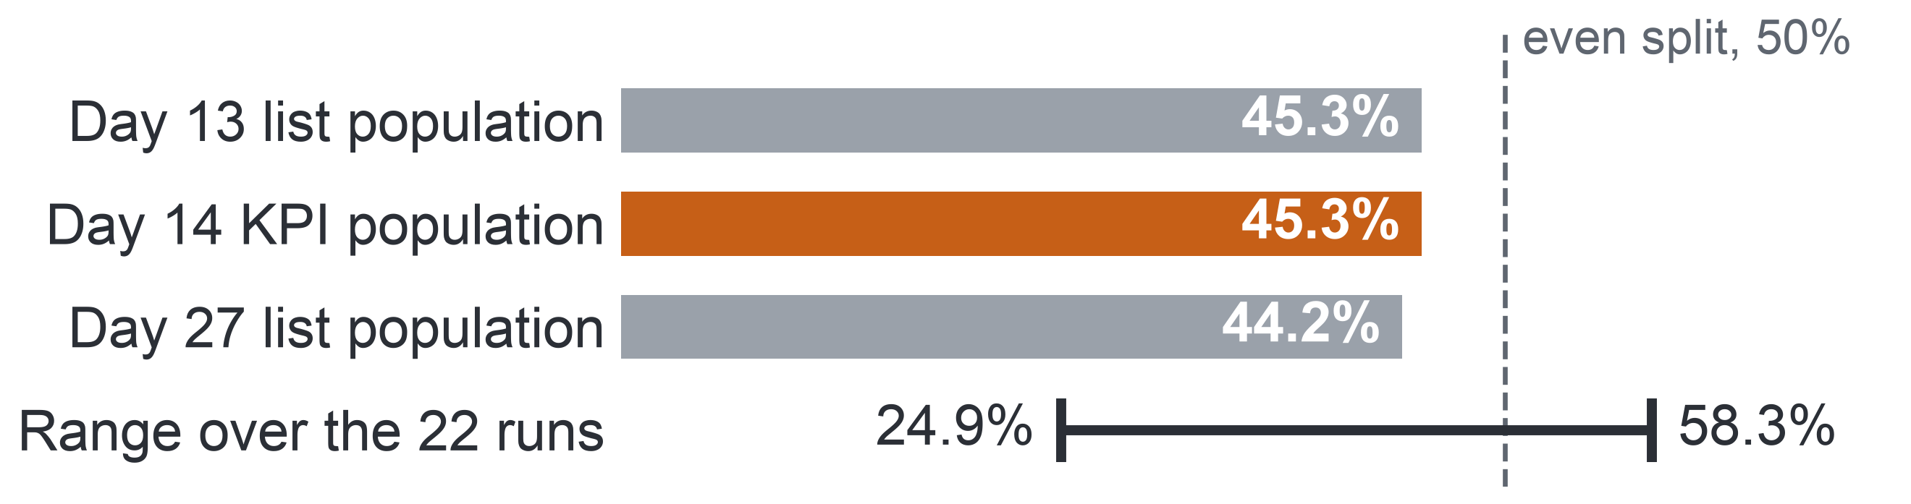
PART 2 · THE DATA (MILESTONE 2)
Detail in the appendix: A16
18
Outcome Balance and Skewed Activity
Completers and non-completers are close in number, so no resampling is needed, while activity is so skewed that counts enter models as logarithms.
Non-completion (Fail or Withdrawn), share of enrolments
602
3,365
median clicks
with no click
2,503
6,977
Key: orange = the KPI population, the 28,061 enrolments still registered at day 14 (54.7% completed); grey = enrolments registered at the list cut-offs, day 13 and day 27; line = lowest and highest run.
outliers
in one record
Mix by module: withdrawal is highest in the CCC runs (43–46%); GGG has the fewest withdrawals but the most failures.
Key: clicks per enrolment over a run. 602 and 6,977 count clicks, the others enrolments; outliers lie beyond the upper fence of the interquartile range; one record = one student, one page, one day.
Profile: all 10.9 million rows of the seven raw tables, not a sample; 13 figures recounted by separate code, all 13 in agreement.
Decision: no resampling or reweighting; counts enter models as logarithms; no value is removed; AQ1, the descriptive question, reports Fail and Withdrawn apart.
Notes:
(~64 seconds) Before answering anything, we needed to know which features of the data could change a conclusion. In Milestone 3 we profiled all 10.9 million rows, not a sample, and recounted thirteen figures with separate code; all thirteen agreed. Two shapes matter. First, balance: of the 28,061 enrolments still registered at day 14, 54.7 percent completed, and non-completion is 45.3 percent at day 13 and 44.2 at day 27, so the two classes are close in size and no resampling is needed, even though runs range from 24.9 to 58.3 percent. Second, skew: the median enrolment has 602 clicks, 3,365 have none, 2,503 are outliers, and one record reaches 6,977 clicks in a day. These are real students, so we remove nothing and use logarithms. Every later number belongs to a defined population, shown next.
Source: Milestone 5 report, Section 6 and Appendix VI.

Slide 19
PART 2 · THE DATA (MILESTONE 2)
Detail in the appendix: A17, A18, A19
19
Three Quality Issues That Change the Method
Of nineteen logged quality issues, three are serious enough to change the method.
Issue log: 19 issues, each rated against the questions: High = ignoring it would change a rate, the target or a feature; Medium = it changes a measure by a known amount; Low = otherwise.
High issue
Change in method
18 of 24 exams have no result rows, so counting exams would make every student of those modules miss one.
A task means a TMA or a CMA only (TMA: tutor-marked assignment; CMA: computer-marked assessment, a quiz).
Few tasks fall due by the cut-offs: no 2013 run has a task due by day 13, and 7 of 9 have one by day 27.
The early-sign rule needs an activity part: a week with no click.
The data are seven UK modules of 2013–2014.
The scope is stated with every result, and students are compared within module.
Key: the orange row marks the issue that reshapes the early-sign rule (Slide 21).
Medium and Low issues: duplicate click rows, activity after unregistration, missing values and outliers are handled by flags, truncation or a "Missing" group; nothing is deleted or imputed (Appendix A17).
Notes:
(~66 seconds) The profile turned into a log of nineteen quality issues, each rated by whether ignoring it would change a rate, the target or a feature. Three are High, and each changed the method. First, 18 of 24 exams have no result rows, so if exams counted as tasks, every student of those modules would seem to miss one; a task therefore means a tutor-marked assignment or a computer-marked quiz only. Second, few tasks fall due by the cut-offs: no 2013 run has a task due by day 13. That is the data reason behind the activity part of the early-sign rule, marked in orange. Third, the data are seven UK modules from two years, so we state the scope and compare students only within module. The Medium and Low issues are handled by stated rules, shown next.
Source: Milestone 5 report, Sections 6 and 6.1, Table 6.2, and Appendix VI, Table A.15.

Slide 20
PART 3 · PREPARATION (MILESTONE 3)
20
Who Counts: the Add-drop Rule
We count only students still registered at day 14, because that is when registration closes on OULAD.
University rule: the completion rate counts students enrolled after the add-drop period.
OULAD proxy: an enrolment counts when it is still registered at day 14, because registration closes two weeks after a run starts.
Day 13 (end of week 2): week-3 list
28,069 enrolments
Day 27 (end of week 4): week-5 list
27,535 enrolments
days
Day 0
Day 7
Day 21
Day 14: the completion KPI
28,061 enrolments
Key: the orange marker is the KPI (key performance indicator) population; grey markers are the populations of the two lists.
One population rule: an enrolment counts on day d when the student registered by day d and had not unregistered by it. It removes the 58 late registrants (days 16–167) from the KPI population and gives each list the students it can name on its day.
The denominator alone can move a run's rate by up to 13.6 points (Slide 35).
Notes:
(~67 seconds) Preparation starts with who counts, a choice that looks technical but moves every rate. At the university, the completion rate counts only students enrolled after the add-drop period, because those who leave during add-drop never really started. OULAD has no add-drop field, but registration closes two weeks after a run starts, so an enrolment counts if it is still registered at day 14. On the timeline, that leaves 28,061 enrolments for the KPI, in orange. Fifty-eight enrolments registered later, as late as day 167, so the rule is stated for every day: registered by day d and not unregistered by it. The same rule gives 28,069 enrolments for the week-3 list and 27,535 for the week-5 list. Later we will see the denominator alone move a run's rate by up to 13.6 points. The second rule concerns the early sign.
Source: Milestone 5 report, Sections 2.1, 6 and 11.2, Tables 2.1 and 6.1, and Appendices III, V and VII.

Slide 21



PART 3 · PREPARATION (MILESTONE 3)
21
The Early-sign Rule
Few tasks fall due in the first weeks, so the early-sign rule also counts a week without activity.
Early-sign rule (final): by the data cut-off, any one of three parts
Milestone 1 rule
Two or more assessed tasks missed or late by week 4.
Missed task
a TMA or CMA due by the cut-off, not submitted
No click in the last 7 days
no platform activity in the seven days before the cut-off
Late TMA
a TMA submitted late
1 of 22
runs has two or more tasks due by day 27.
Key: the orange part is the activity part added for the data. TMA: tutor-marked assignment; CMA: computer-marked quiz. Cut-off: day 13 for the week-3 list, day 27 for the week-5 list.
One rule serves OULAD and the pilot. AQ2, the diagnostic question, tests these three parts and two more activity signs: activity below the run median and no click before the start.
Late quizzes stay out: the meaning of a late CMA in 2013–2014 is not documented, and counting them would raise the share flagged at day 27 from 28.8% to 41.2%.
Reach: the rule flags 20.2% of 28,069 enrolments at day 13 and 28.8% of 27,535 at day 27.
One or more tasks fall due by day 27 in 16 of 22 runs, and by day 13 in only 1; no 2013 run has a task due by day 13.
Notes:
(~65 seconds) The second rule concerns the early sign itself. Milestone 1 set a rule of two or more tasks missed or late by week 4. The data said no: two tasks fall due by day 27 in only one of 22 runs; even one task, in only sixteen; and by day 13, in one. A task-only rule would stay silent in most runs exactly when a list is needed. So the final early-sign rule has three parts: a task due and not submitted, an assignment submitted late, or no platform activity in the last seven days, the orange part the data forced. One rule serves OULAD and the pilot, and it flags 20.2 percent of enrolments at day 13 and 28.8 percent at day 27. With who counts and what counts fixed, three rules govern the rest.
Source: Milestone 5 report, Sections 2.1 and 6.1, and Appendices II, III and VI.

Slide 22
PART 3 · PREPARATION (MILESTONE 3)
Detail in the appendix: A20, A21, A22
22
Three Rules That Govern Preparation
Preparation deletes or imputes nothing, dates every feature by its cut-off, and learns every parameter from the training runs alone.
1 · Delete or impute nothing
2 · Date every feature
3 · Learn from training runs only
Nothing recorded is deleted or imputed in the prepared views.
Why: Every count traces back to the raw files; only model fitting fills or scales values.
Check: Missing counts and value ranges are the same after preparation as before.
Every feature uses only events dated on or before its cut-off, day 13 or day 27.
Why: No information from after the moment of the list can reach a model.
Check: A recount without the date filter differs only where later clicks exist.
Every learned parameter, such as a median or a scale, comes from the 2013 training runs alone.
Why: The 2014 runs stay an independent test.
Check: Parameters stay unchanged when test rows are altered.
Before any record changed, each issue got a decision, its reason and a check that fails if the decision is not carried out: 22 checks, all passing.
Notes:
(~67 seconds) With who counts and what counts as a sign fixed, three rules govern the whole preparation. First, nothing recorded is deleted or imputed in the prepared views, so every count traces back to the raw files. Second, every feature uses only events dated on or before its cut-off, so nothing from after the moment of the list can reach it. Third, every learned value, such as a median or a scale, comes from the 2013 training runs alone, so the 2014 runs stay an independent test. Each rule has a check that would catch a breach: missing counts unchanged, a recount without the date filter, parameters that ignore test rows. Before any record changed, each issue received a decision, its reason and such a check: 22 checks, all passing. Next, the matrix that applies these rules need by need.
Source: Milestone 5 report, Sections 7 and 7.2, and Appendix VII, Tables A.17 and A.20.

Slide 23

PART 3 · PREPARATION (MILESTONE 3)
23
Leakage Control
Leakage, using information that would not exist at the moment of prediction, is blocked in four ways, and the date-filter check is built so that it can fail.
Registration
Clicks up to day 27
Tasks due by day 27
Later clicks
Withdrawal day
Final result
Day 0
Data cut-off: day 27 (the same rule holds at day 13)
Key: grey = events left of the cut-off that may feed a feature; red cross = events right of it that never enter. TMA = tutor-marked assignment.
Form of leakage | Case in OULAD | Control
Target leakage | Final result, withdrawal day, later activity, TMA marks | Features only from events dated up to the cut-off
Train–test contamination | Medians, scales and levels computed on all runs | Learned on 2013 only, refitted inside each fold
Student leakage | 1,586 test enrolments at day 27 of students seen in 2013 | Kept in the test; removed in a strict check
Temporal leakage | A random split that mixes the two years | Train on 9 runs of 2013, test on 13 of 2014
The check can fail: recounting the click features without the date filter changes them only for the enrolments that clicked after the cut-off, 26,755 at day 13 and 25,663 at day 27, and for no other.
Notes:
(~63 seconds) Features that look back from a cut-off invite one danger: leakage, using information that would not exist when the list is made. On the timeline, everything right of the cut-off never enters: later clicks, the withdrawal day, the final result. The table names four forms and their controls: the timing rule; medians and scales learned on 2013 alone; 1,586 test enrolments at day 27 of students already seen in 2013, kept in the test as in real use and removed in a strict check; and a split by year. Most important, our date-filter check can fail: without the filter, the click features change exactly for the enrolments that clicked after the cut-off, 26,755 at day 13 and 25,663 at day 27, and for no other. The result is one versioned dataset.
Source: Milestone 5 report, Section 7.1 and Appendix VII, Tables A.19 and A.20.

Slide 24
PART 3 · PREPARATION (MILESTONE 3)
24
The Final Versioned Dataset
The prepared dataset is named and versioned, passes all 22 checks, and rebuilds byte for byte from the public download.
OULAD-N04-prepared-1.0
Check | Raw data → prepared data | Result
Enrolments | 32,593 enrolments of 28,785 students and their outcome mix: identical | Pass
Populations | 28,069 at day 13; 28,061 at day 14; 27,535 at day 27, equal to the profile | Pass
Clicks | 39,506,354 kept; 98,745 after withdrawal left out | Pass
Missing values | Deprivation band 1,111; registration day 45; TMA score 173: identical | Pass
Joins | 25 joins, rows in equal rows out | Pass
Features | Six features recomputed by separate code: 0 differences in 55,604 rows | Pass
Documented: a data dictionary gives each of the 88 prepared variables its source, transformation, role and sensitivity.
Stored: as Parquet files, a column-based file format.
Rebuilt: one command, from the pinned figshare download; two runs give byte-identical files.
Shared: the CC BY 4.0 licence (Creative Commons Attribution) allows sharing with attribution.
No invented data: synthetic records appear only in unit tests, never in a view or a finding.
Key: TMA = tutor-marked assignment; days 13 and 27 = list cut-offs; day 14 = the KPI population.
Notes:
(~64 seconds) All that preparation ends in one named dataset, OULAD-N04-prepared-1.0, and all 22 validation checks pass. The table shows the main before-and-after comparisons: the 32,593 enrolments and their outcome mix are unchanged; the populations at days 13, 14 and 27 equal the profile; clicks after withdrawal are the only clicks left out; every missing value is still missing; and six features recomputed from the raw files by separate code differ in none of the 55,604 feature rows. Each of the 88 prepared variables is documented with its source, transformation, role and sensitivity. One command rebuilds everything from the pinned public download, byte for byte, and the licence lets us share it with attribution. Synthetic records exist only to test code. With the data side closed, we turn to method: from questions to technical tasks.
Source: Milestone 5 report, Section 7.2 and Appendix VII, Tables A.20 and A.21.

Slide 25
PART 4 · METHOD (MILESTONE 4)
Detail in the appendix: A23, A24, A25, A26
25
From Questions to Technical Tasks
Each question's purpose fixes its technical task and how its result may be read.
Question
Technical task
How its result may be read
AQ1
Descriptive
Aggregation and rate comparison
States what happened, with its denominator and 95% interval.
AQ2
Diagnostic
Association within module run
An association, never a cause: a regression that captures associations describes.
AQ3
Predictive
Binary classification at day 13 and day 27
Judged on runs the model has not seen: explaining data well does not mean predicting well.
AQ4
Prescriptive
Ranking under a fixed capacity
A decision option for staff, untested until a pilot.
Key: AQ1–AQ4 = the four analytical questions; the level under each names its analytics type. Capacity = 3 or 5 contacts per 20 students. Reading rules after Shmueli (2010): explanatory power does not imply predictive power.
Designed at Level 1 (the compulsory level: method and evaluation design) in Milestone 4, without training any model; AQ1 and AQ2 then ran as specified on 2013 and 2014.
Notes:
(~64 seconds) With the versioned dataset in hand, we turn from data to method, all of it fixed in Milestone 4 before any result existed. The first step is purpose: each question's purpose fixes its technical task and how its result may be read. AQ1 is aggregation, rates and shares that state what happened. AQ2 is association within module run; a regression used this way describes how a sign and an outcome move together, so it is never read as a cause. AQ3 is binary classification at day 13 and day 27, and because explaining data well does not mean predicting well, it must be judged on runs it has never seen. AQ4 is ranking under a fixed capacity, which can only give a decision option. Next, the methods chosen for the first two questions.
Source: Milestone 5 report, Section 8 and Appendix VIII, Table A.22.

Slide 26


PART 4 · METHOD (MILESTONE 4)
26
Judging a List by Capacity
A list is judged by how many later non-completers it reaches against the most a list of its length could reach.
Worked example: 20 students, a list of 5
Capacity k: 3 or 5 contacts per 20 students, that is 15% or 25% of a run; the main operating point is 5 per 20 at day 27.
Recall at capacity: the share of a run's non-completers who are on its list.
Normalised recall: recall divided by the most a list of length k can reach. A list of k holds at most k non-completers; in the training runs that ceiling is 46% to 100% of a run's non-completers.
Lift: the share of non-completers on the list divided by the run's base rate (the share of the run who do not complete); 1 = chance.
Recall = 4 of 9 non-completers.
Normalised recall = 4 of 5, the most a list of 5 can reach.
Lift = (4 of 5) ÷ (9 of 20) = 1.8.
Key: orange figure = later non-completer; navy box = on the list. Illustration, not data.
Why not "precision of at least 50%" (Milestone 1): with non-completion near 45%, a random list already reaches about 45% precision.
Framework: the TRIPOD+AI reporting guideline for prediction models: discrimination, calibration and usefulness for the decision.
Notes:
(~61 seconds) A list's length is set by capacity, not by a probability threshold, so we judge it by how many later non-completers it reaches. Look at the worked example: twenty students, nine of whom will not complete, and a list of five. Four of the nine are on the list, so recall is four of nine. But a list of five can hold at most five, so normalised recall is four of five; one would mean the best list possible. In the training runs that ceiling ranges from 46 to 100 percent of a run's non-completers, which is why raw recall would compare unlike runs. Lift compares the list with the run's base rate, so one means chance. This follows the TRIPOD+AI reporting guideline. Next, the whole evaluation plan.
Source: Milestone 5 report, Section 9 and Appendices III (Table A.8) and IX.

Slide 27
PART 4 · METHOD (MILESTONE 4)
Detail in the appendix: A27, A28
27
Evaluation Plan
Each question has a primary metric, a baseline, a validation and a success criterion fixed before any code ran.
Question | Primary metric | Baseline | Validation | Success criterion
AQ1 – Descriptive | Non-completion rates and outcome shares with 95% intervals | Pooled rate; rate over all enrolments; rate without flagged enrolments | Two independent aggregation paths: prepared views and raw tables | Both paths agree to the enrolment; every rate carries its denominator and interval
AQ2 – Diagnostic | Average risk difference of each sign within module run, 95% interval | Unadjusted rate difference | 9 runs of 2013; sensitivity runs; replication on the 13 runs of 2014 | At least 5 points, interval excluding 0, same direction in at least two-thirds of modules
AQ3 – Predictive | Pooled normalised recall at capacity (day 27, 5 per 20) | Rule-ranked list; background-only model; random list | Leave-one-run-out folds in 2013; one logged test on all 13 runs of 2014 | Gate S1: the model's list must beat the rule's list
AQ4 – Prescriptive | Normalised recall at capacity | Random list; rule-ranked list | As AQ3, a list per test run | Gate S1 met by the list, and fairness rule FR1 passed or its flags reviewed
Key: AQ1–AQ4 = the four analytical questions. Normalised recall = recall divided by the most a list of its length can reach. Rule-ranked list = the early-sign rule's flags ordered by their number of signs. S1 = the single gate of the predictive model; FR1 = the fairness review rule. Orange column = the success criterion, fixed in Milestone 4.
Notes:
(~59 seconds) With the list metric defined, here is the Evaluation Plan, fixed in Milestone 4 before any code ran, so no threshold could bend to a result. AQ1 succeeds when two independent ways of counting agree to the enrolment and every rate carries its denominator and interval. AQ2 calls a sign a consistent association at five points or more, with an interval excluding zero and the same direction in two-thirds of the modules. AQ3 is developed on 2013 and tested once on all thirteen runs of 2014, and one gate, S1, decides: the model's list must beat the rule's list. AQ4 must pass the same gate plus the fairness rule FR1. We take the AQ2 criterion first, because AQ2 is the question with results.
Source: Milestone 5 report, Section 9, Table 9.1, and Section 9.1.

Slide 28
PART 4 · METHOD (MILESTONE 4)
28
Gate S1 and the Calibration Condition
One gate decides whether a model replaces the rule's order, and probabilities are shown only if calibration holds.
Pass: the model's order
reported with the number of extra non-completers listed
Gate S1: all three must hold
Pooled normalised recall above the rule list's.
95% paired two-level bootstrap interval of the difference above 0.
One-sided sign-flip test over the 13 per-run differences: p below 0.05.
Model list against rule-ranked list
All 13 test runs of 2014
Day 27, 5 contacts per 20 students
Fail: the rule's order stays
an acceptable outcome
S2: precision at capacity
S3: calibration
The share of the list who do not complete. Reported, not a gate: recall, precision and lift at capacity re-express the same listed non-completers, so S1 alone decides.
Probabilities are shown only if calibration-in-the-large lies between −0.2 and 0.2 and the slope between 0.8 and 1.2; otherwise staff see ranks and reasons only. Never recalibrated on 2014.
Key: S1–S3 = the success criteria of the predictive model (AQ3), fixed in Milestone 4. Normalised recall = recall divided by the most a list of its length can reach. Rule-ranked list = the early-sign rule's flags ordered by their number of signs.
Notes:
(~60 seconds) Here is the gate, S1, the single success criterion for AQ3. On all thirteen test runs, at day 27 with five contacts per twenty students, the model's pooled normalised recall must exceed the rule list's. Beating it means two things: the paired two-level bootstrap interval of the difference lies above zero, and a one-sided sign-flip test over the thirteen per-run differences gives p below 0.05. The gate sets no minimum gain, so a pass would be reported with the number of extra non-completers listed. If the model fails, the rule's order stays, which is an acceptable outcome. Precision, S2, is reported but decides nothing. Calibration, S3, decides only whether staff see probabilities; otherwise they see ranks and reasons. A good list must also be fair.
Source: Milestone 5 report, Section 9.1 and Appendix IX, Table A.23.

Slide 29
PART 4 · METHOD (MILESTONE 4)
Detail in the appendix: A29
29
Fairness and Rule FR1
The list is audited for equal recall across groups, and a clear gap sends the group to human review, not to an automatic verdict.
Group attributes stay out of the predictors and serve only the audit, because bias cannot be audited without group membership.
Criterion: equal recall at capacity, so a struggling student has the same chance of being listed whatever the group.
Rule FR1 (fairness review rule): flag a group for human review when its recall is more than 10 points below the other students' and the Holm-adjusted (corrected for several tests) one-sided interval of the gap lies below 0.
No flag means no evidence of a gap at that precision, not proof that the list is fair.
A flag calls for review of why the gap arises, not rejection of the model.
Confirmatory groups in the 2014 test at day 27 (enrolments)
1,488
1,486
610
declared disability
most deprived band (0–10%)
missing deprivation band
Confirmatory: fixed in advance, each with at least 400 test enrolments. Aged 55 or over: 118, too few; the gap is reported as "insufficient data, not cleared". Deprivation band = band of the Index of Multiple Deprivation of the student's home area.
FR1 threshold
10 points
0
10
20
30
Key: the bar is the largest recall gap, in percentage points, allowed before human review. Recall at capacity = share of a group's non-completers who make the list. No recall values exist yet.
Notes:
(~62 seconds) A list can be accurate overall and still miss one group, so the design audits fairness with one criterion: equal recall at capacity. The main harm of a list is missing a student who struggles, so a struggling student should have the same chance of being listed whatever the group. Rule FR1 flags a group for human review when its recall falls more than ten points below the other students' and the Holm-adjusted interval of the gap lies below zero. The confirmatory groups are declared disability, 1,488 test enrolments, the most deprived band, 1,486, and the missing band, 610. Students aged 55 or over, 118, are too few and stay not cleared. No flag means no evidence of a gap, not proof of fairness. What else protects the evaluation?
Source: Milestone 5 report, Section 9.2 and Appendix IX, Table A.24.

Slide 30
PART 5 · EVIDENCE (MILESTONE 5)
Detail in the appendix: A30
30
What We Ran: Level 2 Not Run
We answered AQ1 and AQ2 on both years; AQ3 and AQ4 remain complete designs with no model trained.
AQ1
AQ2
AQ3
AQ4
Answered
Answered
Deferred
Deferred
descriptive
diagnostic
predictive
prescriptive
Key: filled orange = Answered, the results answer all of the question; grey outline = Deferred, the design is complete and no result exists yet. No question is dropped.
Why AQ3 and AQ4 are deferred: Level 1, the compulsory level of the course (method and evaluation design), is complete. Level 2, the optional prototype, was specified in full in Milestone 4 and not run, because the 13 runs of 2014 are the only independent test and are kept for one complete run of the frozen protocol; a partial early run would spend it.
AQ1 and AQ2
AQ3 and AQ4
Run as fixed in Milestone 4, on the 9 runs of 2013 and again on the 13 runs of 2014. They train no predictive model and change nothing in the AQ3 design.
Designed in full. No model is trained, so no model metric, chart or confusion matrix exists, and none is shown.
Notes:
(~61 seconds) Here is what we ran, stated plainly. We answered AQ1 and AQ2 on both years. Level 1, the compulsory level of the course, is complete: the modeling strategy and evaluation design you have just seen. The optional Level 2 prototype for AQ3 and AQ4 was specified in full in Milestone 4, and we have not run it, so there is no model metric, chart or confusion matrix, and we show none. This was our choice of scope. The thirteen runs of 2014 are our only independent test, and they can be used once, for one complete run of the frozen protocol; a partial early run would spend it. AQ1 and AQ2 train no predictive model and change nothing in the AQ3 design. Next, what that frozen protocol fixes.
Source: Milestone 5 report, Sections 3, 10 and 11, Table 3.1, and Appendix X.

Slide 31
PART 5 · EVIDENCE (MILESTONE 5)
Detail in the appendix: A31
31
Traceability Matrix: From Goal to Data
Each question traces in one row from the goal and its KPI to the data we actually had, with GAP where OULAD lacks a variable.
All rows share one Business Goal: improve successful course completion by identifying students who stop taking part early enough to support them within the semester. SMART Goal: raise completion after the add-drop period in the pilot courses by five percentage points (assumed 70% to 75%) by the end of 2027–2028.
Question | Goal and KPI | Final question, short | Level | Required data | Actual dataset and variables
AQ1 | Primary KPI | Outcome shares; first missed week | Descriptive | Dated result, tasks | 22 runs, day 14: 28,061; GAP: delivery mode, year of study
AQ2 | Primary KPI; KPI 1 | Signs by week 4, within module | Diagnostic | Signs, weeks 1–4 | Day 27: 11,811 (2013) and 15,724 (2014); GAP: attendance
AQ3 | KPI 1 (the rule to beat) | Weeks 2 and 4 against the rule | Predictive | Enrolment at cut-off | 19 predictors; 2014 test
AQ4 | KPIs 1–2: GAP | Ranked list per group of 20 students | Prescriptive | Capacity; contacts | GAP: contacts
Key: AQ1–AQ4 = the four analytical questions. KPI = key performance indicator; primary KPI = completion rate of enrolments after the add-drop period; KPI 1 = early-sign contact rate; KPI 2 = follow-up rate. GAP (red) = a link without data in OULAD (Open University Learning Analytics Dataset). SMART = specific, measurable, achievable, relevant, time-bound.
Notes:
(~64 seconds) The course asks us to show the whole chain for each question, and the Final Project Traceability Matrix does it in two halves. This first half runs from the goal to the data. All four rows share one Business Goal and one SMART Goal. AQ1 feeds the primary KPI and is met by 28,061 enrolments registered at day 14 over 22 runs, with a gap where OULAD has no delivery mode or year of study. AQ2 feeds the primary KPI and KPI 1, met by 11,811 and 15,724 enrolments at day 27, with attendance missing. AQ3 is tied to the rule it must beat, with 19 predictors and 2014 as its test. AQ4's link to the contact KPIs is a gap, because no contact is recorded. The second half continues from method to decision.
Source: Milestone 5 report, Sections 2.1 and 11.1, Table 11.1, and Appendix XI, Table A.27.

Slide 32
PART 5 · EVIDENCE (MILESTONE 5)
32
Traceability Matrix: From Method to Decision
For AQ1 and AQ2 every link holds evidence and both meet their criteria; for AQ3 and AQ4 the chain ends at the evaluation design.
Question | Preparation | Method and rationale | Evaluation / result | Decision | Status
AQ1 | Day-14 rule; TMA, CMA | Grouped rates; no model needed | Paths agree; 45.3% | D2, D3 | Answered
AQ2 | Dated by day 27 | Logistic, run effects | 5 of 5 signs, both years | D2; D1 | Answered
AQ3 | Refit per fold | Penalised logistic; reasons | S1 planned; N.A. | D1 | Deferred
AQ4 | 3 or 5 per 20 | Top-k with signs | S1, FR1; N.A. | D1 | Deferred
Key: AQ1–AQ4 = the four analytical questions. Grey = the link holds evidence; blue = designed, not run; N.A. (red) = no result exists. TMA, CMA = tutor- and computer-marked tasks. S1 = the gate a model must pass to replace the rule; FR1 = the fairness review rule. Decisions: D1 whom to contact, D2 where to place support time, D3 whether to extend. Status: Answered = real results answer all of the question; Deferred = design complete, no result yet; no question is dropped.
Notes:
(~55 seconds) The second half follows the same rows from preparation to decision. AQ1 rests on the day-14 rule and on tutor- and computer-marked tasks, uses grouped rates, passes its check and gives 45.3 percent; it informs where support time goes and how the university would measure an extension. AQ2 rests on signs dated by day 27 and the fixed-effects logistic model, and all five signs pass in both years; it informs support time and gives the reasons on the contact list. AQ3 and AQ4 stop at the evaluation design: gate S1 and the fairness rule are planned, and their result cells read not applicable. Both are deferred, not dropped. Now let us open the AQ1 row.
Source: Milestone 5 report, Section 11.1, Table 11.2, and Appendix XI, Tables A.27 and A.28.

Slide 33
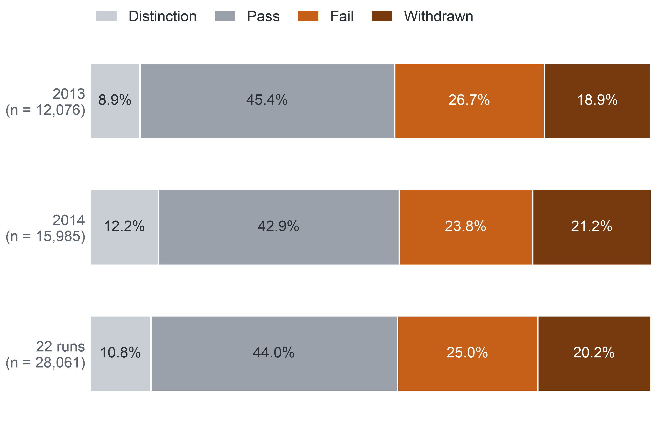
PART 5 · EVIDENCE (MILESTONE 5)
33
AQ1: How Many Do Not Complete
Close to half of the enrolments still registered at day 14 do not complete, a quarter by failing and a fifth by withdrawing, and the two years agree.
45.3%
Final outcome, enrolments registered at day 14 (%)
(44.7–45.8) of 28,061 enrolments over 22 runs did not complete: 12,700.
2013: 45.7% (44.8–46.6) of 12,076.
2014: 44.9% (44.2–45.7) of 15,985.
Success criterion met: prepared views and raw tables agree in all 176 outcome cells, and the first missed week agrees for all 32,593 enrolments.
Confidence: high for OULAD 2013–2014; validity for the university's courses remains open.
Key: AQ1 = descriptive question (outcome shares and timing). Day 14 = end of the add-drop period. Non-completion = Fail or Withdrawn. Intervals = 95% Wilson intervals. OULAD = Open University Learning Analytics Dataset.
Notes:
(~61 seconds) AQ1, the descriptive question: how many students are lost? Of the 28,061 enrolments still registered at day 14 over the 22 runs, 45.3 percent did not complete, 12,700 students: a quarter failed and a fifth withdrew. The two years are almost the same, 45.7 percent of 12,076 in 2013 and 44.9 percent of 15,985 in 2014, with overlapping intervals. We trust these counts because two independent ways of counting, from the prepared views and straight from the raw tables, agree in all 176 outcome cells, and the first missed week agrees for every one of the 32,593 enrolments. So confidence is high, for OULAD. It says nothing yet about the university, whose own rate must be recounted. But a pooled rate hides how different the runs are.
Source: Milestone 5 report, Section 11.2 and Appendix XII, Table A.29.

Slide 34
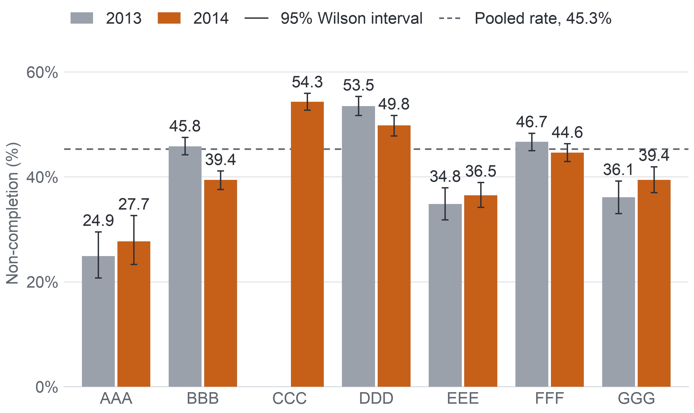
PART 5 · EVIDENCE (MILESTONE 5)
34
AQ1: Modules, Runs and Start Months
Non-completion ranges from about a quarter to over half between modules and runs, and February runs lose more students than October runs in both years.
Non-completion per module, students registered at day 14
Modules, both years: lowest AAA, 26.3% of 720; highest CCC, 54.3% (2014 only).
Runs, all 22: from 24.9% (AAA 2013J) to 58.3% (CCC 2014B).
Start month: February 51.6% against October 42.4% in 2013; 49.6% against 41.6% in 2014.
How students leave: in GGG 2013, 4.3% withdrew and 31.7% failed; in CCC, 33.1% withdrew and 21.3% failed.
So: a hypothesis for decision D2, where support time would go first, to be checked on the university's records.
Key: bar = rate in %; whisker = 95% Wilson interval; CCC ran only in 2014. AAA–GGG = anonymised module codes of OULAD (Open University Learning Analytics Dataset).
Key: AQ1 = descriptive question. Run = one offering of a module, named by year and start month (B = February, J = October).
Notes:
(~64 seconds) That 45.3 percent is an average over very different courses. The chart shows each module in each year, with its interval and the pooled line. Over both years, module AAA has the lowest rate, 26.3 percent, and CCC, which ran only in 2014, the highest, 54.3. Across all 22 runs, run rates span from 24.9 percent in AAA's October 2013 run to 58.3 percent in CCC's February 2014 run. February runs lose more students than October runs in both years: 51.6 against 42.4 percent in 2013, 49.6 against 41.6 in 2014. And students leave differently: in GGG in 2013 only 4.3 percent withdrew while 31.7 failed; in CCC, 33.1 percent withdrew. For the program manager that is a hypothesis about where support time would go first. But there is a trap in these rates.
Source: Milestone 5 report, Section 11.2, Figure 11.1, and Appendix XII, Table A.30.

Slide 35
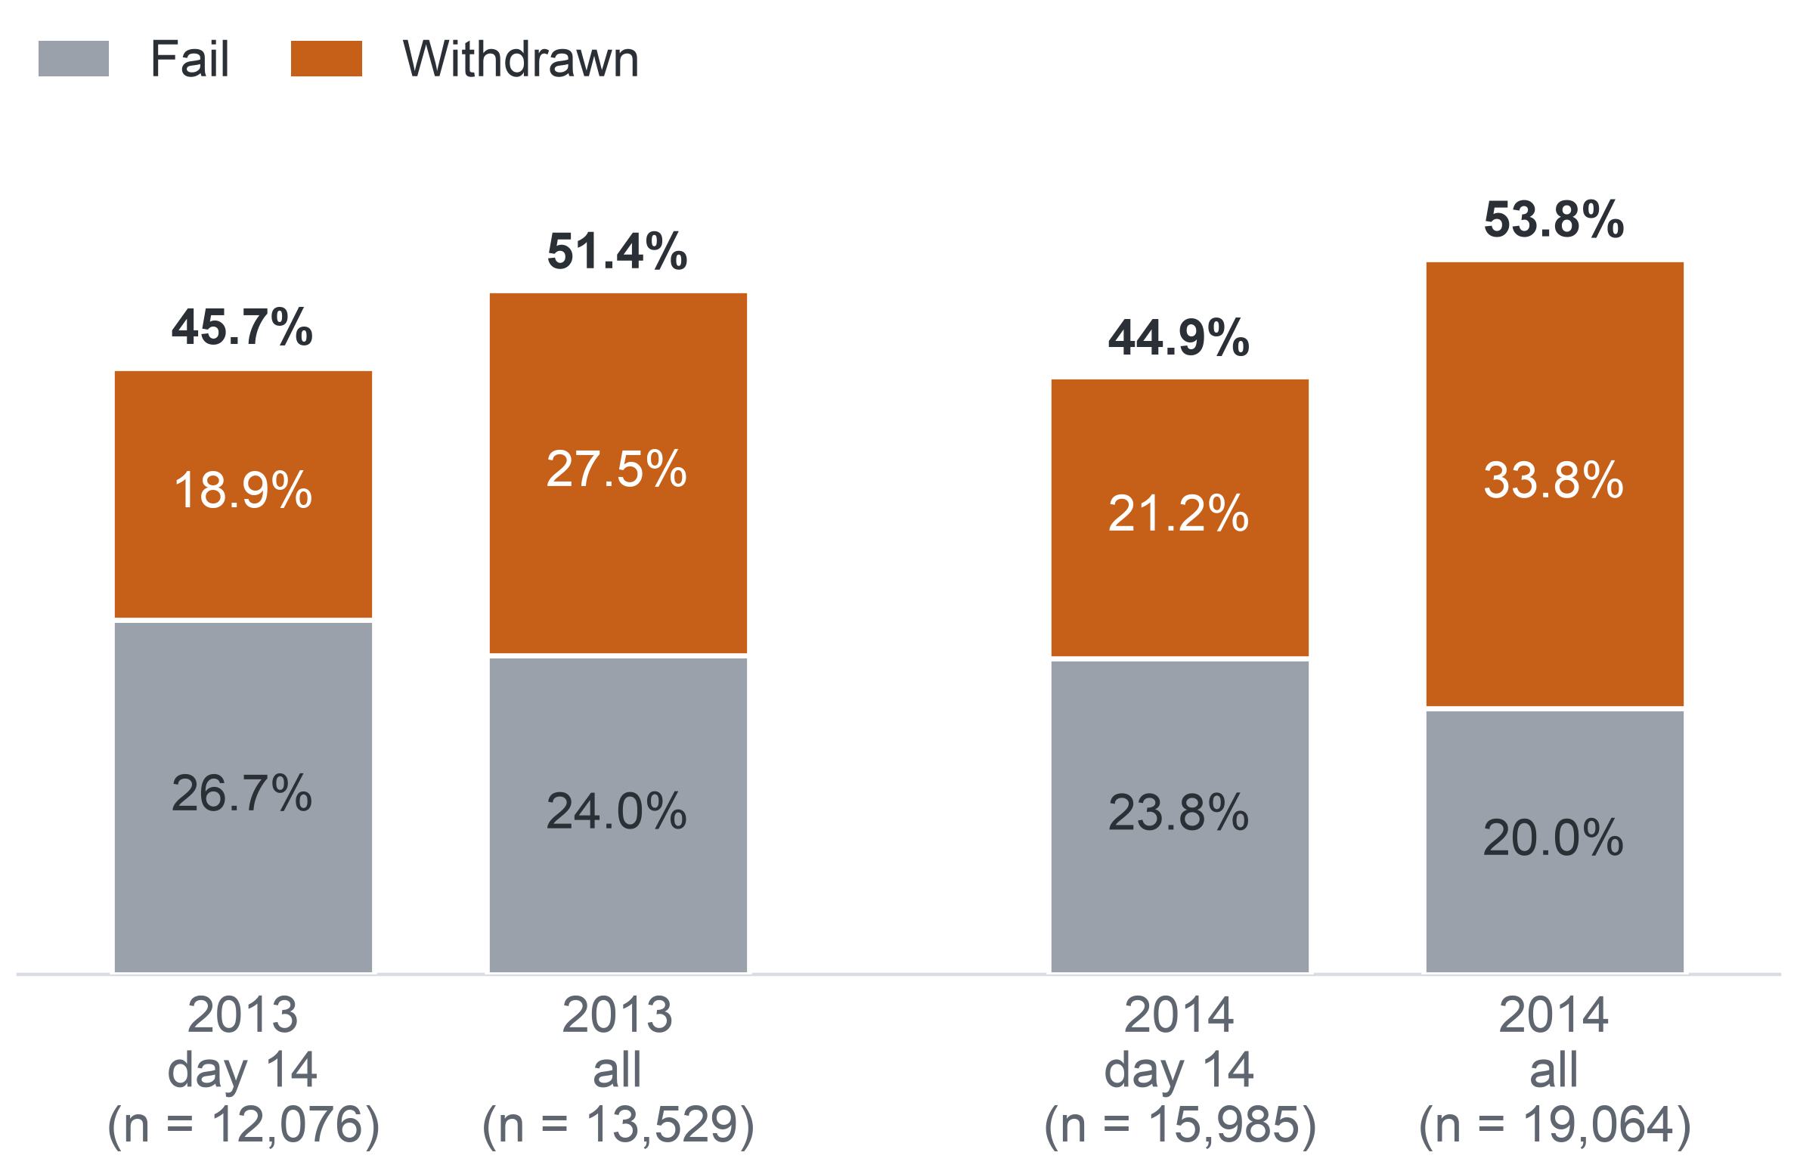
PART 5 · EVIDENCE (MILESTONE 5)
Detail in the appendix: A32, A33
35
AQ1: The Denominator Matters
Counting all enrolments instead of those registered at day 14 lifts non-completion above half, almost entirely through early withdrawals.
Non-completion under two denominators, %
The failed share barely moves
The extra non-completers are early withdrawals.
One run: 13.6 points
BBB 2014J: 36.2% of 1,791 at day 14; 49.7% of all 2,292.
Flagged records change nothing
Without unknown withdrawal or registration days: 45.6% (2013) and 44.6% (2014) at day 14.
So
Key: day 14 = enrolments still registered at the end of the add-drop period (the KPI population); all = every enrolment, including those who left before day 14. Bar = Fail plus Withdrawn; bold = non-completion. KPI = key performance indicator.
Every rate must name its denominator; the KPI fixes the add-drop rule.
Notes:
(~62 seconds) Here is the trap. Count over every enrolment instead of those still registered at day 14, and non-completion jumps above half: 51.4 percent in 2013 and 53.8 in 2014. The extra students are nearly all early withdrawals. The withdrawn share rises from 18.9 to 27.5 percent in 2013 and from 21.2 to 33.8 percent in 2014, while the failed share barely moves. In a single run the shift is larger still: in BBB's October 2014 run, 36.2 percent of those registered at day 14 did not complete, against 49.7 percent of all enrolments, 13.6 points for the same students. Dropping the enrolments with an unknown withdrawal or registration day leaves the day-14 rates at 45.6 and 44.6 percent. So every figure must state its denominator. Next, the year comparison.
Source: Milestone 5 report, Section 11.2 and Appendix XII, Tables A.29 and A.32.

Slide 36
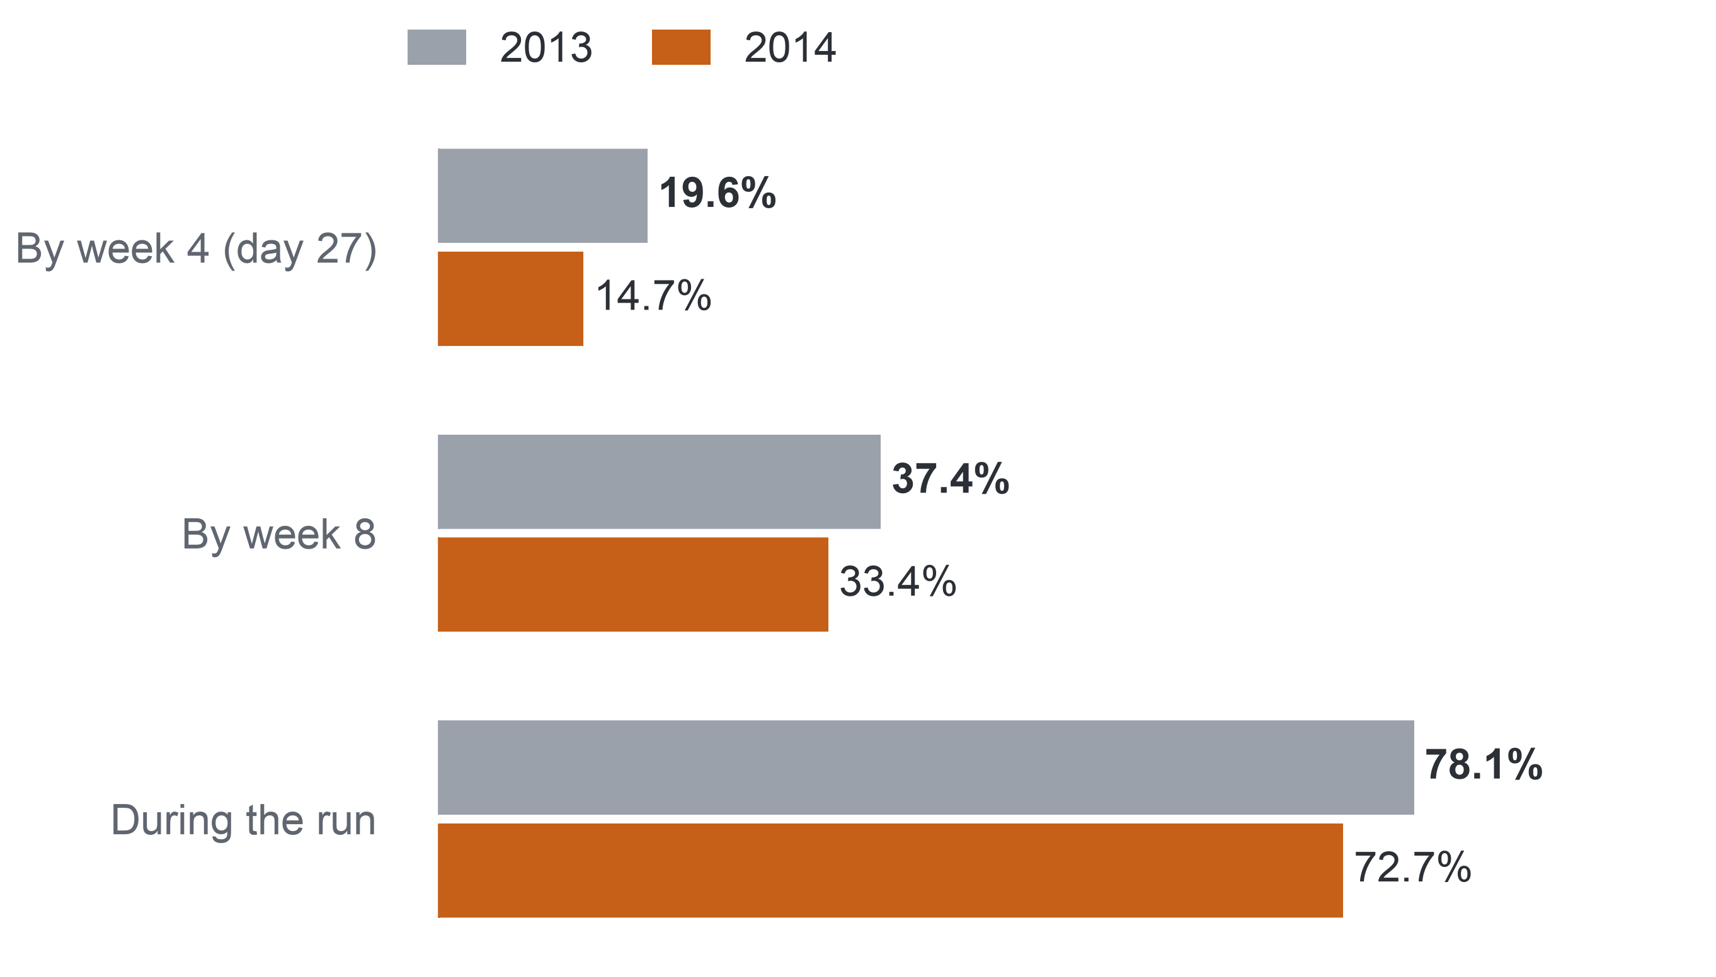
PART 5 · EVIDENCE (MILESTONE 5)
36
AQ1: When Non-completers First Miss a Task
Most non-completers miss a task at some point, but under one in five has missed one by week 4, when the list is made.
Non-completers who had missed a task (TMA or CMA), %
Completers rarely miss early
Under 1% by week 4; 21.9% (2013) and 19.4% (2014) during the run.
Late for most
The median non-completer first misses a task in week 9 in both years; six of the 22 runs had no task due by day 27.
So
A rule on tasks alone comes too late, which is why the early-sign rule also counts inactivity. Confidence: high for OULAD.
Key: population = non-completers registered at day 14, 5,515 in 2013 and 7,185 in 2014. TMA = tutor-marked assignment; CMA = computer-marked assessment; missed = fell due with no submission. Week 4 ends on day 27. OULAD = Open University Learning Analytics Dataset.
Notes:
(~66 seconds) This is the result that turned our design. Missing a task separates the two groups sharply: 78.1 percent of non-completers in 2013 and 72.7 percent in 2014 missed a tutor- or computer-marked task at some point, against about one in five completers. But look at the timing. By the end of week 4, when the week-5 list is drawn, only 19.6 and 14.7 percent of non-completers had missed one, and by week 8 still only 37.4 and 33.4 percent. Their median first missed week is week 9. In six of the 22 runs no task was even due by day 27. So a rule on tasks alone comes too late for most non-completers, which is why the early-sign rule also counts inactivity. Does inactivity go with non-completion? AQ2 tests that, starting with how we tested the signs.
Source: Milestone 5 report, Section 11.2 and Appendix XII, Table A.31.

Slide 37
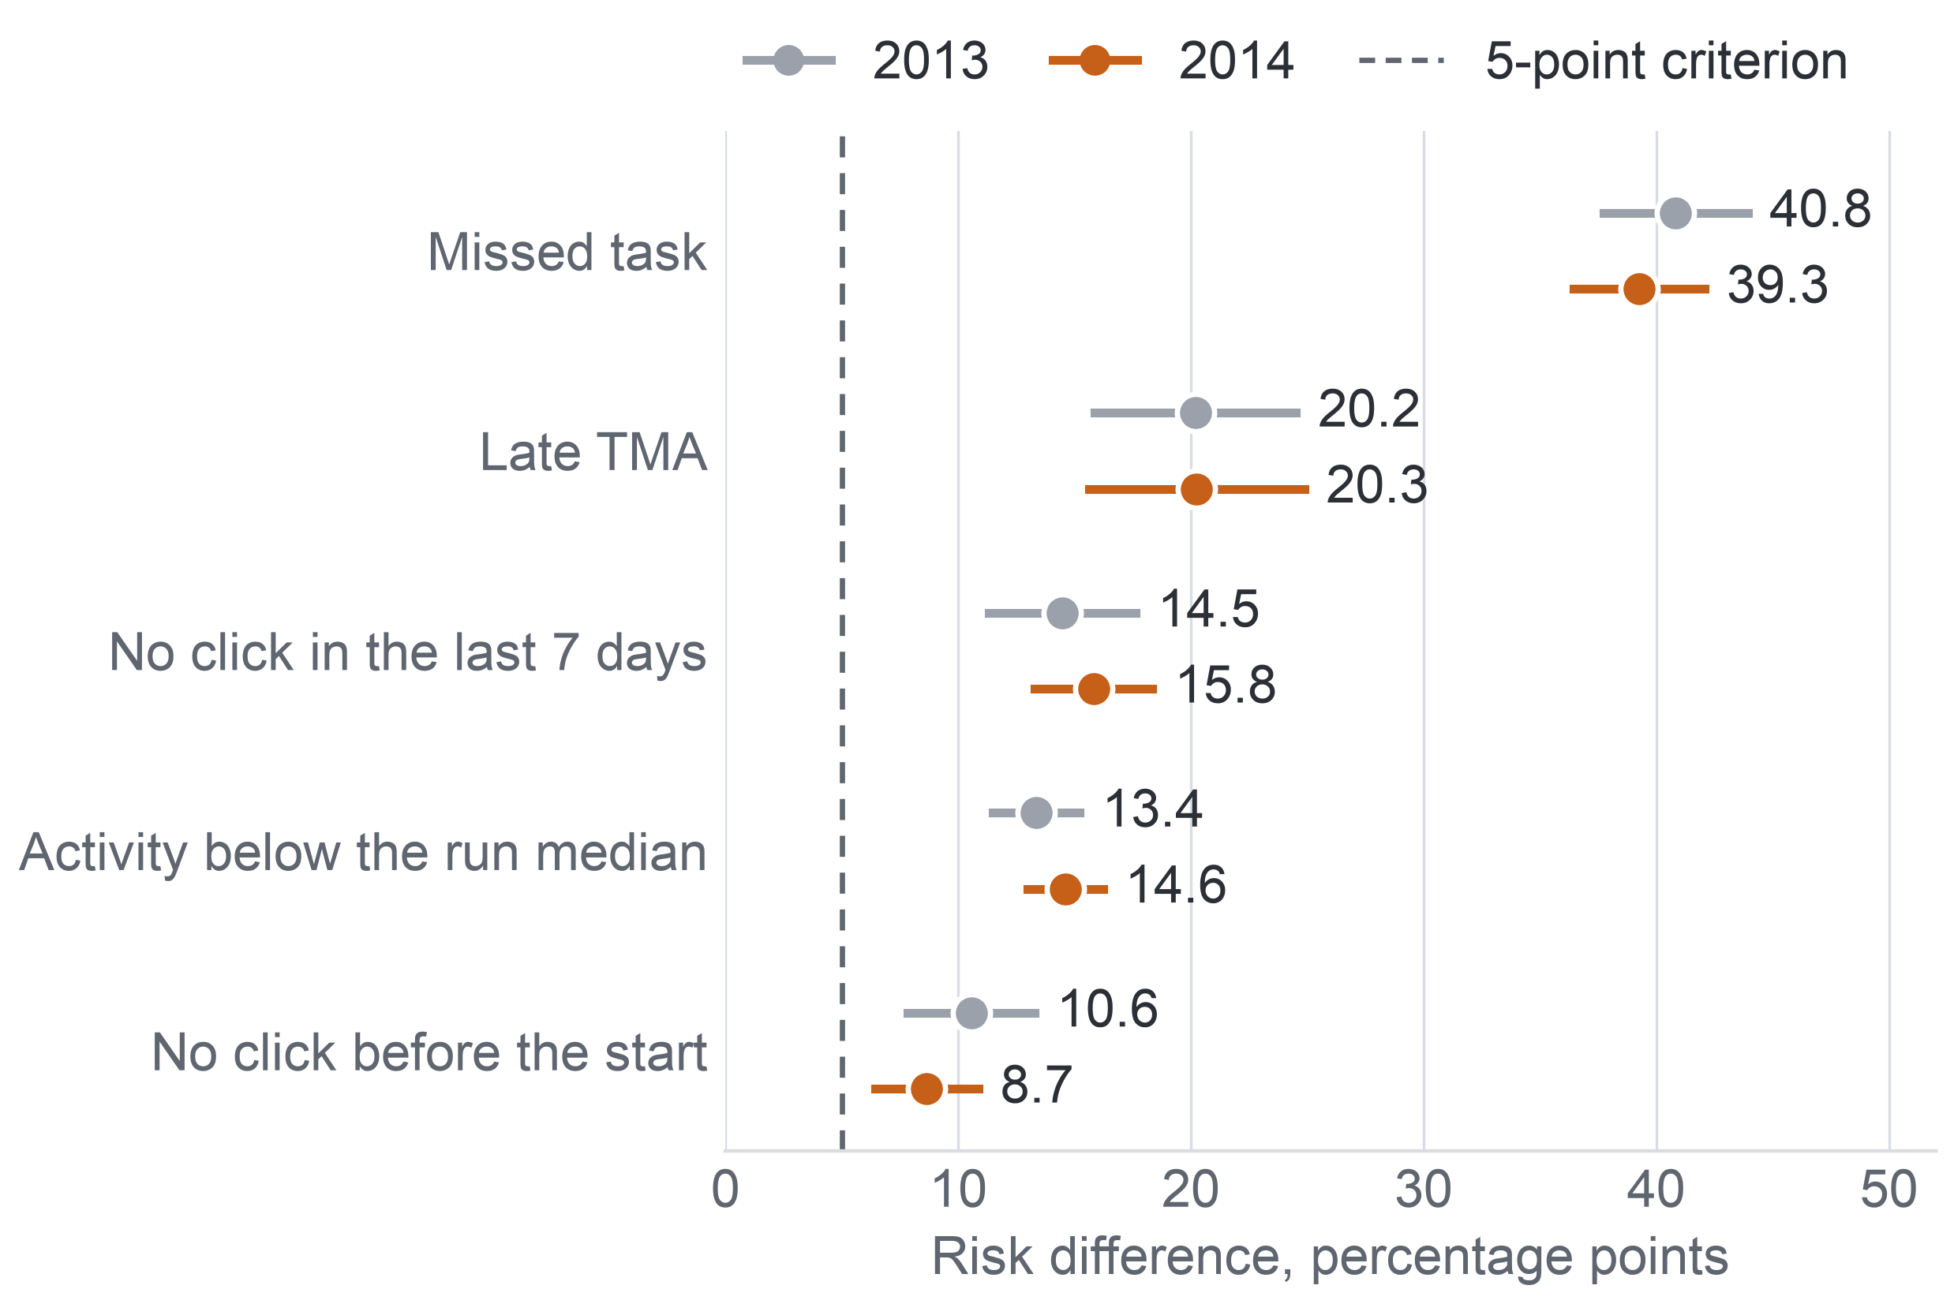
PART 5 · EVIDENCE (MILESTONE 5)
Detail in the appendix: A34, A35, A36, A37
37
AQ2: Five Early Signs
All five early signs, inactivity included, go with later non-completion within module run, by similar amounts in 2013 and 2014.
Extra later non-completion with each sign at day 27
The five signs: the rule's three parts (Missed task, Late TMA, No click in the last 7 days, that is days 21–27) and two activity signs tested only here: Activity below the run median (clicks on days 0–27) and No click before the start (day 0).
Risk difference: the extra percentage points of later non-completion among enrolments with the sign against those without, within module run, adjusted for the other signs.
Population: registered at day 27; 11,811 enrolments in 2013 (44.4% non-completion) and 15,724 in 2014 (44.0%); task signs on 9,960 and 12,585.
Criterion: at least 5 points, an interval excluding 0, and the same direction in two-thirds of modules.
These are associations, not causes.
Key: dot = risk difference; whisker = 95% interval; dashed line = the 5-point criterion; TMA = tutor-marked assignment. Task signs on runs with a task due by day 27; click signs on all runs.
Notes:
(~66 seconds) With the method fixed, here are the results. Each dot is a risk difference: how many more percentage points of later non-completion students with the sign show, against students without it in the same run. A missed task by day 27 goes with 40.8 more points in 2013 and 39.3 in 2014; in raw terms, 90.0 percent of the 2013 students with a missed task did not complete, against 39.6 percent without one. A late TMA goes with 20.2 and 20.3 points. No click in the last seven days, 14.5 and 15.8. Activity below the run median, 13.4 and 14.6. No click before the start, 10.6 and 8.7. All five clear the criterion in both years, and no sign moves by more than two points between them. These are associations, not causes. Do they hold module by module?
Source: Milestone 5 report, Sections 9 and 11.3, Table 9.1, Figure 11.2 and Appendices VIII and XIII, Table A.33.

Slide 38
PART 5 · EVIDENCE (MILESTONE 5)
38
AQ2: What the Signs Mean for the List
The signs give each name on a contact list a factual reason staff can check and show that the early-sign rule needs its activity part, but they do not show that contact would help.
40.8 points
19.6%
6 of 22 runs
The strongest sign, a missed task, in 2013 (39.3 in 2014).
of 2013 non-completers (Fail or Withdrawn) had missed a task by week 4; 14.7% in 2014.
had no task due by day 27, while the click signs are defined in every run.
The signs can
The signs cannot
Give each listed name a factual reason that a member of staff checks against the record.
Show that each part of the early-sign rule (missed task, late tutor-marked assignment, no click in the last 7 days) carries information on its own, inactivity included.
Suggest, as a hypothesis, where early support could go.
Show a cause: a student who stops clicking may already have decided to leave.
Show that contacting a flagged student helps.
Justify treating a group differently: the missed-task sign holds in each of the 15 groups of 2013, as a description.
Confidence: moderate. Two years agree, but the click signs rest on a known misfit, and unrecorded reasons could explain the associations.
Notes:
(~67 seconds) Let us put timing and signs together, because this is the turning point of the project. A missed task is the strongest sign, 40.8 points in 2013. Yet by week 4 it has appeared for only 19.6 percent of the students who will not complete, and in six of the 22 runs nothing was even due. A week without clicks can be measured in every run. So the early-sign rule must keep its activity part. What can the signs do? They give each name on a list a factual reason that a member of staff can check, and each part of the rule carries information on its own. What can they not do? Show a cause: a student who stops clicking may already have decided to leave. So confidence is moderate. Now, the two questions still waiting for their test.
Source: Milestone 5 report, Sections 11.2 and 11.3, Appendix XII, Table A.31, and Appendix XIII, Table A.33 and the sections on groups of students and on what AQ2 means for the project.

Slide 39
PART 5 · EVIDENCE (MILESTONE 5)
39
AQ3 and AQ4: Expected Outputs
AQ3 and AQ4 would give a ranked, capacity-limited list with reasons, and the simple rule stays if the model does not beat it.
AQ3 would give: a risk rank per enrolment at days 13 and 27, and a probability only if calibration holds; gate S1 answers it on the 13 runs of 2014.
If the model does not beat the rule: the rule's order stays, and its list is measured as a baseline.
AQ4 would give: a list of 3 or 5 per 20 students per run, with the signs behind each name. It is answered when it meets S1 (the gate to replace the rule), rule FR1 (the fairness review) passes or its flags are reviewed, and the assumption that the order of risk matches the order of need is stated as untested.
Status: Deferred; expected outputs, no model metric. AQ3 = the predictive question; AQ4 = the prescriptive ranking question.
Expected output – not a result
Missed task
No click in the last 7 days
Late TMA
Missed task
Missed task
Late TMA
No click in the last 7 days
Neither says who should make contact or whether contact helps.
Key: tag = the sign behind the name; TMA = tutor-marked assignment. The card shows the form of the output only: no names and no numbers.
Notes:
(~67 seconds) Those were the questions we could answer. The predictive and ranking questions, AQ3 and AQ4, have expected outputs, not results, because no model has been trained. AQ3 would give each enrolment a risk rank at day 13 and day 27, shown as a probability only if calibration holds, and gate S1 alone, judged once on the 13 runs of 2014, decides whether it beats the rule. If it does not, the rule's order stays, and the same test measures how good the rule's own list is. AQ4 would turn the ranking into a list of three or five per twenty students, with the signs beside each name, and is answered only with the fairness rule passed or its flags reviewed. Neither output says who should call a student or whether calling helps. Here are the four answers side by side.
Source: Milestone 5 report, Sections 11.1 and 11.4, and Appendix XIV, Table A.37.

Slide 40
PART 5 · EVIDENCE (MILESTONE 5)
40
Answers by Question
We can describe the size and timing of non-completion and name its early signs; we cannot yet rank better than the rule or say whether contact helps.
Question | Evidence and method | Main finding or expected output | Confidence | Implication for decision
AQ1, descriptive | 22 runs, day 14: 28,061 enrolments; rates under two denominators | 45.3% did not complete; runs 24.9–58.3%; under 20% of non-completers missed a task by week 4 | High for OULAD 2013–2014; KPI proxy | D2 hypothesis; tasks alone come too late
AQ2, diagnostic | Day 27: 11,811 and 15,724; logistic, run fixed effects | Five signs consistent in both years; missed task 40.8 and 39.3 points | Moderate; association | D1 reasons; contact to test
AQ3, predictive | Proposed: 2013 → 2014; penalised logistic | Expected: risk rank; gate S1 | Not applicable | D1 order only if S1 is met
AQ4, prescriptive ranking | Proposed: AQ3 scores; top-ranked list; FR1 | Expected: 3 or 5 per 20 with signs | Not applicable; no contact data | D1 list, not a contact plan
Key: orange = answered on data; blue = deferred, expected output only. D1 = whom to contact; D2 = where support time goes; S1 = the gate a model must pass to replace the early-sign rule; FR1 = the fairness review rule; KPI = key performance indicator; OULAD = Open University Learning Analytics Dataset.
Notes:
(~66 seconds) The four answers, each read at its own level. AQ1, descriptive: 45.3 percent of the enrolments registered at day 14 did not complete, runs ranged from 24.9 to 58.3 percent, and fewer than one in five non-completers had missed a task by week 4; high confidence for OULAD. AQ2, diagnostic: five signs consistent in both years, a missed task at 40.8 and 39.3 points; moderate confidence, because these are associations. AQ3 and AQ4: expected outputs only, so their confidence reads not applicable. Read across the rows: we can describe the problem and name its early signs, but we cannot yet say whether a model ranks better than the rule, and not at all whether contact helps. The last column is what matters to staff, so let us take the decisions one by one, starting with whom to contact.
Source: Milestone 5 report, Section 11.5, Table 11.3, and Appendix XIV, Tables A.38 and A.39.

Slide 41
PART 6 · INTEGRATION AND USE (MILESTONE 5)
41
Decision D1: Whom to Contact
For whom to contact, the early-sign rule is the candidate list, with its signs shown as reasons, once its own list performance has been measured.
Decided by: course lecturers, lecturer-advisors and the support office, at each review point; a reversible decision
Evidence now
Decision option
Check before adoption
AQ2: a missed task goes with 40.8 more points of non-completion (37.7–43.9) in 2013, and each part of the rule carries information on its own.
AQ1: by week 4 only 19.6% of non-completers had missed a task; 2 of the 9 runs of 2013 had no task due by day 27.
Build the pilot's week-3 and week-5 lists from the early-sign rule, including its activity part, ordered by the number of signs, with the signs beside each name.
A member of staff checks every name. The AQ3 ranking replaces the order only if gate S1 is met.
The rule's list of 3 or 5 per 20 reaches more later non-completers than a random list of the same length (baseline B2).
Contact raises completion against usual support: a randomised pilot, with the contact person and the offer left open.
28.8%
Why ranking matters: the rule flags 28.8% of the 27,535 enrolments registered at day 27 across the 22 runs, more than a list of 5 per 20 students (25%) can hold, so the list is ordered by the number of signs.
Key: early-sign rule = a task due but not submitted, a late TMA (tutor-marked assignment) or no click in the last 7 days; S1 = the gate the AQ3 model (predictive question) must pass to replace the rule's order; B2 = the rule's own list, measured in the same test; AQ1, AQ2 = the descriptive and diagnostic questions.
Notes:
(~60 seconds) Starting with D1, whom to contact, a decision of the lecturers, the lecturer-advisors and the support office, and a reversible one. The evidence supports a clear candidate: the early-sign rule. It is interpretable, computable from records the university already holds, and each of its parts goes with later non-completion in both years. So the option is to build the week-3 and week-5 lists from it, ordered by the number of signs, with the signs shown beside each name, and a member of staff checks every name. Two checks come first. How well its list reaches non-completers has not been measured; that is baseline B2 of the AQ3 test. And whether contact helps can only be tested in a randomised pilot. Next, where support time goes.
Source: Milestone 5 report, Section 11.5, Appendices VIII and IX, and Appendix XIV, Table A.40.

Slide 42
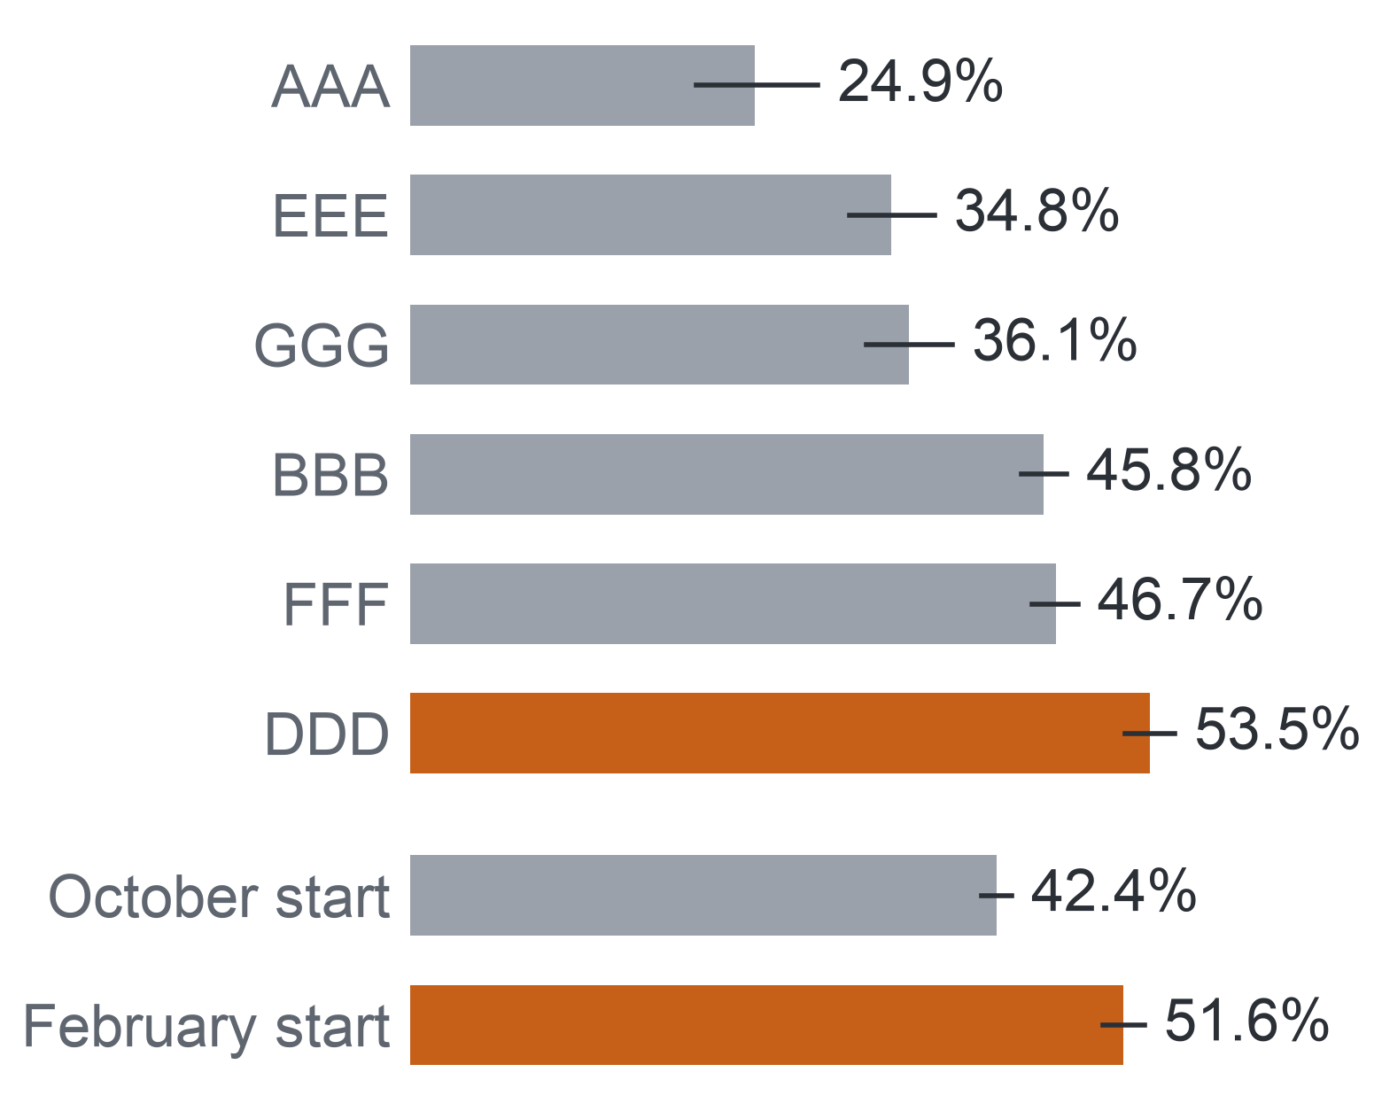
PART 6 · INTEGRATION AND USE (MILESTONE 5)
42
Decision D2: Where Support Time Goes
Support time could go first where non-completion and early signs are highest, as a hypothesis to check on the university's own records.
Decided by: the program manager, for the time of the support office and the lecturer-advisors; each semester
Where losses concentrate, 2013
Evidence now
Decision option, a hypothesis
Check before adoption
AQ1: non-completion from 24.9% to 57.5% between the runs of 2013; February runs 51.6% against October runs 42.4%.
AQ2: no click on days 21–27 in 54.8% of GGG 2013J but 7.6% of DDD 2013B.
Place early support time first in the courses and intakes with the highest non-completion and the highest share of early signs, measured on the university's own records.
Caution: high risk marks where losses concentrate, not where support helps most.
The pattern repeats in the university's courses over several semesters.
The baseline is recounted under the add-drop rule: only students still registered at day 14 count.
Key: bar = non-completion among students registered at day 14, 2013 (modules AAA–GGG of the Open University Learning Analytics Dataset, then all runs by start month); line = 95% Wilson interval; orange = above 50%. AQ1, AQ2 = the descriptive and diagnostic questions.
Notes:
(~63 seconds) From D1 to D2, the program manager's choice of where support time goes each semester. In the 2013 runs of OULAD, non-completion ranged from 24.9 to 57.5 percent, February intakes lost more than October ones, 51.6 against 42.4 percent, and the share of students with no click in the last week before day 27 ranged from 7.6 percent in one run to 54.8 in another. So the option is to place early support time first where both non-completion and early signs are highest. But it is a hypothesis, for two reasons. OULAD is not the university, so the pattern must repeat in its own courses over several semesters, under one add-drop rule. And a high-risk course shows where losses concentrate, not where support would help most. Finally, the largest decision, D3.
Source: Milestone 5 report, Section 11.5, Appendix XII, Table A.30, and Appendix XIV, Table A.40. Run codes: B = February start, J = October start.

Slide 43
PART 6 · INTEGRATION AND USE (MILESTONE 5)
43
Decision D3: Whether to Extend
For extending the approach, the project offers a measurement method, a gate and a fairness audit, not a verdict; extension waits for a pilot result.
Decided by: leadership with the legal and data office, on the pilot's results; close to a one-way door
What the project offers
Extend only if all three hold
Evidence now
The denominator alone can move a completion rate by up to 13.6 points.
AQ3 and AQ4 (the predictive and ranking questions) have no result yet.
No evidence on the effect of contact exists.
A measure
one completion rule (the AQ1 method)
1. A completion gain
against comparison courses
A gate
S1, fixed in advance
2. Legal approval
Vietnam's rules on high-risk AI
An audit
fairness by rule FR1
3. Staff capacity
confirmed for the lists
Key: D3 = whether to extend the approach to all courses and link data routinely; S1 = the gate to replace the early-sign rule; FR1 = the fairness review rule; AQ1 = the descriptive question; AI = artificial intelligence.
Even a negative pilot result shows, at small scale, which part of the path fails.
Notes:
(~65 seconds) D3 is the decision closest to a one-way door: extending the approach to all courses and linking data routinely. Here the project offers tools rather than a verdict. First, a way to count completion by one rule in pilot and comparison courses, which matters because the denominator alone can move a rate by up to 13.6 points. Second, a gate a model must pass, fixed in advance. Third, a fairness audit. What it cannot offer yet is any evidence that contact helps. So extension waits for three conditions: a completion gain against comparison courses, legal approval under Vietnam's rules on high-risk AI, and confirmed staff capacity. Even a negative pilot is valuable, because it shows at small scale which part of the path fails. That brings us to the limits of everything we have shown.
Source: Milestone 5 report, Section 11.5, Appendix XII and Appendix XIV, Table A.40.

Slide 44
PART 6 · INTEGRATION AND USE (MILESTONE 5)
Detail in the appendix: A38, A39
44
Three Kinds of Limit
We keep three kinds of limit apart, because each calls for a different next step.
No evidence found
No data to test
Not yet tested
A comparison was made and showed no clear difference: for example, the year difference over all enrolments in the six shared modules, −0.2 points (−1.4 to 0.9).
OULAD and every screened dataset lack the data: contacts and their outcomes, delivery mode, year of study, attendance, staff capacity.
The data exist, but the analysis waits for the single AQ3 test (the predictive question): AQ3 and AQ4 results.
Next step: no claim; reported as uncertain
Next step: collect in the randomised pilot
Next step: the single test, design unchanged
Three conditions on every answer
Scope
Confounding
Ethics
UK distance-learning modules of 2013–2014; instructional conditions change what predicts success.
The effect of contact cannot be known from these data.
A flag must not become a label: predictive analysis can carry bias and stereotyping.
Key: OULAD = Open University Learning Analytics Dataset, our open stand-in for the university's records.
Notes:
(~64 seconds) Every answer we gave has a boundary, and we sort the boundaries into three boxes, because each needs a different next step. "No evidence found" means we compared and saw no clear difference, such as the year difference within the six shared modules over all enrolments; we make no claim. "No data to test" means neither OULAD nor any dataset we screened holds the data: contacts, delivery mode, year of study, attendance, staff capacity. Only the pilot can create them. "Not yet tested" means the data exist, but the analysis waits for the single AQ3 test. On top of that, three conditions hang over every answer: two years of UK distance learning, confounding that hides the effect of contact, and a flag that must never become a label. Here is the full log.
Source: Milestone 5 report, Section 12 and Appendix XV, Table A.41.

Slide 45
PART 6 · INTEGRATION AND USE (MILESTONE 5)
Detail in the appendix: A40, A41
45
Future Work in Order
Two steps can run on OULAD as it stands; three need the university, and the last, a randomised pilot, alone can show whether contact helps.
On OULAD now
At the university
4. Risk classification and consent
5. Randomised pilot
2. AQ4 list and fairness audit
3. Transfer to the university
1. The AQ3 test
Does contact raise completion? Which contact and offer work? KPI 1 contact part and KPI 2.
Data: Contact record: time, person, offer, outcome
Depends on: Steps 3 and 4
Does a model at day 27 list more non-completers than the early-sign rule (gate S1)? The rule's own list; calibration.
Data: OULAD as prepared
Depends on: The frozen protocol of Milestone 4
Recall at 3 and 5 per 20, gain over a random list, FR1 by disability and deprivation band.
Data: The frozen AQ3 scores on 2014
Depends on: Step 1
Baseline completion under the add-drop rule; the rule on the university's task calendar; AQ1 and AQ2 re-checked.
Data: Two years of the university's records
Depends on: Data access approved
Is the list a high-risk use, and what human control does it need? Do students accept activity-based contact?
Data: Legal review; consultation with students
Depends on: Step 3
Key: AQ1–AQ4 = the descriptive, diagnostic, predictive and ranking questions; AQ3 test = its Level 2 prototype; add-drop rule = only students still registered at day 14 count; OULAD = Open University Learning Analytics Dataset; S1 = the gate a model must pass to replace the rule; FR1 = the fairness review rule; KPI 1 = early-sign contact rate; KPI 2 = follow-up rate.
Notes:
(~63 seconds) The limits translate directly into work, in order. Two steps run on OULAD as it stands. Step one is the Level 2 prototype of AQ3, exactly as Milestone 4 froze it: does a model list more non-completers than the rule, and how good is the rule's own list. Step two takes those frozen scores, forms the AQ4 lists of three or five per twenty, and runs the fairness audit by disability and deprivation band. Then three steps need the university. Step three recounts the baseline under the add-drop rule and re-checks AQ1 and AQ2 on its records. Step four is a legal risk classification and consultation with real students. Step five is the randomised pilot, which finally answers whether contact raises completion. Let us look at the university steps in turn.
Source: Milestone 5 report, Section 12.1 and Appendix XV, Table A.42.

Slide 46
PART 6 · INTEGRATION AND USE (MILESTONE 5)
46
The Randomised Pilot
Only a randomised pilot among flagged students can separate the effect of contact from the reasons students are flagged, and its contacts are logged before any model is retrained.
Contact
person and offer logged
Flagged students
in the pilot courses; time zero at the eligibility cut-off
Outcome logged
time, person, offer, outcome
Completion compared
contact against usual support
Random assignment
Usual support
no extra contact
Why random
What it answers
One rule
Timing
Only random assignment separates the effect of contact from the reasons a student was flagged.
Whether contact raises completion; which contact and offer work; the contact part of KPI 1 and KPI 2.
Contacts logged with their outcomes before any model is retrained, or a model would learn its own influence.
Steps 3 and 4 complete before contact begins in Semester 2 of 2026–2027.
Key: KPI 1 = early-sign contact rate; KPI 2 = follow-up rate (the two secondary key performance indicators); steps 3 and 4 = the transfer to the university and the risk classification.
Notes:
(~63 seconds) And step five, the pilot. Among the flagged students in the pilot courses, some are randomly assigned to contact and the rest receive usual support, with time zero at the eligibility cut-off. Why randomise? Because flagged students differ from others in ways we cannot see; only random assignment separates the effect of contact from the reasons they were flagged. The pilot logs every contact: when, by whom, which offer, and what happened, which also measures the contact parts of our two secondary KPIs. One subtle rule: contacts are logged before any model is retrained, or the model would learn its own influence. Steps three and four must be complete before contact starts in Semester 2 of 2026–2027. Before we conclude, one more part of our process to account for: generative AI.
Source: Milestone 5 report, Section 12.1 and Appendix XV, Table A.42 and the text after it.

Slide 47
PART 6 · INTEGRATION AND USE (MILESTONE 5)
Detail in the appendix: A42, A43
47
Generative AI: Roles and One Rule
AI proposed and challenged, and we verified; it was never a source of data, statistics, licence information or results.
AI proposed
We verified with
One rule
Simulated stakeholder
Quotes against transcripts
AI is never a source of data, statistics, licence information or results; every fact it offered was checked against a saved source, the data files or code we ran.
No AI produced a metric value, threshold or result.
Research and code assistant
Literature against saved copies with verbatim quotations
Critic
Code against fixtures (small inputs with known answers) and independent recounts
Writing partner
Critics confined to the brief and the data
Guidance followed: UNESCO (United Nations Educational, Scientific and Cultural Organization) holds that generative AI cannot be trusted to be accurate and that its information should never be accepted at face value.
Notes:
(~64 seconds) We used generative AI in every milestone, and we owe you an account of how. It played four roles: a simulated stakeholder in Milestone 1, which is why we always call the interviews simulated; a research and code assistant; a critic of our plans; and a writing partner. In every role one rule held: AI was never a source of data, statistics, licence information or results. We matched each check to what could go wrong: quotes against transcripts, literature against saved copies with exact quotations, code against fixtures and independent recounts, and critics confined to the brief and the data. No AI produced a metric value, a threshold or a result. This follows UNESCO's guidance never to accept generative AI's output at face value. Here is what that looked like milestone by milestone.
Source: Milestone 5 report, Sections 13, 13.1 and 13.2, and Appendix XVI.

Slide 48
CONCLUSIONS
48
Conclusions, Firmest First
On OULAD, an early list cannot rest on missed tasks alone, and the early signs can serve as reasons that staff check beside each name.
45.3% of the enrolments registered at day 14 did not complete; runs varied from 24.9% to 58.3%; the year comparison depends on the add-drop rule; most non-completers first missed a task after week 4.
1. High confidence, OULAD 2013–2014
All five early signs go with later non-completion in both years, a missed task by 40.8 and 39.3 points, in the same direction across modules, with one wide exception. These are associations.
2. Moderate confidence
A penalised logistic model judged once against the early-sign rule, and a capacity-limited list audited for fairness; outputs are expected, not measured.
3. Design only
Key: tiers run from the firmest finding at the top; the label of each tier is its confidence level. OULAD = Open University Learning Analytics Dataset; add-drop rule = only students still registered at day 14 count.
Notes:
(~61 seconds) Let us draw it together, firmest first. With high confidence on OULAD: 45.3 percent of the enrolments still registered at day 14 did not complete, runs ranged from 24.9 to 58.3 percent, any year comparison depends on the add-drop rule, and most non-completers first missed a task after week 4. Two independent computations agree on these counts. With moderate confidence: all five early signs go with later non-completion in both years, a missed task by 40.8 and 39.3 points, in the same direction across modules; they are associations, useful as reasons, not causes. And as a design only: a penalised logistic model judged once against the rule, and a capacity-limited list audited for fairness; those outputs are expected, not measured. Just as important is what we cannot conclude.
Source: Milestone 5 report, Sections 11.2, 11.3, 11.4 and 14.

Slide 49
CONCLUSIONS
49
What We Cannot Conclude, and Open Problems
Three claims stay out of reach of these data, and each maps to an open problem with a planned answer.
We cannot conclude that… | Because | Open problem and planned answer
the signs cause non-completion | A regression capturing associations is descriptive, not causal. | Treat the signs as reasons to check, never as causes.
a model ranks students better than the early-sign rule | No model has been trained or tested. | The single AQ3 test under the frozen protocol.
contacting a listed student raises completion | No data record contact, and questions of effectiveness need a randomised experiment. | A randomised pilot with contacts and outcomes logged.
Key: orange column = the planned answer; AQ3 = the predictive question (a model against the early-sign rule).
Over all three: every result describes UK distance-learning modules of 2013–2014 and is recounted on the university's records, after a risk classification of the list.
Notes:
(~61 seconds) Equally firm is what we cannot say. We cannot say the signs cause non-completion: a regression that captures associations describes them; it does not explain them. So the signs stay reasons to check, never causes. We cannot say a model ranks students better than the simple rule, because no model has been tested; that is the single AQ3 test we kept clean. And we cannot say that contacting a listed student raises completion, because no data record a contact, and questions of effectiveness need a randomised experiment; that is the pilot. Over all three sits the scope: UK distance-learning modules of 2013 and 2014, to be recounted on the university's own records after a risk classification of the list. If you remember one thing, make it this.
Source: Milestone 5 report, Sections 12, 12.1 and 14.

Slide 50
CONCLUSIONS
50
Take-home
Start early with an interpretable list that counts inactivity, test a model against it once, and let a randomised pilot decide whether contact helps.
1
Don't wait for missed tasks.
Under one in five non-completers had missed one by week 4 (19.6% in 2013, 14.7% in 2014).
2
Start simple, test once.
The early-sign rule, with its signs as reasons beside each name, is the list to beat; a model replaces it only by passing one gate fixed in advance.
3
Prove it before scaling.
Only a randomised pilot can show whether, and for whom, early contact improves completion.
Take-home: a missed task comes too late; count silence too, and test contact before trusting it.
Notes:
(~61 seconds) So here is what we hope you take away. Do not wait for missed tasks: by week 4, fewer than one in five of the students who will fail or withdraw have missed one, so an early list has to look at whether students are still active. Start simple and test once: the early-sign rule is interpretable and computable from records the university already has, its signs give staff a reason beside every name, and a model replaces it only by passing one gate fixed in advance. And prove it before scaling: only a randomised pilot can tell us whether, and for whom, early contact improves completion. That is the question no open dataset can answer, and it is where this project hands over to the university.
Source: Milestone 5 report, Sections 11.2, 11.5 and 14, and Appendix XII, Table A.31.

Slide 51
Thank you. Questions?
Early Identification of Disengaging Students in Online Courses – team N04
Take-home: a missed task comes too late; count silence too, and test contact before trusting it.
Data: Open University Learning Analytics Dataset (Kuzilek, Hlosta and Zdrahal), CC BY 4.0.
Notes:
(~60 seconds) Thank you for following the chain with us: from students noticed too late, through open data and its preparation, methods fixed in advance and evidence on two years of runs, to the two questions we could answer and the two we have designed and kept for one honest test. Our report and its appendices hold every table behind the numbers you saw, with its population and interval, and the Final Project Package carries the code, the data access instructions, the pipeline, the data dictionary and the AI Decision Log, so anyone can rebuild our results from the public download. We are happy to take your questions on any link of the chain: the add-drop rule, the early signs, the gate, the fairness audit or the pilot.
Source: Milestone 5 report, Sections 5 and 7.2, and Appendix XVI.

Slide 52
Appendix
Detail slides the talk points to; not presented.
A1 Withdrawal Is a Regulated Measure
A2 Why Early Matters: What Studies Report
A3 What Staff Asked For
A4 Is the Target Achievable?
A5 How Each Level May Be Read
A6 Quality Check of the Questions
A7 What the Data Forced Us to Change
A8 Questions Mapped to Decisions
A9 Six Must-Have Gates
A10 Why OULAD, and on What Condition
A11 Provenance and Licence
A12 Seven Tables and Their Keys
A13 Coverage over Years and Runs
A14 Key Variables
A15 Gaps Only the University Can Fill
A16 The Populations Behind Every Number
A17 Duplicates, Missing Values and Invalid Records
A18 Time Coverage and Representativeness
A19 Sensitive Fields and Privacy
A20 Preparation Decision Matrix
A21 Ten Scripted Steps
A22 Derived Variables and Encoding
A23 Method Selection: AQ1 and AQ2
A24 Method Selection: AQ3 and AQ4
A25 Eight Criteria and the Tie-break
A26 Why a Ranking, Not a Threshold
A27 The AQ2 Success Criterion
A28 Validation Design
A29 Leakage and Interpretability in the Evaluation
A30 What the Frozen Protocol Fixes
A31 How We Read the Findings
A32 AQ1: The Year Comparison Depends on the Add-drop Rule
A33 AQ1: Non-completion by Group of Students
A34 AQ2: How We Tested the Signs
A35 AQ2: Consistent Across Modules
A36 AQ2: Sensitivity Runs
A37 AQ2: Activity Works as a Gradient
A38 Limitation Log
A39 Measurement and Model Limits
A40 Next at the University: Recount and Replace Assumptions
A41 Risk Classification and Human Control
A42 AI Decision Log
A43 What AI Changed, and What We Rejected

Slide 53
APPENDIX A1: PART 1 · THE PROBLEM (MILESTONE 1)
53
Withdrawal Is a Regulated Measure
Vietnamese regulation caps withdrawal, so a university needs an exact record of each student's status and an early view of who is drifting away.
10%
15%
30%
Cap on the annual withdrawal rate (Circular 01/2024).
Cap on the first-year withdrawal rate; a university above it may not raise its enrolment quota.
Share of a full-time or work-study program that may be taught in online classes (2021 training regulation).
Circular 83/2026, in force from 15 November 2026
What follows for our project
• Replaces Circular 01/2024 and keeps both caps.
• Students on approved leave, and those who transfer to another program or institution, no longer count as withdrawn.
• Completion means passing the course, and withdrawal follows Circular 83/2026, so the university's baseline is recounted under its rule.
• Our open stand-in data record neither leave nor transfer, so there they count as withdrawal.
Basis: the two Circulars and the 2021 training regulation are cited through Vietnamese news reports (2021, 2024 and 2026), which are secondary sources.
Notes:
(~63 seconds) A university with records but no questions might still wait; regulation is why it cannot. Circular 01/2024 caps the annual withdrawal rate at 10 percent and the first-year rate at 15 percent, and a university above the first-year cap may not raise its enrolment quota. Circular 83/2026, in force from 15 November 2026, keeps both caps and no longer counts approved leave or transfers as withdrawal. At the same time, a program may now teach up to 30 percent of its volume online. Together these rules make withdrawal a measured quality indicator and require an exact record of each student's status. That is why our completion measure follows Circular 83/2026, and why we note that our stand-in data cannot separate leave or transfer from withdrawal. Next, what published research says about timing.
Source: Milestone 5 report, Section 1 and Appendix I (news reports of the Circulars, 2024 and 2026, and of the 2021 training regulation).

Slide 54
APPENDIX A2: PART 1 · THE PROBLEM (MILESTONE 1)
54
Why Early Matters: What Studies Report
Published studies agree that non-completion online is common and that the useful moment for support lies in the first weeks of a course.
How common non-completion is
When support is most useful, by week of the course
A review of 110 articles, 2013–2023
Week 1
Week 2
Week 3
Week 4
Week 5
Week 6
Week 7
Week 8
Dropout in online higher education is a significant concern, with several contributors acting at once (Rahmani et al., 2024).
Massive open online courses: about half of enrolled students never show up, and the first two weeks are critical (Jordan, 2015).
A review of 40 studies, 2010–2018
The window for effective support of a student at risk is short: it lasts two to four weeks (Herodotou et al., 2019, at the Open University).
Completion in online courses is about 8 to 14 points below face-to-face courses (Muljana and Luo, 2019).
Best point for an early warning in a blended first-year statistics course (Howard et al., 2018).
A Vietnamese review, 2024
Key: each grey bar spans the weeks a study names; the orange text gives a length of time, not weeks of the course.
Dropout among university students is about 20–30% (Lê et al., 2024).
So a useful signal must arrive early, and the time to act on it is short.
Notes:
(~69 seconds) Regulation raises the stakes; published studies tell us when to act. On the left, how common the problem is. A 2024 review of 110 articles treats online dropout as a significant concern with several causes. A review of 40 studies puts completion in online courses about 8 to 14 points below face-to-face courses. And a Vietnamese review puts university dropout at about 20 to 30 percent. On the right, timing, week by week. In massive open online courses, about half of enrolled students never show up, and the first two weeks are critical. The window for effective support is short: two to four weeks. And in one blended first-year statistics course, weeks five to six were the best point for an early warning. So a useful signal must arrive early, and the time to act on it is short. Who could act on it?
Source: Milestone 5 report, Appendix I; Rahmani et al. (2024); Muljana and Luo (2019); Lê et al. (2024); Jordan (2015); Herodotou et al. (2019); Howard et al. (2018).

Slide 55
APPENDIX A3: PART 1 · THE PROBLEM (MILESTONE 1)
55
What Staff Asked For
Simulated interviews set the shape of the list, short, timed and with a reason for each name, but they are never evidence.
How the needs were established: in Milestone 1, generative AI played both the stakeholder and the interviewer, followed by a validation round; we verified every transcript and kept 51 key statements, each labelled as an opinion, an assumption or scenario information.
Six themes that recur across five stakeholders
How we settled where they differed
• Students are noticed late.
• Disengagement starts early, often with a missed quiz or assignment.
• Capacity is small: about 30–40 contacts a week for the support office, three to five per lecturer-advisor.
• Contact helps when it comes from someone the student knows.
• The data must be trusted: linked records, correct status, a lawful purpose.
• Support only: no labels, no effect on grades, no evaluation of lecturers.
• Lists at two review points, week 3 and week 5.
• A factual reason beside each name, checked by a member of staff.
• Contact from the lecturer or the student's lecturer-advisor; the support office takes the harder cases.
• No step is automated.
• The validation round added: completion means passing; review points avoid registration and examination weeks; the target runs over a full academic year.
Status: simulated stakeholder views; they set the timing and the length of the lists, and every finding rests on the data or on published work. Lecturer-advisor: a lecturer who advises a student class.
Notes:
(~66 seconds) We have to be honest about these needs. We could not interview real staff, so in Milestone 1 generative AI took both sides of every interview: an isolated AI persona answered as the stakeholder, and an AI interviewer asked our questions, followed by a validation round. We checked every transcript and kept 51 key statements, each labelled as an opinion, an assumption or scenario information. Six themes recur, on the left: detection comes late, disengagement starts early, capacity is small, contact works from someone known, the data must be trusted, and use is for support only. On the right, how we settled where stakeholders differed: two review points, a checked reason per name, contact by someone the student knows, nothing automated. These views shaped the design; they are never evidence. With the needs set, we drew the boundary.
Source: Milestone 5 report, Section 1.1 and Appendix I.

Slide 56
APPENDIX A4: PART 1 · THE PROBLEM (MILESTONE 1)
56
Is the Target Achievable?
At the assumed baseline, five more points means about one in six non-completers passing after support, which fits staff capacity but stays an assumption.
Worked example
The goal against the five SMART criteria
600
Criterion | How the goal meets it
Specific | One measure (completion), one population (enrolled after add-drop) and one set of pilot courses, fixed in advance.
Measurable | Completion and its denominator are read from the academic management system at the end of each semester (the primary KPI).
Achievable | About 30 more passes in 600 enrolments; reaching them fits the weekly capacity staff reported (worked example on the left).
Relevant | Measures the Business Goal directly and answers the program manager's and the support office's needs.
Time-bound | Contact runs from Semester 2 of 2026–2027; the target is read on the pilot courses over the 2027–2028 year.
enrolments in about four pilot courses (assumed)
about 180
end without a pass at the assumed 70% completion
about 30
more passes give five more points: one in six of the 180
Key: the one-in-six share is an assumption, not an estimate; no data in the project measure the effect of contact, so the pilot tests it. KPI = key performance indicator.
Notes:
(~67 seconds) Here is the arithmetic behind achievable. At the assumed 70 percent baseline, about 180 of 600 enrolments end without a pass. Five more points means about 30 more passes, roughly one in six of those 180 students passing after support. Reaching 30 students over a year fits the weekly capacity staff described. But that one in six would then pass is an assumption, not an estimate: nothing in our data measures what contact achieves, which is exactly why the pilot exists. The table on the right checks the other criteria: one measure and one population, read each semester from the academic records, tied directly to the goal, and timed from Semester 2 of 2026–2027 to the 2027–2028 year. A full year, because the simulated program manager doubted five points in one semester. How do we watch progress along the way?
Source: Milestone 5 report, Section 2 and Appendix II, Table A.2.

Slide 57
APPENDIX A5: PART 1 · THE PROBLEM (MILESTONE 1)
57
How Each Level May Be Read
The analytics level of a question fixes what its answer may claim: a diagnostic answer is an association, and a prescriptive answer on observational data is an option to test.
Question and level | Evidence reached | What the answer states | What the answer does not state
AQ1 – Descriptive: completion and timing | Real results, 2013 and 2014 | Outcome shares and the week of the first missed task, with denominator and 95% interval. | Why a module or run has a higher rate; any rate for the university's own courses.
AQ2 – Diagnostic: early signs by week 4 | Real results, 2013, replicated on 2014 | Which signs go with later non-completion within module runs, by how many points. | That a sign causes non-completion, or that removing a sign would raise completion.
AQ3 – Predictive: estimate at weeks 2 and 4 | Design only; no model trained | The expected output and the gate that would decide it. | Any recall, precision, calibration or other model metric.
AQ4 – Prescriptive: ranking under capacity | Design only; depends on AQ3 | The expected list and the conditions under which it would be used. | Whom contact helps, or which contact works: options for a randomised pilot.
Every finding in this talk is held to this table: an association is never read as a cause.
Key: AQ = analytical question. Observational data = records of what students did, with no assigned treatment. Orange = real results; grey = designs only.
Notes:
(~65 seconds) This table is the reading rule we hold every finding to. A descriptive answer, AQ1, states outcome shares and timing, with denominator and interval, but not why a module has a higher rate, and not any rate for the university. A diagnostic answer, AQ2, states which signs go with later non-completion and by how many points; it never says a sign causes non-completion or that removing it would raise completion. For AQ3 and AQ4 we have designs only, so we can state the expected output and the conditions of use, never a model metric, and never whom contact helps; those are options for a randomised pilot. The strongest temptation in this project is to read an association as a cause, and this table is there to stop it. Next, were the questions themselves well formed?
Source: Milestone 5 report, Section 3 and Appendix XI, Table A.26.

Slide 58
APPENDIX A6: PART 1 · THE PROBLEM (MILESTONE 1)
58
Quality Check of the Questions
All four questions are clear, specific, scoped and data-oriented; they differ only in how far the data can answer them.
Criterion | Test | AQ1 | AQ2 | AQ3 | AQ4
Clear | Asks one thing a reader can restate | Met | Met | Met | Met
Specific | Names its measure and groups | Met | Met | Met | Met
Scoped | Fixes its population and period | Met | Met | Met | Met
Data-oriented | Names its data | Met | Met | Met | Met
Answerable | Those data can settle it | Answered for 2013 and 2014 | Answered, as an association | By a design not yet run | Ranking part only; contact has no data
Final status: Answered when results answer all of a question; Partial when they answer its core while a named part waits; Deferred when the design is complete but no result exists; Dropped when abandoned. AQ1 and AQ2 are Answered, AQ3 and AQ4 Deferred, and no question is dropped.
Key: AQ = analytical question; AQ1 descriptive, AQ2 diagnostic, AQ3 predictive, AQ4 prescriptive (ranking under staff capacity). Cell colours: green = met or answered; orange = answerable in part; grey = answerable only by a design not yet run.
Notes:
(~64 seconds) Before answering the questions, we checked that they were worth answering. The course brief asks every question to be clear, specific, scoped, data-oriented and answerable. Clear means it asks one thing a reader can restate; specific, it names its measure and groups; scoped, it fixes its population and period; data-oriented, it names its data; answerable, those data can settle it. In their final wording all four pass the first four checks. They differ only in the last row. AQ1 and AQ2 are answered for 2013 and 2014, AQ2 as an association. AQ3 is answerable by a design not yet run. For AQ4 only the ranking is answerable, because no data record a contact, so we deferred the contact part rather than fill it with assumptions. None of this wording is where we started.
Source: Milestone 5 report, Sections 3 and 3.1, Table 3.1, and Appendix III, Table A.4.

Slide 59
APPENDIX A7: PART 1 · THE PROBLEM (MILESTONE 1)
59
What the Data Forced Us to Change
Six changes came straight from the data; none of them touched the goal or the decisions.
Setting
Time
Who counts
Before: a Vietnamese university.
After: OULAD module runs as an open stand-in; the pilot uses the university's records.
Why: no open Vietnamese course data exist.
Before: a semester, weeks 1–5.
After: a module run counted in days; cut-offs on day 13 (week-3 list) and day 27 (week-5 list).
Why: OULAD dates events in days from the run start.
Before: students enrolled after the add-drop period.
After: enrolments still registered at day 14; 58 late registrants removed.
Why: registration closes two weeks after a run starts (Slide 20).
Comparisons
Early-sign rule
List quality
Before: by delivery mode and year of study.
After: by module and run; fairness by deprivation band and disability.
Why: OULAD records neither field.
Before: two or more missed or late tasks.
After: a missed or late task, or no platform activity in the last seven days.
Why: two tasks fall due by day 27 in only 1 of 22 runs (Slide 21).
Before: a precision of at least 50%.
After: lift over the run's base rate and normalised recall.
Why: about 45% do not complete, so a random list already reaches about 45% precision.
Key: OULAD = Open University Learning Analytics Dataset. Lift = share of non-completers on the list ÷ share in the whole run (1 = chance). Normalised recall = share of later non-completers the list reaches ÷ the most a list of that length can reach.
Notes:
(~66 seconds) These six changes from our change log reach every question. OULAD stands in for the university's courses, while the university's records stay the target of the pilot. A semester becomes a module run counted in days, with cut-offs at day 13 and day 27. Enrolled after add-drop becomes still registered at day 14, which also removes 58 late registrants. Comparisons by mode and year of study become comparisons by module and run. The early-sign rule gains its activity part, because two tasks fall due by day 27 in only one of 22 runs. And a precision floor of 50 percent rewards nothing when about 45 percent do not complete anyway, so we judge a list by lift and normalised recall. None of this touched the goal or the decisions. So how do the questions plug into the decisions?
Source: Milestone 5 report, Sections 2.1 and 3.2, and Appendix III, Table A.8.

Slide 60
APPENDIX A8: PART 1 · THE PROBLEM (MILESTONE 1)
60
Questions Mapped to Decisions
Each decision draws on different questions: D1 on the list and its reasons, D2 on patterns, D3 on a measure.
AQ1
Descriptive: outcome shares and timing
D1 – Whom to contact at each review point
Uses: the list and its order (AQ3, AQ4); the reason beside each name (AQ2).
Now: the reasons; the ranked list waits.
AQ2
Diagnostic: early signs by week 4
D2 – Where to place support time
AQ3
Predictive: a model against the early-sign rule
Uses: the patterns of AQ1 and AQ2 and the primary KPI.
Now: a hypothesis on where support time goes first.
AQ4
Prescriptive: a ranked list within capacity
D3 – Whether to extend the approach
Uses: AQ1's count of completion and the KPIs in pilot and comparison courses.
Now: a way to measure; the decision waits for the pilot.
KPIs
Completion rate and the two contact rates
Key: orange boxes and lines = questions answered on the 2013 and 2014 runs; white boxes and grey lines = designed, not yet run. KPI = key performance indicator. Early-sign rule: a missed or late task, or a week with no platform activity.
Notes:
(~65 seconds) To close part one, here is how the four questions feed the three decisions. D1, whom to contact, needs a list and its order, which come from AQ3 and AQ4, and a reason beside each name, which comes from AQ2. D2, where the program manager places support time, draws on AQ1 and AQ2 and on the completion KPI. D3, whether to extend, needs AQ1's way of counting completion and the KPIs, measured in pilot and comparison courses. Follow the orange lines: the two questions we answered already serve D2 and the reasons part of D1. The ordering part of D1 waits on the questions we designed. So the problem, the goal, the decisions and the questions are set. Part two turns to the data, and it starts with what we required of them before we searched.
Source: Milestone 5 report, Abstract, Section 3, Table 3.1, and Appendix II, Table A.3.

Slide 61





APPENDIX A9: PART 2 · THE DATA (MILESTONE 2)
61
Six Must-Have Gates
Six gates decide first and scores only inform, so a dataset that fails any gate is out whatever its total.
G1 · Dated outcome
A final result that separates pass, fail and withdrawal, with the date of each withdrawal.
G2a · Dated tasks
Due dates and dated submissions, because missed and late tasks are early signs.
G2b · Dated activity
Platform activity per student by day or week, to compare the first weeks.
G3 · History
At least three runs of the same courses in time order, so a model can be tested on a later run.
G4 · Access
An open licence for academic use, documentation and verifiable provenance.
G5 · Linkage
Anonymised data with a student identifier that persists across tables and runs.
Rule
Optional, not a gate
Gap declared before the search
Gates decide, scores inform: a score of 0–2 on each of the brief's ten criteria never rescues a failed gate.
Delivery mode, year of study, attendance, leave or transfer: their absence only narrows a question.
No dataset would hold a contact record or weekly staff capacity.
Notes:
(~64 seconds) From the requirement matrix we derived six must-have gates, numbered G1 to G5 with G2 in two parts. G1, a dated outcome that separates pass, fail and withdrawal. G2a and G2b, dated tasks and dated activity, because the early signs are built from them. G3, at least three runs of the same courses in time order, so that a model can be tested on a later run. G4, an open licence with documentation and provenance. And G5, an anonymised identifier that persists across tables and runs. The rule was strict: gates decide and scores only inform, so no total can rescue a failed gate. Delivery mode, year of study and attendance were useful but optional. And before searching, we declared one gap: no dataset would hold contacts or staff capacity. Then we searched.
Source: Milestone 5 report, Sections 4 and 4.1, and Appendix IV.

Slide 62


APPENDIX A10: PART 2 · THE DATA (MILESTONE 2)
62
Why OULAD, and on What Condition
OULAD was chosen for its fit with the questions, not for ease of access, and only after its files confirmed the facts its documentation left open.
Three facts checked in the files
Why OULAD, not ease
Confirmed
It alone has a final result for every enrolment, including a dated withdrawal, dated submissions and daily clicks per page.
Its 12 of 20 is modest because scores count only what the documentation states; five candidates score higher on quality feasibility.
The results separate pass from fail, and 10,063 of the 10,156 withdrawals carry their date (dated-outcome gate).
Confirmed
A student keeps one identifier across tables and runs; 3,538 students appear in more than one run (identifier gate).
Limits of the choice
UK distance-learning modules of 2013–2014, chosen partly because many students failed them, so rates are likely above a typical program's.
No delivery mode, year of study, attendance, or leave and transfer status.
Met in part
Enough runs for testing: five of seven modules have three or four runs (history gate). So the model test uses all 13 runs of 2014, with the 4 runs that have no earlier twin reported apart.
Key: green = confirmed; orange = met in part. Twin = an earlier run of the same module and start month.
Notes:
(~64 seconds) OULAD's twelve is modest because the scores counted only what its documentation states, and that documentation leaves facts open. So the choice was made for fit, not ease of access: five candidates scored higher on quality feasibility, yet none could show when a student stopped taking part. We made the selection conditional on three facts and checked them in the files. Do the results separate pass from fail? Yes. Does a student keep one identifier across runs? Yes. Does each module have enough runs for testing? Partly: five of the seven modules have three or four runs. That is why the predictive test uses all thirteen runs of 2014, with the four runs that have no earlier twin reported apart. The choice also brings limits, on the right. Next, where our copy comes from.
Source: Milestone 5 report, Section 4.1 and Appendices IV and V.

Slide 63
APPENDIX A11: PART 2 · THE DATA (MILESTONE 2)
63
Provenance and Licence
Our copy of OULAD is a pinned public release under an open licence, so anyone can rebuild every number from the same files.
Item | Record
Dataset | Open University Learning Analytics Dataset (OULAD)
Authors | J. Kuzilek, M. Hlosta and Z. Zdrahal, Knowledge Media Institute, The Open University
Copy and version | figshare deposit, doi:10.6084/m9.figshare.5081998.v1, version 1
Accessed | 6 November 2026
Raw files | One archive of 46,750,706 bytes holding seven tables in CSV (comma-separated values) format
Integrity | Size and SHA-256 checksum of the archive and of each table pinned; all seven tables matched, and every checksum was confirmed again before preparation
Licence | Creative Commons Attribution 4.0 (CC BY 4.0): academic use and sharing with attribution
Privacy | Anonymised by the publisher with k-anonymity, k = 5; we make no attempt at re-identification and enter no record into public AI tools
Key: SHA-256 = a checksum (a file fingerprint) that changes if a single byte changes; k-anonymity with k = 5 = every combination of identifying attributes is shared by at least five students.
Notes:
(~64 seconds) Having chosen OULAD, we made sure anyone can obtain exactly the same files. Our copy is version 1 of the figshare deposit by Kuzilek, Hlosta and Zdrahal at the Open University's Knowledge Media Institute, accessed on 6 November 2026. We pinned the size and SHA-256 checksum of the archive and of each of its seven tables; all matched, and they were checked again before preparation, so a rebuild either matches byte for byte or stops. The licence is Creative Commons Attribution 4.0, which allows academic use and sharing with attribution. The publisher anonymised the data with k-anonymity at k equal to five: every combination of identifying attributes is shared by at least five students. We never try to re-identify anyone, and no record goes into public AI tools. So what does the copy contain?
Source: Milestone 5 report, Section 4.1 and Appendix IV, Table A.11.

Slide 64
APPENDIX A12: PART 2 · THE DATA (MILESTONE 2)
64
Seven Tables and Their Keys
Seven tables join on module, run and student, and every link between them holds, so no record is lost in a join.
Table (plain meaning) | Rows | One row is
courses (runs) | 22 | a module run, with its length in days
assessments (tasks) | 206 | a task with its type (TMA, CMA or exam) and due day
vle (platform pages) | 6,364 | a page of the learning platform
studentInfo (enrolments) | 32,593 | an enrolment, with background attributes and final result
studentRegistration (dates) | 32,593 | an enrolment's registration and unregistration day
studentAssessment (submissions) | 173,912 | a submitted task, with its day and score
studentVle (clicks) | 10,655,280 | one student's clicks on one page in one day; no key
Key: vle = virtual learning environment, the learning platform; TMA = tutor-marked assignment; CMA = computer-marked assessment (a quiz). Orange rows = the enrolment tables at the centre of every join; every submission, task, click record and page has its parent row.
Notes:
(~65 seconds) Behind those counts sit seven tables. At the centre, in orange, student information and student registration each hold one row per enrolment, 32,593, with the background, the final result, and the registration and unregistration days. Around them, the courses table has one row per run; the assessments table lists 206 tasks with their type and due day, where a TMA is a tutor-marked assignment and a CMA a computer-marked quiz; student assessments hold 173,912 submissions with their day and score; the platform pages table has 6,364 pages; and the click table, by far the largest, holds 10,655,280 rows of daily clicks, with no documented key. What matters most: every link holds, so results, tasks and activity join for the same student and run without losing a record. Next, how the runs spread over the years.
Source: Milestone 5 report, Section 5 and Appendix V, Table A.12.

Slide 65
APPENDIX A13: PART 2 · THE DATA (MILESTONE 2)
65
Coverage over Years and Runs
2013 holds 9 runs of six modules and 2014 holds 13 runs of all seven, so some test runs have no earlier twin, and tasks fall due late.
2013 February
2013 October
2014 February
2014 October
2013: development
AAA
AAA 2013J
AAA 2014J
9 runs of six modules, 13,529 enrolments.
7 of the 9 runs have a task due by day 27; none has one by day 13.
BBB
BBB 2013B
BBB 2013J
BBB 2014B
BBB 2014J
CCC
CCC 2014B
CCC 2014J
2014: single test
13 runs of all seven modules, 19,064 enrolments.
Module CCC and the February runs of EEE and GGG appear only here, so they test transfer to runs a model has not seen.
DDD
DDD 2013B
DDD 2013J
DDD 2014B
DDD 2014J
EEE
EEE 2013J · first task day 33
EEE 2014B
EEE 2014J
FFF
FFF 2013B
FFF 2013J
FFF 2014B
FFF 2014J
GGG 2013J · first task day 61
Tasks fall due late
GGG
GGG 2014B
GGG 2014J
Over all 22 runs, a task other than the exam falls due by day 27 in 16 runs and by day 13 in only 1.
Key: a filled cell is a run, named by year and start month (B = February, J = October); empty = no run. Orange = a run only in 2014; grey = a 2013 run with no task due by day 27.
Notes:
(~65 seconds) Now the coverage, because it fixes how any model can be tested. Each row is a module, each column a start month in a year. The nine runs of 2013 cover six modules and 13,529 enrolments; the thirteen runs of 2014 cover all seven and 19,064. Module CCC, and the February runs of EEE and GGG, exist only in 2014, outlined in orange, so a model built on 2013 has never seen them. And tasks fall due late. In 2013, seven of nine runs have a task due by day 27; the October runs of EEE and GGG set their first task on day 33 and day 61, shown in grey. Over all 22 runs, a task falls due by day 27 in sixteen and by day 13 in only one. Which variables carry the analysis?
Source: Milestone 5 report, Sections 5 and 6.2, and Appendices V and VI.

Slide 66
APPENDIX A14: PART 2 · THE DATA (MILESTONE 2)
66
Key Variables
A short data dictionary names the variables every question rests on; two of them serve only the fairness checks.
Variable (name in OULAD) | Meaning | Used by
Final result (final_result) | Pass, Distinction, Fail or Withdrawn | Target of all four
Module and run (code_module, code_presentation) | Module AAA–GGG; run by year and start month | All four
Registration days (date_registration, date_unregistration) | Registration and unregistration day, counted from day 0 | Populations; withdrawal timing
Tasks (assessment_type, date, date_submitted) | Kind of task (TMA, CMA, exam), due day and submission day | AQ1–AQ3
Clicks (sum_click, date) | Clicks of one student on one page in one day | AQ2, AQ3
Background (num_of_prev_attempts, studied_credits) | Earlier attempts at the module; credits studied in the run | AQ2, AQ3
Group attributes (imd_band, disability) | Deprivation band of the home area; declared disability | Group checks only, never a predictor
Key: TMA = tutor-marked assignment; CMA = computer-marked assessment (a quiz). AQ1 descriptive, AQ2 diagnostic, AQ3 predictive, AQ4 prescriptive ranking question. Grey row = audit only. The full data dictionary travels with the Final Project Package.
Notes:
(~63 seconds) From the tables, a short list of variables carries every question. The final result is the target of all four. Module and run codes key every table. Registration and unregistration days, counted from day zero, decide who is enrolled at each cut-off and when a withdrawal happened. Task type, due day and submission day give missed and late tasks. Daily clicks give the activity signs. Earlier attempts and credits studied adjust the association model and enter the predictors. And the last row, in grey, matters ethically: the deprivation band of the home area and declared disability serve only the group checks, never as predictors. Each code name sits beside its plain meaning, and the full dictionary travels with our Final Project Package. So how well do these variables fit each question?
Source: Milestone 5 report, Section 5, Table 5.1, and Appendix V.

Slide 67

APPENDIX A15: PART 2 · THE DATA (MILESTONE 2)
67
Gaps Only the University Can Fill
We never impute a missing value or simulate a missing variable, so three parts of the proposal wait for the university's own records.
Class of gap | Cases in OULAD | Handling
Missing value | Deprivation band (1,111 enrolments); registration day (45); TMA score (173) | A "Missing" category or an indicator; no imputation
Recorded absence | No click row; no submission row | Zero counts after the joins
Missing variable | Year of study, delivery mode, attendance, leave or transfer, contacts, staff capacity | Never imputed or simulated; questions narrowed or the contact part deferred
Missing target | None: every enrolment has a final result | Supervised target available
Key: TMA = tutor-marked assignment. Orange row = the class only new records can close.
Needs the university's records
Contact part of AQ4
Group comparisons
Contact parts of the KPIs
AQ4, the ranking question: which contact works for which student, and whether contact raises completion: a randomised pilot with logged contacts.
By year of study, delivery mode or attendance; on OULAD they become comparisons by module, run and start month.
The two secondary key performance indicators (KPIs) need a record of each contact.
Notes:
(~64 seconds) The fit ratings point to four kinds of gap, and each is handled differently. A missing value, such as the 1,111 enrolments without a deprivation band, keeps its own category or an indicator; we never impute it. A recorded absence, no click on a day or no submission, is real information and becomes a zero after the join. A missing variable, such as year of study, attendance or any contact, was never collected, and we never simulate it, because invented values would turn assumptions into apparent evidence. There is no missing target. So three parts of the proposal wait for the university's records: the contact part of AQ4, comparisons by year of study, delivery mode or attendance, and the contact parts of the secondary KPIs. Next, what the data look like up close.
Source: Milestone 5 report, Section 5.1 and Appendix V, Table A.14.

Slide 68
APPENDIX A16: PART 2 · THE DATA (MILESTONE 2)
68
The Populations Behind Every Number
Every later number refers to one of seven populations, set by year and by the day a student is counted as enrolled.
Population | Enrolments | Non-completers | Used by
All 2013 enrolments (9 runs) | 13,529 | 6,959 (51.4%) | AQ1, second denominator
2013, registered at day 14 | 12,076 | 5,515 (45.7%) | AQ1, primary denominator
2013, registered at day 13 | 12,080 | 5,519 | AQ3 development, day 13
2013, registered at day 27 | 11,811 | 5,245 (44.4%) | AQ2; AQ3 development, day 27
2013, day 27, 7 runs with a task due | 9,960 | – | AQ2 task-based signs
2014, registered at day 14 | 15,985 | 7,185 (44.9%) | AQ1, primary denominator
2014 test (13 runs), day 13 and day 27 | 15,989 and 15,724 | day 27: 6,911 (44.0%) | AQ2 replication; AQ3 and AQ4 test
Split rule: models are developed on the 9 runs of 2013 and tested once on the 13 runs of 2014; AQ1 and AQ2 describe both years.
Key: registered at day d = registered by day d and not unregistered by it; day 14 = end of the add-drop window on OULAD; day 13 and day 27 = cut-offs of the week-3 and week-5 lists. AQ1 descriptive, AQ2 diagnostic, AQ3 predictive, AQ4 prescriptive ranking question. Orange rows = the AQ1 primary denominators and the single test population.
Notes:
(~62 seconds) Here are those populations, so that any later figure can be checked. Model development uses the nine runs of 2013, the thirteen runs of 2014 are kept for a single test, and the descriptive and diagnostic questions describe both years. Each year has a primary population, the students still registered at day 14: in 2013, 45.7 percent of 12,076 did not complete; in 2014, 44.9 percent of 15,985. Over all 2013 enrolments the rate is higher, 51.4 percent, because it also counts those who left before day 14. At day 27, the list population is 11,811 in 2013 and 15,724 in the 2014 test, and the task-based signs use the 9,960 enrolments of the seven runs with a task due. Keep this table in mind. Now, the quality problems.
Source: Milestone 5 report, Section 6, Table 6.1.

Slide 69
APPENDIX A17: PART 2 · THE DATA (MILESTONE 2)
69
Duplicates, Missing Values and Invalid Records
Every other issue gets a stated rule, and the two whose size is known become sensitivity runs instead of silent choices.
Issue | Evidence | Severity | Decision
Duplicate click rows | 787,170 rows (7.39%) repeat another exactly, carrying 3.19% of clicks | Medium | Keep every row, sum by day; a de-duplicated twin of each click feature
Late CMAs | 32,991 of 69,956 CMAs late; counting them would raise the share the rule flags at day 27 from 28.8% to 41.2% | Medium | The rule uses TMA lateness; late CMAs in a sensitivity run
Missing deprivation band | 1,111 enrolments (3.41%), who pass in 65.7% of cases against 46.6% | Medium | Kept as its own "Missing" group; never imputed
Activity after unregistration | 98,745 clicks and 588 submissions after the student left | Medium | Truncated at the unregistration day
Banked results | 1,909 results carried over from an earlier attempt, dated −1 | Medium | Known at registration, never timed
Outliers | 2,503 enrolments beyond the upper fence; one record of 6,977 clicks | Low | Every value kept; logarithms in model inputs
Key: TMA = tutor-marked assignment; CMA = computer-marked assessment (a quiz); orange rows = issues kept visible as a sensitivity run; upper fence = the outlier bound from the interquartile range.
Notes:
(~65 seconds) Below the High issues, every other issue received a stated rule, and two of them could move a number by a known amount. Duplicate click rows are 7.39 percent of rows but carry only 3.19 percent of clicks; we cannot tell double logging from repeat visits, so we keep them and test a de-duplicated twin. Counting late computer-marked quizzes would raise the share the rule flags at day 27 from 28.8 to 41.2 percent, and what a late quiz meant in those years is undocumented, so the rule uses assignment lateness and the wider version is a sensitivity run. Missing deprivation bands relate to the outcome, 65.7 against 46.6 percent passing, so they stay a group of their own. Activity after leaving is cut, banked results are never timed, and outliers stay. Next, time and representativeness.
Source: Milestone 5 report, Section 6.1, Table 6.2, and Appendix VI, Table A.15.

Slide 70
APPENDIX A18: PART 2 · THE DATA (MILESTONE 2)
70
Time Coverage and Representativeness
The run structure leaves one honest test, train on 2013 and test on 2014, and the narrow sample means every result needs a re-check at the university.
Time coverage
Representativeness
Busiest weeks: weekly clicks peak in week 3, so the cut-offs at day 13 and day 27 fall in the weeks of highest activity.
One earlier run: each module has at most one earlier run of the same start month, so the only test on a later run is to train on 2013 and test on 2014.
Chosen modules: the publisher chose modules partly because many students failed them, so rates are likely above a typical program's.
Distance learners: 70.4% are under 35, and 63.1% study 60 credits or fewer.
Uneven mix: women are 11.5% of the enrolments of EEE and 88.4% of those of BBB.
Unseen module: module CCC appears only in the test year.
Train: 2013
9 runs of six modules
Test once: 2014
13 runs: 9 with a twin in 2013, 4 unseen
Key: D1 = whom to contact; D2 = where to place support time; D3 = whether to extend the approach. Twin = an earlier run of the same module and start month.
Results describe OULAD: groups are compared within module, and each result is re-checked on the university's records before decisions D1–D3.
Notes:
(~66 seconds) Quality is one question; coverage in time is another. Weekly clicks peak in week 3, so the cut-offs at day 13 and day 27 fall in the busiest weeks, which is good for early signs. But each module has at most one earlier run of the same start month, so the only honest test on a later run, the way the university would use a model next semester, is to train on 2013 and test on 2014. Of the thirteen test runs, nine have a twin in 2013 and four test transfer. Representativeness is the bigger limit: modules chosen partly because many students failed them, and gender mixes that swing widely by module. So results describe OULAD, groups are compared within module, and every result is rechecked before any of the three decisions. What about sensitive fields?
Source: Milestone 5 report, Section 6.2 and Appendix VI.

Slide 71

APPENDIX A19: PART 2 · THE DATA (MILESTONE 2)
71
Sensitive Fields and Privacy
We keep six sensitive attributes for the fairness audit and out of the predictors, because bias cannot be audited without knowing group membership.
Attribute | Role | Known group size
Gender | Audit only | Women 11.5% of EEE, 88.4% of BBB
Age band | Audit only | Aged 55 or over: 216 enrolments
Declared disability | Audit only; fairness group | 3,164 enrolments
Deprivation band | Audit only; fairness group | 1,111 with a missing band, its own group
Region | Audit only | –
Highest education | Predictor, also audited | Postgraduates: 313 enrolments
Why we keep them
Bias can enter through proxies, other fields that carry the same information, so removing the attributes hides bias instead of preventing it.
A published fairness study on OULAD reproduced a gap of five to six percentage points in favour of male students.
Privacy
Under Vietnam's Personal Data Protection Law, re-identifying de-identified data is prohibited, so OULAD is never linked to another source.
In a pilot, a declared disability is health information and needs the student's consent.
Key: orange row = the one attribute used as a predictor. Deprivation band = the deprivation level of the home area, not of the student.
Notes:
(~61 seconds) Coverage leads to fairness. OULAD holds six sensitive attributes: gender, age band, declared disability, deprivation band, region and highest education. Five serve only the audit and never enter a predictor set; highest education is a predictor whose groups are audited too. Why not delete them? Because a model can learn group membership through other fields, so removing the attributes hides bias instead of preventing it, and bias cannot be audited without knowing who belongs to which group. The need is concrete: a published fairness study on OULAD reproduced a gap of five to six percentage points in favour of male students. On privacy, Vietnam's Personal Data Protection Law forbids re-identifying de-identified data, so OULAD is never linked to any other source. Now preparation, starting with who counts.
Source: Milestone 5 report, Section 6.2 and Appendix VI, Table A.16; the fairness study and the law are in its reference list.

Slide 72
APPENDIX A20: PART 3 · PREPARATION (MILESTONE 3)
72
Preparation Decision Matrix
Every preparation need has one decision, and one check that fails if the decision is not carried out.
Need | Decision | Check that would fail
Population | Flags for days 13, 14 and 27; views keep those enrolled | Populations equal the profile
Missing values | "Missing" category or indicator; no imputation | Counts unchanged; filling from training rows
Duplicates, keys, joins | All rows kept; clicks summed by day; left joins | Unique keys; totals reconcile; no row lost
Invalid values, outliers | Labels corrected; carried-over results untimed; values kept | Every category in its set; ranges unchanged
Activity after withdrawal | Truncated at the unregistration day | No click or submission counted after it
Derived features | Assignment and quiz tasks; early-sign rule; run-median activity | Features recomputed by separate code
Time, encoding | Cut-offs at days 13 and 27; transforms learned on training rows | Date-filter recount; parameters stable
Sensitive attributes, split | Audit columns outside predictors; train 2013, test 2014 | No audit predictor; no run in both parts
Notes:
(~64 seconds) Building on those three rules, here is the decision matrix in full, one row per need. Population: flags for who is enrolled at days 13, 14 and 27, and each feature view keeps only those enrolled at its cut-off. Missing values: a Missing category or an indicator, never an invented value. Duplicates and joins: every click row kept, clicks summed by day, and left joins from the enrolment table so no student drops out. Invalid labels corrected, results carried over from an earlier attempt never timed, every value kept. Activity after withdrawal cut. Derived features from assignments and quizzes only. Transforms learned on training rows, sensitive columns outside the predictors, 2013 to train and 2014 to test. The right-hand column names the check that would fail. Next, the pipeline that carries this out.
Source: Milestone 5 report, Section 7, Table 7.1, and Appendix VII, Table A.17.

Slide 73
APPENDIX A21: PART 3 · PREPARATION (MILESTONE 3)
73
Ten Scripted Steps
Preparation runs in ten scripted steps with no manual step, and no join loses or multiplies a row.
The ten steps, in order
4 Keys and duplicates
10,655,280 click rows into 1,808,119 enrolment-days
5 Missing values
1,111 missing bands; doubtful records flagged
1 Load and check
raw tables against SHA-256 checksums
2 Select
the populations at days 13, 14 and 27
3 Standardise
3,516 deprivation band labels fixed
6 Invalid values
98,745 clicks recorded after withdrawal left out
7 Integrate
286,898 enrolment-task rows
8 Build features
at day 13 and at day 27
9 Analysis views
the prepared views for each question
10 Save
with a dictionary, lineage and version record
Key: orange = steps that change the grain of the data (one row per enrolment and day, or per enrolment and task).
Joins that keep every row: integration starts from the enrolment table, one row for each of the 32,593 enrolments, and adds each other table by a left join after summing it to the enrolment; all 25 joins kept their input rows, and the 3,365 enrolments with no click stay in.
Notes:
(~68 seconds) The matrix is carried out by a pipeline of ten scripted steps, with no manual step; follow the arrows. It checks the raw tables against their checksums and selects the populations. It corrects 3,516 deprivation band labels written in a second form, and sums 10,655,280 click rows into 1,808,119 enrolment-day records. It flags uncertain records, leaves out the 98,745 clicks recorded after a student withdrew, integrates 286,898 enrolment-task rows, builds the features at both cut-offs, writes the analysis views and saves them with a dictionary, lineage and a version record. Integration always starts from the enrolment table, one row per enrolment, with left joins, so no enrolment is lost and none is multiplied: all 25 joins kept their input rows. An inner join would have dropped the 3,365 silent enrolments, whose silence is itself a sign. Next, what the pipeline derives.
Source: Milestone 5 report, Section 7 and Appendix VII; Milestone 3 report, pipeline steps table.

Slide 74
APPENDIX A22: PART 3 · PREPARATION (MILESTONE 3)
74
Derived Variables and Encoding
We derive activity, task and rule variables dated to each cut-off, giving 19 usable predictors encoded so that a model can handle an unseen module.
Derived variable | Meaning, at cut-off c
Clicks before the start | Clicks before day 0
Clicks and active days | Clicks, and days with a click, from day 0 to c
Activity against the run | (clicks + 1) ÷ (median clicks of the same run + 1)
No click in the last 7 days | No click on days c − 6 to c
Missed tasks | A TMA or CMA due by c, due on or after the registration day, not submitted
Late tasks | Submitted after the due day but by c, counted by type
Early-sign rule | A missed task, a late TMA, or no click in the last 7 days
Never used
Activity after the cut-off, the withdrawal day, the final result, and TMA marks, which have no release day.
Predictor set
19 usable predictors, 23 parameters once module and start month are coded.
The mean CMA mark is set aside: known for only 1.4% (day 13) and 5.2% (day 27) of training rows, below the 10% required.
Encoding
Counts as log(1 + count); transforms refitted in each development fold; module terms coded so an unseen module gets the average effect.
Key: c = cut-off day (13 or 27); TMA = tutor-marked assignment; CMA = computer-marked assessment (a quiz); fold = the 2013 runs with one run held out.
Notes:
(~67 seconds) From the pipeline come the variables the questions use. Activity is counted before the start and up to the cut-off, and also against the median of the same run, so each student is compared with their own cohort. It records a week without clicks, missed tasks, late tasks, and the early-sign rule itself. Two timing details protect validity and fairness: a late registrant is never charged with tasks set before joining, and tutor-marked marks are never used, because we cannot know when a student saw them. The primary set holds 19 usable predictors, 23 parameters after coding; the mean quiz mark was set aside, known for too few training rows. Counts enter as logarithms, refitted in each fold, and an unseen module gets the average effect. Since every feature looks back from a cut-off, leakage is the next risk.
Source: Milestone 5 report, Section 7.1 and Appendix VII, Table A.18.

Slide 75
APPENDIX A23: PART 4 · METHOD (MILESTONE 4)
75
Method Selection: AQ1 and AQ2
AQ1 needs no model, only grouped rates with intervals, and AQ2 needs a within-run association model that makes no causal claim.
 | AQ1 – Descriptive | AQ2 – Diagnostic
Analytics type and task | Descriptive: aggregation and rate comparison. | Diagnostic: association within module run.
Baseline | Pooled rate; rate over all enrolments; rate without enrolments flagged for an unknown withdrawal or registration day. | Unadjusted rate difference per sign.
Candidate methods | Grouped rates with 95% intervals. | Logistic regression with run fixed effects and sign × module terms; mixed-effects logistic regression.
Primary proposal | Grouped rates with Wilson intervals; cumulative first missed week by outcome; year difference with a Newcombe interval. | The fixed-effects logistic regression, robust standard errors; effects as average risk differences, odds ratios beside them.
Rationale | A descriptive question needs no model; the denominator decides the rate. | Every run is observed, so fixed effects suit; 6 modules are too few for a random effect; no causal claim.
Key: AQ1 = descriptive question (outcome shares and timing); AQ2 = diagnostic question (early signs, association only). Wilson / Newcombe interval = 95% interval of a rate / of a difference of two rates. Run fixed effects = a term per module run, so students are compared only within their run. Risk difference = extra percentage points of later non-completion with a sign. Orange row = primary proposal.
Notes:
(~65 seconds) Here is the first half of the Model and Method Selection Matrix. AQ1 is descriptive, so it needs no model. Its baselines are other ways of counting: the pooled rate, the rate over all enrolments and the rate without flagged enrolments, because the denominator decides the rate. The proposal is grouped rates with Wilson intervals, the week of the first missed task by outcome, and a year difference with a Newcombe interval. AQ2 compares students within each run. Its baseline is the plain difference in non-completion with and without a sign; the proposal is a logistic regression with a fixed effect per run and sign-by-module terms, reported as average risk differences in points. We set aside a random-effects model, because six modules are too few to estimate the spread between them. Now the two predictive questions.
Source: Milestone 5 report, Section 8.1, Table 8.1, and Appendix VIII.

Slide 76
APPENDIX A24: PART 4 · METHOD (MILESTONE 4)
76
Method Selection: AQ3 and AQ4
AQ3 proposes an interpretable penalised logistic model that must beat the early-sign rule, and AQ4 a top-k list per run with the signs behind each name.
 | AQ3 – Predictive (proposal, no model trained) | AQ4 – Prescriptive (proposal, no list produced)
Analytics type and task | Predictive: binary classification at day 13 and day 27. | Prescriptive: ranking under a fixed capacity.
Baseline | Early-sign rule ranked by its number of signs; background-only logistic model; random list. | Random list; rule-ranked list of the same length.
Candidate methods | Penalised logistic regression; gradient-boosted trees; discrete-time survival as an extension. | Top-k per run from the AQ3 scores; risk tiers from capacity.
Primary proposal | Penalised logistic regression on the 19 primary predictors (23 parameters), unless a challenger wins by a margin fixed in advance. | Top-k per run, with the signs behind each name.
Rationale | Interpretable reasons for staff; about 230 non-completers per parameter; classes close in size; transfer to a later run. | Capacity is fixed; no contact data, so no ranking by expected benefit; a member of staff decides.
Key: AQ3 = predictive question (model against the early-sign rule); AQ4 = prescriptive question (ranking under capacity). Early-sign rule = flags a task due and not submitted, a tutor-marked assignment submitted late, or no click in the 7 days before the cut-off. Penalised = coefficients shrunk to avoid overfitting. Top-k = the k highest-ranked students of a run; capacity = 3 or 5 contacts per 20 students. Orange row = primary proposal.
Notes:
(~62 seconds) The second half covers the two questions we designed but did not run. For AQ3 the baselines matter most: the early-sign rule ranked by its number of signs, a model that uses background only, and a random list. A model earns its place only if it beats what staff could do without it. The proposal is a penalised logistic regression on 19 predictors, 23 parameters once module and start month are coded. Staff must see why a student is listed, and with about 230 non-completers per parameter the simple model is well supported. Gradient-boosted trees can still win, but only by a margin fixed in advance. AQ4 takes the top k of each run from the AQ3 scores, with the signs behind each name. How did we choose between candidates?
Source: Milestone 5 report, Section 8.1, Table 8.1, and Appendix VIII.

Slide 77
APPENDIX A25: PART 4 · METHOD (MILESTONE 4)
77
Eight Criteria and the Tie-break
Every candidate is judged on the course's eight criteria, and ties go to the simpler, more interpretable method, because decisions about people call for it.
The eight course criteria
When candidates tie
1
Fit to the question
2
Fit to the data
Start from a rule: a simple heuristic often delivers much of the gain.
Does it directly give the output the question needs?
Do size, feature types and time structure suit it?
Prefer the simpler: when many models reach about the same error, choose the simpler one.
3
Assumptions
4
Interpretability
What does it require, and do the data roughly meet it?
How much of its logic must the users understand?
Count the upkeep: complexity is costly to maintain.
Interpretable by design: for high-stakes decisions about people, prefer a model interpretable by design to a black box explained afterwards.
5
Complexity against the baseline
6
Robustness and reproducibility
What does a more complex method add?
Can it be rerun stably and kept free of leakage?
7
Ethics and fairness
8
Actionability
For AQ3, the predictive question: penalised logistic regression first; boosted trees only as challenger.
Could its errors harm a group; does it use a sensitive attribute?
Does its output support the decision it serves?
Notes:
(~61 seconds) Behind both halves of the matrix sit the eight criteria the course makes compulsory: fit to the question, fit to the data, assumptions, interpretability, complexity against the baseline, robustness and reproducibility, ethics and fairness, and actionability. When candidates tie, four findings from the literature on prediction systems decide. A simple heuristic often delivers much of the gain, so predictive work starts from a rule baseline. When many models reach about the same error, the simpler one costs nothing. Complexity is costly to maintain. And for high-stakes decisions about people, a model interpretable by design is preferable to a black box explained afterwards. That is why penalised logistic regression, not a boosted ensemble, is our primary proposal for AQ3. But why do we need a ranking at all?
Source: Milestone 5 report, Section 8.1 and Appendix VIII.

Slide 78
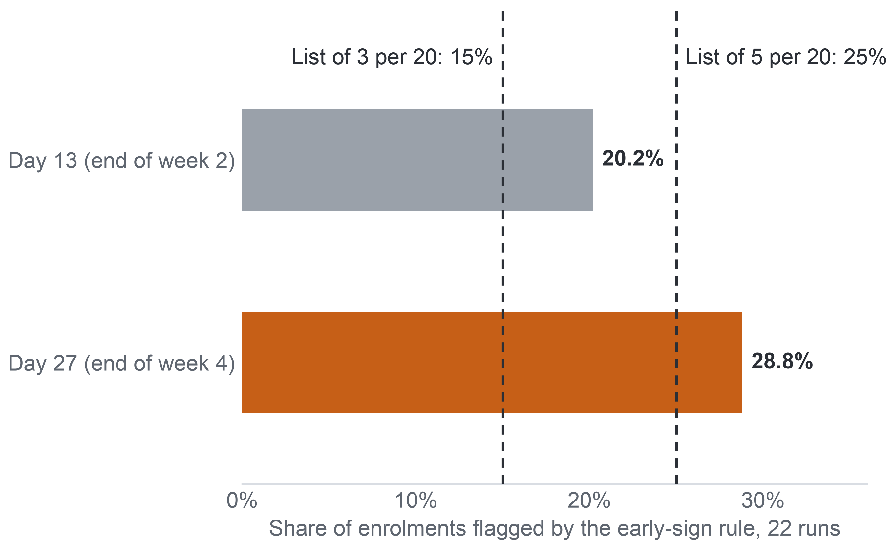
APPENDIX A26: PART 4 · METHOD (MILESTONE 4)
78
Why a Ranking, Not a Threshold
The early-sign rule flags more students than staff can contact, so the list must be ranked to fit capacity.
The rule flags more students than a list can hold
Staff need an order
The rule names more students than a list of 15% or 25% of a run can hold, so someone must decide who comes first.
Risk, not benefit
No data record a contact or its outcome, so the list cannot rank by the expected benefit of a contact.
A person decides
The list orders by risk and shows its reasons; a member of staff decides. Risk as need stays untested until a randomised pilot.
Key: bar = share of the enrolments registered at the cut-off that the early-sign rule flags (a task due and not submitted, a tutor-marked assignment submitted late, or no click in the 7 days before the cut-off). Dashed lines = list lengths at 3 or 5 contacts per 20 students, scenario values.
Notes:
(~64 seconds) Why rank instead of simply flagging? The early-sign rule already names students at risk without any model: 20.2 percent of enrolled students at day 13 and 28.8 percent at day 27, over the 22 runs. Staff capacity, in our scenario, is three or five contacts per twenty students, that is 15 or 25 percent of a run. So the rule names more students than a list can hold, and someone has to decide who comes first. A ranking does that. But a ranking by risk is not a ranking by benefit. No data record a contact or what happened after it, so we cannot say who would gain most from a call. The list orders by risk, shows its reasons, and a member of staff decides. How would we judge such a list?
Source: Milestone 5 report, Section 8 and Appendices VIII and IX.

Slide 79
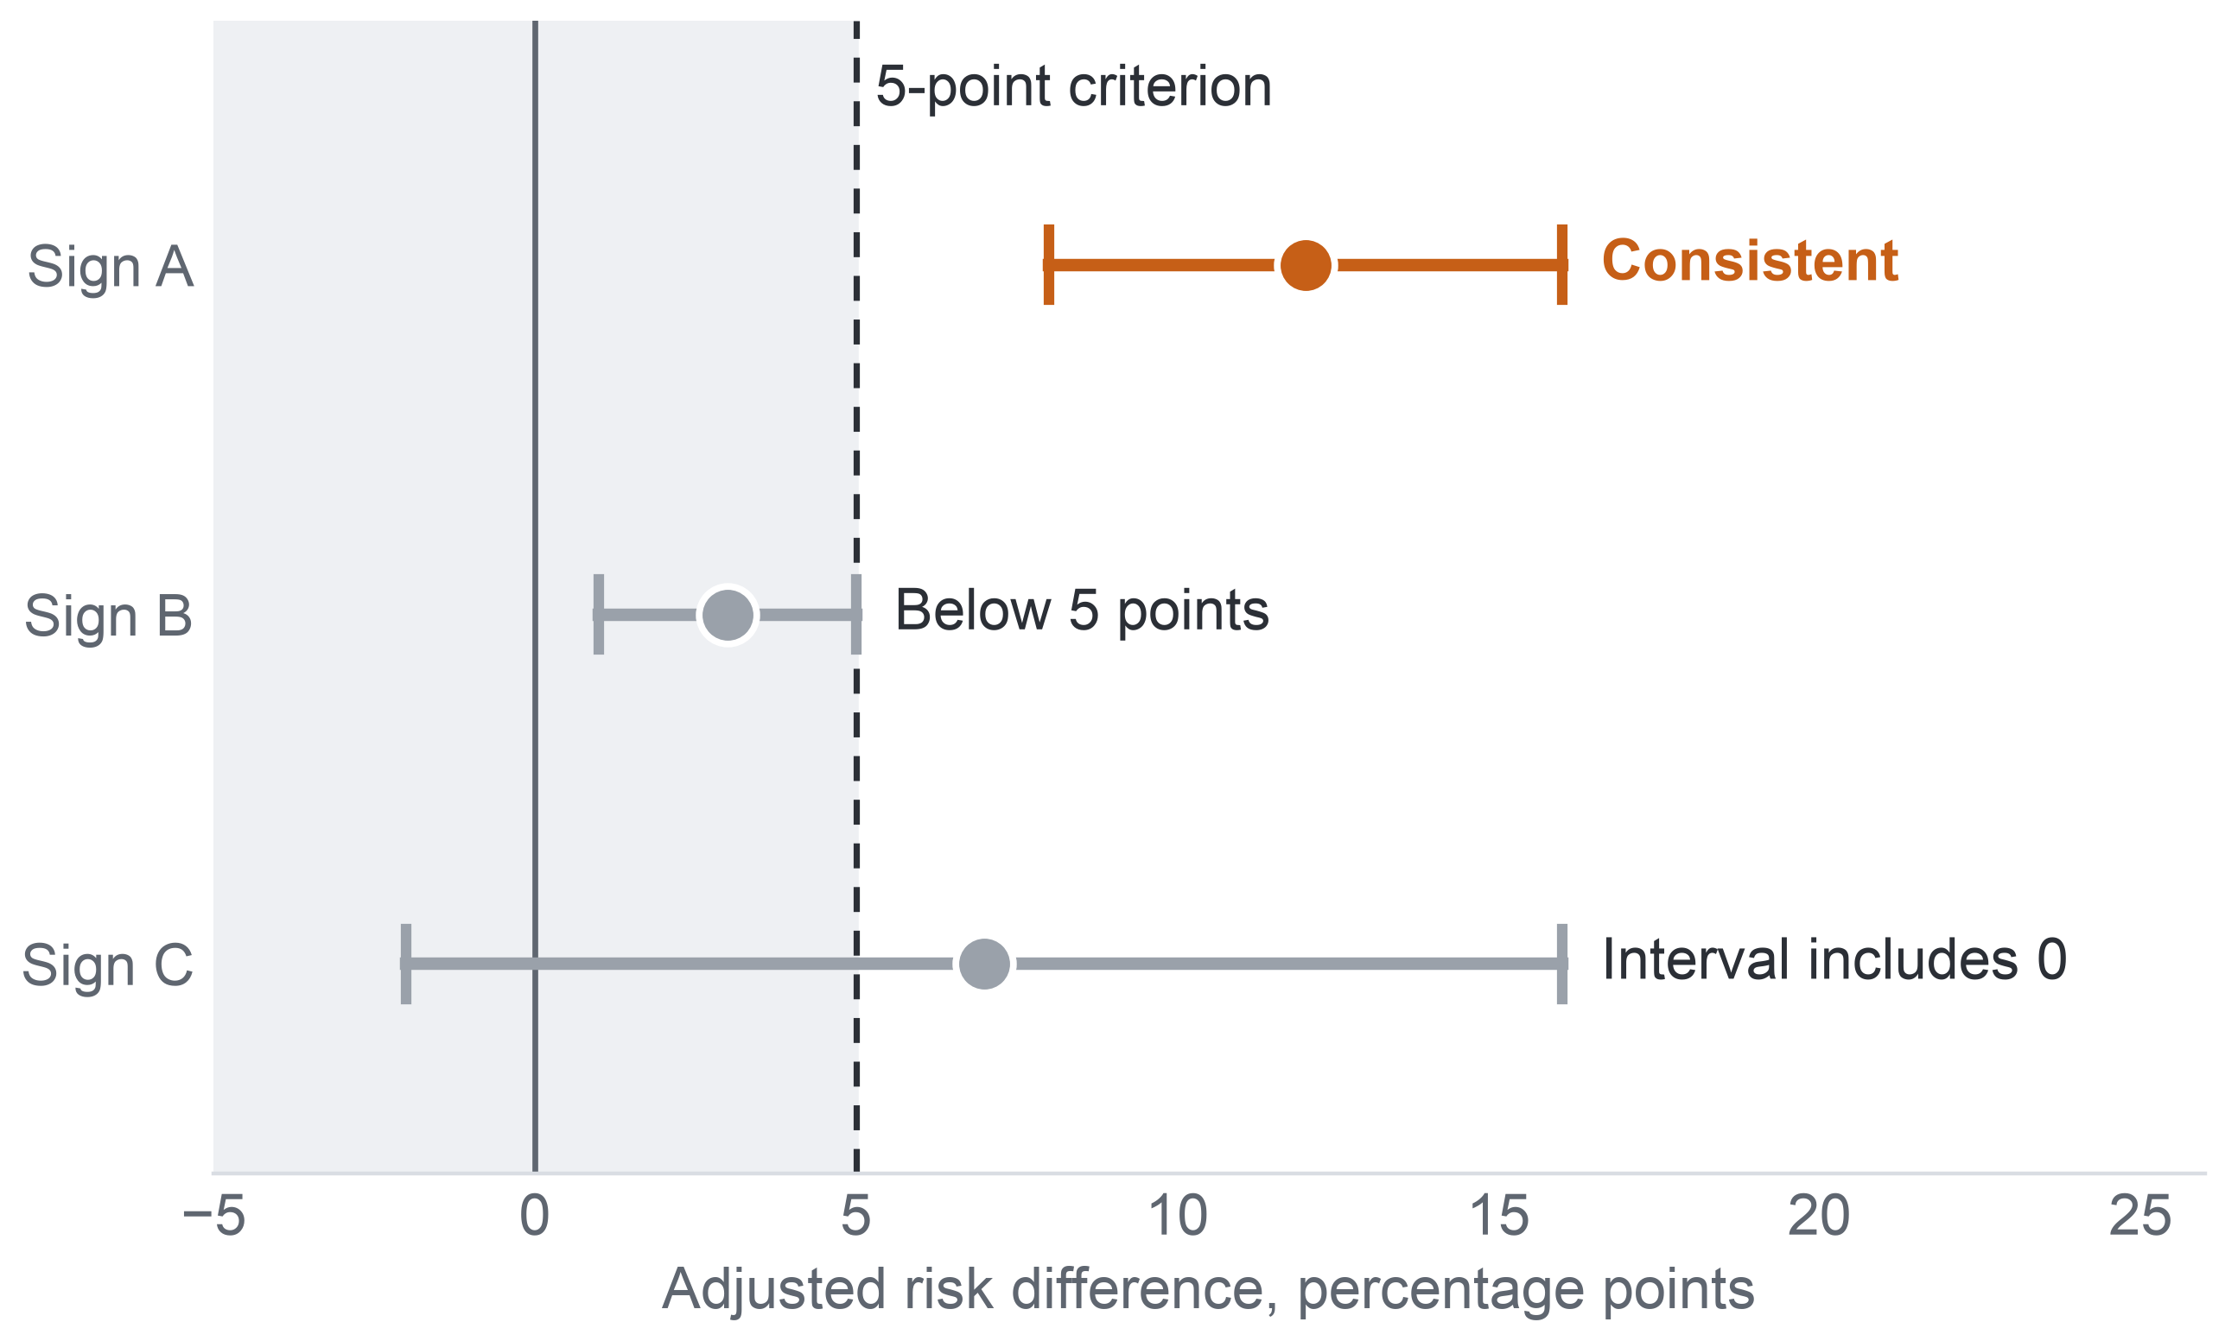
APPENDIX A27: PART 4 · METHOD (MILESTONE 4)
79
The AQ2 Success Criterion
A sign counts as a consistent association only when its adjusted difference is at least 5 points, its interval excludes 0 and its direction holds in two-thirds of modules.
All three conditions must hold
How the criterion sorts three signs (illustration, not data)
1
Risk difference, adjusted for the other signs, of at least 5 percentage points.
2
95% interval of the risk difference excluding 0.
3
Same direction in at least two-thirds of the modules where the sign is defined.
Why 5 points: the smallest gap worth staff attention, a convention fixed in Milestone 4. It is lenient at a base rate near 44%, so the size of each estimate distinguishes the signs.
Why no p-values: a p-value does not measure the size of an effect; p-values are reported but take no part in the verdict.
Key: dot = adjusted risk difference of an invented sign; whisker = its 95% interval; dashed line = the 5-point criterion; grey band = below 5 points. Risk difference = extra percentage points of later non-completion with the sign, within module run. AQ2 = the diagnostic question on early signs.
Notes:
(~63 seconds) Zooming in on AQ2. A sign counts as a consistent association only if three things hold together. Its risk difference, adjusted for the other signs, is at least five percentage points. Its 95 percent interval excludes zero. And it points the same way in at least two-thirds of the modules where it is defined. The three illustrative intervals show the logic: only the first passes; the second is too small, and the third has an interval that reaches below zero. Five points is the smallest gap we treat as worth staff attention, a convention fixed in Milestone 4. It is lenient at a base rate near 44 percent, so the size of each estimate, not the pass, tells the signs apart. P-values take no part. Now the stricter design, for AQ3.
Source: Milestone 5 report, Sections 9 and 9.1, Table 9.1, and Appendix IX.

Slide 80




APPENDIX A28: PART 4 · METHOD (MILESTONE 4)
80
Validation Design
Development and model choice stay inside 2013, and the 13 runs of 2014 are scored once by a model frozen in advance.
2013: 9 runs
leave-one-run-out folds
Freeze 1
question, splits, metrics, baselines
Model choice
challenger rule on the folds
Freeze 2
final model; test access recorded
2014: 13 runs
scored once: 15,724 enrolments at day 27
Inside each fold
Challenger rule
Test populations
Every learned step (filling, scaling, tuning) is refitted; students who also appear in the held-out run are removed from its training data.
Fold results only choose between candidates; they are never reported as performance.
Trees or the extended set replace the primary model only with a gain of at least 0.03 in pooled normalised recall (about 89 more non-completers listed) and a gain in 7 of 9 folds, fixed before any fold result.
9 paired runs (10,801 enrolments) test a later run of a known module; 4 unpaired runs (4,923) test transfer; both also reported apart. The 1,586 test enrolments of students seen in 2013 stay in, and are removed in a sensitivity analysis.
Key: AQ3 = the predictive question. Fold = one 2013 run held out while the model learns from the other 8. Paired run = a 2014 run whose module and start month also ran in 2013. Normalised recall = recall divided by the most a list of its length can reach.
Notes:
(~64 seconds) A predictive claim lives or dies on unseen data, so the validation for AQ3 keeps development and test apart in time. All development happens inside the nine runs of 2013, one run held out at a time, and every step that learns, filling, scaling and tuning, is redone inside each fold. A challenger such as boosted trees replaces the primary model only with a gain of at least 0.03 in pooled normalised recall, about 89 more non-completers listed, and a gain in seven of nine folds, a margin fixed before any fold result. Then two freezes and one test: the model is frozen and scored once on all thirteen runs of 2014. Nine paired runs test a later run of a known module; four unpaired runs test transfer. What must the model achieve there?
Source: Milestone 5 report, Section 9.1 and Appendix IX.

Slide 81
APPENDIX A29: PART 4 · METHOD (MILESTONE 4)
81
Leakage and Interpretability in the Evaluation
No 2014 outcome enters any AQ3 choice, and each listed student's reasons come from the same model that ranks the student.
What a lecturer would see (illustration, not data)
Leakage controls of the evaluation
1. Choices fixed on 2013. Predictors, candidates, selection rule and gate were fixed in Milestone 4 on the 2013 runs alone.
Student, rank 1 of the run's list
1
Task due, not submitted
No click, days 21–27
Clicks below run median
2. Refit inside each fold. Filling, scaling and tuning are redone, so no held-out run informs its own prediction.
Reasons shown are reasons used: each name's signs come from the same model that ranks the student.
3. Folds only choose. Fold results are never reported as performance, because a score that guided a choice flatters the chosen model.
No coefficient is read as a cause: a sign that raises a rank is a reason to look, not an explanation.
Documented: a model card for the model and a datasheet for its data.
Key: AQ3 = the predictive question (model against the early-sign rule). Leakage = information that would not exist at the moment of use. Fold = one 2013 run held out in development. Model card and datasheet = standard documents of a model's and a dataset's use and limits.
Notes:
(~60 seconds) Two last protections. On leakage: the predictors, the candidates, the selection rule and the gate were all fixed in Milestone 4 on 2013 alone, so no 2014 outcome touches any choice. Every learned step is refitted inside each fold, so no held-out run informs its own prediction. And fold results only choose between candidates; they are never reported as performance, because a score that guided a choice flatters the chosen model. On interpretability: the mock row shows what a lecturer would see, a rank and the signs behind it. Those reasons come from the same model that ranks the student, and no coefficient is read as a cause. The model would carry a model card, its data a datasheet. So what did we actually run?
Source: Milestone 5 report, Section 9.2 and Appendix IX.

Slide 82
APPENDIX A30: PART 5 · EVIDENCE (MILESTONE 5)
82
What the Frozen Protocol Fixes
The protocol leaves no modeling choice open: three baselines and four configurations are fixed, and the 2014 outcomes are opened once.
ID | Role | Method | Predictors
B1 | Baseline | Random list | –
B2 | Baseline | Early-sign rule, ranked by its number of signs | Rule columns
B3 | Baseline | Background-only logistic model | Module, start month, attempts, credits, education, registration lead
M1 | Primary | Penalised logistic regression | Primary set
M2 | Challenger | Penalised logistic regression | Extended set
M3 | Challenger | Gradient-boosted trees | Primary set
M4 | Challenger | Gradient-boosted trees | Extended set
Eight steps
1
Reproduce the input; check hashes
2
Fit the baselines
3
Fit the candidates
4
Apply the split and folds
5
Evaluate all; report unfavourable results
6
Error and subgroup analysis
7
Compare with the Level 1 proposal
8
Record the experiment log
One logged test: 2014 outcomes opened once, after the second freeze.
Key: B = baseline; M = model configuration. Primary set = the 19 primary predictors; extended set = the primary set plus 10 further predictors. Early-sign rule = flags a missed task, a late tutor-marked assignment or no click in the 7 days before the cut-off. Orange row = B2, the benchmark the contact decision needs whichever model wins. Ties go to the simpler one.
Notes:
(~60 seconds) The unrun prototype is fully specified, so whoever runs it has no modeling choice of their own. It compares three baselines, a random list, the early-sign rule ranked by its number of signs, and a background-only logistic model, against four configurations: penalised logistic regression and gradient-boosted trees, each on the primary and on the extended predictor set. Ties go to the simpler configuration. Notice baseline B2, the rule's own list: even if no model wins, measuring it tells the contact decision how good the simple rule is. The protocol runs in eight steps, from checking every file's hash to the experiment log, and the 2014 outcomes are opened once, after the second freeze. That closes the method. Now the evidence, starting with how to read it.
Source: Milestone 5 report, Section 10 and Appendix X, Table A.25.

Slide 83
APPENDIX A31: PART 5 · EVIDENCE (MILESTONE 5)
83
How We Read the Findings
A number means different things at different analytics levels, so every finding carries its level and confidence.
Question | Evidence reached | What the answer states | What it does not state
AQ1 – Descriptive | Results on 2013, 2014 and the 22 runs pooled | Outcome shares and first missed week, with denominator and 95% interval | Why a module or run has a higher rate; any rate for the university's own courses
AQ2 – Diagnostic | Results on 2013, replicated on 2014 | Which signs go with later non-completion within module runs, by how many points | That a sign causes non-completion, or that removing it would raise completion
AQ3 – Predictive | Design only; no model trained | The expected output and its gate | Any recall, precision, calibration or other model metric
AQ4 – Prescriptive | Design only; depends on AQ3 | The expected list and the conditions for its use | Whom contact helps, or which contact works
Key: AQ1–AQ4 = the four analytical questions; every finding is an effect size with its 95% interval and population; orange column = what the answer does not state.
Confidence high: two independent computations verify the counts on the stated population, not for the university's courses.
Confidence moderate: estimates keep their direction under the checks but rest on observational data or a model with a known weakness.
Confidence not applicable: no result exists yet; the design waits for its single test.
Notes:
(~61 seconds) Before the first number, a reading guide, because the same number means different things at different analytics levels. AQ1 states what happened on a population, with its denominator and interval; it does not say why. AQ2 states which signs go with later non-completion within module runs; it never says a sign causes it. AQ3 and AQ4 state only their expected outputs and the conditions for use, with no model metric. Every finding is an effect size with its 95 percent interval and its population. Confidence follows the same logic. High means two independent computations agree on the stated population, which says nothing about the university. Moderate means the direction holds under checks but rests on observational data or a known weakness. Next, the whole chain in one matrix.
Source: Milestone 5 report, Section 11 and Appendix XI, Table A.26.

Slide 84
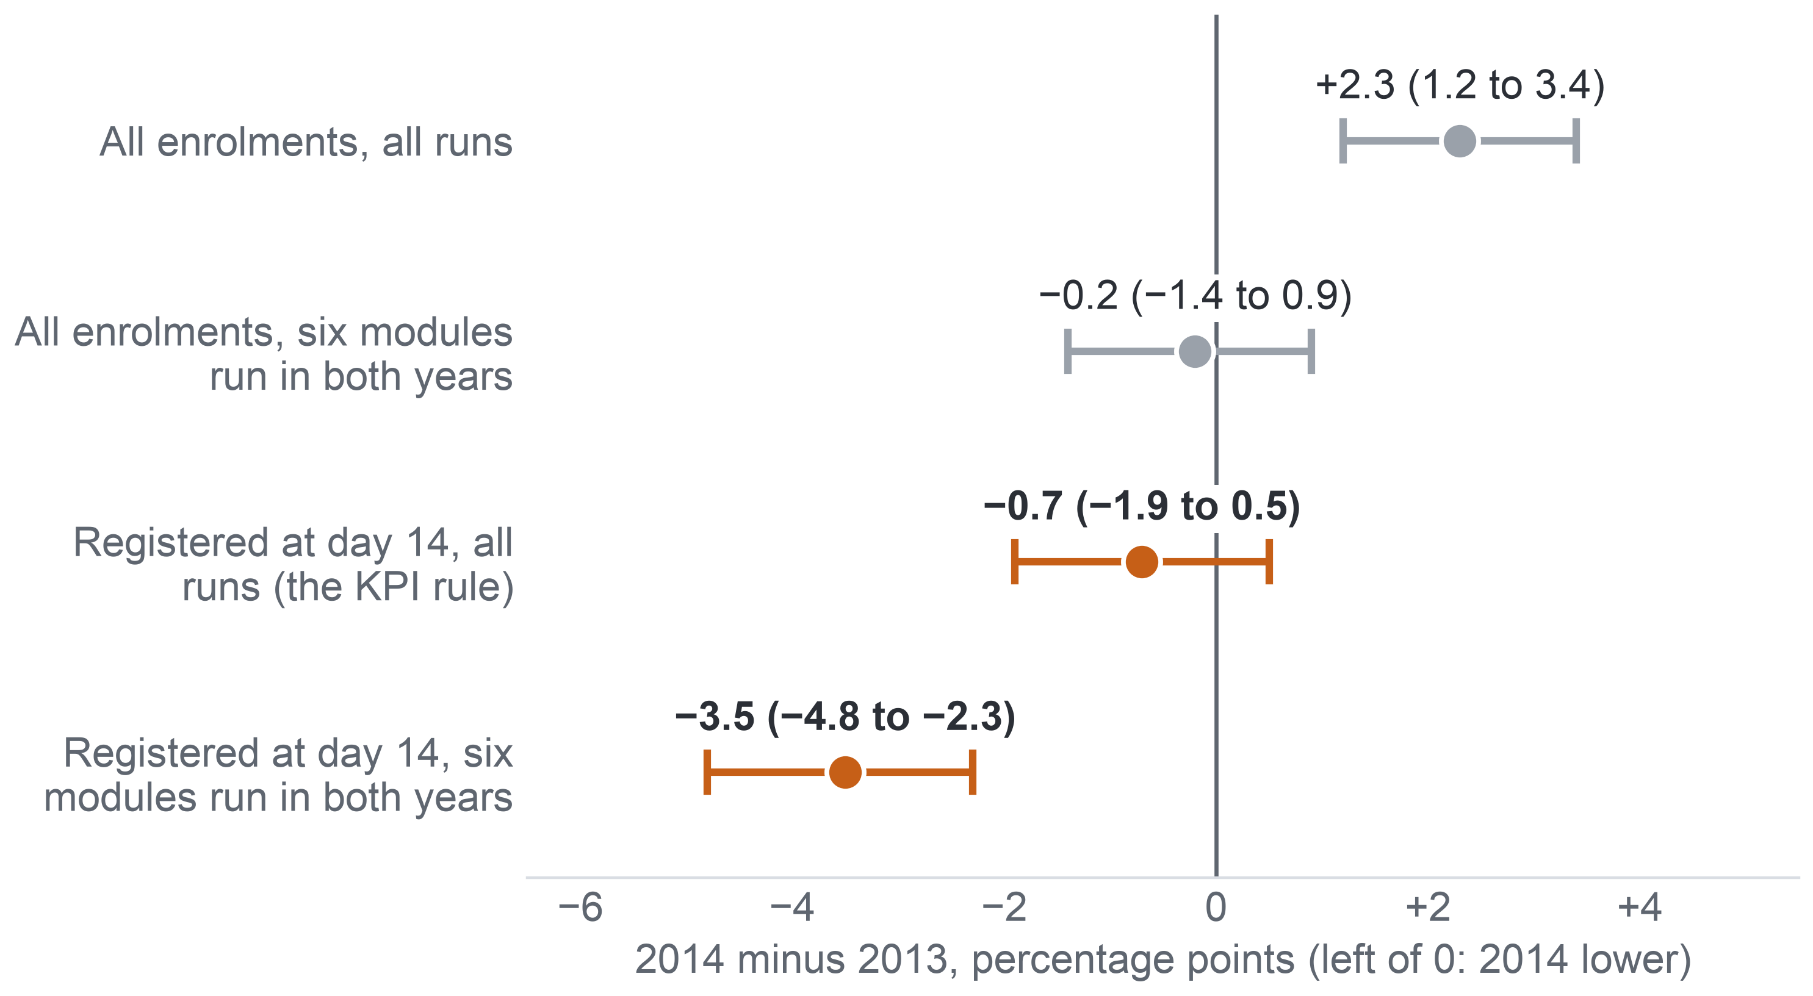
APPENDIX A32: PART 5 · EVIDENCE (MILESTONE 5)
84
AQ1: The Year Comparison Depends on the Add-drop Rule
Over all enrolments 2014 looks worse than 2013, but among students registered at day 14 it is no worse, because more 2014 students left before day 14.
Change in non-completion from 2013 to 2014
The rise comes from CCC
Over all enrolments the +2.3 points come from module CCC, which ran only in 2014 (62.2% of its enrolments); the six shared modules show −0.2.
Why the years flip
16.2% of 2014 enrolments against 10.7% of 2013 were not registered at day 14, so more 2014 non-completers left before the KPI counts them.
So
No general rise among the students the KPI counts; a yearly figure must state its add-drop rule.
Key: dot = 2014 minus 2013 in points; whisker = 95% Newcombe interval, and one that crosses 0 shows no clear difference. Grey = over all enrolments; orange = registered at day 14 (the KPI rule). KPI = key performance indicator (completion after add-drop).
Notes:
(~62 seconds) The denominator matters most when we compare years. Over all enrolments, non-completion was 2.3 points higher in 2014, and that rise comes from module CCC, which ran only in 2014; in the six modules that ran in both years the difference is minus 0.2. Among students registered at day 14, 2014 was 0.7 points lower, and 3.5 points lower in the six shared modules. Same data, opposite stories. The reason: 16.2 percent of 2014 enrolments, against 10.7 percent in 2013, were not registered at day 14, so more of the 2014 students who would not complete left before the KPI counts them. We find no general rise among the students the KPI counts. That is why the KPI fixes the add-drop rule. Next, how rates differ between groups of students.
Source: Milestone 5 report, Section 11.2 and Appendix XII, Table A.32.

Slide 85
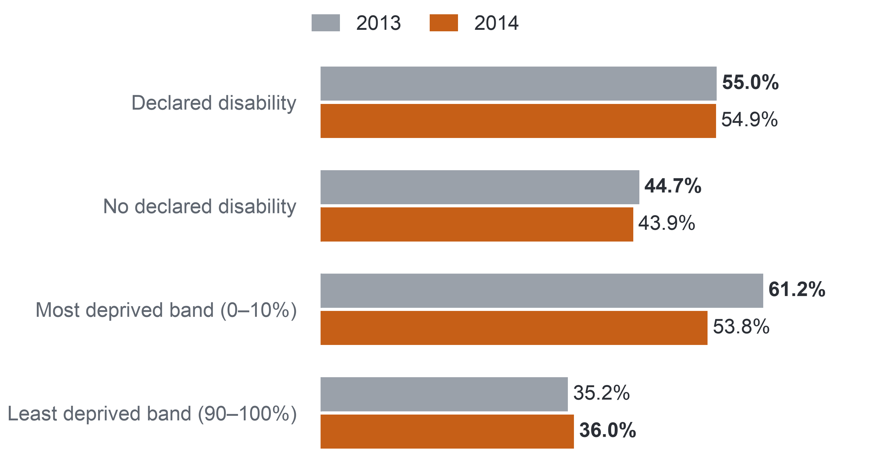
APPENDIX A33: PART 5 · EVIDENCE (MILESTONE 5)
85
AQ1: Non-completion by Group of Students
Non-completion is higher for students with a declared disability and rises with deprivation, which is why these groups anchor the fairness audit.
Non-completion by group, students registered at day 14 (%)
Described, not explained
The rates are not adjusted for any other difference, so they say nothing about why the groups differ.
Too few to compare
Students aged 55 or over: 76 in 2013 and 122 in 2014, too uncertain for any comparison.
So
These are the groups where a list could fail students most: the confirmatory groups of the fairness audit (Slide 29).
Key: bar length = non-completion (Fail or Withdrawn) in the group. Groups: declared disability 1,157 (2013) and 1,519 (2014); most deprived band 1,196 and 1,512; least deprived band 969 and 1,299. Deprivation band = Index of Multiple Deprivation band of the student's home area.
Notes:
(~62 seconds) One more descriptive pattern, on the same day-14 population, before the timing result. Students with a declared disability did not complete in 55.0 percent of enrolments in 2013 and 54.9 percent in 2014, against 44.7 and 43.9 percent of other students. Non-completion falls from the most deprived home areas to the least deprived: from 61.2 to 35.2 percent in 2013, and from 53.8 to 36.0 percent in 2014. These are descriptions without adjustment; they say nothing about why. Students aged 55 or over are too few for any comparison. But these gaps show where a list could fail students most, which is why disability and the deprivation bands are the groups the fairness audit checks. Now the finding that shaped the design: when do non-completers first miss a task?
Source: Milestone 5 report, Sections 9.2 and 11.2, and Appendix XII.

Slide 86
APPENDIX A34: PART 5 · EVIDENCE (MILESTONE 5)
86
AQ2: How We Tested the Signs
We compared each early sign within its own module run, adjusted for the other signs, on 2013 and again, unchanged, on 2014.
Task signs: runs with a task due by day 27 (9,960 and 12,585 enrolments)
Population
Registered at day 27: 11,811 enrolments in the 9 runs of 2013 (44.4% did not complete) and 15,724 in the 13 runs of 2014 (44.0%), module CCC included.
Missed task
a TMA or CMA due by day 27, not submitted by then
Late TMA
a TMA due by day 27, submitted after its deadline
Model and result
Logistic regression with a fixed effect for each run, background terms and sign × module terms. Result: a risk difference in percentage points, each sign adjusted for the other four; an association, not an effect.
Click signs: every run (11,811 and 15,724 enrolments)
No click in the last 7 days
no platform click on days 21–27
Activity below the run median
clicks on days 0–27 below the median of the same run
Criterion, fixed in Milestone 4
At least 5 points, a 95% interval excluding 0, and the same direction in at least two-thirds of the modules; p-values take no part.
No click before the start
no click before day 0, the start of the run
Key: AQ2 = the diagnostic question (which early signs go with later non-completion); TMA = tutor-marked assignment; CMA = computer-marked assessment; run = one offering of a module.
Notes:
(~67 seconds) Missed tasks came too late for most non-completers, so the diagnostic question, AQ2, asks what else shows by day 27. We took the enrolments still registered at day 27: 11,811 in the nine runs of 2013, and 15,724 in the thirteen runs of 2014, where we reran the same model unchanged. Each sign is dated on or before day 27. Task signs exist only in runs with a task due by then; click signs exist in every run. The model is a logistic regression with a fixed effect for each run, so a student is compared only with others in the same run, and each sign is adjusted for the other four. Each result is a risk difference in percentage points: an association, not an effect. The verdict rule was fixed in Milestone 4. Here is what the signs show.
Source: Milestone 5 report, Section 11.3, Section 9, Table 9.1, and Appendix XIII.

Slide 87
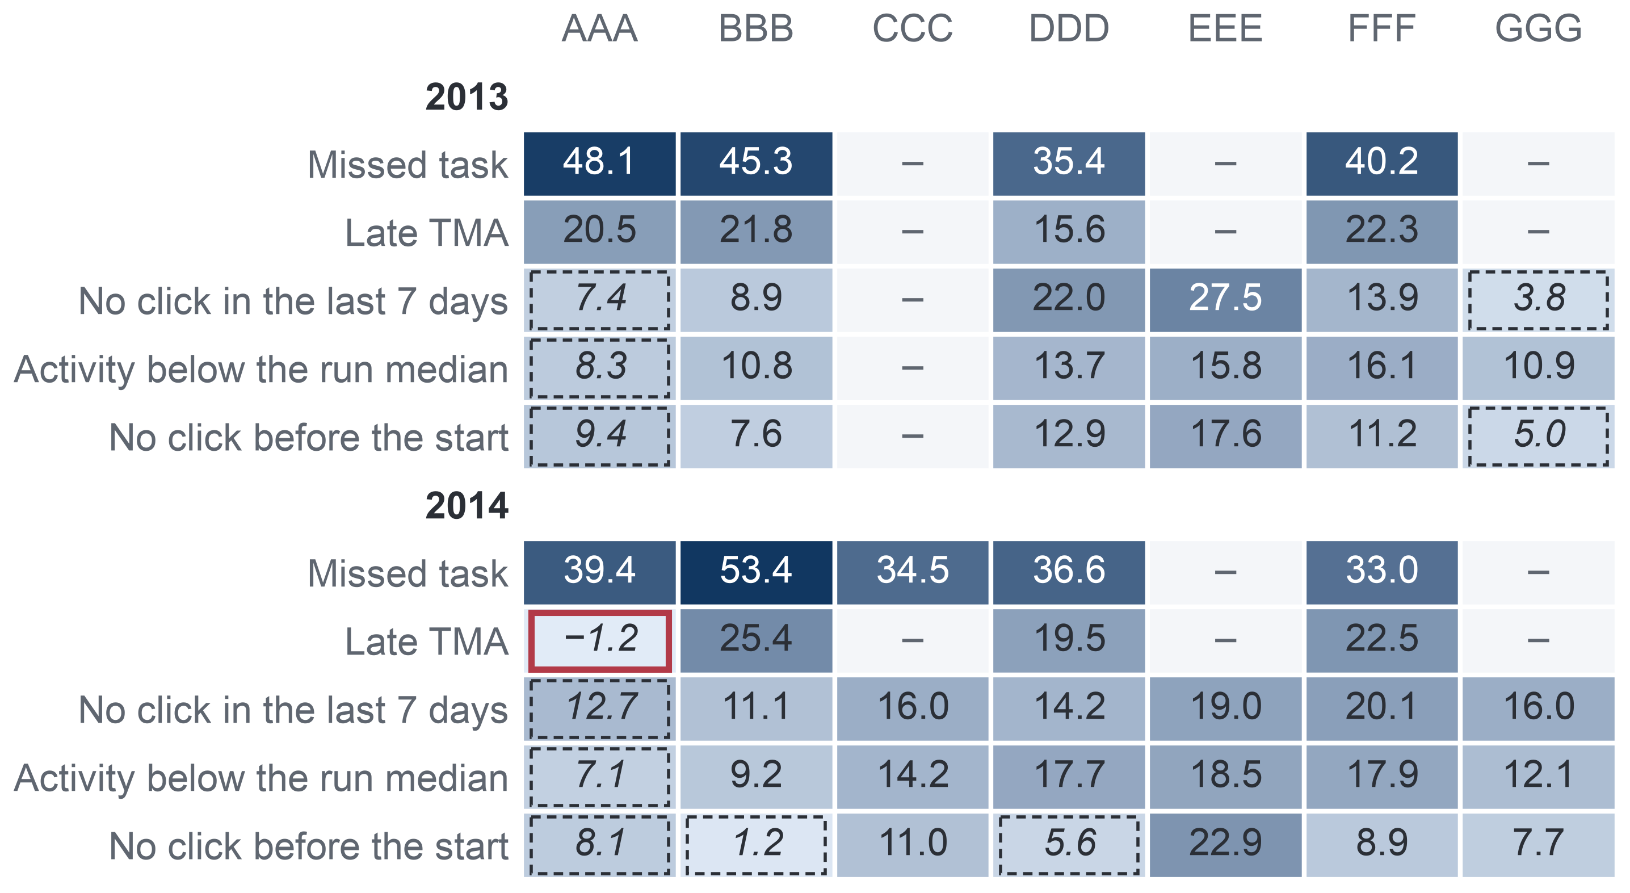
APPENDIX A35: PART 5 · EVIDENCE (MILESTONE 5)
87
AQ2: Consistent Across Modules
Each sign points the same way in every module in 2013 and in 29 of 30 module estimates in 2014, but its size varies between modules.
Risk difference by module, points, adjusted for the other signs
Direction holds
2013: every sign keeps its direction in every module where it is defined (4 of 4 for the task signs, 6 of 6 for the click signs). 2014: 29 of 30 module estimates.
One wide exception
A late TMA (tutor-marked assignment) in AAA 2014: −1.2 points on 348 enrolments, interval −14.4 to 12.1, which includes 0. No CCC student had a late TMA by day 27.
Size varies
No click in the last 7 days goes with 27.5 points in EEE but 3.8 in GGG (2013). Intervals that include 0 lie mostly in the small module AAA: no evidence there, not evidence of no information. Consistency means the same direction, not the same size.
Key: darker cell = larger risk difference; – = sign not defined (no task due by day 27) or module not run; italic with dashed frame = 95% interval includes 0; red frame = the one estimate in the opposite direction. AAA–GGG = the seven anonymised modules of the Open University Learning Analytics Dataset.
Notes:
(~67 seconds) Two years agreeing is encouraging; the next test is module by module. In this heat table each cell is one sign in one module, and the darker the cell, the larger the risk difference. In 2013 every sign points the same way in every module where it is defined. In 2014, 29 of the 30 module estimates do. The one exception is a late TMA in the small module AAA: minus 1.2 points on 348 enrolments, with an interval from minus 14.4 to plus 12.1, so it tells us little either way. What does vary is size: no click in the last seven days goes with 27.5 points in EEE but only 3.8 in GGG. So consistency means the same direction, not the same size, and a new run may differ. Next, did our own analysis choices drive these results?
Source: Milestone 5 report, Section 11.3 and Appendix XIII, Table A.34.

Slide 88
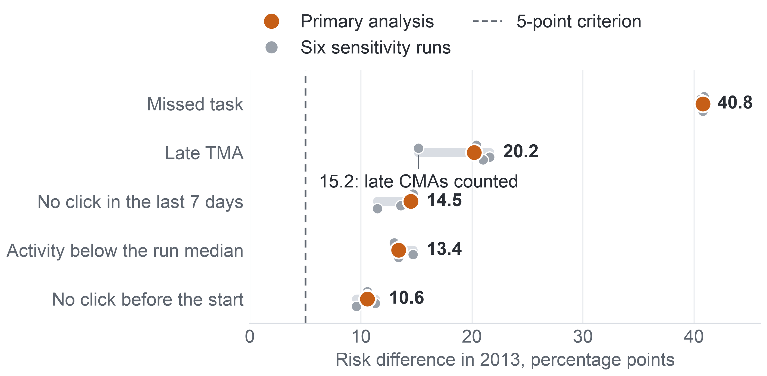
APPENDIX A36: PART 5 · EVIDENCE (MILESTONE 5)
88
AQ2: Sensitivity Runs
Six sensitivity runs in each year change no verdict: every sign stays above 5 points with an interval excluding 0.
Each sign under the primary analysis and six sensitivity runs, 2013
Largest shift
Counting late CMAs lowers the late sign from 20.2 to 15.2 points, because by day 27 a late CMA occurs only in DDD 2013B, in 85.65% of its enrolments.
2014 agrees
The same six runs leave every 2014 verdict unchanged: the smallest estimate under any of them is 6.9 points, with a lowest interval bound of 4.3.
All 22 runs pooled
Key: sensitivity run = the same model with one analysis choice changed: de-duplicated clicks; late CMAs (computer-marked assessments) counted as late, beside late TMAs (tutor-marked assignments); flagged enrolments removed; the 2 runs with no task due removed; low activity cut at half the run median; one sign effect for all modules. The grey band spans all seven estimates.
On 27,535 enrolments registered at day 27, the five signs go with 39.8, 20.6, 14.7, 14.0 and 9.4 points and meet the criterion in every module.
Notes:
(~62 seconds) Next, were these results an artefact of our choices? We reran the 2013 model six times, each time changing one choice: removing duplicate clicks, counting late computer-marked tasks as late, dropping uncertain records, dropping the two runs with no task due, cutting low activity at half the median, and forcing one sign effect for all modules. On the chart, the orange dot is the primary estimate and the grey dots are the variants; every dot stays to the right of the five-point line. The biggest move is the late sign, from 20.2 to 15.2, because only one run had late computer-marked tasks by day 27, in 85.65 percent of its enrolments. In 2014 the smallest estimate under any variant is 6.9 points. One model check, though, found a real weakness.
Source: Milestone 5 report, Appendix XIII, Table A.35 and the sections on sensitivity runs and on the comparison of the two years.

Slide 89
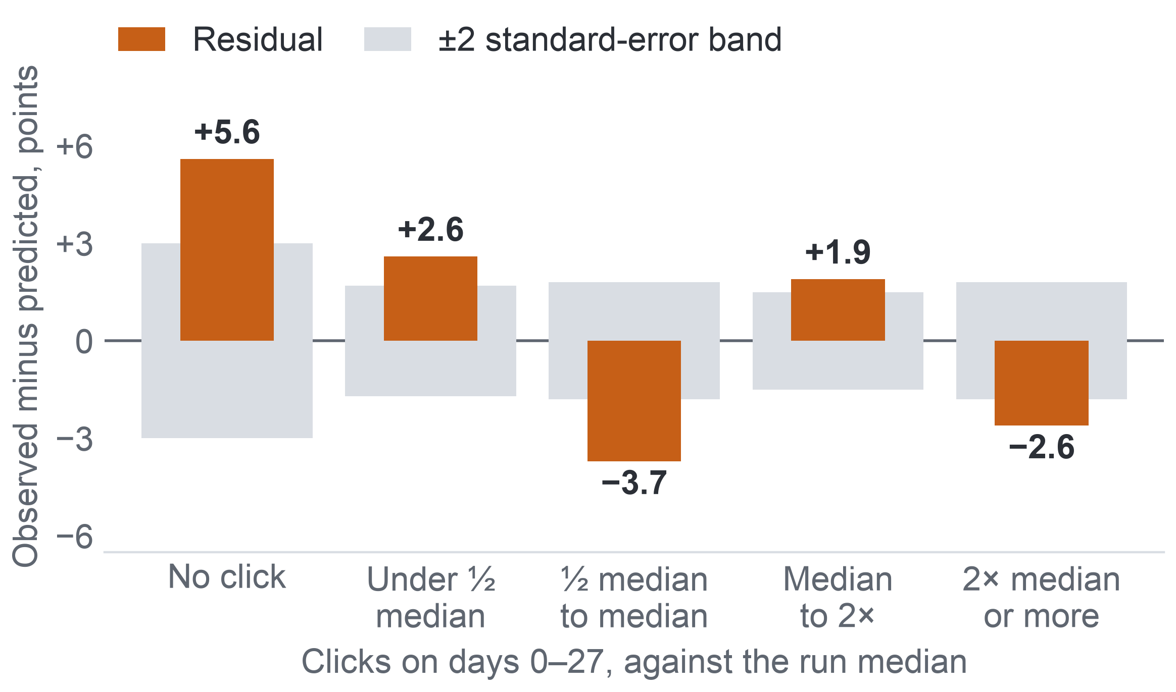
APPENDIX A37: PART 5 · EVIDENCE (MILESTONE 5)
89
AQ2: Activity Works as a Gradient
The yes-or-no click signs miss a graded activity pattern; with clicks as a continuous measure, the below-median sign falls below the criterion in 2014 while the other four still meet it.
Model error by activity level, 2013
Risk difference, planned → with clicks as a continuous adjustment, points
Sign | 2013 | 2014
Missed task | 40.8 → 37.3 | 39.3 → 35.6
Late TMA | 20.2 → 19.5 | 20.3 → 19.5
No click in the last 7 days | 14.5 → 9.3 | 15.8 → 10.7
Activity below the run median | 13.4 → 5.8 | 14.6 → 5.9: same direction in 4 of 7 modules, criterion not met
No click before the start | 10.6 → 8.9 | 8.7 → 6.5
Key: residual = observed minus predicted non-completion; all five levels lie outside their band. 11,811 enrolments.
Key: continuous adjustment = log(1 + clicks on days 0–27) added to the model; TMA = tutor-marked assignment.
Chosen after seeing the residuals, so the added run qualifies the verdict; the planned estimates remain the primary result. Design consequence: the AQ3 model (the predictive question) uses continuous click measures.
Notes:
(~66 seconds) One model check found a real weakness. Observed against predicted non-completion by activity level, the model is off in all five levels. Students with no click at all in four weeks did not complete 5.6 points more often than predicted; students between half the median and the median, 3.7 points less often. The yes-or-no sign treats everyone under the median alike, yet non-completion keeps falling as activity rises. So, after seeing this, we added one run with clicks as a continuous measure. The misfit disappears in 2013 and shrinks in 2014. The click signs shrink, and the below-median sign falls to 5.8 points in 2013 and 5.9 in 2014, where it no longer meets the criterion. The other four still do. Chosen after looking, this run qualifies the verdict. So what do the signs mean for a list?
Source: Milestone 5 report, Section 11.3 and Appendix XIII, Table A.36 and the section on sensitivity runs and model checks.

Slide 90
APPENDIX A38: PART 6 · INTEGRATION AND USE (MILESTONE 5)
90
Limitation Log
Each limit is logged with its kind and its handling, so a reader knows where each answer can and cannot be used.
Limitation | Kind | Handling
Year difference over all enrolments in shared modules; small-module click signs (intervals include 0) | No evidence found | No claim; reported as uncertain
Contact and its outcome; delivery mode, year of study, attendance; staff capacity | No data to test | Randomised pilot
Several-modules sign before 2014; approved leave and transfer | No data to test | Described on 2014; university recount
AQ3 and AQ4 results | Not yet tested | Single AQ3 test, design unchanged
Binary click signs; below-median sign weak in 2014 once adjusted; KPI proxy and denominator | Measurement | Continuous click measures in AQ3; one add-drop rule
UK distance learning of 2013–2014; observational design | Scope and causal | Re-check on the university's records; options as hypotheses
Key: kind colours: red = no evidence found; blue = no data to test; orange = not yet tested; violet = measurement; teal = scope and causal. Several-modules sign = tasks missed in more than one module at once; KPI = key performance indicator; add-drop rule = only students still registered at day 14 count; AQ3, AQ4 = the predictive and ranking questions.
Notes:
(~65 seconds) Following those three boxes, here is the log. Where we saw no clear difference, such as the year difference in shared modules over all enrolments, or click signs in the smallest module, we make no claim. Contacts, delivery mode, year of study, attendance and capacity have no data anywhere, so they go to the pilot. The several-modules sign has almost no cases before 2014, and leave or transfer cannot be told apart from withdrawal, so the university must recount. AQ3 and AQ4 are not yet tested, and their design stays unchanged until the single test. Then measurement: the click signs are binary, the below-median sign is weak in 2014 once adjusted, and the KPI is a proxy. And the largest: two years of UK distance learning, observed rather than randomised. Next, a closer look at measurement.
Source: Milestone 5 report, Section 12, Table 12.1, and Appendix XV, Table A.41.

Slide 91
APPENDIX A39: PART 6 · INTEGRATION AND USE (MILESTONE 5)
91
Measurement and Model Limits
Several design values are assumptions and several estimates are lenient, so the sizes of the estimates matter more than the verdicts.
Limit | What it means | What it affects
KPI proxy | Completion of a module run stands for course completion; approved leave or transfer counts as withdrawal. | The baseline completion rate
Denominator | Who counts as enrolled moves a run's rate by up to 13.6 points. | Every year comparison
Capacity assumed | 3 or 5 contacts per 20 students; runs stand in for each lecturer-advisor's groups. | List lengths of D1 and AQ4
Lenient criterion | 5 points at a base rate near 44%. | AQ2 verdicts: sizes separate the signs
Runs held fixed | Intervals treat the runs as fixed; module estimates span 3.8 to 27.5 points. | How far a later run may differ
Run length | A module run lasts 234 to 269 days, longer than a semester. | The meaning of “week 4” at the university
No minimum gain | Gate S1 sets no minimum size of gain. | A pass is read with the number of extra non-completers listed
Fairness trade-off | Fairness criteria cannot all hold when base rates differ. | One criterion: equal recall at capacity
Key: KPI = key performance indicator; D1 = whom to contact; AQ2 = the diagnostic question; AQ4 = the ranking question; S1 = the gate a model must pass to replace the early-sign rule.
Notes:
(~65 seconds) Following the log, a closer look at measurement and model limits. The KPI is a proxy: a module run stands for a course, and approved leave or transfer counts as withdrawal; and the denominator alone moves a rate by up to 13.6 points. Capacity is assumed, three or five per twenty, with runs standing in for each lecturer-advisor's groups. Our five-point criterion is lenient when the base rate is near 44 percent, so the sizes, not the verdicts, separate the signs. The intervals treat runs as fixed, so a new run may vary more. A module run lasts 234 to 269 days, longer than a semester. Gate S1 sets no minimum gain. And fairness criteria cannot all hold at once when base rates differ, so we fixed one. Next, the work that would lift these limits.
Source: Milestone 5 report, Section 12, Appendix XII, Appendix XIII, Table A.34, and Appendix XV, sections on measurement and on model and analysis limits.

Slide 92
APPENDIX A40: PART 6 · INTEGRATION AND USE (MILESTONE 5)
92
Next at the University: Recount and Replace Assumptions
At the university, the baseline is recounted under the add-drop rule, the early-sign rule is checked on its task calendar, and every assumed value is replaced by its records.
Five assumed values to replace
Step 3: transfer to the university
Recount baseline completion under the add-drop rule: the denominator alone moves a rate by more than ten points.
Check the early-sign rule on the university's task calendar.
Re-check the AQ1 and AQ2 results.
Baseline completion rate
Capacity figures
The university's records
its own counts replace each value
One-week data delay
Data needed
List lengths: 3 or 5 per 20
Two years of the university's enrolment, task and platform records, with access approved by the legal and data office.
Ten-point fairness gap of FR1
Not imputed or simulated
Acceptance of activity-based contact was voiced only by simulated students, so real students in Vietnam must be asked.
Contacts, attendance and year of study: invented values would turn assumptions into apparent evidence.
Key: add-drop rule = only students still registered at day 14 count; FR1 = the fairness review rule; AQ1, AQ2 = the descriptive and diagnostic questions.
Notes:
(~63 seconds) Step three moves to the university. First, recount the baseline completion rate under the same add-drop rule we used, because, as AQ1 showed, the denominator can move a rate by more than ten points. Second, check the early-sign rule against the university's own task calendar. Third, re-check the AQ1 and AQ2 patterns on two years of its records. Along the way, five assumed values get replaced: the baseline rate, the staff capacity, the one-week data delay, the list lengths and the ten-point fairness gap. We do not impute or simulate contacts, attendance or year of study, because invented values would look like evidence. And one more honest point: only simulated students said they would accept contact based on their activity, so real students must be asked. Then come the legal duties.
Source: Milestone 5 report, Section 12.1 and Appendix XV, Table A.42 and the text after it.

Slide 93
APPENDIX A41: PART 6 · INTEGRATION AND USE (MILESTONE 5)
93
Risk Classification and Human Control
A contact list built from a model is likely a high-risk use of AI in education under Vietnamese law, so it needs a risk classification first, and staff keep the final say.
Law on Artificial Intelligence, No. 134/2025/QH15
Decision 33/2026/QĐ-TTg
Applies from 1 March 2026: human control and the ability to intervene over every decision of an AI system.
Lists among high-risk uses in education AI systems that automatically assess or rank learners, and those that monitor or analyse learner behaviour.
Step 3: transfer
records recounted
Step 4: risk classification
legal review and consultation with students, before any contact
Step 5: pilot
staff keep the final say on every contact
Personal data
Ethics
A declared disability is health information, so the pilot needs the student's consent to use it.
Predictive analysis carries a potential for bias and stereotyping, so a flag leads to support, expires with the run and never becomes a label.
Key: AI = artificial intelligence. Arrows from the two legal texts point to the step they require.
Notes:
(~62 seconds) Following the transfer step, the law. Vietnam's Law on Artificial Intelligence applies from 1 March 2026 and requires human control, and the ability to intervene, over every decision of an AI system. A 2026 government decision lists among high-risk uses in education systems that rank learners and systems that analyse learner behaviour. A contact list built from a model is likely to fall in that class. So step four is a risk classification first, with legal review and consultation with students, and staff keep the final say on every contact. A declared disability is health information, so the pilot needs consent to use it. Ethically, a flag leads to support and expires with the run; it never follows a student as a label. That brings us to the pilot itself.
Source: Milestone 5 report, Sections 12 and 12.1, Appendix VI and Appendix XV.

Slide 94
APPENDIX A42: PART 6 · INTEGRATION AND USE (MILESTONE 5)
94
AI Decision Log
Each milestone records what AI was used for, how we checked its output and what we decided.
Milestone | AI used for | Our check | Our decision
1 Problem | Simulated stakeholders and a reviewer: 12 critiques | Each quote checked against its transcript; 9 accepted, 2 in part, 1 rejected | Cut-offs moved to the end of weeks 2 and 4; the interviews count as simulated
2 Data | Requirement critic and selection reviewer: 22 critiques | No dataset fact without the official source | Gates require a dated withdrawal and dated tasks
3 Preparation | Code assistant and a separate leakage auditor: 8 findings | Fixture tests; 13 of 13 numbers equal to an independent recount | All eight findings acted on
4 Method | Three isolated reviewers: 24 critiques | Each checked against design facts and arithmetic | Switching rule with a margin fixed in advance; gate S1 fixed on all 13 test runs
5 Evidence | Evidence extraction, AQ1 and AQ2 code, drafting and review | 369 statements checked against 32 sources, 0 errors; 2014 associations re-estimated by separate code, 35 of 35 agree | 66 critiques: 42 accepted, 14 in part, none rejected, 10 handled in finishing
Key: S1 = the gate a model must pass to replace the early-sign rule; AQ1, AQ2 = the descriptive and diagnostic questions; fixture = a small input with a known answer; no AI produced a metric value, threshold or result.
Notes:
(~64 seconds) Behind that rule is a decision log for every milestone. In Milestone 1, a reviewer gave twelve critiques; we accepted nine, two in part, and rejected one. In Milestone 2, critics pushed the gates to require a dated withdrawal and dated tasks. In Milestone 3, every script was kept only after review, thirteen of thirteen numbers matched an independent recount, and all eight findings of the leakage auditor were acted on. In Milestone 4, three isolated reviewers led us to fix a switching rule and the single gate in advance. In this milestone, 369 extracted statements were checked against 32 sources with no errors, the 2014 estimates were re-estimated by separate code, 35 of 35 agreeing, and the full draft drew 66 critiques. What did AI actually change, and what did we refuse?
Source: Milestone 5 report, Section 13.1 and Appendix XVI, Table A.43.

Slide 95
APPENDIX A43: PART 6 · INTEGRATION AND USE (MILESTONE 5)
95
What AI Changed, and What We Rejected
AI helped most when it had to argue from the data, and the decisions stayed ours.
Where it helped
What we rejected
Decisions that stayed ours
The Milestone 3 auditor found tasks due before registration counted as missed, and a leakage check that could not fail, that is, one that would pass even with leakage.
The Milestone 4 reviewer found that the 2013 runs hold 6 modules, not 7, which made the AQ2 criterion a share of modules.
Removing early identification from the Business Goal.
An imbalance argument for precision–recall curves: non-completion is 44–46%.
Looking at the outcomes of repeat test students, which would break the independent test.
Keep the 2014 runs out of every AQ3 choice.
One early-sign rule for OULAD and the pilot.
Report AQ3 and AQ4 as designs.
State every association as an association.
Every result in the report comes from code we reran and checked.
Key: leakage check = a test that information from after the cut-off does not enter the predictors; AQ2 = the diagnostic question; AQ3, AQ4 = the predictive and ranking questions; OULAD = Open University Learning Analytics Dataset.
Notes:
(~61 seconds) Looking back, AI helped most when it had to argue from our data rather than from general advice. In Milestone 3 the auditor found real errors: tasks due before registration counted as missed, and a leakage check that could never fail. In Milestone 4 a reviewer noticed that the 2013 runs hold six modules, not seven, which changed our AQ2 criterion. Rejections mattered as much. We kept early identification in the Business Goal, did not use an imbalance argument when the classes are near half and half, and refused to look at repeat students' outcomes, which would have broken the test. And the key choices were ours: protect 2014, keep one rule, report designs as designs, and associations as associations. With that, we can draw our conclusions.
Source: Milestone 5 report, Section 13.2 and Appendix XVI.

