Slide 1
Garbage Collector in
Java Explained
You cannot see it, but it’s there...

Slide 2
A Definition of Java Garbage Collection
Performs automatic memory management.
Java runs on the JVM, objects are created on the heap.
Eventually, some objects will no longer be needed.
GC finds and deletes unused objects to free up memory.

Slide 3
So how it Works?
STEP 1: Marking
STEP 2: Normal Deletion
STEP 2a: Deletion with Compacting
Java GC is an automatic process. The garbage collection implementation lives in the JVM. Each JVM can implement garbage collection however it pleases. There are many JVMs, Oracle’s HotSpot is by far the most common. All HotSpot’s GC follow the same basic process:

Slide 4
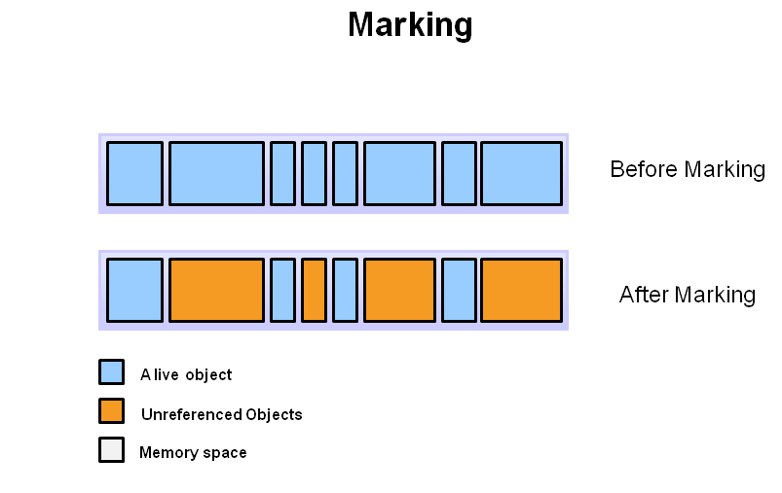

Slide 5
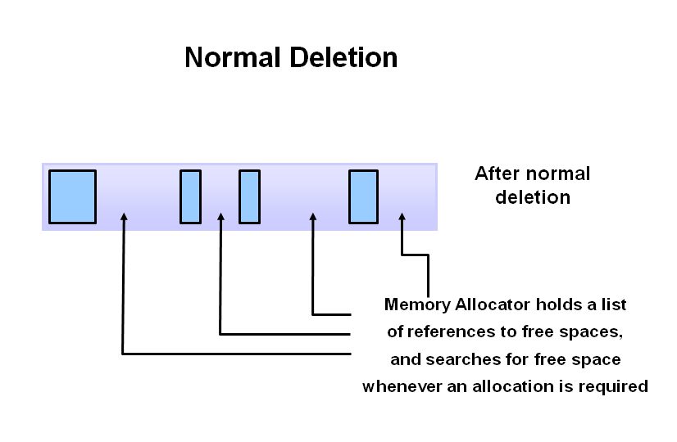

Slide 6
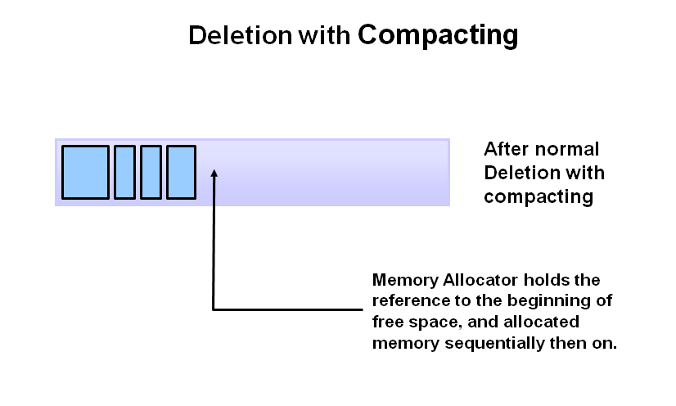

Slide 7
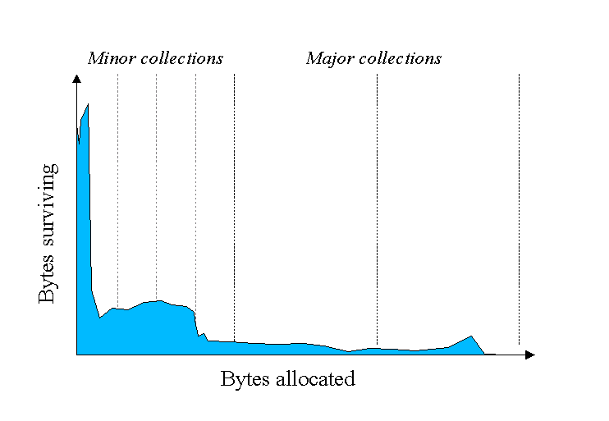
Why Generational GC?
As you can see, fewer and fewer objects remain allocated over time. In fact most objects have a very short life as shown by the higher values on the left side of the graph.

Slide 8
JVM Generations
FIRST: Young Generation
SECOND: Old Generation
THIRD: Permanent generation

Slide 9
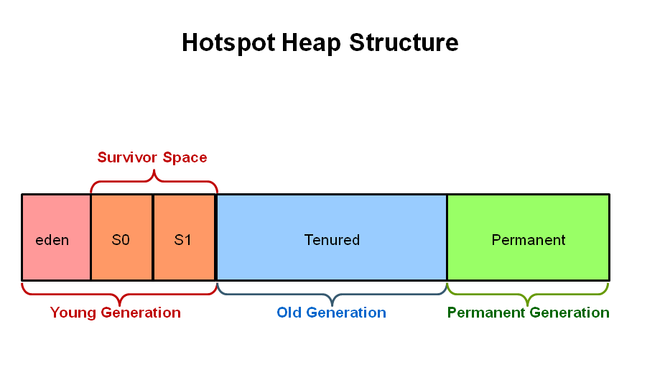

Slide 10
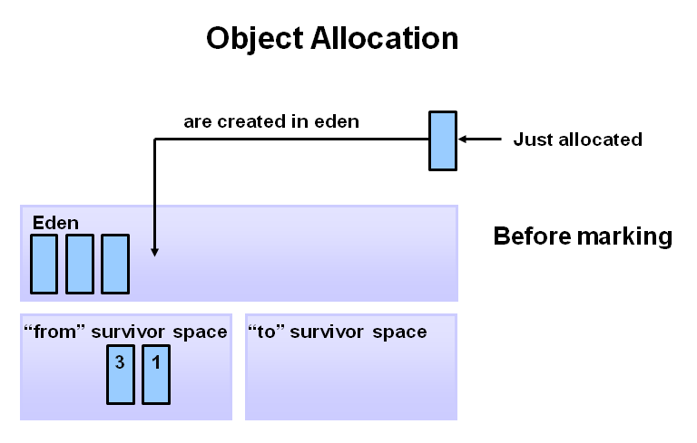

Slide 11
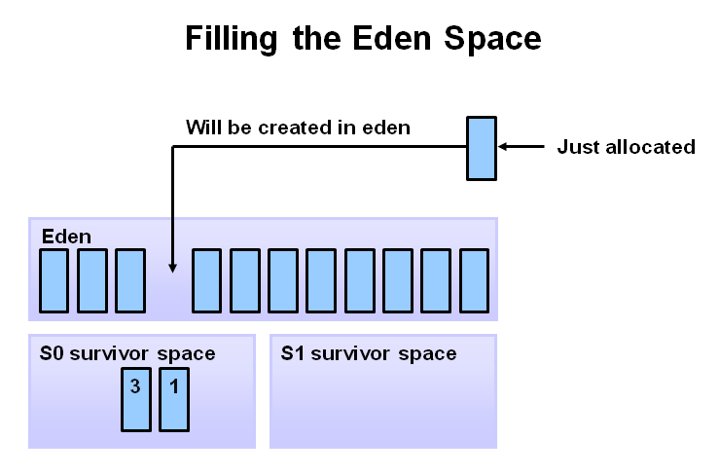

Slide 12
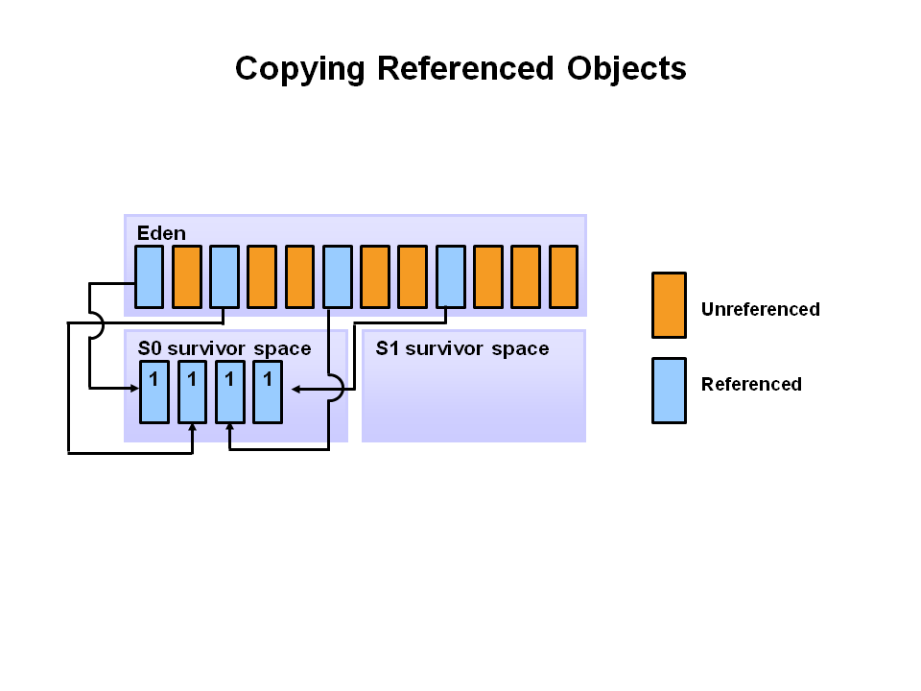

Slide 13
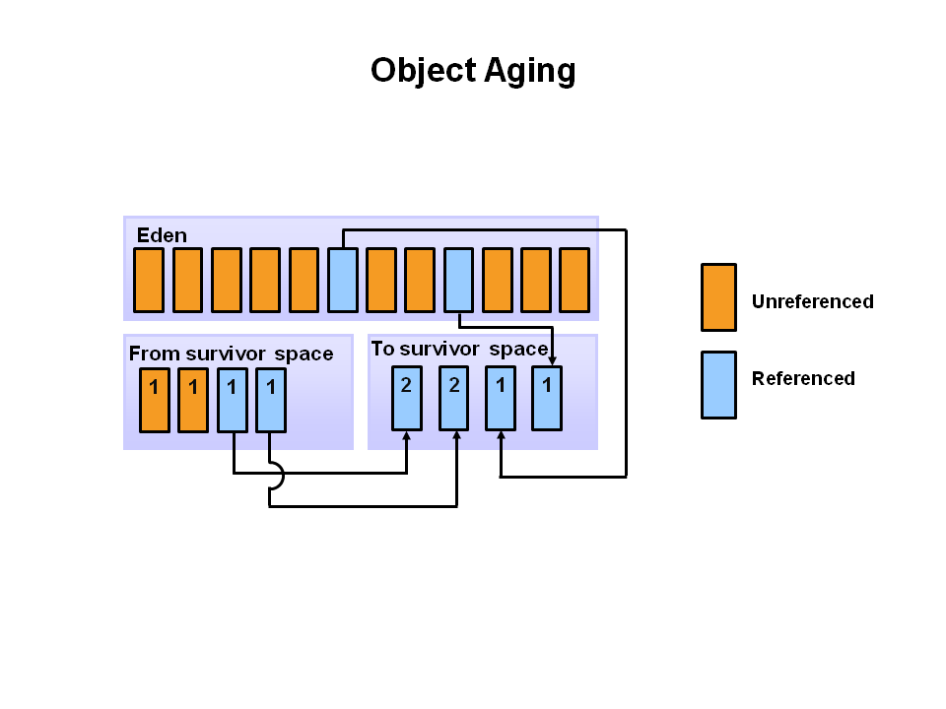

Slide 14
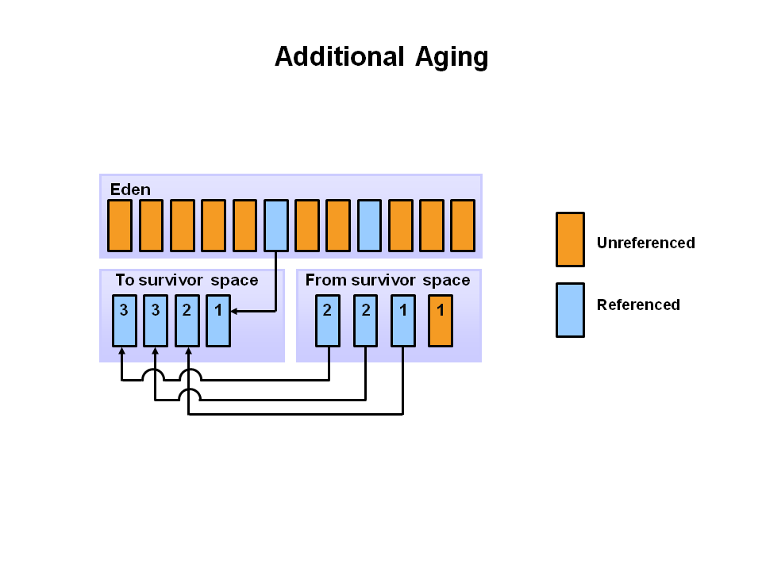

Slide 15
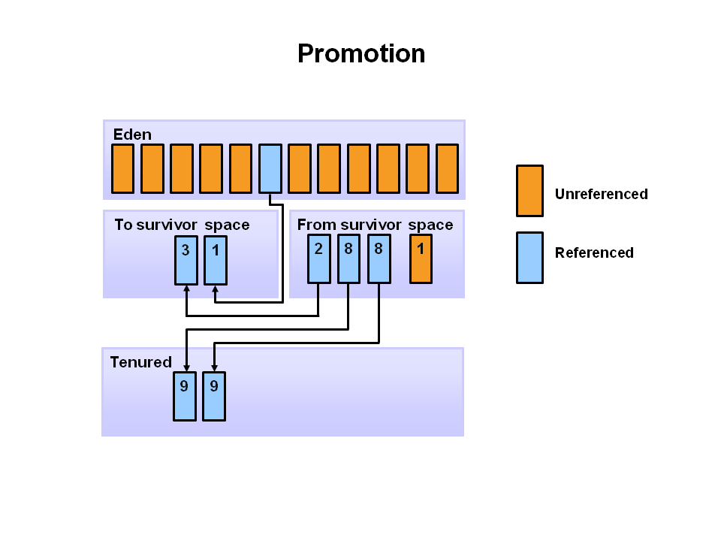

Slide 16
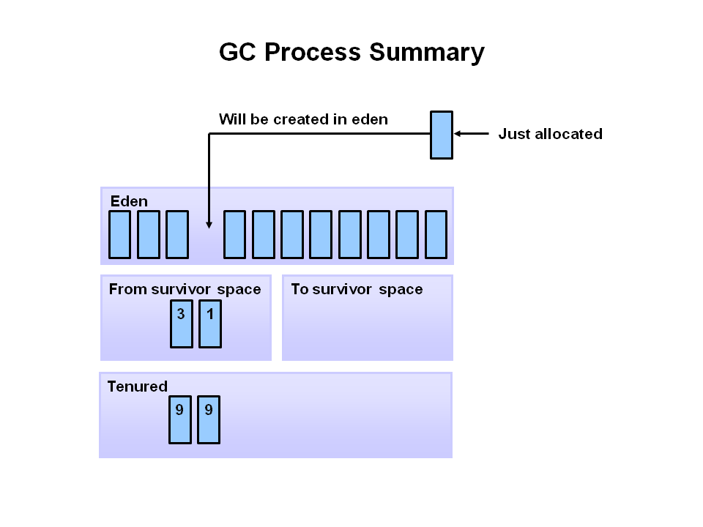

Slide 17
Java GC: Best Practices
All Stop the world event.
Reduce the number of temporary objects being used, especially in loops.
Use StringBuilder in preference to the String concatenation operator (+).
Be aware of which methods alter objects directly without making copies and which ones return a copy of an object.
Avoid using generic classes that handle Object types when you are dealing with basic data types.
Changing the initial and maximum size of the heap or its sections.

Slide 18


