Slide 1

Uses of Computer Networks

Slide 2
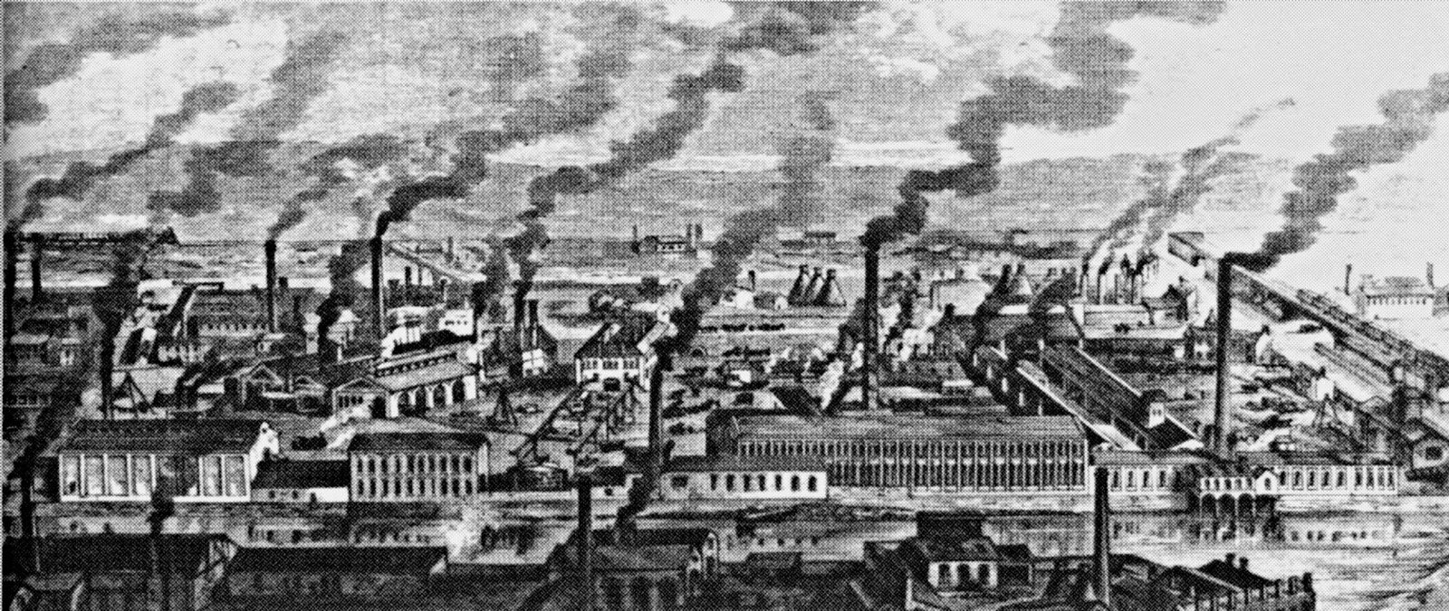

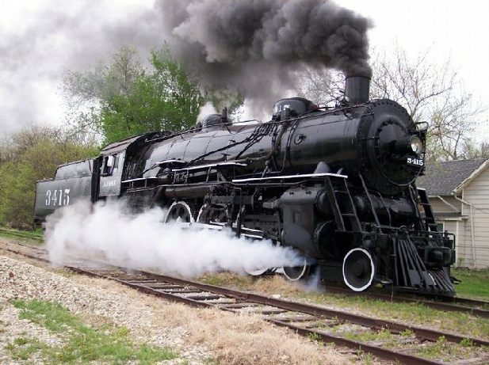
Technologies of the past

Slide 3
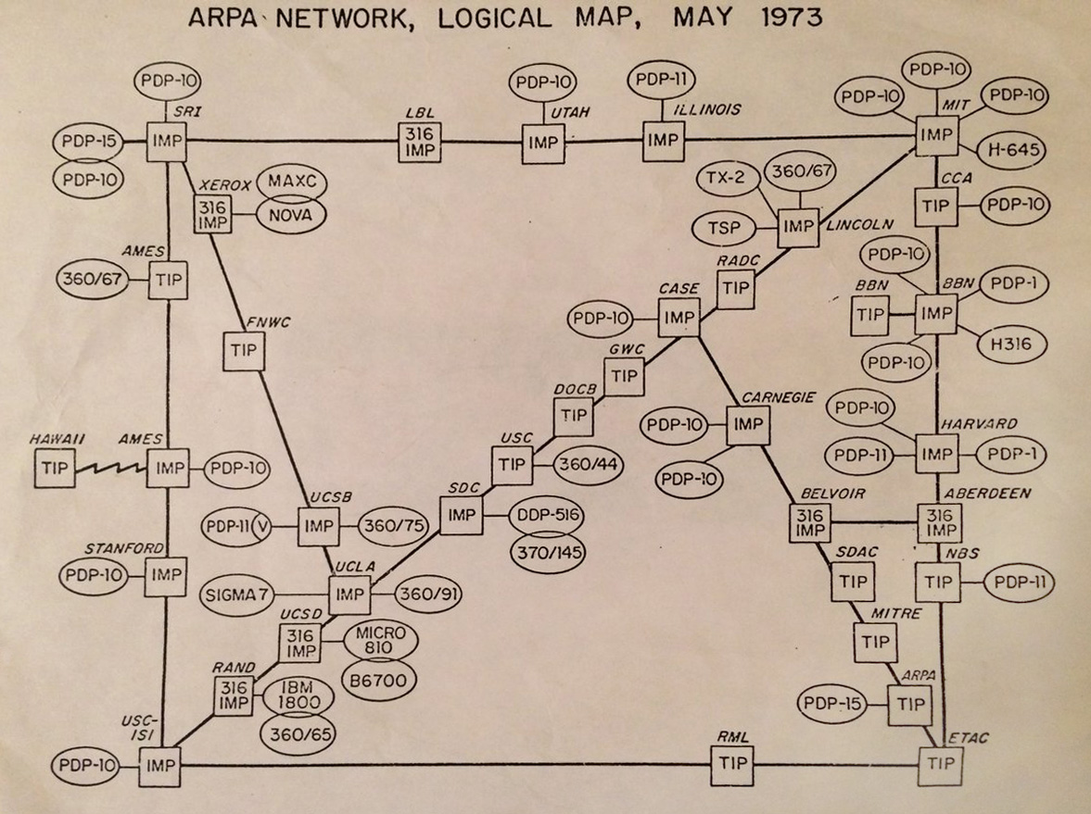
DARPA

Slide 4
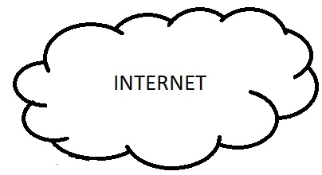
Internet

Slide 5

Internet

Slide 6
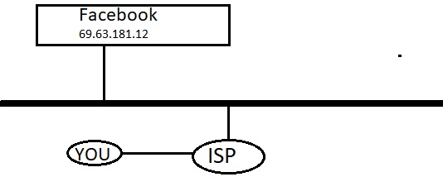
Internet

Slide 7
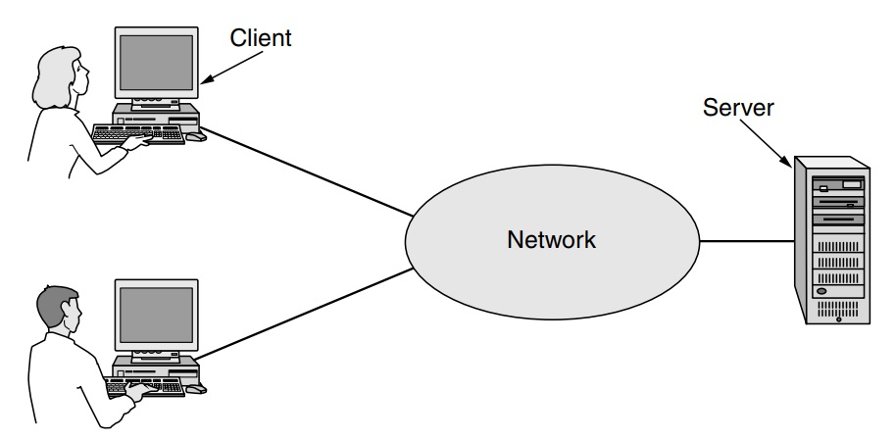


Business Applications
Client-Server model
Communication medium
Email
IP Telephony
Desktop sharing
E-commerce

Slide 8
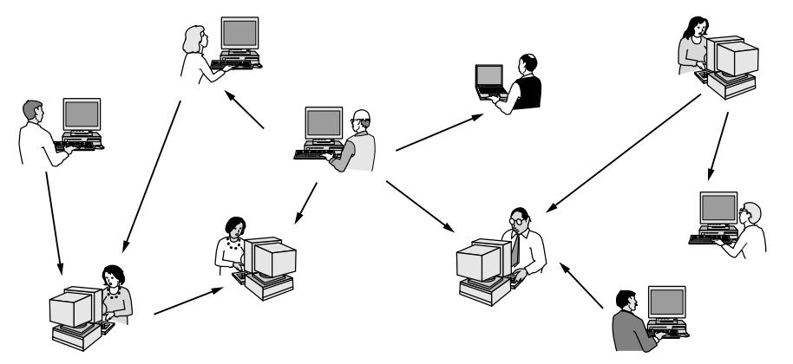
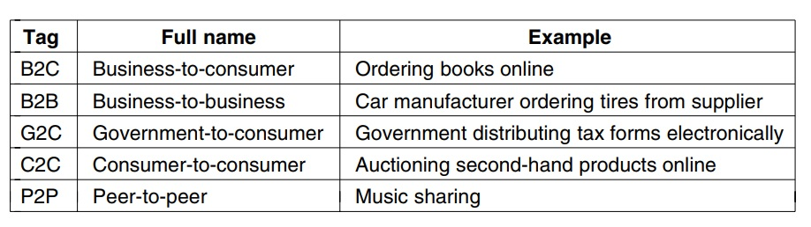
Home Applications
BitTorrent
Napster
Facebook
Wikipedia

Slide 9
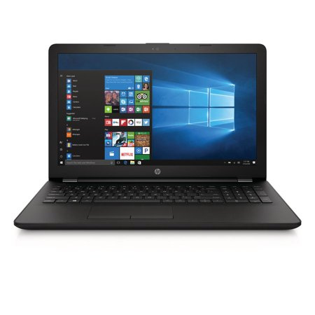
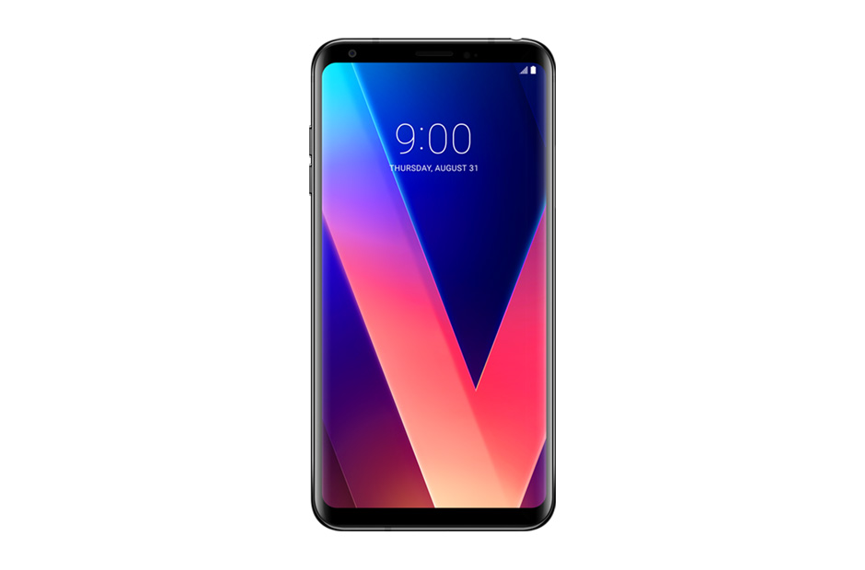
Mobile Users
Wireless
Texting
GPS

Slide 10

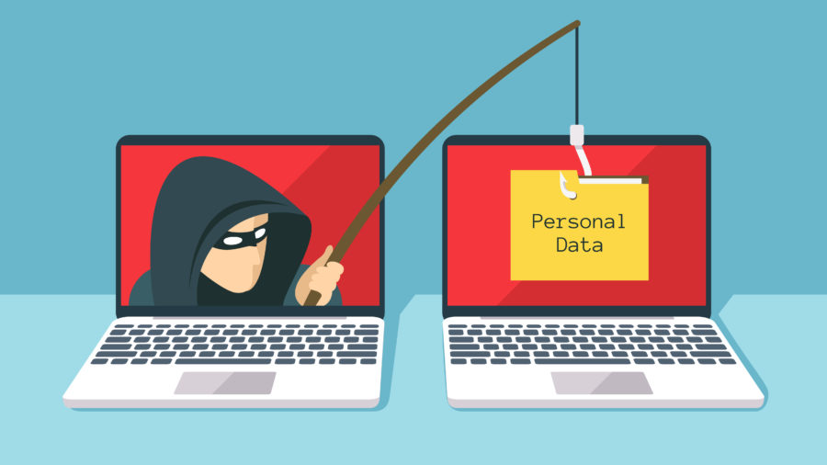
Social Issues
Network neutrality
Cookies
Phishing

Slide 11


