Slide 1
Hash-Based Indexing

Slide 2
Hash-Based Indexing
Hashing techniques prove to be very useful in implementing relational operations such as joins
Static and dynamic hashing techniques exist
Significant advantage for many equality selection queries
Hash-based indexing techniques cannot support range searches like tree based
Static and dynamic hashing techniques exist

Slide 3
Static Hashing
The number of buckets is fixed
Creating overflow page when the bucket is full
Inefficient for storing big amounts of data, due to the long overflow chains

Slide 4
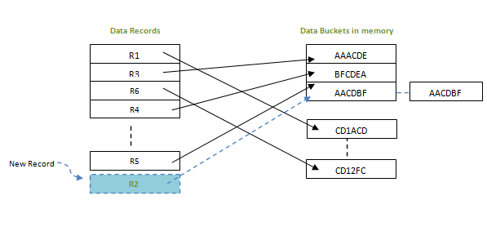
Static Hashing
Soultions:
- Periodic rehashing
( takes too much time to rehash the storage
and the indexes can not be used in this time )
- Use dynamic hashing

Slide 5
Extendible Hashing
Extendible hashing uses directory of pointers to buckets
Double the number of buckets by doubling the directory pointers
Splitting just the bucket that overflowed
No overflow pages

Slide 6
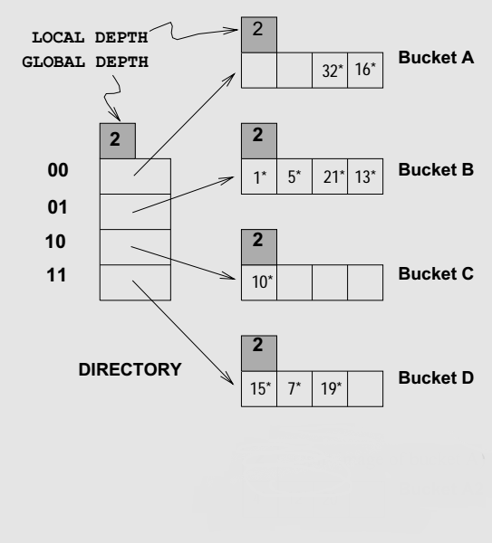
Extendible Hashing
Global depth of directory: Max number of bits used for pointer
Local depth of a bucket: Number of bits used to determine if an entry belongs to this bucket

Slide 7
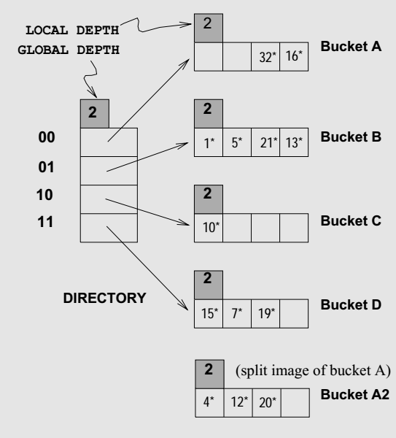
Extendible Hashing
For increasing capacity we are double the directory.
Splitting a bucket does not always require doubling

Slide 8
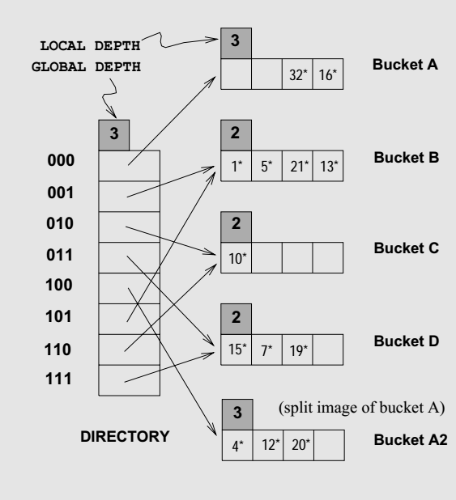
Extendible Hashing
Directory's capacity is doubled when we split a bucket which have local depth equal to the global depth

Slide 9
Linear Hashing
This is another dynamic hashing scheme, an alternative to Extendible Hashing
Linear hashing handles the problem of long overflow chains without using a directory and handles duplicates

Slide 10
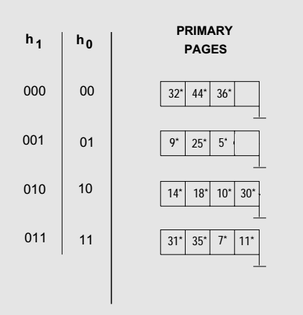
Linear Hashing
overflow page
...
Custom trigger for bucket splitting
Whenever a split is triggered, all buckets should be splitted

