Slide 1

Tree-Structured Indexing

Slide 2
Motivation
Performance – faster search in big databases
2 Ways – Tree-structured indexing & Hash-based indexing

Slide 3
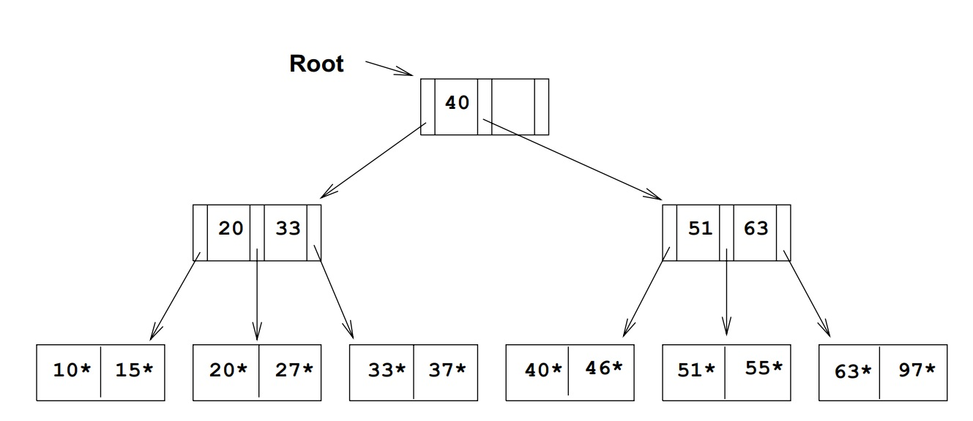
ISAM
Indexed Sequential Access Method
Static structure
Overflow pages
No index-level locking
Keys are copied in the leaf nodes

Slide 4
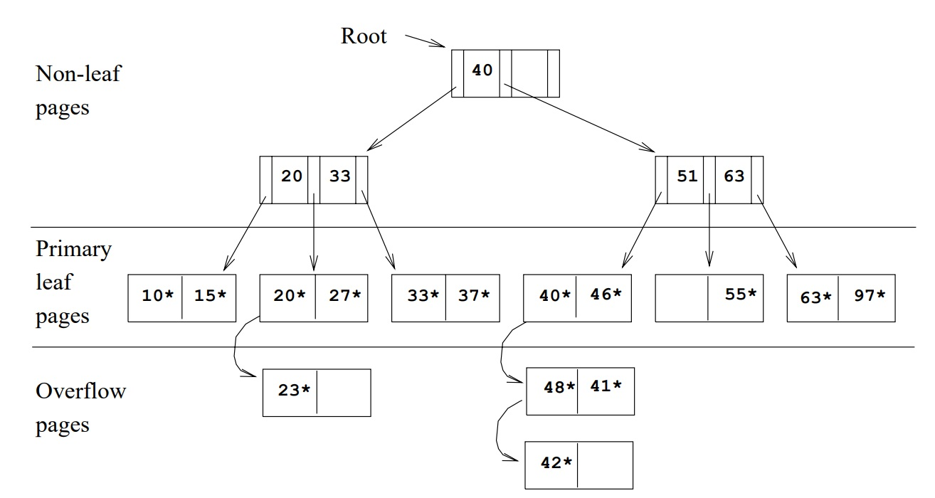
ISAM Overflow Problem

Slide 5
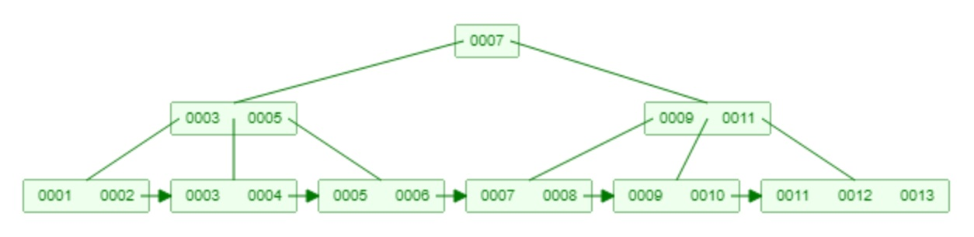
B+ trees
Dynamic structure
Balanced
Minimum 50% occupancy

Slide 6
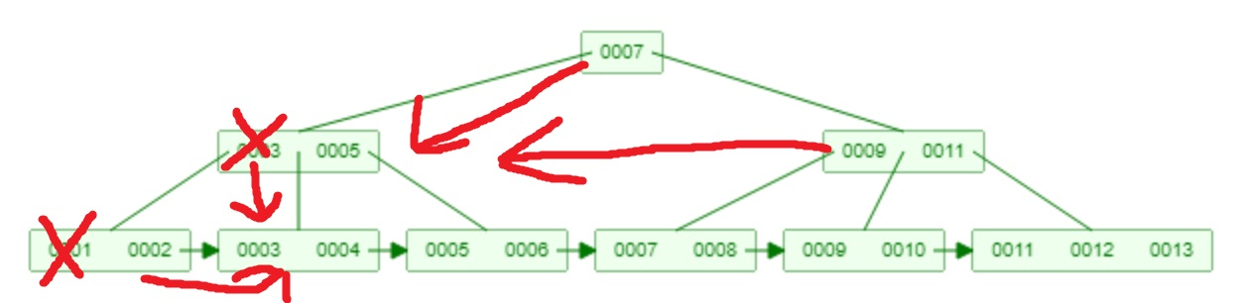
B+ Deletion

Slide 7
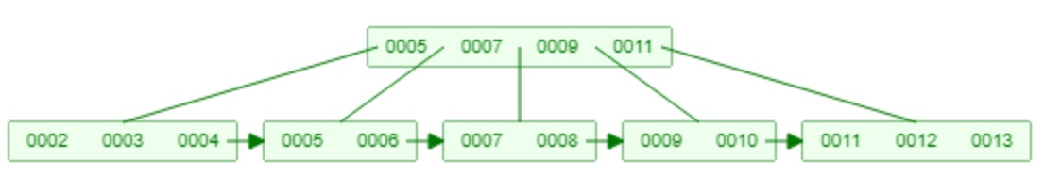
B+ Deletion

Slide 8
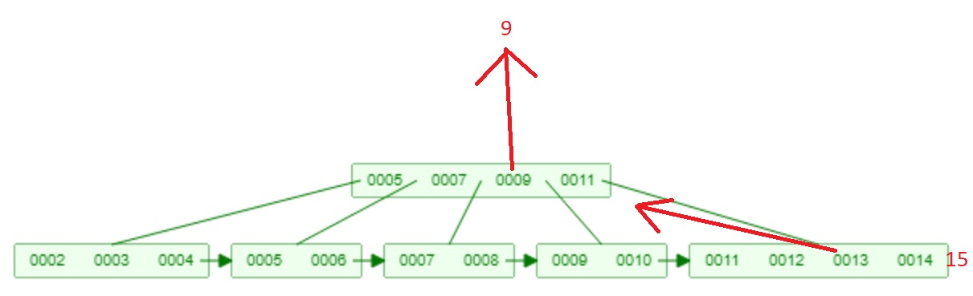
B+ Insertion

Slide 9
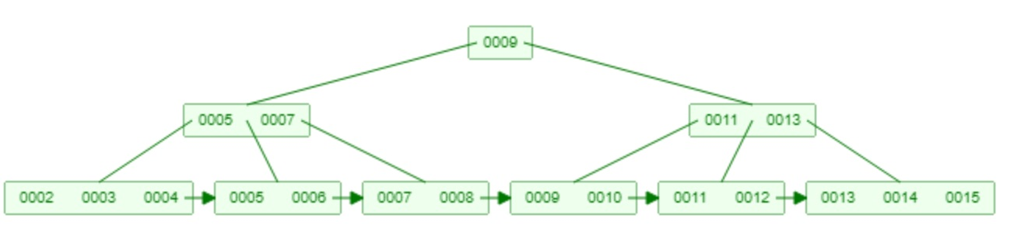
B+ Insertion

Slide 10
Summary
ISAM
Static
Overflow pages
No index-level locking
B+ Tree
Dynamic
Balanced
>=50% full nodes

