Slide 1
Heroku
Cloud Application Platform
Notes:
<szám>
<szám>

Slide 2
What is Heroku?
A multi-language Cloud Application Platform built on Amazon EC2
Supported languages:
  Ruby
  Java
  Clojure
  Python
  Node.js
  Scala
<szám>
Notes:
<szám>

Slide 3
History of Heroku
Developed since June, 2007
Salesforce.com completes acquisition of Heroku January, 2011
Cedar Stack May, 2011
Facebook and Heroku September, 2011
<szám>
Notes:
<szám>

Slide 4
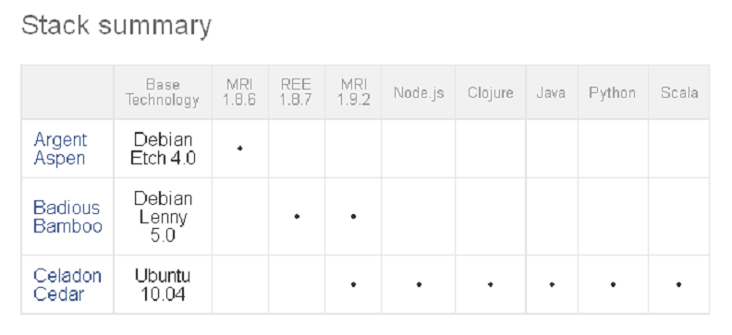
Stacks
Deployment environment including operating system, language runtime and libraries
<szám>
Notes:
<szám>

Slide 5
Forget servers
Dynos:
  Fully-isolated execution environments
Features:
Elasticity
Intelligent routing
Process management
Distribution and redundancy
Isolation
<szám>
Notes:
<szám>

Slide 6
The Process Model
Process types:
  Web processes
  Workers
  One-off admin processes
Processes are defined in special file called Procfile
<szám>
Notes:
<szám>

Slide 7
Easy deployment with Git
  Init git repository:
  git init
  Adding changes to the index:
  git add .
  Commit to local repo:
  git commit –m ”commit message”
  Create your application on Heroku
  heroku create myapp --stack cedar
  Commit to Heroku’s remote repo:
  git push heroku master
<szám>
Notes:
<szám>

Slide 8
Control Surfaces
Heroku toolbelt
  https://toolbelt.heroku.com/
Web console
  https://api.heroku.com/login
Heroku REST API
  https://api-docs.heroku.com/
<szám>
Notes:
<szám>

Slide 9
Heroku for Java
  OpenJDK 6, Maven 3.0.3
  Java applications do not run in any Java container at all
  Any application server can be used, that can be embedded and defined with a Maven dependency (Jetty, Tomcat, Glassfish and Resin)
  Embedded Tomcat (version 7.0.x) and embedded Jetty (version 7.4.x) have been tested with Heroku.
<szám>
Notes:
<szám>

Slide 10
Scaling with instant spin-up
Heroku command line:
  heroku scale web=6 worker=2
Nezumi http://nezumiapp.com/
Autoscaling
  Not supported at the moment
  Solutions:
  http://hirefireapp.com/
  http://www.heroscale.com/
<szám>
Notes:
<szám>

Slide 11
Dynos prices
Prices
  Dynos cost $0.05 per hour, prorated per second
  Each application receives 750 free dyno hours per month
  Apps that have only 1 web dyno will be idled out after 1 hour of inactivity
  More info at http://www.heroku.com/pricing
<szám>
Notes:
<szám>

Slide 12
Add-ons
  Release management
  New Relic
  PG Backups
  MongoLab
  Loggly
  Heroku Scheduler
  SendGrid
  MySQL: ClearDB and Xeround
  IronMQ
  And many more: https://addons.heroku.com/
<szám>
Notes:
<szám>

Slide 13
Competitors
  Amazon Elastic Beanstalk (beta) http://aws.amazon.com/elasticbeanstalk/
  Cloud Foundry (beta) http://www.cloudfoundry.com/
  Google App Engine http://code.google.com/appengine/
  Microsoft Azure Services Platform http://www.windowsazure.com/
  Jelastic Java PaaS (beta)
  http://jelastic.com/
<szám>
Notes:
<szám>

Slide 14
  Questions?
<szám>
Notes:
<szám>

