Slide 1

Forge
Developers:
Arthur Wuterich, Zack Thompson,
Kelsey Wood, James Foster,
DJ Scott, Melissa Morel
CS370, Professor Ledin

Slide 2
Forge: Main Concept
Forge is an application about connecting students in the SSU campus and dynamically forming study groups.
Forge will boast a slick and easy to use interface that will allow anyone, no matter their major, to enjoy the benifits of Forge.

Slide 3
Forge: Features
Easy to use Interface
Dynamic Group Generation
- Based on availability
Mobile and Web Clients
-Android
-iOS(*)
-Web
* Proposed but require further research

Slide 4
Forge: Ease of Use
One of the core concepts of Forge is that anyone will be able to use our application
This concept will be realized through attempting to keep the on-screen keyboard hidden for most of the tasks.

Slide 5
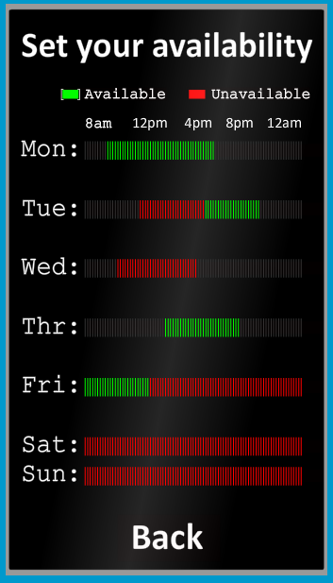
Forge: Ease of Use, Example
Users will enter their schedule by ‘painting’ their availability on this screen
Hides the keyboard, and allows easy insertion of schedule
Fun!

Slide 6

Forge: Group Generation
Forge will connect students dynamicaly through comparing availability and forming the perfect group
This will be the core feature of the Forge.

Slide 7





Forge: Multiple Clients
Forge will launch with two functional clients
- Android Client
- Web Client
iOS support will be based on the progress the pockwester team has on the Android and Web client.

Slide 8

Forge V2.0
After forge is suscessfuly launched that won’t be the end of the development.
Following is an backlog position ordered list of features that are planned to be intergrated into Forge.

Slide 9
Forge V2.0: Features
Social Intergration
Dynamic Map of Campus
Message Board
Flashcard Utility
Enrollment Assistant
F.A.Q. For Majors

Slide 10
Social Integration
-Connection with Facebook allowing for easier creation of Forge profile.
-Connection with Moodle, Blackboard, etc.

Slide 11
Dynamic Map of Campus
-Directs student to classrooms or location of study group.

Slide 12
Message Board
-A place for students to post questions for other students.
-Could be used for selling textbooks,etc.
-When making a study group, automatically adds it to google calendar.
-Reminds student when a study group is coming up.

Slide 13
Flashcards Utility
-Virtually creates flash cards.
-Possible multiple choice addition that would test student on material.

Slide 14
Enrollment Assistant Utility
-Connection with University where students would be able to sign up for classes through Forge.
-A place where companies could list possible internship opportunities.

Slide 15
F.A.Q for Majors
-A Frequently Asked Questions(F.A.Q) section created by the teacher.
-Planning for future classes, jobs, etc.

