Slide 1
Information Systems Security Winter 2016-17
Instructor: Zonghua Gu
Notes:
This chapter provides an overview of computer security. We begin with a discussion
of what we mean by computer security. In essence, computer security deals
with computer-related assets that are subject to a variety of threats and for which
various measures are taken to protect those assets. Accordingly, the next section of
this chapter provides a brief overview of the categories of computer-related assets
that users and system managers wish to preserve and protect, and a look at the
various threats and attacks that can be made on those assets. Then, we survey the
measures that can be taken to deal with such threats and attacks. This we do from
three different viewpoints, in Sections 1.3 through 1.5. We then lay out in general
terms a computer security strategy.
The focus of this chapter, and indeed this book, is on three fundamental
questions:
1. What assets do we need to protect?
2. How are those assets threatened?
3. What can we do to counter those threats?

Slide 2
Logistics
Time & Location:
Lectures: Sat 9:50-11:25 & 14:05-15:40 西一415
Experiments: Sat 15:55-17:30机房
Instructor: Zonghua Gu
QQ Group: 461902186 (Everyone must join)
Website: http://www.cs.zju.edu.cn/people/zgu/sec/

Slide 3
Grading Scheme
Final Exam: 60%; Experiments: 40%
Exam covers lecture PPTs, not experiments; open book, you can bring any printed materials.
Reading textbook is recommended, but not strictly necessary
All teaching materials in English
Notes:
This is a note

Slide 4
Course Topics
Textbook: COMPUTER SECURITY: PRINCIPLES AND PRACTICE, 3rd EDITION, WILLIAM STALLINGS (electronic copy in QQ group)
Lecture topics:
Cryptographic Tools; User Authentication; Access Control; Database Security; Malicious Software; Denial-of-Service Attacks; Intrusion Detection; Firewalls and Intrusion Prevention Systems; Buffer Overflow; Software Security; Operating System Security; Trusted Computing and Multilevel Security

Slide 5
Experiments
Focus on Android security
8 experiments, 5 points each
Form groups of 1-4 students each
Requires Java and Android programming expertise.
For learning Android, click on “Links and References” for some MOOCs

Slide 6
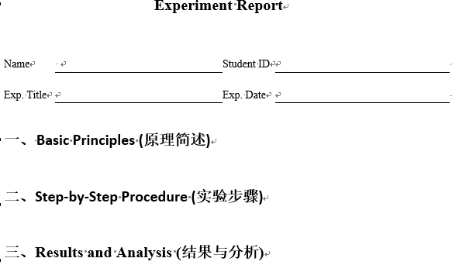
Experiment Report
Experiment report (in either English or Chinese) and source code for Sat lab is due next Friday 11:59pm to Email MobileSecurity2014@163.com
Please include in the report some screenshots with one of the team members’ names in the picture.
If you submit the report on time, and the report is reasonable, you will get the full 5 points
Each late day costs you 1 point!
Notes:
Late reports will be deducted 1 point for each late day.

Slide 7
Final Exam
Based on lecture PPTs
All questions are multiple choice, single answer.
Open book, so print out all PPTs and bring to the exam

Slide 8
关于点名的那点事
理论与实验课均不点名，凭个人兴趣上课，上课提问回答不计分。
实验课可以课外自主完成。

