Slide 1
CMPT 300 Introduction to Operating Systems
Course Organization

Slide 2
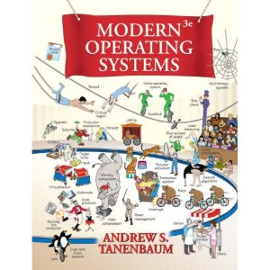
CMPT 300: Operating Systems
Time: Wed 5:30-8:20pm
Location: RCB 8100
Textbook:
Modern Operating Systems, Third edition, Andrew S. Tanenbaum, Prentice Hall 2008

Slide 3
Contact Information
Instructor: Zonghua Gu
Office: TASC 1, Room 9215
Office Hours: Wed 3:00-5:30 pm or by appointment
Email/MSN: zonghua(at)gmail.com
QQ: 59331972
Notes:
Technical questions should be addressed to the email list

Slide 4
Web-site
All the information discussed today and more can always be found on the class web-site
To find the class web site go to http://www.cs.sfu.ca/CourseCentral
Select Course Home pages
Select the Homepage for CMPT 300
2 sections: Dr. Evans (300D) and Dr. Gu (300E)
http://www.cs.sfu.ca/CourseCentral/300/csguestk is 300E
Notes:
Course Central is also a useful link to abundant information useful to students taking a computing science course

Slide 5
Grading Scheme (Tentative)
Mid-term exam: 20%
Final Exam: 50%
2 Programming Assignments: 30%

Slide 6
Collaboration on assignments
Assignments will be completed individually OR in pairs You may choose to work with a partner or by yourself
You may not work with the same partner on more than one assignment
Each individual or pair will submit a single assignment
Each individual or pair must set up a group on the course information system in order to submit
Partners will each receive the same grade on the assignment

Slide 7
Topics
History, Evolution, and Philosophies
The User's View of Operating System Services
Tasking and Processes
Inter-process Communication, Concurrency Control and Resource Allocation
Scheduling and Dispatch
Physical and Virtual Memory Organization
File Systems
Security and Protection

Slide 8
CMPT 300 Introduction to Operating Systems
Introduction / Review

Slide 9
Hardware and Software
A computer is a machine designed to perform operations specified with a set of instructions called a program.
Hardware refers to the computer equipment.
keyboard, mouse, terminal, hard disk, printer, CPU
Software refers to the programs that describe the steps we want the computer to perform.
The software that manages the hardware and shares the hardware between different application programs is called the operating system.

Slide 10
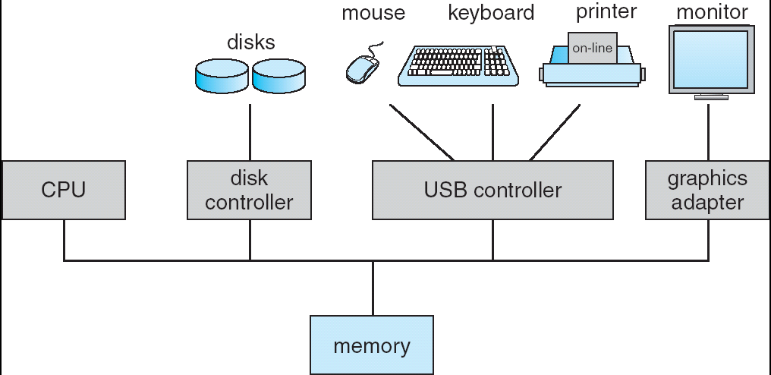
Computer Hardware
Computer-system operation
One or more CPUs, device controllers connect through common bus providing access to shared memory
Concurrent execution of CPUs and devices competing for memory cycles

Slide 11
Sample of Computer Architecture
Input/Output and Storage
Disks, WORM, Tape
RAID
Emerging Technologies
Interleaving
Bus protocols
DRAM
Memory
Hierarchy
Coherence,
Bandwidth,
Latency
L2 Cache
Network
Communication
Other Processors
L1 Cache
Addressing,
Protection,
Exception Handling
VLSI
Instruction Set Architecture
Pipelining, Hazard Resolution,
Superscalar, Reordering,
Prediction, Speculation,
Vector, Dynamic Compilation
Pipelining and Instruction
Level Parallelism

Slide 12
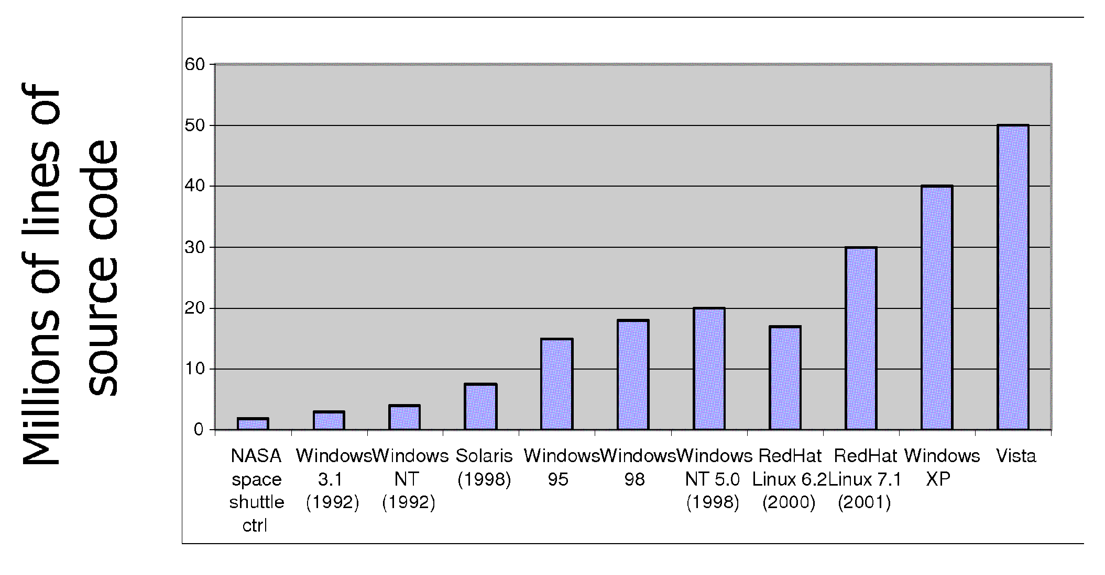
Increasing Software Complexity
From MIT’s 6.033 course

Slide 13
How do we tame complexity?
Every piece of computer hardware different
Different CPU
Pentium, PowerPC, ColdFire, ARM, MIPS
Different amounts of memory, disk, …
Different types of devices
Mice, Keyboards, Sensors, Cameras, Fingerprint readers, touch screen
Different networking environment
Cable, DSL, Wireless, Firewalls,…
Questions:
Does the programmer need to write a single program that performs many independent activities?
Does every program have to be altered for every piece of hardware?
Does a faulty program crash everything?
Does every program have access to all hardware?

Slide 14
Virtual Machine Abstraction
Application
Operating System
Hardware
Virtual Machine Interface
Physical Machine Interface
Software Engineering Problem:
Turn hardware/software quirks ⇒ what programmers want/need
Optimize for convenience, utilization, security, reliability, etc…
For any OS area (e.g. file systems, virtual memory, networking, scheduling):
What’s the hardware interface? (physical reality)
What’s the application interface? (nicer abstraction)
Notes:
Same as IP layer….

Slide 15
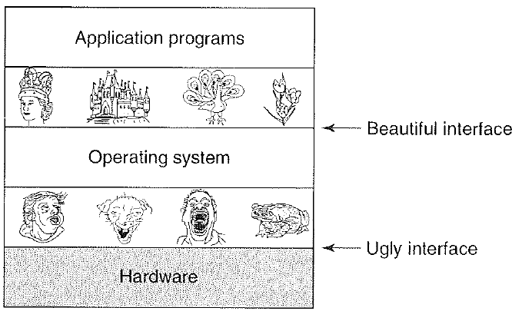
Virtual Machines
Software emulation of an abstract machine
Make it look like hardware has features you want
Programs from one hardware & OS on another one
Programming simplicity
Each process thinks it has all memory/CPU time
Different Devices appear to have same interface
Device Interfaces more powerful than raw hardware
Bitmapped display ⇒ windowing system
Ethernet card ⇒ reliable, ordered, networking (TCP/IP)
Fault Isolation
Processes unable to directly impact other processes
Bugs cannot crash whole machine
Notes:
Java interface safe and stable across many platforms

Slide 16
What does an OS do?
Silberschatz and Gavin: “An OS is Similar to a government”
Begs the question: does a government do anything useful by itself?
Coordinator and Traffic Cop:
Manages all resources
Settles conflicting requests for resources
Prevents errors and improper use of the computer
Facilitator (“useful” abstractions):
Provides facilities/services that everyone needs
Standard Libraries like Windowing systems
Make application programming easier, faster, less error-prone
Some features reflect both tasks:
File system is needed by everyone (Facilitator) …
… but File system must be protected (Traffic Cop)

Slide 17
What is an Operating System,… Really?
Most Likely:
Memory Management
I/O Management
CPU Scheduling
Synchronization / Mutual exclusion primitives
Communications? (Does Email belong in OS?)
Multitasking/multiprogramming?
What about?
File System?
Multimedia Support?
User Interface?
Internet Browser? ☺

Slide 18
Operating System Definition (Cont’d)
No universally accepted definition
“Everything a vendor ships when you order an operating system” is good approximation
But varies wildly
“The one program running at all times on the computer” is the OS kernel
Everything else is either a system program (ships with the operating system) or an application program

Slide 19
Summary
Operating systems provide a virtual machine abstraction to handle diverse hardware
Operating systems coordinate resources and protect users from each other
Operating systems simplify application development by providing standard services and abstractions
Operating systems can provide an array of fault containment, fault tolerance, and fault recovery

Slide 20
Machine language
Each type of processor (like Pentium 4, Athalon, Z80, …) has its own instruction set
Each instruction in an instruction set does a single thing like access a piece of data, add two pieces of data, compare two pieces of data …
Each instruction is represented by a unique number .This # may be different for different instruction sets, but no two instructions in the same instruction set should have the same #
19

Slide 21
Machine Language programs
A machine language program is a list of instructions
Each instruction is represented by a number
Inside the memory of the computer, each number is represented in binary (as a string of 1’s and 0’s)
The long string of 0’s and 1’s is easy for the computer to understand, but difficult for a human to read or write

Slide 22
Assembly
Assembly languages make it easier for the programmer.
Assembly is easier for humans to read/write
Use mnemonics like ADD, CMP, … to replace the numbers that identify each of the instructions in the instruction set
The code for an Assembly program is written into a text file, which is translated into machine language program and executed.

Slide 23
Computer Software: Languages
Some Computer Languages
Machine language (machine instruction set)
assembly language
high level languages (Compilers/Interpreters)
C, C++, Ada, Fortran, Basic, Java
Do YOU know of any others?
mathematical computation tools (MATLAB, Mathematica, ...)
Application software is written using computer languages.
Operating systems are also written using computer languages (often C, some assembly)

Slide 24
Computer Software: Applications
Application Software (Software Tools)
Word processors (Microsoft Word, WordPerfect, ...)
Spreadsheet programs (Excel, Lotus1-2-3, ...)
Computer games
Communication software (email, chat, web browser…)
Telecommunication software (VOIP, …)
Integrated programming environments

Slide 25
User mode / kernel mode
Most application software runs in user mode. Applications have access to a subset of the instruction set that does not include most direct hardware access
Operating systems run in kernel mode (supervisor mode) and have access to the complete instruction set, including the instructions used to directly manage the hardware
Application software running in user mode can used system calls to access hardware managed by the Operating System
User mode programs may perform duties for the OS

Slide 26
Modes
Applications
USER MODE
KERNEL (OS) SERVICE PROCESSES
Application interface (system libraries)
Operating System
KERNEL MODE
Hardware
For some operating systems there may not be a separation between kernel mode and user mode (embedded systems, interpreted systems)

Slide 27
Basic computer configuration
CPU
I/O devices
Registers
Memory
DISK
Arithmetic Unit
I/O buffers
Controller
Cache
BUS

Slide 28
Registers in CPU
Data registers
Accumulator
Address registers
Control/Status registers
Program counter
Stack pointer
Instruction register
Status registers

Slide 29
Controller
Fetch, Decode, Execute cycle (each instruction)
Fetch next instruction: Instruction contains op-code and possibly data
Decode op-code
Execute op-code (using data if necessary)
Instructions
access data, moving it from memory (or disk or cache) to/from registers, and between registers
Complete arithmetic and logical manipulations of data in registers

Slide 30
Executing an instruction (1)
Examine program counter
Fetch instruction indicated by program counter
Increment program counter to point at next instruction to be executed
Place fetched instruction in instruction register
N binary digits
integer
opcode
instruction
Address(es) of data

Slide 31
Executing an instruction (2)
Decode the instruction
Determine what is to be done
If needed, load address into an address register
opcode
instruction
Address(es) of data

Slide 32
Executing an instruction (3)
Execute the instruction in the instruction register, may result in one or more of the following
Fetch any data from memory (locations given in instruction) and place into the appropriate data registers
Place results from a data register or the accumulator into a memory location indicated in the instruction
Operate (arithmetic or logical operation) on data in data registers and save the result in the indicated register
Control the flow of the program (for example change the value in the program counter register)

Slide 33
Adding 2 numbers (Z=X+Y)
Program counter points to instruction to load value at location X
Instruction is fetched into the instruction register, decoded and executed to load the first number into data register A
Program counter is incremented and now points to an instruction to load value at location Y
Instruction is fetched into the instruction register, decoded and executed to load the second number into data register B
Program counter is incremented and now points to an instruction to add the values in data register A and B
Instruction is fetched into the instruction register, decoded and executed to add the two numbers and place the result in the accumulator register.
Program counter is incremented and now points to an instruction to place the value in the accumulator register into memory location Z
Instruction is fetched, decoded and executed to place result in Z
(See animation)

Slide 34
Memory Hierarchy
Different types of memory have different access speeds and costs
Faster access speed implies higher cost
Greater capacity often implies lower access speed
From fastest access to slowest access
Registers
Cache
Memory
Disk
Tapes

Slide 35
Memory
Modern computers use several kinds of storage
1 nsec
registers
< 1KB
1.5 nsec
Cache
8 MByte
6 nsec
Main Memory
( RAM volatile. ROM non volatile)
10 GByte
Flash Memory (non volatile, rewritable)
5 msec
DISK
3000 GByte
CD, DVD, USB memory stick

Slide 36
Memory Hierarchy
As you go down the pyramid
Decreasing cost per bit, Increasing capacity
Increasing access time, Decreasing frequency of access
Note that the fastest memory, sometimes referred to as primary memory, is usually volatile (register, cache, main memory)
Non-volatile (continues to store information when the power is off) memory is usually slower. Referred to as secondary or auxiliary memory. Examples flash memory (flash that holds the BIOS, or removable flash), internal and external hard drives, CD, tape, …

Slide 37
Registers and cache
Parts of the CPU
Register access speed comparable to CPU clock speed
Cache memory may be as fast or as much as several times slower
Registers
Usually 64x64 for 64-bit machine, 32x32 for 32-bit machine
Usually < 1 Kbyte
Cache
As much as 8Mbytes

Slide 38
Concept of Cache
Provide memory on the CPU that is slower that the registers, cheaper and larger than registers, but can be accessed much faster than main memory
The next few instructions, and data that will be needed will be loaded into cache in anticipation of faster access by the processor.

Slide 39
Cache and main memory
CPU
Registers
Main memory
Cache

Slide 40
Using Cache
Instructions (and data) are generally moved from main memory to cache in blocks; one such block (N bytes of memory) is called a cache line
Cache has a series of slots, each N byes long, and can hold a copy of one cache line.
The main memory can contain many more cache lines than there are slots in the cache.
Each time a copy of a new cache line is loaded into a cache slot, the original content of that slot is overwritten

Slide 41
Cache design
Cache size and Cache line size
Determined to optimize access time
Mapping function
Which cache lines may be loaded into which cache slots
can any line go in any slot, or is there a mapping function to define rules governing which line can be place in which slot
Replacement algorithm
When is a cache line in a cache slot replaced by another cache line

Slide 42
Hit ratio
A hit occurs when a memory access finds its information in the cache.
A miss occurs when it is necessary to access the slower main memory (or lower level cache) to find the information.
The proportion of accesses that are hits is called the hit ratio
Consider an example,
Assume that any access to the cache takes .01μs, any access to main memory takes 0.1μs (100 nsec)
Any instruction or piece of data not in cache will have to be accessed in main memory and moved to cache before being accessed (0.1+0.01)μs
For a hit ratio of x%, the average memory access time
0.01*x%+0.11*(1-x%)
Notes:
Every instruction incurs at least 0.01 μs; some may incur an additional 0.1 μs.

Slide 43
Hit ratio

Slide 44
Cache Line size
As cache line size increases from a single byte, the hit ratio will increase at first.
It is very likely that bytes near a needed byte will be accessed in the near future (principle of locality (spatial & temporal))
But as cache line size increases, the number of lines decreases
As cache line size increases past it’s optimal value then the hit ratio will begin to decrease
This happens when it becomes more probable that the next access will involve the cache line that was just removed, i.e., the useful cache line was kicked out prematurely.
Performance heavily depends on the application workload, mapping function and replacement algorithm, hence difficult to generalize.

Slide 45
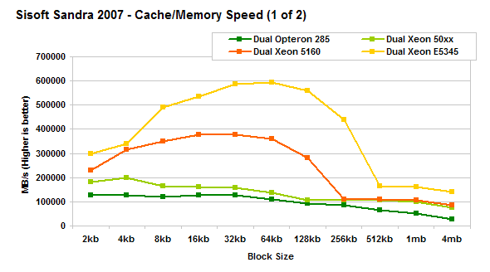
Effect of Line size (example)
NOTE: MB/s = 1/nsec * 1000

Slide 46
Cache specifications on common systems
Most modern CPUs have an on-chip cache called an L1 cache
Many modern systems also have a 2nd , and even 3rd level of cache between the L1 cache and the main memory called the L2 (L3) cache.
L2 cache can be on-chip or off-chip (connected to the CPU via a bus)
L3 cache is typically off-chip

Slide 47
Multiple levels of cache: L2
CPU
Main memory
registers
L1 cache
(instructions)
L1 cache
(data)
L2 Cache

Slide 48
Multiple levels of cache: L3
L
registers
L1 cache
(instructions)
L3
cache
Main memory
L1 cache
(data)
core1
L2 Cache
registers
L1 cache
(instructions)
L1 cache
(data)
core2
L2 Cache

Slide 49
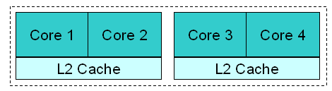
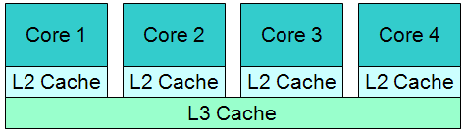
Modern Cache Architectures
Shared cache requires more complicated cache controller
Individual caches are more difficult to keep coherent (properly synchronized)
Core 2 Duo Core2 Quad
Nehalem (i5, i7) AMD K10 (Phenom 9)
On-chip L1 caches are omitted from the figure

Slide 50
Memory
Main memory is typically DRAM (Dynamic Random Access Memory)
Cache is typically SRAM (Static Random Access Memory)
Smaller and faster than DRAM
Both are volatile: contents lost when power is turned off

Slide 51
Disk
Hard disk
CD, DVD, Blu-Ray
Disk storage is much cheaper that memory
(3GB memory or 2000GB disk about the same cost)
Access time for disk is at least one order of magnitude slower than for memory

Slide 52
Input / Output
Reading or writing data from a perepheral device is not simple
Each device has its own controller (hardware)
Each device is managed by a device driver (software to use the controller)
Device drivers are specific to hardware and to the operating system using the device
Input and output is SLOW in comparison to CPU operations.

Slide 53
Busy Waiting
Reading or writing data to a device is SLOW in comparison to the time it takes to complete one CPU operation
The CPU must send one or more instructions to the controller to make the I/O device begin to read or write. These instructions tell the controller where to find the data and/or where to store the data
The CPU can then wait until the I/O operation is finishes.
While it waits the CPU will be in a loop
Each time through the loop the CPU will check a register in the controller to see if the I/O operation is complete
This is called busy waiting.

Slide 54
Alternatives to Busy waiting
Busy waiting does not use CPU resources efficiently
Want to use the CPU to execute other instructions while the I/O operation is being completed by the I/O device (instead of executing the busy waiting loop)
To use the CPU for other calculations while to I/O device controller completes the I/0 operation, we need to use interrupts (a mechanism to tell the CPU when the controller completes the I/O)

Slide 55
Interrupts
Interrupts are a mechanism by which other modules (memory, I/0, timers …) may interrupt the normal sequence of instructions being executed by the processor
Interrupts are a critical component of the operation of spooling and multiprogramming (more later).
Interrupts allow the transfer of control between different programs (remember the OS is also a program)
Interrupts are generated by hardware (asynchronous)
Exceptions are generated by particular instructions in software (synchronous), e.g., divide by 0, overflow, illegal instruction or address…

Slide 56
Some types of interrupts
I/0
Signaling normal completion of an operation (read or write)
Signaling error during operation
Timer expiry
Begin regularly scheduled task
End task that has exceeded allocated time
Hardware failure

Slide 57
Increase in efficiency
No interrupts
With interrupts
Time
B1
B1
Write Instruction
Write Instruction
CPU (processor)
wait
B2
Complete Write
ISR execution
B2
B3
B3
The busy waiting time is eliminated.

Slide 58
Interrupt example: Output (1)
Program executes until it reaches a write instruction
The write instruction sets up the hardware output device operation then leaves the output device controller (not the CPU) processing the output
The program continues execution of additional instructions (N+3 to N+7 next slide)
When the hardware device completes the output operation, it generates and sends an interrupt to the CPU, signaling normal completion of output

Slide 59
Interrupt example Output (2)
When the currently executing instruction completes, the program is interrupted
The program’s registers and state are saved
An ISR (interrupt service routine) completes the output operation
Rgisters and state are restored
The original program continues executing

Slide 60
Interrupt operation
ISR (interrupt service routine)
program
Instruction N
B1
Instruction N+1
Initialize hardware,
Begin print
Write instruction
Instruction N+3
Save registers and state
B2
Instruction N+5
Print complete
Send interrupt
Instruction N+7
Instruction N+8
Instruction N+9
Restore registers and state
.
:
B3
Print hardware

Slide 61
Instruction cycle with interrupts
START
execute
Interrupts disabled
Fetch
Interrupts enabled
Decode
Check for
interrupt

Slide 62
Interrupt processing (1)
A device issues an interrupt request
The CPU (processor) finishes execution of the present instruction
The CPU tests to see if there is a pending interrupt, determines there is, and sends a acknowledgement to the device requesting the interrupt
The CPU saves registers and state to the stack (including the program counter register value)
The CPU loads the address of the appropriate ISR into the address register

Slide 63
Interrupt processing (2)
The CPU executes the ISR
When the ISR finishes, the saved register and state information is restored to the CPU registers
The program counter is reset to point to the next instruction
The original program continues execution
REMEMBER: the time when an interrupt occurs is not known in advance!! Interrupts are asynchronous

Slide 64
CMPT 300 Introduction to Operating Systems
Operating Systems
Overview Part 2: History

Slide 65
History of Operating Systems
First generation 1945 - 1955
vacuum tubes, plug boards
Second generation 1955 - 1965
transistors, batch systems
Third generation 1965 – 1980
ICs and multiprogramming
Fourth generation 1980 – present
personal computers

Slide 66
The earliest computers (1945-55)
Built of relays, vacuum tubes
Very large, Very slow by today’s standards
Built, programmed and maintained by the same people
Programmed by using switches, paper tape, etc
No operating system, single operation, single problem, sequential access

Slide 67
The next generation (1955-65)
Transistor-based, increased reliability
The first commercial mainframes, still very large and very expensive
Used assembly or even early high level languages like Fortran or ALGOL
Rudimentary operating system, one program at a time, with control commands to compile, load, execute, terminate, basic compilers
Input using cards, paper tape, magnetic tape …

Slide 68
Single Job to Batch
Earliest machines had very rudimentary OS.
To run a job, needed to load the compiler as well as the code for the job.
Required a great deal of operator intervention
CPU not efficiently used
Batch processing evolved to reduce the amount of time wasted setting up single jobs

Slide 69
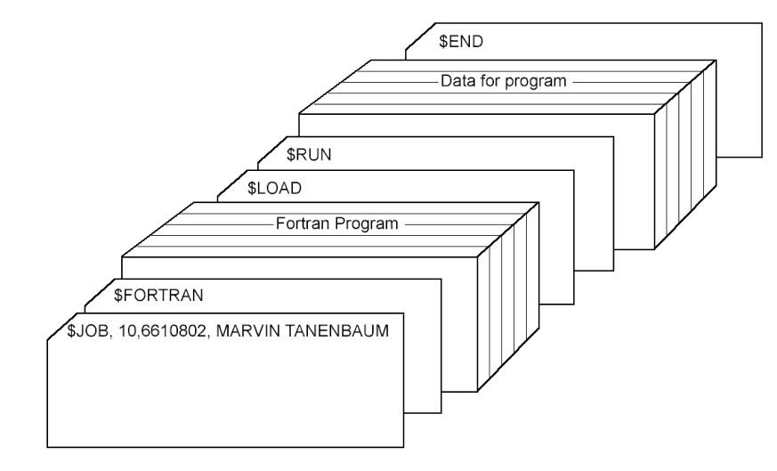
Early Batch processing
Collect a group of jobs
Each job was submitted as a stack of punched cards.
Job card, language definition card
One card per line of code in program
Cards for load and run instructions
Cards containing data for program
End card indicating end of job
A group of jobs was submitted as a batch to the card reader
Each job was read in, executed, produced it output, terminated, then the next job took over the machine

Slide 70
Early Batch Processing
CPU
Card reader
Line printer

Slide 71
Operating System
Commands to
Read a single card to memory
Compile to machine language
Place machine language code in memory
Start execution (load address of first instruction in program in Program counter then begin execution)
Write output to the line printer (or other output device)
Trap condition switches control from program to OS
END card being executed
Illegal opcode, divide by zero, …

Slide 72
Problems with early batch processing
Input and output, particularly from peripheral I/0 devices (card reader, line printer), are very slow when compared to the execution of other instructions
When input and output is happening the CPU is mostly idle. An expensive resource is being wasted
A program trapped in a infinite loop would never terminate

Slide 73
Improving batch processing
Offload the slow I/O tasks to less costly and powerful computers
Use faster I/O media (like tapes) for input to fast powerful machine
Add timers, if your time runs out an interrupt is generated which terminates your program (deals with infinite loops)
Adds complexity, improves efficiency

Slide 74
Improving batch processing
input
output
output
Line printer
Card reader
input
Fast
CPU
Line printer
Less powerful
CPU
Less powerful
CPU

Slide 75
The next generation (1965-1980)
More complicated OS
Deal both with I/O intensive and CPU intensive jobs efficiently
Multi-programming (with partitioned memory)
Switches between tasks
Load and run jobs
Read cards to job queue on disk (whenever card reader is ready)
Print results to printer from printer queue on disk (only when printer is available and job is complete)
Changes enabled by going from tape to disk
Tape is sequential-access
Disk is random-access, hence faster for general workload

Slide 76
The next generation (1965-1980)
Fast
CPU
DISK
Card reader
Program queue
Line printer
Printer queue

Slide 77
Simultaneous Peripheral Operation On Line (Spooling)
Spooling refers to the process of placing data in a temporary working area for another program to process.
Send jobs from card reader to program queue on disk
Send job outputs into printer queue on disk
When card reader or printer are available, it can add to/print from queue
When a job is finished, the next job is loaded from the queue

Slide 78
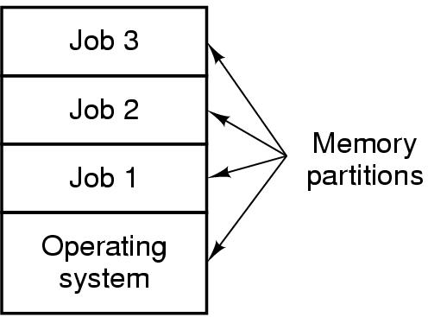
Multiprogramming
Partition memory into pieces (often of different sizes)
Load one job into each partition (choose partition according to needs of job)
Have multiple jobs executing simultaneously, one in each partition
When one job is doing I/O, another can be using the CPU

Slide 79
Recall: Interrupt operation
ISR (interrupt service routine)
program
Instruction N
B1
Instruction N+1
Initialize hardware,
Begin print
Write instruction
Instruction N+3
Save registers and state
B2
Instruction N+5
Print complete
Send interrupt
Instruction N+7
Instruction N+8
Instruction N+9
Restore registers and state
.
:
B3
Print hardware

Slide 80
Interrupts for input
We have seen an example of using an interrupt to facilitate output
What about input? Can we do the same?
If we do the same we have problems
If we execute the code following the read, the value being read may be used in that code
If the value being read has not yet been placed in the variable, results will not be correct
How to solve the problem?
Instead of executing the next block of code in the same program we let a different program run until the I/O has completed.
Notes:
We combine spooling with multiprogramming

Slide 81
Multiprogramming: Interrupt example (1)
Program executes until it reaches a read instruction
The read routine sets up the input operation, then returns leaving the input hardware device (not the CPU) processing the input
Because successive instructions in the program may use the input value, the program itself cannot continue until the read is complete.
The read routine then interrupts program 1, saving its registers and state. Then the ISR loads the registers and state for program 2 and continues execution of its instructions (P to P+7 next slide)

Slide 82
Multiprogramming: Interrupt example (2)
When the input hardware device completes operation, it generates and sends an interrupt to the system (signaling normal completion)
When the currently-executing instruction in program 2 completes, program 2 is interrupted
The registers and state of program 2 are saved
An interrupt service routine completes the input operation
The registers and state of program 1 are restored
The original program continues executing

Slide 83
Multiprogramming operation
Program 1
ISR3 (interrupt service routine)
Program 2
Instruction N
Save registers and state program1
Instruction P
Instruction N+1
Restore registers and state program2
Instruction P+1
Read instruction
Instruction P+2
InstructionP+3
Instruction N+3
Instruction P+5
Instruction N+5
Instruction P+7
Read complete
Send interrupt
Instruction N+6
Save registers and state program2
Instruction P+8
ISR2
.
:
Restore registers and state program1
Instruction P+9
Instruction N+8
.
:
Instruction N+9
Read hardware
Initialize hardware,
Begin read

Slide 84
Multiprogramming example
Program A, uniprocessing
I/O wait
I/O wait
I/O wait
Followed by Program B, uniprocessing
I/O wait
I/O wait
I/O wait
multiprocessing
I/O wait

Slide 85
Time sharing: Scheduling, fair sharing
Once multiple jobs can share the CPU (sequentially, not at the same time) it becomes necessary to determine how time is shared between the processes
The simplest approach to time sharing(taken by CTSS (Compatible Time-Sharing System) and some later OS’s) is time-sliced round-robin
Each process is given N seconds of CPU, after N seconds the next processes takes its turn
There are many other variants of scheduling, some of which we will discuss later.

Slide 86
Simple time sharing operation
The interrupt source is a timer!
Program 1
ISR4 (timer interrupt service routine)
Program 2
Instruction N
Save registers and state program1
Instruction P
Instruction N+1
Restore registers and state program2
Instruction P+1
Instruction N+2
Instruction P+2
InstructionP+3
Instruction N+3
Instruction P+5
Instruction N+5
Instruction P+7
Instruction N+6
Save registers and state program2
Instruction P+8
Instruction N+7
Restore registers and state program1
Note: program1 has been selected by the scheduler as the next program to run
Instruction P+9
Instruction N+8
.
:
.
:
Timer for program 1’s allowed time expires
Send interrupt
Timer
Timer for program 1’s allowed time expires
Send Interrupt

Slide 87
Time sharing and scheduling
In the previous example the simplest case (only two programs) was considered
In a real system there will be many programs running.
Each time an ISR runs, at the end of the interrupt servicing, the OS scheduler must run to determine which program to give the CPU to next, and/or what to set the timer to

Slide 88
Minicomputers
Near the end of this generation (1965-1980) small, less expensive machines came into common use (for example the DEC PDP and VAX series)
Costs were reduced from millions to 100’s of thousands (about a factor of 20).
Memory in Kbytes
Used to develop UNIX operating system (multi-user)
Problems as mini-computers proliferated: each vendor had their own flavor of UNIX (BSD, system 5, POSIX …) or their own proprietary OS (VMS … ), compatibility was an issue
Mainframes and supercomputers were still necessary for computationally intensive applications.

Slide 89
The next generation(1980- now)
Use VLSI (very large scale integrated circuits) to build microcomputers
Reduced price (thousands not 100’s of thousands)
First used early operating systems like CP/M (control program for microcomputers) or DOS (disk operating system)
First uses of user friendly GUIs

Slide 90
Commonly used OSs
Versions of commonly used OSs like Windows, Unix, Linux are available for different types of platforms (PCs, Handhelds, Embedded systems)
Specialized OSs for purposes such as real time embedded systems or large servers

